Slide 1
Azure Times #194
February 23, 2026

Slide 2
Compute

Slide 3
Compute Updates
Public Preview: Unified tooling in the AKS MCP server
Managing AKS MCP servers can be affected by the number of tools and the amount of context required, which can increase latency and cost. The unified tooling for the AKS MCP Server introduces two new tools in public preview, call_az and call_kubectl, that enable agents to access cluster data through Azure APIs and kubectl. These tools consolidate existing capabilities and reduce the total number of tools in the AKS MCP by 30%.
The open-ended nature of these tools also brings power back to AI agent, allowing them to customize and call any kubectl or Azure API command of their choosing rather than being restrained by tightly-defined tools. The new tools are available starting from v0.0.12 of the AKS MCP server.
Public Preview: Cluster mode for the agentic CLI for AKS
Cluster mode for the Agentic CLI for AKS is now in public preview, delivering expert-level AI diagnostics directly inside your AKS cluster with stronger security boundaries and improved operational efficiency.
Traditionally, diagnostic agents may inherit broad user permissions (for example, cluster-admin rights), and each user must deploy and manage their own instance. This creates both security risks and operational overhead.
Cluster mode addresses these challenges by providing a shared, centrally managed AI assistant deployed directly into your AKS cluster.
Fine-grained RBAC control with Azure and Kubernetes RBAC
Shared AKS Agent instances deployed to a namespace of your choosing
Faster CVE detection and fixes with a centrally managed image, sourced from MCR

Slide 4
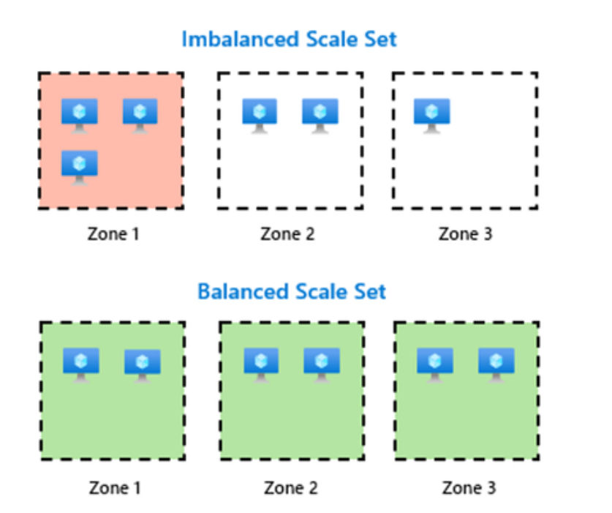
Compute Updates
Public Preview: Automatic zone balance for Virtual Machine Scale Sets
In multi-zone deployments, VM distribution can become uneven over time due to:
Manual scaling operations
Capacity constraints in specific zones
Rolling upgrades
Partial failures
An imbalanced distribution increases the risk that a single zone failure disproportionately impacts your application.
Automatic Zone Balance addresses this by continuously evaluating VM placement and rebalancing as needed.

Slide 5
Compute Updates
Generally Available: Azure Functions .NET 10 support
Azure Functions support for .NET 10 is generally available, enabling production use of the latest .NET runtime for serverless applications.
.NET 10 is supported using the isolated worker model across all Linux and Windows Azure Functions hosting plans, except Linux Consumption.
This release enables workloads to take advantage of the latest .NET platform improvements while continuing to use the Azure Functions programming model.
As part of this release, .NET 10 is supported only with the isolated worker model. The legacy in‑process model is not supported. As the Linux Consumption plan is being retired, workloads running on Linux Consumption should be migrated to the Flex Consumption plan, which supports .NET 10 using the isolated worker model. Migration guidance is available in the Azure Functions documentation.
Generally Available: Quota and deployment troubleshooting tools for Azure Functions Flex Consumption
Azure Functions Flex Consumption introduces new platform‑integrated tools that provide clearer insight into quota availability and deployment behavior.
The quota troubleshooting experience surfaces Flex Consumption quota limits and related constraints, helping distinguish between platform‑level limits and application configuration issues when evaluating scale behavior.
The deployment and troubleshooting experience provides richer diagnostics for Flex Consumption deployments, surfacing actionable signals when deployments fail or encounter validation, configuration, or readiness issues.
Together, these tools improve operational visibility and reduce friction when deploying and operating workloads on the Flex Consumption plan.
The Flex Consumption Quota and Flex Consumption Deployment tools are available in the Azure portal under Diagnose and solve problems.

Slide 6
Compute Updates
Generally Available: Node auto-provisioning support in Azure government and private cloud
Azure Kubernetes Service (AKS) now provides General Availability (GA) support for Node Auto-Provisioning in Azure Government and private cloud environments.
Node auto-provisioning eliminates the need for teams to manually size and manage compute resources for Kubernetes workloads. Instead of predefining VM sizes and node pools, AKS dynamically provisions and manages nodes based on real workload requirements.
Generally Available: Node auto-provisioning enabled clusters in AKS now support LocalDNS
Previously, customers could not enable LocalDNS on Azure Kubernetes Service (AKS) clusters that used Node Auto-Provisioning, limiting DNS optimization capabilities in dynamic environments.
LocalDNS is now Generally Available (GA) for AKS clusters with Node Auto-Provisioning enabled.
This enhancement allows teams to use in-cluster DNS caching and resolution optimizations alongside dynamic node management.

Slide 7
Compute Updates
Generally Available: Encryption at host & disk encryption sets support in node auto-provisioning
Previously, AKS clusters with Node Auto-Provisioning enabled did not support:
Encryption at Host
Disk Encryption Sets (DES)
This limitation prevented customers with strict encryption or compliance requirements from adopting node auto-provisioning.
That gap is now closed.
Node auto-provisioning in Azure Kubernetes Service (AKS) now supports both Encryption at Host and Disk Encryption Sets, enabling organizations to combine dynamic compute scaling with enterprise-grade encryption controls.
Generally Available: Instant access support for incremental snapshots of Azure Premium SSD v2 and Ultra Disk
Announcing the General Availability of instant access support for incremental snapshots of Premium SSD v2 (Pv2) and Ultra Disk. This new capability enables to restore new disks immediately after creating snapshots of Pv2 and Ultra disks. Newly restored disks deliver high performance instantly, while data hydration continues rapidly in the background.
Instant access snapshots accelerate backup and recovery workflows, enabling faster environment refreshes and rapid scaling. Common use cases include:
Create instant backups before software updates and revert quickly if needed.
Quickly scale stateful applications by creating multiple copies of primary data for new instances, such as adding read-only SQL Server replicas.
Rapid nightly refresh of training or testing environments from the production.
Instant access support for incremental snapshots of Pv2 and Ultra Disk is available in all public regions where Premium SSD v2 and Ultra Disk are supported. For pricing details, please visit Managed Disk Pricing.

Slide 8
Compute Updates
RDP Shortpath (UDP) over Private Link is now generally available
This release enables a direct, high‑performance, UDP‑based RDP connection between AVD session hosts and clients over Azure Private Link using RDP Shortpath for managed networks.
This capability complements the existing TCP-based RDP connectivity over Private Link. Together, these options support customers with strict private network boundaries by allowing RDP traffic over both TCP and UDP transports, using defined private IPs when Private Link is in use.
UDP support over Private Link extends Azure Virtual Desktop connectivity options for highly controlled network environments, while maintaining secure, opt-in deployment.
For most environments, standard AVD connectivity remains the recommended approach. For organizations requiring strict private IP routing control, this GA release delivers improved performance with strong governance control.

Slide 9
Storage & Data

Slide 10
Storage & Data Updates
Generally Available: Azure Premium SSD v2 Disk is now available in Brazil Southeast, and in a third Availability Zone in Malaysia West and Indonesia Central
Azure Premium SSD v2 is now available in Brazil Southeast (a region without Availability Zone), and in a third Availability Zone in Malaysia West and Indonesia Central.
Azure Migrate: Now Supporting Premium SSD V2, Ultra and ZRS Disks as Targets
MS is excited to announce expanded assessment and migration support in Azure Migrate for the following Azure disk types:
Premium SSD v2 – Generally Available (GA)
Zone-Redundant Storage (ZRS) Disks – Generally Available (GA)
Ultra Disk – Public Preview
This enhancement enables organizations to assess and migrate workloads directly to these high-performance and high-resiliency storage options with greater accuracy and confidence.

Slide 11
Databases

Slide 12
Databases Updates
Azure Database Migration Service Expands to New Azure Regions
Azure Database Migration Service is now generally available in the following Azure regions as part of our latest regional expansion:
Indonesia Central
Mexico Central
Poland Central
Spain Central
With this expansion, customers can run their SQL Server migration from more geographies while continuing to benefit from Azure’s enterprise-grade security, reliability, and compliance offerings.

Slide 13
ML & AI & IOT

Slide 14
ML & AI & IOT Updates
Generally Available: Anthropic Claude Sonnet 4.6 is now available on Azure Databricks
Azure Databricks now supports Anthropic Claude Sonnet 4.6 through Azure Databricks AI Model Serving.
Claude Sonnet 4.6 delivers frontier-level performance for:
Complex coding tasks
Agentic workflows
Advanced reasoning scenarios
Professional knowledge work
The model provides fast responses combined with controllable, extended “thinking” capabilities for more challenging problems. Compared to earlier Sonnet versions, it offers:
Improved deep reasoning
Stronger long-context understanding
Enhanced reliability
Lower price point per capability tier
Claude Sonnet 4.6 in Microsoft Foundry-Frontier Performance for Scale
Claude Sonnet 4.6 is now available in Microsoft Foundry, delivering frontier AI performance for coding, AI agents, and enterprise knowledge work—at scale.
Following the recent release of Claude Opus 4.6 (the highest performance tier), Sonnet 4.6 builds on that momentum by offering near-Opus intelligence at a lower price point, while often being more token-efficient than Claude Sonnet 4.5.
It’s designed for teams that want advanced reasoning and productivity capabilities to make AI a practical, everyday tool for development, automation, and enterprise workflows.

Slide 15
DevOps & IaC & Automation

Slide 16
DevOps & IaC & Automation
Regional Endpoints for Geo-Replicated Azure Container Registries (Private Preview)
Azure announces the private preview of Regional Endpoints for geo-replicated Azure Container Registry (ACR) (Premium SKU).
This new capability gives customers explicit control over which geo-replica handles container registry operations.

Slide 17
Information

Slide 18
Information
Azure Times GitHub Repo

Slide 19
Questions

