Slide 1
Azure Times #192
February 9, 2026

Slide 2
Networking

Slide 3
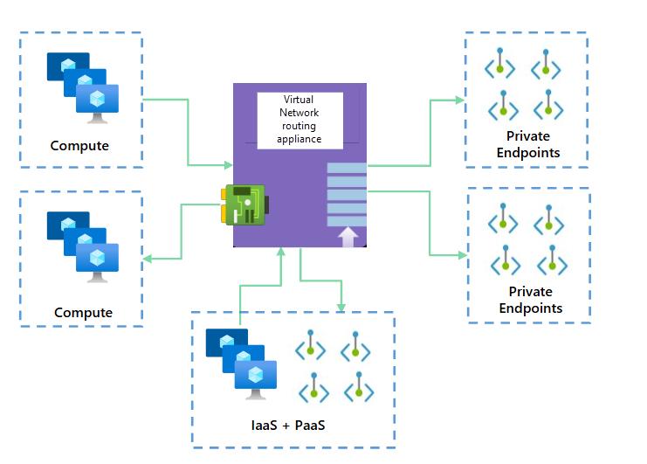
Networking Updates
Public Preview: Azure virtual network routing appliance
Azure Virtual Network routing appliance is a high-performance, Azure-managed routing service that delivers low-latency, high-throughput traffic forwarding without relying on VM-based routers. Deployed as a top-level Azure resource in a dedicated subnet, it runs on specialized networking hardware and integrates seamlessly with Azure’s native management, governance, and deployment tools.
Why it matters
Scales routing capacity horizontally to meet growing bandwidth needs
Reduces latency for east-west traffic
Removes routing bottlenecks in hub-and-spoke architectures
Eliminates the operational overhead of managing VM-based routing appliances

Slide 4
Networking Updates
Public Preview: X-Forwarded-For (XFF) grouping for rate limiting on Application Gateway WAF v2
Application Gateway WAF v2 now supports additional preview rate-limiting GroupBy options using the X-Forwarded-For (XFF) header. This allows customers operating behind proxies or CDNs to apply rate limits based on the original client IP, rather than the TCP source IP.
With this enhancement, rate-limit rules can be grouped by Client Address (XFF) or Geo Location (XFF), enabling more accurate mitigation of abusive or high-volume traffic without impacting legitimate users. The feature integrates seamlessly with existing Application Gateway WAF v2 custom rate-limit rules and policies.

Slide 5
Networking Updates
Generally Available: Default Ruleset 2.2 in WAF for Azure Application Gateway
DRS 2.2 delivers enhanced, Azure-managed protection against common web vulnerabilities and exploits. It builds on OWASP Core Rule Set 3.3.4, adding refined detections and new protections—such as identifying mismatched content types and improved remote code execution (RCE) detection. The release also includes eight new Microsoft Threat Intelligence rules, expanding coverage for SQL injection, XSS, and other application-security attack patterns, while continuing to reduce false positives.
To minimize disruption to legitimate traffic, DRS 2.2 defaults to Paranoia Level 1 (PL1), which focuses on high-signal, low-noise rules. PL2 remains disabled by default due to its more aggressive nature, but can be selectively enabled and tuned as needed.
Announcing Microsoft Azure Network Adapter (MANA) support for Existing VM SKUs
Microsoft will begin deploying MANA across existing VM families starting in February 2026. This initiative brings many of the advantages of next-generation Azure hardware to today’s SKUs, helping organizations modernize performance and security without requiring an immediate VM migration.
The rollout is capacity-driven and not region-restricted. As MANA hardware becomes available in a region, VMs from eligible size families may be placed on it automatically.
What improvements MANA brings
For operating systems and images that fully support MANA, workloads can benefit from:
Sub-second NIC firmware updates, reducing maintenance impact
Higher throughput and lower latency
Improved security posture
Azure Boost–enabled data-path accelerations
If an OS doesn’t yet support MANA, the VM can still run on the new infrastructure, but networking performance will be comparable to previous generations.

Slide 6
Networking Updates
Retirement: Azure Front Door and Azure CDN profiles will end support for DHE cipher suites on April 1, 2026
Microsoft has announced that Azure Front Door (Standard, Premium, Classic) and Azure CDN from Microsoft (Classic) will retire support for weak TLS cipher suites on April 1, 2026.
The following cipher suites will no longer be supported for both client-to-service and service-to-origin connections:
TLS_DHE_RSA_WITH_AES_256_GCM_SHA384
TLS_DHE_RSA_WITH_AES_128_GCM_SHA256
What customers need to do
To avoid service disruption and maintain strong encryption standards, organizations should:
Update origin servers to disable DHE-based ciphers and enable Microsoft-recommended cipher suites.
Ensure client applications connecting to Azure Front Door or Azure CDN use supported cipher suites.
Proactively configure TLS policies (for Front Door Standard/Premium) to disable DHE ciphers ahead of the April 2026 deadline.
After April 1, 2026, Microsoft will automatically disable these weak ciphers across all affected Front Door and CDN profiles. This change aligns with modern security best practices and strengthens TLS posture across Azure’s global edge network.

Slide 7
Security & Identity

Slide 8
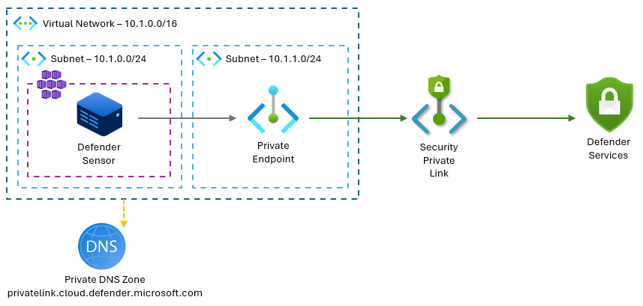
Security & Identity Updates
Microsoft Security Private Link (Preview)
Microsoft Security Private Link enables secure, private connectivity from virtual networks to Microsoft Defender for Cloud. By using private endpoints, all security telemetry flows over the Microsoft backbone without public internet exposure.
Microsoft Security Private Link supports the following scenarios:
Network-isolated environments -Protect workloads in isolated or restricted networks where outbound internet access is limited or not permitted.
Hybrid and on-premises connectivity -Securely connect on-premises or hybrid environments to Microsoft Defender for Cloud by using VPN or ExpressRoute with private peering.

Slide 9
Security & Identity Updates
General Availability - Ability to convert Source of Authority of synced on-prem AD users to cloud users is now available
Microsoft Entra ID now generally supports object-level Source of Authority (SOA) switching, allowing individual users to move from Active Directory–synced to cloud-managed accounts. This enables gradual, low-disruption migration away from AD while maintaining full support through Entra Connect Sync and Cloud Sync, giving organizations more flexibility and control over their identity strategy.
General Availability - Entra ID Governance guest billing meter enforcement
Enforcement of the Microsoft Entra ID Governance guest billing meter is now active for Entitlement Management and Lifecycle Workflows (Access Reviews enforcement follows in CY26 Q1). To continue using Entra ID Governance premium features for guest users, organizations must link a valid Azure subscription to enable the guest add-on. Without billing configured, creating or updating guest-scoped governance settings will be restricted and related actions may fail.

Slide 10
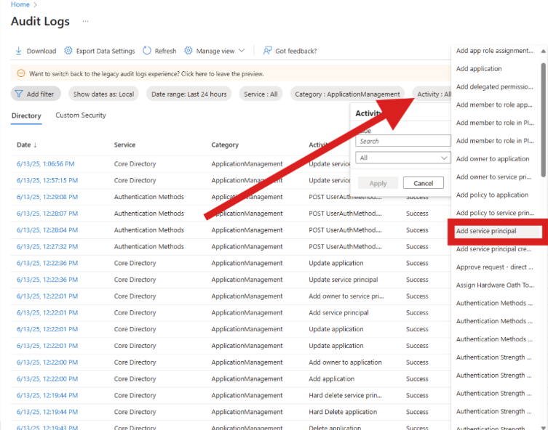
Security & Identity Updates
General Availability - Client Credentials in Microsoft Entra External ID
Client credentials (OAuth 2.0) are now generally available in Microsoft Entra External ID, enabling secure machine-to-machine (M2M) authentication without user involvement. Applications can authenticate using their own credentials, with permissions granted directly by administrators.
Note: Using this capability requires the M2M Premium add-on, so organizations should review licensing and cost implications before enabling it.
General Availability - Service Principal creation audit logs for alerting & monitoring
New audit log enhancements now provide clear visibility into why and how a service principal was created. Admins can see the provisioning mechanism, the specific SKUs or service plans that triggered just-in-time creation, and the app’s home tenant. This makes it easier to distinguish Microsoft-initiated provisioning from tenant-initiated activity, improving security investigations, alerting, and operational clarity.

Slide 11
Security & Identity Updates
General Availability - Entra Private Access for Domain Controllers
This capability enables multi-factor authentication (MFA) for on-premises applications accessed locally, without routing traffic through the cloud. It protects domain controllers from identity-based threats while allowing secure access to private applications that rely on Kerberos authentication. Organizations can strengthen security for legacy and on-premises workloads by enforcing MFA consistently—even for local-to-local access scenarios—without disrupting existing authentication flows.

Slide 12
Management & Governance

Slide 13
Management & Governance Updates
Backup support for Confidential VMs (preview)
Azure Backup now supports Confidential VMs, enabling secure backup and restore for highly sensitive workloads. Data is protected end-to-end across the backup lifecycle using Azure Disk Encryption Sets with platform-managed or customer-managed keys, ensuring confidentiality even from the virtualization layer and meeting strict security and compliance requirements.
Private Preview: Vaulted Backups for Azure Disk
Until now, Azure Disk Backup primarily delivered crash-consistent snapshots in the Operational Tier, ideal for rapid restores after accidental deletion or corruption and often used together with Azure VM Backup. However, many organizations follow the 3-2-1 principle, which requires an isolated, off-site copy to stay protected during tenant-level or ransomware incidents.
With Vault Tier backups, disk recovery points can now be stored in a hardened backup vault with independent access controls and immutability. This aligns disk protection with modern cyber-recovery expectations and brings it closer to the security posture customers expect from Azure Site Recovery and VM-level backup strategies.
What’s new in the private preview
Vault Tier Backup – keep disk backups in an isolated vault to improve ransomware resilience and meet compliance needs.
Regional Disaster Recovery – restore disks into a paired Azure region, enabling broader DR architectures.
The result is a more resilient backup model: fast operational restores when you need speed, plus vault-isolated copies when you need trust.

Slide 14
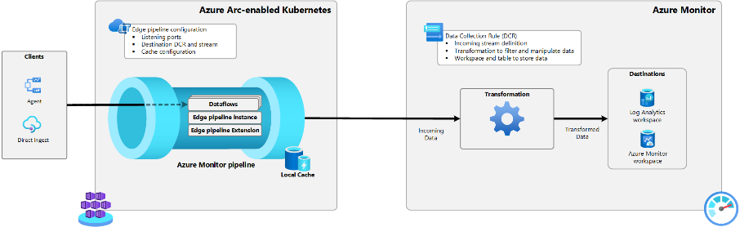
Management & Governance Updates
Public Preview: Azure Monitor pipeline data transformations
Azure Monitor now allows transform telemetry before ingestion. In the new Public Preview, organizations can filter, aggregate, and reshape data such as Syslog and CEF within the pipeline, reducing noise and improving data quality.
Built-in validation ensures compatibility with standard schemas, while prebuilt KQL templates make it easy to apply common scenarios.
The result: lower ingestion cost, cleaner datasets, and faster analytics, especially for high-volume or hybrid environments.
Private Preview: New planned datacenter region in Thailand (Thailand South)
Microsoft is announcing its intent to establish a new datacenter region in Thailand. The datacenter region will expand the availability of Microsoft’s hyperscale cloud services in the region, facilitating enterprise-grade reliability, performance, and compliance with data residency and privacy standards.

Slide 15
Compute

Slide 16
Compute Updates
Public Preview: Azure Kubernetes Fleet Manager namespace-scoped resource placement
Namespace-scoped resource placement is now available in public preview for Azure Kubernetes Fleet Manager, enabling fine-grained control over how individual namespace-scoped resources are selected and propagated across multiple clusters.
This capability allows teams to apply Fleet Manager’s intelligent placement even when a single namespace hosts multiple applications with different lifecycles and distribution needs. It also supports scenarios where managed fleet namespaces require per-workload scheduling based on specific cluster properties or available capacity.
For customers already using cluster-scoped resource placement, the experience will feel familiar—leveraging the same placement policies and staged rollout concepts—making it easy to extend fleet management to the namespace level.

Slide 17
Compute Updates
Generally Available: AMD v6 confidential VMs in new regions for January 2026
DCa/ECa v6 series AMD based confidential virtual machines are now generally available in 11 new regions: Canada Central, Canada East, Norway East, Norway West, Italy North, Germany North, France South, Australia East, West US, West US 3, Germany West Central.
This is in addition to the 6 regions announced during launch of these VMs: Korea Central, South Africa North, Switzerland North, UAE North, UK South, West Central US
These VMs are powered by 4th generation AMD EPYC™ processors and feature advanced Secure Encrypted Virtualization-Secure Nested Paging (SEV-SNP) technology.
4th generation AMD EPYC processors with SEV-SNP
25% performance improvement over previous generation
Ability to rotate keys online
AES-256 memory encryption enabled by default
Up to 96 vCPUs and 672 GiB RAM for demanding workloads
Generally Available: Serverless workspaces in Azure Databricks
Azure Databricks Serverless workspaces are now generally available, delivering a fully managed, enterprise-ready SaaS experience with no infrastructure setup required.
These workspaces come preconfigured with serverless compute and default storage, allowing teams to run production workloads in minutes or spin up short-lived environments for training and testing directly from the Azure portal.
The release also enables administrators—without cloud provisioning permissions—to deploy and manage secure, governed Databricks environments at scale, natively available to all users in an Entra tenant.

Slide 18
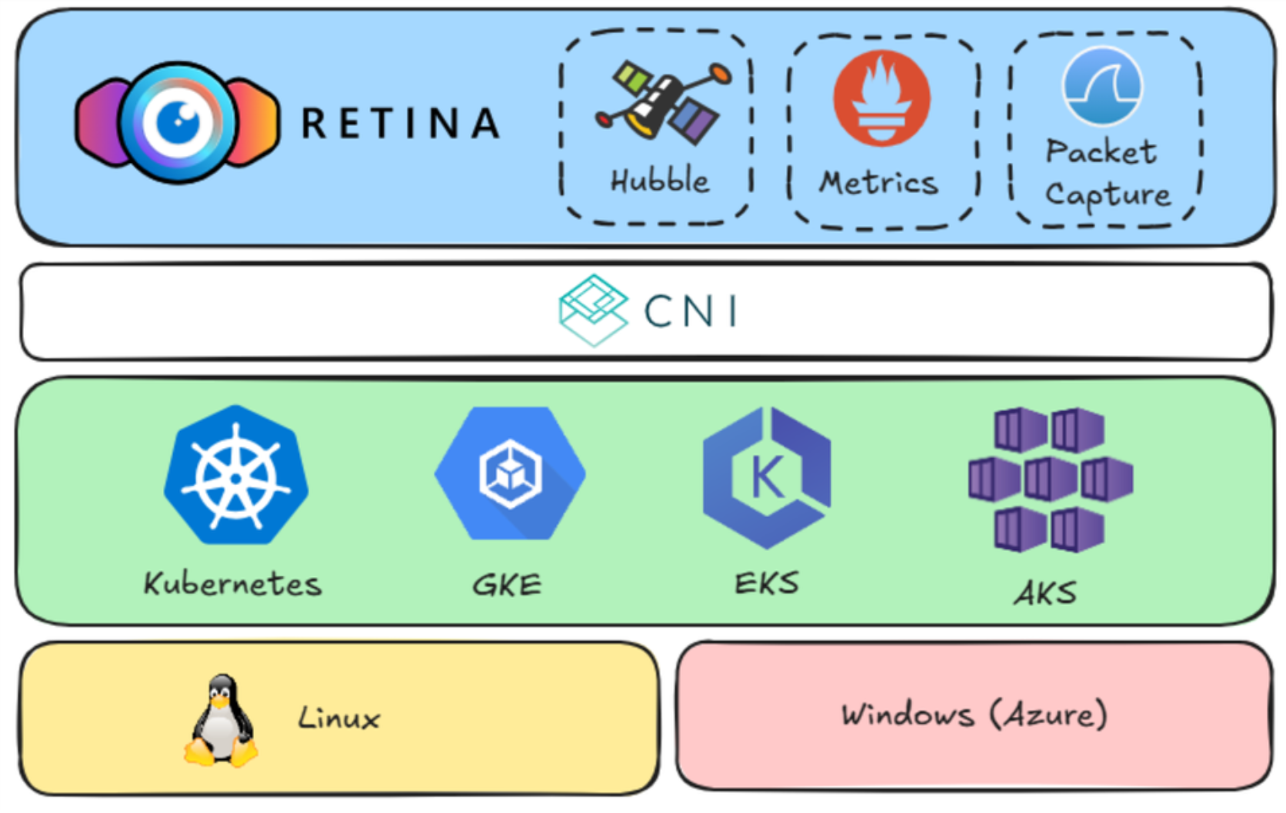
Compute Updates
Retina 1.0 Is Now Available
Retina 1.0 is now available — marking the first major release of the open-source Kubernetes network observability platform. Retina provides continuous network health visibility and on-demand troubleshooting across Kubernetes clusters by collecting real-time metrics and distributed packet captures. It supports cloud- and CNI-agnostic deployments, exports telemetry to tools like Prometheus, Grafana, and Azure Monitor, and integrates with Hubble for enhanced insights. Designed to simplify debugging, monitoring, and compliance for DevOps and SecOps teams, Retina helps surface issues such as dropped packets, connectivity failures, and DNS anomalies across diverse Kubernetes environments.
Generally Available: Azure Container Storage v2.1.0 now with Elastic SAN integration and on demand installation
Azure Container Storage v2.1.0 is now generally available, introducing native Elastic SAN support and a new lightweight, on-demand installation model for Kubernetes workloads on Azure.
With Elastic SAN supported as a native storage type, organizations can provision scalable volume groups and consolidate large numbers of Kubernetes volumes under a single SAN resource. This delivers faster attach/detach operations, higher throughput, and reduced management overhead for stateful applications.
The release also improves setup experience with better defaults and enhanced automation for Elastic SAN and volume group configuration.
In addition, v2.1.0 introduces modular, on-demand installation, allowing clusters to deploy only the components required for the chosen storage type. This reduces cluster footprint, speeds up deployment, and simplifies ongoing lifecycle management.

Slide 19
Compute Updates
Azure Virtual Desktop is now available in US Gov Texas in Azure Government
Azure Virtual Desktop (AVD) has expanded to Azure Government USGov Texas, giving customers an additional region to deploy secure, compliant virtual desktop environments.What this means for customers:
Create AVD host pools directly in the USGov Texas region
Improve user experience with lower latency and better performance
Gain more flexibility to meet mission, geographic, and regulatory requirements
This expansion strengthens Azure Government’s regional coverage while maintaining the high security and compliance standards required for government and regulated workloads.

Slide 20
Storage & Data

Slide 21
Storage & Data Updates
Public Preview: Azure NetApp Files Elastic zone-redundant service level
Azure NetApp Files Elastic zone-redundant storage (ANF Elastic ZRS) is a high-availability service level that ensures continuous file access with zero data loss, even if an entire Azure Availability Zone fails. By synchronously replicating data across zones within a region, it removes single points of failure and keeps mission-critical workloads online without manual intervention.
ANF Elastic ZRS delivers consistent performance for metadata-intensive workloads across VMs and containers, making it well suited for AI, analytics, Kubernetes/OpenShift, and enterprise file services. With support for volumes as small as 1 GiB, it combines strong in-region resilience, operational simplicity, and flexible, cost-effective scalability for workloads of any size.

Slide 22
ML & AI & IOT

Slide 23
ML & AI & IOT Updates
Public Preview: Claude Opus 4.6, Available on Microsoft Foundry
Claude Opus 4.6 is now available in Microsoft Foundry, bringing Anthropic’s most advanced reasoning model to an enterprise-ready Azure platform. The release supports complex coding, long-context reasoning, and agent-driven workflows with governed computer use, enabling organizations to move confidently from experimentation to production. This makes frontier AI practical for high-stakes development, analysis, and automation—without compromising security or operational control.
Kimi-K2.5 Now in Microsoft Foundry
Moonshot AI’s next-generation multimodal and agentic model, Kimi K-2.5, is now available in Microsoft Foundry. The release brings major advances in vision-language understanding, agent orchestration, and multimodal coding workflows.
What’s new
Native multimodality: Trained with 15T additional vision–text tokens for stronger image/video understanding, OCR, and multimodal Q&A
Agent Swarm execution: Orchestrates up to 100 parallel agents and 1,500 tool calls, delivering up to 4.5× faster execution than sequential workflows
Image/video-to-code: Significantly improved visual debugging and UI reconstruction from screenshots or video snippets
Kimi K-2.5 enables faster, more capable multimodal and agent-driven applications—now ready for enterprise use in Microsoft Foundry.

Slide 24
ML & AI & IOT Updates
​Generally Available: Claude Opus 4.6 now available on Azure Databricks
Anthropic’s most advanced model, Claude Opus 4.6, is now integrated into Mosaic AI Model Serving. The model delivers leading performance in agentic coding, complex reasoning, and deep knowledge work, helping teams build more capable and reliable AI-powered solutions.
Claude Opus 4.6 introduces stronger planning, code review, and debugging abilities, making it well suited for large codebases and long-running agent workflows. This allows developers and data teams to automate sophisticated engineering and analytical scenarios with greater confidence.
The model runs securely inside Azure Databricks and is available with flexible consumption options, including pay-per-token and provisioned throughput.
Where it fits best
AI agent development
Advanced developer copilots and code modernization
Research and analytics workflows requiring deep reasoning
This release makes frontier AI capabilities easier to operationalize while maintaining enterprise governance and security.

Slide 25
Information

Slide 26
Information
Azure Times GitHub Repo

Slide 27
Questions

