Slide 1
Azure Times #164
June 2, 2025

Slide 2
Networking

Slide 3
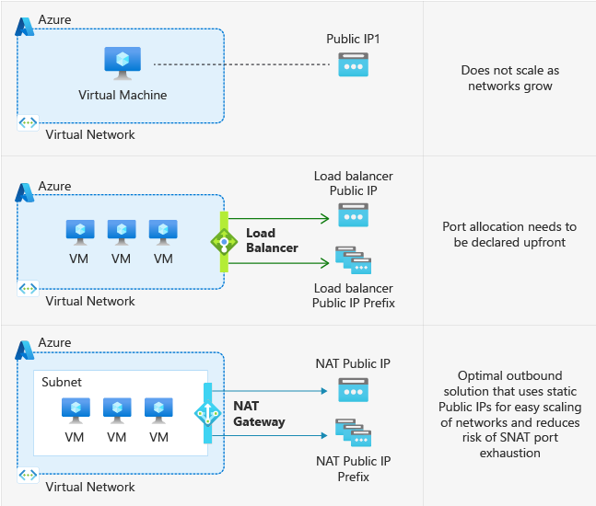
Networking Updates
Generally Available: Private subnet
Currently, when virtual machines are created in a virtual network without any explicit outbound connectivity, they are assigned a default outbound public IP address. These implicit IPs are subject to change, not associated with a subscription, difficult to troubleshoot, and do not follow Azure's model of "secure by default" which ensures customers have strong security without additional steps needed. The private subnet feature prevents this insecure implicit connectivity for any newly created subnets by setting the "default outbound access" parameter to false.
Additionally, please note that after September 30th, 2025, new virtual networks will default to using private subnets, meaning that an explicit outbound method must be enabled in order to reach public endpoints on the Internet and within Microsoft.

Slide 4
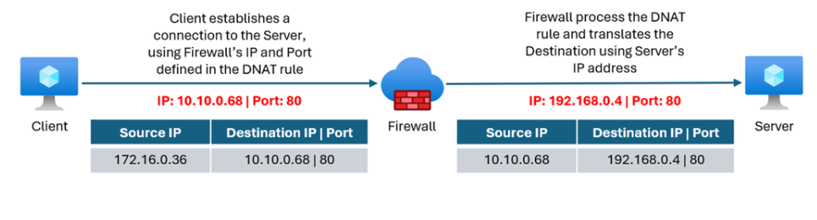
Networking Updates
Generally Available: Container Apps and Functions as Private Link enabled origins for Front Door Premium
It is now possible to configure Azure Container Apps and Azure Functions as Private Link enabled origins in Front Door Premium profile. Private Link enabled origins in Front Door allow to deliver content to end-users through public Front Door endpoints while ensuring that origins remain inaccessible to the public internet.
Generally Available: Destination Network Address Translation (DNAT) on Azure Firewall Private IP address
Azure Firewall enhances the DNAT rule configuration to support port translations on its Private IP address.
DNAT on Azure Firewall Private IP address helps connect overlapped IP networks, which is a common scenario for enterprises when onboarding new partners to their network or merging with new acquisitions.
This capability is also relevant for hybrid scenarios, connecting on-premises datacenters to Azure, where DNAT bridges the gap, enabling communication between private resources over non-routable IP addresses.
Destination Network Address Translation (DNAT) involves transforming the destination IP address and/or port of a packet that is routed and reverses this process for any responses. In other words, DNAT translates destination IP addresses.

Slide 5
Networking Updates
Public Preview: Azure Front Door now supports origin authentication via Managed Identities
Front Door Standard and Premium now supports sending authenticated requests to its origins using Managed Identities. This feature allows customers to secure origins by allowing only approved Front Door profiles to access the origins.
Using Managed Identities eliminates the need for customers to manually handle the credentials involved in the authentication process, thereby reducing potential risks associated with credential leakage.
Public Preview: Using Server-sent events with Application Gateway
Azure Application Gateway supports use of Server-sent events in preview, enabling real-time data streaming from server to client. Server-sent events utilize server push technology on a persistent HTTP connection for seamless updates to the clients.
Server-Sent Events (SSE) is a server-push technology that allows a server to automatically send updates to a client over an HTTP connection.
To implement this, specific configurations are required on both the application gateway resource and the backend application.

Slide 6
Security & Identity

Slide 7
Security & Identity Updates
Public Preview: TLS Inspection now in Microsoft Entra Internet Access
TLS Inspection in Microsoft Entra Internet Access tackles encrypted threats directly by routing traffic through the Microsoft Security Service Edge, where HTTPS traffic is securely decrypted for inline inspection. This allows for a full contextual understanding of the traffic, going beyond just domains, to apply security policies. Intelligent enforcement then leverages identity-centric policies and Conditional Access signals to determine if the traffic is safe. Finally, approved traffic is swiftly re-encrypted and sent on its way, ensuring both robust security and a seamless user experience.
Real-time, performant inspection: Decrypt and inspect encrypted HTTPS traffic without a discernible impact on user experience or network performance.
Identity-driven policy enforcement: Leverage the power Conditional Access signals, including user identity, device compliance, and risk levels, to make intelligent decisions about when and for whom to inspect traffic.
Enhanced web categorization: Benefit from improved signal intelligence, leading to more accurate and granular web category classification.
Improved user experience: Deliver clear and informative messages to end-users when access is blocked, reducing confusion and minimizing help desk inquiries.

Slide 8
Management & Governance

Slide 9
Management & Governance Updates
Announcing Windows Backup for Organizations
Windows Backup for Organizations is now in limited public preview!
Windows 10 reaching its end of support on October 14, 2025 (excluding certain LTSC editions), this new feature can simplify your transition to Windows 11.
Windows Backup for Organizations offers:
Reduced troubleshooting: Easily reset devices with confidence that users can quickly recover and return to their previous settings.
Seamless experience: Smoothly transition from Windows 10 devices to Windows 11 devices thanks to saved backups.
Enhanced productivity: Minimize downtime and maximize user productivity by restoring user settings to their preferred and familiar PC preferences.
Public Preview: Azure Backup for Elastic SAN
Azure Backup now supports Elastic SAN, offering a fully managed solution for backing up and restoring Elastic SAN volumes. This integration helps protect data against accidental deletions, ransomware attacks, and application updates by exporting Elastic SAN volumes to independent Managed Disk Incremental Snapshots. These snapshots are stored in locally redundant storage and are independent of the Elastic SAN volume lifecycle.
The solution supports up to 450 restore points with 24 hours backup frequency. It is currently available in select Azure regions and supports volumes up to 4 TiB. Long-term vaulted backups and hourly backups are not supported in this preview.
This public preview does not incur Azure Backup Protected Instance fees. However, standard charges apply for Managed Disk Incremental Snapshots.

Slide 10
Management & Governance Updates
Public Preview: Azure Migrate expands support for migrations with Ultra SSD
Azure Migrate now supports migration to Ultra Disk, enabling customers to seamlessly migrate their on-premises workloads to Azure while taking advantage of Ultra Disk’s cutting-edge performance and scalability. Designed for I/O-intensive workloads, such as SAP HANA, high-performance databases like SQL and Oracle, and latency-sensitive applications, Ultra Disk delivers up to 400,000 IOPS and 10,000 MBps with low sub-millisecond latency, dynamic scalability, and enterprise-grade reliability.
In regions where Ultra Disk is available, Azure Migrate has been enhanced to offer Ultra Disk as a selectable option for migrating applicable data disks.

Slide 11
Management & Governance Updates
Generally Available: Azure Migrate enhances support with Premium SSD v2 Disks
Azure Migrate now supports migration to Premium SSD v2 (Pv2) disks, offering customers a seamless experience to migrate their on-premises workloads to Azure and benefit from the greater flexibility and enhanced performance of Pv2 disks in Azure.
Pv2 disks offer sub-millisecond disk latencies for demanding IO-intensive workloads at a low-cost. Customers can use that to improve the price-performance of a broad range of enterprise production workloads such as SQL Server, Oracle, MariaDB, SAP, Cassandra, Mongo DB, big data, analytics, gaming, on virtual machines, or stateful containers. Azure Migrate now recommends Pv2 as the target disk type for eligible data disks in regions where Pv2 is available and offers Pv2 as a selectable option for migrating applicable data disks.
Generally Available: Azure Quota Groups
Azure Quota Groups is now generally available, offering improved flexibility and control for Enterprise Agreement (EA) and internal customers. This feature enables quota sharing across a group of subscriptions, reducing the number of individual quota transactions.
Quota management is elevated from the subscription level to a centralized Quota Group Azure Resource Manager (ARM) object, allowing customers to manage procured quota within a group through self-service—without Microsoft approval.
Key benefits:
Cross-subscription sharing: Share and manage quota across multiple subscriptions in a group.
Self-service management: Allocate or reassign unused quota without filing support requests.
Reduced support overhead: Fewer tickets for quota changes or new subscription setups.
Centralized requests: Submit one quota request at the group level and distribute as needed.
Azure Quota Groups streamlines quota operations and empowers customers with greater agility in managing their Azure resources.

Slide 12
Compute

Slide 13
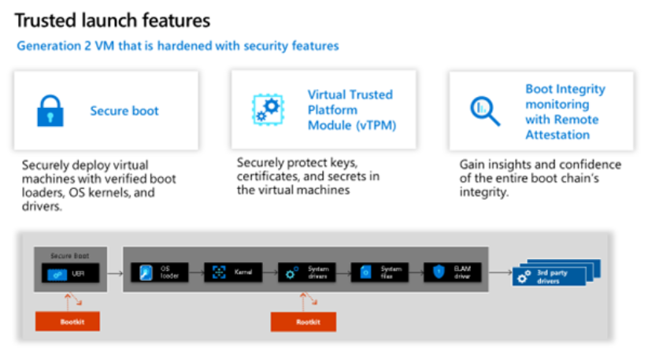
Compute Updates
[Preview] Trusted launch Default for new Azure virtual machine, Scale set, compute gallery and disk
MS announced public preview for upcoming Trusted Launch as default (TLaD) change that will affect new deployments of Gen2 Virtual Machines (VMs), Virtual Machine Scale Sets (Scale set), Azure Compute Gallery (ACG) and OS disk resources in Azure. The change will:
Set security type as “TrustedLaunch” by default for new Gen2 VM & Scale set deployments.
Set security type as “TrustedLaunchSupported” by default for new Gen2 ACG image definitions.
Introduce new property in disk named “SupportedSecurityOption” and inherit the security type value of image using which disk is created.
Generally Available: App Service Hybrid Connection Manager
This new version has an updated look and feel and provides the following advantages over the previous version:
Support for both Windows and Linux clients
Enhanced logging and visibility into operating status
Refreshed GUI and a new CLI experience for cross-platform compatibility

Slide 14
Storage & Data

Slide 15
Storage & Data Updates
Announcing General Availability: Ephemeral OS Disk support for v6 Azure VMs
Microsoft announced the General Availability (GA) of Ephemeral OS Disks with NVMe disk placement for the latest generation of Azure v6 Virtual Machines (VMs), including the Dadsv6, Ddsv6, and related series. This feature brings up to 10X higher OS disk performance compared to Managed OS disks—significantly boosting VM speed and responsiveness for your stateless workloads.
These disks are non-persistent, making them perfect for scenarios where performance, scalability, and fast reimaging matter more than long-term data retention.
Generally Available: Customer-managed keys for Azure NetApp Files volume encryption with Azure Key Vault Managed HSM
Azure NetApp Files volume encryption choices have expanded to offer support customer-managed keys for Azure NetApp Files volume encryption with Azure Key Vault Managed HSM.
This capability offers increased security from FIPS 140-2 Level 2 to FIPS 140-2 Level 3 for critical deployments. Various applications that leverage HSM security include payment processing, application-level encryption, authentication. Industry verticals that use HSMs include financial services, public sector, IT/Telco (secure communications), energy (securing critical infrastructure).

Slide 16
Storage & Data Updates
Public Preview: Live Resize for Premium SSD v2 and Ultra NVMe Disks
MS announced the public preview of Live Resize for Premium SSD v2 (Pv2) and Ultra NVMe Disks. This feature allows to dynamically expand the storage capacity of disks without any disruption to applications. To optimize costs, it is possible to start with smaller disks and gradually increase their storage capacity as needed, all without experiencing any downtime.
This limitation doesn't apply to Premium SSD v2 or Ultra Disks:
If a Standard HDD, Standard SSD, or Premium SSD disk is 4 TiB or less, deallocate VM and detach the disk before expanding it beyond 4 TiB. If one of those disk types is already greater than 4 TiB, it is possible to expand it without deallocating the VM and detaching the disk.
Only supported for data disks.
Not supported for shared disks.

Slide 17
ML & AI & IOT

Slide 18
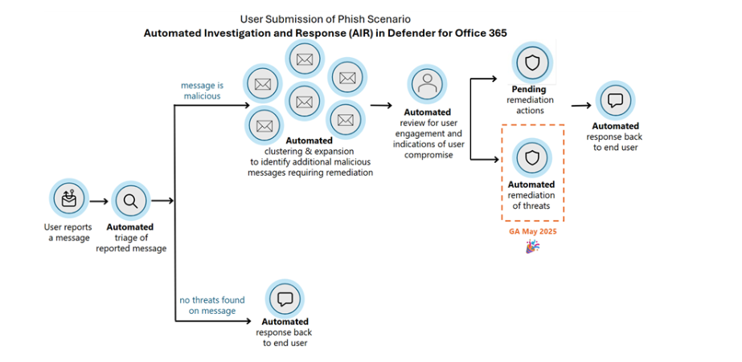
ML & AI & IOT Updates
Introducing Multi-Vector and Scoring Profile integration with Semantic Ranking in Azure AI Search
MS announce two powerful new enhancements in Azure AI Search: Multi-Vector Field Support and Scoring Profiles Integration with Semantic Ranking.
Multi-Vector Field Support - Previously, vector fields `(Collection(Edm.Single))` or other narrow types could only exist at the top level of your index. Now, Azure AI Search enables you to embed multiple vectors within nested fields, providing richer context and deeper semantic understanding
Enhanced Semantic Ranking with Scoring Profiles - Previously, scoring profiles influenced search results only during initial ranking. With this enhancement, scoring profiles also apply after semantic reranking, ensuring that your boosts shape the final results.
Auto-Remediation of Malicious Messages in Automated Investigation and Response (AIR) is GA
MS announced the GA release of auto-remediation of malicious messages through automated investigation and response (AIR) expanding this powerful tool and deliver on full end to end automation of key SOC scenarios.

Slide 19
DevOps & IaC & Automation

Slide 20
DevOps & IaC & Automation
Generally Available: Azure Cosmos DB JavaScript SDK 4.0
The Azure Cosmos DB JavaScript SDK 4.0 is now generally available. This major update brings a range of enhancements to help build more efficient and scalable applications.
Key improvements include enhanced diagnostic logging for better performance tracking, an improved bulk API for faster data operations, and a more flexible query design for efficient scaling. The SDK also introduces client-side encryption to support data security, as well as AI-driven features, including vector search and full-text search to enable advanced search capabilities.
These updates make the Azure Cosmos DB JavaScript SDK 4.0 a powerful tool for building high-performance applications.

Slide 21
Miscellaneous

Slide 22
Miscellaneous Updates
Retirement: Microsoft Fabric Runtime 1.2
End of Support for Microsoft Fabric Runtime 1.2 has been announced. Microsoft Fabric Runtime 1.2 will be deprecated and disabled March 31, 2026. MS recommend upgrading Fabric workspace and environments to use Runtime 1.3 (Apache Spark 3.5 and Delta Lake 3.2).
Retirement: Language Understanding (LUIS) retirement extended to October 31, 2025
Language Understanding (LUIS) would be retired on October 1, 2025. Based on feedback, it will be extended to October 31, 2025.
On October 31, 2025, Language Understanding (LUIS) will be retired. Before that date, please migrate to conversational language understanding, a capability of Azure AI Service for Language. Conversational language understanding provides many of the capabilities of LUIS, plus enhancements such as:
Enhanced AI quality using state-of-the-art machine learning models
Multilingual capabilities that allow to train in one language and predict in others
Built-in routing between conversational language understanding and custom question answering projects using orchestration workflow
Access to a suite of features available on Azure AI Service for Language

Slide 23
Miscellaneous Updates
Retirement: Azure Synapse Runtime for Apache Spark 3.4
End of Support Announcement for Azure Synapse Runtime for Apache Spark 3.4. Azure Synapse Runtime for Apache Spark 3.4 will be deprecated and disabled March 31, 2026.

Slide 24
Information

Slide 25
Information
Azure Times GitHub Repo

Slide 26
Questions

