Slide 1
Azure Times #165
June 9, 2025

Slide 2
Security & Identity

Slide 3
Security & Identity Updates
Announcing the Firmware Analysis Public Preview
It is a new capability available through Azure Arc. This extends the firmware analysis feature MS introduced in Microsoft Defender for IoT, making it available to a broader range of customers and scenarios through Azure.
The goal is to provide deeper visibility into IoT/OT and network devices by analyzing the foundational software (firmware) they run.
Firmware analysis will also help companies that build firmware for devices better meet emerging cybersecurity regulations on their products. In this post, we’ll explain how the service works, its key features, and how it helps secure the sensors and edge devices that feed data into AI-driven industrial transformation.

Slide 4
Security & Identity Updates
Azure Managed HSM and Azure Key Vault Premium are now FIPS 140-3 Level 3
MS announced that the HSM firmware for both Azure Managed HSM and Azure Key Vault Premium are officially upgraded to a modern version validated to FIPS 140-3 Level 3 standard in all Azure public cloud regions. This upgrade represents a significant step forward in our commitment to providing best-in-class security to safeguard your valuable data.
Azure Managed HSM and Azure Key Vault Premium HSM Devices Certified for eIDAS Compliance
The regulation of electronic IDentification, Authentication, and trust Services for Electronic Transactions (eIDAS) is a European regulation aimed at creating a framework for cross-border electronic identification and transactions across EU member countries.
These new certifications to Azure Managed HSM and Azure Key Vault Premium provide Trust Service Providers and others that provide time stamping, website authentication, certificate issuance, electronic registered delivery, electronic seal, and electronic signature services the ability to utilize Azure Managed HSM and Azure Key Vault Premium as part of their eIDAS-compliant solution.

Slide 5
Management & Governance

Slide 6
Management & Governance Updates
Public Preview: Azure Migrate enhances resiliency by supporting ZRS Disks Migration
Azure Migrate now supports migration to ZRS Disks. Zone-Redundant Storage (ZRS) for Azure Disks synchronously replicates data across three physically separate availability zones within a region – each with independent power, cooling, and networking – enhancing Disk availability and resiliency.
In the event of a zonal failure, ZRS disks can be force-detached from the impacted VM and reattached to another VM for workload continuity.
Azure Migrate now migrates ZRS as the target disk type for eligible data disks in regions where ZRS is supported. ZRS for managed disks is only supported with Premium SSD and Standard SSD managed disks.
Public Preview: Azure Site Recovery Support for Virtual Machines with Premium SSD v2 disks
ASR provides seamless disaster recovery for Virtual Machines across Azure Regions and from on-premises to Azure, helping organizations maintain business continuity. It offers cost-effective replication, automated failover, and easy disaster recovery simulation, ensuring minimal production impact during disaster events. With built-in security, compliance support, and native integration with Azure services, ASR helps your organization stay resilient and minimize downtime.
Premium SSD v2 offers low-latency, consistent performance with the flexibility to scale throughput and IOPS independently, making it ideal for a broad spectrum of enterprise production workloads including SQL Server, Oracle, SAP, and big data environments. It is particularly well suited for customers seeking to optimize performance and cost across diverse workloads, without over-provisioning.

Slide 7
Management & Governance Updates
Announcing Azure Command Launcher for Java
MS introduced jaz, a new JVM launcher optimized specifically for Azure. jaz provides better default ergonomics for Java applications running in containers and virtual machines, ensuring a more efficient use of resources right from the start, and leverages advanced JVM features automatically, such as AppCDS and in the future, Project Leyden.

Slide 8
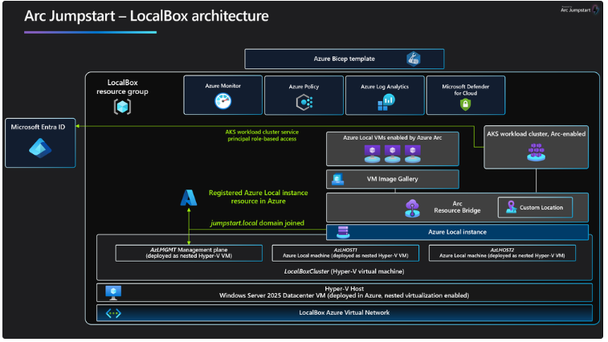
Management & Governance Updates
Jumpstart LocalBox 25H2
With 25H2 release, MS introduced support for Azure VM Spot pricing for the LocalBox Client VM, removed service principal dependency and transitioned to Managed Identity, added support for deploying the LocalBox Client VM and Azure Local instance in separate regions, added dedicated PowerShell modules and updated LocalBox to the Azure Local 2505 release.
Generally Available: Azure Storage Mover support for SMB source to Azure Blob target
Azure Storage Mover can now migrate SMB shares to Azure Blob container.
Storage Mover is a fully managed migration service that enables to migrate on-premises files and folders to Azure Storage while minimizing downtime for workload. Together with just-in-time permission setting and Azure Key Vault, migration is secure from source to target.
Besides the existing general available capability to migrate from an on-premises NFS share to an Azure blob container and SMB source to Azure File shares, Azure Storage Mover now supports SMB source to Azure Blob container as target.

Slide 9
Compute

Slide 10
Compute Updates
Generally Available: NFS Azure Files volume mount support in Azure Container Apps
Azure Container Apps now supports mounting Network File System (NFS) Azure Files volumes to containerized applications. NFS Azure Files volumes provide a scalable and high-performance file system for apps and jobs. It is possible to use NFS Azure Files volumes to share data between multiple containers in application, or to persist data across container restarts.
Azure VMware Solution now available in Korea Central
MS announced that Azure VMware Solution is now available in Korea Central. Now in 34 Azure regions, Azure VMware Solution empowers seamlessly extend or migrate existing VMware workloads to Azure without the cost, effort or risk of re-architecting applications or retooling operations.
Azure VMware Solution supports:
Rapid cloud migration of VMware-based workloads to Azure without refactoring.
Datacenter exit while maintaining operational consistency for the VMware environment.
Business continuity and disaster recovery for on-premises VMware environments.
Attach Azure services and innovate applications at your own pace.
Includes the VMware technology stack and lets you leverage existing Microsoft licenses for Windows Server and SQL Server.

Slide 11
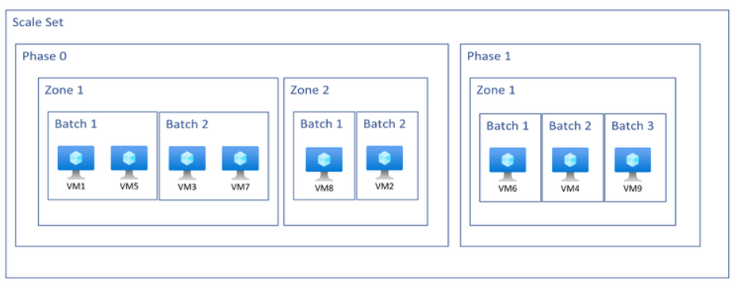
Compute Updates
General Availability: Standby Pools for Azure Container Instances
Standby Pools allow you to create a pool of pre-provisioned, pre-initialized container groups that are ready to receive workloads instantly. This capability significantly reduces cold start latency and enhances responsiveness for bursty, event-driven, or latency-sensitive applications.
Instant startup: Containers are pre-warmed and ready to serve traffic immediately.
Flexible configuration: Apply configuration changes without triggering redeployments.
Scalable automation: Integrate with container group profiles to streamline and standardize deployments across environments.
Improved reliability: Reduce variability in startup times and improve user experience during traffic spikes.
General Availability: Custom Metrics for Rolling Upgrades on Virtual Machine Scale Sets
This feature allows to use the application health extension to emit custom metrics that guide the upgrade process.
Control upgrade order: Define the sequence in which VMs are upgraded.
Skip specific instances: Exclude individual VMs from upgrades without disrupting the rest of the fleet.
Seamless integration: Works with rolling upgrade policies, automatic OS and extension upgrades, and MaxSurge.

Slide 12
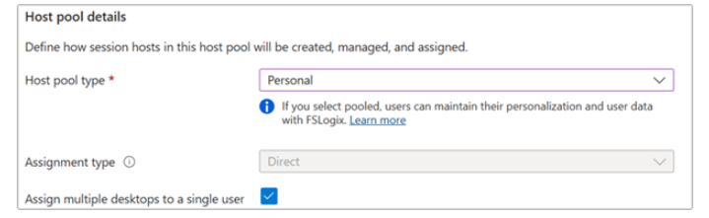
Compute Updates
Multiple personal desktop assignment now generally available
New features allows multiple personal desktops to be assigned to a single user within one host pool.

Slide 13
Databases

Slide 14
Databases Updates
Public Preview: High availability with SSD v2 for Azure Database for PostgreSQL flexible server
It is now possible to enable high availability (HA) with Azure Premium SSD v2 disks while deploying Azure Database for PostgreSQL flexible server. Zonal HA options using SSD v2 help achieve a recovery point objective (RPO) of zero.
Public Preview: Azure Database for MySQL - Flexible Server now supports high availability with dedicated Azure Standard Load Balancer
Announcing the public preview of a dedicated Azure Standard Load Balancer in Azure Database for MySQL - Flexible Server for high availability-enabled servers. With this feature, a high availability configuration gets the benefit of a dedicated Standard Load Balancer, including low latency, high throughput network traffic distribution of front-end requests to backend servers. With Standard Load Balancer managing the MySQL data traffic path, it is possible to enjoy a more optimized failover time for high availability servers.

Slide 15
Databases Updates
Public Preview: In-place major version upgrade to PostgreSQL 17 on Azure Database for PostgreSQL flexible server
It is now possible to upgrade Azure Database for PostgreSQL flexible server instance to PostgreSQL 17 using a simple, in-place upgrade—now available in public preview. This release allows to move from previous PostgreSQL versions (14, 15, or 16) to PostgreSQL 17 without changing server endpoint, reconfiguring application, or performing manual data migration. The in-place upgrade process is designed to minimize downtime and reduce operational complexity, helping stay current with the latest PostgreSQL capabilities.
PostgreSQL 17 introduces several enhancements that benefit both developers and database administrators. improved performance for vacuuming, query planning, and more; expanded SQL/JSON functionality, including support for JSON\_TABLE; new MERGE command capabilities with RETURNING support; and more flexible partition management.
This capability is available through both the Azure portal and the Azure command-line interface (CLI).

Slide 16
Databases Updates
Generally Available: Azure Database for PostgreSQL - Azure Data Factory managed identity
It is now possible to use user-assigned managed identity and system-assigned managed identity Entra authentication to connect to Azure Database for PostgreSQL instance with Azure Synapse Analytics and Azure Data Factory.
Generally Available: Azure Database for PostgreSQL support for pg_cron extension in PG 17
Announcing that pg_cron is now supported in PostgreSQL 17 on Azure Database for PostgreSQL flexible server. This extension brings powerful, built-in job scheduling to PostgreSQL 17—previously available only in earlier versions.

Slide 17
Databases Updates
Generally Available: Upsert and Script activity in data factory in Microsoft Fabric for Azure Database for PostgreSQL
MS announced the general availability of Upsert method and Script activity support in Microsoft Fabric when using Azure Database for PostgreSQL. This enhancement enables to perform efficient, scalable, and declarative data transformations directly within pipelines.
With the Upsert method, it is now possible to merge incoming data into existing tables without writing complex logic, reducing overhead and improving performance. The Script activity allows to execute custom SQL scripts as part of data workflows, enabling advanced transformations, procedural logic, and fine-grained control over data operations.
These capabilities streamline extract, transform, load (ETL) and extract, load, transform (ELT) processes and unlock new flexibility for building robust data integration solutions using Azure Database for PostgreSQL as a source or sink.
Generally Available: Long-term backup retention for Azure Database for PostgreSQL – Flexible Server
Azure Database for PostgreSQL - Flexible Server now offers a backup solution for supporting long-term backup retention and improved compliance for PostgreSQL databases using Azure Backup. This release enables to take advantage of a rich set of capabilities, such as flexible database backup policies, management of individual backups, and streamlined configuration.

Slide 18
Databases Updates
Generally Available: Azure Database for MySQL bindings for Azure Functions
MS announced the general availability of Azure Database for MySQL bindings for Azure Functions. With this integration, Azure Functions can seamlessly interact with Azure Database for MySQL databases using input and output bindings. By simplifying the code required to read from and write to the database, these bindings significantly speed up the development time. You can create scalable, event-driven applications and serverless APIs using popular programming languages such as C#, Java, JavaScript, Python, and PowerShell.

Slide 19
ML & AI & IOT

Slide 20
ML & AI & IOT Updates
Generally Available: Required role assignment for private endpoint approvals in AzureML workspaces and/or AI Foundry hubs with managed network
Starting April 30, 2025, private endpoint approvals from the Azure Machine Learning and Azure AI Foundry managed network will no longer be handled by the internal networking service. Moving forward, either the Azure AI Enterprise Network Connection Approver RBAC role must be assigned to the workspace’s managed identity, or a custom role with the necessary private endpoint connection permissions on the target resource types must be created.
This change addresses security concerns related to the previous automatic role assignment. Existing resources with approved private endpoints are not affected, as the appropriate role was already assigned by the service.

Slide 21
Miscellaneous

Slide 22
Miscellaneous Updates
Retirement: Extended support for .NET 9 (STS) ends on May 12, 2026
On May 12, 2026, extended support for .NET 9 (STS) will end. Apps that are hosted on App Service will continue to run, but security updates will no longer be available and we’ll no longer provide customer service for .NET 9 (STS).

Slide 23
Information

Slide 24
Information
Azure Times GitHub Repo

Slide 25
Questions

