Slide 1
Azure Times #167
June 23, 2025

Slide 2
Networking

Slide 3
Networking Updates (General Availability)
Generally Available: Azure Front Door now supports managed certificate for wildcard domains
Azure Front Door standard and premium profiles now support managed certificate for wildcard domains. Previously, it supported only bring your own certificate for wildcard domains.
This allows to secure multiple subdomains with a single certificate—ideal for SaaS providers and large-scale multi-tenant applications.
It brings the following benefits
Simplified Operations: Customers no longer need to manage individual certificates for each subdomain.
Improved Scalability: Wildcard support reduces configuration overhead and accelerates onboarding.
Enhanced Security: Managed certificates ensure automated renewals.
Generally Available: Azure WAF integration in Microsoft Security Copilot
Azure Web Application Firewall (WAF) integration in Microsoft Copilot for Security has reached general availability. This integration supports both Azure Front Door WAF and Azure Application Gateway WAF.
By integrating Azure WAF with the Security Copilot, organizations can streamline security operations, and accelerate investigations, helping security teams stay ahead of increasingly sophisticated threats.
SQL Injection (SQLi) Attack Analysis
Cross-Site Scripting (XSS) Attack Analysis
Top Offending IP Analysis
Top Azure WAF Rules Analysis

Slide 4
Security & Identity

Slide 5
Security & Identity Updates
General Availability: Key Attestation for Azure Managed HSM
Key attestation for Azure Managed HSM enables a way to validate the origin and integrity of cryptographic keys generated and stored within a trusted, FIPS 140-3 Level 3 certified HSM. This thereby enhances trust in key management processes by offering transparency and further enables compliance with strict security standards. This feature is especially valuable in scenarios where customers need assurance that their keys are protected from unauthorized access, even from cloud providers.

Slide 6
Management & Governance

Slide 7
Management & Governance Updates (Public Preview -1/2)
Public Preview: Continuous Performance Diagnostics for Linux VMs to Enhance VM Troubleshooting
Performance Diagnostics tool helps to identify and troubleshoot performance issues on Azure virtual machine (VM) in one of two modes:
Continuous diagnostics collects data at five-second intervals and reports actionable insights about high resource usage every five minutes. Continuous diagnostics is Generally Available (GA) for Windows VMs and in Public Preview for Linux VMs.
On-demand diagnostics helps troubleshoot an ongoing performance issue by providing more in-depth data, insights, and recommendations that are based on data that's collected at a single moment. On-demand diagnostics is supported on both Windows and Linux.
Data is collected every 5 seconds and updates are uploaded every 5 minutes to preferred storage account, whose retention policies can be customized.
Public Preview: Azure Site Recovery Support for Virtual Machines with Ultra disks
ASR provides seamless disaster recovery for Virtual Machines across Azure Regions and from on-premises to Azure, helping organizations maintain business continuity.
Now ASR supports Ultra disks. It offers cost-effective replication, automated failover, and easy disaster recovery simulation, ensuring minimal production impact during disaster events.

Slide 8
Management & Governance Updates (Public Preview -2/2)
Preview of Arc enabled SQL Server in US Government Virginia
MS announced that Azure Arc-enabled SQL Server on Windows is now in public preview for the US Government Virginia region. With Azure Arc-enabled SQL Server, U.S. government agencies and organizations can manage SQL Server instances outside of Azure from the Azure Government portal, in a secure and compliant manner.

Slide 9
Management & Governance Updates (General Availability – 1/2)
General Available: Microsoft Azure now available from new cloud region in Chile
The first cloud region in Chile is now available with Azure Availability Zones and provides organizations across the globe with access to scalable, highly available, and resilient Microsoft Cloud services, confirming its commitment to promoting cloud transformation and innovation in the country. The Chile Central region connects Chilean customers to the largest and trusted global cloud infrastructure, delivering the highest standards of security, privacy and regulatory-compliant data storage in the country.
General Available: Increased Disk Capacity for Azure VM Backup
VMs can now be protected with individual disks up to 64 TB and a total of 512 TB per VM. This enables large disk support for business continuity and recovery from disasters or ransomware attacks.

Slide 10
Management & Governance Updates (General Availability – 2/2)
Announcing retirement of Microsoft Data Migration Assistant (DMA) Tool
Microsoft Data Migration Assistant (DMA) tool is going to be retired on July 16, 2025.
Replacement:
SQL Server Management Studio (SSMS)
SQL Server enabled by Azure Arc (Assessments)
Azure Database Migration Service (DMS)
Azure Migrate
Microsoft Cost Management updates—May 2025
View estimated carbon emissions in Azure Migrate
Generally available: Azure Carbon Optimization
Microsoft Customer Agreement cost and usage data quality improvements
Limited preview: Export to Microsoft Fabric
New ways to save money:
Generally available: Enhancements to Purchase-Related Cost Details
Generally available: Smart VM Defaults in AKS
Generally available: Free Azure SQL Managed Instance Offer
Generally available: Free Azure SQL Managed Instance Offer
Preview: Network Optimized Azure Virtual Machines

Slide 11
Compute

Slide 12
Compute Updates (Public Preview - 1/5)
Public Preview: Ubuntu 24.04 for AKS
Ubuntu 24.04 is now available on AKS in Kubernetes version 1.32 and above. Containerd 2.0 is enabled by default.
AKS now supports Ubuntu 24.04 as a separate OS SKU, that now allows to create new node pools or update existing node pools to Ubuntu 24.04 by setting the OS SKU to “Ubuntu2404”.
The default in Kubernetes version 1.33 remains Ubuntu 22.04.
Public Preview: Azure Functions enables OpenTelemetry support
MS announced an OpenTelemetry support in Azure Functions
These enhancements deliver better observability, improved performance, and more detailed insights into function executions, helping diagnose issues faster and optimize your applications more effectively. These updates make it easier to monitor and troubleshoot serverless apps with clearer, more relevant insights.

Slide 13
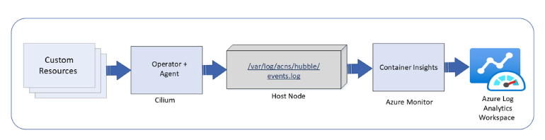
Compute Updates (Public Preview - 2/5)
Public Preview of the Root Cert API in App Service Environment v3
The Root Cert API allows to programmatically add root certificates to ASE, making them available during the startup of apps.
Root certificates are public certificates that identify a root certificate authority (CA). These are essential for establishing trust in secure communications. By adding root certificates to ASE, all web apps hosted within that ASE will have them installed in their root store. This ensures that apps can securely communicate with internal services or APIs that use certificates issued by private or enterprise CAs.
Previously, this functionality was only available in private preview through a workaround involving certificate uploads and a special app setting and included a number of limitations.
Container Network Logs with Advanced Container Networking Services for AKS
Container network logs offer a comprehensive way to monitor network traffic in AKS clusters. Two modes of support, stored-logs and on-demand logs, provides debugging flexibility with cost optimization. The on-demand mode provides a snapshot of logs with queries and visualization with Hubble CLI UI for specific scenarios and does not use log storage to persist the logs. The stored-logs mode when enabled continuously collects and persists logs based on user-defined filters. Logs can be stored either in Azure Log Analytics (managed) or locally (unmanaged).
Managed storage: Logs are forwarded to Azure Log Analytics for secure, scalable, and compliant storage. This enables advanced analytics, anomaly detection, and historical trend analysis. Both basic and analytics table plans are supported for storage.
Unmanaged storage: Logs are stored locally on the host nodes under /var/log/acns/hubble. These logs are rotated automatically at 50 MB to manage storage efficiently. These logs can be exported to external logging systems or collectors for further analysis.

Slide 14
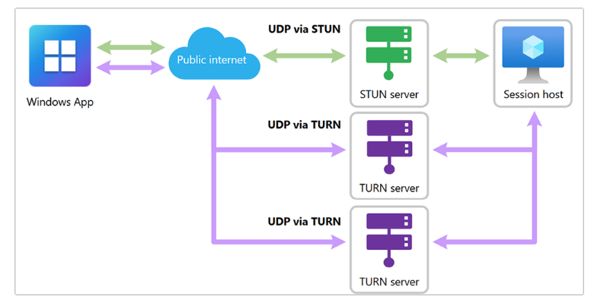
Compute Updates (Public Preview - 3/5)
Now in public preview: RDP Multipath for reliable connectivity
MS announced the public preview of Remote Desktop Protocol (RDP) Multipath for Azure Virtual Desktop. This new feature is designed to enhance remote desktop connectivity and reliability without requiring configuration changes from IT admins and users. By continuously evaluating multiple network paths and dynamically switching to the most reliable one behind the scenes, this feature helps reduce the risk of disconnections and provides a more consistent user experience.
Key features of RDP Multipath include:
Seamless integration
Dynamic path management
Insights and monitoring

Slide 15
Compute Updates (Public Preview - 4/5)
Enhanced security defaults for Windows 365 Cloud PCs
Two new capabilities for newly provisioned and reprovisioned Windows 365 Cloud PCs will be enabled by default:
Disabling by default redirections for clipboard, drive, USB, and printer.
Enabling by default virtualization-based security (VBS), Credential Guard, and hypervisor-protected code integrity (HVCI) for Windows 365 Cloud PCs running a Windows 11 gallery image.
Windows 365 Cloud Apps now in private preview
The newly announced Windows 365 Cloud Apps feature allows to give users secure access to individual apps hosted on a Cloud PC, without requiring a dedicated Cloud PC for every user. Windows 365 Cloud Apps is designed for enterprise customers whether they're experienced with virtual desktop infrastructure (VDI), already using Windows 365, or just starting their journey. It also gives IT teams more flexibility to support a range of user needs and scenarios, while maintaining centralized control. Organizations can use Windows 365 Cloud Apps to:
Streamline app delivery for frontline, seasonal, or remote workers.
Provide information workers with the line-of-business apps they require.
Simplify management with Windows 365 and Microsoft Intune integration.
Accelerate migration from on-premises VDI to the cloud.

Slide 16
Compute Updates (Public Preview – 5/5)
Public Preview: Organizational Templates in Azure Logic Apps
MS announced the Public Preview of Organizational Templates in Azure Logic Apps— empowering teams to author, share, and reuse automation patterns across their organization.
Templates in Azure Logic Apps help teams accelerate workflow creation by providing prebuilt, reusable automation patterns. They package one or more workflows—along with their connections, parameters, and documentation—into easy-to-deploy blueprints.
There are two main types:
Workflow Templates – Reusable single-workflow blueprints.
Accelerators – Bundled solutions made up of multiple related workflows.
These templates have been available in the Logic Apps through the Templates gallery, and many Microsoft-authored templates are already published for common design and integration patterns.

Slide 17
Compute Updates (General Availability – 1/3 )
Generally Available: Azure Linux now also supports AKS LTS with Kubernetes v1.28 & above
Azure Linux now also supports AKS LTS starting with Kubernetes version 1.28 and above. This means you can now pair a stable, enterprise-grade node operating system with the extended lifecycle benefits of AKS LTS — providing a consistent, secure, and well-maintained platform for your container workloads.
Generally Available: Kubernetes v1.31 and v1.32 available as Long Term Support versions in AKS
Kubernetes versions 1.31 and 1.32 are now available in all regions as Long term Support (LTS) versions. Every Kubernetes version supported by community is now LTS compatible.

Slide 18
Compute Updates (General Availability – 2/3 )
Generally Available: Azure Red Hat OpenShift Version 4.17 Now Available with Enhanced Features
Azure Red Hat OpenShift version 4.17 is now available as an installation option. This latest release brings enhanced capabilities and improved performance for enterprise workloads running on the Azure cloud platform.
App-V support and partner integration now available in AVD App Attach
App attach is a modern application delivery solution that separates apps from the base virtual machine image, allowing IT admins to manage and deploy applications dynamically without modifying the core desktop image. This reduces maintenance complexity and speeds up deployment. For end users, it means quicker, more consistent access to the apps they rely on across sessions, locations, and devices—resulting in a smoother, more flexible virtual desktop experience.
MS announced two enhancements to App attach in Azure Virtual Desktop: Support for Microsoft Application Virtualization (App-V) packages, and integration with leading third-party application delivery platforms Liquidware, Numecent, and Omnissa.

Slide 19
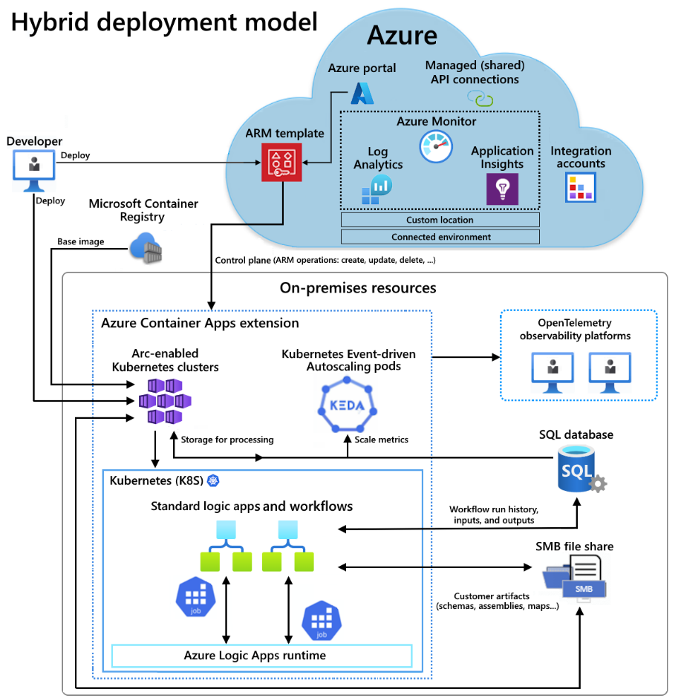
Compute Updates (General Availability – 3/3 )
Announcement: General Availability of Logic Apps Hybrid Deployment Model
This innovative deployment model allows to run Logic Apps workloads on customer-managed infrastructure, providing with the option to host integration solutions on-premises, in a private cloud, or even in a third-party public cloud.
With the Logic Apps Hybrid Deployment Model, you can tailor integration solutions to meet specific needs, whether it's for regulatory compliance, data privacy, or network restrictions.
The Hybrid Deployment Model supports a semi-connected architecture, offering local processing of workflows, local storage, and local network access. This means that the data processed by the workflows remains in local SQL Server, and have the ability to connect to local networks. Additionally, the built-in connectors will execute in local compute, giving you access to local data sources and higher throughput.

Slide 20
Compute Updates (Retirement - 1/2)
Retirement: DCsv2-series Azure Virtual Machines will be retired on June 30, 2026
On June 30, 2026, DCsv2-series Azure virtual machines (VMs) will be retired. After that date, they will no longer be available for use.
Please migrate workloads before June 30, 2026. Options:
To continue using the enclave-based Intel SGX technology, migrate workloads to DCdsv3 virtual machines.
To use a VM based programming model, consider DCasv5/DCadsv5/ECasv5/ECadsv5 VMs, DCasv6/ECasv6 series (currently in preview) or DC/ECesv6 (currently in preview) confidential VMs (CVMs).
For containerized applications, consider using Azure Confidential Container Instances (C-ACI) or Virtual nodes on Azure Container Instances (C-VN2) for Azure Kubernetes Service (AKS).
Retirement: skip-gpu-driver-install nodepool tag retirement om August 14, 2025
On August 14 2025, Azure Kubernetes Service will no longer support the skip-gpu-driver-install node pool tag to skip automatic driver installation on GPU node pools. Starting on August 14 2025, you will no longer be able to use this node pool tag at AKS node pool creation time to install custom GPU drivers or use the GPU Operator. Alternatively, you should use the generally available gpu-driver API field to update your existing node pools or create new GPU-enabled node pools to skip automatic GPU driver installation.

Slide 21
Compute Updates (Retirement - 2/2)
Retirement: Support for .NET 9 (STS) ends on May 12, 2026
On May 12, 2026, support for .NET 9 (STS) will end. Apps that are hosted on App Service will continue to run, but security updates will no longer be available and we’ll no longer provide customer service for .NET 9 (STS). Learn more about App Service language support.

Slide 22
Storage & Data

Slide 23
Storage & Data Updates (General Availability – 1/1)
Generally Available: Azure Premium SSD v2 Disk and Ultra Disk are now available in Malaysia West
Azure Premium SSD v2 and Ultra Disk are now available in Malaysia West region.
Azure Ultra Disks are the highest-performing storage option for Azure virtual machines (VMs), offering high throughput, high IOPS, and consistent low sub-millisecond latency. Ultra Disks are ideal for data-intensive workloads such as SAP HANA, top-tier databases, and transaction-heavy applications.
Azure Premium SSD v2, a next-generation general-purpose block storage solution, offers sub-millisecond latencies and exceptional price performance for IO-intensive workloads at a low cost. Premium SSD v2 is suited for a broad range of enterprise production scenarios, including SQL Server, Oracle, MariaDB, SAP, Cassandra, MongoDB, big data/analytics, and gaming on virtual machines or stateful containers.

Slide 24
Databases

Slide 25
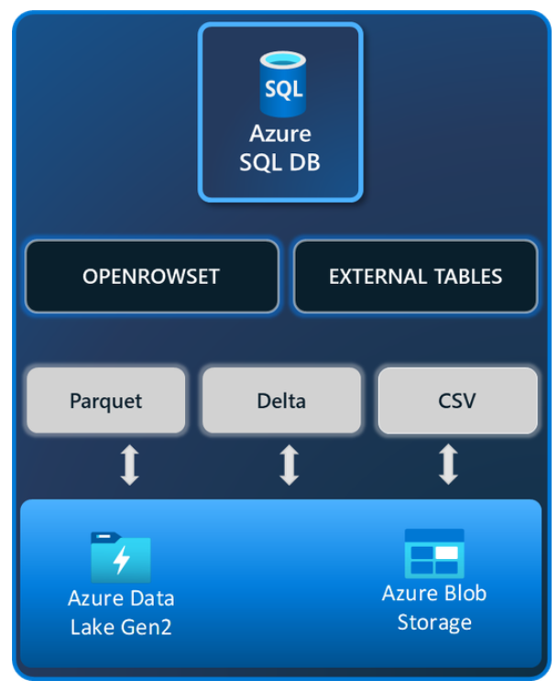
Databases Updates (Public Preview – 1/1)
Public Preview - Data Virtualization for Azure SQL Database
Data virtualization, now in public preview in Azure SQL Database, enables to leverage all the power of Transact-SQL (T-SQL) and seamlessly query external data from Azure Data Lake Storage Gen2 or Azure Blob Storage, eliminating the need for data duplication, or ETL processes, allowing for faster analysis and insights.
Integrate external data, such as CSV, Parquet, or Delta files, with relational database while maintaining the original data format and avoiding unnecessary data movement. Present integrated data to applications and reports as a standard SQL object or through a normal SELECT command. Data Virtualization for Azure SQL Database supports SAS tokens, Managed Identity, and User identity for secure access.
Public Preview: Customizing RAM per vCore with additional memory
A new customizable memory option helps to optimize costs in Azure SQL Managed Instance. Now it is possible to independently configure RAM from the vCores, helping to save on compute and licensing costs. Previously, increasing memory meant adding more vCores—a step that often leads to higher costs because of the need for additional licenses. With this new capability, it is now possible to adjust the memory/vCore ratio to better suit workload requirements, optimizing Azure SQL Managed Instance configuration. This feature is available exclusively in the Next-gen General Purpose tier for premium-series hardware.

Slide 26
Databases Updates (General Availability – 1/2)
Generally Available: Migration service support for Azure Database for PostgreSQL 17
The migration service in Azure Database for PostgreSQL now simplifies the process of moving PostgreSQL databases to Azure with support for PostgreSQL 17. The migration service offers migration options from various PostgreSQL-supported sources, including migrating from a cloud service, from an on-premises environment, or from a virtual machine in Azure
Generally Available: Azure SQL Managed Instance faster management operations
It is now possible to create and manage Azure SQL Managed Instance with improved speed and precision. The new faster management operations experience enhances elasticity by enabling to provision any configuration of instance in under 30 minutes—whether it uses default or custom settings. Update and scaling operations are similarly accelerated, completing in less than 60 minutes compared to the previous four-hour process.
These improvements result from refinements to the underlying virtual cluster processes, such as virtual machine group creation, virtual machine group resizing, and resource allocation, which have been seamlessly incorporated into the Azure platform. Additionally, Azure SQL Managed Instance now offers enhanced compatibility with CI/CD pipelines and environment scripting through its expedited creation process.
The faster management operations experience is fully integrated across all Azure SQL Managed Instance service tiers and is generally available at no extra charge or configuration effort.

Slide 27
Databases Updates (General Availability – 2/2)
Introducing "Backups on Secondary" for SQL Server Always On Availability Groups with SQL Server 2025
MS announced a major enhancement for SQL Server Always On Availability Groups Backups on Secondary, in SQL Server 2025.
Until SQL Server 2022, it was possible to perform COPY_ONLY full backups and transaction log backups on a secondary replica of an Always On Availability Group.
This enhancement in SQL Server 2025 allows to offload all types of backups—full, differential, and transaction logs - to a secondary replica, significantly improving performance, resource utilization, and operational flexibility.

Slide 28
Integration

Slide 29
Integration Updates

Slide 30
ML & AI & IOT

Slide 31
ML & AI & IOT Updates

Slide 32
DevOps & IaC & Automation

Slide 33
DevOps & IaC & Automation (Public Preview – 1/1)
Azure DevOps MCP Server, Public Preview
A local MCP Server (Model Context Provider) is a tool that sits between AI assistant (like GitHub Copilot) and Azure DevOps organization. Its job is to inject rich, real-time context such as work items, pull requests, test plans, etc., into the prompts sent to the LLM. This lets the assistant give better, more accurate, and more relevant answers tailored to specific Azure DevOps project.
Unlike cloud-based solutions, a local MCP Server runs inside network or development environment. That means it can safely access private data and tools without that data ever leaving your system.

Slide 34
Miscellaneous

Slide 35
Miscellaneous Updates

Slide 36
Information

Slide 37
Information
Azure Times GitHub Repo

Slide 38
Questions

