Slide 1
Azure Times #190
January 19, 2026

Slide 2
Security & Identity

Slide 3
Security & Identity Updates
Public Preview: IP Network Firewalls for Azure Managed HSM
MS announced the public preview of IP Network Firewalls for Azure Key Vault Managed HSM, now available in East US, West US, West US 2, West Central US, UK South, and West Europe.
This feature lets you restrict data plane access to Managed HSM by allowing specific IPv4 CIDR ranges (up to 10) in the Managed HSM firewall—ideal for services with static or well-known IP addresses.
Key notes:
Firewall rules apply only to data plane operations (control plane is unaffected).
Only IPv4 is supported in this preview.
To access data via tools like the Azure portal, you must connect from within the configured trusted network boundary.
This enhancement strengthens network security for Managed HSM while maintaining operational flexibility.
There is a limit of 10 IP address or address ranges you can add per resource.

Slide 4
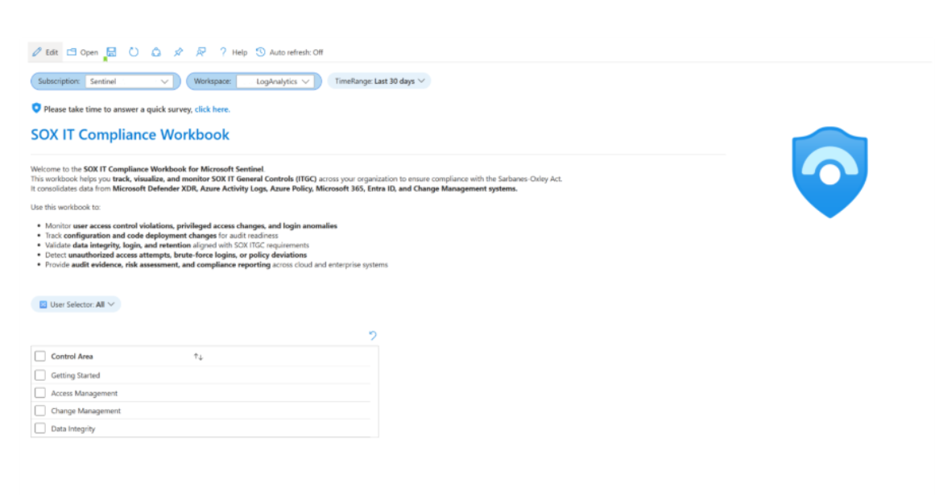
Security & Identity Updates
Announcing Unified SOX & DORA Compliance Solutions in Microsoft Sentinel
As regulatory demands intensify, SOX and DORA have become critical compliance frameworks for financial organizations. Microsoft Sentinel now provides dedicated solutions for both, helping security and compliance teams maintain continuous, audit-ready compliance across cloud and enterprise environments.

Slide 5
Management & Governance

Slide 6
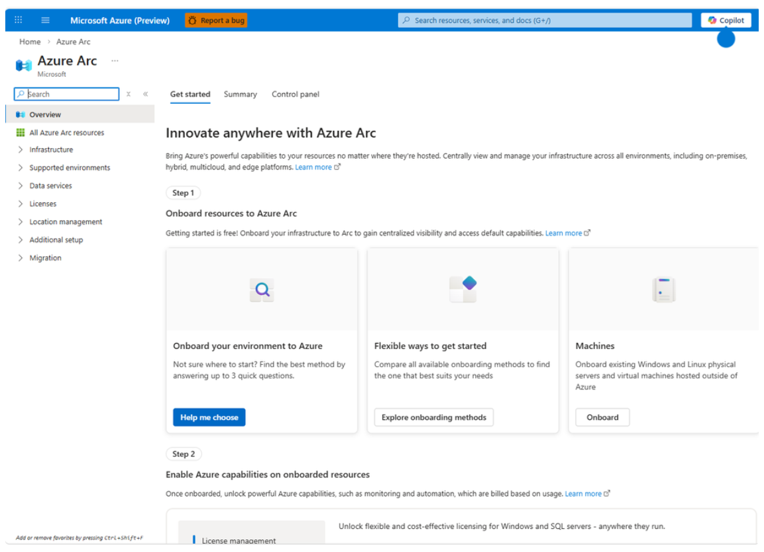
Management & Governance Updates
Azure Arc Portal Update: Simplifying Onboarding and Management at Scale
Improved Learnability & Discoverability:
  Redesigned Landing Page
  Guided Onboarding
  Refreshed Navigation
Unified Machine Onboarding
More Actionable Arc Portal Dashboards

Slide 7
Compute

Slide 8
Compute Updates
Now in public preview: Azure Virtual Desktop regional host pools
Azure Virtual Desktop is moving from a geography-based metadata model to a regional model to improve resiliency and data sovereignty. Previously, a single metadata database per Azure geography served multiple regions, creating cross-region dependencies where issues in one region could affect users in others.
With this update, Azure Virtual Desktop metadata and infrastructure are being deployed in every supported Azure region. As a result, any service issue will be isolated to host pools within the same region, significantly reducing blast radius. In total, this introduces ~40 regional databases across Azure.
The new model also strengthens data sovereignty, as host pool metadata is stored in the selected Azure region. For resilience, metadata continues to be replicated across availability zones locally and to a paired region for cross-region failover.

Slide 9
Compute Updates
Generally Available: Ubuntu 24.04 support in AKS
Ubuntu 24.04 is now generally available on AKS starting with Kubernetes v1.32+, with containerd 2.0 enabled by default. From Kubernetes v1.35 onward, Ubuntu 24.04 becomes the default OS when using the Ubuntu OS SKU.
Kubernetes v1.32+: Use the Ubuntu2404 OS SKU to migrate existing clusters ahead of the default switch.
Kubernetes v1.35+: Use the Ubuntu OS SKU (defaults to Ubuntu 24.04). Existing clusters using Ubuntu will automatically migrate when upgrading to v1.35+.
Rollback option
You can roll back to Ubuntu 22.04 using the new Ubuntu2204 OS SKU on Kubernetes v1.25–1.36, without changing the Kubernetes version.
This provides more flexibility for testing, upgrades, and controlled OS transitions on AKS.
Secure Unique Default Hostnames Now GA for Functions and Logic Apps
We’re pleased to announce that Secure Unique Default Hostnames are now generally available for Azure Functions and Logic Apps (Standard). This enhancement extends the secure hostname model from Web Apps to the entire App Service ecosystem, delivering stronger security and consistent, standardized hostname behavior across all workloads.
Before: <SiteName>.azurewebsites.net
After: <SiteName>-<Hash>.<Region>.azurewebsites.net

Slide 10
Storage & Data

Slide 11
Storage & Data Updates
Announcing Public Preview of User delegation SAS for Azure Tables, Azure Files, and Azure Queues
User Delegation (UD) SAS is now available in public preview for Azure Tables, Azure Files, and Azure Queues across all public regions. Building on existing support for Azure Blobs, this enhancement allows SAS tokens to be securely tied to a user’s Microsoft Entra ID, rather than storage account keys.
With UD SAS, organizations can delegate limited, RBAC-controlled access via pre-authorized URLs, enabling finer-grained and more secure access to storage resources such as tables, entities, queues, messages, file shares, and individual files—without exposing account credentials.

Slide 12
Storage & Data Updates
Azure File Sync available in 4 new regions
Azure File Sync is now generally available in Italy North, New Zealand North, Poland Central, and Spain Central

Slide 13
Integration

Slide 14
Integration Updates
Introducing Administration Client Support for the Azure Service Bus Emulator
MS announced administration client support for the Azure Service Bus emulator, expanding it beyond messaging to include local management operations such as creating, updating, and deleting entities.
Azure Service Bus is a fully managed enterprise message broker for reliable queue- and topic-based messaging. While the local emulator already enabled developers to test message flows, this update now supports end-to-end local workflows that rely on management operations during application startup or deployment—making local development and testing even more complete.

Slide 15
Information

Slide 16
Information
Azure Times GitHub Repo

Slide 17
Questions

