Slide 1
Azure Times #187
December 8, 2025

Slide 2
Networking

Slide 3
Networking Updates
Generally Available: Azure Load Balancer bandwidth metrics now support Protocol dimension
Azure Load Balancer now publishes bandwidth metrics with a new Protocol dimension, enabling deeper insight into traffic patterns. When viewing Byte, Packet, and SYN Count metrics, you will now see traffic broken out by protocol:
Protocol = 6 → TCP
Protocol = 17 → UDP
This added granularity helps improve alerting, monitoring, and troubleshooting by allowing you to distinguish TCP and UDP traffic patterns.
The Protocol dimension is available for Byte, Packet, and SYN Count metrics across all Azure public, China, and Government cloud regions.

Slide 4
Security & Identity

Slide 5
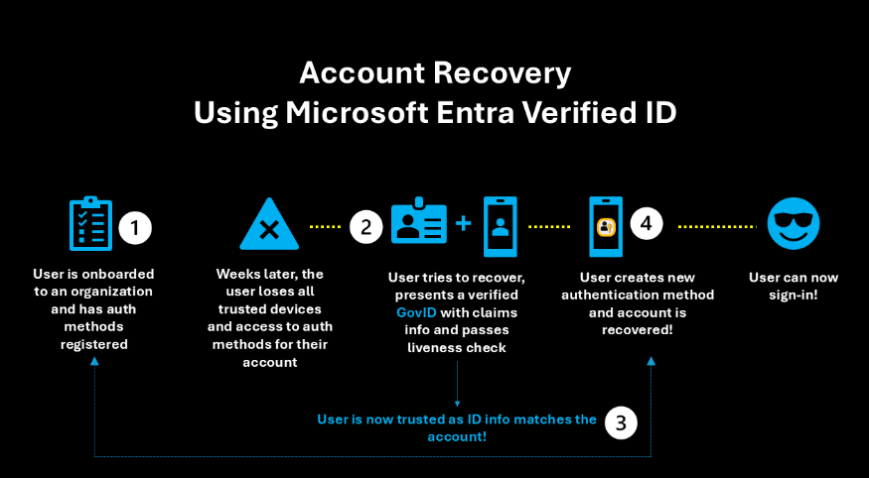
Security & Identity Updates (Entra ID Updates) - 1/7
Public Preview - Entra ID Account Recovery
Microsoft Entra ID Account Recovery is an advanced authentication recovery mechanism that enables users to regain access to their organizational accounts when they've lost access to all registered authentication methods. Unlike traditional password reset capabilities, account recovery focuses on identity verification and trust re-establishment prior to replacement of authentication methods rather than simple credential recovery.
Public preview - Self-remediation for passwordless users
Self-remediation for passwordless users: Risk-based access policies in Microsoft Entra Conditional Access now support self-remediation of risks across all authentication methods, including passwordless ones. This new control revokes compromised sessions in real-time, enables frictionless self-service, and reduces help-desk load.
Possible risk detections include anomalous token, impossible travel, or unfamiliar sign-in properties.

Slide 6
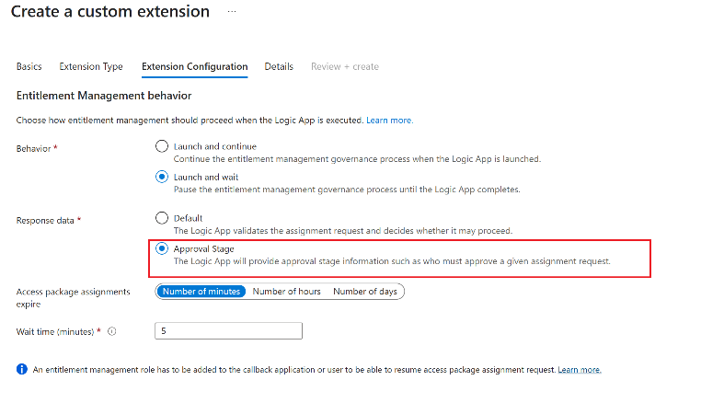
Security & Identity Updates (Entra ID Updates) - 2/7
Public Preview - Externally determine the approval requirements for an access package using custom extensions
In Entitlement Management, approvers for access package assignment requests can either be directly assigned or determined dynamically. Entitlement management natively supports dynamically determining approvers such as the requestors manager, their second-level manager, or a sponsor from a connected organization. With the introduction of this feature you can now use custom extensions for callouts to Azure Logic Apps and dynamically determine approval requirements for each access package assignment request based on your organizations specific business logic. The access package assignment request process will pause until your business logic hosted in Azure Logic Apps returns an approval stage which will then be leveraged in the subsequent approval process via the My Access portal.
Public Preview - Passkey profiles in Microsoft Entra ID
Microsoft Entra ID now supports group‑based passkey (FIDO2) configurations, enabling separate rollouts of different types of passkeys to different sets of users.

Slide 7
Security & Identity Updates (Entra ID Updates) - 3/7
Public Preview - Soft Deletion for Cloud Security Groups
Soft deletion for cloud security groups introduces a safety mechanism that allows administrators to recover deleted groups within a 30‑day retention period. When a cloud security group is deleted, it is not immediately removed from the directory; instead, it enters a soft‑deleted state, preserving its membership and configuration. This feature helps prevent accidental data loss and supports business continuity by enabling quick restoration of groups without requiring manual recreation. Administrators can restore soft‑deleted groups through the Microsoft Entra admin center or Microsoft Graph API during the retention window.
Public Preview - End user experience for managing agent identities
The Manage agents end user experiences lets view, and control, agent identities own or sponsor. With the manage agents feature, it is possible to easily see which agents you’re responsible for, review their details, and take action to enable, disable, or request access for them.

Slide 8
Security & Identity Updates (Entra ID Updates) - 4/7
Public Preview - Conditional Access for Agents
Conditional Access for Agent ID is a new capability in Microsoft Entra ID that brings Conditional Access evaluation and enforcement to AI agents. This capability extends the same Zero Trust controls that already protect human users and apps to agents. Conditional Access treats agents as first‑class identities and evaluates their access requests the same way it evaluates requests for human users or workload identities, but with agent‑specific logic.
Public Preview - User centric access reviews including disconnected applications
This capability enables organizations to manage access reviews for applications that are not yet integrated with Microsoft Entra ID.

Slide 9
Security & Identity Updates (Entra ID Updates) - 5/7
General Availability - External ID regional expansion to Australia and Japan
MS extended Microsoft Entra External ID to Australia and Japan with Go‑Local add‑on that keeps External ID data stored and processed in location. This premium add‑on is selectable when you create a new External ID tenant and is designed for organizations with strict data residency requirements. A small set of centralized platform services remains global (e.g., some MFA/RBAC functions), with no change to security or compliance posture
General Availability - New SCIM 2.0 SAP CIS connector available, with support for group provisioning
An updated SCIM 2.0 SAP Cloud Identity Services (CIS) connector was released to the Microsoft Entra app gallery on September 30, 2025. It replaces previous SAP CIS provisioning integration and now provides support for provisioning and deprovisioning groups to SAP CIS, custom extension attributes, and the OAuth 2.0 Client Credentials grant.

Slide 10
Security & Identity Updates (Entra ID Updates) - 6/7
General Availability - Support for eligible group memberships and ownerships in Entitlement Management access packages
This integration between Entitlement Management and Privileged Identity Management (PIM) for Groups adds support for assigning eligible group memberships and ownerships via access packages. You are now able to govern these just-in-time access assignments at scale by offering a self-service access request & extension process and integrate them into your organization's role model.
General Availability - Reprocess failed users and workflows in Lifecycle Workflows
Lifecycle Workflows now supports reprocessing of workflows to help organizations streamline the reprocessing of workflows when errors or failures are discovered. This feature includes the ability to reprocess previous runs of workflows including failed runs or just runs that you may want to process again. Customers can choose from the following options to fit their needs:
Select specific workflow run to be reprocessed
Select which users from the workflow run to be reprocessed e.g. failed users or all users from the run

Slide 11
Security & Identity Updates (Entra ID Updates) - 7/7
General Availability - Groups Purview sensitivity label support in Lifecycle Workflows
Customers can now view Purview sensitivity labels assigned to groups and Teams in Lifecycle Workflows. When configuring workflow tasks for managing group or Teams assignments, admins will now see actively assigned sensitivity labels to support informed group selection decisions. This helps customer achieve stronger organizational compliance
General Availability - Trigger workflows for inactive employees and guests in Lifecycle Workflows
Lifecycle Workflows now enables customers to configure custom workflows to proactively manage dormant user accounts by automating identity lifecycle actions based on sign‑in inactivity. By detecting inactivity, the workflow automatically executes predefined tasks—such as sending notifications, disabling accounts, or initiating offboarding—when users exceed the inactivity threshold. Admins can configure the inactivity threshold and scope, ensuring dormant accounts are handled efficiently and consistently — reducing security exposure, reducing license waste, and enforcing governance policies at scale.

Slide 12
Security & Identity Updates (Defender for Cloud) – 1/5
Discover Azure AI Foundry agents in your environment (Preview)
It is now possible to discover Azure AI Foundry agents in environment using Defender for Cloud. This new preview feature helps you identify and monitor AI Foundry agents deployed across your resources, providing insights into their security posture and risks.
In-pipeline container vulnerability scanning (preview)
In-pipeline container vulnerability scanning for Defender for DevOps Security is now available in preview through the Defender for Cloud CLI.
Scanning built container images directly within CI/CD workflows provides real-time feedback before they're pushed to registries or deployed. This feature helps you detect vulnerabilities earlier, accelerate remediation, and align security gates with DevOps practices.

Slide 13
Security & Identity Updates (Defender for Cloud) – 1/5
Advanced security posture for API discovery (Preview)
Microsoft Defender for Cloud API security posture management now automatically identifies unauthenticated APIs and APIs exposed to the internet across environment, including APIs discovered on Azure Functions and Logic Apps.
With this release, it is possible to uncover high-risk API endpoints earlier, prioritize API risks by using new posture insights and risk factors, and view and analyze discovered API risks across your environment by using security explorer.
Microsoft Cloud Security Benchmark v2 in Defender for Cloud (Preview)
Defender for Cloud is announcing the Microsoft Cloud Security Benchmark (MCSB) compliance standard v2 in preview.
The MCSB provides a collection of high-impact security controls and recommendations to help secure cloud services across single and multicloud environments. MCSB v2 adds expanded risk and threat-based guidance, expanded Azure Policy measurements, and controls for securing AI workloads. The Regulatory compliance dashboard allows you to assess resources against MCSB v2 controls and track compliance posture across cloud environments.

Slide 14
Security & Identity Updates (Defender for Cloud) – 1/5
Restrict Pod Access response action (preview)
Defender for Containers now includes a new Restrict Pod Access response action, available in preview in Microsoft Defender XDR.
The action blocks sensitive interfaces within Kubernetes pods that could enable lateral movement or privilege escalation. Using this control helps contain potentRestrict Pod Access ial breaches and reduce exposure within your cluster environments.

Slide 15
Security & Identity Updates (Defender for Cloud) – 1/5
Kubernetes gated deployment (GA)
Kubernetes gated deployment in Microsoft Defender for Containers is now generally available. This feature enforces container image security at deployment time by using Kubernetes admission control.
Key capabilities
Admission control for Kubernetes clusters: Blocks or audits deployments of container images that violate organizational security rules.
Security rules framework: Define custom rules for AKS, EKS, and GKE clusters based on vulnerability assessment results.
Audit and Deny modes:
  Audit: Generates recommendations when deployments violate security rules
  Deny: Prevents noncompliant images from being deployed
Multicloud support: Works with Azure Container Registry (ACR), Amazon Elastic Container Registry (ECR), and Google Artifact Registry.
Integrated monitoring: View admission monitoring and violation details in the Defender for Cloud portal.
General availability of AI security posture management in GCP Vertex
Defender for Cloud is announcing the general availability of AI security posture management for GCP Vertex AI. This new capability helps secure AI workloads on GCP by providing continuous monitoring, risk assessments, and actionable recommendations.

Slide 16
Security & Identity Updates (Defender for Cloud) – 1/5
General availability of agentless vulnerability assessment for AKS runtime containers
Defender for Containers and Defender for Cloud Security Posture Management (CSPM) plans now include agentless vulnerability assessment for AKS runtime containers. This update extends vulnerability assessment coverage to running containers that use images from any container registry, rather than only supported registries. It also continues to scan Kubernetes add-ons and third-party tooling running in your AKS clusters.
To enable this feature, make sure that Agentless machine scanning is turned on for your subscription in Defender for Cloud environment settings.

Slide 17
Management & Governance

Slide 18
Management & Governance Updates
Generally Available: Perth - Azure Extended Zones
Microsoft has announced the general availability of the Perth Azure Extended Zone, expanding Azure’s footprint to better serve regional low-latency and data-residency requirements.
Azure Extended Zones are small-footprint Azure deployments placed in key metro areas, industrial hubs, or regulated jurisdictions. They provide access to a curated set of Azure services—including virtual machines, containers, networking, and storage—designed specifically for latency-sensitive and throughput-intensive workloads.
With the launch of the Perth zone, customers can now run applications closer to end users while maintaining compliance with local data residency mandates, enabling improved performance for critical and real-time solutions.
Announcing General Availability for Azure Resource Graph (ARG) GET/LIST API
ARG GET/LIST API delivers 10X higher throttling quotas to callers compared to ARG query unlocking a more scalable, resilient way to perform resource lookups in Azure. ARG GET/LIST API is a new platform capability within Azure Resource Graph that provides a high-performance experience for both Point GET and collection GET requests. A key advantage of this capability is its ability to significantly reduce READ throttling for high volume calls efficiently. This is made possible through intelligent control plane routing based on a query parameter controlled by the caller.

Slide 19
Compute

Slide 20
Compute Updates
Enhancements to RemoteApps (preview)
Enhanced user experiences for RemoteApps are rolling out to public preview. Enhancements include improved support for Windows Snap and full-screen mode, better DPI handling, and refined visuals like borders, shadows, and theme integration in Windows OS
Windows Cloud Keyboard Input Protection (preview)
Windows Cloud Keyboard Input Protection is now in preview - purpose-built to address endpoint security concerns for Windows 365 and Azure Virtual Desktop. This feature encrypts keystrokes at the kernel level, protecting against keylogger malware and other endpoint threats. It marks a major step forward in helping customers secure sensitive input data and strengthen endpoint security in cloud-based workspaces

Slide 21
Compute Updates
Public Preview: Serverless workspaces in Azure Databricks
Serverless workspaces in Azure Databricks are now in Public Preview, introducing a fully managed workspace type that provides built-in serverless compute and default storage—delivering an enterprise-grade SaaS experience with virtually zero infrastructure setup.
With this capability, customers can:
Create “Serverless” Azure Databricks workspaces directly from the Azure portal
Run production workloads entirely on serverless compute, eliminating cluster management
Spin up short-lived training, testing, or experimentation environments in seconds
Enable admins without cloud provisioning permissions to deploy and operate secure, governed Databricks environments at scale
This release simplifies onboarding, accelerates development, and reduces operational overhead while ensuring enterprise-level governance and security.

Slide 22
Compute Updates
RDP Multipath is now fully rolled out!
MS completed the phased deployment of RDP Multipath across all eligible connections. This feature enhances reliability and performance by leveraging multiple network paths for your remote sessions, ensuring a more resilient and seamless experience.
Azure Virtual Desktop support for external identities is now generally available.
It is now possible to provide Azure Virtual Desktop resources for an external identity. There is no change to the administrative flow to assign the resources, as you still assign the user to the app group.
FSLogix profile container user for external identities is in preview.

Slide 23
Compute Updates
General Availability of AI & RAG Connectors in Logic Apps (Standard)
This release brings native support for document processing, semantic retrieval, embeddings, and grounded reasoning directly into the Logic Apps workflow engine.
Logic Apps (Standard) had previously previewed four AI-focused connectors that open the door for a new generation of intelligent automation across the enterprise. Whether you're processing large volumes of documents, enriching operational data with intelligence, or enabling employees to interact with systems using natural language, these connectors provide the foundation for building solutions that are smarter, faster, and more adaptable to business needs.

Slide 24
Storage & Data

Slide 25
Storage & Data Updates
Generally Available: Azure Blob Storage SFTP - Resumable Uploads
The resumable upload feature for Azure Blob Storage SFTP is now generally available. This feature allows users to resume file uploads from the point of failure in the event of partial transfer failures, thereby saving time and reducing network bandwidth usage. The SFTP transfer modes that Azure Blob Storage SFTP supports are below.
Write: This mode lets the client continue an upload by adding data to an existing file from a specific point without creating a new file.
Write + Create: This mode allows the client to resume an upload by either adding to an existing file or creating a new one if it doesn't exist, providing flexibility when the file might not be present initially.
Append: This mode adds data to the end of an existing file without overwriting its current contents. Previously, this feature only supported append mode in public preview, which limited upload resumption with SFTP clients that lacked append mode support. With general availability, we now support write and write + create modes, which benefits users who use SFTP clients without append mode.
Generally Available: Zonal placement for Azure file shares Azure Files Premium LRS in select regions.
Zonal Placement for Azure Files Premium LRS is now GA in select regions! This capability gives explicit control over zone locality by pinning storage accounts to a specific availability zone, enabling high availability, fault isolation, and predictable low-latency performance for mission-critical workloads.
Why it matters: Align compute and storage in the same zone for 10–40% lower latency compared to cross-zone deployments. Design resilient architectures with zone-aware control for better fault isolation.

Slide 26
Databases

Slide 27
Databases Updates
Generally Available: Azure Database for PostgreSQL Flexible Server in Belgium Central
Microsoft has expanded regional availability for Azure Database for PostgreSQL Flexible Server, which can now be deployed in the Belgium Central Azure region.
This update gives organizations operating in or near Belgium more options for optimizing latency, data residency, and compliance while benefiting from PostgreSQL Flexible Server’s managed capabilities—including high availability, automated backups, scaling, and advanced performance tuning.
Generally Available: The credcheck extension in Azure Database for PostgreSQL Flexible Server
Microsoft has added support for the credcheck extension in Azure Database for PostgreSQL Flexible Server.
This extension allows organizations to enforce password and credential validation policies directly inside PostgreSQL, strengthening database-level security and reducing reliance on external validation mechanisms.
With credcheck enabled, administrators can apply rules to ensure stronger password hygiene, prevent weak or reused credentials, and improve overall compliance posture across managed PostgreSQL environments.

Slide 28
Databases Updates
Generally Available: Update pg_squeeze to version 1.9.1 in Azure Database for PostgreSQL Flexible Server
Microsoft has added support for upgrading the pg_squeeze extension to version 1.9.1 in Azure Database for PostgreSQL Flexible Server.
The latest version delivers improved table bloat management, enhanced reliability during online table rewriting, and better performance for routine maintenance operations.
This update allows customers to keep their PostgreSQL environments optimized and maintain healthier storage usage with minimal application impact.
Generally Available: The ip4r extension in Azure Database for PostgreSQL Flexible Server
Microsoft has added support for the ip4r extension in Azure Database for PostgreSQL Flexible Server.
The ip4r extension enables efficient storage, querying, and indexing of IPv4 and IPv6 addresses and address ranges, making it especially valuable for applications that manage network metadata, routing information, security rules, or large-scale IP inventories.
This enhancement improves performance and simplifies development for workloads that rely on IP-aware data operations within PostgreSQL on Azure.

Slide 29
Databases Updates
PostgreSQL 18 Now GA on Azure Postgres Flexible Server
PostgreSQL 18 brings significant under-the-hood improvements such as asynchronous I/O (AIO) for faster read performance, enhanced vacuuming and indexing, OAuth 2.0 support, and more efficient partitioning - all now supported in Azure’s managed environment.
Azure Database for PostgreSQL also now supports over 80 extensions for PostgreSQL 18, including pgvector, POSTGIS, pg_cron, and pg_stat_statements. The engineering team continues to expand this list, ensuring customers can use the same ecosystem they rely on in open-source PostgreSQL with enterprise-grade reliability on Azure.

Slide 30
ML & AI & IOT

Slide 31
ML & AI & IOT Updates
Public Preview: Mistral Large 3 in Foundry
Mistral Large 3, a frontier-class open-weight model licensed under Apache 2.0, is now available in Microsoft Foundry on Azure. This model brings enterprise-ready reliability, advanced long-context understanding, and multimodal reasoning capabilities—making it a strong fit for production copilots, RAG solutions, agentic systems, and complex multimodal workflows.
Key capabilities include:
Highly reliable instruction following for consistent, predictable outputs
Extended context windows supporting long documents and multi-turn interactions
Robust multimodal reasoning across text, images, and structured diagrams
Stable, deterministic behavior optimized for enterprise-scale workloads
Fully open and exportable, enabling hybrid, edge, or on-premises deployment scenarios

Slide 32
ML & AI & IOT Updates
Generally Availaible: Azure MCP Server support for Azure confidential ledger
The Azure MCP (Model Context Protocol) Server now enables seamless management of Azure confidential ledger using natural language prompts—no command syntax or complex APIs required. With this enhancement, customers can easily:
Create immutable, integrity-protected confidential ledgers for secure logging.
Write to and read from the ledger using AI, fully supported and production-ready.
Developers can connect to Azure MCP Server through multiple tools and frameworks, including Visual Studio Code and GitHub Copilot, enabling:
Natural language–driven resource management
Automated script generation
Integration of Azure operations directly into applications
This update makes secure ledger operations more accessible, intuitive, and automation-friendly.

Slide 33
ML & AI & IOT Updates
Retirement: Remove dependency on these Azure ML SDKs before June 30, 2026
Microsoft has announced that AzureML SDK V1 will reach end of life on June 30, 2026. Several dependent SDKs will also be retired on the same date, including:
azureml-train-core
azureml-pipeline
azureml-pipeline-core
azureml-pipeline-internal
azureml-pipeline-steps
After June 30, 2026, these SDKs may continue to function but will no longer receive support, updates, or fixes, and they may stop working without notice. Organizations should begin planning their migration to AzureML SDK V2 or other supported tooling to ensure continuity and compatibility.

Slide 34
Information

Slide 35
Information
Azure Times GitHub Repo

Slide 36
Questions

