Slide 1
Azure Times #188
February 8, 2023

Slide 2
Networking

Slide 3
Networking Updates
Generally Available: FIPS compliant mode for Application Gateway V2 SKUs
Azure Application Gateway V2 now supports FIPS mode, which can be enabled during deployment or at any time afterward. When FIPS mode is turned on, the gateway uses only FIPS-compliant predefined and custom TLS policies, enhancing security and helping meet FedRAMP security requirements.
Application Gateway utilizes a rolling upgrade process to implement configurations with the FIPS validated cryptographic module across all instances. The duration for enabling or disabling FIPS mode may range from 15 to 60 minutes, depending on the number of configured or currently running instances.

Slide 4
Networking Updates
Update: The retirement date for default outbound access has been extended to March 31, 2026.
The retirement date for default outbound access has been extended to March 31, 2026. This change aligns with the broader Azure Virtual Network (VNet) update and replaces the previously communicated September 30, 2025 date.
Starting March 31, 2026, newly created VNets will default to using private subnets. This means:
Explicit outbound connectivity (e.g., via NAT Gateway, UDR, or other methods) must be configured to access public endpoints on the Internet or Microsoft services.
Default outbound access will be disabled by default, but not removed. Customers who do not configure an outbound method will lose internet connectivity from their Batch nodes.
Review your current Batch pool configurations, especially those using simplified node communication without public IPs.
Plan to implement an explicit outbound method before the March 2026 deadline.

Slide 5
Security & Identity

Slide 6
Security & Identity Updates
Now generally available: Modernizing Microsoft Entra ID auth flows with WebView2 in Windows 11
Microsoft has introduced an option to power Entra ID app sign-in through Web Account Manager (WAM) using WebView2, starting with Windows updates KB5072033 (OS Builds 26200.7462 and 26100.7462) and later. WebView2 is a Chromium-based embedded web control that enables modern, secure authentication experiences directly inside applications without launching a separate browser.
This update modernizes the sign-in foundation by aligning identity flows with current web standards and security capabilities. By leveraging WebView2, applications benefit from improved consistency, enhanced security, and future-ready authentication scenarios, delivering a more reliable and seamless sign-in experience across Windows apps and services.

Slide 7
Compute

Slide 8
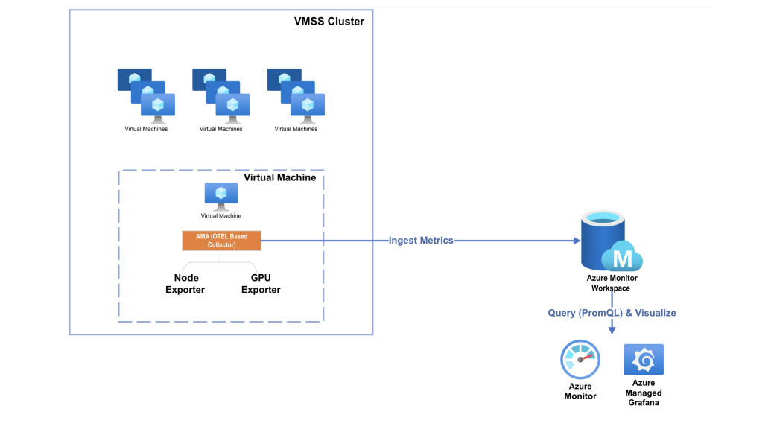
Compute Updates
Private Preview: Azure Managed Prometheus on VM / VMSS
Until now, Managed Prometheus on Azure was primarily targeted at containerized workloads — e.g. Kubernetes (AKS) or Azure Arc–enabled clusters. With this preview, it is possible to extend Prometheus-style monitoring to IaaS workloads running on VMs/VMSS, giving unified, scalable, resilient metric collection and observability across both containers and traditional compute —including full support for GPU and InfiniBand (IB) metric collection for HPC scenarios.
Behind the scenes, Azure Monitor provides the storage, ingestion pipeline, and query engine, while surfacing a fully compatible Prometheus experience — including scraping, PromQL, alerting rules, and dashboards.
Public Preview: Azure Databricks Dashboard subscriptions now support Microsoft Teams
This enhancement delivers timely, actionable data directly into team workflows, reducing the need to check email or switch tools. It supports faster decision-making and keeps everyone aligned in real time. As part of the broader Microsoft vision to unify data, AI, and collaboration, this feature helps you connect insights to action within the Microsoft 365 ecosystem.

Slide 9
Databases

Slide 10
Databases Updates
Windows Authentication for Cloud-Native Identities: Modernizing Azure SQL Managed Instance (Preview)
Traditionally, Windows Authentication relied on on-premises Active Directory, making it difficult for businesses adopting a cloud-only strategy to preserve existing authentication models. With this new capability:
Hybrid Identity Support: Users synchronized between on-premises AD DS and Microsoft Entra ID can continue using a single set of credentials for both environments.
Cloud-Only Identity (Preview): Identities that exist only in Microsoft Entra ID can now leverage Kerberos-based Windows Authentication for workloads like Azure SQL Managed Instance—without requiring domain controllers.
Key Benefits
Seamless Migration: Move legacy applications to Azure SQL Managed Instance without rewriting authentication logic.
Passwordless Security: Combine Windows Authentication with modern credentials like Windows Hello for Business or FIDO2 keys, enabling MFA and reducing password-related risks.
Cloud-Native Integration: Microsoft Entra Kerberos acts as a cloud-based Key Distribution Center (KDC), issuing Kerberos tickets for cloud resources such as Azure SQL Managed Instance and Azure Files
Announcing Private Preview of Azure Backup for Azure Cosmos DB
Azure Backup for Azure Cosmos DB introduces a new, secure way to protect and recover Cosmos DB data for compliance, audit, and ransomware-resilience needs. The service combines Azure Backup’s isolated vault architecture with Cosmos DB’s native backup streams to deliver scalable, long-term, policy-driven protection aligned with regulatory requirements.
Organizations can define backup schedules and retention policies at the Cosmos DB account or collection level.
Backups are streamed into an isolated Azure Backup Vault, providing protection against accidental deletion and malicious activity.
Recovery is supported by restoring data into an empty Cosmos DB account in the same region.
The solution integrates with Azure RBAC, supports flexible policy assignments, and is fully manageable through Azure Backup Center for monitoring and governance.
This preview adds an enterprise-grade, centralized data protection layer to Cosmos DB environments, improving operational resilience and compliance readiness.

Slide 11
ML & AI & IOT

Slide 12
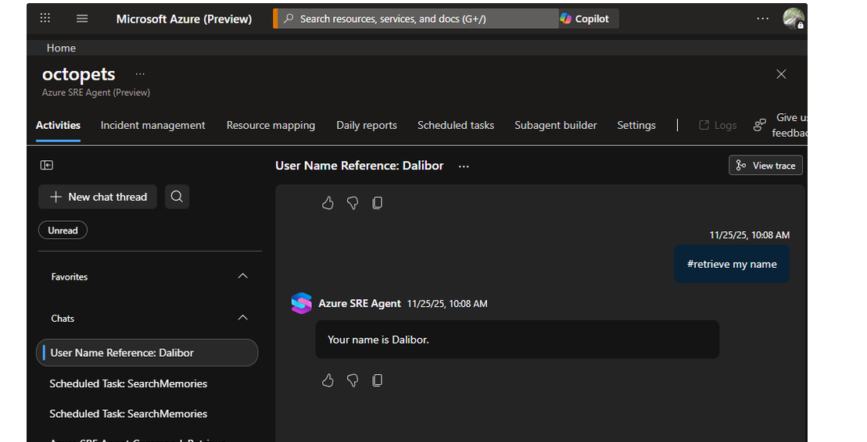
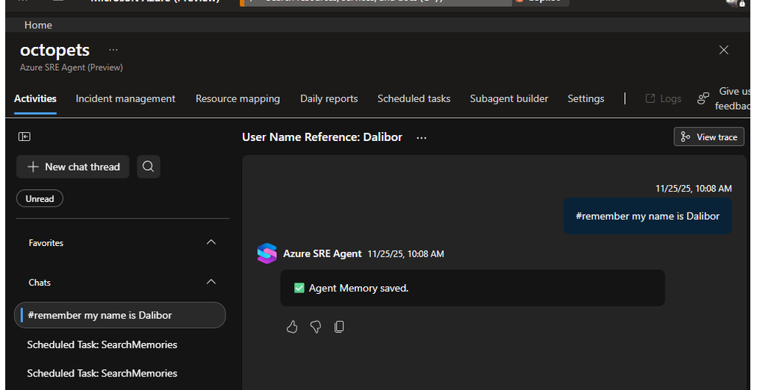
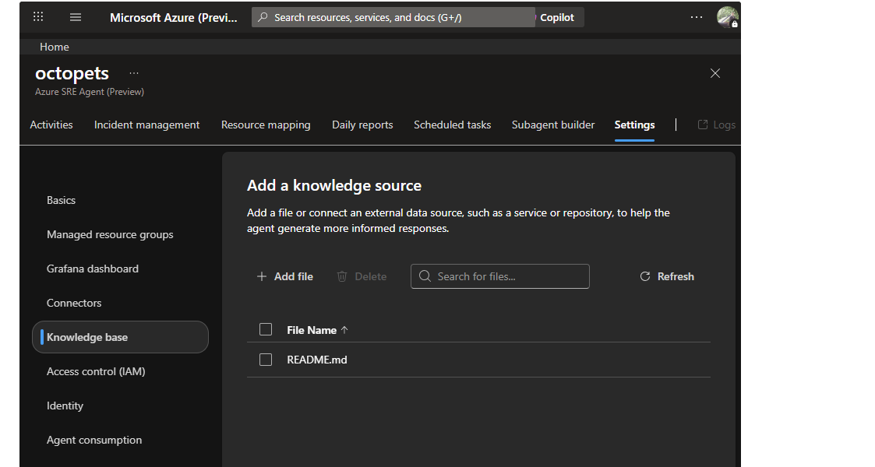
ML & AI & IOT Updates
Introducing Azure SRE Agent memory
Until now, AI assistants started every conversation from scratch, forcing teams to repeatedly explain context that experienced engineers would simply know. The SRE Agent Memory changes this paradigm. It enables agents to:
Remember team facts, preferences, and context across all conversations
Retrieve relevant runbooks and documentation during troubleshooting
Learn from past sessions to improve future responses
Share knowledge across your entire team automatically

Slide 13
ML & AI & IOT Updates
Introducing Cohere Rerank 4.0 in Microsoft Foundry
Cohere Rerank 4.0 Fast and Rerank 4.0 Pro are now available as direct from Azure models in Microsoft Foundry.
These new retrieval models deliver state-of-the-art accuracy, multilingual coverage across 100+ languages, and breakthrough performance for enterprise search and retrieval-augmented generation (RAG) systems.
With Rerank 4.0, customers can dramatically improve the quality of search, reduce hallucinations in RAG applications, and strengthen the reasoning capabilities of their AI agents, all with just a few lines of code.
Introducing GPT-5.2 in Microsoft Foundry
GPT-5.2 series introduces deeper logical chains, richer context handling, and agentic execution that prompts shippable artifacts. For example, design docs, runnable code, unit tests, and deployment scripts can be generated with fewer iterations. The GPT-5.2 series is built on new architecture, delivering superior performance, efficiency, and reasoning depth compared to prior generations. It’s also trained on the proven GPT-5.1 dataset and further enhanced with improved safety and integrations. GPT-5.2 leaps beyond previous models with substantial performance improvements across core metrics.

Slide 14
ML & AI & IOT Updates
Generally Available: Azure Sphere OS version 25.12 is now available for evaluation
Azure Sphere OS version 25.12 is now available for evaluation in the Retail Eval feed. Whilst this release encompasses no customer-facing changes, it represents significant under-the-hood build system changes, as such, this release will operate for an extended evaluation period, until February 2026, enabling additional time for customer evaluation testing.
Following this period, a second evaluation release, 26.02, will be launched to the Retail Eval feed for the standard 14-day testing period, and subsequently promoted to the Retail feed. This means that 25.12 will not be promoted to the Retail feed, and that the next Retail release will be 26.02.
During this time, please verify that your applications and devices operate properly with both the 25.12, and subsequent 26.02 release, before it is deployed broadly to devices in the Retail feed.
The 25.12 OS Retail Eval release includes significant underlying build system updates.

Slide 15
DevOps & IaC & Automation

Slide 16
DevOps & IaC & Automation
Azure DevOps Server is GA
Azure DevOps Server has officially reached General Availability (GA), graduating from the Release Candidate phase to full production readiness. This release provides a robust, self-hosted DevOps platform for enterprises that require on-premises control with modern CI/CD, agile planning, and collaboration features.
Organizations can upgrade directly from Azure DevOps Server RC or any supported version of Team Foundation Server (TFS 2015 or later).
Important: Team Foundation Server 2015 reached end of Extended Support on October 14, 2025. Customers should upgrade to Azure DevOps Server to stay secure, supported, and compliant.

Slide 17
DevOps & IaC & Automation
Retirement of Global Personal Access Tokens in Azure DevOps
Global PATs allow users to authenticate across all accessible organizations. It is strongly recommended to transition to short‑lived, Microsoft Entra–backed authentication, which offers modern protections such as improved token governance, stronger identity controls, and reduced risk of credential exposure.
March 15, 2026 – Creation of new global PATs and regeneration of existing global PATs will be blocked.
December 1, 2026 – All existing global PATs will be fully decommissioned. Tokens will stop working after this date.

Slide 18
Information

Slide 19
Information
Azure Times GitHub Repo

Slide 20
Questions

