Slide 1
Azure Times #189
January 12, 2026

Slide 2
Security & Identity

Slide 3
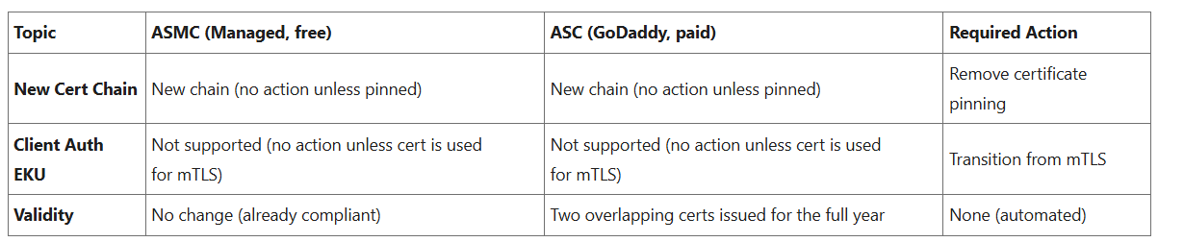
Security & Identity Updates
Industry-Wide Certificate Changes Impacting Azure App Service Certificates
In early 2026, industry-wide changes mandated by browser applications and the CA/B Forum will affect both how TLS certificates are issued as well as their validity period. The CA/B Forum is a vendor body that establishes standards for securing websites and online communications through SSL/TLS certificates. Azure App Service is aligning with these standards for both App Service Managed Certificates (ASMC, free, DigiCert-issued) and App Service Certificates (ASC, paid, GoDaddy-issued).
Public Preview - Data exploration using Microsoft Security Copilot in Entra
Microsoft Security Copilot in Microsoft Entra now supports data exploration when prompts return datasets with more than 10 items. This feature is in preview and available for select Microsoft Entra scenarios. From the Copilot chat response, select Open list to access a comprehensive data grid. This allows to explore large datasets with complete and accurate results, enabling more efficient decision-making. Each data grid displays the underlying Microsoft Graph URL, helping you verify query accuracy and build confidence in the results.

Slide 4
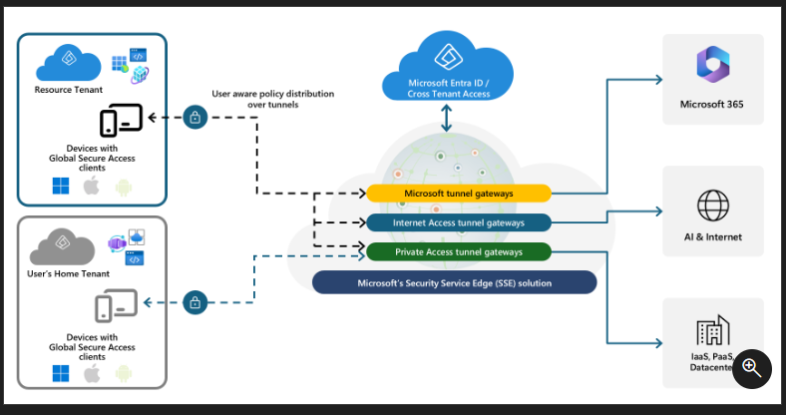
Security & Identity Updates
Public Preview - B2B guest access support in Global Secure Access
Now it is possible to enable the B2B guest access feature for guest users with the Global Secure Access client, signed in to their home organization's Microsoft Entra ID account. The Global Secure Access client automatically discovers partner tenants where the user is a guest and offers the option to switch into the customer's tenant context. The client routes only private traffic through the customer's Global Secure Access service.
Public preview - Protect enterprise generative AI applications with Prompt Shield
Block prompt injection attacks to enterprise GenAI apps in real-time with universal policy controls, extending Azure AI Prompt Shield to all network traffic.

Slide 5
Security & Identity Updates
Public Preview of Just-in-time password migration to Microsoft Entra External ID
The Just-in-Time (JIT) Password Migration feature is designed to provide a seamless and secure experience for customers transitioning to Microsoft Entra External ID. This capability enables external identity providers to migrate user credentials during sign-in, eliminating the need for bulk password resets and minimizing disruption for end users. When a user meets the migration conditions at sign-in, their credentials are securely transferred as part of the process, ensuring continuity and reducing friction.
By integrating migration into the authentication flow, organizations can simplify administrative tasks while maintaining security standards. This approach not only enhances user experience but also accelerates adoption of Microsoft Entra External ID without compromising operational efficiency.

Slide 6
Security & Identity Updates
General Availability - Microsoft Entra Connect security hardening to prevent user account takeover
As part of ongoing security hardening, Microsoft has implemented new safeguards to block account takeover attempts via hard match abuse in Microsoft Entra Connect (known as SyncJacking). Enforcement of this change begins in March 2026.
What’s Changing:
Enforcement logic now checks OnPremisesObjectIdentifier to detect and block remapping attempts.
Audit logs have been enhanced to capture changes to OnPremisesObjectIdentifier and DirSyncEnabled.
Admin capability added to clear OnPremisesObjectIdentifier for legitimate recovery scenarios.
Customer Action Required:
Upgrade to the latest Microsoft Entra Connect version.
Review updated hardening guidance and enable recommended flags:
Disable hard match takeover
General Availability - Modernizing Microsoft Entra ID auth flows with WebView2 in Windows 11
Microsoft Entra ID sign-in via Web Account Manager (WAM) now supports WebView2 (Chromium-based) starting with KB5072033 (OS builds 26200.7462 and 26100.7462). This update delivers a more secure, modern, and consistent authentication experience across Windows apps.WebView2 is expected to become the default for WAM authentication in a future Windows release, replacing the legacy EdgeHTML WebView. Teams are encouraged to opt in early, enable the experience, and validate any required changes such as proxy rules or authentication-related code.This transition strengthens security and modernizes identity experiences across the organization.

Slide 7
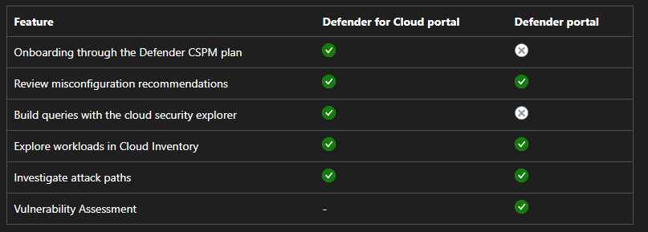
Security & Identity Updates
AWS CloudTrail ingestion (Preview)
When enabled, AWS CloudTrail ingestion enhances Cloud Infrastructure Entitlement Management (CIEM) by incorporating observed AWS management event activity alongside existing entitlement signals such as Access Advisor data. The additional usage context helps improve the accuracy of AWS security recommendations, including identifying unused permissions, dormant identities, and potential privilege escalation paths.
CloudTrail ingestion is supported for single AWS accounts and AWS Organizations that use centralized logging.
Cloud posture management adds serverless protection for Azure and AWS (Preview)
Defender for Cloud extends the capabilities of the Defender Cloud Security Posture Management (CSPM) plan to serverless workloads in Azure and Amazon Web Service (AWS) (Preview) in both the Azure portal and the Defender portal.

Slide 8
Security & Identity Updates
General availability of the Endor Labs integration
Defender for Cloud's integration with Endor labs is now generally available.
Defender for Cloud's integration with Endor Labs enhances vulnerability analysis by using reachability-based Software Composition Analysis (SCA), which shows exploitable vulnerabilities from code to runtime.

Slide 9
Management & Governance

Slide 10
Management & Governance Updates
Generally Available: Cloud-native apps on Kubernetes pricing calculator scenario
The new cloud-native apps on Kubernetes pricing calculator scenario allows teams to estimate the total cost of ownership for a production-ready AKS cluster with other key Azure services, including Azure Container Registry, Azure Monitoring, Microsoft Defender for Cloud, and more. The calculator scenario provides an architecture diagram and cost estimate with customizable inputs to fit your workload requirements.

Slide 11
Compute

Slide 12
Compute Updates
Public Preview: Service Bus SDK type bindings in Azure Functions for Node.js
Azure Functions triggers and bindings enable easy integration of events and data sources with function applications.
Now that SDK type bindings support for Azure Blob Storage is available, MS is also introducing support for Service Bus SDK type bindings in Node.js function apps.
This means in JavaScript or TypeScript function apps, it is now possible to interact with a ServiceBusMessageContext type offering advanced messaging functionality.
Announcing Azure CycleCloud Workspace for Slurm: Version 2025.12.01 Release
Azure CycleCloud Workspace for Slurm has been updated with CycleCloud 8.8.1, delivering improvements across cluster management, monitoring, security, and platform support. This release enhances scalability, operational efficiency, and flexibility for building and running HPC environments on Azure.
Integrated Monitoring with Prometheus self-agent and managed Grafana
Entra ID Single Sign-On (SSO) for secure and seamless authentication
Support for ARM64 compute nodes
Compatibility with Ubuntu 24.04 and AlmaLinux 9

Slide 13
Storage & Data

Slide 14
Storage & Data Updates
Public Preview: Azure Blob-to-Blob migration made simple with Azure Storage Mover
Azure Storage Mover’s new Azure Blob container-to-container migration feature is now in Public Preview, empowering organizations to move data between two Blob containers within the same or different storage accounts, subscriptions or Azure regions securely, reliably, and at scale. With this release, customers can eliminate manual pipelines and tools, automate migrations in the Azure portal, and gain real-time visibility into every job.
The Azure Blob container-to-container transfer feature in Azure Storage Mover has the following limits:
Each migration job supports the transfer of 500 million objects.
A maximum of 10 concurrent jobs is supported per subscription. If you need to run more than 10, create a support request.
Azure Storage Mover doesn't support automatic rehydration of archived objects. You must restore data stored in Azure Blob Archive before migration. Initiate migration jobs only after the data is fully restored.
Blob container-to-container migration doesn't allow you to select the same Source and Target Endpoint in the same Migration Job Creation.
Blobs aren't truly moved but copied. The Blob container continues to exist in its current location along with the Target location set.
Public Preview: Azure NetApp Files advanced ransomware protection
Azure NetApp Files advanced ransomware protection (ANF ARP) is now in Public Preview. ANF ARP is designed to help organizations proactively detect, respond to, and recover from ransomware threats on cloud volumes. ANF ARP monitors Azure NetApp Files volumes for suspicious activity using file extension profiling, entropy, and IOPS patterns. When a threat is detected, the system creates a point-in-time snapshot, enabling rapid evaluation and recovery. Notifications are sent via Azure Activity log and attack reports are retained for 30 days. There is no specific additional charge for ANF ARP.
Advanced ransomware protection is only available for newly created volumes. You must enable protection when you create the volume.
Attack reports are retained for 30 days.
Ransomware threat notifications are sent in the Azure Activity log.
It’s recommended to enable no more than five volumes per Azure region with advanced ransomware protection to mitigate performance issues.
It's recommended to increase QoS capacity by 5 to 10 percent due to potential performance impacts of advanced ransomware protection. The scale of the impact can vary based on the configurations across Azure NetApp Files deployment.

Slide 15
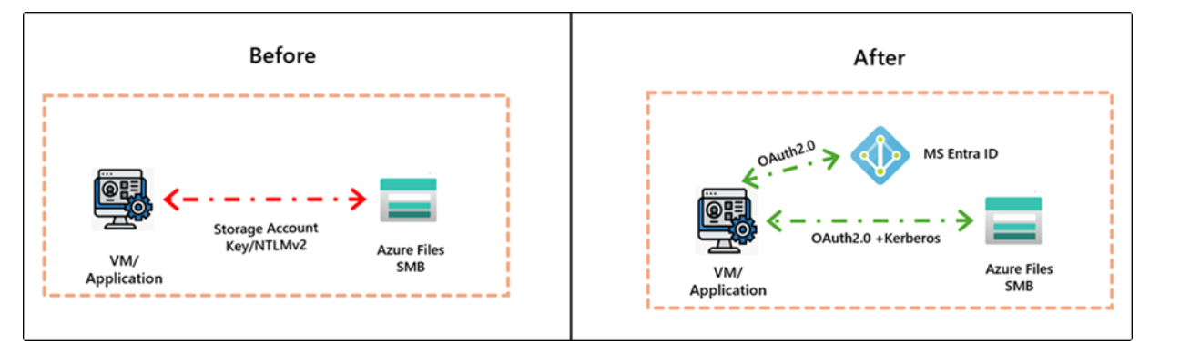
Storage & Data Updates
Public Preview of Managed Identities support with Azure Files SMB
This capability provides a secure, identity-driven approach for customer applications that eliminates credentials-based access and integrates seamlessly with MS Entra ID. Azure virtual machines, containers, and applications running in Azure can now authenticate to Azure Files using their own managed identity, and mount shares using short lived OAuth tokens over Kerberos. This unlocks secure file share access for both first party and customer applications, including Azure Kubernetes Service (AKS), Azure Functions, App Services, and other cloud native services

Slide 16
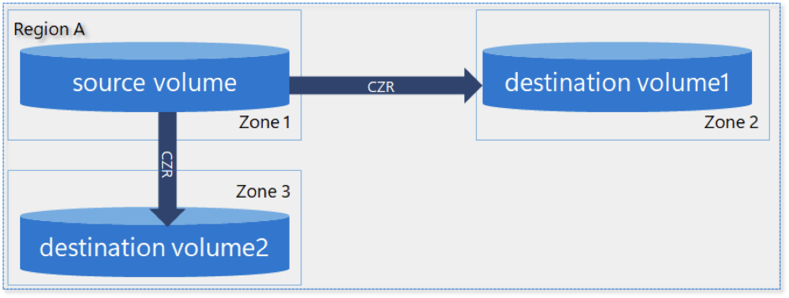
Storage & Data Updates
Generally Available: Azure NetApp Files cross-zone-region replication (CZRR)
Cross-zone-region replication builds on the existing capabilities of cross-region replication and cross-zone replication. It enables to replicate volumes across regions and across availability zones within the same region, combining disaster recovery and business continuity capabilities for volumes. To establish two protection volumes, create a cross-zone replication relationship, and a cross-region replication relationship, or two cross-region replication relationships or two cross-zone replication relationships. The source volume should be in an availability zone for the cross-zone replication relationship.
Generally Available: Azure Premium SSD v2 Disk is now available in Austria East and in a second Availability Zone in Japan West
Azure Premium SSD v2 is now available in Austria East and in a second Availability Zone in Japan West.
Azure Premium SSD v2, a next-generation general-purpose block storage solution, offers sub-millisecond latencies and exceptional price performance for IO-intensive workloads at a low cost. Premium SSD v2 is suited for a broad range of enterprise production scenarios, including SQL Server, Oracle, MariaDB, SAP, Cassandra, MongoDB, big data/analytics, and gaming on virtual machines or stateful containers.

Slide 17
Databases

Slide 18
Databases Updates
ODBC Driver 18.6 for SQL Server Released
Version 18.6 of the Microsoft ODBC Driver 18 for SQL Server has been released. Version 18.6 brings some minor changes and fixes to the driver.
Added
Support for the new vector data type (float32)
Support for ConcatNullYieldsNull as a connection string property
x86 support on Windows Arm64
Support for Azure Linux 3.0 ARM, Debian Linux 13, RedHat Linux 10, Ubuntu Linux 25.10
Fixed
Show the negotiated TDS packet size in BID traces
Public Preview: Cosmos DB Mirroring in Microsoft Fabric with Private Endpoints
MS announced the public preview of Private Endpoint support for Azure Cosmos DB Mirroring with Microsoft Fabric. This enhancement allows customers to maintain private network access to Cosmos DB while seamlessly replicating operational data into Fabric workspaces, preserving strong network security and isolation throughout the mirroring process.

Slide 19
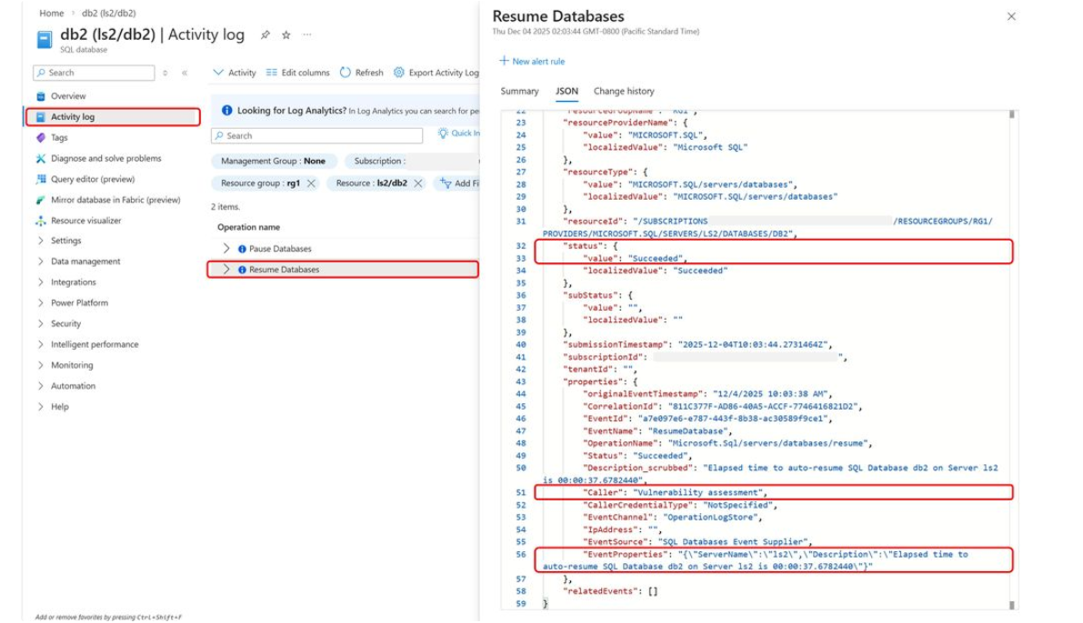
Databases Updates
Generally Avaailable: Azure SQL updates for early December 2025
MS announced that telemetry is now available in Azure Monitor activity log to identify the causes of auto-resuming serverless workloads in Azure SQL Database. Prior to exposing this telemetry, the correlation of specific auto-resume causes with database activity could be time consuming and imperfect with no programmatic solution.
The Azure Monitor activity log keeps a record of all auto-pause and auto-resume events for serverless databases. Auto-resume causes are reported in activity log for "Resume Databases" operations under the “Caller” property of the "Succeeded" event, and latencies for each event are reported under “EventProperties”. This event can be monitored to quickly and deterministically identify auto-resume causes without resorting to inefficient guesswork.

Slide 20
Databases Updates
Announcing Azure Database for MySQL Support for Resource Move with Private Link
Microsoft has announced that Azure Database for MySQL now supports moving servers across subscriptions and resource groups while Private Link remains enabled.
Customers can relocate MySQL servers without deleting or recreating Private Endpoints, avoiding service disruption and reducing operational overhead.
This improvement removes a long-standing limitation where Private Link had to be temporarily disabled during resource moves. The update aligns with Azure’s broader goal of full resource mobility, ensuring that strong network isolation and security via Private Link do not restrict standard management operations.
As a result, reorganizing or migrating MySQL resources is now simpler, faster, and less disruptive—while maintaining consistent security controls.
Generally Available: Azure Database for MySQL Triggers for Azure Functions
This feature, previously in Public Preview, enables tracking changes and developing event-driven applications at scale on any MySQL table. This release completes the unified suite of Azure Database for MySQL bindings for Azure Functions, which now includes native support for Input, Output, and Trigger capabilities.

Slide 21
Integration

Slide 22
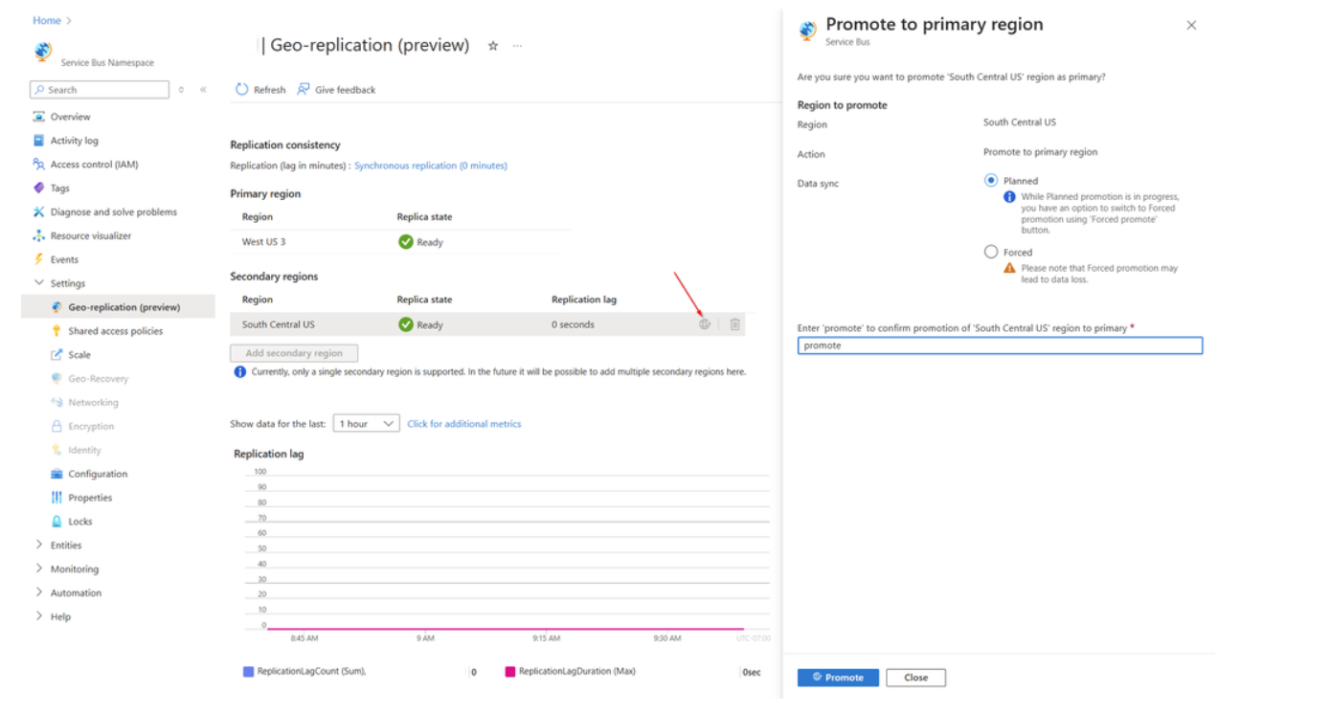
Integration Updates
Announcing General Availability of Geo-Replication for Azure Service Bus Premium
This feature ensures that the metadata and data of a namespace are continuously replicated from a primary region to a secondary region. Moreover, this feature allows promoting a secondary region at any time.
The Geo-Replication feature implements metadata and data replication in a primary-secondary replication model. It works with a single namespace, and at a given time there’s only one primary region, which is serving both producers and consumers. There is a single hostname used to connect to the namespace, which always points to the current primary region. After promoting a secondary region, the hostname points to the new primary region, and the old primary region is demoted to secondary region. After the new secondary has been re-initialized, it is possible to promote this region again to primary at any moment.
There are two replication modes, synchronous and asynchronous.
Asynchronous replication - Using asynchronous replication, all requests are committed on the primary, after which an acknowledgment is sent to the client. Replication to the secondary regions happens asynchronously. Users can configure the maximum acceptable amount of lag time, the offset between the latest action on the primary and the secondary regions. If the lag for an active secondary grows beyond user configuration, the primary will throttle incoming requests.
Synchronous replication - Using synchronous replication, all requests are replicated to the secondary, which must commit and confirm the operation before committing on the primary. As such, the application publishes at the rate it takes to publish, replicate, acknowledge, and commit. Moreover, it also means that the application is tied to the availability of both regions. If the secondary region goes down, messages aren't acknowledged and committed, and the primary will throttle incoming requests.

Slide 23
ML & AI & IOT

Slide 24
ML & AI & IOT Updates
Public Preview: Use Azure SRE Agent with Azure Cosmos DB
It is now possible to simplify how to diagnose and resolve issues in applications running on Azure Cosmos DB with the introduction of the Azure Cosmos DB Site Reliability Engineering (SRE) Agent, built on the Azure SRE Agent platform. This new capability gives you deeper visibility into the health and performance of database workloads by combining client-side telemetry with server-side diagnostics, allowing to identify problems faster and understand them more clearly.
Using the Azure Cosmos DB SRE Agent, you receive recommendations that help improve performance, strengthen security, and optimize cost. Instead of only detecting issues, the agent guides you through best practices tailored to your workload.
Introducing DeepSeek-V3.2 and DeepSeek-V3.2-Speciale in Microsoft Foundry
Microsoft has announced the availability of DeepSeek-V3.2 and DeepSeek-V3.2-Speciale in Microsoft Foundry on Azure. These frontier-class models introduce advanced reasoning capabilities, highly efficient architectures, and reinforcement learning innovations, making them well suited for enterprise AI workloads.By running natively on Azure through Foundry, customers can deploy DeepSeek models with built-in scalability, security, and compliance, while seamlessly integrating with Foundry’s evaluation tools, agent framework, routing, and observability stack. This release expands enterprise access to state-of-the-art reasoning models within a production-ready Azure environment.

Slide 25
ML & AI & IOT Updates
OpenAI’s GPT-5.2 is announced as generally available in Microsoft Foundry
GPT-5.2 series introduces deeper logical chains, richer context handling, and agentic execution that prompts shippable artifacts.
The GPT-5.2 series is built on new architecture, delivering superior performance, efficiency, and reasoning depth compared to prior generations. It’s also trained on the proven GPT-5.1 dataset and further enhanced with improved safety and integrations. GPT-5.2 leaps beyond previous models with substantial performance improvements across core metrics.

Slide 26
DevOps & IaC & Automation

Slide 27
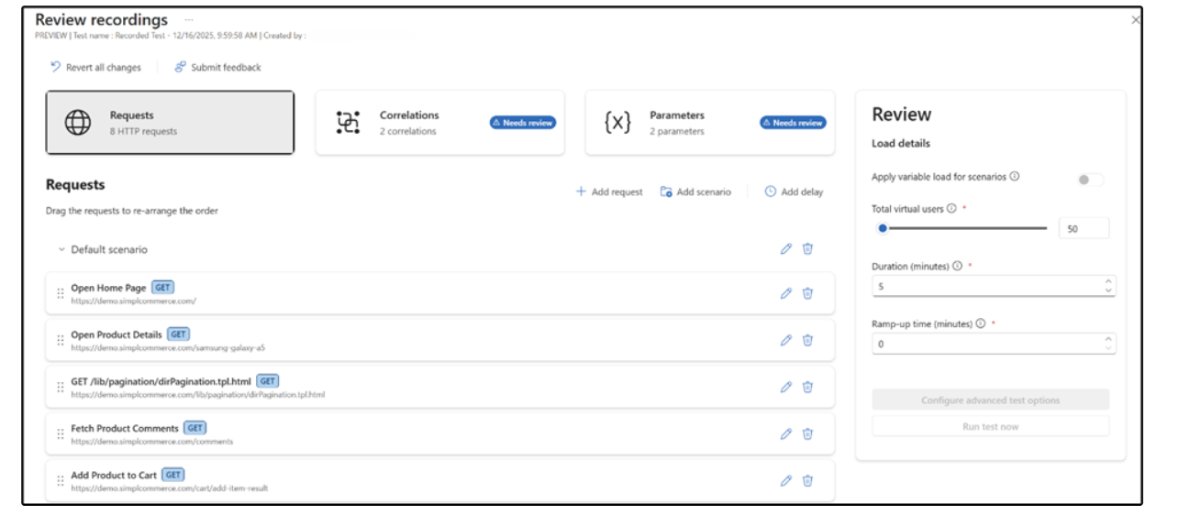
DevOps & IaC & Automation
AI-assisted load test authoring in Azure Load Testing
With AI-assisted load test authoring in Azure Load Testing, it goes from a simple browser recording to a production-ready JMeter script in minutes, while staying fully in control of what gets applied.
This new experience helps :
Create load tests faster by recording real user journeys directly from the browser
Improve script quality automatically with AI-recommended best practices
Run more realistic tests that better reflect real user behavior
Reduce manual effort without giving up transparency or control

Slide 28
Miscellaneous

Slide 29
Miscellaneous Updates
Retirement: Deprecation of Custom Resource Providers
In 2026, Azure Resource Manager will be deprecating the Custom Resource Provider (CuRP) service.
MS will retire the feature by October 31, 2026 and will be performing a scream test on October 27, 2025, as part of this deprecation. On July 31, 2026, creates, updates, patches, and actions to custom resources and resource providers will be blocked.
Only involves triggering an endpoint without the need for persistent resource management, consider Deployment Scripts.
Only involves triggering an endpoint without the need for persistent resource management, and use Bicep, consider Bicep Extensions.
Involves triggering several different endpoints or services for solution, consider Azure Functions.

Slide 30
Information

Slide 31
Information
Azure Times GitHub Repo

Slide 32
Questions

