Slide 1
Azure Times #195
March 2, 2026

Slide 2
Networking

Slide 3
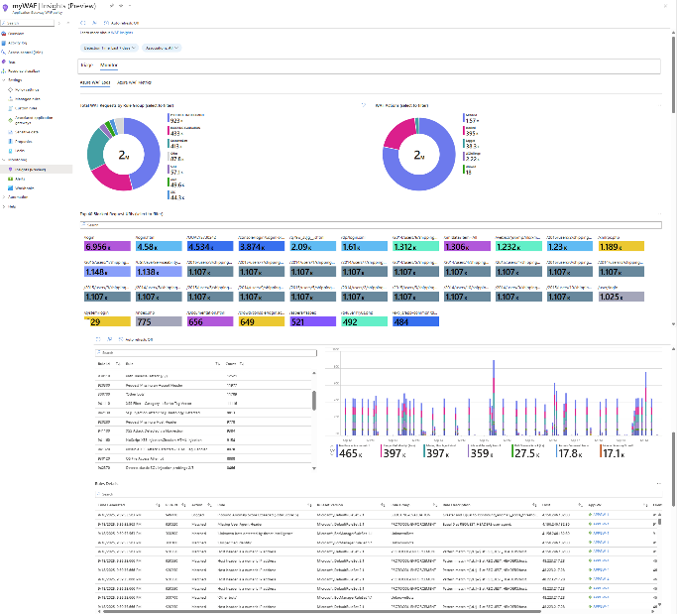
Networking Updates
Public Preview: WAF Insights for Application Gateway
Announcing the public preview of Application Gateway WAF Insights. Azure Application Gateway WAF now offers WAF Insights, providing an interactive view of logs and metrics.
WAF Insights enables quick investigation of blocked requests, analysis of attack patterns, and easy access to details like rule IDs and client IPs. Enhanced filters and visualizations make troubleshooting more efficient and help identify false positives, streamlining WAF tuning.

Slide 4
Security & Identity

Slide 5
Security & Identity Updates
Public Preview: Restrict usage of user delegation SAS to an Entra ID identity
MS announced the addition of enhanced secure authentication in Azure Storage that combines the flexibility of user-delegation shared access signature (SAS) with the user-bound access of Entra ID. User-bound user delegation SAS is now in preview for all regions.
User delegation SAS is an existing feature that allows users to create secure SAS tokens that are tied to the delegator, meaning the delegator must verify their identity with Entra to create the token. The resulting token can be traced to the delegator and can only be valid for up to 7 days. This feature is an extension of user delegation (UD) SAS, which is already generally available for Azure Blobs and in public preview for Azure Files, Azure Tables, and Azure Queues. User-bound user delegation SAS allows users to create a more secure SAS token than account SAS, service SAS, or normal user delegation SAS by restricting the usage of the SAS token to an end user identity. This will help enforce that the user delegated SAS can only be used by intended users.
There is no additional cost to use user-bound user delegation SAS.

Slide 6
Management & Governance

Slide 7
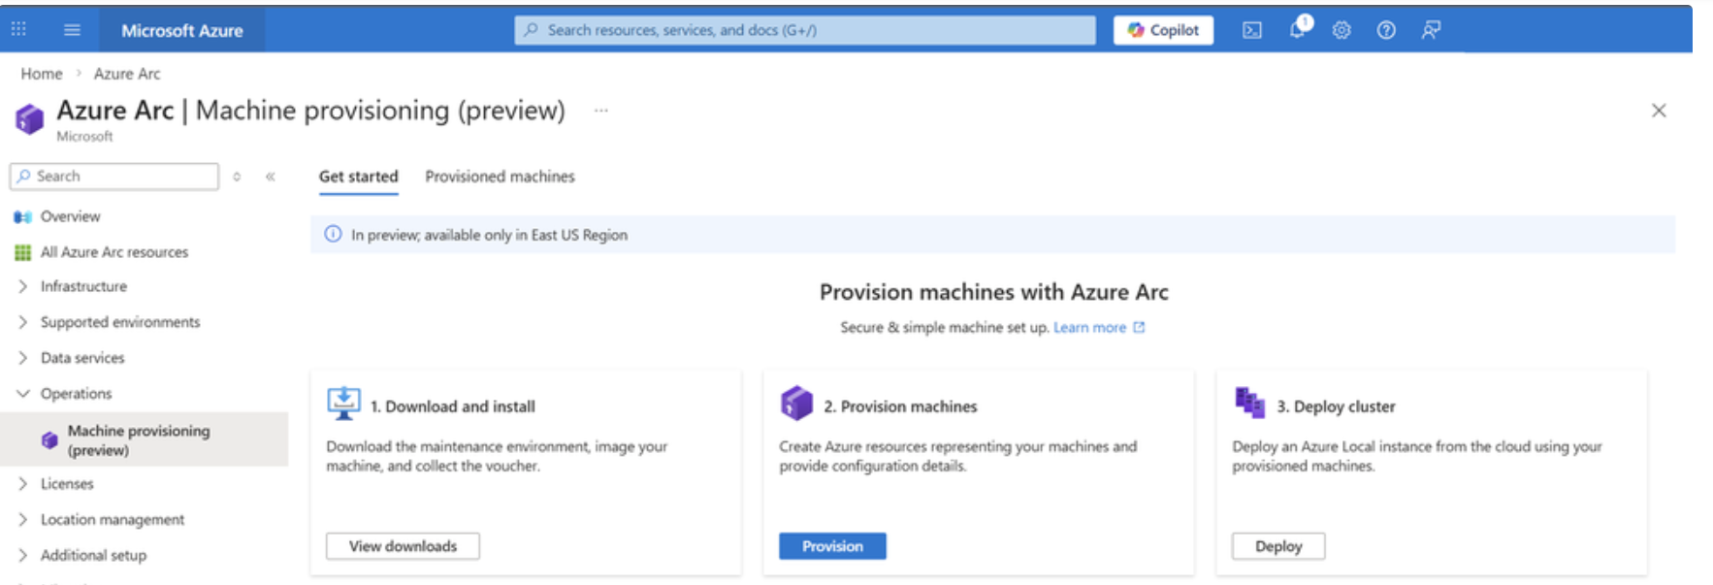
Management & Governance Updates
Public Preview: Secure ingestion and pod placement for Azure Monitor pipeline
MS announced several capabilities in public preview with the Azure Monitor pipeline.
Secure Ingress to Azure Monitor pipeline from external endpoints (TLS/mTLS) with Bring Your Own Certificates: Monitor pipeline supports both TLS and mutual TLS (mTLS) for TCP-based receivers, allowing customers to:
    Configure mTLS with their own certificates for client and server authentication
    Configure TLS with their own server certificates and client CA certificate
Pod placement: Azure Monitor pipeline provides native controls for managing how Azure Monitor pipeline instances are scheduled across Kubernetes cluster nodes.
    Target specific nodes based on their capabilities (e.g., high-resource nodes, specific zones)
    Control instance distribution to prevent resource contention
    Enforce isolation policies for high-scale deployments
Announcing Public Preview: Simplified Machine Provisioning for Azure Local
A new way to provision Azure Local hardware with minimal onsite interaction, while maintaining centralized control through Azure. This new approach enables customers to provision hardware by racking, powering on, and letting Azure do the rest.
Simplified machine provisioning shifts configuration to Azure, reducing the need for technical expertise on-site.
Instead of manually configuring each server locally, IT teams can now:
Define provisioning configuration centrally in Azure
Securely complete provisioning remotely with minimal steps
Automate provisioning workflows using ARM templates and ensure consistency across sites

Slide 8
Compute

Slide 9
Compute Updates
Generally Available: Azure Red Hat OpenShift is now available in Malaysia West, New Zealand North, and Mexico Central
Azure Red Hat OpenShift is now generally available in three additional Azure regions: Malaysia West, New Zealand North, and Mexico Central.
This expansion strengthens Azure Red Hat OpenShift’s presence across Asia Pacific and Latin America, enabling customers to deploy managed OpenShift clusters closer to their users and data to help reduce latency and support data residency and regional regulatory compliance requirements, while maintaining a consistent, enterprise-grade Kubernetes experience on Azure.
Generally Available: DCesv6, DCedsv6, ECesv6, and ECedsv6 confidential VMs
The DCesv6, DCedsv6, ECesv6, and ECedsv6 series are Azure’s next generation of confidential Virtual Machines (VMs) based on 5th Gen Intel® Xeon® processors with Intel® Trust Domain Extensions (Intel® TDX). These new confidential VMs help organizations to move their most sensitive workloads to the cloud—without requiring any application code changes. Available today for production deployments across both general-purpose (DCesv6, DCedsv6) and memory-optimized (ECesv6, ECedsv6) VM families, this release delivers a powerful combination of performance, scalability, and hardware-enforced security.

Slide 10
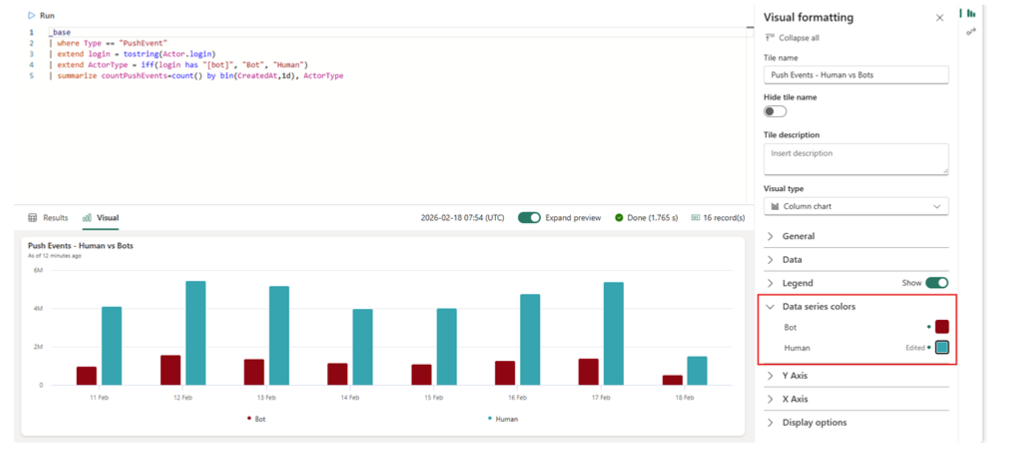
Compute Updates
Introducing Data Series Colors: tell clearer stories with ADX Dashboards
Until now, color assignments in ADX dashboards were largely automatic. While this worked for basic scenarios, it often fell short in operational and reporting use cases where color isn’t decoration - it’s meaning. MS introduced Data Series Colors, a new capability that gives editors direct control over how colors are applied to their visuals.
With Data Series Colors, dashboard editors can now:
Assign colors directly to each data series
Override system defaults with intentional choices
Maintain consistency across visuals and dashboards

Slide 11
Compute Updates
Retirement: Windows Server Annual Channel (preview)
Windows Server Annual Channel (Preview) on AKS will be retired on May 15, 2026, please transition to Long Term Servicing Channel (LTSC) by that date. MS encourage to transition to Long Term Servicing Channel (LTSC) prior to the retirement date to experience the benefits of LTSC, including longer support cycles and increased stability.
From now to May 15, 2026 you can continue to use Windows Server Annual Channel (Preview) without disruption. On May 15, 2026, AKS will no longer produce new Windows Server Annual Channel node images or provide security patches. You will not be able to create new node pools with Windows Server Annual Channel. On May 15, 2027, AKS will remove all existing Windows Annual Channel node images, which will cause scaling and remediation (reimage and redeploy) operations to fail
Retirement: Managed NGINX Ingress with Application Routing Add-on Retiring November 2026
The upstream Ingress-NGINX project is being deprecated and will stop receiving updates after March 2026. Microsoft will continue providing critical security patches through 30 November 2026, after which the NGINX ingress controller will no longer be supported within the Application Routing add-on. Supported alternatives include Gateway API with Application Routing (in development), Application Gateway for Containers, and Istio Service Mesh

Slide 12
Storage & Data

Slide 13
Storage & Data Updates
Generally available: Azure Premium SSD v2 Disk Storage is now available in a third Availability Zone in New Zealan North
Azure Premium SSD v2 is now available in a third Availability Zone in New Zealand North.
Azure Premium SSD v2 disk, a next-generation general-purpose block storage option for Azure virtual machines, offers sub-millisecond latencies and exceptional price performance for IO-intensive workloads at a low cost. Premium SSD v2 is suited for a broad range of enterprise production scenarios, including SQL Server, Oracle, MariaDB, SAP, Cassandra, MongoDB, big data/analytics, and gaming on virtual machines or stateful containers.

Slide 14
Databases

Slide 15
Databases Updates
Public Preview: Azure SQL updates for late-February 2026
In late-February 2026, the following updates and enhancements were made to Azure SQL:
Manage databases directly from the dialog using actions such as Name, Rename, and Drop.
Import a flat file to database in the MSSQL Extension for Visual Studio Code.
Database Backup dialog now provides options for backup type, destination, compression, encryption, and other advanced settings.
Public Preview: Geo‑redundant backups for Premium SSD v2 in Azure Database for PostgreSQL
It is now possible to configure geo‑redundant backups with Premium SSD v2 disks for Azure Database for PostgreSQL, giving an additional layer of disaster recovery for mission‑critical workloads. With this release, automated backups are securely stored in a paired Azure region, so you can restore flexible server in another region if an outage occurs. This update is especially valuable if you run regulated, business‑critical, or customer‑facing applications that require stronger resilience and data protection beyond a single region.
By combining geo‑redundant backups with the performance and scalability benefits of Premium SSD v2 disks, you get high‑throughput storage along with improved recovery options, without having to manage or operate standby infrastructure in the secondary region.

Slide 16
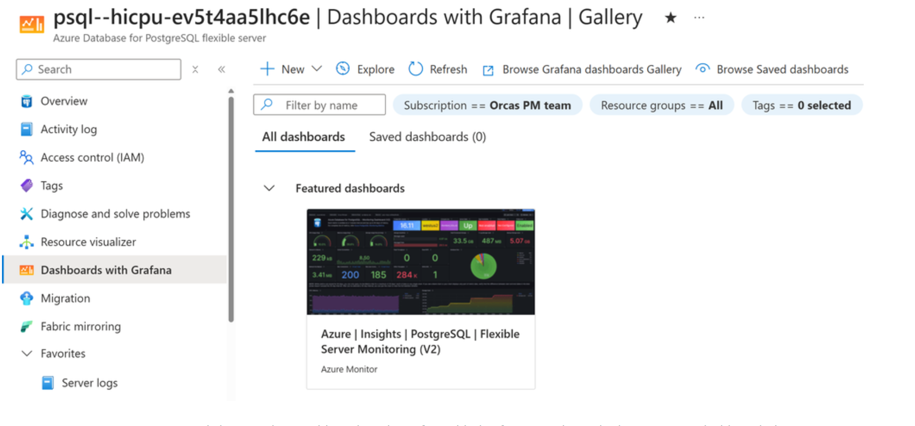
Databases Updates
Generally Available: Azure SQL updates for late-February 2026
In late-February 2026, the following updates and enhancements were made to Azure SQL:
Introducing Search Database Objects in the MSSQL extension for Visual Studio Code. Instantly find tables, views, functions, and procedures with full scripting options across your SQL database.
Import your settings and keyboard shortcuts from Azure Data Studio to the MSSQL Extension.
Dashboards with Grafana - Now in Azure Portal for PostgreSQL
MS announced that Azure Database for PostgreSQL users can now access prebuilt Grafana dashboards directly within the Azure portal - with no additional cost or configuration required. This integration eliminates the complexity of deploying and administering self-hosted or managed Grafana instances. Grafana’s powerful visualization capabilities are now embedded directly in the Azure experience

Slide 17
Databases Updates
Oracle Database@Azure Is Now Generally Available in West Europe (Amsterdam)
Oracle Database@Azure is now generally available in the West Europe (Amsterdam) Azure region.
This new region enables customers across Western Europe to run mission‑critical Oracle databases closer to their Azure applications—meeting stringent regional compliance requirements while benefiting from ultra‑low latency and a fully integrated Azure experience.

Slide 18
Integration

Slide 19
Integration Updates
New Azure API management service limits
Starting in March 2026 and over the following several months, Azure API Management is introducing updated resource limits for instances across all tiers. The limits are shown in the following table.
Entity/Resource | Consumption | Developer | Basic/ Basic v2 | Standard/ Standard v2 | Premium/ Premium v2
API operations | 3,000 | 3,000 | 10,000 | 50,000 | 75,000
API tags | 1,500 | 1,500 | 1,500 | 2,500 | 15,000
Named values | 5,000 | 5,000 | 5,000 | 10,000 | 18,000
Loggers | 100 | 100 | 100 | 200 | 400
Products | 100 | 100 | 200 | 500 | 2,000
Subscriptions | N/A | 10,000 | 15,000 | 25,000 | 75,000
Users | N/A | 20,000 | 20,000 | 50,000 | 75,000
Workspaces per workspace gateway | N/A | N/A | N/A | N/A | 30
Self-hosted gateways | N/A | 5 | N/A | N/A | 100¹

Slide 20
DevOps & IaC & Automation

Slide 21
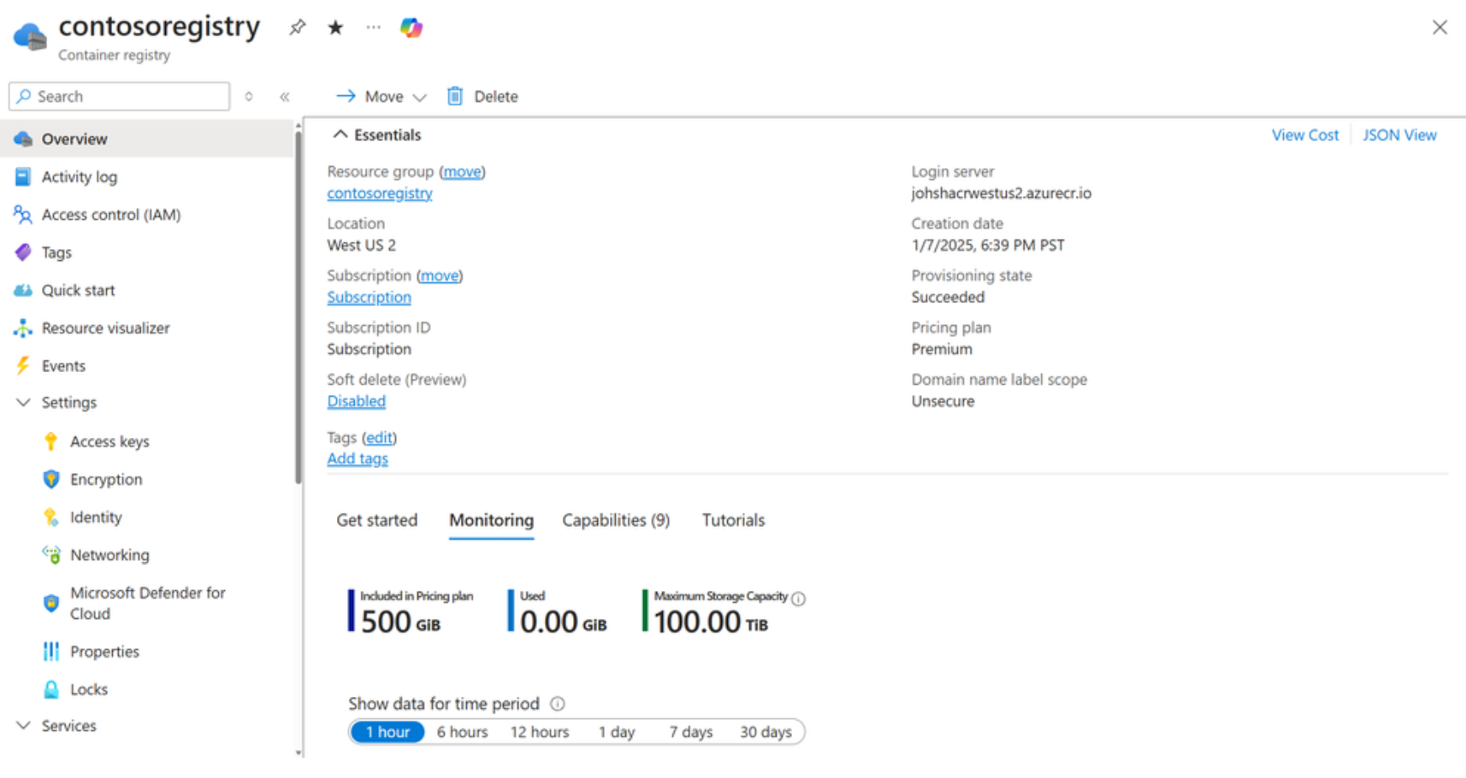
DevOps & IaC & Automation
Azure Container Registry Premium SKU Now Supports 100 TiB Storage
MS announced that Azure Container Registry Premium SKU now supports up to 100 TiB of registry storage—a 2.5x increase from the previous 40 TiB limit, and a 5x increase from the original 20 TiB limit just two years ago.

Slide 22
Information

Slide 23
Information
Azure Times GitHub Repo

Slide 24
Questions

