Slide 1
Azure Times #185
November 24, 2025

Slide 2
Networking

Slide 3
Networking Updates (Application Gateway) 1/4
Public Preview: JWT Validation in Azure Application Gateway
Azure Application Gateway now supports built-in JSON Web Token (JWT) validation in public preview, allowing authentication enforcement at the gateway before traffic reaches your backend services.
Key benefits:
Protect at the edge: Automatically block requests with missing or invalid tokens (401/403) before they hit your applications.
Improve performance: Offload JWT validation from apps and microservices to the gateway for better scalability and faster response times.
Simplify operations: Manage consistent authentication policies centrally across all applications and routes.
This new capability strengthens security, reduces app overhead, and streamlines identity governance across your environment.
Public Preview: Application Gateway for Containers Istio Service Mesh integration
A new optional service mesh extension enables seamless integration between Application Gateway for Containers and Istio, simplifying secure north–south traffic flows into your mesh.
Key benefits:
Unified ingress: Use a single gateway to load balance traffic to services both inside and outside the mesh.
Lower operational overhead: Reduce config complexity with automated mTLS authentication settings.
Managed certificate trust: Automatic certificate trust management and rotation ensures secure, consistent authentication with the service mesh.
This integration streamlines operations and delivers a more secure, cohesive ingress experience for Istio-based environments.

Slide 4
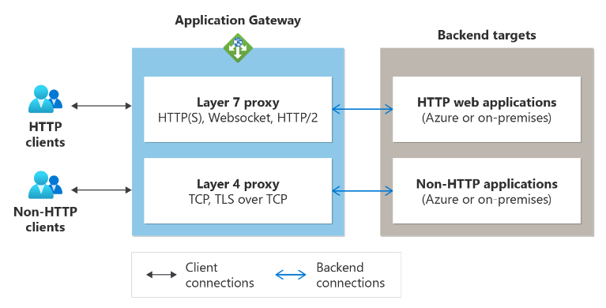
Networking Updates (Application Gateway) 2/4
Generally Available: TLS and TCP termination on Azure Application Gateway
This enhancement adds the ability to load balance and securely process non-HTTP(S) traffic, enabling support for applications that use TCP or TLS protocols. The gateway now terminates incoming connections at the proxy and opens a new connection to backend servers, providing improved security and control.
Key capabilities:
TLS/TCP proxying: Support for secure, low-latency load balancing of TCP and TLS workloads.
Unified certificate management: Manage certificates for both HTTPS and TLS on the same resource, simplifying operations and providing a single client endpoint.
Client IP preservation: PROXY protocol support ensures backend services receive the original client IP.
Expanded listener support: Port 22 is now supported.
Available on: Application Gateway Standard v2 and WAF v2 SKUs.
Limitations
Mixed traffic support: WAF v2 gateways can host both TLS/TCP and HTTP listeners, but each listener only supports its respective protocol.
Fixed draining timeout: Backend server draining is fixed at 30 seconds; custom draining values aren’t supported.
Connection interruptions on updates: Any configuration update (PUT) will terminate active connections after the default draining period.
Client IP preservation: Not supported for TLS/TCP proxying at this time.
Ingress controller: AGIC is not supported; only L7 HTTP(S) proxy features work with AGIC.

Slide 5
Networking Updates (Application Gateway) 3/4
Generally Available: Azure Application Gateway mTLS passthrough support
Azure Application Gateway now supports a new mTLS Passthrough mode, enabling backend applications to validate client certificates and authorization headers while still benefiting from full WAF inspection.
Previously, Application Gateway listeners enforced Strict mTLS, blocking any request that did not include a valid client certificate—preventing token-only traffic from reaching backend services.
With the new Passthrough mode, you can now:
Allow requests without client certificates to pass through WAF for inspection.
Support mixed authentication scenarios, including both mTLS and token-based access.
Let backend applications perform certificate and authorization logic, maintaining full control.
This enhancement improves flexibility for modern applications that combine certificate-based and token-based authentication while keeping traffic protected by WAF.
Generally Available: Application Gateway for Containers – Slow start
Application Gateway for Containers now supports Slow Start as a load-balancing algorithm, improving stability and performance when new backend pods come online. Slow Start gradually ramps up traffic to newly added pods over a configurable warm-up period.
Key benefits:
Smooth scale-up: Prevents sudden traffic spikes that can overwhelm cold pods.
Higher reliability: Ensures new pods warm up properly before receiving full load.
Predictable performance: Maintains consistent response times during scale-outs and rolling updates.
This feature helps deliver safer, more stable scaling behavior for containerized applications.

Slide 6
Networking Updates (Application Gateway) 4/4
Public Preview: Microsoft HTTP DDoS Ruleset 1.0 on Application Gateway WAF v2
Azure WAF’s new HTTP DDoS Ruleset delivers adaptive, automated Layer 7 protection with almost no configuration required.
Once enabled, the ruleset continuously learns normal traffic patterns for each Application Gateway and automatically blocks malicious surges without manual tuning.
Key capabilities:
Automated traffic baselining at both gateway and per-IP levels.
Dynamic thresholds & sensitivity, balancing strong protection with user experience.
Two intelligent detection rules:
  High-rate client anomaly detection
  Bot detection powered by Microsoft Threat Intelligence
This new ruleset provides smarter, real-time HTTP DDoS protection with minimal operational overhead.

Slide 7
Networking Updates (Network Watcher) 1/1
Public Preview: Azure Network Watcher Topology – Agentless Connection Troubleshoot
Connection troubleshoot now supports an agentless experience—no Network Watcher agent VM extension is required to run connectivity tests.
What’s new:
No agent needed: Run connectivity tests between Azure resources without installing the Network Watcher VM extension on source VMs.
Faster, simpler troubleshooting: Diagnostics are performed through Azure platform APIs, reducing setup and operational overhead.
This preview streamlines network troubleshooting directly from the Azure portal with a fully agentless workflow.
Public Preview: Azure Network Watcher Topology – AKS Visualization
Azure Network Watcher Topology now provides end-to-end visualization of AKS clusters, giving teams a unified map that spans both Azure networking and Kubernetes workloads.
Key benefits:
Unified visibility: See AKS pods, services, load balancers, VNets, and subnets in a single topology view.
Faster troubleshooting: Trace traffic paths, identify connectivity issues, and understand dependencies without switching tools.
Operational efficiency: Simplifies performance analysis and accelerates collaborative diagnostics across infra and platform teams.
This release bridges the gap between Azure infrastructure and AKS workloads, offering a clear, Azure-native view from the network edge down to containers.

Slide 8
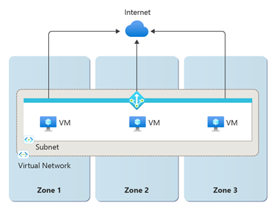
Networking Updates (Standard NAT) 1/1
Public Preview: Standard V2 NAT Gateway and StandardV2 Public Ips
StandardV2 NAT Gateway delivers all the capabilities of the Standard NAT Gateway with major improvements in resiliency, performance, and management:
Zone-redundant: Operates across all availability zones in a region, maintaining outbound connectivity even during a zone failure.
Dual-stack support: Enables outbound connectivity using both IPv4 and IPv6 public IPs and prefixes.
Higher throughput: Provides up to 100 Gbps, doubling the 50 Gbps limit of the Standard NAT Gateway.
VNet-level association: Can be attached at the virtual network level, automatically applying outbound NAT to all subnets.
Flow logs: Supports detailed outbound traffic logging for monitoring and analysis.
This upgrade brings stronger resiliency, simpler configuration, and higher performance for large-scale outbound workloads.
Requires StandardV2 Public IPs: Only StandardV2 public IP addresses or prefixes are supported.
Standard SKU public IPs are not compatible.
No in-place upgrade: Existing Standard NAT Gateways cannot be upgraded to StandardV2.You must deploy a new StandardV2 NAT Gateway and swap it into your subnet
Terraform not supported yet: Terraform currently does not support StandardV2 NAT Gateway or StandardV2 Public IP resources.
No delegated subnet support: StandardV2 NAT Gateway cannot be attached to delegated subnets.

Slide 9
Networking Updates 1/3
Public Preview: Cross region pool association support for Azure Virtual Network Manager IP address management
Azure IPAM now supports multi-region address pools, allowing a single IPAM pool to allocate CIDRs across virtual networks in multiple Azure regions. This enhancement streamlines global address planning and ensures consistent governance at scale.
Key benefits:
Simplified management: Use one centralized pool instead of maintaining region-specific pools.
Consistent governance: Apply uniform CIDR policies globally with optional region restrictions.
Backward compatible: Existing single-region pools continue to function without changes.
This update reduces operational overhead and improves control for organizations managing large, multi-region Azure environments.
Public Preview: Azure VNet Flow Log – Filtering
Azure VNet Flow Logs now support advanced filtering, giving organizations fine-grained control over which network flows are captured. You can filter logs using nine criteria—including IPs, ports, protocols, encryption state, flow direction, allowed/denied actions, and flow states—combined using AND/OR logic for highly targeted visibility.
These enhancements allow teams to log only the traffic that truly matters (e.g., intra-VNet, inter-VNet, CIDR-specific, or port-specific flows), reducing noise and operational overhead. By capturing fewer, more relevant logs, organizations can streamline troubleshooting, lower storage and processing costs, and maintain strong security and compliance visibility.

Slide 10
Networking Updates 2/3
Generally Available: Azure Virtual Network Manager address overlap prevention in mesh
Unintended address overlap in a mesh network can cause dropped traffic and routing failures. Azure Virtual Network Manager now includes built-in address space validation to proactively detect and prevent these conflicts.
With this enhancement:
When adding a virtual network to a mesh, Azure Virtual Network Manager automatically checks that its address space does not overlap with existing members.
When updating a VNet’s address space or adding a peering, the service ensures the change will not introduce conflicts.
Any address space modification automatically triggers revalidation, maintaining real-time consistency and routing integrity across large-scale environments.
This reduces misconfiguration risk and ensures stable, predictable connectivity across your mesh network.
Generally Available: ExpressRoute Scalable Gateway
ExpressRoute Scalable Gateway (ErGwScale) is next-generation that can dynamically scale gateway infrastructure to meet real-time traffic demands.
Dynamic scaling: Deploy ErGwScale to achieve up to 40 Gbps of connectivity for virtual machines and private endpoints within your virtual network.
Auto scaling: Configure minimum and maximum scale units, and Azure automatically adjusts capacity based on bandwidth and flow demand—delivering efficiency and eliminating manual tuning.
Fixed scale option: For predictable workloads, set a steady scale to maintain consistent bandwidth for stable traffic patterns.
FastPath + gateway coexistence: ErGwScale complements FastPath for scenarios where FastPath isn’t supported—such as high-bandwidth or complex routing cases—ensuring seamless performance.

Slide 11
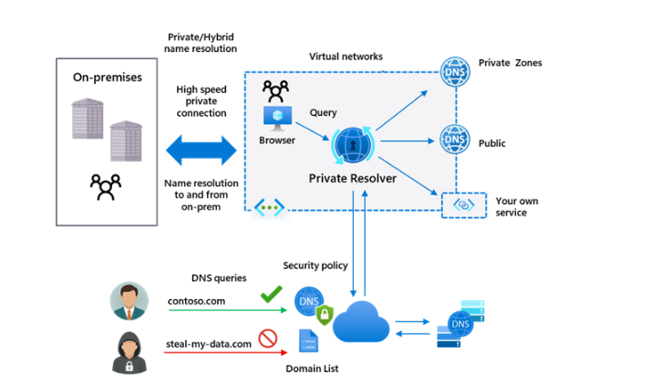
Networking Updates 3/3
Generally Available: DNS security policy Threat Intelligence feed
The Azure DNS security policy Threat Intelligence feed is now generally available, delivering automated protection against known malicious domains using Microsoft-managed threat intelligence.
Key benefits:
Smart protection: Nearly all attacks begin with DNS. The managed malicious domain list helps detect and block threats early.
Continuous updates: Microsoft automatically refreshes the feed with newly identified malicious domains—no manual upkeep required.
Monitor or block: Choose Alert-only mode for visibility or Blocking mode to prevent resolution of risky domains. With DNS logging enabled, you gain full visibility into DNS activity within the virtual network.
This release strengthens DNS-layer security and adds a powerful defense against evolving threats.

Slide 12
Security & Identity

Slide 13
Security & Identity Updates 1/1
Public Preview: Microsoft Defender for Cloud + GitHub Advanced Security
With Microsoft Defender for Cloud and GitHub Advanced Security, organizations can protect cloud-native applications across the entire lifecycle—from code to cloud. This natively integrated solution brings developers and security teams together in a unified workflow, all within the tools they already use.
The integration enables early vulnerability detection and connects real-time threat insights from production environments directly to the most relevant code-level risks, helping teams prioritize remediation efforts. With Copilot Autofix and the Coding agent, developers can apply AI-generated fixes in minutes, significantly reducing remediation time and strengthening application security.
Public Preview: Threat Detection in Azure Backup powered by MDC
Azure Backup has introduced threat detection capabilities for Azure VM backups, powered by Microsoft Defender for Cloud (MDC). This new capability enables customers to assess the health of their Azure VM backup restore points (RPs) by identifying malicious or ransomware-infected backups.
By leveraging signals from Microsoft Defender for Servers, Azure Backup detects indicators of compromise such as disruption patterns, heuristic behavior anomalies, and malware or ransomware signatures.

Slide 14
Management & Governance

Slide 15
Management & Governance Updates (Azure Site Recovery) 1/2
Public Preview: Support for Linux major OS upgrades with Azure Site Recovery
Azure Site Recovery (ASR) now supports major Linux OS upgrades without disabling replication, interrupting protection, or losing recovery points—available for Azure-to-Azure (A2A) disaster recovery.
ASR automatically detects the OS version change during an in-place upgrade and prompts you to update the Mobility Agent if required, ensuring continuous replication and full DR protection throughout the process.
Supported upgrade paths:
RHEL: 7 → 8, 8 → 9
SLES: 12 → 15
This enhancement simplifies lifecycle management while maintaining uninterrupted disaster recovery readiness.
Public Preview: Support 5x churn in Azure Site Recovery
Azure Site Recovery now supports up to 5× higher churn rates—up to 500 MB/s per VM—significantly boosting replication performance for high-IOPS workloads. This enhancement enables reliable disaster recovery for demanding applications such as large databases, analytics platforms, and big-data systems.
Key details:
Scope: Azure-to-Azure disaster recovery only
Availability: Rolling out in select Azure regions
VM Requirements:
  ≥ 256 GB RAM: Supports up to 500 MB/s churn
  < 256 GB RAM: Churn capped at 100 MB/s
  ASR reserves up to 6.25% of RAM (max 16 GB)
Supported OS:
  Windows
  Linux: RHEL 9, SLES 15, Ubuntu 24.04
Disk conditions: Churn limits depend on disk type and size
Infrastructure requirements: Ensure adequate network throughput and CPU capacity for ASR to replicate change data effectively
This improvement allows customers to protect larger and more intensive workloads while maintaining strong recovery performance.

Slide 16
Management & Governance Updates (Azure Site Recovery) 2/2
Generally Available: Capacity guidance for Azure Site Recovery
Azure Site Recovery (ASR) now provides alternative VM size recommendations during failover, helping improve allocation success when the originally selected target VM size faces capacity constraints. This enhancement increases failover reliability by guiding customers toward compatible VM sizes that are more likely to be available in the target region.
When recommendations are not provided:
If the target setup includes:
  Availability Sets
  Virtual Machine Scale Sets (VMSS)
  Proximity Placement Groups (PPG)
If on-demand capacity reservation is configured for the target VM
When failover is triggered using Recovery Plans
For VMware-to-Azure and Hyper-V-to-Azure ASR scenarios
This update improves resilience for Azure-to-Azure failover scenarios by increasing the chances that a suitable VM size can be allocated during disaster recovery.
Generally Available: Seamless failback for HyperV-to-Azure: Managed Disk support in Azure Site Recovery
Azure Site Recovery (ASR) now supports failback from Azure VMs to on-premises Hyper-V even when the original replication was to a storage account and the failed-over Azure VM uses managed disks.
This enhancement removes a long-standing limitation and enables:
Seamless failback from managed-disk Azure VMs
Full recovery flexibility for environments that previously replicated to Azure Storage
Simplified disaster recovery workflows without requiring re-protection or disk format conversion
Organizations can now perform end-to-end DR and failback for Hyper-V environments with greater consistency and fewer manual steps.

Slide 17
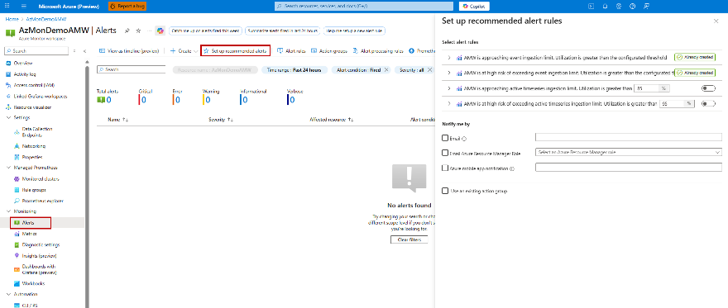
Management & Governance Updates (Azure Monitor) 1/9
Public Preview: Recommended alerts for Azure Monitor Workspace
Azure Monitor now supports one-click enablement of recommended alerts for Azure Monitor Managed Service for Prometheus.
With this update, customers can easily turn on preconfigured alerts in the Azure portal to monitor Azure Monitor Workspace ingestion limits and proactively prevent metrics throttling. This simplifies setup, ensures early detection of ingestion pressure, and improves overall observability reliability.
Public Preview: Introducing SDK Stats to the Azure Monitor OpenTelemetry Distro
Azure Monitor Application Insights now includes a new data collection pipeline designed to make troubleshooting ingestion issues far easier. A common support issue has been customers not seeing expected telemetry—this update directly addresses that.
With the new built-in SDK Stats workbook, you can quickly detect and diagnose ingestion problems. The enhanced SDK emits per-process metrics for successful sends, drops, and retries, including detailed reason codes.
To take advantage of these new diagnostics and improve observability, simply upgrade to the latest Azure Monitor OpenTelemetry Distro.

Slide 18
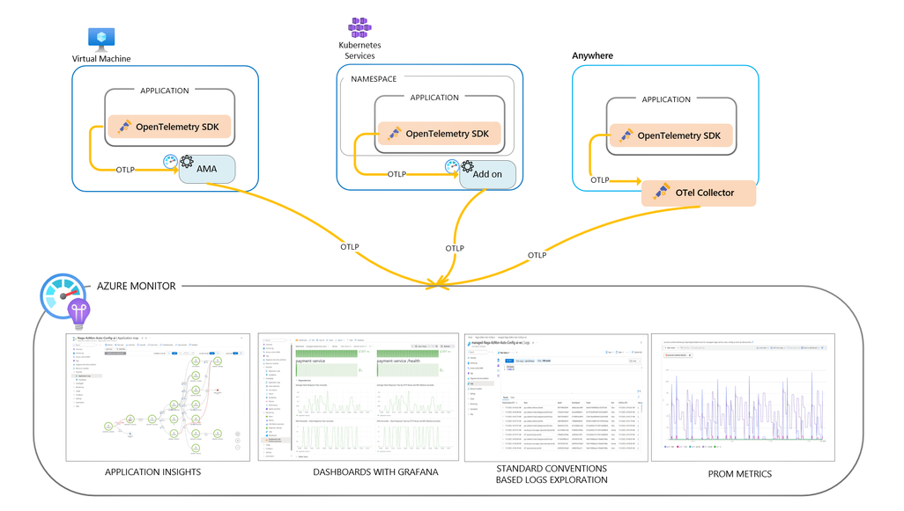
Management & Governance Updates (Azure Monitor) 2/9
Troubleshoot with OTLP signals in Azure Monitor (Limited Public Preview)
Microsoft has expanded Azure Monitor’s support for OpenTelemetry (OTel) with a new limited preview that enables direct OTLP ingestion of logs, metrics, and traces from any environment.
With this preview, applications running anywhere—Azure, hybrid, multicloud, or on-premises—can send OTLP signals directly to Azure Monitor. Azure also simplifies collection orchestration:
Azure VMs/VMSS and Azure Arc: Use the existing Azure Monitor Agent (AMA) to collect infrastructure logs and OTel application telemetry.
AKS: Azure Monitor add-ons for Container Insights and managed Prometheus automatically configure OTel signal collection or auto-instrument applications using the Azure Monitor OpenTelemetry Distro.
Any environment: Use the OpenTelemetry Collector to forward OTLP logs, metrics, and traces to Azure Monitor ingestion endpoints.
Customers can visualize data using Grafana community dashboards, troubleshoot with Application Insights, or build custom analytics using standard OTel semantics.

Slide 19
Management & Governance Updates (Azure Monitor) 3/9
Public Preview: Query-based metric alerts in Azure Monitor
Azure Monitor metric alerts now support all Azure metrics—platform, Prometheus, and custom—providing full monitoring coverage. Alerts can now use PromQL for advanced conditions across Prometheus metrics, OTel-based VM performance counters, and other OTel custom metrics ingested into Azure Monitor Workspace.
Key capabilities include:
PromQL-based alert logic: Build sophisticated conditions using the industry-standard PromQL language.
Flexible scoping: Use resource-centric alerts for fine-grained RBAC or workspace-centric alerts for broad, cross-resource visibility.
Managed identity support: Securely run queries with Azure Managed Identity.
Customizable notifications: Add dynamic custom properties and custom email subjects for richer, more actionable alerting.
With query-based metric alerts, organizations can detect complex patterns, reduce noise, reuse community Prometheus alert rules, and maintain a unified monitoring experience across Azure.
Public Preview: OpenTelemetry visualizations and enhanced monitoring experience in Azure Monitor for Azure VMs and Arc Servers
OpenTelemetry-based visualizations in Azure Monitor are now in public preview, delivering a unified and enhanced monitoring experience for Azure Virtual Machines and Arc-enabled servers. This update consolidates key monitoring capabilities into a single view and introduces a streamlined onboarding experience, making it easier to observe, troubleshoot, and optimize your infrastructure.
Previously, VM insights relied on Log Analytics–based metrics. With this preview, organizations can instead use OpenTelemetry (OTel) system metrics to power these visualizations—offering a more efficient and scalable alternative.
Key benefits:
Lower costs by replacing Log Analytics–based metrics with OpenTelemetry metrics.
Better performance through significantly faster metric query response times.
This preview brings modern, standards-based observability to Azure Monitor while improving both performance and cost efficiency.

Slide 20
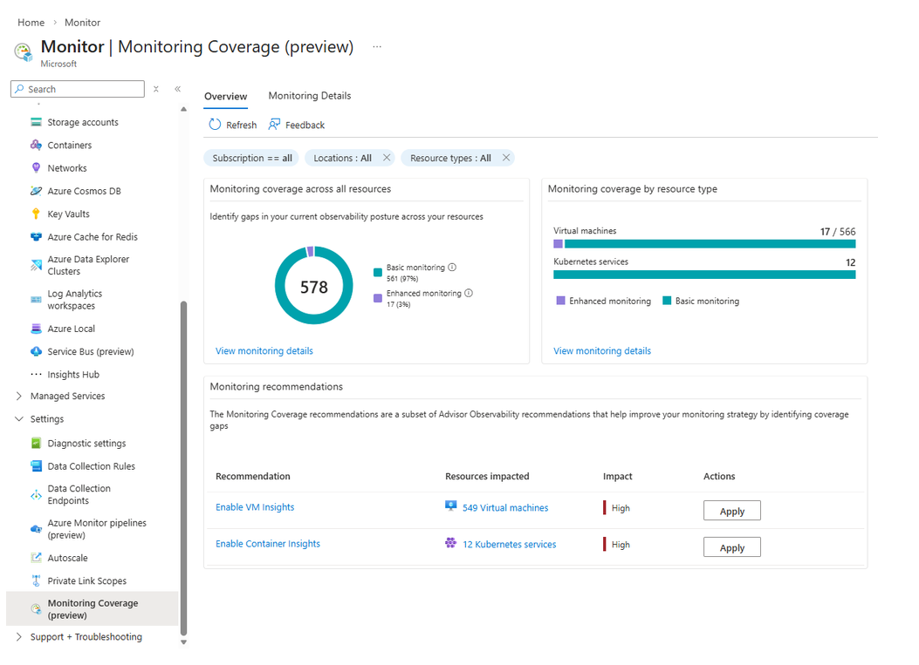
Management & Governance Updates (Azure Monitor) 4/9
Introducing Monitoring Coverage: Assess and Improve Your Monitoring Posture at Scale
Monitoring Coverage (preview) in Azure Monitor introduces a centralized experience to assess and improve monitoring across your Azure environment.
Key capabilities:
Comprehensive visibility: View monitoring coverage for common Azure resource types in one place.
Actionable recommendations: Apply Azure Advisor monitoring recommendations at scale.
Centralized configuration: Enable recommended monitoring settings for multiple resources from a single interface.
Resource-level insights: Drill into individual resources to review active monitoring and relevant recommendations.
During preview, Monitoring Coverage supports Virtual Machines (VMs) and Azure Kubernetes Service (AKS), with more service support coming soon.

Slide 21
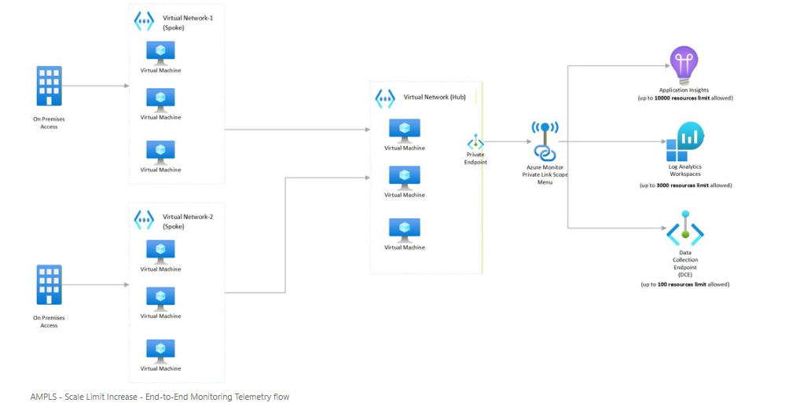
Management & Governance Updates (Azure Monitor) 5/9
Generally Available - Azure Monitor Private Link Scope (AMPLS) Scale Limits Increased by 10x!
10x Scale Increase
  Connect up to 3,000 Log Analytics workspaces per AMPLS (previously 300)
  Connect up to 10,000 Application Insights components per AMPLS (previously 1,000)
20x Resource Connectivity
  Each Azure Monitor resource can now connect to 100 AMPLS resources (previously 5)
Enhanced UX/UI
  Redesigned AMPLS interface supports loading 13,000+ resources with pagination for smooth navigation
Private Endpoint Support
  Each AMPLS object can connect to 10 private endpoints, ensuring secure telemetry flows

Slide 22
Management & Governance Updates (Azure Monitor) 6/9
Public Preview: Dynamic threshold for Log search alerts
Azure Monitor now brings dynamic thresholds to Log Search Alerts, eliminating the need for manual threshold tuning. Dynamic thresholds automatically determine the right alert conditions based on real data patterns.
Key benefits:
ML-powered detection: Uses machine learning to learn historical behavior of log query results.
Seasonality awareness: Identifies hourly, daily, and weekly patterns.
Automatic thresholding: Calculates optimal alert thresholds without manual configuration.
Adaptive updates: Continuously adjusts as data trends change over time.
At-scale monitoring: Computes thresholds independently for each dimension in multi-dimensional alerts.
This enhancement delivers smarter, more accurate, and scalable log-based alerting across complex environments.
Public Preview: Azure Monitor for Azure Arc-enabled Kubernetes with OpenShift and Azure Red Hat OpenShift
Azure Monitor now delivers full monitoring support for Azure Arc-enabled Kubernetes with OpenShift and Azure Red Hat OpenShift, using Container Insights and Managed Prometheus.
This expansion provides end-to-end visibility into cluster health, performance, and workloads—bringing the same rich Kubernetes observability experience to OpenShift environments on Azure and on-premises.

Slide 23
Management & Governance Updates (Azure Monitor) 7/9
Public Preview: Azure Monitor Integration with Fabric Real Time Intelligence Eventhouse
Microsoft has announced a new public preview that integrates Azure Monitor with Fabric Real-Time Intelligence Eventhouse, enabling customers to use observability telemetry for advanced business analytics and operational insights. As demand grows to reuse telemetry data beyond traditional monitoring—such as capacity planning, cost optimization, and service efficiency analysis—this integration makes it easier to correlate Azure Monitor signals with business datasets.
With this capability, organizations can:
Send Windows and Linux VM telemetry from Azure Monitor to Fabric Eventhouse using Data Collection Rules (DCRs)
Perform real-time analytics, visualization, and trend detection across operational and business data
Build richer insights such as mapping utilization telemetry to inventory data or correlating support ticket times with service performance
This integration helps teams enhance data-driven decision-making, improve operational efficiency, and uncover business insights using unified telemetry and analytics pipelines.
Generally Available: Azure Monitor unified onboarding experience for AKS and VMs
Azure Monitor now offers a unified, one-click onboarding experience for both AKS clusters and virtual machines (VMs), automatically deploying the latest monitoring components with optimized defaults.
For AKS:
Integrated onboarding for managed Prometheus metrics, container logs, and Kubernetes events
Newly GA Grafana dashboards
A new application monitoring add-on
Preconfigured AKS-recommended alerts for faster issue detection and troubleshooting
For VMs:
New OpenTelemetry-based system metrics (public preview and free)
Support for Log Analytics performance counters
Recommended VM alerts for comprehensive health monitoring
This unified experience delivers a consistent, streamlined approach to monitoring, enabling organizations to set up Azure Monitor across compute environments in minutes.

Slide 24
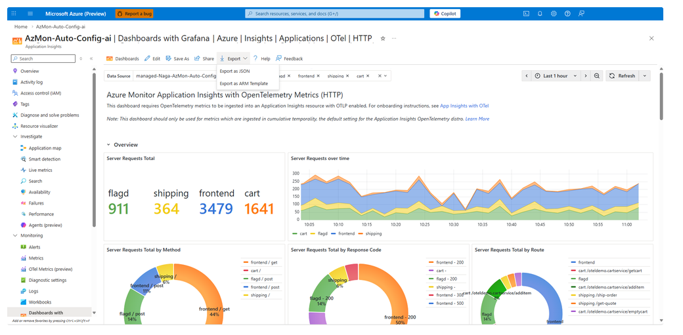
Management & Governance Updates (Azure Monitor) 8/9
Announcing General Availability: Azure Monitor dashboards with Grafana
Microsoft has announced the general availability of Azure Monitor dashboards with Grafana, delivering a seamless, cloud-native monitoring experience fully integrated into the Azure portal. This capability enables users to create and edit Grafana dashboards at no additional cost, without the overhead of self-hosting or operating a managed Grafana service.
Azure Monitor dashboards with Grafana support rich visualizations, client-side data transformations, and direct integration with Azure Monitor metrics, logs, traces, Azure Resource Graph, Prometheus, and Azure Data Explorer. Dozens of pre-built dashboards—for AKS, Application Insights, Cosmos DB, Azure PostgreSQL, OpenTelemetry, and more—are included by default, with the option to import thousands of community dashboards from open-source Grafana.

Slide 25
Management & Governance Updates (Azure Monitor) 9/9
General Availability: Granular RBAC in Azure Monitor Logs
Microsoft has announced the general availability of Granular Role-Based Access Control (RBAC) in Azure Monitor Logs, enabling fine-grained, row-level access control for log data. First introduced in preview in May 2025, the feature is now fully supported for production use.
Granular RBAC extends existing workspace and table-level controls, allowing organizations to:
Enforce least-privilege access at workspace, table, or row level
Keep all data in a single Log Analytics workspace while restricting what each user can view
Use Azure Attribute-Based Access Control (ABAC) to separate data-plane and control-plane permissions
Filter data access based on attributes such as role, region, department, or data sensitivity
Generally Available: Advanced sampling and richer data collection in Azure Monitor OpenTelemetry Distro
Azure continues to advance its support for open standards with new capabilities added to the Azure Monitor OpenTelemetry Distro, which powers Azure Monitor Application Insights.
New capabilities include:
Rate-limited sampling and trace-based log sampling
Performance counters
New telemetry attributes

Slide 26
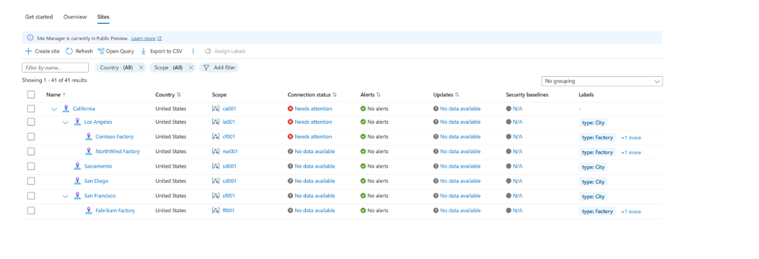
Management & Governance Updates (Azure ARC) 1/3
Workload Identity support for Azure Arc-enabled Kubernetes clusters now Generally Available!
Workload Identity support for Azure Arc-enabled Kubernetes is now generally available, bringing secure, secretless authentication to applications running on Arc-connected clusters outside Azure. Previously, these workloads relied on static credentials or certificates to access services like Azure Key Vault, Event Hubs, or Azure Storage—creating operational overhead and security exposure.
With Microsoft Entra Workload ID federation, Kubernetes workloads can now:
Authenticate to Azure services using OpenID Connect (OIDC) without storing secrets
Exchange trusted tokens for Azure access tokens securely
Eliminate manual secret rotation while reducing attack surface
This GA release delivers stronger security, simplified operations, and improved compliance for hybrid and multicloud Kubernetes environments connected through Azure Arc.
Public Preview Refresh Announcement - Site Manager
Microsoft has announced the Public Preview Refresh of Azure Arc Site Manager, a cloud-native solution that simplifies configuration, governance, and lifecycle management for distributed, hybrid, and edge environments. Designed for organizations running Arc-enabled resources across factories, retail sites, and on-premises datacenters, Site Manager provides a unified view to reduce operational complexity and improve reliability at scale.
Key Capabilities
Flexible site scoping with Service Groups
Hierarchical site organization
Aggregated monitoring and insights
Reusable site configurations

Slide 27
Management & Governance Updates (Azure ARC) 2/3
Public Preview: Multicloud connector support for Google Cloud
Microsoft has announced that the Multicloud connector enabled by Azure Arc now supports Google Cloud Platform (GCP), allowing customers to view and manage cross-cloud workloads from a single Azure experience.
Key Capabilities
Unified multicloud inventory The agentless connector discovers GCP resources—including Compute VMs, GKE clusters, Storage, Functions, and more—and projects them as Azure resources with full metadata, including GCP labels. Customers can now view, query, and tag resources across Azure, AWS, and GCP in one centralized interface.
Automated Azure Arc onboarding Existing and new GCP VMs can be automatically Arc-enabled, allowing organizations to use Azure services such as Azure Monitor and Microsoft Defender for Cloud. The connector installs the Azure Arc agent automatically for eligible machines.
This preview expands Azure Arc’s multicloud reach, giving customers consistent visibility and governance across all major cloud providers.
Announcing General Availability of the Azure Key Vault Secret Store Extension
Microsoft has announced the general availability of the Azure Key Vault Secret Store Extension (SSE) for Arc-enabled on-premises Kubernetes, including both customer-connected clusters and AKS Arc–managed clusters. SSE automatically syncs secrets from Azure Key Vault to on-premises clusters for offline access, enabling secure secret management even in semi-disconnected environments.
Key Benefits
Offline access
Standard Kubernetes usage
Strong security
Scalability
Low maintenance
This GA release brings secure, resilient, and scalable secret management to hybrid and on-premises Kubernetes environments through Azure Arc.

Slide 28
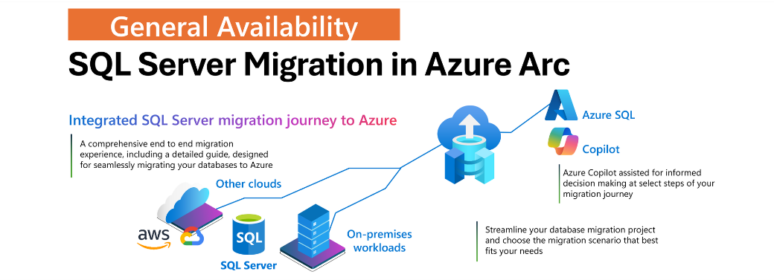
Management & Governance Updates (Azure ARC) 3/3
Generally Available: New SQL Server migration in Azure Arc
A new SQL Server migration in Azure Arc solution streamlines and accelerates journey to Azure SQL Managed Instance. The capabilities in SQL Server migration in Azure Arc include:
Continuous assessment reporting that automatically delivers readiness, cost, and technical insights.
Streamlined provisioning. IT is possible to select or provision Azure SQL targets directly within the portal, eliminating context switching.
Real-time data replication via distributed availability groups (DAGs). Instead of a complex, multiple-step setup, you get a simplified replication process without the need to navigate separate portals.
Read-only replica validation
Client connection summaries that continuously identify which clients connect to each SQL instance, replacing manual tracing.
Copilot assistance and troubleshooting that guides through the migration steps, reducing manual effort and delays.

Slide 29
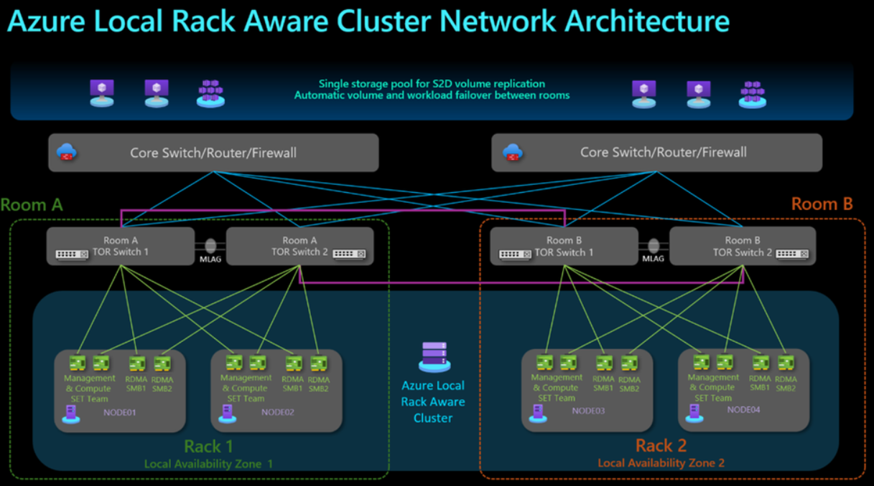
Management & Governance Updates (Azure Local) 1/1
Announcing the preview of Azure Local rack aware cluster
An Azure Local rack-aware cluster is an advanced architecture that improves fault tolerance and data durability within an Azure Local instance. It allows machines to be clustered across two physical racks—typically located in separate rooms or buildings—connected through high-bandwidth, low-latency networking. Each rack effectively acts as a local availability zone, extending from the operating system layer through Azure Local management and Azure Local VMs.
Using top-of-rack (ToR) switches, the architecture supports a single shared storage pool, with data automatically distributed across both racks. If one rack fails, the other continues to maintain full data integrity and service availability. This design is ideal for environments requiring high availability and protection against rack-level failures such as fires, power loss, or localized hardware outages.

Slide 30
Management & Governance Updates (Azure Migration) 1/1
Generally Available: Online migration from Azure Cosmos DB for MongoDB RU to Azure DocumentDB
Microsoft has announced the general availability of seamless, self-serve online migrations from Azure Cosmos DB for MongoDB RU to Azure DocumentDB, fully integrated into the Azure portal. This capability allows organizations to modernize MongoDB workloads with zero downtime, no migration cost, and minimal operational effort.
The migration engine reads natively from Azure Cosmos DB for MongoDB RU and writes directly to Azure DocumentDB, ensuring compatibility and strong performance across a wide range of workloads. Both offline and online migrations are supported. Additional features—such as Microsoft Entra ID integration and partition-level read optimization—are already available to enhance security and efficiency.
Organizations can begin using this capability immediately to accelerate adoption of Azure DocumentDB, gaining access to advanced features, improved performance, and a future-ready database architecture.
Public Preview: Online and offline migrations in Azure DocumentDB Migration extension
Organizations can now migrate MongoDB workloads to Azure DocumentDB using the new Azure DocumentDB Migration extension for Visual Studio Code, available in public preview. This seamless, zero-cost migration experience supports both online and offline modes, helping accelerate modernization efforts.
Migration jobs run entirely on Azure-managed resources maintained by the Azure Cosmos DB team, eliminating the need to deploy or manage migration infrastructure. Users can start and monitor migrations without remaining connected, making the solution well suited for secure, large-scale, or long-running scenarios. The extension also supports private endpoint–enabled targets to meet enterprise security and compliance requirements.
Whether migrating from self-hosted MongoDB, MongoDB Atlas, or other compatible sources, the extension provides a unified and intuitive workflow directly within Visual Studio Code. Organizations benefit from improved performance, reduced operational overhead, and a streamlined path to Azure DocumentDB—all with no additional migration cost.

Slide 31
Compute

Slide 32
Compute Updates (Azure Functions) 1/4
Public Preview: Azure Functions support for Node.js 24
Azure Functions now supports Node.js 24, allowing developers to build functions locally and deploy them to both Windows and Linux plans.
Key notes:
Node.js 24 does not support 32-bit Windows.
New Windows Function Apps using Node.js 24 now default to 64-bit.
Upgrading to Node.js 24 provides improved security, a longer support lifecycle, and full compatibility with the Azure Functions runtime and tools.
This update ensures that Node.js workloads remain modern, secure, and fully supported on Azure Functions.
Public Preview: Azure Functions support for Java 25
Azure Functions now supports Java 25, enabling developers to build functions locally and deploy them to both Windows and Linux environments.
Upgrading to Java 25 delivers stronger security, a longer support lifecycle, and full compatibility with the Azure Functions runtime and development tools—ensuring your Java-based serverless apps stay modern and reliable.

Slide 33
Compute Updates (Azure Functions) 2/4
Announcing: Resources for migrating to Azure Functions Flex Consumption
Azure Functions Flex Consumption is now the recommended hosting plan for serverless workloads that require advanced scaling, enhanced networking, and improved cost optimization. To support customers transitioning from the Azure Functions Consumption plan or from AWS Lambda, Microsoft has released comprehensive migration guides and tooling.
Azure Functions Consumption → Flex Consumption:
The new documentation provides detailed, step-by-step instructions for migrating existing Azure Functions apps. It includes guidance on updating infrastructure-as-code definitions (ARM/Bicep), making necessary configuration changes, and using newly introduced Azure CLI commands to automate portions of the migration.
AWS Lambda → Azure Functions Flex Consumption:
This guide explains how to map AWS Lambda concepts to Azure Functions, outlines code porting strategies, and highlights best practices for deploying to Flex Consumption. It also includes recommendations for using GitHub Copilot in Visual Studio Code to assist with code refactoring, as well as manual migration techniques for more nuanced changes.
These resources are designed to reduce downtime and simplify adoption, helping organizations take full advantage of Flex Consumption’s improved scalability, networking capabilities, and cost controls.
Public Preview: Self-hosted remote MCP servers on Azure Functions
A new capability is now available that enables organizations to host remote Model Context Protocol (MCP) servers—built with the MCP SDKs—on Azure Functions. Hosting MCP servers on the Functions platform offers several key advantages:
Built-in server authentication
Automatic and burst-based scaling
Pay-per-use pricing
Existing MCP servers require no code changes to run on Azure Functions, making adoption seamless.
Currently in public preview, this capability supports remote hosting of MCP servers built with the Python, TypeScript, C#, and Java MCP SDKs on the Flex Consumption plan. Hosted servers must be stateless and use the streamable-http transport.

Slide 34
Compute Updates (Azure Functions) 3/4
Generally Available: Model Context Protocol (MCP) tool trigger for Azure Functions
The Azure Functions MCP tool trigger is now generally available, enabling developers to build remote Model Context Protocol (MCP) tools that operate at cloud scale.
MCP provides a standardized way for applications to expose capabilities and context to large language models, with tools being a key mechanism for enabling agent actions. While MCP servers can run locally, remote servers are required for scalable, enterprise-grade tool hosting.
With this GA release, developers can now implement MCP tools using Azure Functions, benefiting from:
Event-driven execution
Automatic scaling
Fully managed infrastructure
Developers focus solely on the tool’s logic while Azure Functions handles scaling, reliability, and operations—making it easier than ever to build cloud-hosted MCP tools.
Generally Available: Azure Functions enables OpenTelemetry support
Azure Functions now offers general availability support for OpenTelemetry, enabling developers to export logs, traces, and metrics using open, industry-standard formats. Building on the earlier public preview, this release delivers a fully supported, production-grade observability experience for serverless applications.
With this GA release, Azure Functions provides:
Unified observability – Standardized logs, traces, and metrics across serverless workloads.
Vendor-neutral telemetry – Integration with Azure Monitor or any OpenTelemetry-compliant backend.
Broad language support – Available for .NET (isolated), Java, JavaScript, Python, PowerShell, and TypeScript.
Organizations can now adopt OpenTelemetry in Azure Functions to bring modern, standards-based observability to their applications. Documentation is available with step-by-step guidance for enabling OpenTelemetry and configuring exporters for preferred telemetry backends.

Slide 35
Compute Updates (Azure Functions) 4/4
Generally Available: Azure Functions durable task scheduler Dedicated SKU (GA) & Consumption SKU (Public Preview)
Microsoft’s Azure Functions durable task scheduler—designed for complex workflows and intelligent agents—is now generally available on the Dedicated SKU, with the Consumption SKU in public preview.
The scheduler provides resilient orchestration with automatic checkpointing and state management, ensuring fault-tolerant execution for cloud-native and agentic applications.
Dedicated SKU (GA): Predictable pricing for steady, long-running, or mission-critical workflows.
Consumption SKU (Preview): Flexible, pay-as-you-go pricing ideal for dynamic, bursty, or event-driven workloads.
These options give organizations full control over cost and performance when building reliable, large-scale orchestrations on Azure Functions.

Slide 36
Compute Updates (Azure Logical Apps)
Public Preview: Redesigned designer experience for Azure Logic Apps [Standard]
The updated Logic Apps designer introduces a more streamlined and integrated workflow experience by bringing run history and workflow editing into a single unified view, making it easier to iterate, debug, and optimize workflows.
Key enhancements include:
Improved run visualization for faster, clearer troubleshooting
A cleaner design-time interface that removes unnecessary clutter
New Notes feature that lets you add sticky notes directly on the canvas to document logic, share context with teammates, or leave reminders
This redesigned experience is now available as an opt-in preview for Logic Apps (Standard) in the Azure portal, with additional improvements planned for future updates.
Public Preview: New healthcare connectors for Azure Logic Apps
Two new connectors are now in public preview for Azure Logic Apps:
HL7 connector: Supports seamless healthcare data exchange using HL7 messaging standards and helps modernize BizTalk-based integrations.
MLLP connector: Adds Minimal Lower Layer Protocol support for connecting to healthcare systems and enables BizTalk migration scenarios, available in the Logic Apps Hybrid deployment model.
These additions further strengthen Logic Apps as a platform for enterprise-grade, event-driven, and healthcare-integrated workflows—bridging cloud, on-premises, and industry-specific systems with ease.

Slide 37
Compute Updates (Azure Logical Apps) 1/2
Generally Available: Automated Testing Framework for Logic Apps
MS announced the general availability of automated testing for Azure Logic Apps (Standard) in the Visual Studio Code extension. This new capability empowers developers and integration specialists to build more reliable workflows by simplifying the unit testing experience directly within their local development environment.
Starting with version 5.58.8 of the Azure Logic Apps (Standard) extension for Visual Studio Code, you can now:
Generate unit tests from existing workflow runs or saved workflow definitions.
Edit and customize tests directly within Visual Studio Code.
Execute tests locally, enabling faster validation and iteration before deploying to production.
The enhanced testing experience combines a visual designer interface and an SDK for test script implementation, both powered by the same Test Runner engine to ensure consistency and accuracy of results regardless of the testing approach used.
Generally Available: Agent Loop in Azure Logic Apps [Standard] & Azure Logic App [Consumptions]
Agent Loop brings agentic intelligence to Azure Logic Apps, enabling workflows that go beyond predefined automation and instead operate as goal-driven, adaptive processes. Rather than executing a fixed sequence of actions, Logic Apps can now reason, decide, and iterate autonomously based on real-time context.
What Agent Loop enables:
Goal-driven workflows: Automatically refine actions and repeat reasoning cycles until an objective is achieved.
Deep enterprise integration: Leverage 1,400+ connectors to give agents real-time access to business systems and data.
Seamless AI integration: Connect directly with Azure AI Foundry and choose from a wide range of models and AI services.
Full traceability: Maintain auditability of reasoning loops for compliance, transparency, and troubleshooting.
Agent Loop represents a major advancement in enterprise integration—transforming Logic Apps into a platform for intelligent, adaptive, agentic business processes.

Slide 38
Compute Updates (Azure Logical Apps) 2/2
Private Preview: ActiveMQ and JMS connector for Azure Logic Apps
Microsoft has introduced the private preview of the ActiveMQ/JMS connector for Azure Logic Apps. This new capability enables Logic Apps to connect to enterprise messaging systems built on ActiveMQ and JMS, unlocking more advanced hybrid integration scenarios across distributed applications and services.
Generally Available: New Hybrid Integration Connectors for Azure Logic Apps
The following connectors are now generally available:
Confluent Kafka connector: Connect Logic Apps to Confluent Cloud for event streaming and real-time data processing.
XML – Parse and Compose operations: Easily handle complex XML operations, bridging modern workflows with legacy systems and enabling BizTalk migrations.
Inline Code operations (C#, PowerShell, JavaScript): Execute inline code for advanced logic, data manipulation, and integration flexibility.
RabbitMQ connector: Integrate with RabbitMQ for reliable message queuing across distributed systems. Ideal for on-premises scenarios.
These enhancements strengthen Azure Logic Apps as the foundation for enterprise-grade, event-driven workflows, bridging on-premises, cloud, and industry-specific systems with ease.

Slide 39
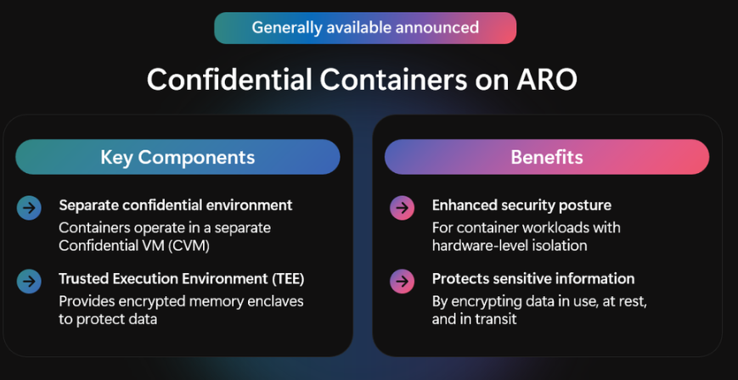
Compute Updates (Azure Red Hat OpenShift) 1/1
Azure Red Hat OpenShift Confidential Containers: General Availability Announced
This new capability brings Azure Confidential Computing protections to Red Hat OpenShift, enabling data-in-use encryption and workload attestation for sensitive applications. Organizations can now secure data even while it is being processed and verify workload integrity in a zero-trust environment—extending confidential computing benefits to OpenShift-based deployments.
Generally Available: OpenShift Virtualization now available on Azure Red Hat OpenShift
Red Hat OpenShift Virtualization is now generally available on Azure Red Hat OpenShift (ARO), enabling organizations to run and manage virtual machines and containers on a single cloud-native platform. Building on customer feedback from the preview, this GA release helps enterprises modernize at their own pace while maintaining support for mission-critical workloads.
Key enhancements include:
Migration Toolkit for Virtualization (MTV) support for streamlined VM migration
Integration with Ansible Automation Platform for consistent automation
Licensing benefits, including built-in RHEL entitlements and Windows Server licensing via Azure Hybrid Benefit
With these capabilities, customers can migrate legacy applications to Azure with minimal disruption, take advantage of Azure’s security and hybrid features, and manage both VMs and containers directly from the OpenShift console. Unifying workloads on ARO enables faster delivery, DevOps consistency, and reduced operational overhead.

Slide 40
Compute Updates (Azure Container Apps) 1/4
Public Preview: Azure Container Apps adds support for agentic Docker Compose
Azure Container Apps now offers native support for Docker Compose, bringing one of the most familiar developer workflows directly into the platform. Developers can define and run multi-container applications using the same Compose files they use locally—then deploy them to Azure Container Apps without changing tools or workflows.
This integration makes it easy to move from local development to cloud deployment, providing a consistent, developer-first experience. When combined with serverless GPU support, Docker Compose becomes a powerful way to build and run AI-powered agents and applications, enabling rapid iteration and scalable execution.
This update unifies the inner-loop and outer-loop experience, giving teams a seamless path from development to production for modern, agentic AI workloads.
Public Preview: Confidential computing in Azure Container Apps
Azure Container Apps now supports hardware-based Trusted Execution Environments (TEEs), bringing confidential computing to containerized workloads. While Azure already encrypts data at rest and in transit, confidential computing adds protection for data in use by encrypting memory and running workloads only after the environment is cryptographically verified.
This prevents unauthorized access — even from cloud operators — and is ideal for organizations handling highly sensitive data or regulated applications.
Confidential computing is enabled through new workload profiles in Azure Container Apps. The public preview is available in select regions.

Slide 41
Compute Updates (Azure Container Apps) 2/4
Public Preview: Dynamic sessions shell environment and MCP support in Azure Container Apps
Azure Container Apps now supports dynamic shell sessions in public preview. These sessions provide a secure, disposable, platform-managed container for running shell commands without deploying your own infrastructure.
With support for empty shell sessions and an integrated MCP server, agents can spin up isolated sandboxes on demand for tasks like code execution, tool testing, and workflow automation. This improves security, enables rapid provisioning, and reduces operational overhead for agentic workloads.
Public Preview: Deployment labels in Azure Container Apps
Azure Container Apps now supports deployment labels in public preview, introducing a more flexible deployment model for managing container revisions. Labels—such as dev, staging, or prod—can be assigned to revisions, enabling clearer organization and more advanced deployment practices.
Key benefits include:
Simplified environment management by grouping revisions under meaningful labels.
Smarter traffic routing for A/B tests, staged rollouts, and blue-green deployments.
Fast promotion and rollback using label history for smooth transitions and minimal downtime.
This feature enhances lifecycle control and reduces complexity across multi-environment and multi-revision workflows.

Slide 42
Compute Updates (Azure Container Apps) 3/4
Generally Available: Rule-based routing in Azure Container Apps
Azure Container Apps now provides general availability of rule-based routing, offering greater flexibility and simpler architectures for microservice applications. This capability enables HTTP traffic to be routed to specific apps within a Container Apps environment based on hostnames or request paths, with full support for custom domains.
By defining routing rules directly in the environment, organizations can:
Streamline A/B testing, blue-green deployments, and multi-service routing.
Remove the need for external reverse proxies like NGINX.
Ensure traffic is automatically routed to the correct application based on configured rules.
This enhancement significantly simplifies traffic management and improves microservice composability.
Generally Available: Premium Ingress in Azure Container Apps
Azure Container Apps now introduces environment-level ingress configuration, with the key enhancement being customizable ingress scaling. This allows the ingress proxy to scale out on workload profiles, enabling applications to handle significantly higher traffic volumes—ideal for scenarios like large-scale performance testing. Running ingress on a workload profile incurs normal compute costs.
Additional ingress settings further improve flexibility and control, including:
Termination grace period
Idle request timeout
Header count limits
These enhancements give organizations deeper control over traffic handling and provide improved reliability under heavy load.

Slide 43
Compute Updates (Azure Container Apps) 4/4
Generally Available: Azure Container Apps serverless GPUs in additional regions
To meet growing demand for GPU-powered workloads, Azure Container Apps serverless GPUs are now generally available in additional regions. This expansion enables developers to run AI inference, model training, and GPU-accelerated applications using the simplicity and efficiency of a serverless model.
Newly available regions:
Americas: East US, West US 2, South Central US, North Central US, Brazil South
Asia: Japan East, Southeast Asia, Central India, South India
Europe: France Central, Italy North
Key benefits of serverless GPUs:
Scale-to-zero GPUs: Automatic serverless scaling for NVIDIA A100 and NVIDIA T4 GPUs
Per-second billing: Pay only for the GPU compute consumed
Built-in data governance: All data remains within the container boundary
This regional expansion provides broader access to cost-efficient, flexible GPU infrastructure for AI-driven and compute-intensive workloads.
Public Preview: Azure Container Apps introduces flexible workload profile
The Flexible workload profile is a new option that combines the simplicity of serverless consumption with the performance and control of dedicated workload profiles. It maintains the same pay-per-use model as the Consumption plan, while adding key capabilities such as:
Planned maintenance windows
Dedicated networking support
Larger replica sizes for resource-intensive workloads
Running on a single-tenant compute pool, it offers improved predictability, isolation, and stability—without adding operational overhead. This profile is ideal for customers who want serverless convenience with enhanced control over performance and environment behavior.

Slide 44
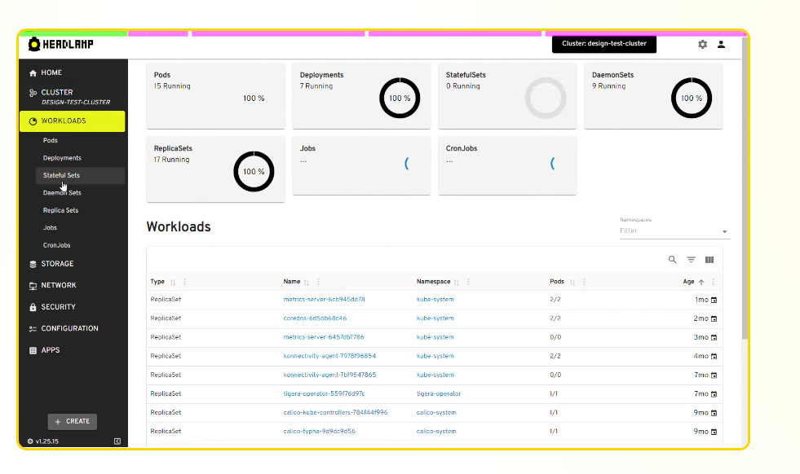
Compute Updates (K8S Updates) 1/7
Public Preview: Azure Kubernetes Service desktop
AKS desktop delivers a modern, application-centric experience for deploying and managing workloads on Azure Kubernetes Service. Built on supported AKS features, best practices, and the open-source Headlamp project, it offers a guided, self-service interface that simplifies Kubernetes operations while preserving control.
Designed to integrate with existing environments and tools, AKS desktop enables seamless team collaboration through role-based access control (RBAC), helping teams move faster and stay aligned.
Public Preview: AKS Automatic managed system node pools
Managed system node pools in AKS Automatic remove the need to provision, scale, patch, or maintain system nodes. Instead of managing system infrastructure manually, AKS Automatic fully handles the underlying compute for system workloads with no customer intervention.
By isolating system components from application workloads, AKS Automatic delivers higher reliability, predictable performance, and SLA-backed stability. This reduces operational burden, accelerates Kubernetes adoption, and lets teams focus entirely on deploying and scaling their applications.

Slide 45
Compute Updates (K8S Updates) 2/7
Public Preview: Container network metrics filtering in Advanced Container Networking Services for (ACNS) for AKS
Container network metrics filtering in Azure Container Networking Services (ACNS) is now available in public preview.
In containerized environments, ingesting large volumes of network metrics can increase storage costs and clutter observability dashboards, making it harder to maintain operational clarity. The new ACNS capability addresses this by allowing users to define fine-grained filters at the Cilium level using a Custom Resource Definition (CRD). Metrics collection can now be scoped by namespace or pod, ensuring only the metrics that matter are captured.
By filtering metrics before they reach Prometheus, organizations can significantly reduce data volume, lower operational overhead, and improve the signal-to-noise ratio in their observability tools.
Announcing Kubernetes Center (Preview) On Azure Portal
Microsoft has introduced the Kubernetes Center in the Azure portal, a new unified experience designed to simplify management, monitoring, and optimization of Azure Kubernetes Service (AKS) environments at scale. As Kubernetes adoption grows, the Kubernetes Center provides a single pane of glass that helps platform teams stay in control while enabling developers to move quickly.
Key capabilities include:
Actionable insights: A unified view surfaces security vulnerabilities, alerts, compliance gaps, and upgrade recommendations so teams can focus on the most important issues first.
Streamlined management: AKS, AKS Automatic, Fleet Manager, and Managed Namespaces are now brought together in one consistent interface—reducing the need to switch between services.
Centralized Quickstarts: Documentation, learning resources, and in-context guidance are consolidated to accelerate onboarding and troubleshooting.
Kubernetes Center delivers clearer visibility, faster operations, and a more intuitive management experience for Kubernetes on Azure.

Slide 46
Compute Updates (K8S Updates) 3/7
Public Preview: Windows Server 2025 on AKS
Organizations running Windows-based workloads on Azure Kubernetes Service (AKS) are facing increasing pressure to modernize as end-of-support timelines for older Windows Server versions approach. To support this transition, AKS now offers preview support for Windows Server 2025, bringing notable enhancements compared to Windows Server 2022.
Windows Server 2025 delivers several key improvements:
Stable ABI, enabling Windows Server 2022 containers to run on Windows Server 2025
Updated defaults, including Generation 2 VMs, containerd 2.0, and FIPS enablement
Enhanced Nano Server flexibility, including new functionality such as 32-bit application support via a Feature on Demand (FoD)
Improved GPU support, enabling CUDA-based workloads to run inside containers
With upcoming retirement dates—Windows Server 2019 on March 1, 2026, and Windows Server 2022 on March 15, 2027—organizations are encouraged to begin testing and evaluating Windows Server 2025. Migration requires recreating node pools using the new OS and shifting existing workloads accordingly.
Public Preview: Azure Kubernetes Fleet Manager for Arc-enabled clusters
Azure is simplifying hybrid and multi-cloud Kubernetes operations with new support for Azure Arc–enabled Kubernetes in Azure Kubernetes Fleet Manager. Any CNCF-compliant cluster—on-premises, in other clouds, or at the edge—can now be Arc-enabled and managed as a Fleet member.
This integration provides centralized visibility into cluster health and performance, along with intelligent workload placement to deploy applications and configurations consistently across environments.
The result: reduced operational overhead, faster and more reliable deployments, and stronger governance across distributed Kubernetes infrastructure.

Slide 47
Compute Updates (K8S Updates) 4/7
Generally Available: Pod sandboxing on AKS
AKS now supports pod sandboxing, enabling containers to run inside per-workload pod VMs for strong, hardware-backed isolation. Each pod VM is fully isolated from other pods and from the host OS, ensuring a robust security boundary for containerized workloads.
Built on the Kata Containers open-source project and running on the Azure Linux container host, pod sandboxing provides a dedicated kernel and isolated compute resources for every sandboxed pod. No resources are shared with other Kata or namespace-based containers on the same node.
This capability significantly strengthens workload security, reduces cross-pod and host-level risk, and is ideal for multi-tenant, regulated, or high-sensitivity applications.
Generally Available: Cluster-wide Cilium network policy with Azure CNI powered by Cilium for AKS
Cluster-wide Cilium network policy for AKS clusters using Azure CNI powered by Cilium is now generally available.
Managing consistent network policies across Kubernetes namespaces has historically been challenging, particularly in multi-tenant environments. With this general availability release, organizations can define and enforce network policies at the cluster level, ensuring consistent governance across all namespaces.
This capability simplifies policy administration and strengthens tenant isolation by leveraging Cilium’s high-performance eBPF dataplane, providing a more scalable and secure approach to Kubernetes network policy management.

Slide 48
Compute Updates (K8S Updates) 5/7
Generally Available: AKS Automatic pod readiness SLA
AKS Automatic clusters now provide a pod readiness SLA, guaranteeing that eligible pods become ready within five minutes at the 99.9th percentile. This ensures faster, more predictable startup times for mission-critical workloads and delivers increased reliability backed by a formal, financially backed service-level commitment.
Generally Available: Layer 7 policy with Advanced Container Networking Services (ACNS) for AKS
Layer 7 Policy is now generally available in Azure Container Networking Services, enabling fine-grained, application-layer traffic control for protocols such as HTTP, HTTPS, gRPC, and Kafka. This capability enhances microservice isolation, strengthens zero-trust security, and provides deeper traffic visibility—all with high performance and simplified policy management.

Slide 49
Compute Updates (K8S Updates) 6/7
Generally Available: Local redirect policy in Azure CNI powered by Cilium for AKS
Local redirect policy with Azure CNI powered by Cilium for AKS is now generally available.
High-scale AKS workloads often encounter latency and performance bottlenecks when traffic is routed across nodes. The local redirect policy solves this by enabling node-local service routing, ensuring that traffic is directed to pods residing on the same node whenever possible. This approach lowers latency, increases throughput, and improves overall reliability—benefits that are especially important for AI training workloads and microservice-based applications.
Generally Available: MCP support for AI toolchain operator add-on in AKS
The AI Toolchain Operator add-on now includes support for KAITO inference workspaces with integrated tool calling and Model Context Protocol (MCP), addressing longstanding challenges related to dynamic model interaction and real-time data integration.
Previously, deploying LLM-based services that required access to external tools—such as APIs or custom functions—often demanded custom orchestration and complex integrations. With this release, KAITO’s vLLM-based tool calling works seamlessly with supported models, while MCP enables models to connect to external systems in real time.
Together, these capabilities allow organizations to deliver smarter, more context-aware AI services directly within AKS, with significantly reduced friction and operational overhead.

Slide 50
Compute Updates (K8S Updates) 7/7
Generally Available: Managed namespaces on AKS
Managing namespace configurations across AKS clusters has traditionally required manual setup and ongoing maintenance, increasing complexity and the risk of misconfiguration. With the general availability of Managed Namespaces, AKS now enables users to deploy preconfigured namespaces with built-in lifecycle management.
This feature streamlines the application of consistent controls across clusters, including ingress and egress network policies, RBAC, and resource limits and requests. By shifting namespace lifecycle management to Azure, organizations can accelerate deployments, strengthen governance, and reduce operational overhead.
Windows Server 2019 Retirement on AKS enabled by Azure Arc
Microsoft has confirmed the retirement of Windows Server 2019 support on Azure Kubernetes Service (AKS) enabled by Azure Arc for all releases after April 1, 2026. To remain supported and continue receiving security updates and Kubernetes version upgrades, organizations must migrate Windows Server 2019 workloads to Windows Server 2022.
Migration Requirements
Windows node pools cannot be upgraded in place. The migration process involves:
Creating new Windows Server 2022 node pools
Rebuilding container images using WS2022 base images
Migrating workloads to the new pools
Retiring the old Windows Server 2019 node pools
Microsoft recommends allocating 2–4 weeks for testing and completing production migrations by March 2026 to ensure continuity and compliance.

Slide 51
Compute Updates (Azure App Service) 1/2
Generally Available: Custom error pages on Azure App Service
Custom error pages are now generally available in Azure App Service. This feature allows you to replace default system-generated error screens with your own branded or user-friendly pages.
You can customize responses for the following HTTP status codes:
403 – Forbidden
502 – Bad Gateway
503 – Service Unavailable
This enhancement improves user experience, supports branding consistency, and provides clearer guidance during service disruptions.
Introducing Preview of Async Scaling for App Service Plans
Azure App Service has introduced a new preview capability that allows App Service Plans to be created and scaled asynchronously. Customers can now specify the final desired number of instances, and the platform will automatically provision and retry until that target is reached—eliminating the need for repeated manual scaling operations.
Current behavior: When creating a new App Service Plan, a request for (e.g.) 15 instances may fail if only 6 are immediately available. Customers must then scale out in small increments as capacity becomes available.
New preview functionality: Customers can request all 15 instances up front. The platform will provision what is currently available (e.g., 6 instances) and automatically continue adding instances until the plan reaches the requested total—no additional user actions required.
This delivers a more consistent, streamlined experience for scaling App Service Plans.

Slide 52
Compute Updates (Azure App Service) 2/2
Public Preview: Managed Instance on Azure App Service
Microsoft has announced the public preview of Managed Instance on Azure App Service, a new capability that enables organizations to move web applications to the cloud with minimal configuration and no code rewrites. Whether applications currently run on-premises or in virtual machines, Managed Instance provides a fully managed PaaS environment that helps future-proof infrastructure and unlock cloud scalability, security, and AI-driven benefits.
Key benefits include:
Full Azure App Service experience with turnkey scaling, resiliency, and integrated platform services
Greater control through Bastion-enabled RDP access, custom configurations, and flexible identity management
Compatibility for complex workloads—including classic .NET Framework apps—without requiring code changes
As part of a broader migration and modernization strategy, Managed Instance on Azure App Service simplifies cloud adoption, reduces costs, and accelerates the path toward modern, cloud-optimized applications.

Slide 53
Compute Updates (Azure Boost) 1/1
Private Preview: Azure Boost confidential device
The Azure Boost confidential device feature is now in preview.
Azure Boost is a Microsoft Azure technology that offloads virtualization functions—such as networking, storage, and host management—from the hypervisor and host operating system to specialized hardware and software. This approach increases CPU availability for customer workloads while strengthening security through physical isolation and a hardware root of trust. By reducing maintenance overhead and improving scalability, Azure Boost delivers faster, more secure, and more efficient cloud operations for demanding workloads.
The new confidential device capability is designed for upcoming generations of Azure confidential VMs. It extends the confidential computing trust boundary of these VMs into the Azure Boost card using the PCIe TDISP standard, which enables hardware-based attestation of the Boost card and hardware-encrypted PCIe data paths. This eliminates the need for a software “bounce buffer” when sensitive data moves beyond the VM’s trust boundary.
The result is faster data movement, lower CPU overhead, and improved confidential VM performance—achieved without compromising the security guarantees of confidential computing.
Private Preview: Azure Boost remote storage throughput and network bandwidth enhancements
Remote storage throughput and network bandwidth enhancements for the latest Azure Boost architecture are now in preview.
Azure Boost is a Microsoft Azure technology that offloads key virtualization tasks—such as networking, storage, and host management—from the hypervisor and host OS to specialized hardware and software. This design frees CPU resources for customer workloads and strengthens security through physical isolation and a hardware root of trust. By reducing maintenance impact and improving scalability, Azure Boost delivers faster, more secure, and highly efficient cloud operations for demanding workloads.
The latest architectural upgrades introduce:
Up to 20 GBps remote storage throughput
Up to 1 million remote storage IOPS
Up to 400 Gbps network bandwidth
These performance improvements will debut with the D/E/Fsv7 Intel “Granite Rapids” VMs (now in preview). Additional new VM series adopting this architecture will offer similar high-performance capabilities.

Slide 54
Compute Updates 1/6
Generally Available: Azure Sphere OS version 25.10 is now available
Azure Sphere OS version 25.10 is now available in the Retail feed. This release includes updates to Azure Sphere OS only; it does not include an updated SDK. If your devices are connected to the internet, they will receive the updated OS from the cloud
Generally Available: Trusted Launch is now supported for Arm64 Marketplace Images
Arm64 VMs bring cost savings, energy efficiency, and high performance to cloud workloads.
Trusted Launch VMs provide foundational compute security to Azure VMs by enabling Secure Boot and vTPM capabilities. Trusted Launch protects OS against rootkits, boot kits and enables attestation by measuring the boot chain of VM.
The Cobalt 100 based Arm64 VMs (Dpsv6/Dplsv6/Epsv6) support the Trusted Launch security type, and users can improve the security of their Cobalt 100 VMs by deploying with Trusted Launch images from the marketplace. Supported images include Ubuntu 24.04, Debian 13, Rocky 9, Azure Linux 3, RedHat Enterprise Linux 10, and more.

Slide 55
Compute Updates 2/6
Generally Available: Scheduled Actions
Scheduled Actions provides the ability to manage the lifecycle of Azure Virtual Machines at large scale on a recurring schedule. It automatically handles subscription throttling and transient-error retries, ensuring that scheduled operations complete successfully without additional operational burden.
Scheduled Actions is a dedicated resource provider—compute.schedule—that runs above the Azure Compute REST API. It performs VM operations on behalf of a subscription at the exact times specified by the user.
Supported VM operations include:
Stop
Start
Hibernate
Introducing Metadata Security Protocol (MSP): Elevating Platform Security for Azure VMs
Metadata Security Protocol (MSP), an industry-first innovation designed to mitigate vulnerabilities at the platform layer. Azure becomes the first major cloud provider to integrate strong authentication and authorization (AuthN and AuthZ) for metadata service endpoints inside virtual machines. MSP introduces a default-closed security model for the Instance Metadata Service (IMDS) and WireServer, ensuring only trusted processes can access sensitive data over it, eliminating a subset of attack classes, reducing another subset of attack surfaces and aligning with zero-trust security principles.
Authentication for IMDS calls
Improved isolation
Default-Closed Model
Guest Proxy Agent (GPA)
Fine-grained access control

Slide 56
Compute Updates 3/6
Azure ND GB300 v6 now Generally Available - Hyper-optimized for Generative and Agentic AI workloads
Microsoft has announced the general availability of ND GB300 v6 virtual machines, delivering the next major leap in Azure’s AI infrastructure. Powered by NVIDIA GB300 NVL72 systems, these VMs are designed for frontier model training, large-scale inference, multimodal reasoning, and agentic AI. Azure has already deployed tens of thousands of GB300 GPUs for production workloads, with scale expected to reach hundreds of thousands.
ND GB300 v6 enables organizations to:
Train trillion-parameter models with exceptional throughput
Accelerate long-context and multimodal inference
Scale efficiently for massive distributed training
Benchmarks show 1.1M tokens/sec on Llama-2 70B—27% faster than ND GB200 v6.
Each rack-scale system includes 72 Blackwell Ultra GPUs, 36 Grace CPUs, 130 TB/s NVLINK bandwidth, 800 Gbps InfiniBand, and up to 1,440 PFLOPS FP4 performance, enabling unified compute and memory with minimal latency.
Azure complements this hardware with a full AI platform—including Azure CycleCloud, Azure Batch, and AKS—allowing customers to build, deploy, and scale AI workloads efficiently at massive scale.
Announcing Cobalt 200: Azure’s next cloud-native CPU
Microsoft has announced Azure Cobalt 200, its next-generation Arm-based CPU designed for cloud-native workloads, delivering up to 50% more performance than Cobalt 100 and full compatibility with existing workloads. Cobalt 200 servers are already running in production, with broader customer availability planned for 2026.
Cobalt 200 is built on Arm’s Neoverse CSS V3 and features 132 cores, per-core DVFS, TSMC 3nm technology, built-in memory encryption, Arm CCA support, and custom accelerators for compression, encryption, and decompression—offloading common operations and reducing CPU cost for workloads like Azure SQL.
The design was informed by more than 140 real-world benchmark variants and 350,000 simulated system configurations, ensuring the CPU is optimized for actual Azure customer workloads. Cobalt 200 also integrates Azure Boost for improved networking and remote storage performance and includes Azure’s integrated HSM for FIPS 140-3 Level 3–compliant key protection.
With Cobalt 200, Microsoft continues advancing cloud infrastructure from silicon to software, delivering higher performance, better efficiency, and stronger security for next-generation AI and cloud applications.

Slide 57
Compute Updates 4/6
Announcing preview of new Azure Dlsv7, Dsv7, and Esv7 VMs based on Intel® Xeon® 6 processors
Microsoft has announced the preview of the Dlsv7/Dsv7 General Purpose and Esv7 Memory Optimized Azure VMs, powered by the latest Intel® Xeon® 6 (Granite Rapids) processors. These new VM series offer three memory-to-vCPU ratios and options with or without local NVMe temp disks.
Compared to the previous v6 generation, the new v7 VMs deliver:
Up to 15% better compute performance with turbo frequencies up to 4.2 GHz
Up to 2× higher memory bandwidth
Larger VM sizes: up to 372 vCPUs and 2.8 TiB RAM (Esv7)
Higher I/O capabilities: up to 400 Gbps networking, 800K IOPS, and 20 GBps remote storage throughput via Azure Boost
The families support three memory ratios—2:1, 4:1, and 8:1—across Dlsv7/Dldsv7, Dsv7/Ddsv7, and Esv7/Edsv7 VMs.
Dlsv7 and Dsv7: ideal for general-purpose workloads such as e-commerce, web apps, VDI, and application servers.
Esv7: optimized for memory-intensive workloads including SQL/NoSQL databases, data warehousing, BI, SAP, Redis, and in-memory analytics
Announcing new hybrid deployment options for Azure Virtual Desktop
Microsoft has announced the limited preview of Azure Virtual Desktop (AVD) for hybrid environments, enabling organizations to run AVD session hosts on on-premises Arc-Enabled Servers. This expands AVD beyond Azure Local to support Microsoft Hyper-V, Nutanix AHV, VMware vSphere, physical Windows Servers, and any on-premises infrastructure managed through Azure Arc.
This capability brings cloud-native desktop virtualization to environments that must remain on-premises for performance, data residency, or compliance reasons, while also providing a smoother path to cloud migration. Session host VMs run in customer datacenters but connect directly to the AVD service in the Microsoft Cloud, delivering unified identity, policy, and management.
Azure Virtual Desktop for Azure Local remains available for customers needing a fully Microsoft-managed edge solution, while the new hybrid option allows organizations to leverage existing hardware and preferred hypervisors with flexibility to use partner tooling for VM provisioning and management.

Slide 58
Compute Updates 5/6
Public Preview: NCv6 Virtual Machines
MS announced a public preview of NCv6 RTX PRO 6000 Blackwell Server Edition Virtual Machines, as the next enhancement of NC Series VMs available on Azure.
The NCv6 VM family will be available in three categories to best suit workload needs:
Compute optimized - NClds_RTXPRO6000BSE_v6 - designed for AI and LLM inferencing workloads
Memory optimized - NCmds_RTXPRO6000BSE_v6 - tailored for visualization and graphics workloads
General purpose - NCds_RTXPRO6000BSE_v6 - category ideal for VDI and general-purpose AI workloads.
For workloads running NCv6, customer experience will be the same as other NC and NV Series VMs such as T4, A100, and H100, with all currently supported workloads from those SKUs also supported on NCv6. Additionally, NCv6 VM SKUs will come with integrated NVIDIA vGPU licenses and support Multi Instance GPU (MIG), enabling greater flexibility and efficiency for a variety of use cases.
Public Preview: Industry-leading storage performance Ebsv6 VM series
The Ebsv6 and Ebdsv6 VMs deliver up to and industry leading 800,000 IOPS and 14 GBps of remote disk storage throughput, providing high-performance remote storage bandwidth for demanding workloads. This new generation provides up to 2x higher remote storage performance compared to the previous generation, enabling workload consolidation on fewer VMs.
Key new features and improved VM specs compared to Ebsv5/Ebdsv5
Up to 192 vCPU and 1832 GiB memory
15-30% improvement in CPU performance
40% larger local SSD capacity with 3X read IOPS
Azure Boost which enables up to:
  800K IOPS and 14GB/s remote storage throughput with Premium v2 and Ultra Disk support
  15% higher remote storage performance per vCPU with up to 6600 IOPS/vCPU
  10% higher remote storage throughput per vCPU
  Up to 200 Gbps VM network bandwidth
  Enhanced security through Total Memory Encryption (TME) technology

Slide 59
Compute Updates 6/6
Public Preview: Built-in CIS benchmarks for Azure endorsed Linux distros in Machine Config
Microsoft Azure now offers built-in Center for Internet Security (CIS) benchmarks in public preview for all Azure endorsed Linux distributions through Azure Machine Configuration’s new customizable security benchmarks capability, powered by azure-osconfig’s compliance engine.
This capability allows organizations to easily customize and apply industry-standard security benchmarks which are in parity with the content published on CIS website.
It supports both Level 1(L1) and Level 2(L2) server profiles, enables exception and parameter customization, operates in audit-only mode at no additional cost, and extends compliance management to hybrid scenarios via Azure Arc.
Using this new capability, it is possible to introduce a flexible, compliance as code driven approach to organization to maintain security and compliance across your hybrid infrastructure. The solution is officially certified by CIS for CIS benchmark assessment for all the supported benchmarks.
Retirement: Migrate to dedicated VM for your compute clusters
On September 30, 2025, Low-Priority VM will reach end of life. However, ms will continue to be supported on Azure Machine Learning until March 31, 2026.
To ensure that your clusters are not automatically scaled down it is recommended to migrate to dedicated VMs before that date.
After March 31, 2026, you'll not be able to use your clusters with low-priority VM.

Slide 60
Storage & Data

Slide 61
Storage & Data Updates (Azure NetApp Files) 1/4
Public Preview: Large volumes up to 7.2 PiB
The Large Volumes up to 7.2 PiB with Cool Access feature allows to create Azure NetApp Files volumes up to 7.2 PiB on dedicated capacity, designed for workloads where most data are rarely accessed. This enhancement extends cool-access support beyond the previous 2 PiB limit, giving customers a new scale option for large deployments. By combining petabyte-scale capacity, cool-tier economics, and enterprise-grade performance, organizations can store massive datasets cost-effectively without compromising efficiency.
This capability helps reduce storage costs for infrequently accessed data while maintaining predictable performance for active workloads. It’s ideal for industries managing large archives, backups, and compliance-driven datasets where 80–90% of data can reside in the cool tier. Use cases include archives, media libraries, healthcare imaging, compliance data lakes, AI/ML datasets, EDA projects, and large file shares—delivering multi-petabyte consolidation, transparent tiering, and lower TCO without sacrificing enterprise-grade performance.
Public preview: Support for large volume breakthrough mode
Breakthrough mode in Azure NetApp Files enables extreme performance and scalability for demanding HPC and EDA workloads. It supports large volumes up to 2PiB, delivering throughput up to 50GiBps, depending on workload characteristics. Breakthrough mode uses six storage endpoints for each large volume ensuring consistent performance. Storage systems hosting breakthrough mode volumes are reserved for each customer to provide peak performance and not compete with other workloads.
Key benefits include:
High-capacity scaling for large-scale, latency-sensitive workloads
Simplified network management with multiple storage endpoints per volume
Dedicated capacity stamps to eliminate noisy neighbor interference and maintain predictable performance

Slide 62
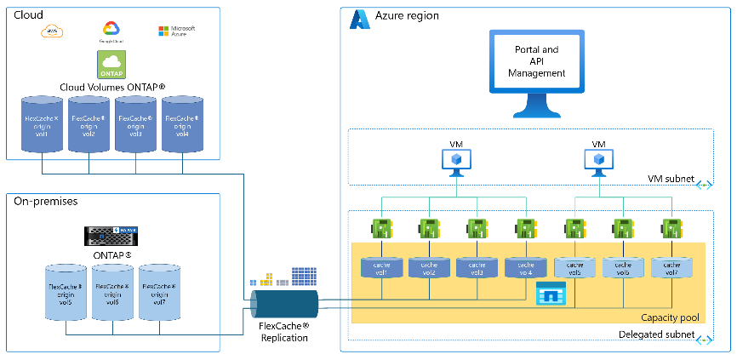
Storage & Data Updates (Azure NetApp Files) 2/4
Public Preview: Azure NetApp Files cache volumes
Azure NetApp Files cache volumes enable to create a cloud-based cache of external NetApp ONTAP and Cloud Volumes ONTAP storage volumes in Azure. Caching active ("hot") data closer to users and cloud applications improves data access speeds and throughput over WAN connections. This results in cost-effective, low-latency remote access to important files. In practical terms, allow to burst on-premises datasets to Azure with near-local performance—ideal for running computational workloads in Azure on on-premises data or enabling globally distributed teams to collaborate without lengthy file transfer delays.
Cache volumes support both reads and writes. New data saved to the cache volume is asynchronously written back to the origin, ensuring the origin remains the authoritative copy. This write-back caching provides near-local write latency, even when the primary storage is in a remote location

Slide 63
Storage & Data Updates (Azure NetApp Files) 3/4
Public Preview: User and group quota reports in Azure NetApp Files
Quota reporting in Azure NetApp Files allows administrators to generate usage reports for an existing volume with quota rules, independent of host-based tooling and without having to mount the volume.
Quota reporting is specific to the volume and its quota rules.
Quota reports are supported on regular and large volumes.
Quota reports are compiled on demand. They aren't persisted.
Entries in the quota report are sorted by percentage used in descending order.
The number of entries in the quota report is currently capped at 1,000 entries.
Public Preview: Azure NetApp Files migration assistant (portal support)
Azure NetApp Files migration assistant (with SnapMirror) provides efficient and cost-effective data migration leveraging ONTAP's built-in replication engine for seamless transition from on-premises or CVO/other cloud providers to Azure NetApp Files (ANF). This feature offers benefits aligned with the goal to accelerate and simplify migrations of business-critical applications and data to Azure. The feature is now available in Azure Portal and is now in Public Preview in all regions.
Key Benefits
Storage-efficient data transfer that reduces network transfer costs for both baseline and incremental updates
Low cutover/downtime window ensuring faster and more efficient final updates, minimizing disruption to customer operations
Volume migration using migration assistant includes source volume snapshots for primary data protection, and directory and file metadata maintaining security attributes

Slide 64
Storage & Data Updates (Azure NetApp Files) 4/4
Generally Available: Azure NetApp Files single file restore from backup
Azure NetApp Files now supports single file restore from backup, allowing organizations to recover individual files directly from an Azure NetApp Files backup vault without restoring an entire volume. By restoring only the required files, this capability reduces both recovery time and associated costs. The feature is available across all regions supported by Azure NetApp Files.

Slide 65
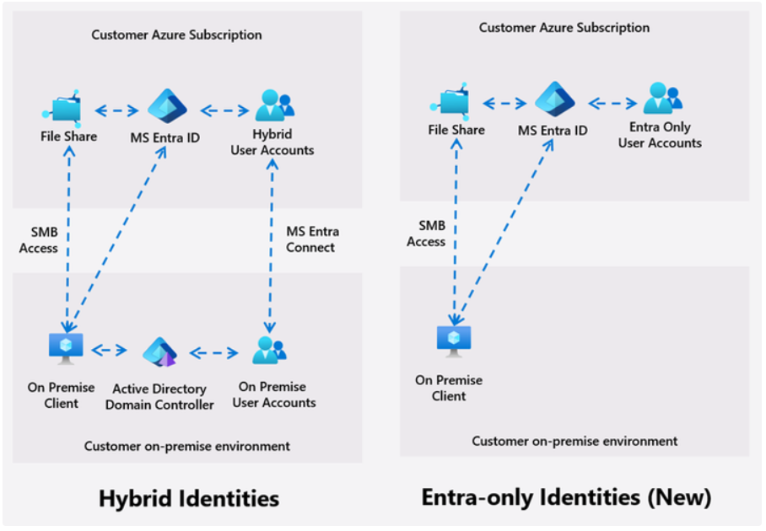
Storage & Data Updates (Azure Files) 1/2
Public Preview: Entra-only identities support with Azure Files SMB
Azure Files now supports Entra-only identities, enabling customers to retire on-premises domain controllers while maintaining secure SMB access to file shares. This feature delivers a fully cloud-native authentication model using Microsoft Entra Kerberos allowing secure access for identities /groups created and managed in MS Entra. Placing identity and access control in the cloud also enhances remote and distributed workforce scenarios—no VPN or hybrid trust required.
While beneficial across all workloads, this capability is especially impactful for:
Information Worker collaboration (departmental shares, project folders)
VDI/AVD environments with FSLogix profiles
Industry workloads requiring secure, mobile access
Limitations:
Azure storage account can't authenticate with both Microsoft Entra ID and a second method like AD DS or Microsoft Entra Domain Services.
You must disable multifactor authentication (MFA) on the Microsoft Entra app representing the storage account.
This feature doesn't currently support cross-tenant access for B2B users or guest users.
Cloud-only identities support (preview) is only available using a default share-level permission.

Slide 66
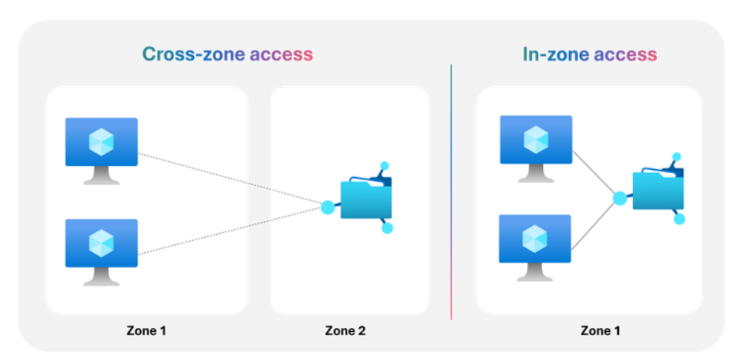
Storage & Data Updates (Azure Files) 2/2
Reduce latency and enhance resilience with Azure Files zonal placement
Azure Files provides both local-redundant storage (LRS) and zone-redundant storage (ZRS) options today. ZRS is leveraged for workloads that require storage-level replication across zones. For applications using Azure Files Premium LRS with application-level replication, customers can now pin storage resources to a specific Availability Zone to co-locate storage with compute resources like Virtual Machines (VMs). Zonal placement can be leveraged with both SMB and NFS shares, making it ideal for latency sensitive Windows and Linux workloads including databases, enterprise platforms, DevOps tools, and line-of-business applications.

Slide 67
Storage & Data Updates (Azure Managed Luster) 1/2
Public Preview: 20 MB/s/TiB Performance Tier for Azure Managed Lustre
Azure Managed Lustre now offers a new 20 MB/s/TiB performance tier in public preview, designed to meet the demands of large-scale AI and high-performance computing (HPC) workloads. This tier enables customers to provision file systems up to 25 PiB in a single namespace, delivering up to 512 GB/s of bandwidth and supporting up to 20 billion inodes for massive file counts.
The 20 MB/s/TiB tier uses Lustre’s DNE2 multi-MDS architecture, adding one MDS per 5 PiB to enable directory striping across multiple metadata targets. This boosts metadata operations, delivering over 5× higher IOPS in mdtest benchmarks as striping scales. Ideal for AI training and HPC workloads, it ensures high metadata throughput and efficient handling of massive datasets.
Public Preview: Auto-import for Azure Managed Lustre
Auto-import enables seamless, policy-driven synchronization of data from Azure Blob Storage containers into AMLFS clusters, automatically reflecting new, changed, or deleted blobs in the Lustre namespace. This feature supports hybrid workflows where data is generated in Blob and consumed in AMLFS.
Customers can configure import policies per Blob container–AMLFS cluster pair, specifying which types of changes are imported and how conflicts are resolved. This flexibility supports a range of scenarios, including post-deployment ingestion, machine learning pipelines, and continuous data synchronization for analytics workloads. Auto-import helps unify object and file-based workflows, enabling near real-time data sharing and reducing operational overhead by eliminating the need for manual import scripts or intermediate file servers.

Slide 68
Storage & Data Updates (Azure Managed Luster) 2/2
Generally Available: CSI Dynamic Provisioning for Azure Managed Lustre
With dynamic provisioning, Kubernetes applications can request AMLFS-backed persistent volumes on demand using standard StorageClass and PersistentVolumeClaim objects—no pre‑provisioning of volumes is required. This simplifies day-to-day operations for AI/ML training, simulation, and high‑throughput analytics that rely on POSIX file semantics and shared access at scale.
This GA supports Azure Kubernetes Service (AKS) clusters running Kubernetes 1.21 and later and uses the Azure Lustre CSI driver. Dynamic provisioning is supported in driver version v0.3.0 and later. Node pools must use the Ubuntu Linux OS SKU.
Generally Available: Azure Managed Lustre Support for Azure MCP Server
Azure MCP Server enables developers and infrastructure teams to manage Azure resources—including Azure Managed Lustre file systems—using natural language prompts, streamlining operations for AI training and high-performance computing (HPC) environments.
With this integration, it is possible to create, list, and manage Azure Managed Lustre file systems directly from supported IDEs (such as Visual Studio Code, Visual Studio, and IntelliJ) or via automation scripts, using the Model Context Protocol (MCP). The Azure Managed Lustre tools for MCP Server support advanced configuration options, including specifying network, capacity, maintenance windows, availability zones, and encryption settings.
This makes it easier to provision and operate scalable, high-performance Lustre file systems for large-scale simulation, model training, and fine-tuning workloads.
Azure MCP Server provides secure, role-based access and supports a wide range of Azure services, enabling unified management and automation for modern AI and HPC pipelines.

Slide 69
Storage & Data Updates (Azure Storage Blob) 1/1
Public Preview: Smart Tier account level tiering (Azure Blob Storage and ADLS)
Smart tier is a fully managed and automated data tiering solution, avoiding manual tier placement for object storage standard online tiers.
Smart tier automatically moves data between hot, cool, and cold access tiers based on usage patterns, optimizing costs for these access tiers automatically. New data is stored in the hot tier. Any object that isn’t accessed for 30 days is moved to the cool tier; after 90 days of inactivity, it transitions to the cold tier. If objects are accessed, they are transitioning back to the hot tier and restart their tiering cycle.
Key Capabilities
Seamless Enablement: Activate smart tier at the storage account scope on new and existing general purpose v2 storage accounts with zonal redundancies today.
Automated Lifecycle: Data movement between tiers is fully automated. Smart tier ensures optimal tier placement for both your active and inactive objects.
Simplified Billing Model: Data uses the existing hot, cool and cold tier capacity prices. There are no charges for tier transitions inside smart tier, early deletion or data retrieval fees. A monitoring fee Is charged for objects stored in smart tier over 128 KiB in size.
Generally Available: The Archive access tier for Azure Blob Storage is now generally available in the Taiwan North region
The Archive access tier for Azure Blob Storage is now generally available in the Taiwan North region.
With this regional expansion, customers in Taiwan can now store infrequently accessed data in the cost-effective Archive tier, while meeting data residency and compliance requirements locally. The Archive tier is ideal for long-term backup, compliance, and archival scenarios, offering the lowest-priced storage option in Azure.

Slide 70
Databases

Slide 71
Databases Updates (Azure DocumentDB) 1/2
Azure DocumentDB is Now Generally Available
Microsoft has announced the general availability of Azure DocumentDB, a fully managed, MongoDB-compatible database service built on the open-source DocumentDB project governed by the Linux Foundation. Formerly known as vCore-based Azure Cosmos DB for MongoDB, Azure DocumentDB offers developers a multi-cloud, first-party database engine that preserves MongoDB skills and tooling while improving portability and cost control through a simple compute and storage model.
At Ignite, Microsoft also introduced enhancements including the AI-powered Index Advisor, Premium Storage v2 disks, and a VS Code migration extension, helping teams build enterprise applications faster.
Because DocumentDB began as an open-source, MIT-licensed, MongoDB-compatible engine, it avoids vendor lock-in and enables consistent deployment across cloud providers. The DocumentDB Kubernetes Operator supports cluster management across Azure, AWS, GCP, and on-premises, and Microsoft’s open-source VS Code extension works with any DocumentDB or MongoDB cluster. Azure DocumentDB is Microsoft’s fully managed, first-party service built on this open, multi-cloud foundation.
Public Preview: Azure DocumentDB high-performance storage
Azure DocumentDB now supports high-performance storage, enabling larger and more demanding workloads to run on fewer nodes. Each physical shard can now deliver:
Up to 64 TiB storage capacity
80,000 IOPS
1,200 MB/s throughput
Clusters with high-performance storage automatically operate at the highest throughput and IOPS supported by their compute and storage tiers.
This upgrade dramatically improves scalability and efficiency for I/O-intensive and large-dataset workloads. Organizations can consolidate data previously spread across many shards while maintaining low latency, even during peak traffic. Ideal use cases include real-time analytics, personalization engines, and high-volume commerce systems.
To get started, create a cluster with high-performance storage in the Azure portal and benchmark workloads to size shards and compute appropriately.

Slide 72
Databases Updates (Azure DocumentDB) 2/2
Public Preview: Index Advisor for Azure DocumentDB
The DocumentDB for VS Code extension now includes the Index Advisor, a natural language–powered tool that helps you optimize MongoDB workloads.
Key benefits:
Identify slow or inefficient queries and pinpoint performance bottlenecks.
Get prioritized, actionable index recommendations based on impact.
Understand each recommendation through clear, plain-English explanations.
Apply suggested indexes instantly from within VS Code.
Automatically compare query performance before and after index creation.
This enhancement makes it easier to tune performance and maintain efficient DocumentDB or MongoDB-based applications directly from your developer workflow.

Slide 73
Databases Updates (Azure Cosmos DB) 1/6
Public Preview: Online container copy in Azure Cosmos DB
Azure Cosmos DB now supports online container copy, allowing you to replicate data from one container to another in real time with minimal downtime.
Key benefits:
Zero-interruption operations: Applications continue using the source container while data is copied.
Real-time synchronization: Changes in the source container are streamed to the destination during the copy.
Seamless switchover: Once the copy is complete, you can switch traffic to the new container with minimal impact.
This capability simplifies migrations, schema changes, and performance optimizations without service disruption.
Public Preview: Azure Cosmos DB Fleet Analytics
Azure Cosmos DB Fleet Analytics is now in public preview, giving organizations a unified, cross-account view of their entire Cosmos DB estate. This capability aggregates insights across multiple accounts, subscriptions, and workloads, enabling teams to:
Analyze performance and usage patterns at scale
Monitor and optimize cost and capacity trends
Identify inconsistencies and manage growth more effectively
With a single consolidated analytics layer, operators can make faster, data-driven decisions and maintain consistency across their Cosmos DB fleet.

Slide 74
Databases Updates (Azure Cosmos DB) 2/6
Public Preview: Support for Italian and Portuguese in Azure Cosmos DB for NoSQL full-text search
Azure Cosmos DB for NoSQL now supports Italian and Portuguese languages in full-text search, available today in public preview. This update adds to the list of supported languages, enabling to build rich, language-aware search experiences that understand the linguistic nuances of Italian and Portuguese text.
It is now possible easily create multilingual applications that deliver a natural and localized search experience for users across Europe and Latin America. Whether building e-commerce catalogs, customer knowledge bases, or AI-powered chat and discovery tools, you can now seamlessly search across Italian and Portuguese content without needing to preprocess or translate data.
Generally Available: Azure Cosmos DB fleet pools
Azure Cosmos DB fleet pools introduce new capabilities for building and operating multitenant SaaS applications at scale.
With fleet pools, you can:
Simplify capacity management by creating a shared pool of throughput (RU/s) that multiple Cosmos DB accounts in the fleet can draw from.
Maintain strong security and performance isolation by using a dedicated Cosmos DB account per tenant or customer.
Avoid overprovisioning at the tenant level by efficiently sharing RU/s across accounts, reducing cost while maintaining predictable performance.
Fleet pools deliver the best of both worlds: per-tenant isolation with centralized, optimized resource management.

Slide 75
Databases Updates (Azure Cosmos DB) 3/6
Generally Available: Cosmos DB in Microsoft Fabric
Cosmos DB in Fabric is now generally available, enabling organizations to unify operational and analytical workloads within Microsoft Fabric.
With this release, you can:
Run SQL queries over JSON data and build real-time intelligence directly on top of transactional data.
Leverage AI-powered capabilities from Azure Cosmos DB alongside Fabric’s analytics and data workflows.
Use new features such as:
  User-defined functions (UDFs) to seamlessly connect to Cosmos DB artifacts
  CI/CD support for managing dev/test/prod pipelines
  Autoscale for elastic throughput
  Vector and full-text indexing and search (enabled by default) to power AI workloads
  Customer-managed keys (CMK) for Fabric (Preview)
This GA release represents a major milestone in making operational Cosmos DB data fully accessible, queryable, and integrated across the entire Fabric ecosystem.
Generally Available: Azure Cosmos DB Mirroring in Microsoft Fabric
Azure Cosmos DB Mirroring in Fabric enables seamless integration of existing operational workloads with the analytical power of Microsoft Fabric.
With this capability, you can:
Run SQL queries over JSON data and build real-time analytics directly on top of your existing Cosmos DB transactional data.
Leverage the full Microsoft Fabric ecosystem, including Copilot-assisted Power BI, without stitching together separate services.
Select exactly which Cosmos DB containers to mirror, giving you full control over what data flows into Fabric for analysis.
This integration delivers a smooth path from operational workloads to unified analytics—ensuring real-time intelligence with minimal operational overhead.

Slide 76
Databases Updates (Azure Cosmos DB) 4/6
Generally Available: Priority-based execution in Azure Cosmos DB
Azure Cosmos DB Priority-Based Execution now allows high-priority operations to be favored during periods of heavy load. When resource contention occurs, low-priority requests are throttled first, ensuring that mission-critical, high-priority workloads continue to run on a best-effort basis.
Developers can set each request to high or low priority using the Azure Cosmos DB SDK. Low-priority operations are automatically retried according to the configured retry policy, helping maintain overall performance and protect critical workflows even under pressure.
Generally Available: Vector indexing performance improvements in Azure Cosmos DB for NoSQL
This release delivers significantly faster vector inserts and index builds in Azure Cosmos DB for NoSQL, reducing end-to-end ingestion and indexing time for large AI workloads. These improvements are powered by enhanced vector indexing algorithms, enabling more efficient scaling and higher performance for vector-heavy applications.

Slide 77
Databases Updates (Azure Cosmos DB) 5/6
Generally Available: Fuzzy search in Azure Cosmos DB for NoSQL full-text search
Azure Cosmos DB for NoSQL now supports fuzzy search in full-text search. With fuzzy search, can deliver typo-tolerant, error-resilient search experiences directly within Azure Cosmos DB, helping users find the right results even when queries or the data itself contain errors. This feature improves the quality and usability of search-driven applications, making them feel more natural and forgiving for end users.
Public Preview: Dynamic data masking with Azure Cosmos DB
Azure Cosmos DB now supports dynamic data masking (DDM), a server-side, policy-based capability that protects sensitive information by automatically redacting fields for non-privileged users. Data is masked in real time before being returned to applications, while the underlying values remain unchanged.
This enhancement helps organizations reduce exposure to sensitive data—such as PII and PHI—and strengthens compliance with security and regulatory requirements.

Slide 78
Databases Updates (Azure Cosmos DB) 6/6
Generally Available: Float16 data type for vector indexes in Azure Cosmos DB
Azure Cosmos DB now supports float16 vector data types, allowing vector indexes to use half-precision floating-point numbers. This reduces storage requirements by 50% compared to float32 while maintaining high retrieval accuracy for most AI workloads.
This improvement is especially valuable for large-scale scenarios—such as semantic search, recommendation engines, and AI agent memory—where storing large volumes of embeddings can be costly. Smaller vectors mean lower storage and indexing costs and improved scalability for vector-driven applications.

Slide 79
Databases Updates (Azure Database for PostgreSQL) 1/5
Public Preview: Native Microsoft Foundry support for Azure Database for PostgreSQL
Microsoft has announced the public preview of Microsoft Foundry support for Azure Database for PostgreSQL, with the Azure PostgreSQL MCP Server now natively integrated into Microsoft Foundry.
This integration enables organizations to build AI agents that can securely query and analyze PostgreSQL data using natural language, with capabilities such as data retrieval, vector search, schema discovery, and more.
Backed by enterprise-grade security through Microsoft Entra ID—and compatible with row-level access controls—the release accelerates secure AI adoption across the organization.
Onboarding can be completed within minutes using the Microsoft Foundry SDK or the Microsoft Agent Framework to build agents that interact with the Azure Database for PostgreSQL MCP Server. For enhanced data protection, organizations also have the option to self-host the MCP Server using Azure Container Apps or Azure Functions within their own Azure subscriptions and virtual networks.
Public Preview: Azure Database for PostgreSQL – Flexible Server v6 series VMs and AMD v6 Confidential Compute
Organizations can now deploy general purpose and memory-optimized v6-series Azure Virtual Machines with local NVMe storage for Azure Database for PostgreSQL Flexible Server. The v6-series offers a choice of either Intel or AMD processors, providing greater flexibility and performance options for PostgreSQL workloads.

Slide 80
Databases Updates (Azure Database for PostgreSQL) 2/5
Generally Available: Elastic clusters on Azure Database for PostgreSQL – Flexible Server
Elastic clusters are now available to horizontally scale Azure Database for PostgreSQL using both row-based and schema-based sharding. This capability simplifies the development of multitenant applications by delegating shard management and operational tasks—such as tenant isolation, shard splitting, and online rebalancing—to the service.
Row-based sharding is well suited for multitenant SaaS scenarios, distributing tenants as rows within a cluster-wide table to increase density and improve per-tenant margins. Schema-based sharding, on the other hand, is ideal for microservices architectures and lift-and-shift migrations, providing greater flexibility to customize schemas for individual tenants.
Generally Available: Azure Database for PostgreSQL storage extension support for Parquet
Azure Database for PostgreSQL – Flexible Server now supports the Azure Storage extension with Parquet format and multiple compression options.
This update enables PostgreSQL to directly read and write Parquet files, delivering faster data exchange with analytics systems and more efficient cloud storage usage.
With Parquet and compression support, teams can:
Streamline data pipelines by interacting with Azure Storage without external ETL tools
Improve performance for large analytical and bulk-processing workloads
Reduce storage costs through highly efficient Parquet compression
All of this is now possible directly within PostgreSQL, simplifying architectures and boosting efficiency.

Slide 81
Databases Updates (Azure Database for PostgreSQL) 3/5
Generally Available: Mirroring in Fabric for PostgreSQL Flexible Server
Organizations can now consolidate data and streamline analytics through Microsoft Fabric mirroring for Azure Database for PostgreSQL Flexible Server, which is now generally available. This capability centralizes data in OneLake and supports network-isolated PostgreSQL servers configured with virtual networks, private endpoints, or high-availability setups.
To enhance application integration with actionable business insights, data from multiple sources can be joined seamlessly, with one-click connectivity to Microsoft Power BI. For faster and more efficient analytical performance, mirrored data can also be optimized using Delta Lake table features.
Generally Available: Azure Database for PostgreSQL – Flexible Server anon extension
The anon extension is now generally available in Azure Database for PostgreSQL Flexible Server. This extension delivers built-in data anonymization capabilities, enabling organizations to protect sensitive information while maintaining data utility for analytics, testing, and development scenarios.

Slide 82
Databases Updates (Azure Database for PostgreSQL) 4/5
Generally Available: PostgreSQL 18 with in-place upgrade on Azure Database for PostgreSQL
Organizations can now use PostgreSQL 18 on Azure Database for PostgreSQL. This release brings the latest PostgreSQL innovations together with seamless in-place upgrade support, enabling upgrades from earlier versions without changing server endpoints, reconfiguring applications, or performing manual data migrations. The result is minimal downtime, reduced operational complexity, and a fully managed path to staying current.
PostgreSQL 18 introduces major advancements in performance, scalability, and developer productivity, including asynchronous I/O (AIO) for faster queries, improved vacuuming, UUIDv7 support, enhancements to logical replication, and virtual generated columns for more flexible schema design. By adopting PostgreSQL 18 on Azure Database for PostgreSQL, organizations gain access to the newest community features with enterprise-grade reliability, integrated security, and high availability.
Generally Available: 2025 REST API for Azure Database for PostgreSQL
Microsoft has announced the general availability of the 2025 REST API for Azure Database for PostgreSQL. This release introduces support for PostgreSQL 17 and 18, enabling organizations to adopt newer engine versions without modifying existing automation workflows. The API also now allows setting a default database name for elastic clusters, improving flexibility in cluster configuration.
To enhance the developer experience, operation IDs have been renamed for clearer navigation, and HTTP response codes have been corrected to ensure scripts, automation, and retry logic behave as expected. Security guidance has been strengthened through a new customer-managed key (CMK) encryption example, demonstrating how key versions can be updated automatically.
Additional improvements—such as renamed files for accuracy, a reorganized specification structure for easier browsing and diffs, and richer local definition metadata—make the 2025 REST API clearer, safer, and more capable for modern PostgreSQL roadmaps.

Slide 83
Databases Updates (Azure Database for PostgreSQL) 5/5
Public Preview: Azure Database for PostgreSQL – Flexible Server pg_duckdb extension
Azure Database for PostgreSQL – Flexible Server now supports creating pg_duckdb extensions, allowing organizations to accelerate analytics workloads with DuckDB’s fast, vectorized, columnar execution engine. This integration enables high-performance analytical queries directly inside PostgreSQL, reducing data movement and simplifying analytics pipelines.

Slide 84
Databases Updates (Azure SQL) 1/5
Public Preview: Azure SQL change event streaming
Azure SQL Database now supports near real-time data change streaming directly into Azure Event Hubs with the public preview of Change Event Streaming (CES). This capability streamlines data integration and enables advanced analytics, event-driven architectures, and the modernization of monolithic applications.
By streaming operational data from SQL databases into Azure Event Hubs, organizations can feed real-time dashboards, microservices, and other downstream systems without relying on traditional batch pipelines. Data is extracted from SQL only once and can be consumed by multiple subscribers, reducing polling overhead on operational databases. With changes available on a shared message bus, new consumers can access data more easily, accelerating innovation—including AI-driven solutions.
CES delivers near real-time latency, an “at least once” delivery guarantee, and minimal impact on source workloads.
Generally Available: SQL database in Microsoft Fabric
Built on the trusted SQL Server and Azure SQL Database engine, this fully SaaS-native solution empowers developers and data professionals to unify operational and analytical workloads with speed, security, and AI-powered capabilities.
Key highlights include fast provisioning, Copilot-powered management, autonomous scaling, enterprise-grade security (with Customer Managed Keys and SQL Auditing), and native support for AI scenarios like semantic search and RAG

Slide 85
Databases Updates (Azure SQL) 2/5
Public Preview: Azure SQL Database DiskANN vector indexing
Microsoft has introduced the public preview of vector indexing with DiskANN in Azure SQL Database, Azure SQL Managed Instance, and SQL Database in Microsoft Fabric.
DiskANN is a high-performance algorithm optimized for large-scale vector similarity search, ideal for scenarios like product recommendations, image search, and multimodal AI applications.
Integrated directly into the SQL query engine, DiskANN enables developers to build advanced semantic search and recommendation capabilities without relying on external services. This preview builds on the earlier GA of vector data types and functions, expanding SQL’s built-in AI capabilities for modern applications.
Public Preview: Azure SQL updates for November 2025
In November 2025, several updates and enhancements were introduced to Azure SQL:
The interactive Edit Data interface in the MSSQL extension for Visual Studio Code now allows users to view, modify, and insert table rows without manually writing T-SQL.
DACPAC import and export capabilities were added to the MSSQL extension, enabling developers to apply DACPAC files to new or existing databases or generate new DACPACs from existing databases.

Slide 86
Databases Updates (Azure SQL) 3/5
Generally Available: Microsoft Python driver for SQL Server
Microsoft has announced the general availability of the mssql-python driver, delivering a modern, high-performance, and developer-friendly experience for Python applications connecting to SQL Server, Azure SQL Database, and SQL databases in Microsoft Fabric.
This GA release provides improved performance, enhanced reliability, and a more intuitive API, making it easier for Python developers to build data-driven and AI-enabled applications on Microsoft’s SQL platforms.
Generally Available: Azure SQL Database long-term retention (LTR) backup immutability
Azure SQL Database now supports immutability for long-term retention (LTR) backups, helping organizations meet strict compliance and regulatory requirements.
When immutability is enabled, LTR backups cannot be altered or deleted until the retention period expires, protecting data integrity and reducing the risk of ransomware, accidental deletion, or malicious tampering throughout the full backup lifecycle.

Slide 87
Databases Updates (Azure SQL) 4/5
Generally Available: Azure SQL updates for November 2025
In November 2025, several updates and enhancements were introduced to Azure SQL:
Reservation discounts for 1-year and 3-year commitments on zone-redundant Azure SQL Managed Instance (General Purpose tier) now apply to both the standard compute and the zone-redundancy add-on.
Additional memory options are now available for Azure SQL Managed Instance, enabling improved performance and cost optimization.
Optimized locking improvements further reduce lock-related overhead within the SQL database engine, enhancing concurrency and efficiency.
Regex support has been added to SQL queries, providing advanced pattern-matching capabilities for more sophisticated data processing.
Bigint support in DATEADD expands calculation ranges, enabling broader date and time manipulation scenarios.
Generally Availabe: SQL Server 2025
SQL Server 2025 is now generally available, bringing integrated AI capabilities and deeper interoperability with Microsoft Fabric and Azure.
This release boosts developer productivity with enhanced T-SQL features, improves performance with intelligent query processing and optimized concurrency, and strengthens security through Microsoft Entra–based identity management.
Built for hybrid environments—on-premises, multi-cloud, and edge—SQL Server 2025 delivers enterprise-grade reliability and compliance while enabling advanced, AI-driven workloads.

Slide 88
Databases Updates (Azure SQL) 5/5
Generally Available: Azure SQL Managed Instance Next-gen General Purpose service tier
The Next-gen General Purpose tier delivers a major performance boost while preserving the cost efficiency of a managed PaaS service.
Customers can achieve 3–5× better performance by upgrading from the classic General Purpose tier, with new options for configurable IOPS and adjustable memory-to-vCore ratios to fine-tune performance without overspending.
This tier supports heavier workloads, scales more effectively, and provides a significantly improved price-to-performance balance, all with the simplicity of a fully managed platform.

Slide 89
Databases Updates (Azure SQL) 1/1
Private Preview: Azure HorizonDB
Engineered for high performance, Azure HorizonDB for PostgreSQL delivers future-ready, autoscaling storage up to 128 TB, up to 3× faster performance than open-source PostgreSQL, and rapid compute scaling up to 3,072 vCores. Now in private preview, HorizonDB is designed for mission-critical applications with enterprise-grade reliability and security.
Developers can build smarter, more scalable applications using in-database, pre-provisioned AI models, advanced features such as DiskANN vector indexing for fast filtered search, and native semantic operators for intelligent query handling. Familiar PostgreSQL extensions and GitHub Copilot integration streamline the development experience, helping teams move from concept to production more efficiently.
Fully integrated into the Microsoft ecosystem, Azure HorizonDB provides seamless access to Azure’s advanced AI and analytics services, reducing integration overhead and enabling unified, end-to-end application innovation.
OracleDatabase@Azure expands footprint to 31 regions and strengthens security with Azure Key Vault
Microsoft is expanding global availability and strengthening security for Oracle Database@Azure. The service is now live in 31 regions worldwide, including new regions in North Central US, South India, and France South. Two additional regions will come online within the next three months, bringing the total to 33 regions—the broadest footprint of any hyperscaler for Oracle workloads.
In addition, Azure Key Vault (Standard, Premium, and Managed HSM) is now generally available for Oracle Autonomous AI Database on Oracle Database@Azure, providing built-in encryption, centralized key management, and strengthened data protection for both Exadata Database and Autonomous AI Database deployments.
Oracle Database@Azure continues to offer enterprises more choice, more control, and more global reach for running mission-critical Oracle workloads.

Slide 90
Integration

Slide 91
Integration Updates (Azure API Management) 1/2
Public Preview: Azure API Management adds support for A2A Agent APIs
With this new capability, organizations can manage and govern agent APIs alongside other API types — AI model APIs, Model Context Protocol (MCP) tools, and traditional APIs such as REST, SOAP, and GraphQL.
This update empowers customers to extend their established API governance and security practices into the evolving agentic ecosystem, strengthening secure access, enforcing policies consistently, and ensuring observability for AI agents.
A2A APIs in Azure API Management offer advanced mediation of JSON-RPC runtime operations with robust policy support, enable agent card exposure to agents, users, or clients, and provide comprehensive tracing aligned with the OpenTelemetry GenAI semantic convention.
AI Gateway in Azure API Management Is Now Available in Microsoft Foundry (Preview)
Microsoft has integrated AI Gateway directly into Microsoft Foundry, bringing enterprise-grade governance, security, and observability for AI models, tools, and agents into the Foundry environment. Built on Azure API Management, this integration gives organizations a unified way to control usage, enforce policies, and monitor AI workloads without slowing development.
Teams can:
Route all model traffic through a governed AI Gateway hostname
Register and manage agents running anywhere for centralized oversight
Govern MCP tools automatically, making them discoverable and secure
Foundry users get simple, built-in governance, while still retaining full API Management capabilities for advanced needs. This integration delivers consistent, scalable AI governance from day one.

Slide 92
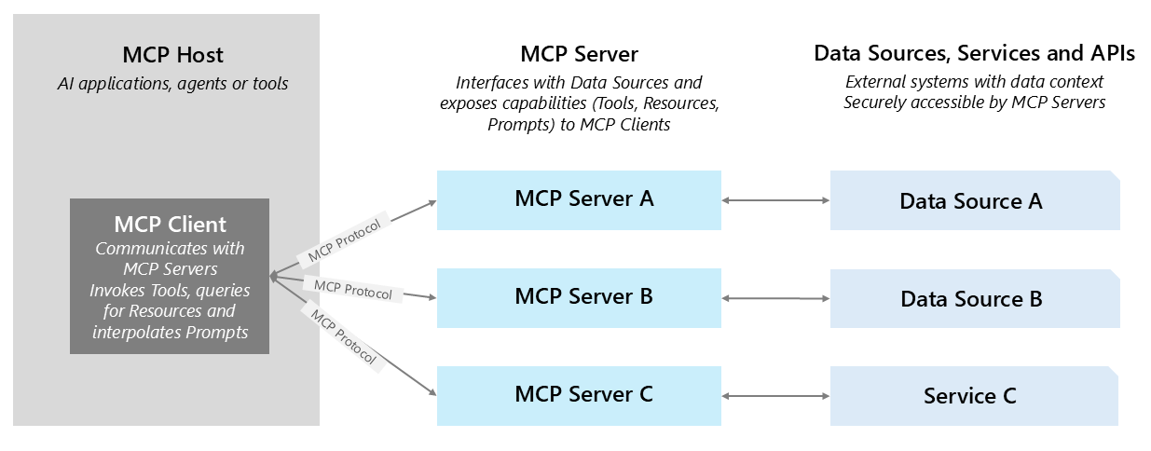
Integration Updates (Azure API Management) 2/2
Generally Available: Premium v2 tier in Azure API Management
Microsoft has announced the general availability of Azure API Management Premium v2, offering higher capacity, unlimited included calls, and the most advanced feature set for enterprise-scale API programs. The new architecture removes management traffic from customer VNets, making private networking simpler and more secure, with support for both VNet injection and VNet integration.
Premium v2 also introduces:
Inbound Private Link for secure, private endpoint access
Availability zone support for improved resiliency
Custom CA certificates for backend TLS validation
The updated VNet injection model requires no route tables or service endpoints and gives customers full control over inbound/outbound traffic—supporting forced tunneling, NVAs, and WAF integration without constraints.
Generally Available: Govern Model Context Protocol (MCP) endpoints using Azure API Management
This release extends Azure API Management’s proven governance, security, and observability model to a new generation of AI-driven workloads. Enterprises can now apply consistent policies, authentication, and monitoring across both traditional APIs and AI systems that connect through MCP. What’s New:
Expose APIs through MCP
Proxy and govern external MCP services
Unify access and governance
Discover and govern through API Center
Available across Azure API Management classic and v2 tiers, including the Developer tier and the Self-hosted Gateway.

Slide 93
Azure Integration Updates 1/1
Announcing: API Center Standard now included at no additional cost for linked Azure API Management Standard and Premium tiers
API Center Standard, previously a separate paid offering, is now included at no additional cost for all Azure API Management Standard and Premium customers, when an API Center instance is linked with a corresponding Azure API Management service (for both classic and v2 SKUs).
With this update, organizations can now use API Center Standard without incurring additional charges once integration is configured, bringing even greater value to existing Azure API Management deployments.
API Center enables teams to track and manage APIs in a centralized location, making it easier to drive discovery, reuse, and governance across the organization. It provides a single source of truth for all APIs, helping teams catalog APIs across environments, improve visibility across the API landscape, and empower developers to find and reuse APIs across teams and business units.
This update enhances the overall value of Azure API Management, helping customers simplify API operations and accelerate innovation without adding cost or complexity once integration is enabled.
Stream data in near real time from SQL to Azure Event Hubs - Public preview
Azure SQL Database has introduced Change Event Streaming (CES) in public preview, a new feature designed to simplify near–real-time data integration. Modern applications increasingly depend on event-driven architectures, but traditional approaches—such as ETL jobs, polling, CDC, or third-party tools—add latency, increase operational overhead, and place extra load on source databases.
CES streams row-level inserts, updates, and deletes directly from Azure SQL Database to Azure Event Hubs in near real time, addressing these challenges by:
Reducing latency: Events are pushed as changes occur, eliminating the need for frequent polling.
Simplifying architecture: No CDC, Change Tracking, custom polling, or external connectors are required. SQL manages delivery tracking, retries, and log truncation internally.
Decoupling producers and consumers: Changes are streamed at the database level after transactions commit, without modifying applications. Data is published once and can be consumed by any number of downstream systems via Event Hubs.
CES provides a simpler, more efficient, and more scalable way to integrate operational SQL data into real-time analytics and event-driven systems.

Slide 94
ML & AI & IOT

Slide 95
ML & AI & IOT Updates (Azure Foundry) 1/14
Public Preview: Claude in Microsoft Foundry
Enterprises can now access Claude Sonnet 4.5, Opus 4.1, and Haiku 4.5 for advanced long-context reasoning, coding, and multimodal comprehension—fully integrated into Foundry Models, Playground, and the Agent Service.
These Claude models are delivered through the global standard deployment type, ensuring consistent availability, enterprise-grade support, and compliance across Azure regions worldwide.
Public Preview: Microsoft Foundry data connection for Azure Databricks
Azure Databricks Genie is now integrated with Microsoft Foundry and available in public preview.
You can now connect Genie spaces directly to Microsoft Foundry agents using Model Context Protocol (MCP), enabling seamless, governed access to trusted data for intelligent workflows.
This integration simplifies AI development by streamlining data connectivity, strengthening governance, and accelerating time-to-value.

Slide 96
ML & AI & IOT Updates (Azure Foundry) 2/14
Public Preview: Microsoft Foundry Fine-Tuning Updates
Microsoft Foundry Fine-Tuning has been redesigned with a new, agent-first UI, now in public preview. The updated experience streamlines model creation, evaluation, and deployment, introduces tighter VS Code integration, and modernizes navigation to reduce friction and accelerate AI development.
The preview includes support for Reinforcement Fine-Tuning (RFT) for GPT-5, enabling organizations to adapt large language models for highly specialized, context-aware applications. Full migration to the new experience is planned after July 2025.
This update equips teams to optimize model performance for unique business needs, future-proof their agent ecosystem, and drive faster, more effective innovation.
Public Preview: Agent mitigations and guardrail customization
Guardrails for agents are now available in the Microsoft Foundry Control Plane, extending beyond model-level protection to provide policy enforcement directly at the agent level. Previously known as content filters, these guardrails help mitigate prompt injection, reduce harmful or risky outputs, and improve groundedness.
A new capability—task adherence detection—identifies when an agent begins to drift away from its intended task, ensuring more reliable and predictable behavior.
The updated control model offers greater flexibility in shaping agent behavior:
Choose which risks to monitor
Select intervention points (prompts, outputs, tool calls, and tool responses)
Define actions such as annotation or blocking
These enhancements enable fine-grained, configurable safety and governance for agents across the Foundry ecosystem.

Slide 97
ML & AI & IOT Updates (Azure Foundry) 3/14
Public Preview: Microsoft Foundry Control Plane & Entra Agent ID
Microsoft Foundry introduces a unified platform for enterprise AI agent observability, security, and governance. The Control Plane integrates identity, monitoring, and compliance, providing centralized control, deep observability, and compliance for agent fleets. Entra Agent ID anchors unified discovery and governance, ensuring agents adhere to enterprise security and Zero Trust standards.
Public Preview: Microsoft Foundry one-click deploy channels in Teams, M365 and non-Microsoft
Microsoft Foundry now enables one-click, no-code publishing of custom agents to Microsoft Teams and Microsoft 365 Copilot. This feature removes the complexity of pro-code deployment, allowing organizations to instantly reach millions of users while maintaining compliance, security, and governance. The streamlined process accelerates adoption and unlocks new enterprise scenarios for AI agents.

Slide 98
ML & AI & IOT Updates (Azure Foundry) 4/14
Public Preview: LLM Speech in Microsoft Foundry
LLM Speech in Microsoft Foundry introduces advanced large language model capabilities to speech processing, delivering highly fluent, context-aware transcription and translation. With expanded multilingual support and powerful prompt-tuning options, the API adapts to diverse business scenarios and consistently outperforms competing solutions across key benchmarks.
This release provides enterprises with customizable, intelligent speech capabilities built directly into the Foundry ecosystem.
Public Preview: New granular controls for network and integration security in Microsoft Foundry
Microsoft Foundry streamlines AI development and management for the enterprise. MS introduced more granular controls for network and integration security and resource management that empower IT admins to deploy AI solutions while meeting enterprise-grade security, compliance, and governance requirements.
Bring Your Own (BYO) Storage for Speech and Language in Foundry is in public preview. Link own Azure Storage account to Speech and Language services in Foundry Tools, for complete control over where and how data is stored, including access policies and retention.

Slide 99
ML & AI & IOT Updates (Azure Foundry) 5/14
Private Preview: Foundry Local Android support
Foundry Local now extends its capabilities to Android, in addition to Windows and Mac supporting advanced on-device AI for smartphones, tablets, and IoT devices, while Whisper model integration delivers robust, privacy-preserving speech and audio processing.
The redesigned Foundry Local SDK lets developers quickly create and launch AI-driven applications. It features dynamic hardware accelerator compatibility and built-in chat and audio interfaces, all operating independently without needing outside dependencies.
Public Preview: New AI templates in Microsoft Foundry
Microsoft Foundry introduces new ready-to-use, customizable AI templates for popular use cases such as live voice agents, release management, data unification, and SharePoint integration applications. These templates eliminate repetitive setup tasks, reduce deployment friction, and accelerate the journey from concept to production. With customizable code samples, pre-integrated Azure services and GitHub-hosted quick-start guides, development teams can launch faster, customize easily, and scale securely on Microsoft’s trusted AI infrastructure.

Slide 100
ML & AI & IOT Updates (Azure Foundry) 6/14
Public Preview: Bring Your Own AI Gateway to Foundry Agent Service
The BYO AI Model Gateway feature allows enterprises to connect Foundry-hosted models through any AI gateway services like Azure API Management, Mulesoft, and Kong, to Foundry Agent Service.
The Agent Service honors pre/post‑LLM hooks, policy‑based model selection, and multi‑region/multi‑provider load‑balancing with automatic failover, so teams can optimize for latency, cost, compliance, and availability without changing application code. This enables organizations to build agents using their own managed endpoints while maintaining enterprise-grade governance, security, and compliance.
Public Preview: Multi-agent workflows in Foundry Agent Service
Developers can now build powerful multi-agent workflows using a visual designer or a code-first API. These workflows offer structured orchestration, shared context, persistent state, and built-in error recovery for complex enterprise processes. Their modular architecture enables secure data handling, easy extensibility, and long-term state management—making them ideal for advanced automation and enterprise-grade scenarios.
If you'd like an even more concise or more marketing-style version, just let me know.

Slide 101
ML & AI & IOT Updates (Azure Foundry) 7/14
Public Preview: Azure Cosmos DB MCP ToolKit for Microsoft Foundry Agent Service
Azure Cosmos DB for NoSQL now offers an MCP Toolkit that can be used with Microsoft Foundry Agent Service, available today in public preview.
This new integration allows to connect Microsoft Foundry Agents directly to data in Azure Cosmos DB. By deploying the Azure Cosmos DB MCP Toolkit Server in your Azure environment, you can enable your agents to perform secure data operations and run semantic searches within Azure Cosmos DB.
The toolkit includes multiple ready-to-use tools that simplify setup and configuration, helping your agents discover data and retrieve the right information for reasoning and task execution. You can now build data-aware agents that respond to user requests with information drawn from live operational data. The integration in Microsoft Foundry Agents Service makes it easy to connect to the MCP server and get started.
Announcing: Developer Training tier for low-cost fine-tuning training
Microsoft Foundry now offers a Developer Training tier, delivering ultra-low-cost model training by using spot capacity. Similar to the affordable Developer tier for model hosting, this tier applies the same pricing advantages to fine-tuning workflows. It’s ideal for rapid experimentation, testing multiple model variants, building MVPs, or running low-throughput training jobs—enabling teams to iterate quickly and cost-effectively before moving to production-grade tiers.
If you want an even shorter, more promotional, or more technical version, I can generate that too.

Slide 102
ML & AI & IOT Updates (Azure Foundry) 8/14
Public Preview: Enterprise MCP enhancements in Foundry Agent Service
Microsoft Foundry has enhanced integration to Enterprise MCP to enable secure, authenticated connections to MCP servers, allowing credentials to be passed to MCP servers securely. These updates enable enhanced flexibility, security, and compliance when integrating MCP with Microsoft Foundry.
Public Preview: Built-in memory in Foundry Agent Service
The new long-term memory capability in the Foundry Agent Service provides developers with a scalable and resilient foundation for building agents that can remember, adapt, and maintain coherence across sessions and workflows. Integrated directly into the Foundry runtime, this persistent memory layer allows agents to store and retrieve chat summaries, user preferences, and important task outcomes. The result is more natural, consistent, and personalized agent behavior throughout ongoing interactions.

Slide 103
ML & AI & IOT Updates (Azure Foundry) 9/14
Public Preview: Enrich agents with a unified catalog of prebuilt and custom tools in Microsoft Foundry
With these latest updates in public preview, Microsoft Foundry enables developers to enrich agents with real-time business context, multimodal capabilities, and custom business logic through a unified catalog of Model Context Protocol (MCP) tools.​
Unified tool discovery: Developers can now find, connect, and manage public or private MCP tools for agents from a single, secure interface in Microsoft Foundry.​
Deep business integration: Logic Apps connectors provide access to 1,400+ systems like SAP, Salesforce, and HubSpot as MCP tools, enabling agents to quickly integrate with core business services and act on real-time business data and events.​
Pre-built AI tools: New Foundry Tools provide out-of-the-box capabilities for transcription, translation, voice, and intelligent document processing, available as MCP servers for rapid agent development.​
Custom extensibility: Through API Management, any API or function can be securely exposed as an MCP tool, enabling developers to reuse existing business logic and further accelerate time to value.
Public Preview: Hosted agents in Foundry Agent Service
Hosted agents in Foundry Agent Service make it effortless for teams to move from local experimentation to full-scale production.
Developers can now deploy custom-code agents built with Microsoft Agent Framework, LangGraph, CrewAI, or other open-source frameworks directly into a fully managed runtime—no container images, Kubernetes clusters, or deployment pipelines required.

Slide 104
ML & AI & IOT Updates (Azure Foundry) 10/14
Foundry IQ in public preview
Microsoft has introduced Foundry IQ in public preview—a unified knowledge layer for agents that provides a single endpoint for contextual retrieval, automated source routing, and secure, permission-aware access to enterprise knowledge. Built on Azure AI Search, Foundry IQ simplifies how agents access and reason over organizational data.
Key Capabilities
Foundry IQ knowledge bases: Topic-centric, reusable knowledge collections available in the new Foundry portal. Agents and applications can share a single API, eliminating the need to stitch together multiple data tools for each project.
Automatic access to indexed and federated sources: Supports both indexed data (with automatic ingestion, vectorization, and enrichment for text, images, and complex documents) and remote sources.
Agentic retrieval engine: A self-reflective AI search and synthesis engine with configurable “retrieval reasoning effort” for more precise, context-aware answers.
Enterprise-grade security: Document-level access controls, alignment with existing permission models, and support for hybrid indexed/remote data.
Public Preview: Foundry IQ by Azure AI Search
Foundry IQ, powered by Azure AI Search, is a knowledge system that delivers a smarter way to ground agents in enterprise data.
Agents only need to connect to a single knowledge base to access multiple sources, removing the need to manage separate APIs and function calls. Knowledge bases perform knowledge retrieval over supported sources including Microsoft SharePoint, Fabric OneLake, and web.
Unlike traditional RAG and vector databases, knowledge bases use an agentic retrieval engine holistically across sources and conversations. It also has broader access to data, because it can connect to data remotely or in a synced index.
This enables better response quality out of the box, where single-shot retrieval can fall short. Foundry IQ is enterprise-ready, with Purview governance and Entra-based access control, so developers can build with trust and confidence. Create and manage knowledge bases from the Foundry portal, or directly in Azure AI Search.

Slide 105
ML & AI & IOT Updates (Azure Foundry) 11/14
Generally Available: Foundry Tools (rebrand from Azure AI Services)
Foundry Tools (rebranded from Azure AI Services) provide a unified suite of prebuilt, production-ready AI capabilities for audio, video, images, documents, and text.
Seamlessly integrated into the Microsoft Foundry platform, these tools empower developers to rapidly build intelligent agents and applications with plug-and-play functionality, robust governance, and enterprise-grade security.
The rebranding simplifies user experience and accelerates onboarding for agentic AI development.
Generally Available: Model Router in Microsoft Foundry
Model router is an AI orchestration layer dynamically selects the optimal model for each prompt.
It now supports a broader range of models including: GPT-4 family, GPT-5 family, GPT-oss, Deepseek-v3.1, Llama-4-maverick-instruct, Grok-4, and Grok-4-fast. New customization modes – cost savings, quality, and balanced-- allow developers to fine -tune routing logic to best suit their unique needs.
Additionally, the model router will be added to Foundry Agent Service providing a single, intelligent endpoint that dynamically routes requests to the most suitable model based on task complexity, performance, and cost. This feature simplifies integration, optimizes outcomes, and delivers enterprise resilience to enhance Foundry’s capabilities in multi-model orchestration.

Slide 106
ML & AI & IOT Updates (Azure Foundry) 12/14
Generally Available: Observability in Foundry Control Plane
Observability in Foundry Control Plane now in public preview for agents with a GA pre-announcement for model evals is a comprehensive suite of capabilities that enable developers to evaluate, monitor, and optimize the quality, performance, and safety of multi-agent AI systems. These capabilities are integrated throughout the agent development lifecycle—spanning both build and operate experiences—empowering teams to deliver production-grade AI with confidence and speed.
Observability in Foundry Control Plane empowers teams to build and manage reliable agents with integrated evaluations (adhoc, continuous on production traffic and scheduled to detect drift), synthetic datasets, and visual cluster analysis for rapid improvement. It provides actionable insights through customizable dashboards, end-to-end OpenTelemetry based tracing, and model upgrade recommendations to optimize cost and performance. Unified observability across agents offers a single view of cost, performance, and security for agents built on Foundry or third-party platforms. Additionally, AI Red Teaming enables continuous safety testing with automated adversarial simulations to uncover vulnerabilities such as data leaks and jailbreaks, ensuring robust and secure AI deployments.
Generally Available: Streamline IT governance, security, and cost management experiences with Microsoft Foundry
Microsoft Foundry streamlines AI development and management for the enterprise. These features are now generally available, empowering IT admins to deploy AI solutions while meeting enterprise-grade security, compliance, and governance requirement:
Manage Foundry costs with Azure Cost Management: Attribute and track costs at the Foundry resource and model deployment level with tags, set budgets with alerts and auto-pause, and provide developers with visibility into costs at the deployment, agent, and run level for AI apps using Azure Cost Management.
Manage Foundry resources with a unified dashboard in Azure Portal: View and manage all resources, projects, connections, users, quota, and API Management integrations for Foundry from a unified dashboard within Azure Portal.
NSP Support for Foundry and Azure OpenAI: Isolate resources within secure, private boundaries using VNETs and private endpoints. This feature ensures data never traverses public networks, simplifies compliance, and strengthens protection against data exfiltration, making it ideal for regulated industries and sensitive workloads.
BYO Key Vault connection for Foundry resources: Securely store and manage secrets, credentials, and encryption keys using your own vaults to ensure compliance.

Slide 107
ML & AI & IOT Updates (Azure Foundry) 13/14
Generally Available: Content Understanding in Microsoft Foundry
Content Understanding, the service now enables connecting to Foundry models, allowing customers to use Foundry model deployments.
Additional key updates include support for VNETs, Managed Identities, Customer Managed Keys (CMK), and expanded region coverage.
The release also introduces simplified pricing, new domain analyzers, RAG analyzers, and agent tools.
Notably, it emphasizes enhanced confidence scores, grounding, and segmentation and routing capabilities, all designed to improve the precision, security, and scalability of AI-powered content analysis and extraction in enterprise environments.
Public Preview: Azure Managed Redis integration with Microsoft Foundry
Azure Managed Redis is now available as part of the Microsoft Foundry MCP tools catalog, allowing customers to use Redis as a knowledge store or memory store for AI agents.
This integration makes it simple to connect Redis to Foundry-based agents, enabling semantic searching, long term and short term memory, and faster reasoning for multi-agent applications—all running on trusted Azure infrastructure.

Slide 108
ML & AI & IOT Updates (Azure Foundry) 14/14
Public Preview: Foundry IQ by Azure AI Search
Foundry IQ, powered by Azure AI Search, is a knowledge system that delivers a smarter way to ground agents in enterprise data.
Agents only need to connect to a single knowledge base to access multiple sources, removing the need to manage separate APIs and function calls. Knowledge bases perform knowledge retrieval over supported sources including Microsoft SharePoint, Fabric OneLake, and web.
Unlike traditional RAG and vector databases, knowledge bases use an agentic retrieval engine holistically across sources and conversations. It also has broader access to data, because it can connect to data remotely or in a synced index.
This enables better response quality out of the box, where single-shot retrieval can fall short. Foundry IQ is enterprise-ready, with Purview governance and Entra-based access control, so developers can build with trust and confidence. Create and manage knowledge bases from the Foundry portal, or directly in Azure AI Search.

Slide 109
ML & AI & IOT Updates (Azure Copilot) 1/2
Public Preview: Azure Copilot observability agent
Cloud operations need more than reactive troubleshooting, they demand intelligent observability that scales across resources and delivers actionable insights when services aren’t performing as expected.
Why It Matters:
Smarter insights, faster recovery across your Azure stack
Automatic anomaly detection from metrics, logs, and observability signals
Correlated findings with clear next steps in natural language
Integrated experience with alerts, Azure portal, and Azure Copilot (preview)
Expanded Capabilities:
The agent now investigates issues across any Azure resource, including Application Insights (AI), Virtual Machines (VM) and Azure Kubernetes Service (AKS)
Metric analysis for CPU, memory, and network patterns
Resource health checks and diagnostics integration for quick remediation
Log-enriched anomaly detection for precise root cause identification
Azure Copilot observability agent
Microsoft is introducing a new era of agentic cloud operations with Azure Copilot agents, starting with the preview of the Azure Copilot observability agent. Formerly known as Azure Monitor Investigate, this agent enhances full-stack troubleshooting by automatically correlating telemetry across services such as AKS, VMs, and application resources. It surfaces actionable root-cause insights in alerts, the Azure portal, and Azure Copilot (gated preview), helping teams diagnose and resolve issues faster and collaborate more effectively.
Alongside this release, the new Azure Copilot experience unifies agentic workflows across Azure. From the Operations Center in the Azure portal, users gain a single view to navigate, operate, and optimize their environments—and can invoke agents directly in their workflows. The observability blade also provides suggested top actions, guided by the observability agent, to help teams prioritize, investigate, and remediate issues efficiently.

Slide 110
ML & AI & IOT Updates (Azure Copilot) 2/2
Public Preview: Azure Databricks Genie in Copilot Studio
Azure Databricks Genie is now available in Microsoft Copilot Studio, giving direct access to intelligent, enterprise-grade AI answers across full Azure Databricks data estate.
This integration unlocks enterprise-grade, conversational analytics across data estate—no code required. Through Model Context Protocol (MCP), Copilot Studio agents can now deliver richer, more accurate responses grounded in actual business data. It is now possible to instantly publish Genie-powered agents to Microsoft Teams and Microsoft 365 to accelerate decision-making and empower users at every level.

Slide 111
ML & AI & IOT Updates 1/3
Public Preview: Azure Copilot brings new intelligent agents to support end-to-end lifecycle management of workloads
Azure Copilot introduces specialized agents (gated preview) to help migrate, operate, and modernize workloads anywhere. Copilot evolves chat into an immersive, full-screen command center (public preview) powered by GPT-5 reasoning, artifact generation, and ARM-driven scenarios. Customers get contextual, multi-modal, and personalized experiences, including chat history and inline actions. A compliance-first architecture and Bring Your Own Storage (public preview) let customers manage chat data securely and control data residency. The new agents (gated preview) are as follows:
Deployment Agent: Streamlines environment planning and guided infrastructure deployment.
Migration Agent: Automates cloud migration, generates AI recommendations, and modernizes apps.
Optimization Agent: Finds cost and carbon savings and enables direct action.
Observability Agent: Diagnoses full-stack app issues and suggests mitigation using Azure Monitor.
Resiliency Agent: Offers resiliency insights, auto-remediation, and ransomware protection.
Troubleshooting Agent: Pinpoints issues, suggests fixes, and guides AKS troubleshooting.
Public Preview: New integration and extensibility capabilities to Azure SRE Agent
Azure SRE Agent is an AI-driven solution that unifies operational workflows into a single, prompt-based automation layer—removing complexity and reducing operational overhead for modern cloud environments. Unlike traditional automation approaches, SRE Agent uses AI and natural-language prompts to convert unstructured domain knowledge into dynamic, context-aware automation at scale.
What’s new:
No-code automation
Event-driven triggers
Expanded observability
Orchestration across MCP-compatible tools
Adaptive memory system

Slide 112
ML & AI & IOT Updates 2/3
Public Preview: Add durability to AI agents in Azure Functions using Microsoft Agent Framework
Organizations can now build and host reliable, production-grade AI agents using the durable extension for the Microsoft Agent Framework. This integration combines the Microsoft Agent Framework with Azure Functions’ durable orchestration capabilities, delivering proven resiliency and scalable serverless hosting for AI agents. Benefits include automatic session management, built-in HTTP endpoints, and elastic scaling—from zero to thousands of instances—supported by pay-per-use pricing and fully managed infrastructure.
Key capabilities include
Stateful agent sessions
Durable tool calls
Deterministic multi-agent orchestration
Human-in-the-loop workflows
Built-in observability
Introducing Microsoft Agent Factory
Microsoft has introduced Microsoft Agent Factory, a new program designed to help organizations move from AI experimentation to large-scale execution. With a single metered plan, organizations can build agents using Work IQ, Fabric IQ, and Foundry IQ through Microsoft Foundry and Copilot Studio, and deploy them anywhere—including Microsoft 365 Copilot—without upfront licensing or provisioning.
Eligible customers can also access hands-on support from Microsoft’s AI Forward Deployed Engineers (FDEs) and benefit from role-based training to strengthen AI skills across teams. Organizations can adopt any combination of these components to match their specific needs.

Slide 113
ML & AI & IOT Updates 3/3
Public Preview: Azure Copilot agents - a closer look at the deployment agent
Following Azure Copilot announcement introducing agentic capabilities, this update focuses on one of the six new agents: the deployment agent. The deployment agent helps you discover, plan, and deploy cloud workloads faster and with confidence using natural language guidance.
With the Azure Copilot deployment agent, users benefit from:
Intelligent workload recommendations based on Azure’s Well Architected Framework pillars.
Step-by-step guidance for planning and deploying infrastructure.
Optimal pre-built template selection or customized IaC that meets user needs.
Ability to pull custom IaC to users Git Hub repositories or VS Code Web based deployment.

Slide 114
DevOps & IaC & Automation

Slide 115
DevOps & IaC & Automation
Public Preview: GitHub Copilot app modernization expanded capabilities
Announcing new enhancements to GitHub Copilot App Modernization that are in Public Preview
For .NET applications:
New App Service Managed Instance as a target for easier migration of legacy Windows .NET apps (Public Preview)
For Python applications:
For Python, customers can now migrate from semantic kernel to agent framework in Visual Studio Code
Database Modernization:
Modernize PostgreSQL and SQL databases on Azure using the latest PostgreSQL extension (Public Preview) and the SQL Server modernization remains supported through the existing Azure Database Migration Service for SQL migration
Portfolio Assessment Integration:
Integrated portfolio assessment via GitHub Issues with Dr. Migrate and Azure Migrate, and CAST support coming soon.
These capabilities help streamline modernization projects, reduce manual effort, and accelerate your journey to Azure.
Public Preview: Oracle to PostgreSQL migration tooling in Visual Studio Code
Migrating from Oracle to PostgreSQL is now easier with the new Oracle-to-PostgreSQL migration tool integrated into the Azure Database for PostgreSQL extension for Visual Studio Code.
The tool lets extract Oracle schemas, convert them to PostgreSQL format, validate results in a temporary PostgreSQL database, and review AI-powered recommendations—all within a guided wizard in VS Code. It automatically detects Oracle-specific features, converts them to PostgreSQL-compatible syntax, and highlights items needing manual attention.
Azure OpenAI Service enhances both database and application-level code conversion to reduce effort and speed up readiness.
Beyond schema conversion, new Application Migration features—powered by GitHub Copilot Agent Mode and specialized converters—help modernize application code that depends on Oracle.Whether migrating a single app or full enterprise workloads, the tool streamlines end-to-end modernization and accelerates the move to PostgreSQL.

Slide 116
DevOps & IaC & Automation

Slide 117
DevOps & IaC & Automation
Generally Available: Visual Studio 2026
Visual Studio 2026 is the next evolution of the world’s most trusted IDE—modernized with AI deeply integrated into everyday workflows. By seamlessly integrating GitHub Copilot and agentic workflows, Visual Studio empowers professional developers to move faster, reduce toil, and deliver higher-quality software. Combined with modern UX, blazing performance, and enterprise-grade trust, Visual Studio remains the IDE of choice for complex, mission-critical development.
Generally Available: GitHub Copilot app modernization expanded capabilities
Announcing new enhancements to GitHub Copilot App Modernization that are Generally Available, making it easier than ever to modernize applications, databases, containers, and accelerate migration to Azure. Below capabilities are now Generally Available:
For Java applications:
Improved custom tasks now offer support for diffs, text, and markdown files, along with instructions designed to address specific modernization requirements
Extended IDE support from Visual Studio Code to IntelliJ
For .NET applications:
Upgrade capabilities to cover .NET Framework to .NET version upgrades for web apps available in Visual Studio
Containerization capability with containerization assist integration
Automatically generate Dockerfiles and related artifacts such as building images for deployment to Azure Kubernetes Service (AKS), AKS Automatic, or Azure Container Apps (ACA)
Deployment on Azure for streamlined modernization and migration:
Automatically generate Bicep files and related artifacts for deployment to App Service, App Service Managed Instance, AKS, AKS Automatic, or ACA

Slide 118
DevOps & IaC & Automation
Generally Available: Azure Cosmos DB for Visual Studio Code
Now generally available, Azure Cosmos DB for VS Code comes with significant updates focused on usability, stability, and performance. It incorporates months of feedback from preview users, who helped shape this extension into the powerful tool it is today.
Core Capabilities
Browse and Explore: Navigate through your Cosmos DB accounts, databases, containers, and items with an intuitive tree view
Query and Inspect: Run queries directly against your containers and view results in a rich, formatted interface
CRUD Operations: Create, read, update, and delete items with ease
Local Development: Seamlessly connect to the Azure Cosmos DB Emulator for cost-free local development and testing
Multi-Account Management: Switch between production, staging, and development accounts effortlessly
Monitor and Optimize: View container metrics, throughput settings, and partition key strategies

Slide 119
Miscellaneous

Slide 120
Miscellaneous Updates 1/6
Generally Available: Resale enabled offers through Microsoft Marketplace
To help commercial customers maximize their technology innovation with Azure, Microsoft Marketplace is fully embracing the channel-led Marketplace opportunity with the general availability of resale enabled offers.
Resale enabled offers enable software companies to empower channel partners to sell their Marketplace listings through a repeatable model designed for scale. This helps software companies break through to new markets without adding overhead while channel partners maintain their customer relationships while getting the added value of Marketplace.
Sales of eligible solutions also count toward customers’ Azure consumption commitments, opening the door to larger, more strategic deals funded by pre-committed cloud budgets—creating stickier relationships and fueling growth.
Generally Available: SQL Server Management Studio (SSMS) 22
SQL Server Management Studio (SSMS) has long served as a trusted environment for managing SQL databases, authoring T-SQL, and diagnosing operational issues. The latest release, SSMS 22, built on Visual Studio 2026, adds support for SQL Server 2025, delivers improved integration with SQL databases in Microsoft Fabric, and provides native compatibility for Windows ARM64 devices.
This version also introduces the GitHub Copilot preview, enabling AI-assisted T-SQL authoring, optimization, and troubleshooting directly within SSMS.

Slide 121
Miscellaneous Updates 2/6
Generally Available: MSSQL extension integration with GitHub Copilot in Visual Studio Code
The MSSQL extension for Visual Studio Code now includes integrated GitHub Copilot, delivering AI-powered SQL assistance directly within the development workflow. This integration reduces repetitive tasks, accelerates development, and supports faster, more intelligent design of database schemas and applications. With just a few clicks, developers can generate T-SQL and ORM code, explore schemas, and build, analyze, and optimize queries—even with limited SQL experience.
The general availability release introduces a more complete Copilot experience, including Ask mode, Agent mode, and slash commands. Developers can interact with SQL Server, Azure SQL, or SQL databases in Microsoft Fabric using natural language, backed by improved connection insights, clearer error handling, better context awareness, and enhanced guidance—making Copilot easier and more intuitive to use day to day.
Whether supporting modern web applications, cloud-native architectures, or AI-driven solutions, GitHub Copilot helps interpret business logic within databases, apply best practices for performance and security, and generate mock data for rapid testing and prototyping.
Generally Available: PostgreSQL extension for Visual Studio Code with GitHub Copilot
Microsoft has announced the general availability of the PostgreSQL extension for Visual Studio Code. This extension enables developers to connect to PostgreSQL database instances, run queries, create and manage connection profiles, and benefit from Microsoft Entra ID support, context-aware IntelliSense, syntax highlighting, and SQL formatting.
Designed to enhance productivity and streamline development, the extension also offers automated local PostgreSQL container deployments using Docker and integrated chat capabilities with GitHub Copilot. By bringing these capabilities directly into Visual Studio Code, the extension allows developers to manage PostgreSQL databases without switching between tools or environments.

Slide 122
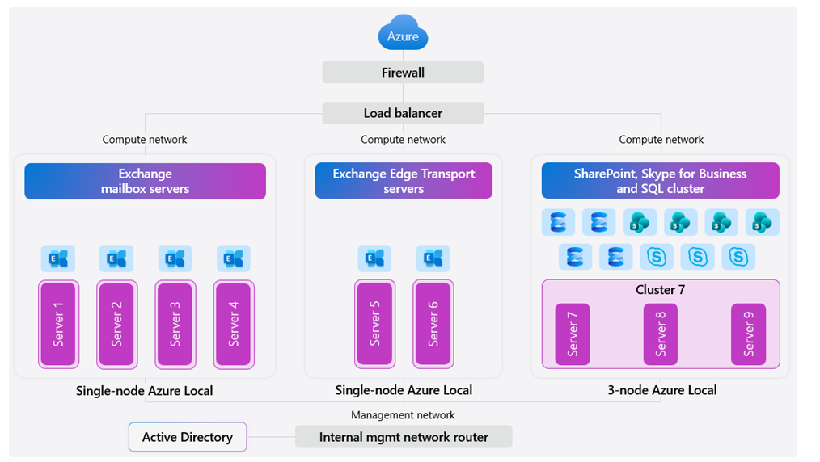
Miscellaneous Updates 3/6
Generally Available: Private Marketplace for VS Code
The VS Code Private Marketplace provides a secure, enterprise-ready solution for hosting and managing extensions internally, fully integrated with Visual Studio Code. It enables organizations to self-host their extension catalog, streamline deployment, and manage updates with greater flexibility and control.
Microsoft 365 Local is Generally Available
Microsoft has announced the general availability of Microsoft 365 Local, a deployment framework that enables core collaboration and communication workloads—Exchange Server, SharePoint Server, and Skype for Business Server—to run on Azure Local. Built on a validated reference architecture using Azure Local Premier Solutions, it provides full compatibility and support for sovereign and regulated environments.
Partner-led services assist with sizing, configuration, and best-practice implementation, ensuring end-to-end deployment that includes networking, security, and operational guidance.

Slide 123
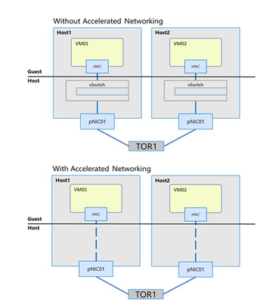
Miscellaneous Updates 4/6
Microsoft Foundry on Windows Server
AI on Windows Server unlocks new opportunities for organizations that need on-premises AI due to data residency, compliance, or low-latency requirements—common in industries such as healthcare, finance, manufacturing, and retail. While Azure remains the best destination for advanced models and large-scale inference, many customers want to enhance existing workloads with local AI.
Microsoft Foundry on Windows brings these capabilities to on-premises server environments. It includes Foundry Local and Windows ML, enabling organizations to build and run local generative AI and real-time inference workloads on their own infrastructure while maintaining full control over data.
Windows Server 2025, now generally available, strengthens this platform with features designed for AI workloads—including advanced storage improvements, GPU partitioning (GPU-P), Discrete Device Assignment (DDA), and expanded Hyper-V scalability supporting up to 2,048 vCPUs per Gen2 VM. This makes Windows Server an enterprise-grade foundation for mission-critical, on-premises AI processing without leaving the datacenter.
Announcing General Availability for AccelNet on Windows Server 2025
Customers modernizing their datacenters consistently emphasize two priorities: every CPU cycle matters and predictable latency beats peak throughput. To meet these needs, Microsoft is bringing Accelerated Networking (AccelNet)—the same high-performance networking technology used in Azure—to Windows Server 2025 Datacenter.
AccelNet uses SR-IOV to bypass the virtual switch for data-plane traffic, delivering key advantages:
Reduced CPU overhead by offloading networking work
Lower latency and jitter, ensuring more predictable performance
Higher VM density per host, freeing CPU cycles for workloads rather than networking
With Accelerated Networking, Windows Server 2025 provides more consistent, efficient performance for mission-critical and latency-sensitive applications.

Slide 124
Miscellaneous Updates 5/6
Windows Admin Center version 2511 is now in public preview!
Windows Admin Center 2511 is now available, bringing key improvements to installation, core tools, and overall reliability. This release addresses customer feedback from versions 2410 and 2410.1 and introduces several enhancements:
Platform & Installer Updates
Virtual Machines tool
VM Conversion tool
Remote Desktop tool
Security tools
SDN management
Known Issues
Registration in Azure Government is not supported.
High Availability deployments are not yet supported with the .NET 8 backend; support will return in GA 2511.
A new private GitHub NDA group is replacing the previous Viva Engage group, and customers or MVPs with an NDA can request access.
Announcing Network HUD: Operational Network Monitoring for Windows Server 2025
Networking issues can cause outages, degraded performance, and costly downtime. Network HUD brings real-time network health monitoring to Windows Server clusters, helping operators detect misconfigurations and drift before they impact workloads. It ensures networking remains aligned with best practices so teams can operate with confidence.
Why Network HUD?
Managing host networking is complex—small errors, outdated drivers, or bandwidth oversubscription can quickly lead to instability. Network HUD continuously monitors cluster networking and provides actionable insights, helping teams:
Detect unstable adapters and PCIe oversubscription
Identify outdated or incompatible drivers
Spot storage networking issues related to PFC/ETS
Catch VLAN misconfigurations
Maintain consistent checks across all nodes
Reduce troubleshooting time and support incidents

Slide 125
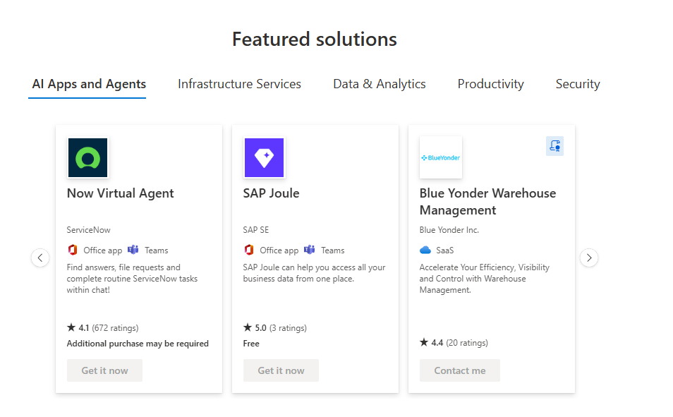
Miscellaneous Updates 6/6
Generally Available: Microsoft Marketplace
Microsoft Marketplace —trusted source for cloud solutions, AI apps, and agents — is now globally available following its launch in the United States in September.
All traffic from legacy storefronts (Azure Marketplace and AppSource) is now redirected to Marketplace.Microsoft.com Featuring the industry’s largest catalog of AI apps and agents, Marketplace extends the Microsoft Cloud, helping customers accelerate their AI-first transformation with tens of thousands of vetted solutions from our partner ecosystem. These solutions integrate easily with Microsoft products, delivering faster time-to-value.

Slide 126
Information

Slide 127
Information
Azure Times GitHub Repo

Slide 128
Questions

