Slide 1
Azure Times #154
March 10, 2025

Slide 2
Management & Governance

Slide 3
Management & Governance Updates
GA: Vaulted Backup for Azure Files Standards Shares
Azure Backup Vaulted support for Azure Files shares standard is now generally available providing enhanced data protection with the ability to configure snapshot and vaulted backup in a single policy and offers cross account/regional recovery.
Vaulted backup support now enables adherence to the widely accepted 3-2-1 backup rule for Azure files protection alongside centralized management to gain visibility, monitor jobs, alerts and reporting using Azure Business Continuity Center.
Protect against ransomware and malicious activities with immutable backups and soft delete functionality on recovery services vault.
Long-term retention is essential for meeting compliance and audit requirements. Vaulted backup provides daily, monthly, and yearly backups that can be retained in cost-effective storage for up to 99 years.
The vaulted backup for Azure Files - premium is in public preview.
Charges for vaulted backup of standard and premium files will start from 1st April 2025.
Public Preview: Azure Site Recovery Support for Azure Trusted Launch VMs running Linux OS
Azure Site Recovery support for Azure Trusted Launch VMs running Linux OS is in public preview.
Following are the distros supported in Public preview:
Ubuntu: 18.04, 20.04, 22.04, 24.04
RHEL: 8.3, 8.4, 8.5, 8.6, 8.7, 8.8, 8.9, 8.10, 9.0, 9.1, 9.2, 9.3, 9.4
SUSE 15: SP3, SP4, SP5, SP6
Alma Linux: 8.10, 9.4
Debian: 12
Azure Site Recovery support for Trusted launch VM running Windows OS is already generally available.

Slide 4
Management & Governance Updates
Microsoft Cost Management updates—February 2025
Cost details datasets now include AccountId and InvoiceSectionId columns to support more cost allocation scenarios.
Copilot is now one click away from the Cost Management overview with new sample prompts that can help you get started with Copilot for Azure.
Documentation updates for Cost Management API modernization, programmatically creating MCA subscriptions, and more.

Slide 5
Compute

Slide 6
Compute Updates
GA: Azure Managed Prometheus Supports Horizontal Pod Autoscaling for Replica Set Pods in AKS
Azure Monitor Managed service for Prometheus now supports Horizontal Pod Autoscaling (HPA) for the ama-metrics replica set pod by default.
With this update, the ama-metrics replica set pod which handles the scraping of Prometheus metrics with custom jobs can scale automatically based on the memory utilization. By default, the HPA is configured to support a minimum of 2 replicas (which is the global default) and a maximum of 12 replicas. Customers will also the have ability to set the shards to any number of minimum and maximum replicas as long as they are within the range of 2 and 12. HPA will automatically take care of scaling based on the memory utilization of the ama-metrics pod to avoid OOM kills.
GA: Custom Secure Boot UEFI Keys for Azure Trusted Launch VM
Trusted Launch VM now supports customizing secure boot UEFI keys. One or more of the secure boot keys and/or databases (PK, KEK, DB, or DBX) can be fully replaced or updated. This allows additional flexibility to further secure workloads using Trusted Launch virtual machines in Azure. Trusted Launch VM improves security posture of workloads in Azure VM.
Protect against persistent boot/kernel malware (improved security posture)
Boot to a defined and trusted state
Meet industry/NIST security best practices/standards + Microsoft security benchmark
UEFI key customization is offered through Azure compute gallery resources. If you currently use a Marketplace image to create a Trusted Launch VM, you must first create Azure compute gallery resources using the Marketplace image to modify UEFI keys.
Note:
USGov and China clouds are currently not supported

Slide 7
Storage & Data

Slide 8
Storage & Data Updates
GA: Azure NetApp Files basic network feature upgrade with no downtime
Standard Network Features provide with an enhanced Virtual Networking experience for a seamless and consistent experience along with security posture for Azure NetApp Files.
Now it is possible to edit existing Azure NetApp Files volumes and upgrade Basic network features to Standard network features with no downtime. This feature is available in all Azure NetApp Files enabled regions.
Increased IP limits for the VNets with Azure NetApp Files volumes on par with VM
Enhanced network security with support for Network Security Groups on the Azure NetApp Files delegated subnet.
Enhanced network control with support for User-defined routes to and from Azure NetApp Files delegated subnets.
Connectivity over Active/Active VPN gateway setup for highly available connectivity to ANF from on-prem.
ExpressRoute FastPath connectivity to Azure NetApp Files. FastPath is designed to improve the data path performance (low latency and high bandwidth connectivity) between on-premises network and Azure virtual network.
Public Preview: Azure Storage Object Replication Metrics for Visibility into Replication Progress
Announcing the public preview of two new metrics in Azure Storage, designed to provide users with enhanced visibility and insights into their object replication progress. These new metrics include:
Pending Operations: The number of operations pending replication.
Pending Bytes: The amount of data pending replication.
These metrics also provide visibility into how long they have been pending for replication. For example, the pending operations metric shows the number of operations based on how long they have been waiting for replication such as less than 5 minutes, between 5-10 minutes, between 10-15 minutes, and so on.

Slide 9
Databases

Slide 10
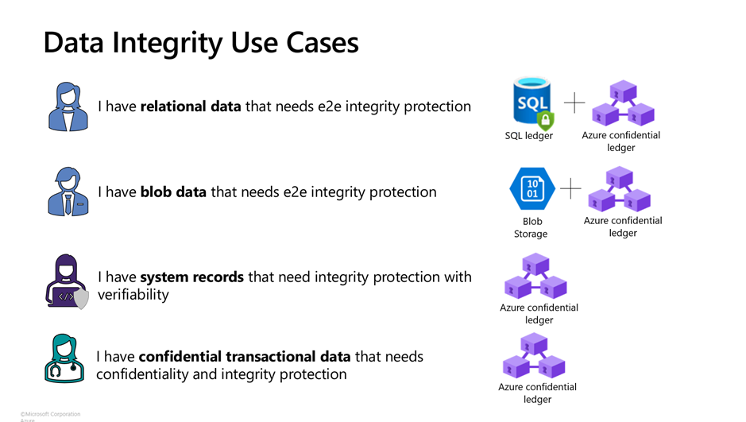
Databases Updates
GA: Lower Pricing for Azure Confidential Ledger
Azure confidential ledger - It is a tamper protected, and auditable data store backed by a Merkle tree blockchain structure for sensitive records that require high levels of integrity protection and/or confidentiality.
Effective March 1, 2025, records in Azure confidential ledger (ACL) will be kept at the reduced price of approximately $3 per day per instance. The reduced price is for the computation and the ledger use.
To protect records, automatically create signatures of blob storage data and keep those in Azure confidential ledger.
Private-preview: User-defined functions for Azure confidential ledger
Azure confidential ledger now allows to deploy custom business logic written in JavaScript/TypeScript and take advantage of increased protection of data in memory by running those scripts in a trusted execution environment (TEE).
For example, create computation rules for financial transaction records from web systems, such as credit card risk analysis records. Or create a counter for when certain conditions are met on the transactions put into the ledger. It is also simple to leverage these features should need to process claims for insurance or healthcare with confidentiality and integrity guarantees.

Slide 11
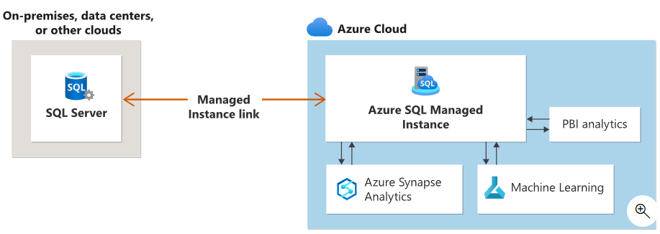
Databases Updates
Managed Instance link with SQL Server 2017 is now GA
MS announced the general availability of Managed Instance link feature with SQL Server 2017, which enables near-real time data replication from SQL Server to Azure SQL Managed Instance.
Link feature is now supported in all SQL Server versions in the mainstream and extended support, from SQL Server 2016 to SQL Server 2022.
To use Managed Instance link feature SQL Server 2017, customers need to install “Azure Connect Pack for SQL Server 2017”.
The Managed Instance link uses distributed availability groups to extend data estate in a safe and secure manner, replicating data in near real-time from SQL Server hosted anywhere to Azure SQL Managed Instance, or from Azure SQL Managed Instance to SQL Server 2022 hosted anywhere.
The link supports single node and multiple-node SQL Server instances with or without existing availability groups.
The link feature currently offers the following functionality:
One-way replication from SQL Server versions 2016, 2017 and 2019: Replicate data one way from SQL instance to Azure SQL Managed Instance.
Disaster recovery (SQL Server 2022): Replicate data between SQL Server 2022 and SQL Managed Instance, manually fail over to secondary during a disaster, and fail back to primary after mitigated the disaster.

Slide 12
Databases Updates
MSSQL Extension for VS Code: What’s new and what’s next
Fixed support for Always Encrypted - Secure Enclaves in the Connection Dialog.
Improved usability by removing SQL editor actions from the Git diff editor.
Enhanced Query Result pane by fixing issues related to copying data while sorting and filtering.
Resolved column filter issues in multiple result set scenarios.
Improved accessibility in Query Plan Visualizer.
Fixed indefinite hangs when connecting to paused Azure SQL Database Serverless databases.
Fixed HTTPS-over-HTTP proxy handling issues.
Announcing Oracle Database@Azure in Southeast Asia
Microsoft and Oracle are pleased to announce the expansion of Oracle Database@Azure availability to Southeast Asia (Singapore)!
Oracle Database@Azure is now available in 13 regions globally – Australia East, Brazil South, Canada Central, East US, Central US, France Central, Germany West Central, Italy North, Japan East, Southeast Asia, UK South, UK West and West US.

Slide 13
ML & AI & IOT

Slide 14
ML & AI & IOT Updates
Retirement: Bing Search APIs with Your LLM on March 6, 2025
Bing Search APIs, with LLM is retired on March 6th 2025. Any existing instances of Bing Search APIs, with LLM will be decommissioned completely, and the product will no longer be available for usage or new customer signups.
Note that this retirement will apply to partners who are using the S15, S16, S17, or S18 resource.
MS recommend transitioning to Grounding with Bing Search as part of Azure AI Agents.
Grounding with Bing Search allows your Azure AI Agents to incorporate real-time public web data when generating responses with an LLM.
Announcing DeepSeek-V3 on Azure AI Foundry and GitHub
​DeepSeek-V3 is an advanced large language model (LLM), that has gained significant attention for its performance and cost-effectiveness. DeepSeek's innovations highlight the potential for achieving high-level AI performance with fewer resources, challenging existing industry norms and prompting discussions about the future direction of AI development.
Features of DeepSeek-V3:
Advanced Mixture-of-Experts Architecture: With 671 billion total parameters, DeepSeek-V3 employs a Mixture-of-Experts (MoE) model where 37 billion parameters are activated per token. This architecture optimizes computational efficiency without compromising performance.
Extended Context Length: The model supports a context length of up to 128K tokens, enabling it to process and understand longer sequences of data effectively.
Efficient Training and Deployment: Despite its scale, DeepSeek reports training DeepSeek-V3 over approximately 55 days at a cost of $5.58 million, utilizing around 2,000 Nvidia H800 GPUs.

Slide 15
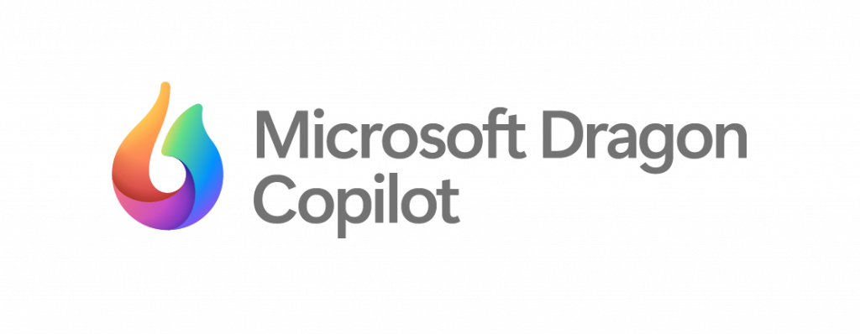
ML & AI & IOT Updates
Microsoft Dragon Copilot
Microsoft Dragon Copilot, the first AI assistant for clinical workflow that brings together the trusted natural language voice dictation capabilities of DMO with the ambient listening capabilities of DAX, fine-tuned generative AI and healthcare-adapted safeguards. Part of Microsoft Cloud for Healthcare, Dragon Copilot is built on a secure modern architecture that enables organizations to deliver enhanced experiences and outcomes across care settings for providers and patients alike.

Slide 16
DevOps & IaC & Automation

Slide 17
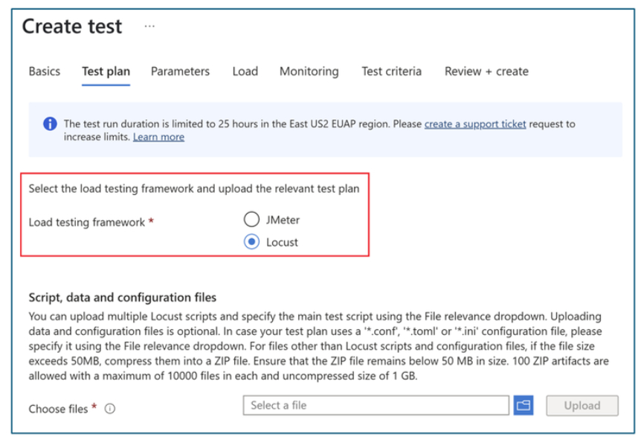
DevOps & IaC & Automation
Locust-based Tests in Azure Load Testing
MS announced support for Locust, a Python-based open-source performance testing framework, in Azure Load Testing. As a cloud-based and fully managed service for performance testing, Azure Load Testing helps easily achieve high scale loads and quickly identify performance bottlenecks. MS now support two load testing frameworks – Apache JMeter and Locust.
Locust is a developer friendly framework that lets write code to create load test scripts as opposed to using GUI based test creation.
Azure Load Testing: Price Drop and Usage Limits to Supercharge
A price reduction for Azure Load Testing effective March 1, 2025:
No more minimum monthly charges for the Azure Load Testing resource. Now, you only pay for the service when you actually use it, i.e. for the Virtual User Hours (VUH) you use.
The price for consumption beyond 10,000 Virtual User Hours (VUH) has dropped from $0.075 per VUH to $0.06 per VUH.
Now it is possible to set a monthly Virtual User Hours (VUH) limit for resource. Once it is reached, Azure Load Testing automatically halts any in-progress tests, ensuring don't overspend.

Slide 18
Information

Slide 19
Information
Azure Times GitHub Repo

Slide 20
Questions

