Slide 1
Azure Times #150
February 10, 2025

Slide 2
Networking

Slide 3
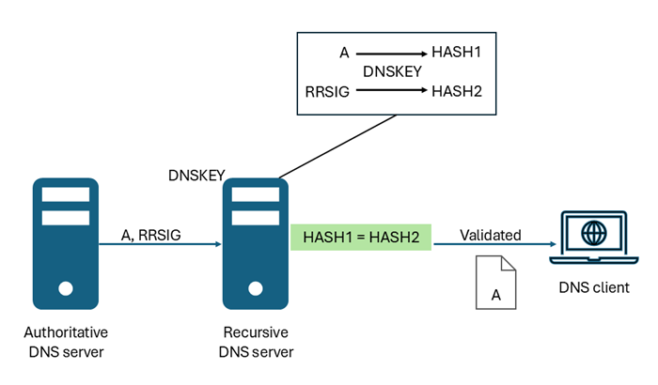
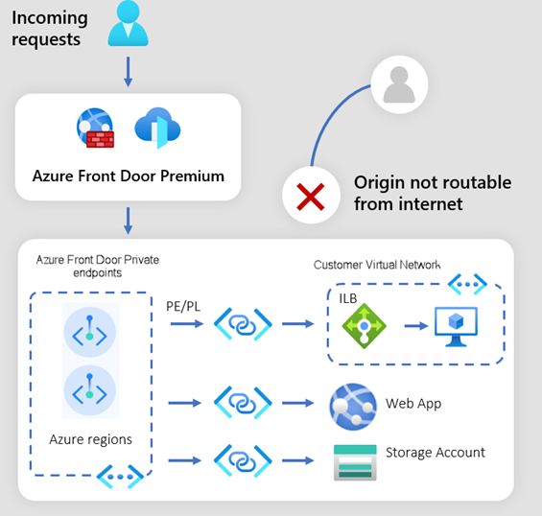
Networking Updates
Public Preview: New Origin Types for Azure Front Door Premium Private Link-Enabled Origins
It is now possible to configure Application Gateway, API Management, and Container Apps as Private Link-enabled origins in Front Door Premium profile.
Private Link-enabled origins in Front Door allow to deliver content to end-users through public Front Door endpoints while ensuring that origins remain inaccessible to the public internet.
GA: Azure DNS Public Zone DNS Security Extension (DNSSEC) support
With this release it is now possible to enable DNSSEC on all existing and new public DNS Zones hosted on Azure DNS.
The Azure DNS service automatically handles all key management and signing operations, simplifying the process for DNS zone administrators.

Slide 4
Security & Identity

Slide 5
Security & Identity Updates
Enhancements for the Linux Baselines recommendation powered by GC
MS enhanced the Baselines Linux (powered by GC) feature to improve its accuracy and coverage. During February, some changes such as updated rule names and additional rules. These improvements are designed to make the baselines assessment more accurate and up-to-date. For more information about the changes, please refer to the relevant blog
Entra ID Connect Release
Added Features
Auditing administrator events in Microsoft Entra Connect Sync enabled for logging any admin changes made on Entra Connect Sync. This includes changes made using the UI and the PowerShell scripts.
Bug fixes
Fixed the removal of the SSPR configuration when changes are made on the Azure AD Connector and saved in the Sync Service manager UI
Fixed validation for the Global Administrator/Hybrid Identity Administrator role done during Entra Connect Sync installation and users with Global Administrator/Hybrid Identity Administrator through Privileged Identity Management (PIM).
Fixed the "no registered protocol handlers" error on Federate with AD FS scenario.
Fixed "Relying party must be unique (conflict error)" error on Federate with AD FS scenario.

Slide 6
Security & Identity Updates
Public Preview - Manage Lifecycle Workflows with Microsoft Security CoPilot in Microsoft Entra
It is now possible to manage, and customize, Lifecycle Workflows using natural language with Microsoft Security CoPilot. Lifecycle Workflows (LCW) Copilot solution provides step-by-step guidance to perform key workflow configuration and execution tasks using natural language. It allows customers to quickly get rich insights to help monitor, and troubleshoot, workflows for compliance.
Public Preview - Flexible Federated Identity Credentials
Flexible Federated Identity Credentials extend the existing Federated Identity Credential model by providing the ability to use wildcard matching against certain claims. Currently available for GitHub, GitLab, and Terraform Cloud scenarios, this functionality can be used to lower the total number of FICs required to managed similar scenarios.

Slide 7
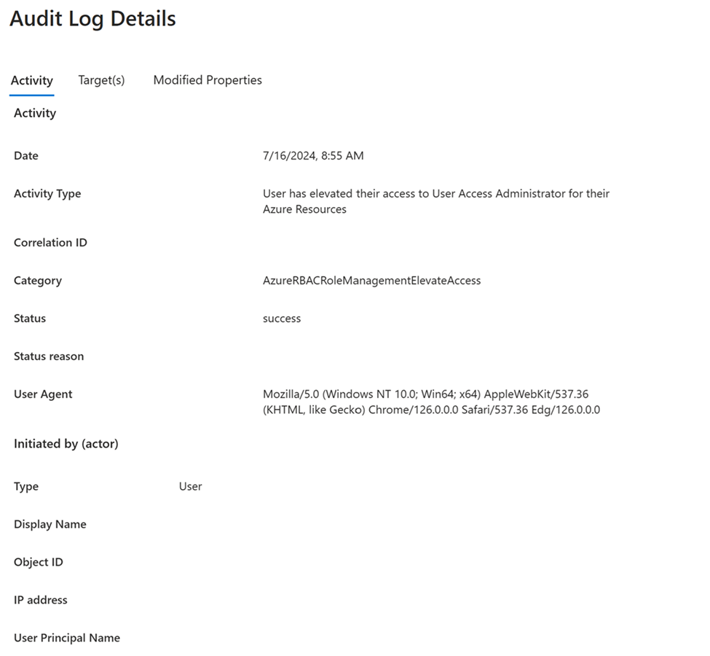
Security & Identity Updates
Public Preview - Elevate Access events are now exportable via Microsoft Entra Audit Logs
This feature enables administrators to export and stream Elevate Access events to both first-party and third-party SIEM solutions via Microsoft Entra Audit logs. It enhances detection and improves logging capabilities, allowing visibility into who in their tenant has utilized Elevate Access.
General Availability - Improving visibility into downstream tenant sign-ins
Interactive sign-in logs currently provide a list of sign in events, but there's no clear indication of which logins are from partners accessing downstream tenant resources. For example, without any additional context, it’s difficult to tell whether logins are from a partner accessing another tenant’s data.
After seeing a partner logging into a downstream tenant’s resources, an important follow-up activity to perform is to validate the activities that might have occurred in the downstream environment. Some examples of logs to look at are Microsoft Entra Audit logs for Microsoft Entra ID events, Microsoft 365 Unified Audit Log (UAL) for Microsoft 365 and Microsoft Entra ID events, and/or the Azure Monitor activity log for Azure events. By following these steps, you're able to clearly identify when a partner is logging into a downstream tenant’s resources and subsequent activity in the environment, enhancing your ability to manage and monitor cross-tenant access efficiently.
To increase visibility into the aforementioned columns, Microsoft Entra will begin enabling these columns to display by default when loading the sign-in logs UX starting on March 7, 2025.

Slide 8
Security & Identity Updates
General Availability - Real-time Password Spray Detection in Microsoft Entra ID Protection
Traditionally, password spray attacks are detected post breach or as part of hunting activity. Now, MS has enhanced Microsoft Entra ID Protection to detect password spray attacks in real-time before the attacker ever obtains a token. This reduces remediation from hours to seconds by interrupting attacks during the sign-in flow.
Risk-based Conditional Access can automatically respond to this new signal by raising session risk, immediately challenging the sign-in attempt, and stopping password spray attempts in their tracks. This cutting-edge detection, now Generally Available, works alongside existing detections for advanced attacks such as Adversary-in-the-Middle (AitM) phishing and token theft, to ensure comprehensive coverage against modern attacks.
General Availability - Protected actions for hard deletions
Customers can now configure Conditional Access policies to protect against early hard deletions.
Conditional Access policies can be applied to limited set of permissions in the following areas:
Conditional Access policy management
Cross-tenant access settings management
Hard deletion of some directory objects
Custom rules that define network locations
Protected action management
Microsoft Entra ID supports two types of deletion for most directory objects: soft deletion and hard deletion. When a directory object is soft deleted, the object, its property values and relationships are preserved in the recycle bin for 30 days. A soft-deleted object can be restored with the same ID and all the property values and relationships intact. When a soft-deleted object is hard deleted, the object is permanently deleted and it cannot be recreated with the same object ID.
To help protect against accidental or malicious hard deletions of some soft-deleted directory objects from the recycle bin and permanent data loss, you can add a protected action for the following permission. This deletion applies to users, Microsoft 365 groups, and applications.

Slide 9
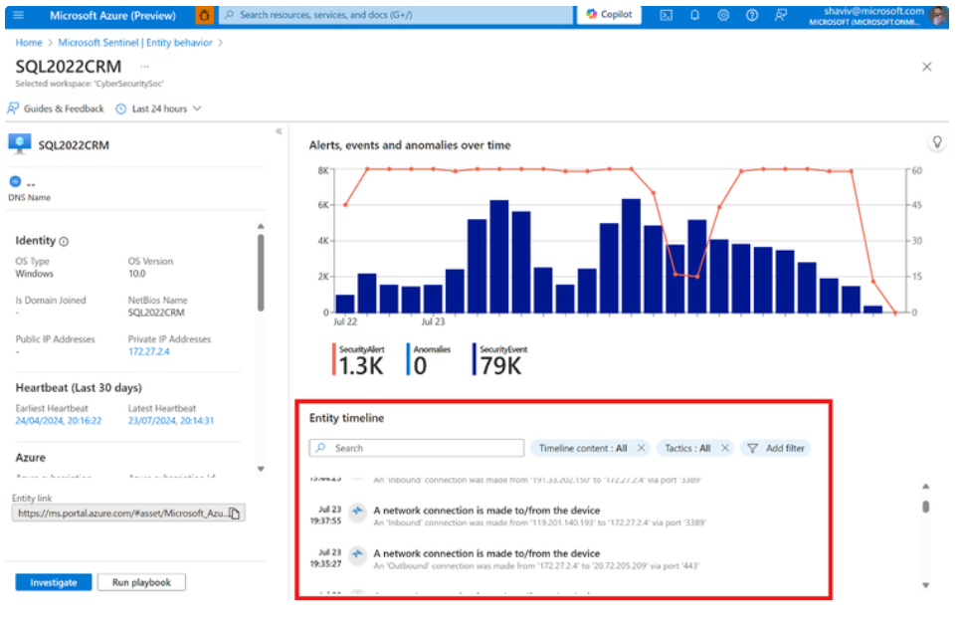
Security & Identity Updates
Azure Container Apps has been certified by Aqua Security.
Aqua Security is a certified security solution for ACA, offering a full-lifecycle approach to securing containerized applications. It provides:
Supply Chain Security: Aqua scans container images for tampering and potential supply chain attacks, ensuring that only verified and secure images are deployed.
Comprehensive Image Scanning: Aqua scans container images in Azure Container Registry (ACR) and CI/CD pipelines for vulnerabilities, misconfigurations, malware, and embedded secrets, enabling developers to address issues early.
Image Assurance Policies: Aqua enforces policies to ensure that only compliant images are deployed, minimizing risks and ensuring adherence to security and compliance standards.
Agentless Discovery and Scanning: Aqua automatically discovers and scans all running services and assets, providing broad visibility into your ACA workloads.
Runtime Protection with MicroEnforcer: Aqua's MicroEnforcer provides non-invasive runtime security, detecting and preventing threats such as cryptocurrency mining, reverse shell execution, and unauthorized access.
Unified Device Timeline Experience in Microsoft SIEM + XDR
MS announced the launch of the Unified Device Timeline, a feature that integrates device activity timelines from Microsoft Sentinel and Defender XDR into a single, cohesive view.
This feature streamlines security investigations by enabling analysts to access all relevant device activities in one place, reducing the need to switch between platforms and accelerating incident response times.

Slide 10
Management & Governance

Slide 11
Management & Governance Updates
Azure ARC Enabled Servers
New features and enhancements
Added support for extension telemetry.
Updated the OpenSSL library for security enhancements.
Improved error reporting for azcmagent commands.
Increased connectivity check timeout for better reliability.
Expanded ARM64 platform support to include RHEL 9.
Updated the mssqldiscovered property to include the detection for SQL Server Integration, Analysis, and Reporting services (SSIS, SSAS, SSRS and PBIRS).
Introduced a scheduled task that checks for agent updates on a daily basis. Currently, the update mechanism is inactive and no changes are made to server even if a newer agent version is available. In the future, you'll be able to schedule updates of the Azure Connected Machine agent from Azure.
Log Analytics Simple Mode is Now Generally Available
Until now, Azure Monitor Logs relied on Kusto Query Language (KQL) for users to express their questions as queries.
KQL is a powerful, easy to learn query language, however, as any query language it requires some knowledge to operate.
Simple mode experience was created to bridge this knowledge gap - allowing most popular KQL operators and actions to be utilized using a very simple, point-and-click experience requiring no KQL knowledge at all!
KQL Mode gives advanced users the full power of KQL to derive deeper insights from their logs.

Slide 12
Management & Governance Updates
SQL Migration assessments now include Next-gen General Purpose Azure SQL MI
MS announced the inclusion of the Next-gen General Purpose service tier in target recommendation for assessments of SQL Server instance migration to Azure SQL Managed Instance. The Next-gen General Purpose service tier is more customizable, allowing the migration tools to tailor the recommendation more closely to the resource requirements of the source instance.
The recently introduced Next-gen General Purpose service tier of Azure SQL Managed Instance is an evolution of the existing General Purpose tier that provides the following additional benefits to users:
Better performance
More vCore click-stops
More IOPS for the same amount of reserved storage.
Increased limit for number of databases to 500

Slide 13
Compute

Slide 14
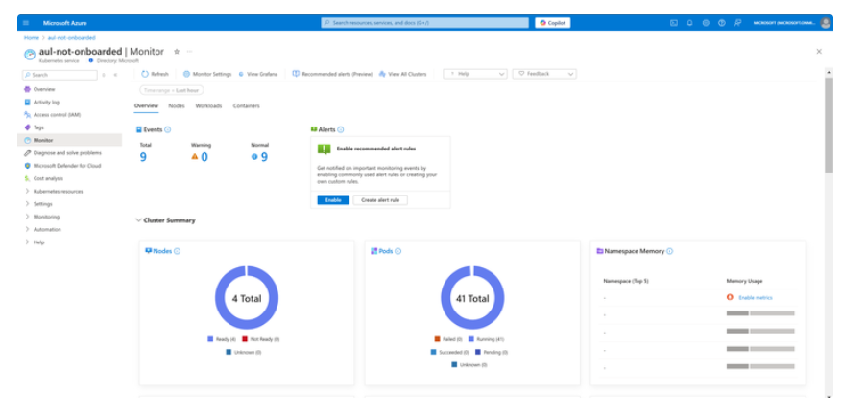
Compute Updates
Public Preview: Introduction the New AKS Monitoring Experience – Unified Insight at Your Fingertips
This redesign of the existing Insights experience brings comprehensive monitoring capabilities into a single, streamlined view, addressing some of the most common challenges users face when managing their AKS clusters.
A new Monitoring experience provides both basic (free) and detailed insights (with enabled Prometheus metrics and logging), offering a unified, single-pane-of-glass experience. The basic experience is available for all AKS users with no configuration required at all.
GA: Azure Databricks Available in Mexico central
Azure Databricks is a data analytics platform optimized for the Microsoft Azure cloud services platform. Azure Databricks offers three environments for developing data intensive applications: Databricks SQL, Databricks Data Science & Engineering, and Databricks Machine Learning.
Azure Databricks is now generally available in Mexico Central.

Slide 15
Storage & Data

Slide 16
Storage & Data Updates
Introducing enhanced conversation with Microsoft Fabric Copilot (Preview)
MS introduced a new way to store chat prompts and history, improved accuracy of responses, and better context knowledge retention.
Improved accuracy of responses - chat conversations will now be used to improve the accuracy of the responses provided by AI functionalities
Enhanced efficacy of Copilot chat - By leveraging cross-Geo data storage, users can experience significantly improved inline chat functionality within the AI Skill (coming soon) and Copilot experience in the Fabric notebook.
Context knowledge retention - Storing conversational history helps retain context knowledge
Context and overview – MS now storing chat prompts and history for some conversation to improve the relevancy and accuracy of Copilot conversations.
Announcing the activation of billing for SQL database in Fabric
Billing for compute usage and data storage for SQL databases in Fabric will commence after February 1st.
Charges for backups will be implemented later

Slide 17
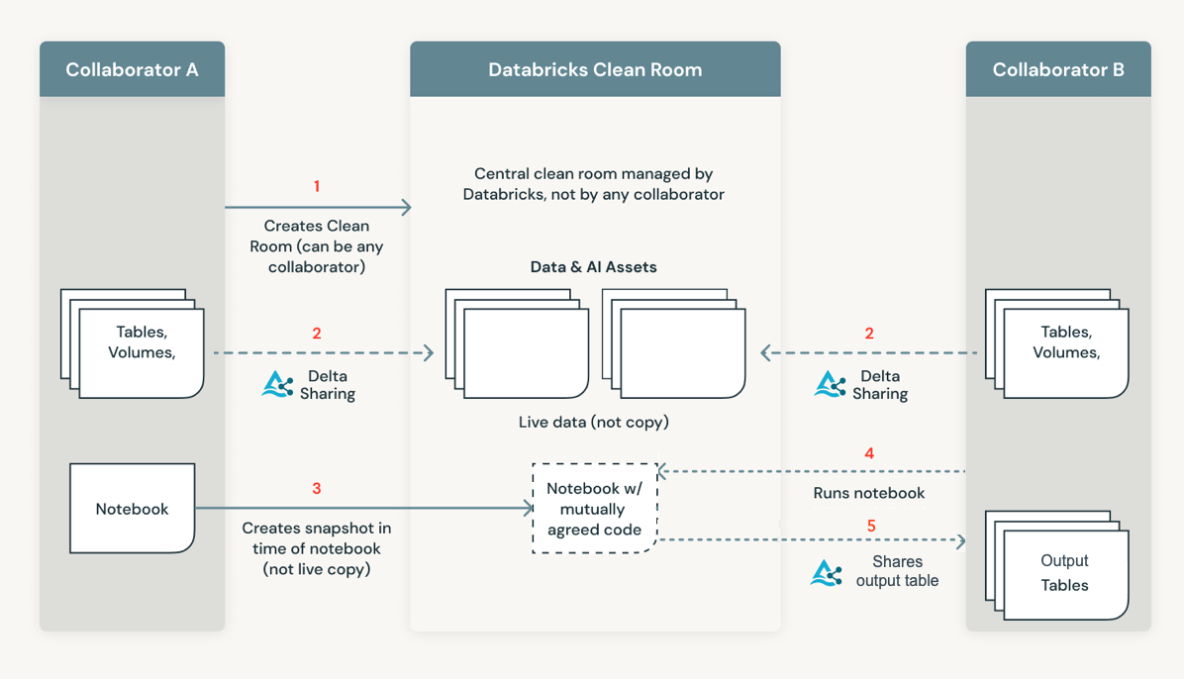
Storage & Data Updates
GA: Azure Databricks Clean Rooms
Azure Databricks Clean Rooms offers a privacy-safe environment for collaboration on all data and AI assets, ensuring no direct access to sensitive information.
Azure Databricks Clean Rooms meets these essential needs, enabling businesses to work seamlessly with their customers and partners across any cloud platform in a privacy-safe manner.

Slide 18
Databases

Slide 19
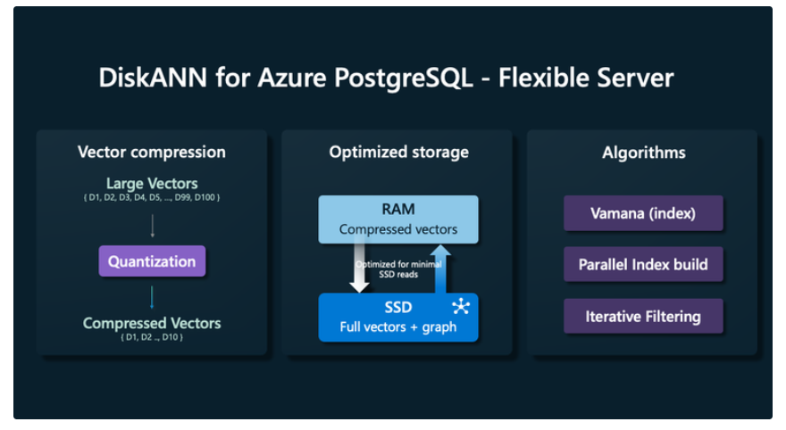
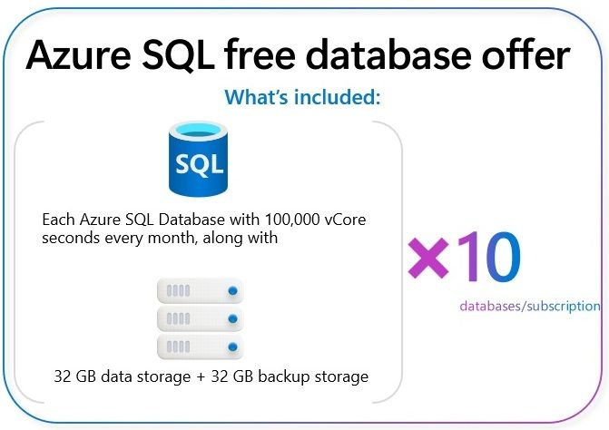
Databases Updates
GA: Azure SQL Database Free Offer
Now it is possible to try 10 Azure SQL Databases free of charge for the life of subscription.
This new offer provides 10 databases, each with 32 GB General Purpose, serverless Azure SQL database, and 100,000 vCore seconds of compute free every month. This is a great starter option for many scenarios, whether you are learning SQL, developing a web app that needs a database, or simply need an additional database for a proof of concept on an application such as PowerBI reporting.
This offer is available for any Azure subscription type. Every month, free amount will renew for the life of the subscription.
Scalable Vector Search with DiskANN - Available to all Azure Database for PostgreSQL
Developed by Microsoft Research and used extensively at Microsoft in global services such as Bing and Microsoft 365, DiskANN is an approximate nearest neighbor search algorithm designed for efficient vector search at scale. It provides high recall, high throughput, and low query latency essential for modern AI and RAG applications.

Slide 20
ML & AI & IOT

Slide 21
ML & AI & IOT Updates
Public Preview: Azure AI Agent Service
Azure AI Agent Service is now publicly available in the Azure AI Foundry SDK and the Azure AI Foundry portal, bringing the power of enterprise-ready AI agents to businesses worldwide.
Azure AI Agent Service is a fully managed service designed to empower developers to securely build, deploy, and scale high-quality, and extensible AI agents without needing to manage the underlying compute and storage resources.
Azure AI Agent Service provides a more streamlined and secure way to build and deploy AI agents. This includes:
Automatic tool calling – no need to parse a tool call, invoke the tool, and handle the response; all of this is now done server-side
Securely managed data – instead of managing your own conversation state, you can rely on threads to store all the information you need
Out-of-the-box tools – In addition to the file retrieval and code interpreter tools provided by Azure OpenAI Assistants, Azure AI Agent Service also comes with a set of tools that you can use to interact with your data sources, such as Bing, Azure AI Search, and Azure Functions.
GPT-4o-Mini Audio Models
MS announced the release of the new GPT-4o-Mini-Realtime-Preview and GPT-4o-Mini-Audio-Preview models, both now available in preview. These new models introduce advanced audio capabilities at just 25% of the cost of GPT-4o audio models.
GPT-4o-Mini-Realtime-Preview:
Real-Time Voice Interaction: Enable real-time, natural voice-based interactions for a more engaging user experience.
When to Use: Ideal for applications requiring immediate, real-time responses, such as customer service chatbots and virtual assistants.
GPT-4o-Mini-Audio Preview:
Advanced Audio Capabilities: Provides high-quality audio interactions at a reduced cost.
When to Use: Perfect for applications requiring asynchronous audio capabilities, such as recording sentiment analysis and text-to-audio content creation.

Slide 22
DevOps & IaC & Automation

Slide 23
DevOps & IaC & Automation
Conditional Access policies Across Azure DevOps
Previously, it was possible to regularly evaluate IP-fencing policies (at a much less frequent cadence than every hour) with older cookie-based authentication. Now, It is possible to support conditional access policies (CAP), such as device compliance that can be used to prevent usage on devices that fail to meet a variety of compliance requirements.
Azure DevOps IP addresses Changes
MS announced important upgrades to networking infrastructure that will enhance the performance and reliability of service. As part of these infrastructure upgrades, they are introducing new IP addresses that should be allowed in firewall configurations.
Please add below new IP addresses to your firewall allow list as soon as possible to ensure continuous service during our infrastructure upgrade.
150.171.22.0/24
150.171.23.0/24
150.171.73.0/24
150.171.74.0/24
150.171.75.0/24
150.171.76.0/24

Slide 24
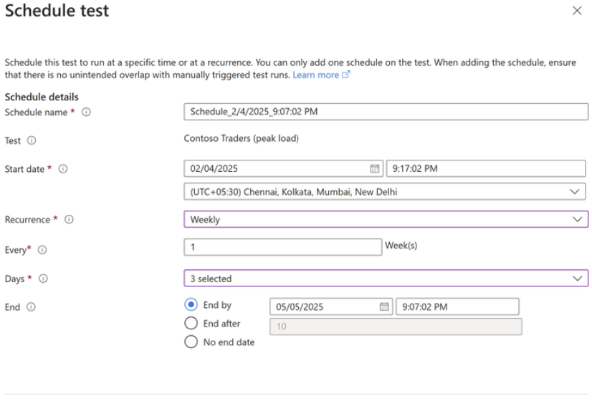
DevOps & IaC & Automation
Multiple JMeter Files and Fragments in Azure Load Testing
MS announced a significant update to Azure Load Testing that allows to use multiple JMeter files and fragments in test configurations. This feature allow users to:
Modularity - Using multiple JMeter files allows you to break down test scenarios into smaller, manageable units.
Reusability - JMeter fragments are reusable components of test plans
Collaboration Across Teams - With modular scripts, different team members can work on specific JMeter files or fragments simultaneously, improving collaboration and accelerating test development.
Easier Debugging and Maintenance - Debugging a modular test setup is more straightforward, as you can isolate and troubleshoot specific files or fragments without affecting the entire test plan
Introducing Scheduled Load Tests in Azure Load Testing
It is now possible to automate test runs at a predefined time or cadence, ensuring seamless performance validation without manual intervention. Azure Load Testing’s scheduling functionality offers flexible options to meet different testing needs:
Customizable scheduling – Set up tests to run once, hourly, daily, weekly, or monthly.
Cron-based scheduling – Define complex recurrence patterns using cron expressions.
Controlled test runs – Set an end condition based on a specific date or number of occurrences.
Failure handling – If three consecutive test runs fail, the schedule is automatically disabled, ensuring you can resolve issues before resuming testing to avoid unnecessary costs.

Slide 25
Miscellaneous

Slide 26
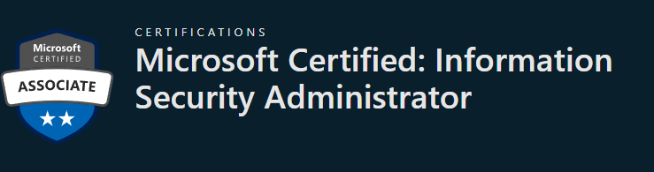
Miscellaneous Updates
Announcing Support for Oracle Applications with Oracle Database@Azure
Microsoft announced that Oracle has introduced new support policies for running Oracle E-Business Suite, PeopleSoft, JD Edwards EnterpriseOne, Enterprise Performance Management, and Oracle Retail Applications in Microsoft Azure using Oracle Database@Azure. This milestone enables businesses to harness the power of Microsoft Azure while leveraging Oracle’s industry-leading database technology to achieve greater scalability, performance, and security.
The latest support policies cover:
Support Policy for Oracle E-Business Suite Running in a Multicloud Environment (Doc ID: 3015095.1)
Support for PeopleSoft Applications Running in a Multicloud Environment (Doc ID: 3066912.1)
Support Policy for JD Edwards EnterpriseOne running in a Multicloud Environment (Doc ID: 3067119.1)
Support Policy for Oracle Enterprise Performance Management Applications Running in a Multicloud Environment (Doc ID: 3066767.1)
Oracle Retail Support Policy for Retail Management System Running in a Multicloud Environment (Doc ID: 3066738.1)
Microsoft Certified: Information Security Administrator Certification that will be available in April 2025
Microsoft Certified: Information Security Administrator Certification that will be available in April 2025. It is possible to get new Certification by passing Exam SC-401: Administering Information Security in Microsoft 365,available in beta on February 11, 2025.
Microsoft Certified: Information Protection and Compliance Administrator Associate Certification and its related Exam SC-400: Administering Information Protection and Compliance in Microsoft 365. The Certification, related exam, and renewal assessments will all be retired on May 31, 2025.

Slide 27
Miscellaneous Updates
Retirement: Azure Data Studio
Azure Data Studio (ADS) will be officially retired on February 28, 2026, to streamline development efforts and improve the user experience in Visual Studio Code (VS Code). VS Code will become the recommended cross-platform tool for developers building backend databases.
ADS will be supported until February 28, 2026, to ensure users have sufficient time to transition. Any files or database projects available locally in ADS will remain accessible through February 28, 2026.
Database projects created in ADS can be opened and continued in VS Code without any migration steps. Most extensions in ADS are also available in VS Code, though some SQL-based exceptions exist. In those cases, customers should consider SQL Server Management Studio 21 (SSMS 21) as an alternative to VS Code.

Slide 28
Information

Slide 29
Information
Azure Times GitHub Repo

Slide 30
Questions

