Slide 1
Azure Times #156
March 24, 2023

Slide 2
Security & Identity

Slide 3
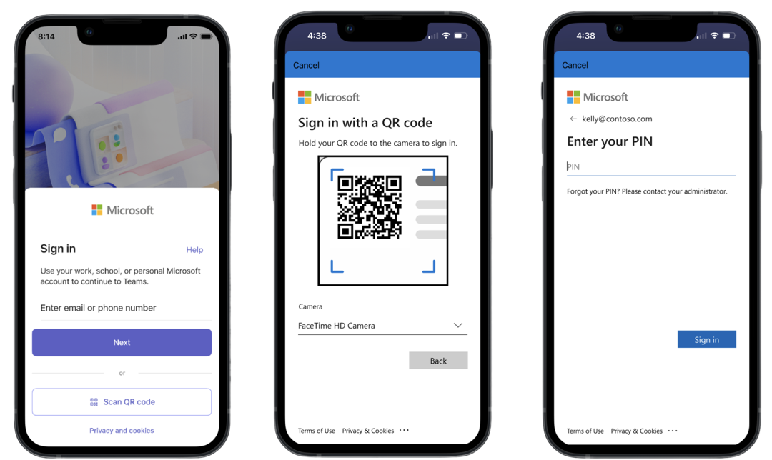
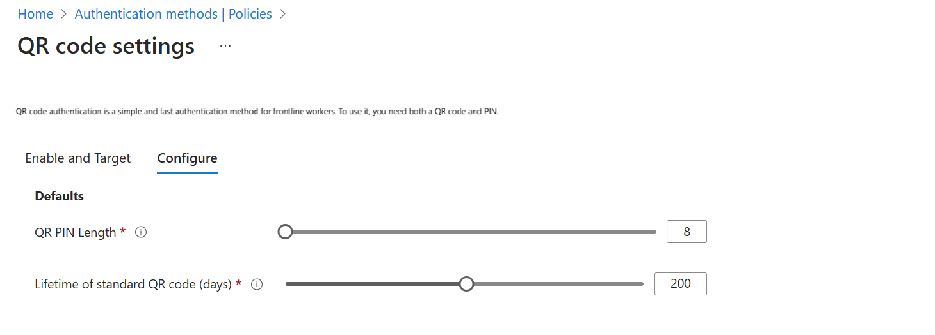
Security & Identity Updates
Microsoft Entra ID - QR code authentication method (Preview)
QR code authentication is a simple authentication method primarily designed for frontline workers. It consists of a unique QR code and a numeric PIN. The QR code serves as an identifier and is unique to the user. It can be downloaded and printed by using the Microsoft Entra admin center, My Staff, or Microsoft Graph. For convenience, the QR code can be attached to a badge or any other wearable item.
Authentication Administrators provide a temporary PIN to users, who then change it during sign-in. Only the user knows the PIN. It's exclusively bound to the QR code only.
Currently, QR code authentication is supported only on mobile devices that run iOS/iPadOS or Android.

Slide 4
Security & Identity Updates
Microsoft Defender Vulnerability Management now support CVSS V4 score
Microsoft Defender Vulnerability Management is now supporting CVSS v4 as the preferred scoring standard for newly published Common Vulnerabilities and Exposures (CVEs). This update aligns Defender Vulnerability Management with the latest vulnerability scoring standards, providing more precise industry-aligned assessments tailored to real world risk evaluation.
CVSS v4 addresses the limitations of its predecessor, CVSS v3, introducing features that provide a more granular and accurate assessment of vulnerabilities.
Announcing the General Availability of OpenID Connect external identity provider support for Microsoft Entra External ID
This feature allows to integrate sign-in and sign-up user flows with identity providers using the OAuth 2.0 authorization standard and OIDC specifications.
Enabling users to access applications with their existing accounts from other identity providers provides two major benefits: it facilitates partner integration through identity federation and allows users to sign in with their existing credentials rather than creating new ones. This seamless approach fosters partnerships, boosts conversion rates, and enhances user satisfaction.
Microsoft Entra External ID’s OIDC external identity provider support enables several key scenarios:
Integrate with cloud identity providers
Federate with Azure AD B2C
Federate with social Identity Providers including Personal Microsoft Account
Implement partner identity providers
Federate with government and citizen identity providers

Slide 5
Management & Governance

Slide 6
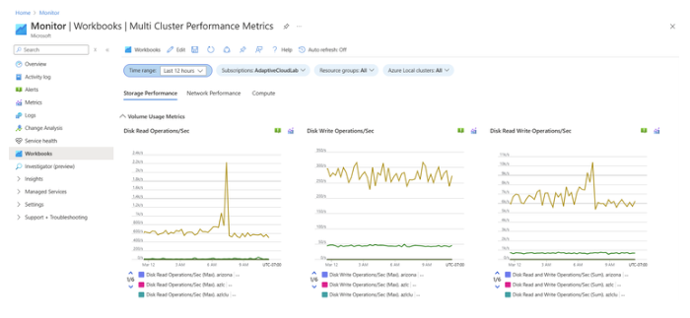
Management & Governance Updates
Azure Monitor Private Link Scope (AMPLS) Scale Limits Increased by 10x!
Azure Monitor Private Link Scope (AMPLS) is a feature that allows to securely connect Azure Monitor resources to virtual network using private endpoints. Azure Monitor Private Link Scope (AMPLS) have been significantly increased by tenfold (10x) in Public Cloud regions as part of the Public Preview.
An AMPLS object can now connect up to 3,000 Log Analytics workspaces and 10,000 Application Insights components. (10x Increase)
The Log Analytics workspace limit has been increased from 300 to 3,000 (10x increase).
The Application Insights limit has increased from 1,000 to 10,000 (10x increase).
An Azure Monitor resources can now connect up to 100 AMPLSs (20x increase).
Data Collection Endpoint (DCE)
Log Analytics Workspace (LA WS)
Application Insights components (AI)
An AMPLS object can connect to 10 private endpoints at most.
Redesign of AMPLS – User experience to load 13K+ resources with Pagination
Azure Local Performance Metrics Dashboard
Azure Local Performance Metrics Dashboard – allows keeping an eye on Azure Local systems. This awesome tool is packed with over 60 metrics, all collected by default and at no extra cost.

Slide 7
Management & Governance Updates
Generally Available: Azure Monitor Managed Service for Prometheus for Azure Arc-enabled Kubernetes
Azure Monitor managed service for Prometheus for Azure Arc-enabled Kubernetes allows customers to monitor their Kubernetes clusters running anywhere. It offers fully managed collection, storage, rule evaluation, and querying of Prometheus data. The metrics time-series database leverages the same platform used by Azure Monitor Metrics, which we extended to handle Prometheus metrics in their native format. When coupled with Azure Managed Grafana it supports a cloud-native approach to monitoring your Kubernetes environment and is an integral component for observing your containerized workloads.

Slide 8
Compute

Slide 9
Compute Updates
Generally Available: VM Hibernation on GPU VMs
VM hibernation is now generally available for GPU Virtual Machines, providing a cost-efficient way to pause workloads while preserving in-memory state. This feature is supported on select sizes and is available on both Linux and Windows operating systems across all public regions. By leveraging hibernation, it is possible to reduce compute costs by deallocating the VM and only pay for associated storage and networking resources.
It does not support:
Ephemeral OS disks
Shared disks
Availability Sets
Virtual Machine Scale Sets in Uniform orchestration mode are not supported. Virtual Machine Scale Sets in Flexible orchestration mode are supported.
Spot VMs
Managed images
Azure Backup
Capacity reservations
Prerequisites:
Hibernation must be enabled on VM.
A persistent OS disk large enough to store the contents of the RAM, OS and other applications running on the VM is connected.
The VM size supports hibernation.
The VM OS supports hibernation.
The Azure VM Agent is installed if you're using the Windows or Linux Hibernate Extensions.
If a VM is being created from an OS disk or a Compute Gallery image, then the OS disk or Gallery Image definition supports hibernation.

Slide 10
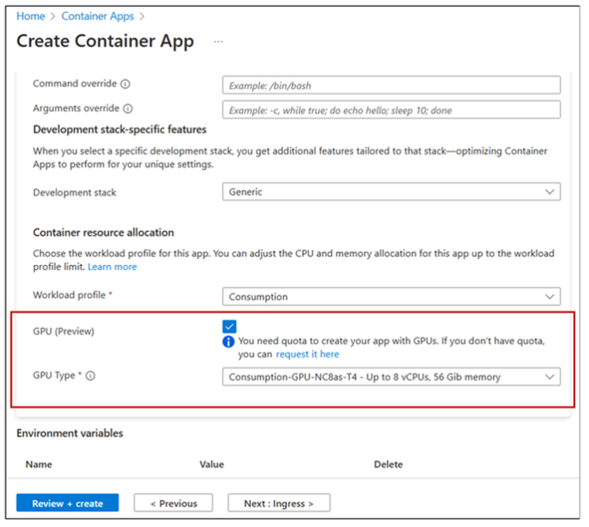
Compute Updates
Generally Available: Serverless GPUs in Azure Container Apps with NVIDIA NIM Support
Serverless GPUs with NVIDIA NIM support is now generally available in Azure Container Apps. Serverless GPUs enable to seamlessly run AI workloads on-demand with automatic scaling, optimized cold start, per-second billing with scale down to zero when not in use, and reduced operational overhead to support easy real-time custom model inferencing and other GPU related tasks.
Serverless GPUs accelerate the speed of AI development teams by allowing customers to focus on core AI code and less on managing infrastructure when using GPUs. This provides an excellent middle layer option between Azure AI model catalog's serverless APIs and hosting custom models on managed compute. This feature will allow customers to build their own serverless API endpoints for inferencing custom AI models. Customers can also provision on-demand GPU-powered Jupyter Notebooks or run other ML workloads with larger computation needs that are ephemeral in nature. It provides full data governance as customer’s data never leaves the boundaries of the container while still providing a managed, serverless platform from which to build your applications.
This GA release of Serverless GPUs also adds support for NVIDIA NIMs, NVIDIA’s purpose-built containers for a wide range of AI scenarios.

Slide 11
Compute Updates
General Availability of Azure's latest AI infrastructure Virtual Machines, the ND GB200 v6
MS announced the general availability of Azure ND GB200 v6 Virtual Machine (VM), powered by NVIDIA GB200 NVL72, that connects 36 Grace CPUs and 72 Blackwell GPUs into a single 72-GPU NVLink domain. This rack-scale system acts like a single massive exa-scale GPU delivering application performance gains and step function architectural improvements that are required to train and host the next generation of reasoning models, AI agents, and LLMs.
Canonical Ubuntu 20.04 LTS Reaching End of Standard Support
MS announced the upcoming end of standard support for Ubuntu 20.04 LTS (Focal Fossa) on 31 May 2025.
Please Upgrading to Ubuntu 22.04 LTS or Ubuntu 24.04 LTS.

Slide 12
Compute Updates
Public preview launch of Azure Functions durable task scheduler
This new Azure-managed backend is designed to provide high performance, improve reliability, reduce operational overhead, and simplify the monitoring of stateful orchestrations.
Durable functions simplifies the development of complex, stateful, and long-running apps in a serverless environment. It allows developers to orchestrate multiple function calls without having to handle fault tolerance. The durable task scheduler is a new storage provider for durable functions, designed to address the challenges and gaps identified. It brings:
Azure Managed
Superior Performance and Scalability
Orchestration Debugging and Management Dashboard
Security Best Practices
Local Emulator
Multiple personal desktops with Azure Virtual Desktop
Multiple personal desktop assignment allows to assign more than one personal desktop to a single user in a single host pool. Multiple desktops are useful for users juggling diverse business roles, such as backend and frontend development or transitioning between testing and production environments. Previously, users were restricted to one personal desktop per host pool, meaning you needed to create multiple host pools for extra desktops. Multiple personal desktop assignment streamlines the process, eliminating the need for multiple host pools in this scenario, and simplifying user assignment management.

Slide 13
Compute Updates
GA: Azure Virtual Desktop Quickstar
Quickstart helps quickly deploy a sample environment and makes it easy to familiarize yourself with Azure Virtual Desktop and the new Windows App.
Think of Quickstart as your Azure Virtual Desktop test drive. Now you can have a fully functioning Azure Virtual Desktop environment up and running after answering only four deployment questions. This guided deployment enables two users to connect to a full virtual desktop session, consisting of one Windows 11 multisession host. Please note, Quickstart is for evaluation and non-production deployments only.

Slide 14
Compute Updates
Retirement: Azure Spring Apps to Be Retired on March 31, 2028
On March 17, 2025, Azure Spring Apps Basic, Standard and Enterprise plans will enter a 3-year sunset period and will be retired on March 31, 2028.
To ensure maintain a high performance and achieve scalability, flexibility, and cost-efficiency for your business, move to Azure Container Apps and Azure Kubernetes Service as the alternative services
New customers will no longer be able to sign up for the service after March 17, 2025; existing customers will remain operational until the plans are phased out on March 31, 2028.
After March 31, 2028, Azure Spring Apps Basic, Standard and Enterprise plans won’t be supported, and Azure Spring Apps instances will no longer be accessible after that date.
Retirement: Kubenet Networking for Azure Kubernetes Service to Be Retired on March 31, 2028
On March 31, 2028, kubenet networking for Azure Kubernetes Service (AKS) will be retired.
To avoid service disruptions, please upgrade to Azure Container Networking Interface (CNI) overlay before that date
Azure CNI overlay provides the same IP address overlay architecture as kubenet, plus new capabilities for increased scalability.

Slide 15
Compute Updates
Retirement: Extended Support for Node 20 LTS Ends on April 30, 2026
On April 30, 2026, extended support for Node 20 LTS will end. Apps that are hosted on App Service will continue to run, but security updates will no longer be available, and we’ll no longer provide customer service for Node 20 LTS. Learn more about App Service language support.

Slide 16
Storage & Data

Slide 17
Storage & Data Updates
GA: Microsoft Purview Data Map 1000 Collections
Collections in the Data Map serve as a logical construct designed to organize assets and data sources within a customer’s data estate by business units.
Additionally, collections are utilized to manage access within Microsoft Purview’s unified catalog.
The increase in collection limit from 400 to 1000 will offer enterprise customers greater flexibility and control over data source segregation in response to evolving business requirements.
Generally Available: Azure NetApp Files Application Volume Group for SAP HANA – Extension 1
With this extension AVG for SAP HANA customers are now able implement zonal deployments for all HANA volumes. This aligns the storage deployment with the Microsoft recommendation to use zonal deployment for their SAP virtual machines, especially in High Availability (HA) scenarios. With this enhancement, the use of PPG and the required manual step for AVset pinning is no longer required, further simplifying the overall SAP infrastructure deployment.
Other enhancements include:
Support for standard network features, allowing customers to benefit from the value add that standard network features bring over basic network features
Support for customer-managed keys, allowing customer to improve their security posture by using their own keys to encrypt Azure NetApp Files data

Slide 18
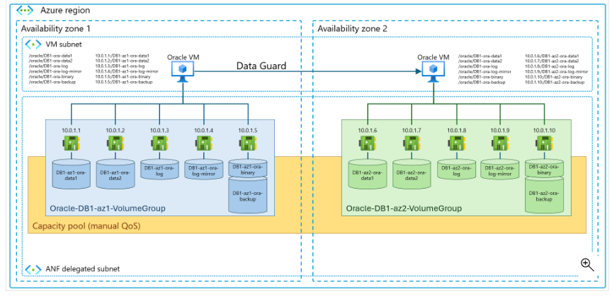
Storage & Data Updates
Generally Available: Azure NetApp Files Application Volume Group for Oracle
Application volume group (AVG) for Oracle enables to deploy all volumes required to install and operate Oracle databases at enterprise scale, with optimal performance and according to best practices, in a single one-step and optimized workflow. The application volume group feature is using the Azure NetApp Files ability to place all volumes in the same availability zone as the VMs to achieve automated, latency-optimized deployments. With application volume group for Oracle numerous technical enhancements have been introduced that simplify, standardize, and streamline the entire process of volume deployments for Oracle in a single 'atomic' operation (through portal, RP, or API).
Azure NetApp Files application volume group for Oracle will shorten database deployment time and increase overall application performance and stability, including the use of multiple storage endpoints. The application volume group feature supports a wide range of Oracle database layouts from small databases with a single volume up to multi-hundred TiB sized databases with up to 8 data volumes and with latency-optimized performance and only limited by the database VM's network capabilities.
Application volume group for Oracle is supported in all Azure NetApp Files enabled regions.

Slide 19
Databases

Slide 20
Databases Updates
JDBC Driver 12.10 for SQL Server Released
Version 12.10 of the Microsoft JDBC Driver for SQL Server has been released. Version 12.10.0 brings several added features, changes, and fixed issues over the previous production release.
Added
Added provision to set SQLServerBulkCopy options in PreparedStatement
Changed
Changed the scope of BULK_COPY_OPERATION_CACHE to connection
Added "requireSecret" exclude tag for tests which require adding a secret to app registration
Added com.ibm.security.auth.module and com.sun.security.auth.module as option import
Updated driver dependency versions
ODBC Driver 18.5 for SQL Server Released
Added
Expose the Packet Size as a connection string option
Some authentication options leverage a new DLL, mssql-auth.dll, now included with the driver installation
Added support for 3 new languages Czech, Polish, and Turkish
Modify the installer to install both features (Core and SDK) by default. This addresses installation issues when the driver is installed by another product that redistributes the driver, installing all features, after the driver has already been installed without all features.
Fixed
Fix connection recovery to obtain the active primary node when a server moves
Fix crashes under low-memory conditions
Fix some error messages

Slide 21
Databases Updates
Oracle Base Database Service
Oracle Base Database Service will soon be available on Oracle Database@Azure. Base Database Service will run Oracle Database Enterprise Edition and Standard Edition 2 versions of 19c and 23ai on virtual machines. It offers automated database lifecycle management for reduced administration, low-code application development for faster deployment, and independently scalable compute and storage with pay-as-you-go pricing for flexible workload demands.
Base Database Service provides a low-friction, cost-effective entry point to Oracle Database@Azure so Oracle database customers can scale effortlessly and unlock agility in the cloud.
Exadata Database Service on Exascale Infrastructure is now generally available
Now workloads of any size can benefit from the performance, reliability, and availability benefits of high performance Exadata infrastructure with Exadata Database Service on Exascale Infrastructure running in Azure datacenters.
By leveraging Exascale’s intelligent data architecture, businesses can reduce infrastructure costs, making high-performance Oracle databases more accessible. Its highly elastic, cost-efficient solution enables organizations of any size to balance automation with control, and optimize AI, analytics, and transactional workloads.
Azure customers can purchase Oracle Exadata Database Service on Exascale Infrastructure through the Azure Marketplace via a custom private offer or pay-as-you-go model, with the option of using Microsoft Azure Consumption Commitment (MACC). Existing Oracle Database customers can also bring their own license (BYOL) or use Unlimited License Agreements (ULAs).
With Exascale infrastructure, organizations only pay for the compute and storage resources used starting with a highly affordable minimum size—all within Azure’s trusted cloud ecosystem.

Slide 22
Databases Updates
Oracle Database@Azure in East US 2
Oracle Database@Azure availability to the East US 2 region of Azure, Oracle Database@Azure is now available in 14 regions globally
Supercharging Performance with Oracle Exadata X11M
Oracle Exadata Database Service on Dedicated Infrastructure on Oracle Database@Azure now supports Oracle Exadata X11M. This next-generation architecture delivers significantly increased performance for your AI, analytics, and mission-critical workloads compared to the previous generation — all without increasing infrastructure or consumption costs.

Slide 23
Databases Updates
TLS 1.3 support in Azure Cosmos DB
Microsoft has implemented updates to enable TLS 1.3 for Azure Cosmos DB. Effective March 31, 2025, support for TLS 1.3 will be enabled for Azure Cosmos DB.

Slide 24
Integration

Slide 25
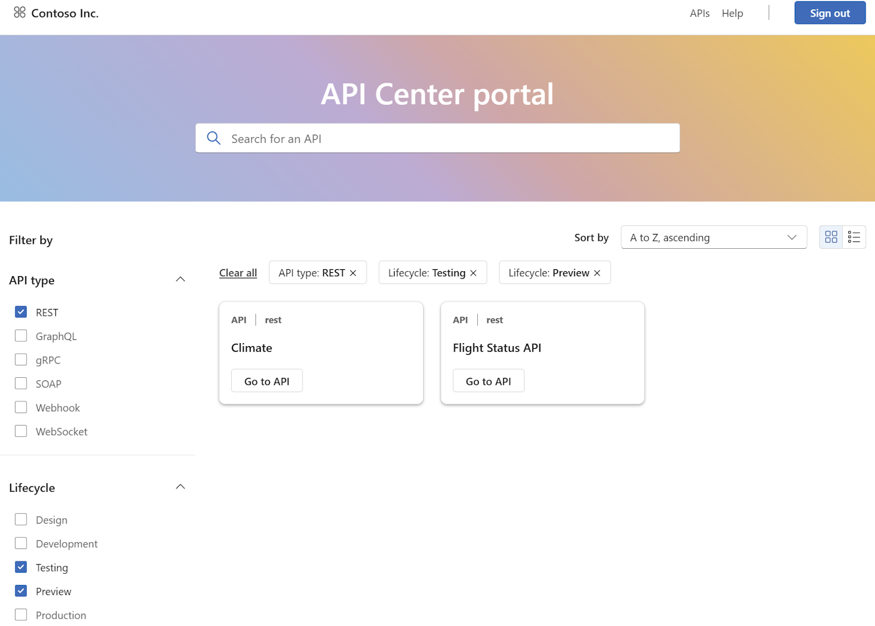
Integration Updates
Public Preview: Managed Developer Portal in Azure API Center (API Center Portal)
MS announced that Azure API Center now offers a managed API Center Portal - an API developer portal designed to support and streamline the work of developers who use and create APIs within an organization.
The managed API Center portal includes:
View API details and definitions: This feature allows developers to access comprehensive information about each API, including endpoints, methods, parameters, and response formats. It helps developers understand how to interact with the APIs effectively.
Customize with branding: The portal allows customers to reflect the organization's branding. Currently, in preview API Center portal supports name customization, enabling organizations to personalize the portal with their brand name.
Integrate with Microsoft Entra: This integration provides seamless authentication and authorization capabilities, leveraging Microsoft Entra's identity and access management services. It ensures secure access to the APIs and simplifies user management.

Slide 26
Integration Updates
Generally Available: Azure Stream Analytics Integration with Schema Registry
This feature enables users to retrieve schema information from the Azure Event Hub Schema Registry and deserialize data from Event Hub inputs in Avro format.
By offloading schema metadata to the Schema Registry, this integration reduces per-message overhead and ensures data consistency and compatibility across various data sources.

Slide 27
ML & AI & IOT

Slide 28
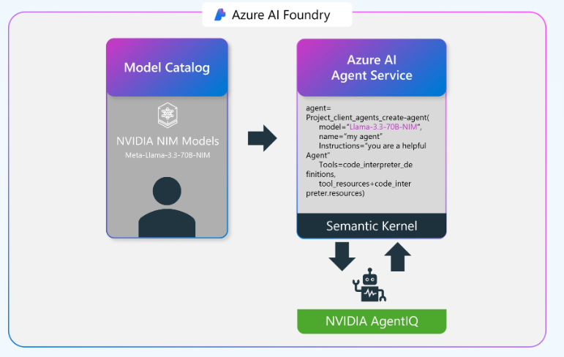
ML & AI & IOT Updates
Azure AI Foundry now offers NVIDIA NIM microservices
MS integrated NVIDIA NIM microservices and NVIDIA AgentIQ toolkit into Azure AI Foundry—unlocking unprecedented efficiency, performance, and cost optimization for your AI projects.
NVIDIA NIM™, part of the NVIDIA AI Enterprise software suite, is a suite of easy-to-use microservices engineered for secure, reliable, and high-performance AI inferencing. Leveraging robust technologies such as NVIDIA Triton Inference Server™, TensorRT™, TensorRT-LLM, and PyTorch, NIM microservices are built to scale seamlessly on managed Azure compute.
NVIDIA Inference Optimizations on Azure AI Foundry
Microsoft has been working closely with NVIDIA to optimize the most popular models lke Meta Llama models using NVIDIA TensorRT-LLM (TRT-LLM).
The following Llama models have been optimized delivering significant throughput and latency improvements:
Llama 3.3 70B
Llama 3.1 70B
Llama 3.1 8B
Llama 3.1 405B
These enhancements are automatically applied, so customers using Llama models from the model catalog in Azure AI Foundry will experience improved performance seamlessly—no additional steps or actions required.

Slide 29
ML & AI & IOT Updates
Announcing new Phi pricing
Small language models are revolutionizing the way businesses operate by offering powerful capabilities without the need for extensive computational resources. These models are not only cost-effective but also highly efficient, making them ideal for a wide range of applications, from customer service to data analysis.
Key benefits of new Phi pricing
Affordability: Our new pricing structure ensures that businesses of all sizes can access the benefits of small language models without breaking the bank.
Scalability: Whether you're a small startup or a large enterprise, our pricing is designed to scale with your needs, providing you with the flexibility to grow.
Efficiency: Small language models are optimized for performance, allowing you to achieve faster results and improve overall productivity.

Slide 30
DevOps & IaC & Automation

Slide 31
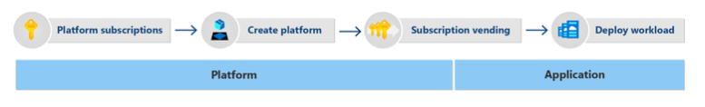
DevOps & IaC & Automation
Generally Available: New Built-In Role for Azure Chaos Studio
A Chaos Studio Target Contributor can onboard targets and manage capabilities in Chaos Studio but cannot create, run, or see details for experiments.
This role can be used alongside other Azure built-in roles for Chaos Studio (Chaos Studio Experiment Contributor, Chaos Studio Operator, Chaos Studio Reader) to properly manage access to Chaos Studio for users within organization.
Subscription Vending
MS updated Bicep and TF modules for the Subscription vending:
Moved to Azure Verified Modules (AVM)
Constrained RBAC
PIM
NAT Gateway
Azure Bastion

Slide 32
Miscellaneous

Slide 33
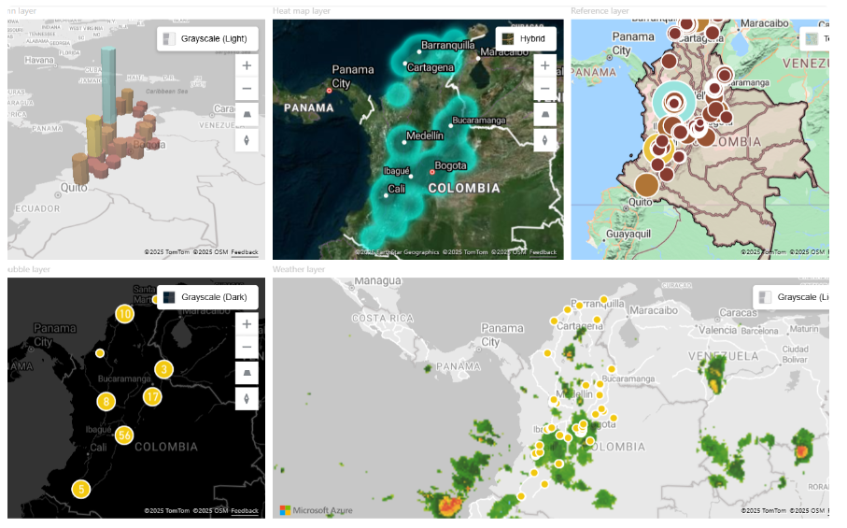
Miscellaneous Updates
Azure Maps Visual in Power BI Now Supports Publish to Web
MS announced that the Azure Maps visual in Power BI now supports Publish to Web, making it easier than ever to share interactive geospatial insights with a wider audience. This update enables Power BI users to embed Azure Maps-powered visualizations in public websites, blogs, and other online platforms, unlocking new possibilities for data storytelling and geographic analysis.
With this enhancement, users can now share interactive maps publicly, embedding Azure Maps visualizations in web pages without requiring viewers to have a Power BI license. This improvement allows for a more engaging way to present geospatial data, making it accessible to decision-makers and the public alike. By incorporating interactive maps into websites, users can bring geospatial insights to life, offering a dynamic way to explore trends, patterns, and location-based data.

Slide 34
Information

Slide 35
Information
Azure Times GitHub Repo

Slide 36
Questions

