Slide 1
Azure Times #184
November 17, 2025

Slide 2
Networking

Slide 3
Networking Updates
Upcoming Changes to Azure Relay IP Addresses and DNS Support
Azure Relay is an integral part of modern hybrid cloud architectures, enabling seamless connectivity between on-premises and cloud resources. To ensure continued reliability and security, Microsoft is implementing important updates to the IP addresses and DNS naming conventions used by Azure Relay services.
IP and Name Transitions:
The IP addresses and corresponding DNS names for Azure Relay endpoints will change during the transition period.
  For example, g0-prod-bn-vaz0001-sb.servicebus.windows.net can change to gv0-prod-bn-vaz0001-sb.servicebus.windows.net
DNS Support Enhancements:
  Improved DNS support will enhance reliability and future-proof connectivity for both WCF Relay and Hybrid Connections users.
Public Preview: Signed request on Azure Front Door
MS announced the public preview of Azure Front Door signed request, a powerful new feature designed to enhance access control for content delivery. This capability allows organizations to restrict access to their content—such as media streams, file downloads, APIs, and documents—based on user authentication, geolocation, or time-based constraints. Configuration is streamlined through the Azure portal, where users can set up keys, key groups, and rules to enforce URL signing.
By leveraging signed requests, Azure Front Door edge servers validate incoming requests before serving content, ensuring that only authorized users can access protected assets. This is especially valuable for subscription-based services, temporary access scenarios, and geo-restricted content. This feature empowers developers to secure their content delivery workflows with precision and flexibility.

Slide 4
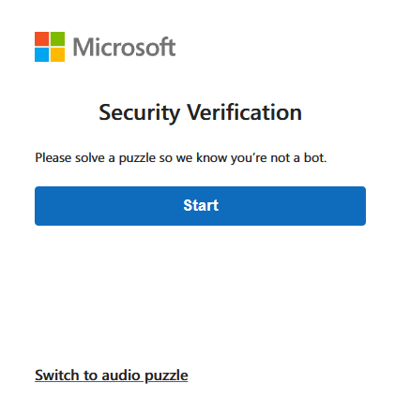
Networking Updates
Generally Available: Azure WAF CAPTCHA Challenge for Azure Front Door
Modern web applications face evolving threats, including bots, web scrapers, and brute-force attacks, many of which can bypass traditional security controls like IP blocking and rate limiting. CAPTCHA provides an adaptive layer of protection, ensuring legitimate users can access applications while blocking harmful automated traffic.
This new security feature enhances bot mitigation strategies by introducing an interactive challenge that verifies human users in real time, helping organizations protect their applications from automated attacks.
The lifetime is configurable between 5 and 1,440 minutes, with a default setting of 30 minutes. The CAPTCHA challenge cookie name is afd_azwaf_captcha on Azure Front Door.
Mobile Apps: Not supported.
AJAX and API calls aren't supported: CAPTCHA verification doesn't apply to AJAX and API requests.
POST body size restriction: The first request that triggers a CAPTCHA challenge is blocked if its POST body exceeds 64 KB on Azure Front Door.
Non-HTML embedded resources: CAPTCHA is designed for HTML resources. Placing CAPTCHA in front of non-HTML resources, such as images, CSS, or JavaScript files, may likely result in issues with content loading and rendering.
Browser compatibility: CAPTCHA isn't supported on Microsoft Internet Explorer. It's compatible with the latest versions of Microsoft Edge, Chrome, Firefox, and Safari.

Slide 5
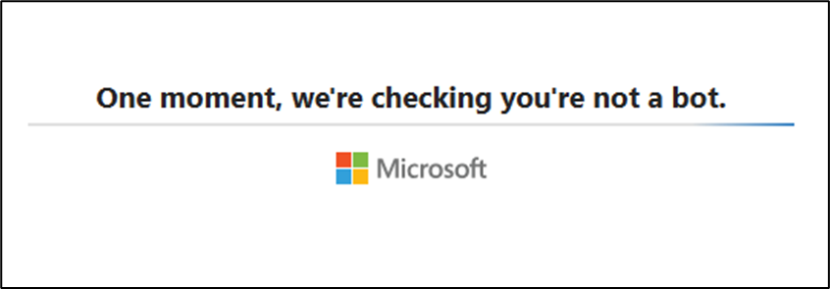
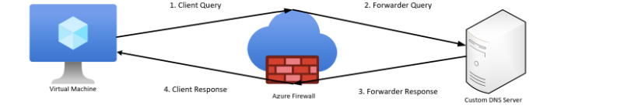
Networking Updates
Generally Available: Azure WAF JavaScript challenge on Azure Front Door
Azure WAF now introduces JS challenge as a new security feature. The JS challenge provides an invisible, frictionless layer of protection by distinguishing legitimate users from malicious bots without requiring human interaction. Unlike CAPTCHA, this challenge runs silently in the background, reducing user disruption while effectively blocking harmful automated traffic.
Key benefits include:
Enhanced bot protection: Malicious bots fail the JS challenge, safeguarding your applications.
Improved user experience: Legitimate users are not interrupted, ensuring seamless access.
Flexible integration: Available as a mitigation action in the Bot Managed ruleset and custom rules.
Generally Available: DNS flow trace logs for Azure Firewall
Azure Firewall now supports DNS flow trace logs — a new logging capability that gives deep, end-to-end visibility into DNS traffic and name resolution paths.
DNS flow trace logs build on existing DNS Proxy functionality by logging critical metadata, including query types, response codes, queried domains, upstream DNS servers, and the source and destination IPs of each request. These insights enable faster diagnosis of application connectivity issues, improved auditing, and better security investigations.
Key highlights
End-to-end DNS visibility — see each step of DNS resolution across your environment
Faster troubleshooting — pinpoint DNS failures and validate forwarding and custom DNS configuration
Cache insights -- determine whether the Azure Firewall cache was used for DNS resolution

Slide 6
Networking Updates
Generally Available: High Scale Private Endpoints
Today, local VNet limits are restricted to 1,000 private endpoints per Virtual Network. Any attempts to create additional endpoints will result in an PrivateEndpointsPerVnetLimitReached error that can only be resolved by either deleting existing private endpoints or raising a support request to increase present limits. However, by activating HSPE you will automatically be able to deploy 5,000 PEs in a singular VNet.
It is also recommended that you only deploy up to 4,000 Private Endpoints in total across your peered virtual networks. Surpassing this recommendation may result in connectivity issues with your private endpoint traffic. If you would like higher limits without the risk of connectivity issues, it is recommended to upgrade to HSPE. This will raise private endpoint cross peering limit to 20,000 endpoints.
This feature is available in all public regions.
NOTE: Upgrading or downgrading this feature triggers a platform update and results in a one-time connection reset.
Generally Available: Enhanced cloning and Public IP retention scripts for Azure Application Gateway migration
Azure Application Gateway introduces two new PowerShell scripts to simplify migration from V1 (Standard or WAF) to V2 (Standard_V2 or WAF_V2) services.
As V1 SKUs’ is scheduled to retire by April 2026, MS advise migrating early and take advantage of Application Gateway V2’s superior performance, scalability, monitoring, and unique features.
Enhanced cloning script:
Automates configuration replication from an existing V1 gateway to a new V2 gateway.
Eliminates manual entry of front-end TLS and trusted root certificates.
Supports creation of private-only V2 gateways.
Public IP retention script:
Enables retention of existing V1 public IP address with V2 gateway.

Slide 7
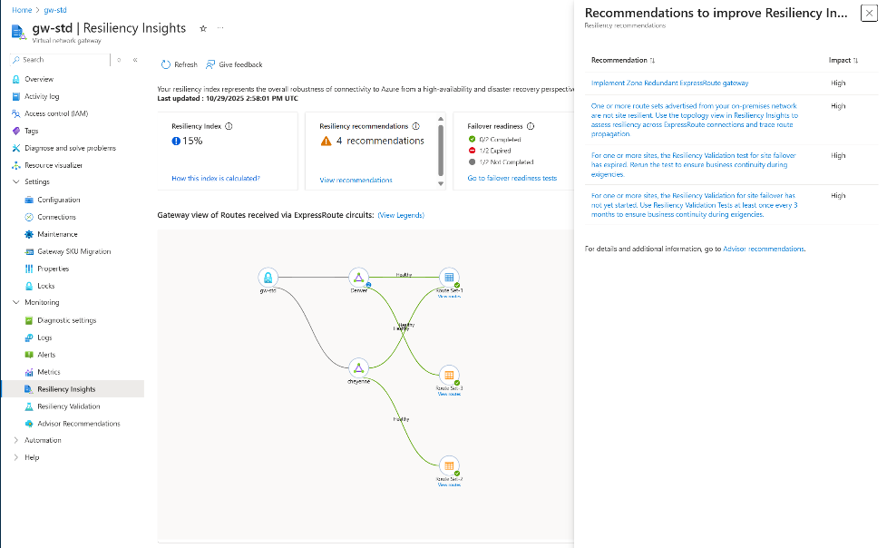
Networking Updates
Generally Available: ExpressRoute resiliency validation
This feature allows for performing site failovers for Virtual Network Gateway, helping to evaluate network resiliency during site outages and validate setup during migrations by testing the effectiveness of failover mechanisms.
Key Features:
Test circuit failover
Route redundancy
Traffic visualization
Test history
Limitations
The Resiliency Validation feature is supported only for ExpressRoute gateways connected to ExpressRoute circuits in at least two distinct peering locations.
The Route List tab can only be refreshed once per hour.
This feature isn't supported for Virtual WAN or ExpressRoute Metro yet.
You can't run the Resiliency Validation test if there are any ongoing tests or if any of the circuits are currently undergoing maintenance.
Generally Available: ExpressRoute resiliency insights
At the core of this capability is the resiliency index, a percentage score calculated based on factors such as route resilience, zone-redundant gateway usage, advisory recommendations, and resiliency validation tests. This index evaluates the control plane resiliency of the ExpressRoute connectivity between Virtual Network Gateway and on-premises network(s). By analyzing and improving this index, you can enhance the robustness and reliability of your connectivity to Azure workloads through ER.

Slide 8
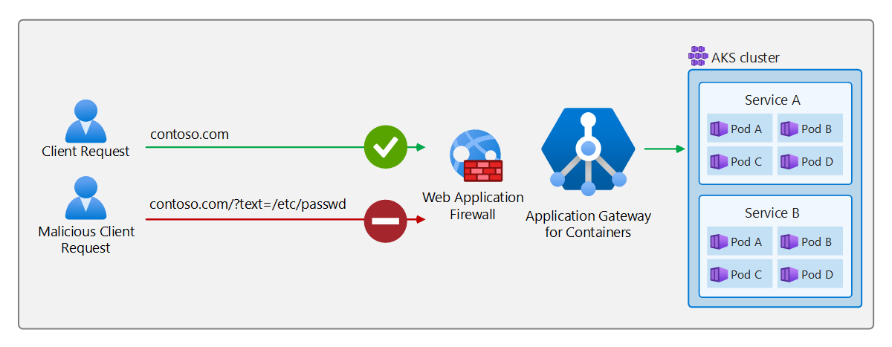
Networking Updates
Generally Available: Monitor end-to-end ExpressRoute connectivity with Connection Monitor
Connection Monitor integration streamlines the setup of end-to-end monitoring for ExpressRoute workloads.
With this capability, it is possible to enable Connection Monitor directly while creating or updating ExpressRoute connections. This removes the need for separate configuration steps, ensuring that monitoring is active from day one. By simplifying the monitoring experience, gain immediate visibility into connectivity health, latency, and reachability for hybrid network workloads.
Generally Available: Application Gateway for Containers with Web Application Firewall (WAF)
Application Gateway for Containers is the next evolution of Application Gateway + Application Gateway Ingress Controller. With the addition of Azure WAF support, Application Gateway for Containers workloads can now protect workloads from web-based attacks like SQL injections, cross-site scripting, protocol anomalies, and more.
When using WAF to protect your Application Gateway for Containers resources you get access to the Azure-managed Default Rulesets (DRS), providing protection not only from threats identified by the Open Web Application Security Project (OWASP), but also additional protections provided by Microsoft’s Threat Intelligence Center (MSTIC). Application Gateway for Containers WAF users also have access to bot protection via bot manager rulesets and protection against DDoS attacks using rate limiting custom rules.

Slide 9
Networking Updates
Generally Available: Azure Virtual Network Manager IP Address Management Pool Association Recommendation
Pool Association Recommendation, customers can now automatically identify all virtual networks within their Network Manager scope that are not yet associated with an IPAM pool. The feature intelligently recommends the most suitable pool for each virtual network by applying longest-prefix matching within the pool hierarchy, ensuring optimal fit and capacity alignment.
Administrators can bulk select and associate virtual networks in a single action directly from the Azure portal—streamlining operations, reducing manual effort, and ensuring full coverage at scale.
This general availability release empowers customers to manage address spaces more efficiently, minimize configuration drift, and maintain consistent governance across large, distributed Azure environments.
Generally Available: Azure Virtual Network Manager peering compliance
Azure Virtual Network Manager peering compliance is now generally available, providing a secure and compliant mechanism to protect network connectivity managed by Azure Virtual Network Manager.
With peering compliance, any virtual network peering created and managed through Azure Virtual Network Manager topology is safeguarded from accidental modification or deletion by virtual network owners outside of Azure Virtual Network Manager.
This release allows users to enforce compliance by restricting direct edits to key peering properties and preventing deletion of peerings. Changes can only be made through Azure Virtual Network Manager connectivity configurations, ensuring consistency and governance across your environment.
With this general availability release, customers gain stronger governance controls, reduced configuration drift, and higher confidence that network topologies remain secure and compliant across teams and subscriptions.

Slide 10
Networking Updates
Generally Available: Azure Virtual Network Manager UseExisting Mode for UDR management
With the UseExisting mode, Azure Virtual Network Manager detects and appends required routes to an existing route table associated with a subnet, preserving the original route table’s name, group, and tags. If no route table exists, Azure Virtual Network Manager automatically creates one as before. Customers seeking Azure Virtual Network Manager-managed route tables can continue using the existing Managed Only mode (the default).
This general availability release empowers customers to:
Maintain governance compliance by retaining ownership of route table configurations
Simplify operations with seamless integration of AVNM automation into existing environments
Enhance flexibility by choosing how AVNM interacts with routing resources
The UseExisting mode makes it easier than ever to adopt Azure Virtual Network Manager UDR management at scale—combining centralized automation with customer-driven governance and control.

Slide 11
Security & Identity

Slide 12
Security & Identity Updates
Announcing Microsoft cloud security benchmark v2 (public preview)
A new Benchmark version with the enhancement in following areas:
Adding artificial intelligence security into scope to address the threats and risks in this emerging domain.
Expanding the prior simple basic control guideline to a more comprehensive, risk and threats-based control guide with more granular technical implementation examples and references details.
Expanding the Azure Policy-based control measurements from ~220 to ~420 to cover more new security controls and expanding the measurements on the existing controls.
Expanding the control mappings to more industry regulations standards such as NIST CSF, PCI-DSS v4, ISO 27001, etc.
Alignment with SFI objectives to introduce Microsoft internal security best practices to our customers.
[Public Preview] Introducing Customizable Security Baseline Policies in Machine Configuration
This feature empowers tailoring industry security benchmarks—such as CIS benchmarks for Linux or Azure Security Baselines for Windows and Linux —to align with your organization’s unique compliance standards across both Azure and Arc-connected machines.
IT allows to tailor security standards through the Modify Settings wizard under Policy > Machine Configuration.
Enable, exclude, or adjust rules from existing benchmarks
Apply organization-specific parameters
Export your custom configuration as a downloadable JSON file

Slide 13
Management & Governance

Slide 14
Management & Governance Updates
Public Preview: Audit and Enable Windows Recovery Environment (WinRE) for Azure Arc-enabled Servers
Azure Policies allow auditing and enable Windows Recovery Environment (WinRE) for Azure Arc-enabled servers.
Windows Recovery Environment is a secure, isolated partition that enables diagnostics and repair when a system encounters critical failures – such as a stop error (commonly known as the blue screen of death). WinRE provides a reliable fallback mechanism for mission-critical workloads, allowing IT administrators to recover systems quickly and securely.
These Azure Policies are available at no additional cost for servers covered under:
Windows Server 2012 Extended Security Updates (ESUs)
Microsoft Defender for Servers Plan 2
Windows Server Software Assurance attestation
Windows Server Pay-as-you-Go licensing
Azure Local using local identity with Azure Key Vault (Preview)
In addition to Active Directory (AD) based deployment, Azure Local supports deployment through local identity with Azure Key Vault, previously known as AD-less deployment.
With local identity using a Local Administrator Account, the deployment process configures cluster-level integration with certificate-based authentication. This setup ensures secure communication during deployment and ongoing operations.
As part of this configuration, an Azure Key Vault in the Azure Cloud is provisioned during deployment to serve as a secure backup for Azure Local secrets, including BitLocker keys and other critical configuration data.

Slide 15
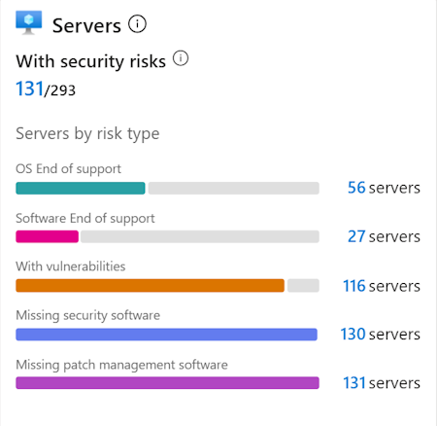
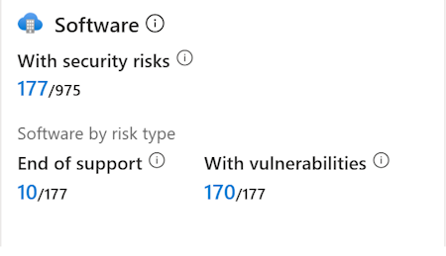
Management & Governance Updates
Public Preview: Insights in Azure Migrate
Azure Migrate now offers integrated Security insights, allowing to assess potential risks within their on-premises environment. The solution delivers actionable recommendations to effectively mitigate these risks as part of the migration planning.
Review security risks in your datacenter early during migration planning.
Plan mitigation to fix security issues and make migration to Azure smooth and secure.
Identify and plan upgrade of Windows and Linux servers with end of support operating system, end of support software and pending updates.
Detect vulnerabilities in discovered software and take action to remediate risks.
Identify servers without security or patch management software, and plan to configure Microsoft Defender for Cloud and Azure Update Manager.

Slide 16
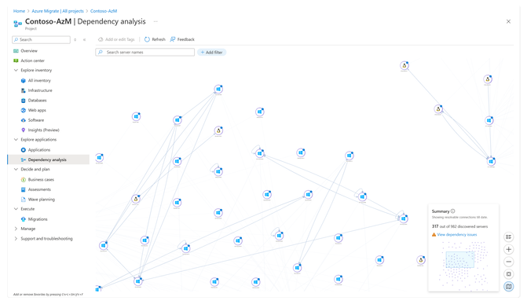
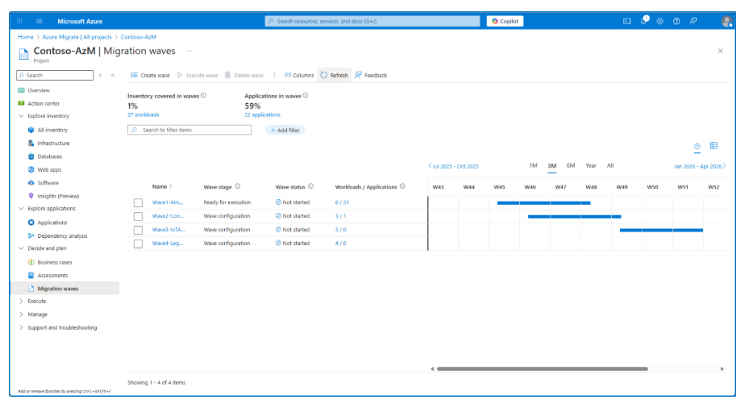
Management & Governance Updates
Multi-server dependency mapping and subsequently define them
Wave Planning in Azure Migrate
It is a new capability designed to make large-scale migrations more manageable and predictable. With wave planning, it is possible now to organize migration journey into logical, iterative waves, enabling your teams to plan, execute, and track progress with greater speed, confidence, and control.

Slide 17
Management & Governance Updates
Public Preview: Instant Access Snapshots for Azure Premium SSD v2 and Ultra Disks Storage
By default, snapshots of Ultra Disks and Premium SSD v2 aren't instant access snapshots and can't be used until the snapshot’s background data copy completes.
This new capability enables to restore new disks immediately after creating snapshots of Pv2 and Ultra disks. Restore disks deliver high performance instantly, while data hydration continues rapidly in the background.
You can't use an instant access snapshot to create an Ultra Disk or a Premium SSD v2 larger than the snapshot's size
Instant access snapshots count towards the Ultra Disk and Premium SSD v2 limit of three in-progress snapshots per disk

Slide 18
Management & Governance Updates
Azure Migrate Expands Capabilities to Accelerate Migration to Azure Local
With this release, organizations can easily move their VMware workloads to cloud-managed infrastructure while maintaining consistency across environments.
Orchestrate migrations from Azure portal
Leverage an agentless architecture
Replicate with no downtime impact
Migrate securely with sovereign control
Perform cutovers with minimal downtime
Static IP address retention for Windows and Linux VMs.
PowerShell migration support for scripting and automation.
Advanced compute and disk customization during migration.
General Availability of Software Defined Networking (SDN) on Azure Local
This release introduces cloud-native networking capabilities for access control at the network layer, utilizing Network Security Groups (NSGs) on Azure Local.
Key highlights in this release are:
Centralized network management: Manage Logical networks, network interfaces, and NSGs through the Azure control plane – whether preference is the Azure Portal, Azure Command-Line Interface (CLI), or Azure Resource Manager templates.
Fine-grained traffic control: Safeguard edge workloads with policy-driven access controls by applying inbound and outbound allow/deny rules on NSGs, just as would in Azure.
Seamless hybrid consistency: Reduce operational friction and accelerate IT staff’s ramp-up on advanced networking skills by using the same familiar tools and constructs across both Azure public cloud and Azure Local.

Slide 19
Management & Governance Updates
Generally Available: Vaulted Backup for Azure Data Lake Storage (ADLS)
Azure Backup vaulted protection for ADLS Gen2 delivers secure, off‑site backups to help organizations meet resilience and compliance goals. Vaulted backups maintain an independent copy of data, isolated from the source account - providing protection against accidental deletion, malicious activity, and ransomware.
Capabilities at a Glance:
Off‑site protection: Recover data safely by restoring to alternate storage accounts to support clean recovery workflows.
Automated & flexible scheduling: Configure daily or weekly backup policies and trigger on‑demand backups when needed.
Long‑term retention: Store backups for up to 10 years to meet compliance and archival requirements.
Security‑first design: Soft‑delete, immutability, encryption, and multi‑user authorization protect backup data in the vault.

Slide 20
Management & Governance Updates
Retirement: Windows Server 2022 on Azure Kubernetes Service enabled by Azure Arc
Announcing the retirement of Windows Server 2022 on Azure Kubernetes Service enabled by Azure Arc in October 2026.

Slide 21
Compute

Slide 22
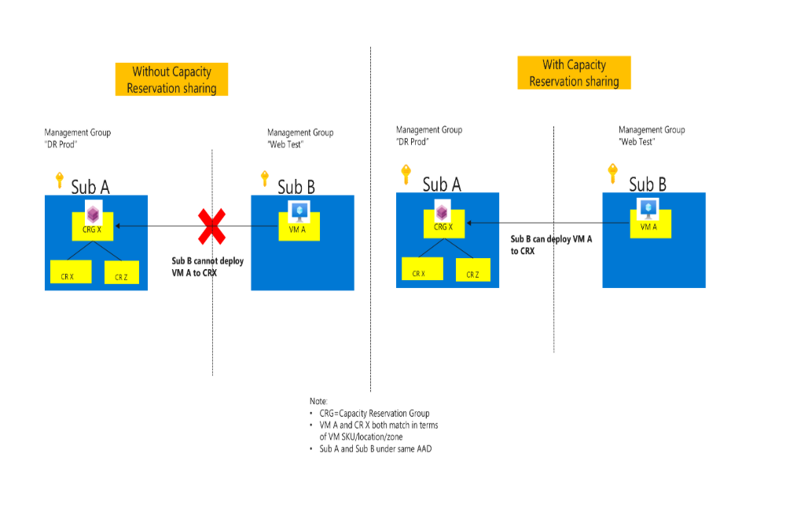
Compute Updates
Public Preview: VM vCore customization features disabling simultaneous multi-threading (SMT/HT) and constrained cores
Azure announces the public preview of VM Customization features, a new capability that gives customers greater control over virtual CPU configurations to optimize performance and licensing costs. This feature introduces two powerful options: Disable Simultaneous Multi-Threading (SMT/HT) and Configurable Constrained Cores.
With VM Customization, customers can now:
Disable Simultaneous Multithreading (SMT/HT) to run VMs with one thread per core for improved performance on latency-sensitive and single-threaded workloads
Select a custom vCPU count from a guided list of valid options to reduce software licensing costs while retaining full memory, storage, and I/O bandwidth
Public Preview: Sharing Capacity Reservation Groups
The ability to share Capacity Reservation Groups (CRGs) with subscriptions is now in Public Preview.
Previously, customers could deploy VMs in a Capacity Reservation Group within the same subscription only. On-demand Capacity Reservation Group (CRG) can now be shared with other subscriptions. Using this option can make it easier to manage some common configuration needs like resource reuse, centralized capacity management, more cost-effective scale-out and separating security and capacity concerns.

Slide 23
Compute Updates
Public Preview: openCypher support for KQL graph semantics
openCypher now is supported for KQL graph semantics, bringing the widely adopted open-source graph query language to graph data.
This update allows to run openCypher queries on any Fabric Eventhouse or Azure Data Explorer, making it easier to work with graph data using a popular, declarative pattern matching syntax.
openCypher provides ASCII-art style pattern matching that intuitively represents graph relationships, making complex graph queries more readable and easier to write.
Public Preview: Azure Linux OS Guard for AKS
Built on the FedRAMP-certified Azure Linux 3.0 base, OS Guard is a next-generation immutable container host that enforces immutability, code integrity, and mandatory access control.
It leverages advanced technologies like dm-verity, SELinux, and Integrity Policy Enforcement (IPE)—recently upstreamed in Linux kernel 6.12—to ensure only trusted binaries from signed sources can run, while locking down user space against tampering. With Trusted Launch enabled by default, OS Guard also secures boot components using measured integrity backed by vTPM keys.
Azure Linux is the trusted OS powering Microsoft’s own fleet, and OS Guard builds on that foundation to deliver enhanced protection for cloud-native environments.

Slide 24
Compute Updates
Public Preview: Flatcar Container Linux for AKS
Azure Kubernetes Service now supports Flatcar Container Linux in public preview. Flatcar uses an immutable OS filesystem, and it eliminates configuration drift and prevents unauthorized changes, ensuring robust protection for your workloads across multiple cloud platforms. Designed for versatility, Flatcar enables cross-cloud deployment, empowering businesses to scale effortlessly and securely.
As a Cloud Native Compute Foundation (CNCF) project, Flatcar also supports cross-cloud deployment, making it a strong choice for organizations seeking enhanced security and operational efficiency across diverse environments.
Flatcar Container Linux for AKS has the following limitations:
FIPS isn't supported with Flatcar Container Linux.
Trusted Launch isn't supported with Flatcar Container Linux.
Confidential VM sizes aren't supported with Flatcar Container Linux.
The SecurityPatch node OS upgrade channel isn't supported with Flatcar Container Linux.
During preview, AKS doesn't support in-place updates with Flatcar Container Linux.
Artifact Streaming (preview) isn't supported with Flatcar Container Linux.
Generation 1 VMs aren't supported with Flatcar Container Linux, which means you can't use VM sizes that only support Generation 1.
Pod Sandboxing (preview) isn't supported with Flatcar Container Linux.
Node auto-provisioning isn't supported with Flatcar Container Linux.
Azure Monitor VM(SS) extension isn't supported.

Slide 25
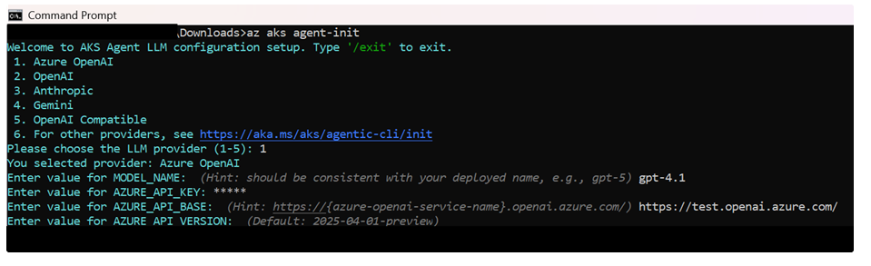
Compute Updates
Public Preview: Agentic CLI for AKS
This new capability brings agentic reasoning directly into the Azure CLI, allowing developers and operators to interact with their clusters using natural language. By describing an issue or query, users can trigger an intelligent agentic loop that gathers signals from multiple sources, analyzes diagnostics, identifies health issues and root causes, and provides actionable recommendations. The CLI agent also integrates with the AKS MCP server and can seamlessly create and manage an Azure OpenAI instance, though it supports any LLM provider.
Powered by HolmesGPT—an open-source project co-maintained by the AKS team and under review for CNCF Sandbox—this feature is now available in public preview.
Public Preview: Scheduler profile configuration for AKS
This new capability enables users to customize scheduling behavior and define workload priorities across specific nodes or the entire cluster. It’s especially beneficial for advanced scenarios such as data processing, AI/ML, and cost-optimized workload distribution.
A scheduler profile is a set of one or more in-tree scheduling plugins and configurations that dictate how to schedule a pod. Previously, AKS managed the scheduler configuration, and it wasn't accessible to users. Starting from Kubernetes version 1.33, it is now possible to configure and set a scheduler profile (preview) for the Kubernetes scheduler on your cluster.

Slide 26
Compute Updates
Public Preview: eBPF host routing in Advanced Container Networking Services (ACNS) for AKS
As containerized applications scale across distributed environments, traditional networking approaches can introduce latency and reduce throughput. To address this, Azure CNI powered by Cilium now offers eBPF Host Routing in public preview for Azure Kubernetes Service.
This feature uses eBPF technology to embed routing logic directly into the Linux kernel, eliminating the need for iptables and reducing reliance on the host network stack. By enabling Cilium to make direct routing decisions, eBPF host routing delivers lower latency, fewer network hops, and higher throughput for Kubernetes clusters.
Public Preview: Pod CIDR expansion in Azure CNI Overlay for AKS
To meet the growing demands of dynamic and large-scale Kubernetes workloads, Azure Kubernetes Service now offers Pod CIDR Expansion in public preview for clusters using Azure CNI Overlay. While Azure CNI Overlay already delivers scalable pod IP address management via a logical overlay network, many enterprise customers require additional flexibility to support evolving business needs.
This new capability allows users to expand existing pod CIDR ranges, enhancing both scalability and adaptability for workloads that require more IP space. The preview currently supports CIDR range expansion only, enabling organizations to better manage IP allocation without redeploying clusters.

Slide 27
Compute Updates
Container Network Metrics Filtering in Azure Container Networking Services (ACNS) for Azure Kubernetes Service (AKS) is now in Public Preview
Unlike traditional sampling or post-processing, filtering happens at the Cilium agent level—inside the kernel’s data plane.
Define filters using the ContainerNetworkMetric Custom Resource to include or exclude metrics such as:
DNS lookups
TCP connection metrics
Flow metrics
Drop (error) metrics
This reduces data volume before metrics leave the host, ensuring observability tools receive only curated, high-value data.
Public Preview: Azure Functions zero-downtime deployments with rolling updates in Flex Consumption
Azure Functions now supports rolling updates in the Flex Consumption plan, delivering zero-downtime deployments with a simple configuration change.
Instead of forcefully restarting all instances during code or configuration updates, the platform gracefully replaces live instances by draining batches every few seconds while dynamically scaling out the latest version to meet demand. This approach ensures uninterrupted execution and resilient throughput across HTTP, non-HTTP, and Durable workloads—even during intensive scale-out scenarios.
Known limitations:
Scale-out issues may occur with low HTTP concurrency; recommended value is 16.
Real-time rollout monitoring is not supported; allow up to two minutes for completion.
No automatic rollback; intervene by redeploying the last healthy version.
Internal details such as batch size and drain intervals are not configurable and are subject to change.

Slide 28
Compute Updates
Generally Available: Azure Sphere OS version 25.10 is now available for evaluation
Azure Sphere OS version 25.10 is now available for evaluation in the Retail Eval feed. The retail evaluation period for this release provides 14 days (about 2 weeks) of testing. During this time, please verify that your applications and devices operate properly with this release before it is deployed broadly to devices in the Retail feed.
The 25.10 OS Retail Eval release includes quality and underlying build system updates.
Generally Available: RHEL Software Reservations Now Available on Azure with Updated Pricing
Red Hat Enterprise Linux (RHEL) software reservations are now available again for purchase on Azure following important updates to billing meters and pricing. This update addresses issues with previous billing meters and aligns with Red Hat's new pricing model, ensuring customers can access cost-effective RHEL licensing options with improved accuracy and transparency.
The updated billing structure provides clearer pricing visibility and better alignment with Red Hat's current licensing framework, making it easier for organizations to plan and optimize their RHEL deployment costs on Azure. Customers can now confidently purchase RHEL software reservations to reduce their operational expenses while maintaining enterprise-grade Linux capabilities.
For detailed information about the billing updates and how to purchase RHEL software reservations, visit the official blog announcement.

Slide 29
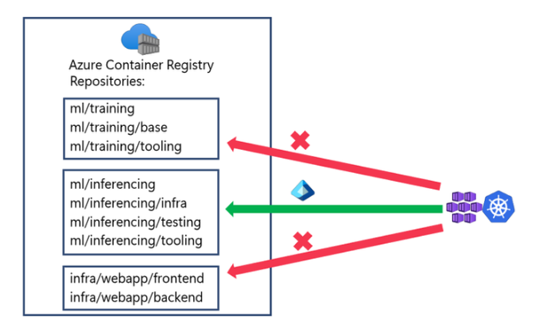
Compute Updates
Azure Container Registry Repository Permissions with Attribute-based Access Control (ABAC)
Azure Container Registry (ACR) supports repository permissions with Microsoft Entra attribute-based access control (ABAC).
ABAC augments the familiar Azure RBAC model with namespace and repository-level conditions so platform teams can express least-privilege access at the granularity of specific repositories or entire logical namespaces. This capability is designed for modern multi-tenant platform engineering patterns where a central registry serves many business domains. With ABAC, CI/CD systems and runtime consumers like Azure Kubernetes Service (AKS) clusters have least-privilege access to ACR registries.

Slide 30
Compute Updates
Python 3.14 is now available on Azure App Service for Linux
Azure App Service for Linux now offers Python 3.14 as a first-class runtime. It is possible to create a new 3.14 app through the Azure portal, automate it with the Azure CLI, or roll it out using your favorite ARM/Bicep templates — and App Service continues to handle the OS, runtime updates, and patching for you so you can stay focused on code.
Python 3.14 (released October 7, 2025) lands with real performance and runtime improvements.
Faster under load. Internal interpreter work reduces overhead in common call paths and improves memory behavior, which can translate to lower latency and less CPU churn in web apps and APIs.
Smarter concurrency. Python 3.14 continues the rollout of subinterpreters and a free-threaded build (no GIL), making it easier to take advantage of multi-core parallelism for CPU-bound or high-throughput workloads. In 3.14, that free-threaded mode is more mature and shows significantly better multi-threaded performance than earlier releases.
Developer quality-of-life. You get a more helpful interactive REPL (better highlighting and error hints), cleaner typing through deferred annotations, and new template string syntax (“t-strings”) for safe, structured interpolation
Node.js 24 is now available on Azure App Service for Linux
Node.js 24 LTS is live on Azure App Service for Linux. It is possible to create a new Node 24 app through the Azure portal, automate it with the Azure CLI, or roll it out using your favorite ARM/Bicep templates - faster runtime, tighter tooling, same App Service simplicity.

Slide 31
Compute Updates
Open Source: Announcing the DocumentDB Kubernetes Operator
Now it is possible to use the open-source DocumentDB Kubernetes Operator to run DocumentDB on Kubernetes.
DocumentDB is a Mongo-DB–compatible, open-source document database built on PostgreSQL. The operator extends Kubernetes with custom resource definitions (CRDs) and makes it easier for you to deploy and manage DocumentDB clusters using familiar tools such as kubectl and Helm.
Announcing General Availability of Larger Container Sizes on Azure Container Instances
MS announced the general availability of larger container sizes on Azure Container Instances (ACI). Now it is possible to deploy workloads with higher vCPU and memory for standard containers, confidential containers, containers with virtual networks, and containers utilizing virtual nodes to connect to Azure Kubernetes Service (AKS).
After improving this feature based on customer feedback, ACI now supports vCPU counts greater than 4 and memory capacities of 16 GB, with a maximum of 31 vCPU and 240 GB for standard containers and a maximum of 31 vCPU and 180 GB for confidential containers.

Slide 32
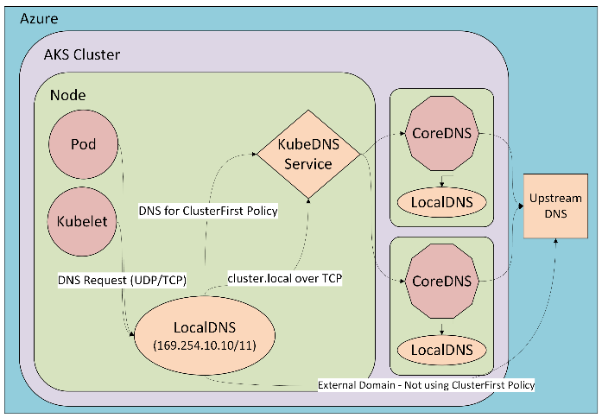
Compute Updates
Generally Available: Azure HBv5-series VMs
Azure HBv5-series VM is now generally available in the Azure South Central US region. HBv5 VMs are optimized for memory bandwidth-intensive HPC applications, such as computational fluid dynamics, automotive and aerospace simulations, weather modeling, energy research, molecular dynamics, computer-aided engineering, and more. HBv5 VMs feature 6.7 TB/s of memory bandwidth across 450 GB (438 GiB) of memory (HBM) capacity.
Also included are 368 4th Generation EPYC™ processor cores with a 3.5 GHz base frequency, 4 GHz boost frequency, and no simultaneous multithreading. HBv5-series VMs also provide 800 Gb/s of InfiniBand from NVIDIA Networking to enable supercomputer-scale MPI workloads, and 15 TiB of local NVMe SSD storage with up to 50 GB/s (reads) and 30 GB/s (writes) of block device performance.
Generally Available: LocalDNS for AKS
Large-scale Kubernetes clusters often face DNS resolution delays and reliability issues, especially during upstream outages or high query volumes. To address this, Azure Kubernetes Service (AKS) now offers LocalDNS, a feature that is generally available.
LocalDNS deploys a DNS proxy on each node, enabling faster and more reliable DNS resolution by handling queries locally. This eliminates bottlenecks, reduces latency, and ensures continued resolution even during upstream DNS outages through configurable serve-stale settings.
With no application-level changes required, LocalDNS delivers immediate performance improvements and supports advanced DNS customization for both internal and external domains.

Slide 33
Compute Updates
Layer 7 Network Policies for AKS: Now Generally Available for Production Security and Observability!
Microsoft has announced that Layer 7 Network Policies, powered by Cilium and ACNS (Advanced Container Networking Services), are now generally available (GA) for production use in AKS.
This means it is possible to now enforce application-layer (HTTP/HTTPS) controls such as “only allow GET requests to /api/inventory/…” rather than just port/port-range rules.

Slide 34
Compute Updates
Retirement: Support for Node.js 20 ends on April 30, 2026 – upgrade your apps to Node.js 22
In alignment with the end of community support, on April 30, 2026, support for Node.js 20 in Azure Functions will end. Your apps that are hosted on Functions will continue to run, but security updates and performance optimizations will no longer be available and we'll no longer provide customer support for Node.js 20.
Retirement: Support for Python 3.10 ends on October 1st, 2026
On October 1, 2026 extended support for Python 3.10 will end.
To avoid potential security vulnerabilities and minimize risk for App Service apps, migrate app to Python 3.11 before October 1, 2026.

Slide 35
Storage & Data

Slide 36
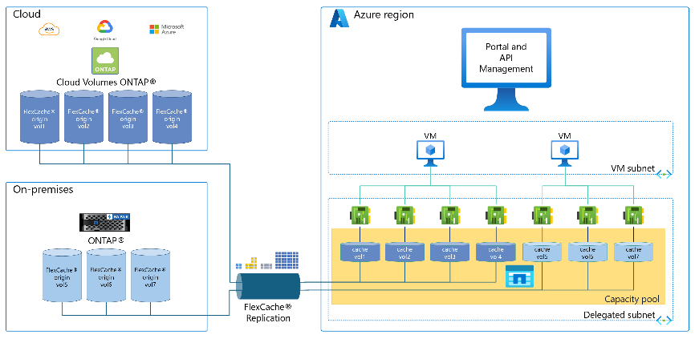
Storage & Data Updates
Public Preview: Azure NetApp Files cache volumes
Azure NetApp Files cache volumes enable to create a cloud-based cache of external NetApp ONTAP and Cloud Volumes ONTAP storage volumes in Azure. Caching active ("hot") data closer to users and cloud applications improves data access speeds and throughput over WAN connections. This results in cost-effective, low-latency remote access to important files. In practical terms, allow to burst on-premises datasets to Azure with near-local performance—ideal for running computational workloads in Azure on on-premises data or enabling globally distributed teams to collaborate without lengthy file transfer delays.
Cache volumes support both reads and writes. New data saved to the cache volume is asynchronously written back to the origin, ensuring the origin remains the authoritative copy. This write-back caching provides near-local write latency, even when the primary storage is in a remote location

Slide 37
Storage & Data Updates
Public Preview: Azure NetApp Files Object REST API
The Object REST API, an S3-compatible REST API, on Azure NetApp Files bridges the gap between traditional file-based storage and modern cloud services, enabling customers to use their existing data in new ways.
Azure NetApp Files supports the Object REST API, an S3-compatible REST API. The object REST API extends file-based storage, enabling native S3 read and write access.
Object REST API allows to present the same data set as a file hierarchy or as objects in a bucket. To do so, object REST API creates buckets that allow S3 clients to read, write, and enumerate files in network attached storage (NAS) storage using S3 object requests. This mapping conforms to the NAS security configuration, observing file and directory access permissions.
This mapping is accomplished by presenting a specified NAS directory hierarchy as an S3 bucket. Each file in the directory hierarchy is represented as an S3 object whose name is relative from the mapped directory downwards. Directory boundaries are represented by the slash character (/).

Slide 38
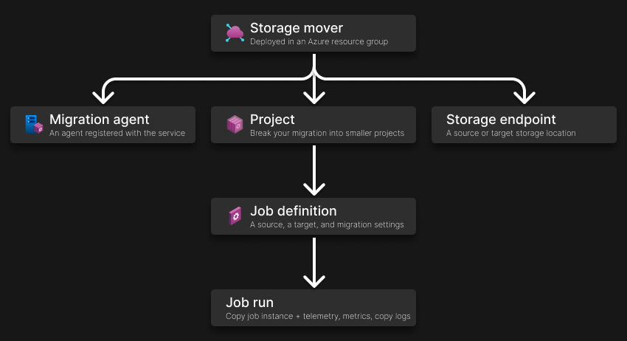
Storage & Data Updates
Generally Available: Near-zero downtime scaling for HA-enabled Azure Database for PostgreSQL servers
It is now possible to scale Azure Database for PostgreSQL servers that have high availability (HA) enabled with minimal impact to users. The process usually takes less than 30 seconds, while traditional scaling can take 2 to 10 minutes. This new capability ensures near-zero downtime during scaling operations, allowing to maintain business continuity while adapting to changing workloads.
Near-zero downtime scaling doesn't work for a replica server
Consider capacity and available IP addresses
Near-zero downtime scaling doesn't work with unlogged tables.
Generally Available: Azure Storage Mover support for NFS source to Azure File Share (NFS 4.1) target
Azure Storage Mover can now migrate NFS File shares to Azure File Shares (NFS 4.1).
Storage Mover is a fully managed migration service that enables to migrate on-premises files and folders to Azure Storage while minimizing downtime for workload. Together with just-in-time permission setting and Azure Key Vault, your migration is secure from source to target.
Besides the existing general available capability to migrate from an on-premises NFS share to an Azure Blob container and SMB source to Azure File shares/Azure Blob containers, Azure Storage Mover now supports NFS source to Azure File shares (NFS 4.1) as target.

Slide 39
Storage & Data Updates
Generally Available: Cloud-to-Cloud migration made simple with Azure Storage Mover
Azure Storage Mover’s new AWS S3 to Azure Blob migration feature is now generally available, empowering organizations to move data directly from AWS to Azure securely, reliably, and at scale. With this release, customers can eliminate manual pipelines and third-party tools, automate migrations in the Azure portal, and gain real-time visibility into every job.
Fully Managed and Scalable
No On-Premises Agent Required
High-Speed, Parallel Transfers
Limitations:
Each migration job supports the transfer of 500 million objects.
A maximum of 10 concurrent jobs is supported per subscription. If you need to run more than 10, you can do so by creating a support request.
Azure Storage Mover doesn't support automatic rehydration of archived objects. Data stored in AWS Glacier or Deep Archive must be restored before migration. Migration jobs should only be initiated after the data is fully restored.
Private Networking is currently not supported. However, Azure Storage Mover's Cloud-to-Cloud feature securely transfers data by limiting S3 access to trusted Azure IP ranges. This approach ensures secure, controlled connectivity over the public internet.

Slide 40
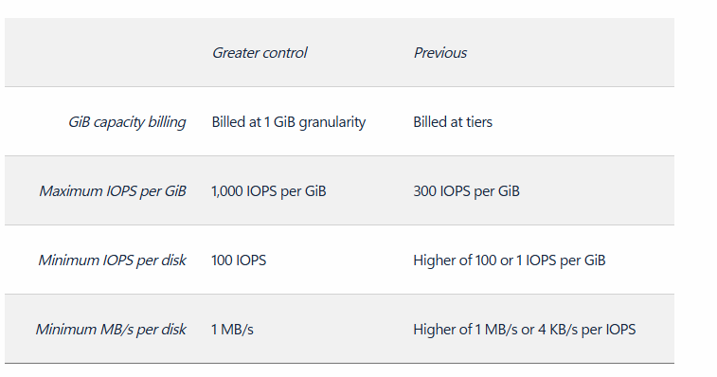
Storage & Data Updates
Generally Available: Ultra Disk’s new flexible provisioning model
This enhancement gives the freedom to configure capacity, IOPS, and throughput (MBPS) more independently—so it is possible to tailor performance to workload needs and optimize total cost of ownership. These improvements are available for both new and existing Ultra Disks.
Below is a comparison of the new enhancements versus the previous state
Generally Available: Object Replication Metrics
Blob storage Object Replication metrics for pending operations and pending bytes are now generally available in all regions. These replication metrics will empower optimization of the performance, troubleshoot replication delays, and maintain high availability across your Object Replication policies.
The two metrics that will provide deeper visibility and insights into object replication progress are:
Pending Operations: Tracks the total number of operations pending replication from the source to the destination storage account of your OR policy
Pending Bytes: Tracks the total volume of data pending replication from the source to the destination storage account of your OR policy
Both metrics are emitted in time buckets (e.g. <5min, 5-10 min, 10-15 min, etc.) which show how long operations have been pending replication to the destination account. This assists with quickly identifying delays in the replication pipeline and makes it easier to monitor replication performance.

Slide 41
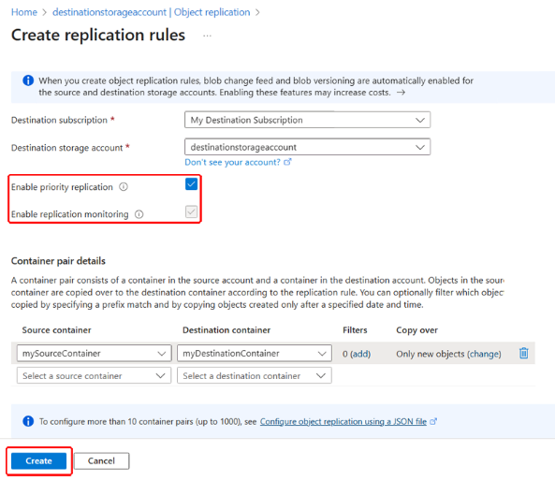
Storage & Data Updates
Generally Available: Object Replication Priority Replication for Azure Blob
Object replication (OR) currently copies all operations from a source storage account to one or more destination accounts asynchronously, with no guaranteed completion time. However, with the introduction of object replication priority replication, users can now choose to prioritize the replication of the operations in their replication policy.
When a replication's source and destination account are within the same continent, OR priority replication also replicates 99.0% of objects within 15 minutes for supported workloads.
Generally Available: Geo Priority Replication for Azure Blob
Azure Blob Storage Geo Priority Replication is designed to meet the stringent compliance and business continuity requirements of Azure Blob users. The feature prioritizes the replication of blob data for storage accounts with geo-redundant storage (GRS) and geo-zone redundant storage (GZRS) enabled. This prioritization accelerates data replication between the primary and secondary regions of these geo-redundant accounts.
For supported workloads, a Service Level Agreement (SLA) also backs geo priority replication, and applies to any account that has Geo priority replication enabled. It guarantees that the Last Sync Time (LST) for your account's Block Blob data remains lagged 15 minutes or less for 99.0% of the billing month. In addition to prioritized replication traffic, the feature includes enhanced monitoring and detailed telemetry.

Slide 42
Storage & Data Updates
Generally Available: Planned Failover for Azure Storage
Planned Failover is a customer-managed failover that provides the ability to failover a geo-redundant storage account while keeping geo-redundancy and data durability.
It is possible to seamlessly swap the primary and secondary storage endpoints of a geo-redundant account. After the Planned Failover is completed, all new write operations will be directed to the original secondary region, which will serve as the new primary region.
Planned Failover can be utilized in a variety of scenarios including disaster recovery drills, partial outages where storage remains healthy or proactive disaster preparation. It is now generally available for GPv2 storage accounts and is compatible with Blob, ADLS Gen2, Table, File, and Queue data.

Slide 43
Databases

Slide 44
Databases Updates
Public Preview: Azure Database for PostgreSQL read replicas with Premium SSD v2
It is now possible to configure read replicas (in-region and geo-replicas) with Premium SSD v2 storage tier in Azure Database for PostgreSQL flexible server.
Read replicas enable scaling out read-heavy workloads and improve performance by offloading read operations to replica servers, while write operations continue on the primary. In addition, geo-replicas can serve as read-write failover servers in the event of a disaster, enhancing your business continuity strategy.
Replication is performed asynchronously using the native physical replication technology in PostgreSQL, enabling you to replicate from a primary server to up to five replicas.
With Premium SSD v2, each managed disk delivers up to 80,000 IOPS. When combined with five read replicas, you can achieve up to 480,000 IOPS, helping you meet the demands of your most performance-intensive workloads.
Public Preview: Azure SQL updates for early November 2025
In early November 2025, the following updates and enhancements were made to Azure SQL:
Azure SQL Hyperscale now supports multiple geo-secondary replicas, making it easier to design and deploy disaster recovery topology spanning multiple regions. Azure SQL Database enables you to restart your database in the Azure portal.
The portal uses the same API that is available for PowerShell, REST, and Azure CLI.

Slide 45
Databases Updates
Generally Available: PgBouncer 1.23.1 support in Azure Database for PostgreSQL – Flexible Server
PgBouncer 1.23.1 is now generally available in Azure Database for PostgreSQL – Flexible Server.
With this update, you benefit from the latest community improvements, including enhanced protocol handling and important stability fixes, giving you a more reliable and resilient connection pooling experience. Because PgBouncer is integrated into Flexible Server, you don’t need to install or maintain it separately—simply enable it on port 6432 and start reducing connection overhead in your applications. This release keeps your PostgreSQL servers aligned with the community while providing the reliability of a managed Azure service.
Generally Available: Azure SQL updates for mid-October 2025
In mid-October 2025, the following updates and enhancements were made to Azure SQL:
Improve the redirect connection type to require only port 1433 and promote to default.
  Redirect now handles older clients as if the "proxy" connection type were set. This happens on a per-connection basis, though, so while modern SQL drivers will be redirected, any older driver will be transparently proxied. Overall, this hardens your entire fleet of clients against transient gateway disconnections and ekes out maximum performance.
  Redirect now only requires inbound port 1433 to be open. We've changed the mechanism by which the correct replica is selected so that all replicas now listen on SQL Server's standard TDS port. Simply put, no matter which connection type is set, all managed instances now only expect inbound traffic on port 1433 – and your SQL clients' outbound traffic to managed instances will always only target that port.
Convert Azure SQL Database to Hyperscale while preserving existing geo-replication or failover group settings.

Slide 46
Databases Updates
Generally Available: Azure Database for MySQL – Flexible Server now supports high availability with dedicated Azure Standard Load Balancer
With this feature, a high availability configuration gets the benefit of a dedicated Standard Load Balancer, including low latency, high throughput network traffic distribution of front-end requests to backend servers.
Generally Available: Query Advisor in Azure Cosmos DB
Query Advisor helps write faster, more efficient queries by analyzing query structure and providing clear, actionable recommendations. It identifies ways that can potentially reduce Request Unit (RU) cost and improve performance.
As applications grow, even small changes in query design can have a big impact on scalability and cost. Query Advisor reviews queries, detects patterns that may cause excessive scans or processing, and suggests improvements, such as optimized filters, more efficient array operations, or simplified subqueries. Each recommendation includes a brief explanation and an example rewrite so you can learn and decide what to apply.
This feature helps developers and database engineers understand how to fine-tune queries for their workloads, achieve better performance, and control RU consumption.

Slide 47
Databases Updates
Generally Available: ORDER BY ST_DISTANCE in Azure Cosmos DB for NoSQL Geospatial Queries
Azure Cosmos DB for NoSQL now supports ORDER BY ST_DISTANCE for geospatial queries, now generally available.
With this feature, it is possible to sort query results by their distance from a given point or GeoJSON object directly within Azure Cosmos DB.
You no longer need to calculate distances in application code or perform client-side sorting. This function makes it easier to deliver real-time, location-aware experiences for logistics, retail, mapping, and smart-city scenarios with less code and better performance, such as “find the nearest store,” “list drivers by proximity,” or “rank properties by distance.”
General Availability: Server Parameters support for lower_case_table_names in Azure Database for MySQL- Flexible Server
MS announced the General Availability of a highly requested feature: Self-serve configuration of the lower_case_table_names server parameter during server creation.
For MySQL version 8.0+ it is possible to configure lower_case_table_names only when you're initializing the server. For restore operations or replica server creation, the parameter will automatically be copied from the source server and cannot be changed.

Slide 48
Databases Updates
Generally Available: Azure Database for MySQL Triggers for Azure Functions
Azure Database for MySQL triggers for Azure Functions are now generally available, enabling to set up change tracking and develop event-driven applications at scale on any MySQL table. It is possible to trigger a function when a row in a MySQL table is created, updated, or deleted.

Slide 49
Integration

Slide 50
Integration Updates
Introducing the RabbitMQ Connector (Public Preview)
MS announced the introduction of the RabbitMQ Connector in Logic Apps (Standard) which allows to both send and receive messages between Logic Apps and RabbitMQ.
RabbitMQ is a robust, open-source message broker widely used for building reliable, scalable, and flexible messaging solutions. It is trusted across industries such as financial services, e-commerce, IoT, telecommunications, and cloud-native microservices.
Our RabbitMQ connector allows messaging scenarios on-premises using Logic Apps hybrid.
Benefits of Using RabbitMQ
Reliability:
Flexible Routing
Clustering & High Availability
Management & Monitoring
Extensibility
Introducing native Service Bus message publishing from Azure API Management (Preview)
MS announced a preview capability in Azure API Management (APIM) — you can now send messages directly to Azure Service Bus from your APIs using a built-in policy.
This enhancement, currently in public preview, simplifies how you connect your API layer with event-driven and asynchronous systems, helping you build more scalable, resilient, and loosely coupled architectures across your enterprise.
Modern applications increasingly rely on asynchronous communication and event-driven designs. With this new integration:
Any API hosted in API Management can publish to Service Bus — no SDKs, custom code, or middleware required.
Partners, clients, and IoT devices can send data through standard HTTP calls, even if they don’t support AMQP natively.
You stay in full control with authentication, throttling, and logging managed centrally in API Management.
Your systems scale more smoothly by decoupling front-end requests from backend processing.

Slide 51
ML & AI & IOT

Slide 52
ML & AI & IOT Updates
Announcing Public Preview: AI Toolkit for GitHub Copilot Prompt-First Agent Development
MS announced the Public Preview of the GitHub Copilot prompt-first agent development in the AI Toolkit for Visual Studio Code. With this release, building powerful AI agents is now simpler and faster - no need to wrestle with complex frameworks or orchestrators. Just start with natural language prompts and let GitHub Copilot guide you from concept to working agent code.

Slide 53
ML & AI & IOT Updates
Sora 2 now available in Azure AI Foundry
Sora 2 in Azure AI Foundry isn’t just another video generation tool; it’s a creative powerhouse, seamlessly integrated into a platform built for innovation, trust, and scale. Unlike standalone solutions, Azure AI Foundry offers a unified platform where developers can access Sora 2 alongside other leading generative models in a secure, scalable, and structured environment
Generally Available: Azure MCP Server
Azure MCP server is an open-source implementation of the MCP specification, designed to bridge AI agents and cloud resources with a “write once” approach.
The Azure MCP Server enables AI agents and other types of clients to interact with Azure resources through natural language commands. It implements the Model Context Protocol (MCP) to provide these key features:
MCP support: Because the Azure MCP Server implements the Model Context Protocol, it works with MCP clients such as GitHub Copilot agent mode, the OpenAI Agents SDK, and Semantic Kernel.
Entra ID support: The Azure MCP Server uses Entra ID through the Azure Identity library to follow Azure authentication best practices.
Service and tool support: The Azure MCP Server supports Azure services and tools such as the Azure CLI and Azure Developer CLI (azd).

Slide 54
ML & AI & IOT Updates
Announcing Qwen3-VL family of models on Azure AI Foundry
Qwen3-VL is the most powerful vision-language model in the Qwen series to date, marking a leap from perception to true multimodal understanding and reasoning.
Qwen3-VL integrates advanced visual agent abilities to operate interfaces, generate code from images, and reason over long contexts of up to 1 million tokens. It shows major gains in spatial understanding, STEM reasoning, and multilingual OCR (32 languages), alongside broader visual recognition across everyday and professional domains. Altogether, Qwen3-VL represents a new generation of models that not only see and describe the world — but truly understand it.
Overall, the largest mixture-of-experts Qwen3-VL-235B-A22B-Instruct achieves top performance on most metrics among non-reasoning models, significantly outperforming closed-source models such as Gemini 2.5 Pro and GPT-5, while also setting new state-of-the-art results among open-source multimodal models, demonstrating its strong generalization ability and comprehensive performance on complex visual tasks.

Slide 55
ML & AI & IOT Updates
Retirement: Azure Computer Vision – Image Analysis will be retired on September 25, 2028
Microsoft is announcing the planned retirement of the Azure Computer Vision – Image Analysis service.
Microsoft will provide full support for all existing Azure Computer Vision – Image Analysis customers until 9/25/2028. During this support window, customers are encouraged to begin planning and executing their transition to one of the following Azure products.
For OCR and Read capabilities, utilize Document Intelligence
For Face scenarios, use the Face API
For other Computer Vision scenarios, utilize the GPT model series found in the Azure AI Foundry
Azure AI is offering a new product currently in preview, Azure AI Content Understanding, that is powered by LLMs and also supports many image analysis use cases
See the Azure Computer Vision – Image Analysis documentation for more information on your specific use case
Retirement: Remove dependency on these preview features before March 31, 2026
On March 31, 2026, the following preview features will be retired:
Group multiple steps as a whole to better organize complex pipelines
Compare pipeline jobs to debug failures or unexpected issues
Import data into a data labelling project
Use v2 data asset (uri_folder and mltable) in a data labelling project
Monitor data drift between training and inference
Add linked services
Monitor compute resource
After March 31, 2026, these preview features will no longer be available.

Slide 56
DevOps & IaC & Automation

Slide 57
DevOps & IaC & Automation
Public Preview: GitHub Copilot in SQL Server Management Studio (SSMS)
GitHub Copilot in SSMS helps write Transact-SQL (T-SQL) faster and with greater accuracy.
Using the database and connection context, it can also answer general SQL questions and assist with administrator tasks, directly in SSMS environment. GitHub Copilot in SSMS can answer questions for databases in SQL Server, Azure SQL Database, Azure SQL Managed Instance, and SQL databases in Microsoft Fabric.

Slide 58
Miscellaneous

Slide 59
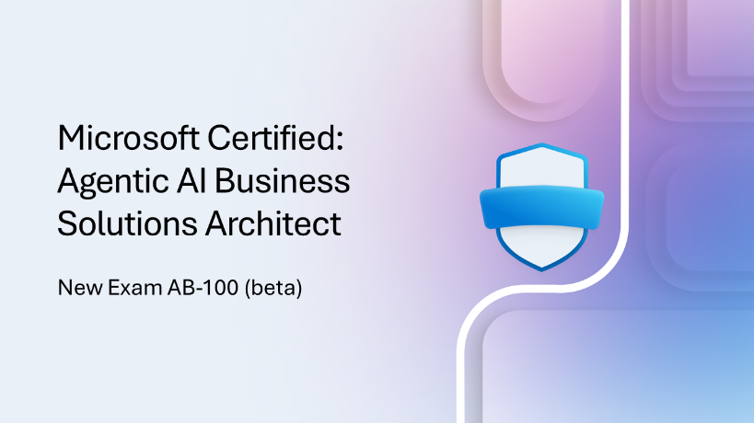
Miscellaneous Updates
New Certification for architects of agentic AI business solutions

Slide 60
Information

Slide 61
Information
Azure Times GitHub Repo

Slide 62
Questions

