Slide 1
Azure Times #191
February 2, 2026

Slide 2
Security & Identity

Slide 3
Security & Identity Updates
Upcoming Conditional Access change: Improved enforcement for policies with resource exclusions
Today, when a user signs in through a client application that requests only OIDC scopes or a limited set of directory scopes, Conditional Access policies that target All resources are not enforced if the policy has one or more resource exclusions.
After this change, Conditional Access policies that target All resources will be enforced for these sign-ins, even when resource exclusions are present. This ensures that policies are consistently applied regardless of the scope set requested by the application.
Microsoft Entra ID will begin enforcing this change starting March 27, 2026. This will be rolled out progressively across all clouds over several weeks until June 2026.
This change only affects tenants that have a Conditional Access policy targeting All resources with one or more resource exclusions, and these tenants will be notified through M365 Message Center messages. Tenants without this policy configuration will not be impacted.

Slide 4
Management & Governance

Slide 5
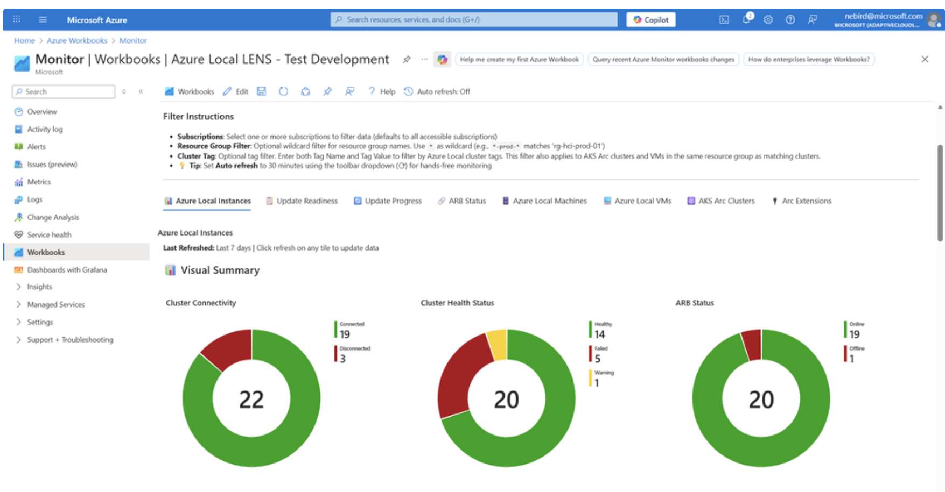
Management & Governance Updates
The Windows Admin Center: Virtualization Mode preview build has been updated
At Microsoft Ignite last year, Windows Admin Center: Virtualization Mode (vMode) was introduced as a purpose-built management experience designed to simplify large-scale administration of on-premises Windows Server Hyper-V environments across multiple hosts and clusters, while seamlessly integrating with Azure Arc to enable a true hybrid cloud operating model.
The solution has since been updated to version 2.6.4. This release establishes the foundation for virtualization mode agent updates. When a newer version of Windows Admin Center: Virtualization Mode is installed, agents deployed on existing vMode-managed machines are automatically upgraded to the latest version, ensuring consistency and alignment across the infrastructure.
Azure Local LENS workbook—deep insights at scale, in minutes
As Azure Local deployments scale from a limited number of instances to hundreds or even thousands, operational focus shifts significantly. Management is no longer centered on troubleshooting individual environments but on identifying trends and patterns across the entire fleet. Key questions emerge, such as which sites are exhibiting recurring health issues, where workload density is increasing over time and whether sufficient capacity is available, and which clusters deviate from established operational baselines.
To address these challenges, Azure Local LENS has been introduced—a free, community-driven Azure Workbook designed to provide deep, fleet-wide visibility across large Azure Local environments. Azure Local LENS enables operators to analyze health, capacity, and deployment trends quickly and consistently, supporting a transition from reactive troubleshooting to proactive, data-driven operations.

Slide 6
Management & Governance Updates
Retirement: "Send data to Event Hubs & Storage (Preview)" retiring July 31, 2026
On July 31, 2026, MS will retire the preview feature “Send virtual machine client data to Event Hubs and Storage (Preview)” and it will no longer be supported by Microsoft. You will not be able to create any new data collection rules using this feature, and any existing configurations using this capability will stop sending data.
You will need to switch to alternatives

Slide 7
Compute

Slide 8
Compute Updates
Public Preview: Azure Command Launcher for Java
At Microsoft Ignite 2025, MS announced the Public Preview of the Azure Command Launcher for Java, a new JVM launcher optimized specifically for Azure. This tool provides better default ergonomics for Java applications running in containers and virtual machines, ensuring more efficient use of resources right from the start.
By using Azure Command Launcher for Java to automatically set JVM parameters tailored for cloud deployments, workloads have reduced wasted memory and CPU cycles, improving first-deploy performance, and enhancing cost efficiency. This is ideal for developers, Ops, and SREs, who want better JVM defaults without diving deep into JVM tuning guides, and develop and deploy cloud-native microservices.
Key Features
Automatically benefits from battle-tested defaults for cloud-native and container workloads.
Optimizes resource utilization by setting JVM parameters tailored for cloud deployments.
Improves likelihood of first-deploy performance and cost efficiency.
Public Preview: 7th generation Intel-based VMs – Dlsv7/Dsv7/Esv7
The latest Azure Intel-based v7 VMs are designed to power ever increasing compute demands in today’s data center environment and deliver exceptional performance across a wide range of workloads, from traditional enterprise applications to cutting edge AI.
These VMs deliver several important features and improvements compared previous generation (v6) Intel-based VMs including:
Up to 15% better general compute performance, powered by Intel® Xeon® 6 CPUs with turbo frequencies up to 4.2 GHz and up to 2x higher memory bandwidth
Expanded sizes and memory capacity: Dsv7 and Esv7 VMs now scale up to 372 vCPUs with Esv7 VMs enabling up to 2.8TiB of memory
Increased networking and remote storage performance driven by latest Azure Boost capabilities:
  Up to 400 Gbps networking bandwidth with the largest size
  Up to 800k IOPS and 20 GBps throughput to Premium v2 and Ultra Disk remote storage with the largest size

Slide 9
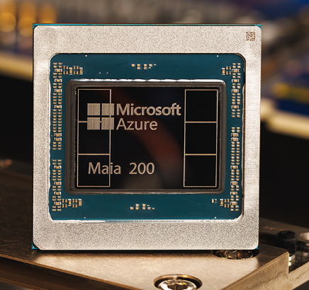
Compute Updates
Windows 365 now supported in Brazil South
MS announced that Windows 365 is now available in the Brazil South region. Organizations can now provision Cloud PCs closer to their users in Brazil and across South America, helping reduce latency and support regional data residency requirements.
With this update, Brazil South joins the list of supported Azure regions for Windows 365, giving IT teams greater flexibility in how they deploy and scale Cloud PCs.
Note: Brazil South was previously available only through an exception process. With capacity now in place to support all customers, the region is now fully open for general availability.
MS introduced Maia 200
Microsoft introduced Maia 200, a next-generation AI inference accelerator designed to dramatically improve the performance and cost efficiency of AI token generation. Built on TSMC’s 3nm process, Maia 200 features native FP8/FP4 tensor cores, 216 GB of HBM3e memory delivering 7 TB/s bandwidth, and a redesigned architecture optimized for feeding and serving massive models at high utilization. It delivers industry-leading performance, outperforming competing hyperscaler silicon and achieving up to 30% better performance per dollar than the latest hardware currently deployed in Microsoft datacenters.
Maia 200 is a key part of Microsoft’s heterogeneous AI infrastructure and will power workloads across Microsoft Foundry and Microsoft 365 Copilot, including serving the latest GPT-5.2 models from OpenAI. It will also be used by Microsoft’s Superintelligence team for synthetic data generation and reinforcement learning, accelerating the development of next-generation in-house models.

Slide 10
Compute Updates
Generally Available: Azure Databricks Agent Bricks Knowledge Assistant
Azure Databricks Agent Bricks knowledge assistant empowers to create, deploy, and manage AI agents directly within the Azure Databricks platform, using unified data and AI capabilities.
This feature simplifies agent development by providing prebuilt components, secure integration with enterprise data, and scalable orchestration.
Agent Bricks allows to accelerate automation, enhance decision-making, and deliver personalized experiences all while maintaining compliance and governance standards under the Azure ecosystem.
Generally Available: Azure AMD Turin Dasv7, Easv7, and Fasv7-series Virtual Machines
These virtual machines deliver significant enhancements over the previous generation, offering improved CPU performance, greater scalability, and expanded configuration options to meet the demands of a wide range of workloads.
Key improvements include:
Up to 35% CPU performance improvement compared to similarly sized v6 VMs
Significant performance gains on other workloads:
  Up to 25% for Java-based workloads
  Up to 65% for in-memory cache applications
  Up to 80% for crypto workloads
  Up to 130% for web server applications
New VM series introduced: Fadsv7, Faldsv7, and Famdsv7 with local disk support.
These VMs are available in the following Azure regions: Australia East, Central US, Germany West Central, Japan East, North Europe, South Central US, Southeast Asia, UK South, West Europe, West US 2, and West US 3. The large 160 vCPU Easv7-series and Eadsv7-series sizes are available in North Europe, South Central US, West Europe, and West US 2.

Slide 11
Compute Updates
Announcing General Availability of RDP Shortpath Configuration via GPO and Microsoft Intune
This update introduces a unified, policy-driven approach for managing which RDP Shortpath modes—Managed, Public/STUN, and Public/TURN—are enabled across Azure Virtual Desktop (AVD) session hosts and Windows 365 Cloud PCs. The Shortpath controls are now exposed as registry-backed policies, allowing organizations to enforce consistent configuration across large-scale or distributed environments.
RDP Shortpath supports multiple optimized UDP-based transport paths to improve connection performance and reliability across varying network conditions. These include Managed, Public/STUN, and Public/TURN modes, which together form the complete RDP Shortpath feature set. Microsoft recommends keeping all modes enabled to allow automatic selection of the optimal path. However, organizations with stricter networking or security requirements—such as disabling STUN-based traversal to ensure traffic flows exclusively through TURN’s dedicated ports and subnets—can now enforce these constraints through centralized policy

Slide 12
Fabric January 2026 Feature Summary
Events & Announcements
  Upgrade your skills and certifications before FabCon
  Have you registered for FabCon Atlanta yet?
General
  Microsoft acquires Osmos to extend Fabric with agentic data engineering
Fabric Platform
  AI Auto-Summary for semantic models (Preview)
  Parent-Child hierarchy in OneLake catalog
  Item Reference Variable Type (Preview)
  Git integration – enhanced support for GitHub Enterprise Cloud with data residency
  Git integration – Commit to standalone branch
  Python SDK for Microsoft Fabric REST API (Preview)
OneLake
  Granular APIs for OneLake security (Preview)
  OneLake security support for Mirrored item types
  OneLake diagnostics immutable logs
Data Engineering
  High Concurrency mode for Lakehouse operations
  Fabric connection inside Notebook (Preview)
  Open and edit workspace’s Notebook inside VS Code
  Create or replace semantics support for Materialized Lake View
  Lineage enhancements in Materialized Lake views
Data Warehouse
  Proactive statistics refresh
  Incremental statistics refresh
  Result set caching (Generally Available)
  MERGE Transact-SQL (Generally Available)
Real-Time Intelligence
  MQTT v3 support for the Eventstream MQTT Connector
  Real-Time Weather Connector for Eventstream (Generally Available)
  Eventhouse accelerated OneLake shortcuts now support acceleration based on date-time columns
  Eventhouse accelerated OneLake shortcuts control data freshness latency
  Simplified KQL syntax for querying shortcuts in Eventhouse
  Copilot support for querying shortcuts in Eventhouse

Slide 13
Compute Updates
Retirement: Support for Python 3.10 ends on October 1, 2026 – upgrade your Azure Functions apps to Python 3.13
In alignment with the end of community support, on October 1, 2026, support for Python 3.10 in Azure Functions will end. Apps that are hosted on Functions will continue to run, but security updates and performance optimizations will no longer be available and we'll no longer provide customer service for Python 3.10.
Required action
To avoid potential security vulnerabilities and take advantage of the latest features, upgrade Functions apps to Python 3.13 by 1 October 2026.

Slide 14
Storage & Data

Slide 15
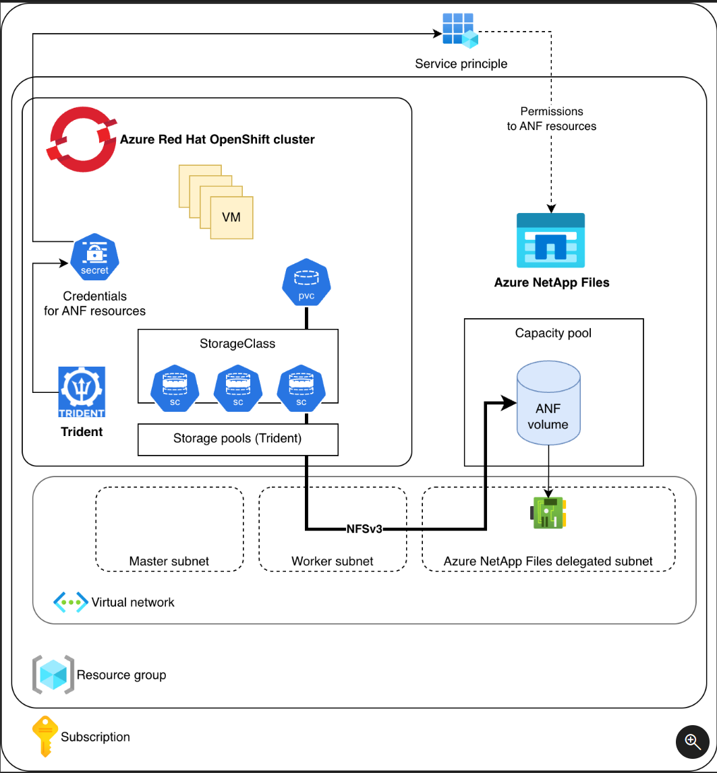
Storage & Data Updates
Public Preview: Azure NetApp Files support in OpenShift Virtualization
Azure NetApp Files now enables fast virtual machine (VM) provisioning, instant cloning, and live migration in OpenShift Virtualization. It offers seamlessly scalable storage with predictable performance and enterprise data management for VM workloads from infrastructure VMs to business-critical databases.
Support for Azure NetApp Files in OpenShift Virtualization is now in preview and is available in all Azure regions where Azure NetApp Files and Azure Red Hat OpenShift are offered.

Slide 16
Databases

Slide 17
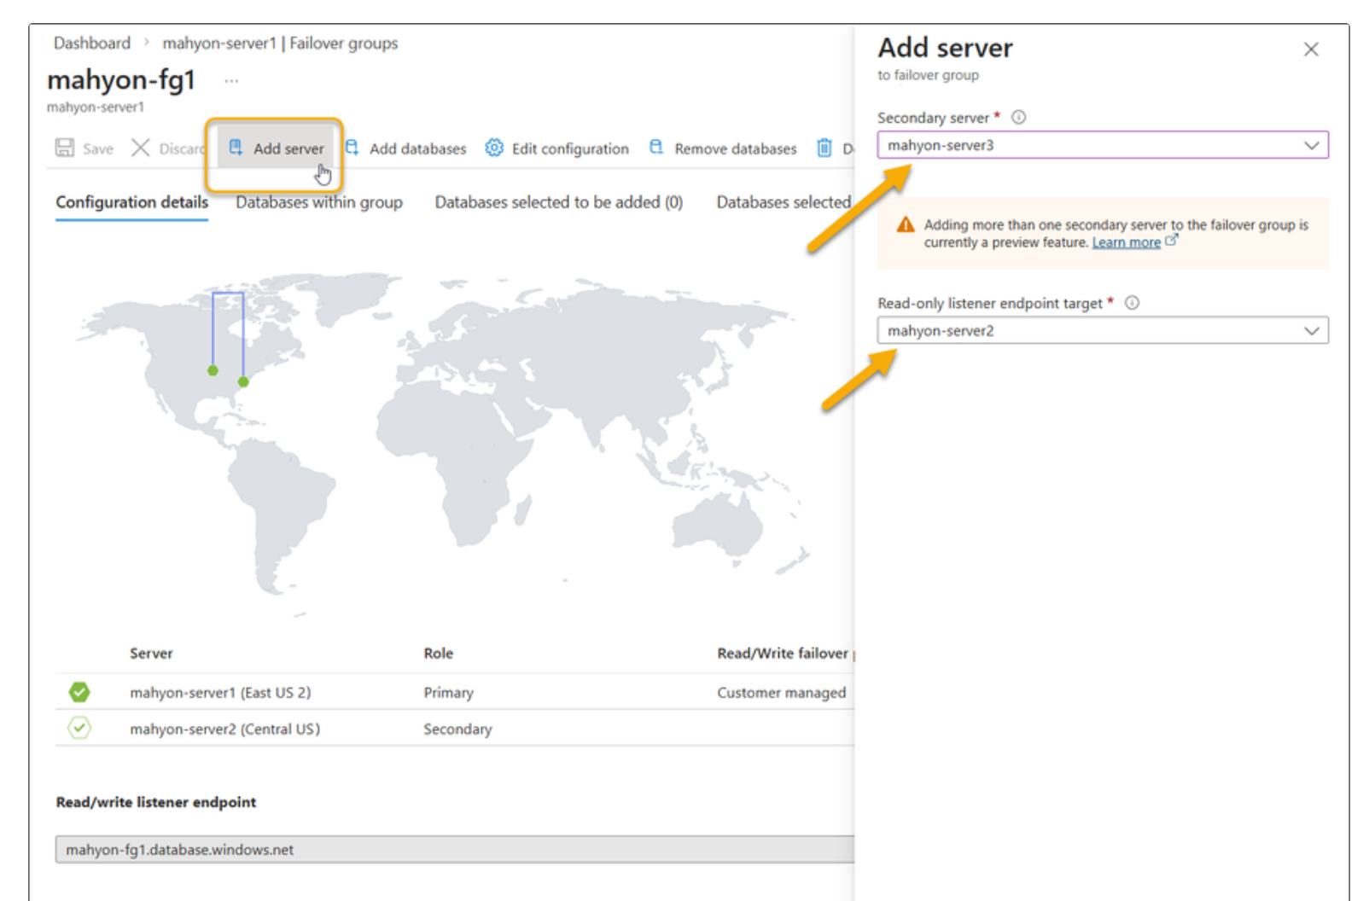
Databases Updates
Multiple secondaries for failover groups is now in public preview
Azure has announced that support for up to four secondary replicas per failover group is now available in public preview. This enhancement significantly expands design options for disaster recovery, read scalability, and high-availability architectures.
What’s New
Support for up to four secondary databases within a single failover group, deployed in the same or different Azure regions
Ability to leverage additional secondaries for regional read scale-out, enabling greater flexibility for read-only workloads
Enhanced disaster recovery planning through multiple failover targets
Improved resilience by distributing replicas across multiple geographic regions
Simplified regional migration scenarios, allowing workloads to transition to new regions without compromising existing disaster recovery protection
This update enables more sophisticated availability and resiliency architectures for Azure SQL Database, particularly for globally distributed applications with advanced continuity and performance requirements.

Slide 18
Databases Updates
Generally Available: Latest PostgreSQL minor versions supported by Azure Database for PostgreSQL – Flexible Server
PostgreSQL minor versions 18.1, 17.7, 16.11, 15.15, 14.20, and 13.23 are now supported by Azure Database for PostgreSQL – Flexible Server.
These minor version upgrades are automatically performed as part of the monthly planned maintenance in Azure Database for PostgreSQL – Flexible Server. This upgrade automation ensures that databases are always running the latest optimized versions without requiring manual intervention.

Slide 19
DevOps & IaC & Automation

Slide 20
DevOps & IaC & Automation
Minimum Usage in Azure App Testing
Following the recent introduction of AI-assisted load test authoring, which enables tests to better mirror real-world usage patterns, the service is now introducing a change focused on more efficient utilization of underlying test infrastructure. Each load test run requires dedicated resources to be provisioned, managed, and later deprovisioned. Short-lived or low-user test runs can result in underutilization of this infrastructure.
To address this, a minimum usage threshold per load test run will be enforced.
Effective March 1, 2026
Load tests executed in Azure App Testing will incur a minimum charge based on Virtual User Hours (VUH) per test run, calculated as follows:
10 Virtual Users (VUs) per engine for the actual test run duration, or
10 VUs per engine for 10 minutes, if the test duration is shorter than 10 minutes
Test runs that already meet or exceed this minimum threshold will not be affected by this change.
This update applies only to load tests and does not impact Playwright tests executed within Azure App Testing.
The change is intended to ensure more judicious use of test infrastructure while maintaining predictable and sustainable service costs.

Slide 21
Information

Slide 22
Information
Azure Times GitHub Repo

Slide 23
Questions

