Slide 1
Azure Times #205
May 11, 2026

Slide 2
Networking

Slide 3
Networking Updates
Public Preview: Application Gateway for Containers managed add-on + AKS Automatic
Application Gateway for Containers can now be used with AKS Automatic through the Application Gateway for Containers AKS Add-on.
With this update, customers using AKS Automatic can deploy Application Gateway for Containers by enabling the AKS Add-on, allowing Application Gateway for Containers to be managed and integrated as part of the AKS Automatic experience. This removes the need to manually provision or manage supporting infrastructure and aligns with the simplified operational model of AKS Automatic.
This enhancement enables customers to:
Use Application Gateway for Containers as the managed ingress and load balancing solution for AKS Automatic clusters
Benefit from a fully managed, Azure-native experience through the AKS Add-on
Reduce operational overhead while adopting a Gateway API–based application delivery

Slide 4
Management & Governance

Slide 5
Management & Governance Updates
Public Preview: Bulk Restore for Azure Virtual Machines using Azure Backup
Azure Backup now supports ‘Bulk Restore’ for Azure virtual machines (VMs), enabling customers to restore multiple VMs (up to 100) in a single operation. This feature simplifies large-scale recovery scenarios while preserving control and granularity at an individual VM level. Customers can select multiple VMs, choose restore points, apply common restore parameters and track restore progress centrally. This feature is optimized for scenarios such as outages, ransomware recovery, improving recovery speed and operational efficiency.
Bulk VM restore doesn’t support Classic, Unmanaged, Encrypted, or Confidential virtual machines.
Bulk VM restore isn’t supported for cross‑region restore (CRR) scenarios.
Target subnets must use /16 or a smaller subnet mask.
Cross-subscription backup for Azure VMs (preview)
Azure Backup now supports protecting Azure VMs using a Recovery Services vault in a different subscription, within the same Azure AD tenant and region. This capability lets central backup or security teams maintain a single vault to govern VM protection across multiple team or project subscriptions, without requiring the vault and the VM to share the same subscription.
Key capabilities:
Centralized governance: One vault can protect VMs spread across many subscriptions in the same tenant, simplifying policy management and compliance reporting.
Flexible restore: Vault-tier recovery points can be restored to the protected VM subscription, the vault subscription, or any other subscription when Cross Subscription Restore is enabled on the vault. Snapshot-tier recovery points restore only within the protected VM subscription.

Slide 6
Management & Governance Updates
Introducing cert-manager for Azure Arc-enabled Kubernetes: now in Public Preview
Cert-manager for Azure Arc-enabled Kubernetes is now in public preview, enabling automated certificate management for Kubernetes environments connected through Azure Arc. It simplifies the issuance, renewal, and lifecycle management of TLS certificates across clusters. The integration helps standardize secure communication and identity management in hybrid and multicloud Kubernetes deployments. It also reduces manual certificate operations and improves operational reliability. This enhances security and simplifies management for enterprise Kubernetes environments.

Slide 7
Management & Governance Updates
Simplified CLI experience to enable backup for AKS clusters
Azure Backup now supports configuring backups for Azure Kubernetes Service (AKS) clusters using a single Azure CLI command. This simplified experience eliminates the need for multiple manual setup steps, such as installing the Backup extension, preparing storage, creating a backup vault and policy, configuring Trusted Access, and creating the backup instance.
The single command automatically completes all required configuration, including extension deployment, storage preparation, vault and policy provisioning or reuse, Trusted Access setup, and backup instance creation. Optional configuration files let you reference existing resources and apply tags, making this capability well‑suited for automation, infrastructure‑as‑code, and CI/CD pipelines.

Slide 8
Compute

Slide 9
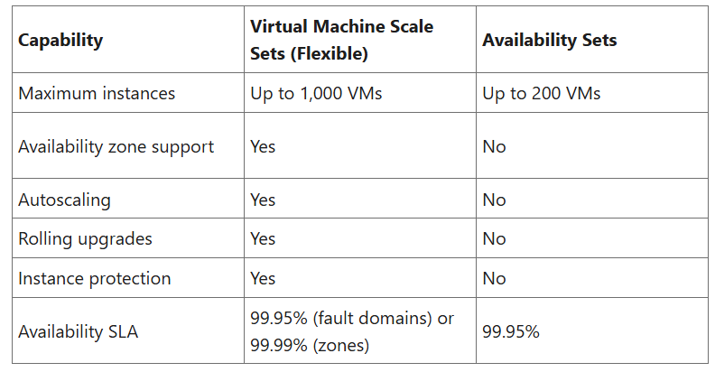
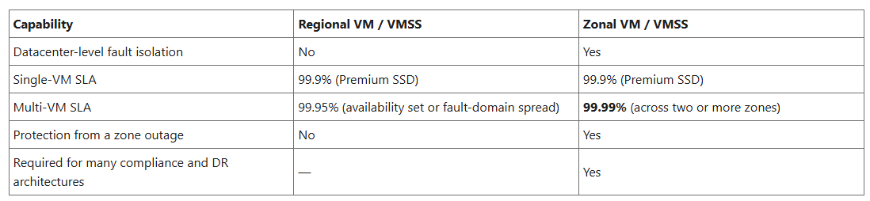
Compute Updates
Public Preview: Migrate Availability Sets to Virtual Machine Scale Sets
MS announced the public preview of availability set to Virtual Machine Scale Set migration for Azure Virtual Machines. This new capability enables to move existing VMs from availability sets to Virtual Machine Scale Sets with Flexible orchestration—unlocking higher availability, autoscaling, and zone-level resiliency without recreating your workloads from scratch.
Virtual Machine Scale Sets with Flexible orchestration provide several advantages over availability sets:
Public Preview: Migrate your regional virtual machines to availability zones
This new capability enables you to move your existing regional (nonzonal) VMs and VMSS Flex deployments into specific availability zones while preserving the VM names, data disks, and other stateful properties.
MS announced the public preview of regional to zonal migration for Azure Virtual Machines and for VMs in Virtual Machine Scale Sets with Flexible orchestration. With a small number of API calls, it is possible to take a VM that was originally deployed without a zone and assign it to availability zone 1, 2, or 3—keeping the same VM resource ID, name, OS and data disks, NICs, IP addresses, and scale set membership.

Slide 10
Compute Updates
Announcing the public preview of Oracle Database built-in connector for Azure Logic Apps Standard
Azure Logic Apps now includes a built-in Oracle Database connector (public preview), simplifying integration with Oracle workloads. The connector enables direct connectivity to Oracle databases without requiring additional gateway infrastructure. It supports building automated workflows and integrations between Oracle systems and Azure services. This helps organizations modernize hybrid and enterprise integration scenarios more easily. The built-in approach improves performance, manageability, and deployment simplicity for Oracle-based integrations.
Windows 365 and Azure Virtual Desktop: Expanding access
Windows 365 and Azure Virtual Desktop are expanding access with broader availability and enhanced deployment options. The updates improve flexibility for organizations adopting cloud-based desktop and application delivery. Customers can better align deployments with regional, compliance, and performance requirements. The expansion also supports more scalable and accessible virtual desktop experiences for different user scenarios. This helps organizations accelerate hybrid work and cloud desktop adoption.

Slide 11
Compute Updates
Generally Available: Azure Dl/D/E v7 Virtual Machines
Azure has announced the general availability of the new Dl/D/E v7 Virtual Machines, powered by the latest Intel® Xeon® 6 (Granite Rapids) processors. These general‑purpose and memory‑optimized VMs deliver up to 20% better general compute performance than previous-generation Intel‑based v6 VMs, alongside major improvements in scale, networking, and storage.
The v7 families support three memory-to-vCPU ratios (2:1, 4:1, and 8:1) and offer configurations with or without local NVMe temp disks. Customers can scale up to 372 vCPUs and 2.8 TiB of memory on Esv7/Edsv7 sizes, enabling larger and more demanding workloads.
Built on Azure Boost, the v7 VMs deliver up to 400 Gbps networking, up to 800k IOPS and 20 GBps of remote storage throughput, and up to 9.6M IOPS on local NVMe. Intel® AMX enables built‑in AI acceleration for inference workloads, while Intel® TME enhances memory security.
Dl/D/E v7 VMs are ideal for web and application servers, containerized workloads, databases, analytics, and in‑memory workloads such as SAP and Redis.
These VMs are now generally available in Central US, with additional regions coming soon.
Generally Available: Azure Functions durable task scheduler Consumption SKU
The Durable Task Scheduler Consumption SKU is now generally available. Run durable workflows and AI agent orchestrations on Azure with pay-per-use pricing. No storage to manage, no capacity to plan, and no idle costs.
The Consumption SKU charges only for actions dispatched, making it ideal for bursty workloads like AI agent orchestration, event-driven pipelines, and API-triggered workflows.
It supports up to 500 actions/second, 30-day data retention, a built-in monitoring dashboard, and identity-based security with Entra ID and RBAC. Works across Azure Functions, Azure Container Apps, AKS, and any compute environment using the Durable Task SDKs.

Slide 12
Compute Updates
Retirement: Azure Reserved Virtual Machines Instances for select VM series
Starting July 1, 2026, purchases and renewals will no longer be available for one-year Azure Reserved VM Instances for the Av2, Amv2, Bv1, D, Ds, Dv2, Dsv2, F, Fs, Fsv2, G, Gs, Ls, and Lsv2 VM series. Additionally, one-year and three-year reserved instances (RIs) for the Dv3, Dsv3, Ev3, and Esv3 VM series will no longer be available for purchase and renewal.

Slide 13
Storage & Data

Slide 14
Storage & Data Updates
Public Preview: Azure NetApp Files enable backup by default
Azure NetApp Files now enables backup by default when creating new volumes, delivering a more seamless and secure data‑protection experience. Backups are automatically provisioned during volume creation, reducing setup effort while still allowing customers to opt out when needed. This enhancement improves usability, strengthens data resilience, and is available across all Azure NetApp Files regions

Slide 15
Storage & Data Updates
Generally Available: AVS Support for AV64 SKU on Azure Elastic SAN
Azure Elastic SAN datastores are now supported with AV64 SKUs, enabling higher-scale and higher-performance storage options for Azure VMware Solution deployments.
Generally Available: Single Volume Snapshots on Azure Elastic SAN
Azure Elastic SAN now supports single volume snapshots, enabling incremental, point‑in‑time backups of individual SAN volumes. Snapshots capture only changes since the previous snapshot and reside within the SAN, allowing customers to quickly deploy new volumes from a restore point or export data to managed disk snapshots for long‑term retention. Snapshots are capacity efficient, consume SAN storage instead of incurring separate billing, and inherit the redundancy configuration of the parent SAN.
Snapshots consume provisioned SAN capacity rather than incurring separate billing and can be exported to managed disk snapshots for longer‑term retention beyond the lifecycle of the source volume. Snapshot redundancy is automatically aligned with the redundancy configuration of the parent Elastic SAN.

Slide 16
Storage & Data Updates
Generally Available: Azure Elastic SAN support for AVS Gen2 Private Cloud
Elastic SAN datastores deliver simpler connectivity and improved performance when used with AVS Gen2 Private Cloud:
Simpler connectivity & configuration
No ExpressRoute gateway required
A single Private Endpoint is sufficient to configure the optimal number of iSCSI sessions
Higher performance
No throughput limitations imposed by the ExpressRoute gateway bandwidth
Ability to achieve the entire provisioned Elastic SAN throughput
This significantly simplifies deployment while maximizing performance for throughput‑intensive AVS workloads.
Generally Available: Azure Premium SSD v2 Disk is now available in all three available zones in Japan West
Azure Premium SSD v2 is now available in all three Availability Zones in Japan West.
Azure Premium SSD v2 disk, a next-generation general-purpose block storage option for Azure virtual machines, offers sub-millisecond latencies and exceptional price performance for IO-intensive workloads at a low cost. Premium SSD v2 is suited for a broad range of enterprise production scenarios, including SQL Server, Oracle, MariaDB, SAP, Cassandra, MongoDB, big data/analytics, and gaming on virtual machines or stateful containers.

Slide 17
Databases

Slide 18
Databases Updates
Public Preview: Azure Cosmos DB Shell—your new command line for data workflows
Azure Cosmos DB Shell is now available in public preview, introducing a modern command-line experience with agentic capabilities powered by Model Context Protocol (MCP). You can now query, explore, and manage your data more efficiently through intelligent, AI-assisted workflows.
Public Preview: Azure SQL update for early-May 2026
In early May 2026, the following update and enhancement was made to Azure SQL:
Right‑size memory for Business-Critical Azure SQL Managed Instance to improve performance without overprovisioning.

Slide 19
Databases Updates
Retirement: Azure Document Intelligence v3.0 API will be retired on March 30, 2029
On March 30, 2029, Azure Document Intelligence v3.0 API will be retired. Please migrate to latest generally available Azure Document Intelligence API version, v4.0, by that date. After March 30, 2029, Azure Document Intelligence v3.0 API will no longer be supported and will become unusable.

Slide 20
ML & AI & IOT

Slide 21
ML & AI & IOT Updates
Introducing OpenAI's newest chat model in Microsoft Foundry
OpenAI's GPT-5.5 Instant (or Chat-latest in the API) begins rolling out in Microsoft Foundry today as GPT-chat-latest. Built on GPT-5.4 and GPT-5.3-chat, the new model delivers measurable gains in factual accuracy, tool calling, and response efficiency. These improvements translate directly into more reliable production deployments.
GPT-chat-latest is designed for the workflows builders are actually shipping: multi-turn assistants, agentic systems that orchestrate tools, and retrieval-grounded applications where precision and grounding matter as much as conversational quality.
Public Preview: Azure Cosmos DB spherical quantization for improved vector search
Azure Cosmos DB now offers spherical quantization in public preview to help you achieve faster vector indexing with higher recall and accuracy at scale. Spherical quantization is an advanced vector compression technique designed to preserve search quality while improving vector indexing and search performance.

Slide 22
ML & AI & IOT Updates
Three real-time models are now available
OpenAI’s GPT-realtime-translate, GPT‑realtime‑2 and, GPT-realtime-whisper are now available in Microsoft Foundry.
GPT-realtime-translate and GPT-realtime-whisper together extend the realtime stack for live multilingual audio workflows. GPT-realtime-translate is built for continuous, real-time translation, producing translated output as speech unfolds without relying on segmented pipeline processing, while GPT-realtime-whisper provides low-latency streaming transcription of the original audio in parallel.
GPT‑realtime‑2 is a generational upgrade to OpenAI's speech-to-speech model, bringing internal reasoning and an expanded context window to real-time voice applications. Where previous speech to speech models responded immediately, GPT‑realtime‑2 can work through a problem before speaking — making it well suited for voice applications that need to handle complex, multi-step queries entirely in the audio layer without routing to a separate text pipeline.
Now in Foundry: IBM Granite 4.1, NVIDIA Nemotron Nano Omni, and Qwen3.6-35B-A3B
Microsoft added two major model families alongside a reasoning powerhouse that spans the full spectrum from specialized speech and vision to general-purpose coding and long-context analysis.
IBM's Granite 4.1 is a family of 10: six LLMs across 3B, 8B, and 30B sizes in both full-precision and FP8 variants, plus a safety model, a vision-language model for document extraction, and a multilingual speech recognition model.
NVIDIA's Nemotron-3-Nano-Omni-30B-A3B-Reasoning brings multimodal capability—video, audio, image, and text—to a 31B Mamba2-Transformer Hybrid Mixture-of-Experts (MoE) architecture that activates only 3B parameters per forward pass; three variants are available in Foundry (BF16, FP8, and NVFP4), with the FP8 variant featured here.
Qwen3.6-35B-A3B is designed for agentic coding among open models, with thinking preservation across conversation turns and a context window extensible to 1 million tokens.

Slide 23
Miscellaneous

Slide 24
Miscellaneous Updates
Generally Available: Cleanup legacy AlternateId usage to ensure continued service
MS identified an issue impacting Multi-line (Multiple Number Assignment) feature for Teams Phone enablement related to the usage of AlternateId in customer internal implementations for Azure Communication Services (ACS). AlternateId is an Microsoft internal usage parameter for phone numbers related to Multi-line in Teams Phone. To ensure compatibility with the phone system, AlternateId should not be used by any customer for ACS. We have detected that some customer configurations are currently using non-phone MRI values for AlternateId in internal provisioning workflows. This configuration is not supported and can result in call failures or unintended behavior as Multi-line capabilities are enabled within your tenant.
If your organization is using AlternateId:
Ensure that usage of AlternateId is ceased immediately
Continued use of unsupported AlternateId values may result in service disruption.

Slide 25
Information

Slide 26
Information
Azure Times GitHub Repo

Slide 27
Questions

