Slide 1
Azure Times #153
March 3, 2025

Slide 2
Networking

Slide 3
Networking Updates
GA: Azure Load Balancer Health Event Logs
Azure Load Balancer health event logs are now generally available in all public, Azure China, and Government regions.
It allows to collect, store, and analyze information to help understand the health of Azure Load Balancer resource. These built-in logs help troubleshoot specific scenarios and allow to identify and alert on availability issues affecting load balancer. Examples of scenarios where Load Balancer health event logs can help are:
Traffic distribution issues: When load balancer may not be distributing traffic as intended, due to causes ranging from misconfiguration to Azure platform issues.
Port exhaustion: When load balancer may be experiencing outbound connectivity issues due to SNAT port exhaustion.
No healthy backends: When load balancer’s frontend has no healthy backend instances to distribute traffic to

Slide 4
Security & Identity

Slide 5
Security & Identity Updates
Azure Lighthouse support for MSSP use of Security Copilot Sentinel scenarios in Public Preview
MSSPs can purchase SCUs and attach them to the managing tenant in Azure Lighthouse and use those SCUs to run Security Copilot skills related to Microsoft Sentinel on their customer tenants via Azure Lighthouse. All the Sentinel skills available in Security Copilot will be invokable from the Azure Lighthouse tenant without the customer needing to have Security Copilot, thereby making Security Copilot available to MSSPs who manage multiple customers.
Removal of DES in Kerberos for Windows Server and Client
The Data Encryption Standard (DES) encryption algorithm will be intentionally removed from Kerberos after Windows Server 2025 and Windows 11, version 24H2 computers install Windows Updates released on or after September 9, 2025.
The DES symmetric-key encryption algorithm is a block cipher algorithm that encrypts and decrypts messages using a 56-bit key. It was established in 1977 as the first standard encryption algorithm for business use in the United States. DES was added to Kerberos in RFC1510 (1993) and was present in the first Windows Kerberos implementation in Windows 2000, but it was only used for third-party compatibility. Windows machines defaulted to using RC4 in all Windows-to-Windows transactions. As of Windows 7 and Windows Server 2008 R2, DES was disabled by default but remained available as an optional component when manually enabled by an administrator. It was deprecated in the Kerberos standard by RFC6649 in calendar year 2012.

Slide 6
Security & Identity Updates
MDC Cost Calculator (Preview)
MS introduced a new MDC Cost Calculator to help easily estimate the costs associated with protecting cloud environments. This tool is tailored to provide with a clear and accurate understanding of expenses.
Cost calculator simplifies the process of estimating costs by allowing to define the scope of protection needs. Select the environments and plans want to enable, and the calculator automatically fills in the billable resources for each plan, including any applicable discounts.
Key Features:
Scope Definition
Automatic and Manual Adjustments
Comprehensive Cost Estimation
Multicloud Support
Export and Share
Data and AI security dashboard (Preview)
Defender for Cloud is enhancing the Data security dashboard to include AI Security with the new Data and AI security dashboard in Preview. The dashboard provides a centralized platform to monitor and manage data and AI resources, along with their associated risks and protection status.
Unified view
Data insights
Protection coverage
Critical issues
Sensitive data discovery
AI workloads
To have full access to the dashboard, you must enable the Defender Cloud Security Posture Management (CSPM) plan, and Defender CSPM's extension sensitive data discovery, Defender for Storage, Defender for Databases, and threat protection for AI workloads.

Slide 7
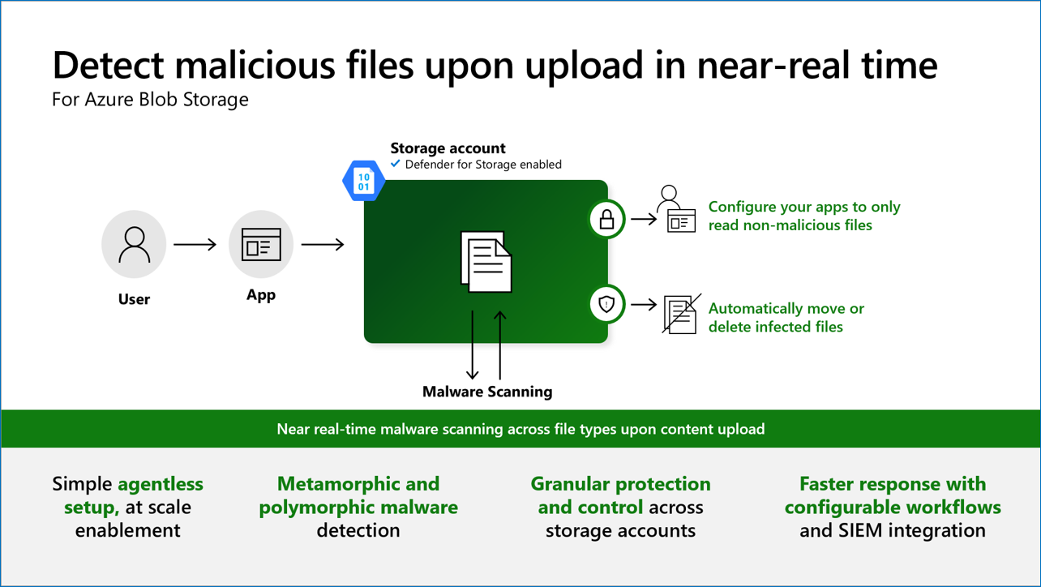
Security & Identity Updates
Defender for Storage malware scanning for blobs up to 50 GB
Defender for Storage malware scanning now supports blobs up to 50GB in size (previously limited to 2GB).
Please note that for storage accounts where large blobs are uploaded, the increased blob size limit will result in higher monthly charges.
To avoid unexpected high charges, set an appropriate cap on the total GB scanned per month.
On-demand malware scanning in Microsoft Defender for Storage
On-demand malware scanning in Microsoft Defender for Storage, now in GA, enables scanning of existing blobs in Azure Storage accounts whenever needed. Scans can be initiated from the Azure portal UI or via the REST API, supporting automation through Logic Apps, Automation playbooks, and PowerShell scripts. This feature uses Microsoft Defender Antivirus with the latest malware definitions for every scan and provides upfront cost estimation in the Azure portal before scanning.
Incident response: Scan specific storage accounts after detecting suspicious activity.
Security baseline: Scan all stored data when first enabling Defender for Storage.
Compliance: Set automation to schedule scans that help meet regulatory and data protection standards.

Slide 8
Security & Identity Updates
Improved AWS EC2 Resource Name display
MS enhancing how resource names are shown for AWS EC2 instances. If an EC2 instance has a “name” tag defined, the Resource Name field will now display the value of that tag. If no “name” tag is present, the Resource Name field will continue to show the instance ID as before. The Resource ID will still be available in the Resource ID field for reference.

Slide 9
Management & Governance

Slide 10
Management & Governance Updates
Upcoming Breaking Change in Az SSH for Arc Connections Extension
This breaking change affects all customers who use Az SSH extension for connecting to Azure Arc Machines. By May 21st, all versions of the Az SSH extension prior to 2.0.4 will become unusable upon installation for connecting to Arc resources. This breaking change is due to deprecation of a storage blob used during installation.
Versions of the Az SSH extension prior to 2.0.4 will still be functional, but if there is corruption of the extension files, you will not be able to reinstall the extension.
To minimize the potential breaking of the Az SSH extension for connecting to Arc machines considering:
Update the Az SSH Extension to the latest version (2.0.6).
Review and Update Scripts
Public Preview: Azure Migrate now supports discovery and assessment of MySQL databases
After discover MySQL instances and their attributes in on-premises environment, a MySQL Assessment provides the following information on the instances:
An assessment of their readiness for migration to Azure Database for MySQL.
Recommendations on the suitable compute, storage, and IO SKUs for hosting the MySQL workloads on Azure Database for MySQL, along with the associated costs.
MySQL assessments are performed on the performance-based sizing criteria, making recommendations based on collected performance data of MySQL instances, including CPU utilization, Memory utilization, IOPS, IO Count, total number of connections and read-write ratio.
The assessments only include MySQL database instances that are in online status.

Slide 11
Compute

Slide 12
Compute Updates
GA: Vaulted Backups by Azure Backup for Azure Database for PostgreSQL – Flexible Server in 5 Regions
Microsoft announced the general availability (GA) of Vaulted Backups by Azure Backup for Azure Database for PostgreSQL Flexible Server, a robust and scalable backup solution designed to meet the needs of enterprises and developers alike. Vaulted backup support from PostgreSQL flexible server adds to the broad coverage of workloads that Azure Backup supports including workloads like AKS, Blobs, AFS etc. that power cloud-native applications on Azure.
Key benefits:
Regional Disaster Recovery
Compliance with Regulations
Enhanced Security and Cyber Resilience
Azure Backup for PostgreSQL Flexible Server is now generally available in selected Azure regions namely East Asia, Central India, Southeast Asia, UK South and UK West (In all other Azure regions, we are currently in public preview).
PP: Azure Functions Support for Python 3.12
It is now possible to develop functions using Python 3.12 locally and deploy them to all Azure Functions plans.
Python 3.12 builds on the performance enhancements that were first released with Python 3.11 and adds a number of performance and language readability features in the interpreter.

Slide 13

Compute Updates
Windows 365: Available in New Zealand North
Windows 365 will be available in New Zealand North.
PP: Azure CNI Powered by Cilium Node Subnet Support in AKS
This enhancement allows users to configure AKS clusters with Azure CNI powered by Cilium and Node Subnet. Thereby, it extends compatibility of Cilium’s eBPF dataplane to all supported IP address management configurations on AKS clusters.
Every pod gets an IP address from the subnet and can be accessed directly. Systems in the same virtual network as the AKS cluster see the pod IP as the source address for any traffic from the pod. Systems outside the AKS cluster virtual network see the node IP as the source address for any traffic from the pod.

Slide 14
Storage & Data

Slide 15
Storage & Data Updates
Fabric Platform support for Transport Layer Security (TLS) 1.1 and earlier versions will end on July 31, 2025
Fabric platform will soon(July 31, 2025) require TLS 1.2 or later versions for all outbound connections from Fabric to customer data sources. All incoming connections to Fabric Platform already required TLS 1.2 or later versions since June 2020.
PP: Network security group (NSG) support for private link connectivity
Azure NetApp Files now supports private links with NSGs in all regions. This feature allows to apply NSG policies to private link endpoints, enhancing the security of workload deployments.

Slide 16
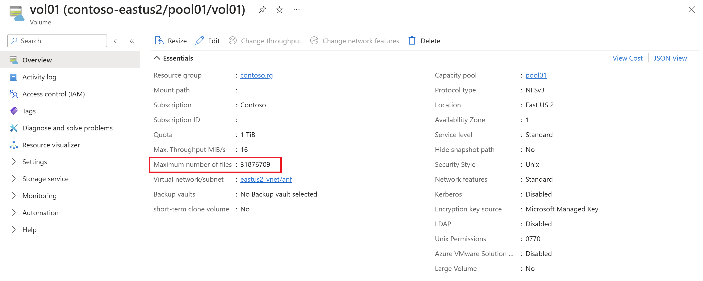
Storage & Data Updates
New volume usage metric: volume inodes percentage
Azure NetApp Files metrics now allows to see the percentage of a volume's total inodes consumed.
Azure NetApp Files volumes have a value called maxfiles that refers to the maximum number of files and folders (also known as inodes) a volume can contain. The maxfiles limit for an Azure NetApp Files volume is based on the size (quota) of the volume, where the service dynamically adjusts the maxfiles limit for a volume based on its provisioned size and uses the following guidelines.
When the maxfiles limit is reached, clients receive "out of space" messages when attempting to create new files or folders.

Slide 17
Databases

Slide 18
Databases Updates
GA: Latest PostgreSQL Minor Versions Supported by Azure Database for PostgreSQL – Flexible Server
PostgreSQL minor versions 17.2, 16.6, 15.10, 14.15, 13.18, and 12.22 are now supported by Azure Database for PostgreSQL – Flexible Server.
These minor version upgrades are automatically performed as part of the monthly planned maintenance in Azure Database for PostgreSQL – Flexible Server.
This upgrade automation ensures that databases are always running the latest optimized versions without requiring manual intervention. This release fixes one security vulnerability and more than 55 bugs reported over the last several months.
GA: The Availability metric tracks availability at individual Azure SQL Database level
Availability is granular to one minute of connection outage. Availability is determined based on the database being operational for connections. A minute is considered as downtime or unavailable if all continuous attempts by users to establish connection to the database within the minute fail due to a service issue. If there is intermittent unavailability, the duration of continuous unavailability must cross the minute boundary to be considered as downtime. Typically, the latency to display availability is less than three minutes.
Here's the logic used for calculating Availability for every one-minute interval:
If there is at least one successful connection, then availability is 100%.
If all connections fail due to user errors, availability is 100%.
If there are no connection attempts, availability is 100%.
If all connections fail due to system errors, availability is 0%.
Currently, availability metric data is not yet supported for the serverless compute tier and will be displayed as 100%.

Slide 19
Databases Updates
Native Windows principals for Azure SQL Managed Instance are now generally available
This capability simplifies the migration to Azure SQL Managed Instance and unblock the migration of legacy applications that are tied to windows logins.
This feature is crucial for the SQL Managed Instance link. While the Managed Instance link facilitates near real-time data replication between SQL Server and Azure SQL Managed Instance, the read-only replica in the cloud restricts the creation of Microsoft Entra principals. The Windows authentication metadata mode allows customers to use an existing Windows login to authenticate to the replica in the event of a failover
With this feature, the following Authentication metadata modes are available for SQL Managed Instance, and the different modes determine which authentication metadata is used for authentication, along with how the login is created:
Microsoft Entra (Default): This mode allows authenticating Microsoft Entra users using Microsoft Entra user metadata. In order to use Windows authentication in this mode, see Windows Authentication for Microsoft Entra principals on Azure SQL Managed Instance.
Paired (SQL Server default): The default mode for SQL Server authentication.
Windows (New Mode): This mode allows authenticating Microsoft Entra users using the Windows user metadata within SQL Managed Instance.
PP: Azure Cosmos DB Rust SDK
The Azure Cosmos DB Rust Software Development Kit (SDK) is now in public preview. It is possible to use the Rust SDK to connect to an Azure Cosmos DB for NoSQL account and perform operations on databases, containers, and items.
In addition to creating, reading, updating and deleting items, execute queries that are scoped to a single partition.

Slide 20
Databases Updates
T-SQL features: Regex support, Fuzzy string-matching, and bigint support in DATEADD – preview
MS announced the public preview of three powerful T-SQL features that will elevate SQL queries: Regular Expressions (Regex) support, Fuzzy string-matching, and bigint support in DATEADD.
Here is the list of Regex functions being included in this release:
REGEXP_LIKE: This function returns TRUE if a string matches a regular expression pattern, or FALSE otherwise.
REGEXP_COUNT: This function returns the number of times a regular expression pattern matches in a string.
REGEXP_INSTR: This function returns the starting or ending position, based on the specified option, of the given occurrence of a regular expression pattern in a string.
REGEXP_REPLACE: This function returns a modified string replaced by a ‘replacement string’, where occurrence of the regular expression pattern found.
REGEXP_SUBSTR: This function returns a substring that matches a regular expression pattern from a string.
Here is the list of fuzzy match functions that are being introduced:
The EDIT_DISTANCE function calculates the number of characters that need to be substituted, inserted, or deleted, to transform one string into another.
The EDIT_DISTANCE_SIMILARITY function returns a similarity score based on the edit distance.
The JARO_WINKLER_DISTANCE function calculates the similarity between two strings using the Jaro-Winkler algorithm.
The JARO_WINKLER_SIMILARITY function returns a similarity score using the Jaro-Winkler algorithm.
Advantages of bigint support in DATEADD
It will help perform accurate date and time calculations, especially with precise units like MICROSECOND or NANOSECOND.
The earlier limit of INT could result in an overflow if the interval value is large. Bigint ensures safe calculations for historical or long-term data.

Slide 21
ML & AI & IOT

Slide 22
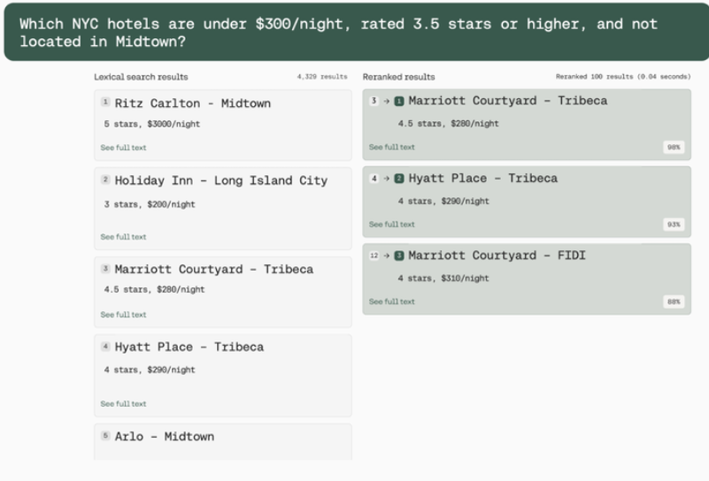
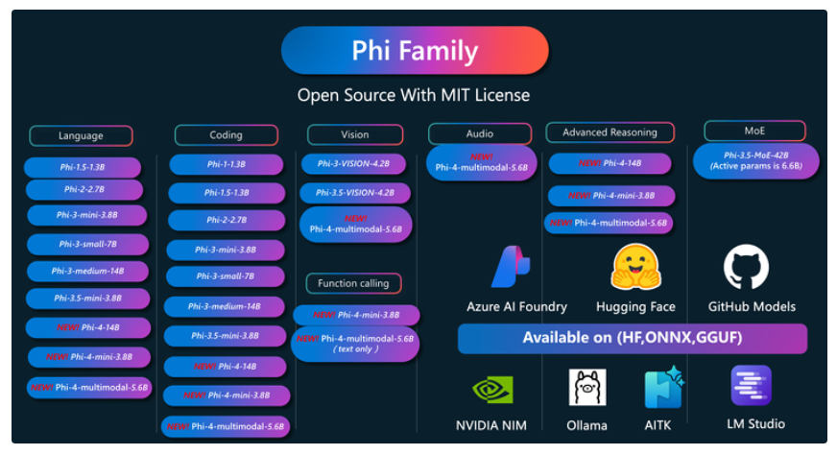
ML & AI & IOT Updates
Cohere Rerank v3.5 is lunched on Azure AI Foundry
Cohere Rerank v3.5 is the latest iteration in Cohere's series of reranking models, designed to reorder search results based on a deep semantic understanding of user queries and document content. With a context window of 4,096 tokens, Rerank v3.5 excels in processing complex queries and large documents, delivering precise and relevant search outcomes. Notably, it offers multilingual support for over 100 languages, making it an invaluable tool for global enterprises.
Announcement of announce Phi-4-multimodal and Phi-4-mini
These models are designed to empower developers with advanced AI capabilities. Phi-4-multimodal, with its ability to process speech, vision, and text simultaneously, opens new possibilities for creating innovative and context-aware applications. Phi-4-mini, on the other hand, excels in text-based tasks, providing high accuracy and scalability in a compact form.
Phi-4-multimodal – is a SLM with 5.6B parameter model, that seamlessly integrates speech, vision, and text processing into a single, unified architecture.
Phi-4-mini is a 3.8B parameter model and a dense, decoder-only transformer featuring grouped-query attention, 200,000 vocabulary, and shared input-output embeddings, designed for speed and efficiency

Slide 23
DevOps & IaC & Automation

Slide 24
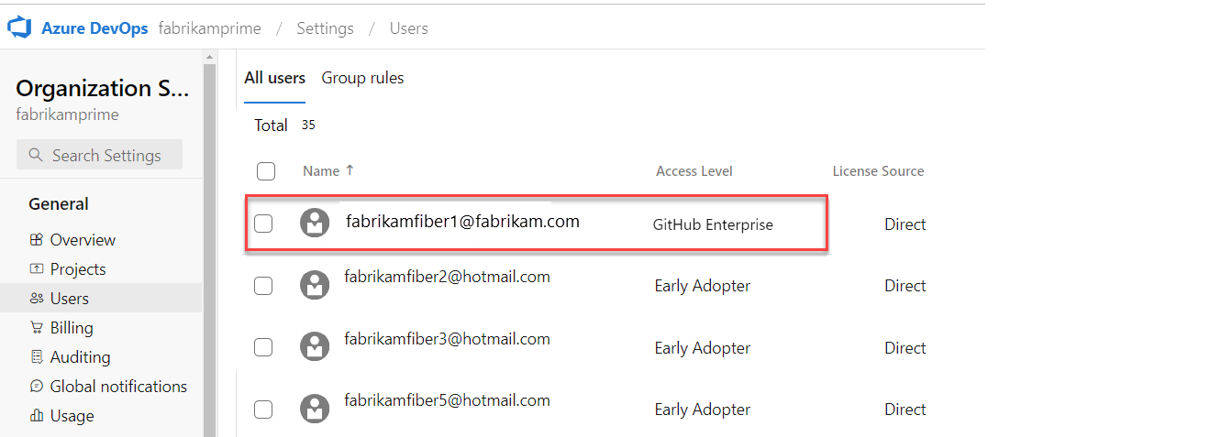
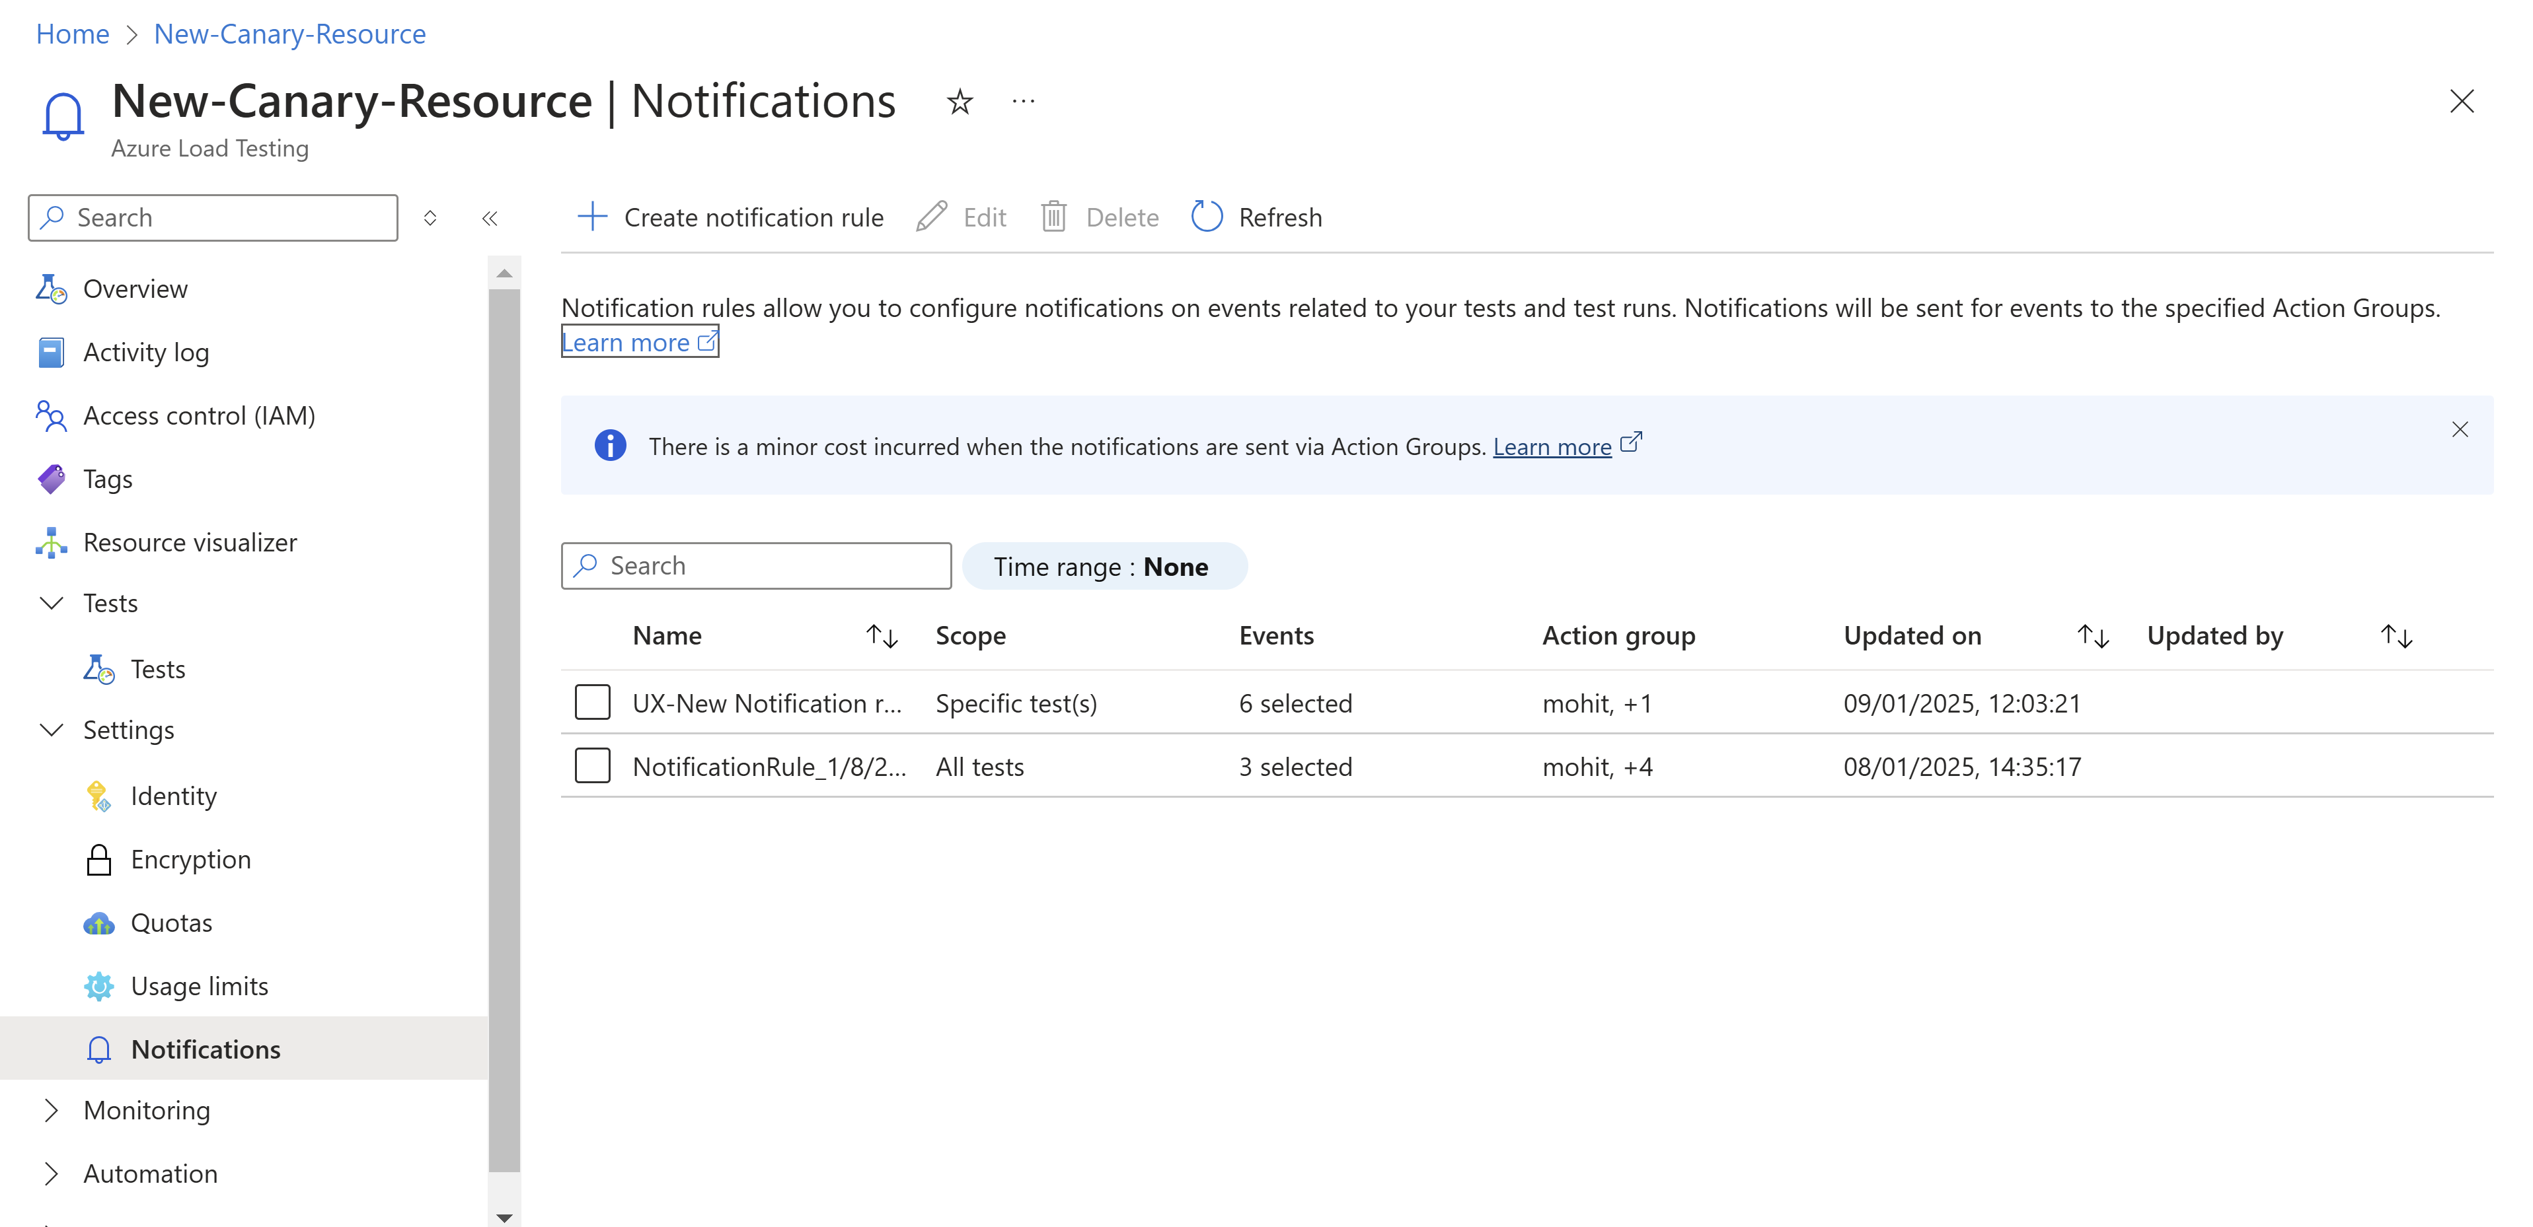
DevOps & IaC & Automation
General Available: Configure Notification in Azure Load Testing
Azure Load Testing now allows to configure notifications to receive updates for key events, such as test completion or schedule changes. These notifications can help automate follow-up actions and improve team collaboration.
Azure Load Testing supports the following events for notifications:
Test Run Started: Notifications for all test runs when they start.
Test Run Completed: Notifications when a test run is completed, including failed tests or failed results.
Schedule Events: Notifications when schedules complete or are disabled.
Azure DevOps Basic usage included with GitHub Enterprise
Customers using both GitHub and Azure DevOps until now have to purchased Visual Studio subscriptions with GitHub Enterprise. With the Sprint 252 release, Azure DevOps Basic usage rights are included with GitHub Enterprise Cloud.

Slide 25
Information

Slide 26
Information
Azure Times GitHub Repo

Slide 27
Questions

