Slide 1
Azure Times #161
May 12, 2025

Slide 2
Networking

Slide 3
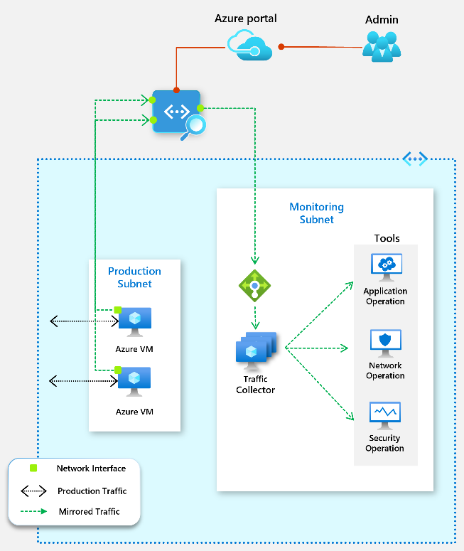
Networking Updates
VMs behind a Standard Load Balancer with Floating IP enabled can't be set as a mirroring source.
VMs behind Basic Load Balancer can't be set as a mirroring source.
Virtual network doesn't support mirroring of inbound Private Link Service traffic.
VMs in a virtual network with encryption enabled can't be set as mirroring source.
Virtual network TAP doesn't support IPv6.
When a VM is added or removed as a source, the VM might experience network downtime (up to 60 seconds).
Public Preview: Azure virtual network terminal access point (TAP)
Virtual network TAP enables customers to continuously stream virtual machine network traffic to a network packet collector or analytics tool. Unlike traditional packet capture solutions that require the deployment of additional agents or network appliances, virtual network TAP leverages Azure’s native infrastructure to mirror traffic with minimal overhead, enhancing both analytics and security capabilities.
As organizations migrate to the cloud, traditional network monitoring approaches often fall short. Many security and performance monitoring tools depend on packet-level visibility, which is challenging to obtain in cloud environments. Virtual network TAP addresses this challenge by offering the following benefits:
Agentless, transparent traffic mirroring without having to alter topology
Zero performance impact on VMs; mirrored traffic does not count against VM bandwidth.
Broad compatibility with third-party security and monitoring tools, allowing seamless integration into existing cybersecurity frameworks.
Limitations:
Virtual network TAP only supports virtual machine's (VM) network interface as a mirroring source.
Virtual network TAP supports Load Balancer or VM's network interface as a destination resource for mirrored traffic.
Virtual network doesn't support Live Migration. VM set as source for virtual network TAP will have live migration disabled.

Slide 4
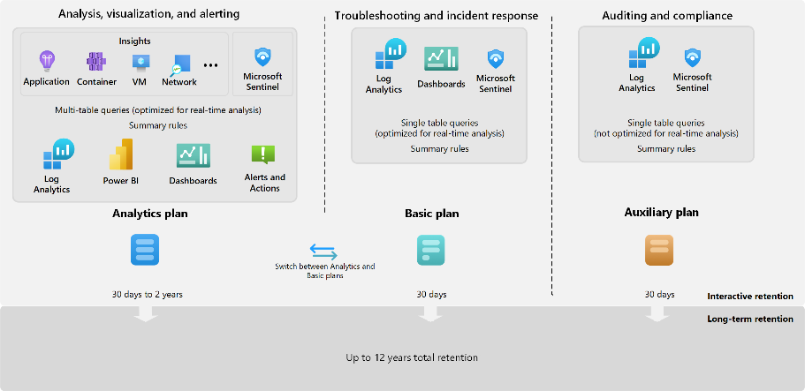
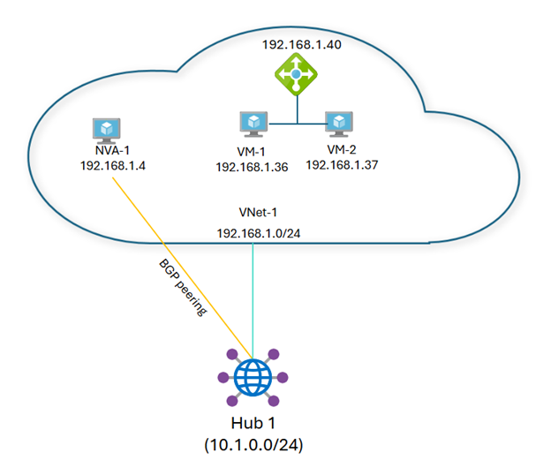
Networking Updates
Generally Available: Azure Firewall resource specific log tables get Azure Monitor Basic plan support
All resource specific log tables for Azure Firewall now support the Basic log plan which can reduce logging costs by 80%. However, Policy Analytics and Security Copilot integrations will not work with the Basic log plan.
Generally Available: Next hop IP support for Virtual WAN
Azure Virtual WAN hub router, also called virtual hub router, acts as a route manager and provides simplification in routing operation within and across virtual hubs. The virtual hub router exposes the ability to peer with it, thereby exchanging routing information directly through the Border Gateway Protocol (BGP) routing protocol. With the added support for Next hop IP in Virtual WAN, it is possible to peer the hub with NVAs or BGP endpoints and advertise routes for VMs that are deployed behind a load balancer.

Slide 5

Networking Updates
Generally Available: Azure Firewall integration in Security Copilot
The Azure Firewall integration in Security Copilot helps analysts perform detailed investigations of the malicious traffic intercepted by the IDPS feature of their firewalls across their entire fleet using natural language questions:
Retrieve the top IDPS signature hits for an Azure Firewall
Enrich the threat profile of an IDPS signature beyond log information
Look for a given IDPS signature across tenant, subscription, or resource group
Generate recommendations to secure environment using Azure Firewall's IDPS feature
Public Preview: Azure WAF CAPTCHA Challenge for Azure Front Door
MS Announced the public preview of CAPTCHA for Azure Web Application Firewall (WAF) with Azure Front Door.
Modern web applications face evolving threats, including bots, web scrapers, and brute-force attacks, many of which can bypass traditional security controls like IP blocking and rate limiting. CAPTCHA provides an adaptive layer of protection, ensuring legitimate users can access applications while blocking harmful automated traffic.
This new security feature enhances bot mitigation strategies by introducing an interactive challenge that verifies human users in real time, helping organizations protect their applications from automated attacks.

Slide 6
Security & Identity

Slide 7
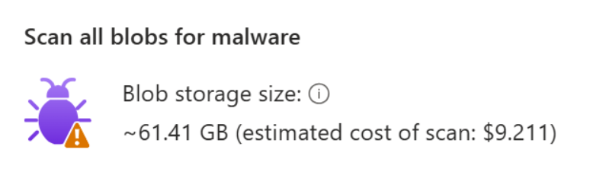
Security & Identity Updates
Introducing ActorInfoString in Exchange Online
MS Introduced ActorInfoString, a significant new feature in the Exchange Online (EXO) audit schema that enhances the depth and accuracy of audit logs. While ClientInfoString provides valuable client application information, the addition of ActorInfoString offers even more detail by capturing the True UserAgent, supporting greater clarity when tracking the origin of actions within Exchange Online environment.
ActorInfoString solves this by recording the exact user agent responsible for each audited event. Currently, ActorInfoString exists in production but is not yet enabled by default.
Example (simplified log entry):
Date: 2025-04-24T14:25:59Z
User: john.doe@yourdomain.com
Operation: MailItemAccessed
ClientInfoString: “Client=Rest;Client=RESTSystem;;
ActorInfoString: “Client=REST;Client=RESTSystem;Mozilla\/5.0 (Windows NT 10.0; Microsoft Windows 10.0.22631; en-US) Powershell\/5.1.22621.3958 Invoke-MgGraphRequest[AppId=xxxxxxxx-xxxx-xxxx-xxxx-xxxxxxx
General Availability of on-demand scanning in Defender for Storage
Unlike on-upload scanning, which is a security feature that automatically scan blobs for malware when they are uploaded or modified in cloud storage environments, on-demand scanning enables security administrators to manually initiate scans of entire storage accounts for malware. This scanning method is particularly beneficial for targeted security inspections, incident response, creating security baselines for specific storage accounts and compliance with regulatory requirements. Scanning all existing blobs in a storage account can be performed via the API and Azure portal user interface.

Slide 8
Management & Governance

Slide 9
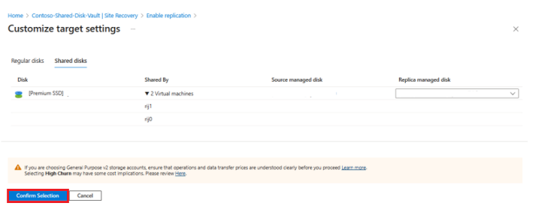
Management & Governance Updates
Generally Available: Azure Site Recovery for Shared Disk
This feature enables to protect, monitor, recover, and re-protect workloads running on Windows Server Failover Clusters (WSFC) on Azure VMs with Shared Disk.
Now it is possible to have the same benefits of Shared Disk for mission-critical applications such as SQL FCI, SAP ASCS, Scale-out File Servers, etc., while ensuring business continuity and disaster recovery with Azure Site Recovery.
OS Support: Windows Server 2016 and later.
Nodes: Up to 4 nodes per cluster.
Shared Disks: Any number of shared disks can be attached to the cluster.
High Churn and PowerShell Support
Public Preview: Multitenant managed logging in Container insights
Customers need the ability to configure container console log collection in a way that segregates logs by different teams so that each has access to the container logs of the containers running in K8s namespaces that they own and the ability to access the billing and management associated with the Azure Log analytics workspace. For example, container logs from infrastructure namespaces such as kube-system can be directed to a specific Log Analytics workspace for the infrastructure team, while each application team's container logs can be sent to their respective workspaces.

Slide 10
Management & Governance Updates
Public Preview: Metrics Usage Insights
This feature currently designed for Azure Managed Prometheus users which will analyze all metrics ingested in Azure Managed Workspace (AMW), surfacing actionable insights to optimize your observability setup.
Metrics usage insights is built to empower teams with the visibility and tools the organizations need to manage observability costs effectively. It empowers customers to pinpoint metrics that align with their business objectives, uncover areas of unnecessary spend by identifying unused metrics, and sustain a streamlined, cost-effective monitoring approach.
Metrics usage insights sends usage data to a Log Analytics Workspace (LAW) for analysis. This is a free offering, and there is no charge associated for the data sent to the Log Analytics workspace, storage or queries. Customers will be guided to enable the feature as part of the standard out of the box experience during new AMW resource creation. For existing AMWs this can be configured using diagnostic settings.
Public Preview: Larger container sizes on Azure Container Instances
It is now possible to deploy workloads with higher vCPU and memory for standard containers, confidential containers, containers with virtual networks, as well as containers utilizing virtual nodes to connect to AKS.
This setup supports vCPU counts greater than 4 and memory capacities of 16 GB, with a maximum of 32 vCPU and 256 GB per standard container group and 32 vCPU and 192 GB per confidential container group.

Slide 11
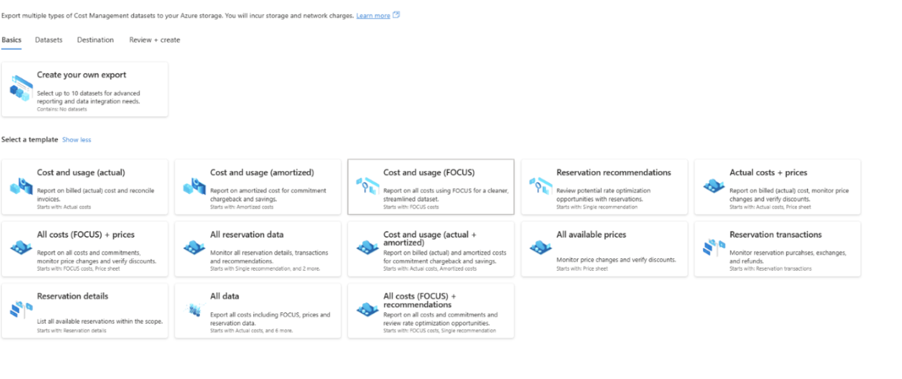
Management & Governance Updates
Generally Available: Enhancements to Purchase-Related Details in Cost Management for MCA Customers
MS is going to introduce improvements that will provide more detailed and accurate information on reservations (RIs), Azure Saving Plans (ASP), and 3rd party purchases from the Azure Marketplace.
RIs and ASP purchases will now show their billing subscription ID, helping customers with showback and chargeback.
ServiceStart and ServiceEnd dates will now show the term of the offer.
Data for RIs and ASP purchases will now populate the payGCostinBillingCurrency and the paygCostinUSD. This enables customers to compare their costs to retail prices in both currencies. This will be released by June.
Generally available: Enhanced Cost Management exports
The new exports experience takes a more holistic approach to managing cost-related data. In addition to exporting standard cost and usage datasets, users can now include expanded datasets such as price sheets, reservation recommendations, reservation details, and reservation transactions.
Alongside expanded dataset support, the portal experience has been redesigned to make export creation more intuitive. A unified interface now allows users to configure multiple datasets, define destination storage settings, select file formats, and apply compression settings in a single, streamlined workflow.

Slide 12
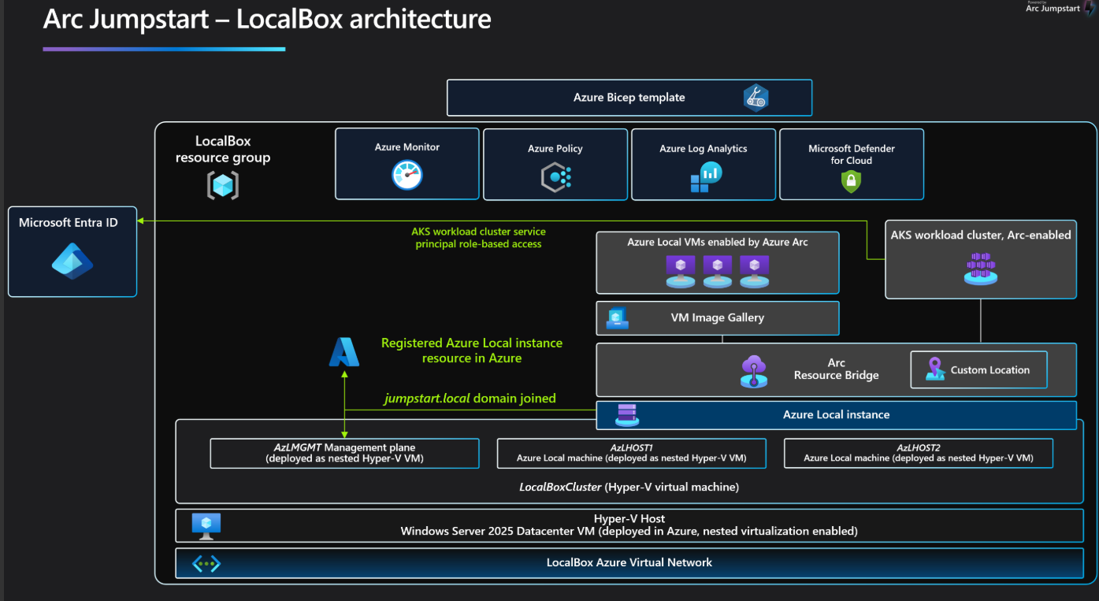
Management & Governance Updates
Generally Available: Azure Database Migration Service in China North 3
Azure Database Migration service is now available and allow to migrate to Azure SQL offerings in the China North 3 region. As a fully managed service, Azure Database Migration Service enables seamless migrations from multiple database sources to Azure data platforms with minimal downtime. This service generates assessment reports for database migration readiness to Azure SQL offerings and provides right-sized target recommendations before performing migration.
Jumpstart LocalBox - New name for HCIBox!
The transition from HCIBox to LocalBox reflects evolving mission: to support a broader spectrum of edge and on-premises deployments. While HCIBox was originally focused on Azure Stack HCI, Jumpstart LocalBox embraces the expanding needs of hybrid and edge solutions under the Azure Local umbrella.

Slide 13
Compute

Slide 14
Compute Updates
Generally Available: Azure Functions support for Python 3.12
It is now possible to use functions using Python 3.12 locally and deploy them to all Azure Functions plans.
Python 3.12 builds on the performance enhancements that were first released with Python 3.11 and adds several performance and language readability features in the interpreter.
Generally Available: Instance Mix for Virtual Machine Scale Sets
Instance mix allows to specify multiple VM sizes within a single Virtual Machine Scale Set, providing greater flexibility and cost efficiency.
Key Features
Flexible VM Combinations: Mix and match various VM sizes within a single VMSS to better align with your workload requirements.
Capacity-informed deployments: Optimize for the available capacity in Azure regions/zones with capacity. Optimized for more confidence that you’ll get the capacity requested.
Simplified Management: Manage a diverse set of VMs in a single scale set, reducing the complexity of handling multiple scale sets.
Easily scale with a mix of VM offerings: When using Spot Priority Mix, customers can deploy a heterogeneous mix of VM sizes of both Spot and On-Demand pricing in their scale sets.
Attain Capacity: By utilizing a diversified mix of VM sizes, customers can tap into a greater pool of capacity, increasing their ability to get the capacity needed.

Slide 15
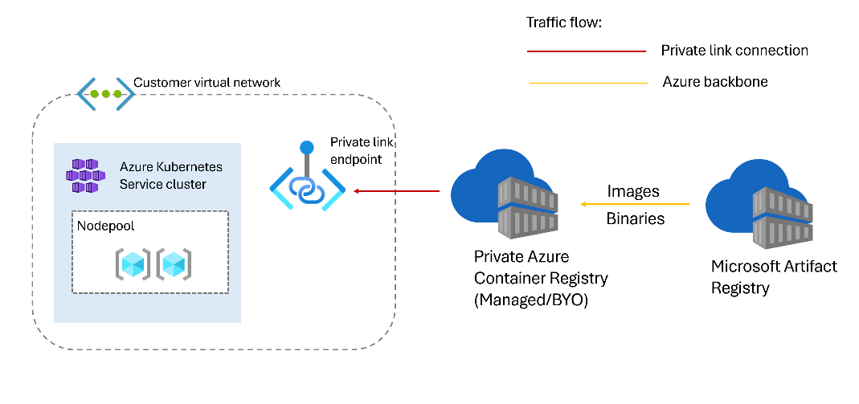
Compute Updates
Generally Available: Network isolated cluster in AKS
AKS now provides the option to use network isolated clusters to simplify the process of restricting network access and reduce the risk of unintentional exposure of the cluster's public endpoints to prevent security breaches.
Network isolated clusters are supported on AKS clusters using Kubernetes version 1.30 or higher.
SecurityPatch channel of auto-upgrade for node OS images is not yet supported for network isolated clusters.
Unmanaged channel of auto-upgrade for node OS images is not supported.
Windows node pools are not currently supported.
The following AKS cluster extensions aren't supported yet on network isolated clusters:
Dapr
Azure App Configuration
Azure Machine Learning
Flux (GitOps)
Azure Container Storage
Azure Backup for AKS

Slide 16
Compute Updates
Generally Avaialble: Azure NVads V710 v5-series virtual machines
The NVads V710 v5-series virtual machines are designed for lightweight AI inferencing and graphics-intensive applications that demand cost-effective, high-performance GPUs with more memory and faster CPUs. Powered by AMD Radeon™ Pro V710 GPUs and 4th generation AMD EPYC CPUs, these VMs are tailored for small-to-medium AI/ML inferencing workloads, Virtual Desktop Infrastructure (VDI), visualization, and cloud gaming workloads.
The series provides several options ranging from 1/6 of a GPU with 4 GB memory, perfect for lightweight virtual desktop experiences, to a full V710 GPU with a massive 28 GB for graphics intensive engineering applications or AI. This flexibility is ideal for customers that need to support a variety of inferencing and graphical workloads efficiently without requiring a full GPU for each application if it’s not needed.
GA in the following regions: East US, North Central US, South Central US, West US, and West Europe.
Generally Available: Azure Compute Fleet
Azure Compute Fleet is now generally available in all regions. Azure Compute Fleet allows users to easily obtain large amounts of compute capacity algorithmically mixing and matching a variety of available and VM sizes suitable to a user's workload, up to 10,000 VMs in a single fleet. A user can specify a variety of VM criteria such as RAM size, core count, SKU type, location, and pricing structure, and Azure Compute Fleet will deploy capacity tailored to those criteria.
Deploy up to 10,000 VMs with a single API, using Spot VM and Standard VM types together.
Implement personalized Compute Fleet allocation strategies, catering to both Standard and Spot VMs, optimizing for cost, capacity, or a combination of both.
Embrace the "Fire & Forget-it" model, automating the deployment, management, and monitoring of instances without requiring intricate code frameworks.
Streamline the initial setup process
Alleviate concerns about scripting complexity
Attempt to maintain your Spot target capacity if your Spot VMs are evicted for price or capacity

Slide 17
Compute Updates
Generally Available: Announcing Service Update Configuration for Azure API Management
Select an update group for their API Management instance:
Early – Receive updates at the beginning of the rollout for testing and early access (not recommended for production).
Default – Receive updates as part of the standard rollout (recommended for most use cases).
Late – Defer updates to later in the cycle (ideal for mission-critical workloads).
AI Gateway Early – Get early access to AI Gateway updates while receiving other service updates on the Late schedule.
Configure a custom maintenance window:
Set preferred times for updates to occur, with the ability to specify different windows per day.
Default window is 10 PM to 6 AM in the instance’s local time zone.
Public Preview: Inbound Private Endpoint for Azure API Management Standard v2
This capability enables private, secure access to the API Management gateway from within virtual network using Azure Private Link.
Enable inbound traffic to API Management over a private IP address from virtual network
Use Azure Private Link to route traffic via the Microsoft backbone, avoiding public internet exposure
Configure multiple Private Link connections per API Management instance
Apply policies to differentiate traffic sources (e.g., private vs. public)
Restrict API gateway access to private endpoints only to reduce data exfiltration risks
Use custom DNS or Azure Private DNS zones for private hostname resolution
Combine with outbound virtual network integration for end-to-end network isolation
Additionally, Azure Front Door Premium can now connect privately to API Management instances (Standard v2 and classic v1 tiers) using Private Link.

Slide 18
Compute Updates
Retirement: Azure Static Web Apps – Dedicated Pricing Plan
To focus on supporting users of the Standard pricing plan, the Static Web Apps Dedicated pricing plan (currently in Public Preview) will be retired on October 31, 2025.
Deployments using the Dedicated pricing plan can be migrated to the Static Web Apps Standard pricing plan or to Azure Container Apps.
Starting May 1, 2025, users won’t be able to create new deployments using the Dedicated plan. On October 31, 2025, all existing Dedicated plan resources will be deleted.
Announcement: Azure Logic Apps (Standard) Automated Testing Public Preview
MS announced the public preview of the Azure Logic Apps (Standard) Automated Testing Framework! This new framework is designed to simplify and enhance the testing process for Logic Apps workflows, ensuring that integrations are robust, reliable, and ready for production.

Slide 19
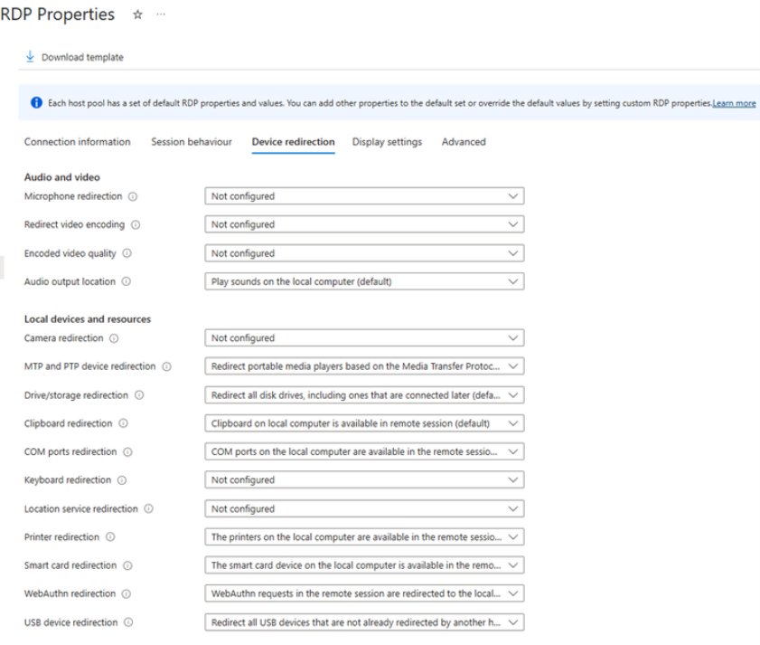
Compute Updates
Host pool redirection defaults changing in Azure Virtual Desktop
Azure Virtual Desktop is enhancing its default security by disabling clipboard, drive, USB, and printer redirections for all newly created host pools. This change minimizes the risk of data exfiltration and malware injections, making it easier to have a more secure experience by default.
For existing host pools, no changes to redirection configuration will be made.
Azure Local Public Preview on Microsoft Azure Government Cloud
MS announced that Azure Local is now available for Azure Government customers in public preview. Building upon the earlier introduction of Azure Local, MS bring this innovative solution to government agencies. Government customers benefit from the same user experience as they would in the Azure public cloud.
Azure Local enables organizations to deploy cloud-connected infrastructure at their own physical locations, under their operational control, while maintaining compliance with stringent regulations and security standards. This innovative approach empowers customers to leverage the benefits of Azure’s robust ecosystem—including compute, networking, storage, and application services—locally, while seamlessly integrating with broader cloud workflows.

Slide 20
Compute Updates
General Availability: App Service Webjobs on Linux
App Service Webjobs on App Service Linux for both code an containers scenarios are now GA.
Webjobs enable the execution of background tasks and scheduled processes, which, unlike traditional web applications, are not triggered by an HTTP request.
New enhancements for Windows App on web
Remote App Launcher
Improved printing capabilities
Access remote sessions natively

Slide 21
Compute Updates
Public Preview: Continuous patching in Azure Container Registry
The continuous patching feature automates the detection and remediation of operating system(OS) level vulnerabilities in container images. By scheduling regular scans with Trivy and applying security fixes using Copa, it is possible to maintain secure, up-to-date images in registry—without requiring access to source code or build pipelines. Simply customize the schedule and target images to keep Azure Container Registry(ACR) environment safe and compliant.

Slide 22
Storage & Data

Slide 23
Storage & Data Updates
Generally Available: Azure Ultra Disk Storage is now available in Spain Central
Azure Ultra Disk Storage now is available in Spain Central region and provides high-performance along with low sub-millisecond latency for most-demanding workloads.
Azure Ultra Disk Storage offers high throughput, high IOPS, and consistent low latency disk storage for Azure virtual machines (VMs). Ultra Disk is suited for data-intensive workloads such as SAP HANA, top-tier databases, and transaction-heavy workloads.
Generally Available: Cross-Region Data Transfer Capability in Azure Data Box Devices
MS announced the general availability of cross-region data transfer for all region pairs using Azure Data Box. Customers can now select any source location and directly upload data to any Azure destination region, offering flexibility and convenience for distributed data storage needs. This data transfer is facilitated without the Data Box device being shipped across commerce boundaries.
For instance, data stored on-premises in Japan can be directly uploaded to an Azure region in the EU. The Data Box device is transported to an Azure data center within Japan, and the data transfer occurs over the Azure network at no additional cost, ensuring the Data Box device remains within the source country, Japan. This capability is particularly beneficial for large, distributed organizations with Azure workloads in multiple regions.

Slide 24
Storage & Data Updates
Generally Available: Azure Premium SSD v2 and Ultra Disk Storage is now available in Australia Central 2 and Norway West
Azure Premium SSD v2 and Ultra Disk Storage are now available in Australia Central 2 and Norway West regions. Azure Ultra Disk Storage delivers high throughput, high IOPS, and consistently low latency for Azure virtual machines, making it ideal for data-intensive workloads such as SAP HANA, top-tier databases, and transaction-heavy applications.
Azure Premium SSD v2, a next-generation general-purpose block storage solution, offers sub-millisecond latencies and exceptional price performance for IO-intensive workloads at a low cost. It is well-suited for a broad range of enterprise production scenarios, including SQL Server, Oracle, MariaDB, SAP, Cassandra, MongoDB, big data analytics, gaming on virtual machines, and stateful containers.
Generally Available: Metadata Cache for Azure SSD (Premium) SMB
This enhancement accelerates metadata operations for both SMB and REST protocols, benefiting new and existing file shares at no extra cost.
Metadata caching is an enhancement for SSD Azure file shares aimed to improve the following:
Reduce metadata latency
Raised metadata scale limits
Increase latency consistency, available IOPS, and boost network throughput
This feature improves the following metadata APIs and can be used from both Windows and Linux clients:
Create
Open
Close
Delete
Currently this feature is only available for SSD file shares.

Slide 25
Storage & Data Updates
Public Preview: Cross-tenant customer-managed keys for Azure NetApp Files volume encryption
This feature enables individual customers to manage own keys across different tenancies. In scenarios such as SaaS provider/user configurations, it ensures that the end user retains full control of keys, rather than the SaaS provider. This capability provides SaaS providers with the flexibility to offer customers customizable key management options. It is available in all Azure NetApp Files supported regions.
Generally Available: Azure Premium SSD v2 now available in more regions
MS announced that Premium SSD v2 is now GA in the following non-AZ regions: US West, UK West, Canada East, Australia Southeast, North Central US, West Central US, Australia Central 2, and Norway West. Azure Premium SSD v2, a next-generation general-purpose block storage solution, offers sub-millisecond latencies and exceptional price performance for IO-intensive workloads at a low cost.

Slide 26
Storage & Data Updates
Generally Available: Azure Storage Actions – Serverless storage data management
Azure Storage Actions is fully managed platform that transforms how organizations automate data management tasks for Azure Blob and Data Lake Storage, is now generally available in select Azure regions.
Azure Storage Actions enables to quickly compose and deploy tasks that can scan, analyze and process billions of objects across multiple storage accounts without requiring any programming skills.

Slide 27
Databases

Slide 28
Databases Updates
Public Preview: Azure SQL updates for late-April 2025
The MSSQL extension for VS Code now includes Schema Compare in its April release—making it easier to compare database schemas, identify differences, and apply updates across databases or files.
Generally Available: Azure SQL updates for mid-April 2025
Read-access geo-zone redundant storage (RA-GZRS) as a backup storage type is now generally available for non-hyperscale service tiers. Pricing for RA-GZRS is now the same as RA-GRS in regions where available.

Slide 29
Databases Updates
Generally Available: Azure Database for PostgreSQL - Azure Data Factory service principal authentication
MS announced possibility to use service principal Entra authentication to connect Azure Database for PostgreSQL instance with Azure Synapse Analytics and Azure Data Factory. This feature enhances security and simplifies the authentication process.
Generally Available: Support for time-series databases in the migration service for Azure Database for PostgreSQL
It is now possible to use migration service in Azure Database for PostgreSQL to easily migrate time-series databases—without dropping the extension.
This new capability replaces the slow, tedious processes required previously—using pg_dump and pg_restore, or dropping the TimescaleDB extension, then recreating it after migration.

Slide 30
Databases Updates
Generally Available: Latest PostgreSQL minor versions supported by Azure Database for PostgreSQL – Flexible Server
PostgreSQL minor versions 17.4, 16.8, 15.12, 14.17, and 13.20 are now supported by Azure Database for PostgreSQL – Flexible Server.
Generally Available: Support for Mongo 8.0 on vCore-based Azure Cosmos DB for MongoDB
It is now possible to use MongoDB version 8.0 on vCore-based Azure Cosmos DB for MongoDB. This release provides access to the latest MongoDB features, helping build and manage applications more efficiently.

Slide 31
Databases Updates
Generally Available: PostgreSQL 17 performance management server parameters now modifiable on Azure Database for PostgreSQL
This enhancement provides greater flexibility and control over your database configurations, allowing to optimize performance and tailor settings to meet your specific needs.
commit_timestamp_buffers: Adjust the number of buffers allocated for commit timestamps.
enable_parallel_append: Enable or disable parallel append operations.
event_triggers: Configure event triggers for specific database events.
multixact_member_buffers: Set the number of buffers for multi-transaction members.
multixact_offset_buffers: Define the number of buffers for multi-transaction offsets.
notify_buffers: Manage the buffers used for notifications.
serializable_buffers: Control the buffers allocated for serializable transactions.
subtransaction_buffers: Adjust the buffers for subtransactions.
transaction_buffers: Set the number of buffers for transactions.
plan_cache_mode: Configure the caching mode for query plans.
Public Preview: Versionless customer managed keys in Azure Database for PostgreSQL flexible Server
It is now longer needed to manage the key version for customer-managed keys (CMKs) in Azure Database for PostgreSQL flexible Server. Versionless keys automate the propagation of newly rotated CMKs independent of the rotation method (auto-rotation or manual).

Slide 32
Databases Updates
Public Preview: Sharded DiskANN in Azure Cosmos DB for NoSQL
Azure Cosmos DB for NoSQL introduces sharded DiskANN, a powerful feature enhancing vector search experience. Sharding partitions a DiskANN vector index into smaller, more manageable segments. By simply defining the VectorIndexShardKey parameter in your collection’s indexing policy, can effortlessly shard vector indexes based on your data’s attributes, significantly improving search efficiency and reducing costs.
Key benefits of sharded DiskANN include:
Lower latency. Smaller, sharded indexes accelerate vector searches, ensuring faster response times for your applications.
Reduced costs. Smaller indexes mean less computational overhead, directly translating to lower Request Unit (RU) charges.
Enhanced accuracy and recall. Searches confined to focused subsets of your data improve accuracy and recall, delivering more relevant results by limiting the search scope to specific shard keys.
Effortless scalability. Sharding distributes your data efficiently, making it straightforward to scale your vector search capability as your dataset grows, ensuring consistent performance without complexity.
Data isolation and security. By isolating vector data based on shard keys, sharded DiskANN provides enhanced data management and security, restricting searches to relevant data subsets.
Generally Available: Data API in vCore-based Azure Cosmos DB for MongoDB
Now it is possible to interact with Mongo DB data directly from applications through a simple RESTful, HTTPS interface.
The Data API is a RESTful HTTPS interface that enables developers to interact with their MongoDB data hosted in vCore-based Azure Cosmos DB directly from their applications—no drivers or complex query logic required. It offers a simple, efficient way to connect your MongoDB data with web apps, mobile apps, and tools like Power BI.
At launch, the Data API supports the following read operations:
aggregate
listDatabases
listCollections
getSchema

Slide 33
Integration

Slide 34
Integration Updates
Public Preview: Azure API Center May Updates
Users can now configure and granularly assign access to APIs and their specific versions, providing more control and flexibility in managing API permissions. This new capability ensures that users can manage their API permissions with greater precision, enhancing security and operational efficiency.
Additionally, MS is now offering integration with Copilot Studio. This integration aims to provide low-code developers with access to organizational APIs by creating a custom connector in Copilot Studio from Azure API Center, thereby simplifying the development process and expanding the usability of APIs.
Furthermore, the updates bring MCP server support, allowing users to register remote MCP servers into API Center. This means that API Center can now serve as a private remote MCP registry, providing a centralized and secure repository for MCP services.
Lastly, we are introducing semantic search capabilities, making it easier to find and discover APIs within the API Center portal or through data plane API. This feature uses advanced search algorithms to quickly find relevant APIs.

Slide 35
ML & AI & IOT

Slide 36
ML & AI & IOT Updates
Public Preview: Easy service upgrade and change service tier in Azure AI Search
Azure AI Search has two new self-serve options that make it easy to change or upgrade service, directly from Azure portal or the management API.
Changing service tier is now as easy as adding partitions or replicas; no rebuild required.
Self-service option to perform upgrades to new service capabilities, like increased capacity limits or improved features, without having to recreate the service or reindex data.
Change service tiers between Basic, S1, S2, and S3 tiers.​ Free, S3 HD, L1, and L2 services are not eligible to change their tier.​
Service upgrade increases total storage in your service to the higher capacity limits available for new services.
At time of release, service upgrade will be available in select regions, with more regions added in the coming months.
Public Preview: Azure Logic Apps now available as Agent tool in Azure AI Foundry
MS announced that Azure Logic Apps connectors and templates are now available as tools within the AI Agent Service in Foundry. This integration brings the power of enterprise-grade integration to AI agents, enabling them to interact with hundreds of systems from databases to SaaS applications through low-code workflows.
With this release, developers and business users can:
Seamlessly connect AI agents to enterprise systems using prebuilt Logic Apps connectors
Leverage templates to automate complex tasks and orchestrate intelligent actions
Rapidly extend agents’ capabilities without writing custom code
This integration unlocks a faster path to building goal-oriented, enterprise-ready agents that act across systems with precision and reliability.

Slide 37

ML & AI & IOT Updates
MS announced GPT-image-1
MS announced the launch of GPT-image-1, the latest and most advanced image generation model. API is available now to all gated customers: limited access model application, and playground is coming early next week. This groundbreaking model sets a new standard in generating high-quality images, solving complex prompts, and offering zero-shot capabilities in various scenarios.
GPT-image-1 builds upon the strengths of its predecessor, DALL-E, with significant enhancements:
Granular instruction response: GPT-image-1 excels at understanding and executing detailed instructions, ensuring precise and accurate image generation.
Text rendering: The model reliably renders text within images, enhancing its utility in creating educational materials and storybooks.
Image input acceptance: Users can upload images and provide text prompts to generate new images or edit existing ones, offering a versatile tool for creative projects.
GPT-image-1 supports multiple modalities and features:
Text-to-image: Generate images from text prompts, similar to text2im in ChatGPT DALL-E.
Image-to-image: Create new images from user-uploaded images and text prompts, a feature not available in ChatGPT DALL-E.
Text transformation: Edit images using text prompts, akin to the transform feature in ChatGPT DALL-E.
Inpainting: Edit images with text prompts and user-drawn bounding boxes, similar to inpainting with DALL-E.

Slide 38
ML & AI & IOT Updates
New Phi-4 models
MS introduced Phi-4-reasoning, Phi-4-reasoning-plus, and Phi-4-mini-reasoning—marking a new era for small language models and once again redefining what is possible with small and efficient AI.
Reasoning models are trained to leverage inference-time scaling to perform complex tasks that demand multi-step decomposition and internal reflection.
Hubs and Workspaces on Azure Machine Learning – General Availability
MS announced that hubs and workspaces is now generally available on Azure machine learning allowing users to use hub for team’s collaboration environment for machine learning applications.
Azure Hubs and Workspaces provide a centralized platform capability for Azure Machine Learning. This feature enables developers to innovate faster by creating project workspaces and accessing shared company resources without needing repeated assistance from IT administrators.
Key Benefits
Centralized Management
Cost Efficiency
Resource Management
Improved Security and Compliance
Simplified Workspace Creation
Enhanced Collaboration

Slide 39
DevOps & IaC & Automation

Slide 40
DevOps & IaC & Automation
Generally Available: UAE North regional availability with Microsoft Dev Box
United Arab Emirates (UAE) North is now a supported region for Microsoft Dev Box.
Public Preview: Improve the security of Generation 2 VMs via Trusted Launch in Azure DevTest Labs
To improve the security of Generation 2 (Gen2) virtual machines (VMs) in Azure DevTest Labs, MS introduced Trusted Launch for Gen2 VMs, now in public preview. Trusted Launch protects against advanced and persistent attack techniques and is composed of several coordinated infrastructure technologies that can be enabled independently.

Slide 41
DevOps & IaC & Automation
Multi-Select, Sorting, Grouping, and Tags in Azure DevTest Labs
MS announced a new enhancements in the My Virtual Machine view within Azure DevTest Labs that will revolutionize VM management experience. With these updates, managing virtual machines has never been easier or more efficient.
It is now possible to sort VMs and group them by various attributes such as type, status, size, and more, making it simpler to organize and locate the VMs need.
Public Preview of LambdaTest HyperExecute on Azure
MS announced the public preview of the integration between LambdaTest HyperExecute and Microsoft Azure now available directly on the Microsoft Azure portal, SDK, and CLI through Azure Native Integrations. The integration between Microsoft Azure and LambdaTest HyperExecute represents a significant advancement in this space, combining Azure's robust cloud infrastructure with LambdaTest's powerful test execution platform. This integration enables development teams to achieve unprecedented speed, scale, and reliability in their testing workflows.

Slide 42
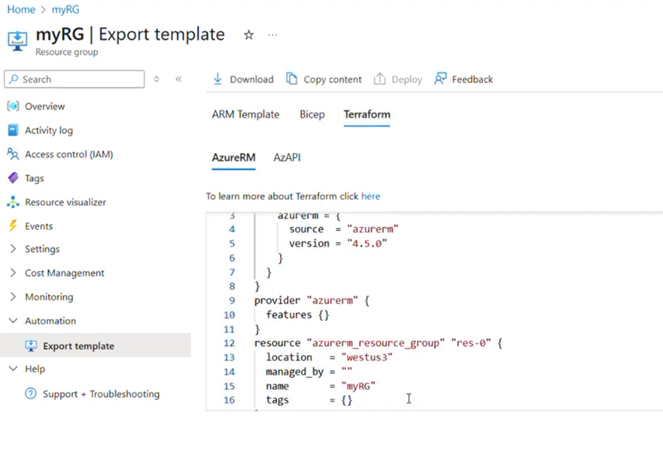
DevOps & IaC & Automation
Announcing Public Preview of Terraform Export from the Azure Portal
With this new feature, It is now possible easily export existing Azure resources to be managed declaratively directly from the Azure Portal. This will streamline infrastructure-as-code (IaC) workflows, making it simpler to manage and automate Azure resources via the AzureRM and AzAPI providers.

Slide 43
Miscellaneous

Slide 44
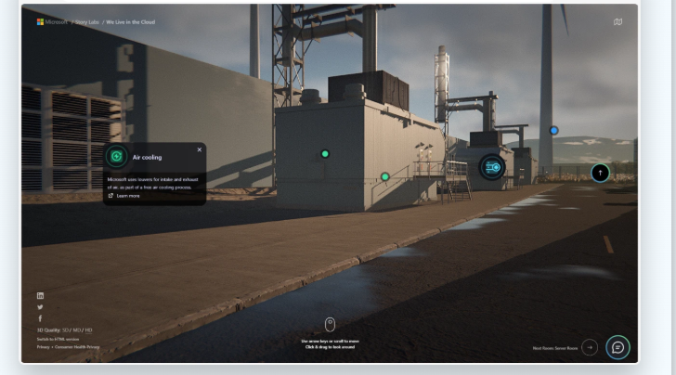
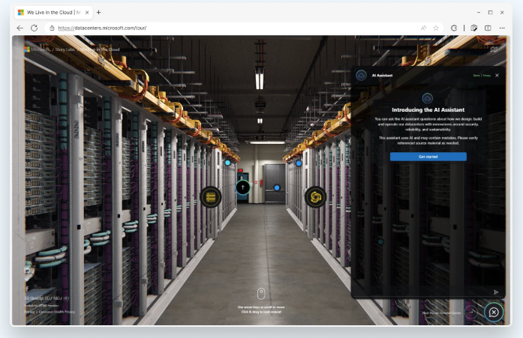
Miscellaneous Updates
Transitioning to Microsoft Planner and retiring Microsoft Project for the web
MS announced the transition to Planner, which aims to provide a unified work management experience through a modern work stack integrating Project for the web, To Do, and Planner. In August 2025, MS will retire Project for the web, as well as the Project and Roadmap apps in Microsoft Teams. Users will be redirected to Planner for the web and Planner in Teams as Project for the web becomes Planner.
Microsoft’s Virtual Datacenter Tour opens a door to the cloud

Slide 45
Information

Slide 46
Information
Azure Times GitHub Repo

Slide 47
Questions

