Slide 1
Azure Times #162
May 19, 2025

Slide 2
Networking

Slide 3
Networking Updates
Public Preview: Azure Virtual Network Manager high-scale private endpoints in connected groups
Azure Virtual Network Manager high-scale private endpoints in connected groups is now in public preview, delivering enhanced scalability for complex Azure network environments.
As organizations grow, the need to large numbers of private endpoints becomes critical. This new capability enables up 20,000 private endpoints within a connected group—empowering you to scale workloads more efficiently in Azure.

Slide 4
Security & Identity

Slide 5
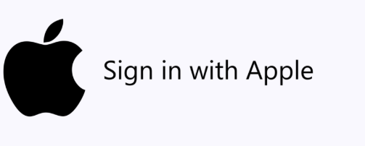
Security & Identity Updates
Generally Available: Apple identity provider support for Microsoft Entra External ID
MS announced that “Sign in with Apple” is now generally available for external tenants in Entra External ID. The feature has been in public preview since February.
By configuring Apple as an external identity provider, it is possible to add Apple as a social provider to user flows. Then, users can sign up and sign in to the associated applications using their Apple ID accounts through a simple “Sign in with Apple” option.

Slide 6
Management & Governance

Slide 7
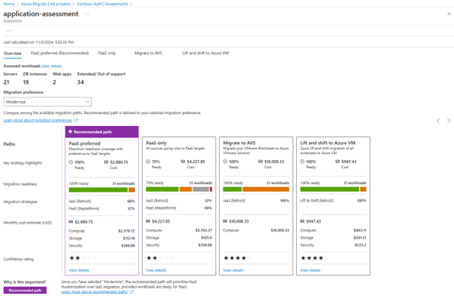
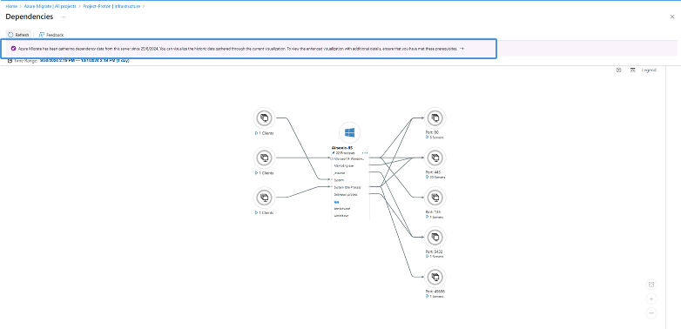
Management & Governance Updates
Azure Migrate Updates
General availability: Azure Migrate now supports a simplified experience through its upgraded version of the agent-based migration stack. This stack offers a streamlined experience for customers and is set to replace the classic experience over the next three years. Learn more.
Public preview: Azure Migrate supports application awareness to offer an enhanced and modernized user experience. This feature streamlines the discovery, assessment, and migration of on-premises applications and workloads to Azure. It streamlines and enhances the decision-making, planning, and migration workflow by identifying and evaluating the current state of your on-premises infrastructure.
Updated inventory view
Tags: Tags in Azure Migrate enhance analysis by enabling customers to group and visualize related resources based on specific properties
Enhanced dependency analysis: Use the new dependency analysis experience to identify application boundaries and group workloads accordingly.
Application assessment: The assessment then evaluates all potential Azure target services for these workloads and provides a recommended migration path, along with cost and readiness details. Learn more.
Action Center: Azure Migrate now includes Action Center, which offers a centralized hub for users to view and manage all migration-related issues, pending actions, and jobs within a project.

Slide 8
Management & Governance Updates
Generally Available: Carbon optimization in Azure
Carbon optimization in Azure — a built-in solution to help measure, manage, and reduce carbon emissions from your Azure workloads.
With Carbon Optimization, it is possible to :
Track progress over time with built-in dashboards and KPIs, available directly in the Azure portal
Access granular, resource-level emissions data to uncover deeper optimization opportunities
Use Azure RBAC to manage access and ensure the right stakeholders see the right data
Get actionable recommendations that highlight both carbon reduction and cost-saving opportunities
Align with your cloud sustainability goals and drive meaningful environmental impact

Slide 9
Compute

Slide 10
Compute Updates
Generally Available: App Service Webjobs on Linux
WebJobs allow for the execution of background tasks and scheduled processes, which unlike traditional web applications, are not triggered by HTTP requests. The WebJobs feature is now generally available (GA) for Linux code and container scenarios, bringing feature parity with the App Service Windows option.
Generally Available: Azure App Configuration now offers a Developer pricing plan
MS announced the availability of the Developer pricing tier for App Configuration. The Developer tier is a cost-efficient offering designed for low-volume, non-production use cases. It comes equipped with features and capabilities specifically tailored for development and testing needs.
Key Features:
Cost-efficient: In typical usage scenarios, it costs only a fraction of the Standard tier, making it practical for each developer or test environment to have its own dedicated store.
Flexible: Compared to the Free tier, developers can create as many stores as needed in any region. The daily requests limit has been removed and replaced with a reasonable hourly quota.
Enhanced Security: Includes essential security features like private endpoints, ensuring that development environments are secure.

Slide 11
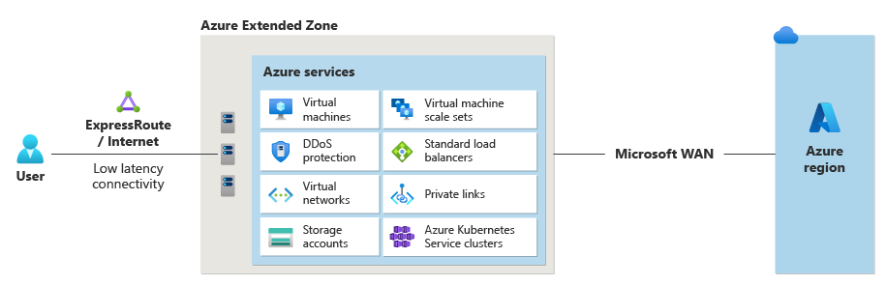
Compute Updates
Public Preview: Perth - Azure Extended Zones
MS announced the public preview of the Perth Azure Extended Zone.
Azure Extended Zones are small-footprint extensions of Azure placed in metros, industry centers, or a specific jurisdiction to serve low latency and data residency workloads. They support virtual machines (VMs), containers, storage, and a selected set of Azure services and can run latency-sensitive and throughput-intensive applications close to end users and within approved data residency boundaries.
 | Available Azure services and features
Compute | Azure Kubernetes Service* Azure Virtual Desktop* Virtual Machine Scale Sets Virtual machines
Networking | DDoS (Standard protection) ExpressRoute Private Link Standard Load Balancer Standard public IP Virtual Network Virtual network peering
Storage | Managed disks Premium Page Blobs Premium Block Blobs Premium Files Data Lake Storage Gen2 Hierarchical Namespace Data Lake Storage Gen2 Flat Namespace Change Feed Blob Features - SFTP - NFS
BCDR | Azure Site Recovery* Azure Backup
Arc-enabled PaaS | ContainerApps* PostgreSQL* ManagedSQL*

Slide 12
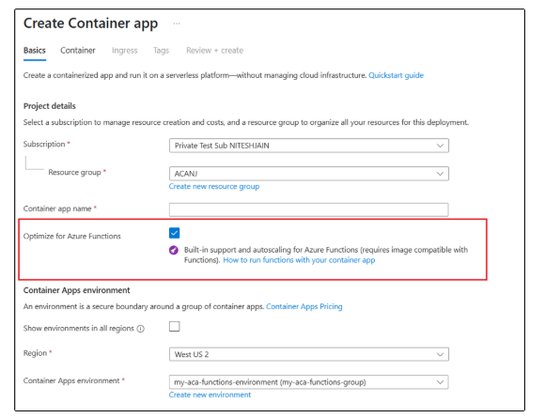
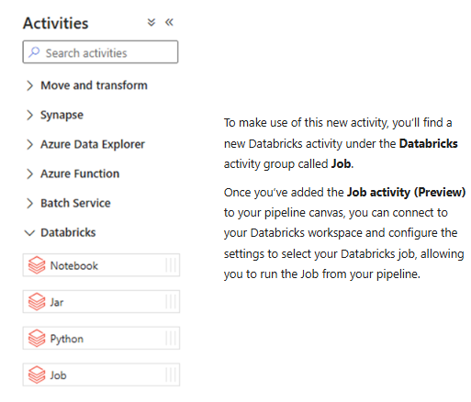
Compute Updates
Announcing the new Databricks Job activity in ADF!
MS Announced that Azure Data Factory now supports the orchestration of Databricks Jobs!
Databrick Jobs allow to schedule and orchestrate a task or multiple tasks in a workflow in Databricks workspace. Since any operation in Databricks can be a task, this means it is possible run anything in Databricks via ADF, such as serverless jobs, SQL tasks, Delta Live Tables, batch inferencing with model serving endpoints, or automatically publishing and refreshing semantic models in the Power BI service.
Announcing Native Azure Functions Support in Azure Container Apps
MS introduced a new, streamlined method for running Azure Functions directly in Azure Container Apps (ACA). This powerful integration allows to leverage the full features and capabilities of Azure Container Apps while benefiting from the simplicity of auto-scaling provided by Azure Functions.
With the new native hosting model, Azure Functions are now fully integrated into ACA. This means it is possible to deploy and run functions directly on ACA, taking full advantage of the robust app platform.

Slide 13
Compute Updates
Public Preview: Predictive Pooling for Standby Pools
Predictive Pooling for Azure Virtual Machine Scale Sets (VMSS) and Azure Container Instances (ACI)—is a new capability that brings intelligent, data-driven sizing information to your standby pools.
Predictive pooling uses historical usage data and machine learning to forecast demand and recommend the optimal number of pre-provisioned instances to maintain in your standby pool.
Right-size your standby pools to balance cost and readiness.
Reduce latency by ensuring the right number of instances are always ready.
Improve operational efficiency by automating pool sizing decisions.
Prediction results are available 2-3 weeks after creating the standby pool.
Public Preview: Use Spot Instances in Standby Pools for Virtual Machine Scale Sets
With this new capability, it is possible to configure standby pool to use Spot VMs. When a scale-out event occurs:
Instances are pulled from the Spot standby pool into the scale set.
These instances retain their Spot pricing and characteristics.
If capacity is unavailable or Spot VMs are evicted, VMSS can fall back to provisioning new instances based on your scale set policy.
This gives the flexibility to optimize for cost while still maintaining fast scale-out performance.
No SLA: Spot VMs do not come with availability guarantees.
Eviction Policy: Using Spot Instances in a standby pool are only supported when using a delete eviction policy and with scale set deployments using 100% Spot Instances (Spot-Mix is not yet supported)
Capacity-Aware: Azure only allocates Spot VMs when capacity is available, so standby pool readiness may vary.

Slide 14
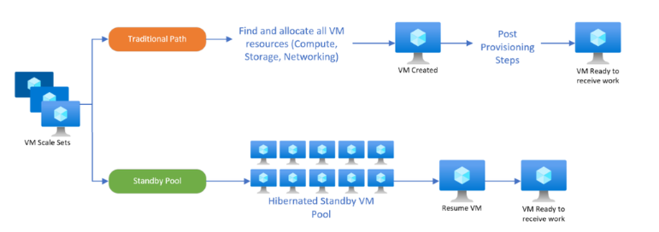
Compute Updates
Public Preview: Hibernated VMs in Standby Pools for Virtual Machine Scale Sets
Standby pools for Virtual Machine Scale Sets allow to pre-provision virtual machines that are ready to be pulled into your scale set when demand spikes. Until now, these VMs could be kept in either a running or deallocated state. With this public preview, you can now maintain VMs in a hibernated state—preserving memory and OS state while avoiding compute charges.
This is especially valuable for workloads that require fast startup times but don’t need to be continuously running, such as:
Session-based applications
Stateful services
Burstable compute tasks
How It Works
Public Preview: Zone Support for Standby Pools in Azure Container Instances
With zone support, it is now possible to configure ACI standby pools to span one or more availability zones within a region. This enables:
Improved fault tolerance: Spread standby containers across zones to mitigate the impact of zone-level outages.
Faster recovery: Maintain warm capacity in multiple zones for quicker failover.
Better placement control: Align standby capacity with your application’s architecture and regional strategy.

Slide 15
Compute Updates
Now Available: Logging and Monitoring for Standby Pools in VMSS and ACI
Standby pools are designed to reduce scale-out latency by pre-provisioning compute resources. With the addition of logging and monitoring, it is possible to:
Track pool health and readiness
Audit provisioning and scale-out events
Diagnose issues faster with integrated telemetry
Set up alerts for degraded pool states or capacity shortfalls
These capabilities are powered by Azure Monitor and Log Analytics, giving you a centralized, queryable view of standby pool activity across both Virtual Machine Scale Sets and Azure Container Instance environments.

Slide 16
Storage & Data

Slide 17
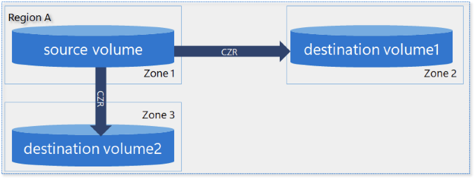
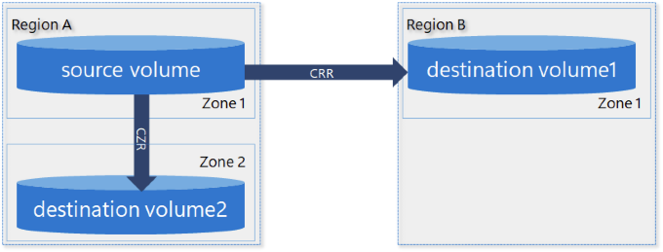
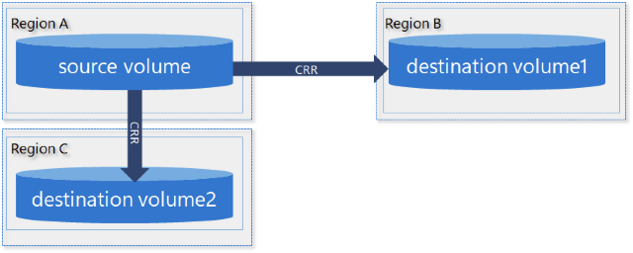
Storage & Data Updates
Generally Available: Azure NetApp Files cross-zone and cross-region replication across subscriptions
Cross-subscription replication is a feature for Azure NetApp Files that allows replication across different subscriptions under the same tenant. This enhances disaster recovery and operational agility by leveraging NetApp SnapMirror technology, which ensures efficient data transfer by sending only changed blocks in a compressed format. The feature is supported with both cross-zone replication in all Azure NetApp Files regions with availability zones and cross-zone replication in all supported regions.
Public Preview: Azure NetApp Files cross-zone-region replication (CZRR)
Cross-zone-region replication builds on the existing capabilities of cross-region replication and cross-zone replication. It enables to replicate volumes across regions and across availability zones within the same region, combining disaster recovery and business continuance capabilities for volumes. To establish two protection volumes, you can create either of the following setups (1) cross-zone replication and a cross-region replication relationship, (2) two cross-region replication relationships or (3) two cross-zone replication relationships. The source volume should be in an availability zone for the cross-zone replication relationship.

Slide 18
Storage & Data Updates
Generally Available: Azure File Sync in Italy North
Azure File Sync enables seamless tiering of data from on-premises Windows Servers to Azure Files for hybrid use cases and simplified migration. It also enables to leverage the performance, flexibility and compatibility of on-premises File Server while leveraging the scale and cost effectiveness of Azure Files.
The expansion into Italy North brings the service closer to organizations in these regions, offering lower latency, better performance, and support for local data residency requirements.
Generally Available: Azure Premium SSD v2 Disk Storage is now available in Japan West
Azure Premium SSD v2 (Pv2) Disk Storage is now available in Japan West. Pv2 is Azure’s next-generation general-purpose block storage designed to deliver an ideal balance of low-latency performance, flexible scalability, and cost efficiency. With sub-millisecond latency and the ability to independently scale IOPS, throughput, and capacity, Pv2 is optimized for a wide range of real-world production workloads.

Slide 19
Storage & Data Updates
Generally Available: Azure NetApp Files support for Active Directory connection per NetApp account
The feature allows each NetApp account to connect to its own Active Directory Forest and Domain, providing the ability to manage more than one Active Directory connections within a single region under a subscription. This enhancement enables distinct Active Directory connections for each NetApp account, facilitating operational isolation and specialized hosting scenarios. Active Directory connections can be configured multiple times for multiple NetApp accounts to make use of it. With the creation of SMB volumes in Azure NetApp Files now tied to these Active Directory connections in the NetApp account, the management of Active Directory environments becomes more scalable, streamlined and efficient.

Slide 20
Databases

Slide 21
Databases Updates
Public Preview: MongoDB Atlas—an Azure Native Integration
MongoDB Atlas is now available as an Azure Native Integration, offering a fully managed document database with native vector search capabilities and direct integration with the Azure ecosystem. Developed through collaboration between Microsoft and MongoDB, this integration simplifies the management of MongoDB Atlas.
You get seamless provisioning within the Azure portal and unified billing on existing Azure invoices. In addition, support for single sign-on (SSO) using Microsoft credentials helps to enhance security and improve the developer experience. Now developers can manage their resources across multiple programming languages using Azure CLI and SDKs.
OLE DB Driver 19.4.1 and 18.7.5 for SQL Server Released
Versions 19.4.1 and 18.7.5 of the Microsoft OLE DB Driver for SQL Server have been released. Both versions fix a couple of bugs and version 19.4 switches from ADAL to a new underlying authentication library for Microsoft Entra authentication methods.
Changes
Microsoft SQL Driver Authentication library (mssql-auth.dll) replaces ADAL. mssql-auth.dll is installed as part of installation process.
Added support for three new languages, Czech, Polish, and Turkish (to align with Visual Studio and SSMS supported languages).
A single 64-bit MSI package is provided that installs x64 or Arm64 based on the OS platform.
Modified the installer to include Code and SDK components by default (to solve setup errors when the driver is redistributed).
Bug Fixes
Fixed a prepared statement issue when connection recovery is performed.
Fixed an installer issue to prevent the installer from asking for a pending file reboot prior to installation when it's not actually necessary.
Modified the installer to not copy the TrustServerCertificiate registry flag value from a previously installed major version; and instead use the installer default value for the flag.

Slide 22
Miscellaneous

Slide 23
Miscellaneous Updates
Retirement: Bing Search APIs on August 11, 2025
Bing Search APIs will be retired on August 11, 2025. Any existing instances of Bing Search APIs will be decommissioned completely, and the product will no longer be available for usage or new customer signup.
Note that this retirement will apply to partners who are using the F1 and S1 through S9 resources of Bing Search, or the F0 and S1 through S4 resources of Bing Custom Search.
Retirement: Language Understanding (LUIS) retirement extended to October 31, 2025
In September 2022, MS announced that Language Understanding (LUIS) would be retired on October 1, 2025. Based on feedback, MS is extending the retirement date to October 31, 2025, to give more time to plan for migration.
On October 31, 2025, Language Understanding (LUIS) will be retired. Before that date, please migrate to conversational language understanding, a capability of Azure AI Service for Language. Conversational language understanding provides many of the capabilities of LUIS, plus enhancements such as:
Enhanced AI quality using state-of-the-art machine learning models
Multilingual capabilities that allow you to train in one language and predict in others
Built-in routing between conversational language understanding and custom question answering projects using orchestration workflow
Access to a suite of features available on Azure AI Service for Language

Slide 24
Information

Slide 25
Information
Azure Times GitHub Repo

Slide 26
Questions

