Slide 1
Azure Times #178
September 15, 2023

Slide 2
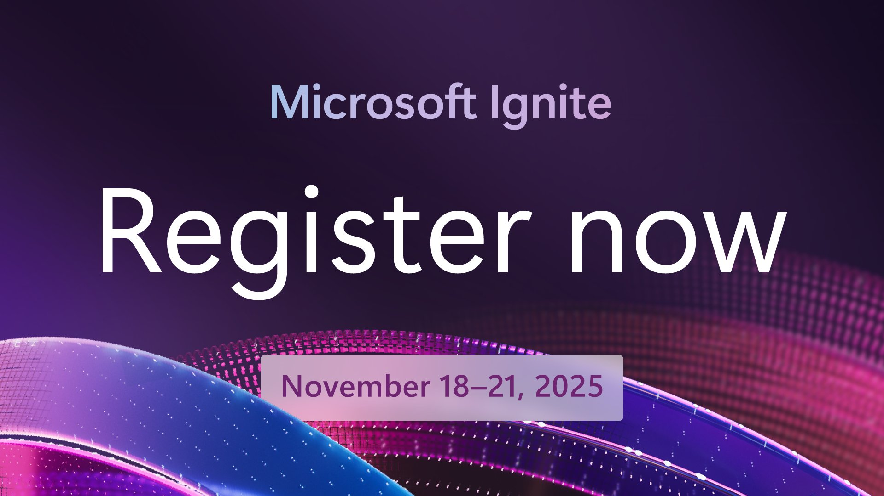

Slide 3
Networking

Slide 4
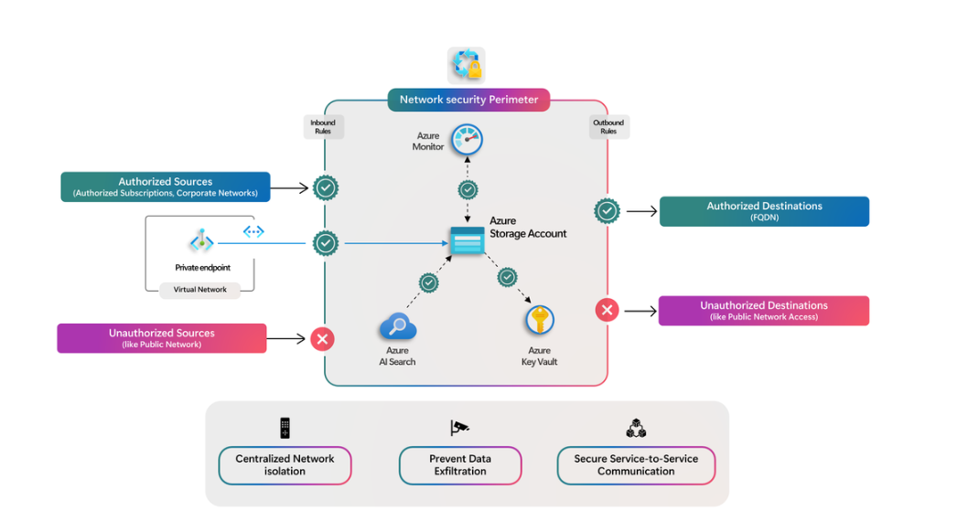
Networking Updates
GA: Network Security Perimeter for Storage Account
A network security perimeter allows organizations to define a logical network isolation boundary for Platform-as-a-Service (PaaS) resources like Azure Storage accounts that are deployed outside your organization’s virtual networks. This restricts public network access to PaaS resources by default and provides secure communication between resources within the perimeter. Explicit inbound and outbound rules allow access to authorized resources.

Slide 5
Security & Identity

Slide 6
Security & Identity Updates
Support tip: Upcoming Microsoft Intune network changes
Starting on or shortly after December 2, 2025, Intune will also use Azure Front Door IP addresses to improve security and simplify firewall management.
If you use outbound traffic policies based on IP addresses or service tags, you need to review and update firewall rules to avoid service disruptions.
Do not remove any existing network endpoints required for Microsoft Intune. Additional network endpoints are documented as part of the Azure Front Door and service tags information referenced in the files linked below:
Public clouds: Download Azure IP Ranges and Service Tags – Public Cloud from Official Microsoft Download Center
Government clouds: Download Azure IP Ranges and Service Tags – US Government Cloud from Official Microsoft Download Center
The additional ranges are those listed in the JSON files linked above and can be found by searching for “AzureFrontDoor.MicrosoftSecurity”.

Slide 7
Management & Governance

Slide 8
Management & Governance Updates
Public Preview: Graph Query Language (GQL) in KQL graph semantics
MS added the Graph Query Language (GQL) support to KQL graph semantics, aligned with the ISO standard.
Graph Query Language (GQL) is an emerging ISO standard for querying graph databases. GQL lets use SQL-like syntax for graph pattern matching, so it's easier to analyze relationships in your data. This article explains how to use GQL, its benefits, and key features.
GQL provides standardized graph pattern matching capabilities for analyzing relationships in your data using the ISO standard syntax.
This update allows running GQL queries on any Fabric Eventhouse or Azure Data Explorer, making it easier to work with graph data using an industry-standard language.

Slide 9
Management & Governance Updates
Microsoft Cost Management updates—July & August 2025
MS announced that Azure now supports assigning the Partner Admin Reader role to Service Principals. This enhancement empowers Enterprise Agreement indirect partners (CSPs who manage customer Azure costs) to programmatically access cost data across their customers’ enrollments under their Partner Customer Number (PCN) Entra ID applications—without relying on interactive user accounts.

Slide 10
Compute

Slide 11
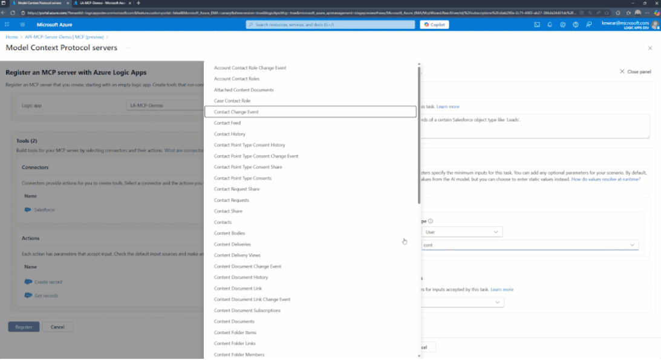
Compute Updates
Private Preview: Azure AMD-based Dasv7, Easv7, and Fasv7-series Virtual Machines
The general-purpose Dasv7 and Dalsv7, memory-optimized Easv7, and compute-optimized Fasv7, Falsv7, Famsv7 VMs, are now available in preview with and without local disk support.
Key improvements include:
Up to 35% CPU performance improvement compared to similarly sized v6 VMs
Significant performance gains on other workloads compared to the previous generation of similarly sized (v6) AMD-based VMs
Expanded VM sizes: Dasv7-series, Dalsv7-series and Easv7-series now scale up to 160 vCPUs. Fasv7-series supports up to 80 vCPUs, with a new 1-core size for lightweight workloads.
Increased memory capacity: Dasv7-series now offers up to 640 GiB of memory. Easv7-series scales up to 1280 GiB, ideal for memory-intensive applications.
Enhanced remote storage performance, offering up to 20% higher IOPS (up to 355K IOPS) and up to 50% greater throughput (up to 11 GBps).
New VM families introduced: Fasv7, Falsv7, and Famsv7 now available with local disk support.
Introducing Logic Apps MCP servers (Public Preview)
Using Logic Apps (Standard) as MCP servers transforms the way organizations build and manage agents by turning connectors into modular, reusable MCP tools.
This approach allows each connector—whether it's for data access, messaging, or workflow orchestration—to act as a specialized capability within the MCP framework. By dynamically composing these tools into Logic Apps, developers can rapidly construct agents that are both scalable and adaptable to complex enterprise scenarios. The benefits include reduced development overhead, enhanced reusability, and a streamlined path to integrating diverse systems—all while maintaining the flexibility and power of the Logic Apps platform.

Slide 12
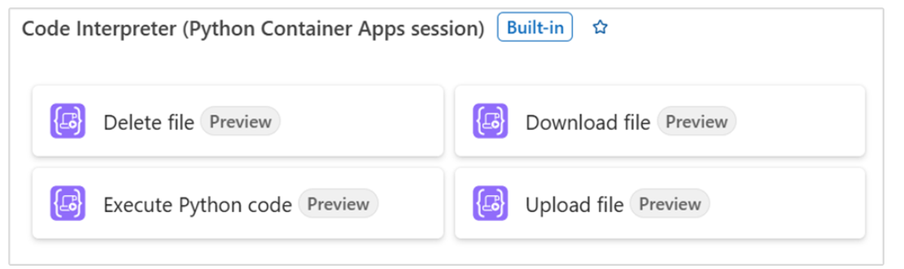
Compute Updates
Announcement! Python Code Interpreter in Logic Apps is now in Public Preview
This capability enables Logic Apps developers to use Python Code Interpreter in their workflows and also as a tool in Agent loop. It is possible to author the code or use LLM to write code. As a code interpreter tool, it
Accept natural language instructions
Automatically generate Python code
Execute that code securely on uploaded datasets (like CSV or JSON)
Return insights, visualizations, or next-step data back to the user

Slide 13
Compute Updates
Generally Available: Azure D192 Sizes in the Azure Dsv6 and Ddsv6-series VM Families
These sizes are now generally available in several Azure regions. These new VM sizes offer 192 vCPUs and 768 GiB of RAM, making them ideal for general-purpose workloads such as enterprise-grade applications like SAP, SQL, in-memory analytics platforms, and large relational databases.
Azure Boost delivers up to 400k IOPS and 12 GB/s remote storage throughput for these VMs with NVMe-enabled local and remote storage for scalable performance. Additionally, Intel® Total Memory Encryption (TME) provides secure memory data protection.
Key Highlights
Large Size: 192 vCPUs with 768 GiB of RAM for demanding workloads.
Azure Boost: Up to 400K IOPS and 12 GB/s remote storage throughput and up to 82 Gbps network bandwidth.
Security First: Intel® TME ensures data protection in system memory.
NVMe Interface: 3X improvement in local storage IOPS for low-latency access.
Generally Available: Bring Your Own License (BYOL) Support for JBoss EAP on Azure App Service
Announcing that Azure App Service now supports Bring Your Own License (BYOL) for JBoss Enterprise Application Platform (EAP), enabling enterprise customers to deploy Java workloads with greater flexibility and cost efficiency.

Slide 14
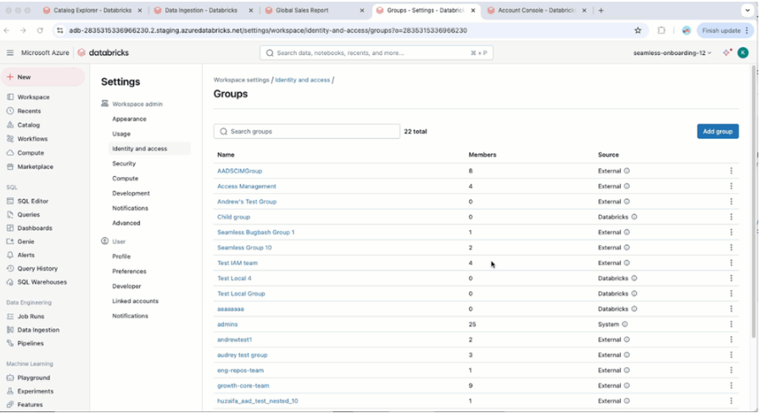
Compute Updates
General Availability: Automatic Identity Management (AIM) for Entra ID on Azure Databricks
It is now possible to automate user provisioning and deprovisioning through native integration with Microsoft Entra ID—eliminating manual overhead, reducing security risks, and ensuring that users have timely access to the right data and tools.
By aligning with enterprise identity governance policies. Automatic identity management gives a more unified, secure, and intelligent platform experience. With deeper integration between Azure Databricks and Microsoft Entra ID, you benefit from simplified cloud-native data and AI workflows—all within a unified platform.
Cross-region Disaster Recovery for Windows 365 Frontline (dedicated mode)
MS announced that Cross-region Disaster Recovery for Frontline in dedicated mode is now generally available. This Windows 365 add-on feature creates “snapshots” of Cloud PCs in customer-defined, geographically distant locations. In the event of a regional outage, these snapshots can be recovered as Cloud PCs running in the selected backup location, helping keep your users productive even if their primary region goes down.
Cross-region Disaster Recovery was first introduced for Windows 365 Enterprise, and now Windows 365 Frontline users with dedicated Cloud PCs have the same rapid failover option. This capability is especially relevant for industries and organizations that are highly regulated or have workflows requiring geographic separation between primary and backup Cloud PC locations.

Slide 15
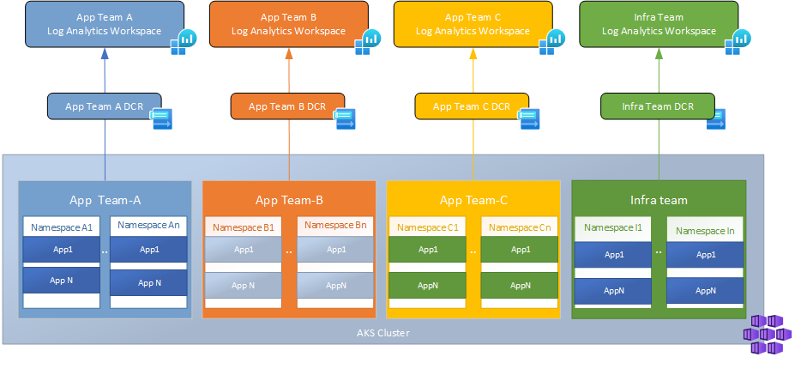
Compute Updates
Generally Available: Multitenant Managed Logging in Container Insights
This functionality enables teams to independently manage and access their container logs within Kubernetes namespaces while preserving centralized log collection in Azure Log Analytics workspaces.
Container logs (stdout & stderr) from different namespaces can be directed to different workspaces based on the team’s needs. This includes the ability to) to a dedicated infrastructure team workspace while sending application logs to other teams' workspaces. Additionally, the same logs can be sent to multiple workspaces to support diverse operational requirements.
Generally Available – High-scale mode in Azure Monitor - Container Insights
MS announced the General Availability of High Scale mode. High-scale mode is ideal for customers approaching or above 10,000 logs/sec from a single node.
When High Scale mode is enabled, Container Insights makes multiple configuration changes, leading to a higher overall throughput. These include using a more powerful agent setup, using a different data pipeline, allocating more memory for the agent, and more. All these changes are made in the background by the service and do not require input or configuration from customers. High Scale mode impacts only the data collection layer (with a new DCR) – the rest of the experience remains the same. Data flows to our existing tables, your queries and alerts work as before too.

Slide 16
Compute Updates
Retirement: Operating System (OS) Disks on Standard HDD will be retired on 08 September 2028
To better align with current usage patterns and future investments in disk performance and reliability, service for OS disks running on Standard HDD will be retired on September 8, 2028.
Service for OS Disks running on Standard HDD will be retired on September 8, 2028
After September 8, 2028, OS Disks on Standard HDD will be converted from Standard HDD to Standard SSD of equivalent size if not migrated prior
Standard HDD data disks (non-boot volumes) && Ephemeral OS disks are not impacted
Retirement: Microsoft Playwright Testing (Preview) will be retired on March 8, 2026
Last August, MS introduced Azure App Testing, a unified testing service that brings together two powerful testing capabilities—Azure Load Testing and Microsoft Playwright Testing—to help developers and QA teams run large-scale functional and performance testing.
After March 8, 2026, any remaining Microsoft Playwright Testing resources will stop working and will be permanently retired.

Slide 17
Storage & Data

Slide 18
Storage & Data Updates
Public Preview: File share centric management model (Microsoft.FileShares) for Azure Files
The new top-level Azure resource provides:
Simplified management:
Independent capacity and performance
Granular configuration
Predictable, flexible billing
Improved scale and performance
What is not supported now:
SMB Shares
File Sync
HDD supportability
GRZ
GZRS

Slide 19
Databases

Slide 20
Databases Updates
Generally Available: Azure Cosmos DB for MongoDB (vCore) same-region replica cluster
It is now possible to create a replica cluster of Azure Cosmos DB for MongoDB (vCore) in the same region where the primary cluster is hosted. This replica is continuously synchronized with the primary (read-write) cluster, ensuring data consistency.
Same-region replica clusters are ideal for offloading intensive read operations, such as dashboards serving tens of thousands of users, helping to reduce load on the primary cluster and to improve overall performance.
Additionally, if your primary cluster isn’t enabled for in-region high availability, the replica cluster can serve as an in-region disaster recovery solution. In the event of a failure, it can be promoted the replica cluster to become the new read-write cluster.
The global read-write connection string always points to the active write cluster.
Generally Available: Azure Cosmos DB for MongoDB (vCore) encryption with customer-managed key
Now, in addition to service-managed key encryption (SMK), there is an option to add another layer of security by enabling encryption with a customer-managed key (CMK).

Slide 21
Databases Updates
Generally Available: Azure Database for MySQL 8.4
8.4 servers are now backed by the Azure service-level agreement, giving the confidence to run mission-critical applications on the latest MySQL version.
If you’re running an existing server on an earlier version, you can upgrade to 8.4 after your server receives the upcoming maintenance update, targeted for September.
This release empowers you to modernize your database infrastructure with the latest MySQL capabilities while maintaining high availability, scalability, and reliability.
Generally Available: Azure MySQL Extended Support
MS introduced Extended Support for Azure Database for MySQL – Flexible Server, starting in spring 2026. If your server is running on a MySQL version that has reached the end of standard support, it automatically enters Extended Support after a one-month grace period. During this time, you continue to receive critical security updates and benefit from Microsoft’s commitment to service availability and reliability for up to three additional years. New features and minor version updates may not be included; however, Extended Support helps ensure that your workloads remain protected and operational. To avoid Extended Support charges, you can upgrade your server to a MySQL version that is still under standard support.

Slide 22
Databases Updates
Public Preview: Azure MySQL Self Heal
It is now possible to use self-healing tools to proactively resolve common server issues—without opening a support case.
Whether a server is unresponsive, stuck in a restart state, or experiencing log corruption, Self-Heal provides a one-click recovery experience directly in the Azure portal.
It is now possible to trigger it anytime—even if no alerts are shown—giving greater control over server’s health and uptime. The system runs predefined, safe remediation workflows tailored to specific scenarios and clearly informs you of any potential impact before execution. Using Self-Heal helps reduce downtime, avoid delays waiting for support, and maintain service reliability with minimal effort. With every new scenario supported, Self-Heal strengthens its role as an essential tool for managing MySQL workloads efficiently.
Generally Available: Azure Database for PostgreSQL flexible server in Austria East and Chile Central
It is now possible to deploy Azure Database for PostgreSQL flexible server in the Austria East and Chile Central regions.

Slide 23
Integration

Slide 24
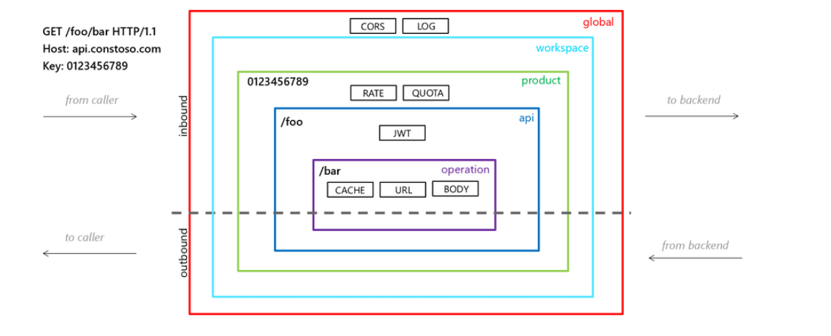
Integration Updates
Enforce or Audit Policy Inheritance in API Management
MS announced a new Azure Policy definition that lets enforce or audit policy inheritance in Azure API Management. With this capability, platform and governance teams can ensure that API Management policies are always inherited across all policy scopes — operations, APIs, products, and workspaces — strengthening consistency, compliance, and security across your API estate.

Slide 25
ML & AI & IOT

Slide 26
ML & AI & IOT Updates
o4-mini Reinforcement Fine-tuning (RFT) Now Generally Available on Azure AI Foundry
MS announced Reinforcement Fine-tuning for o4-mini.
Customers can meaningfully fine-tune o4-mini starting with just 100 samples and a wide variety of graders!
MS introduced Custom Python Code as a grader, which can be included as part of the finetuning job on both UI and SDK for predictable tasks.

Slide 27
DevOps & IaC & Automation

Slide 28
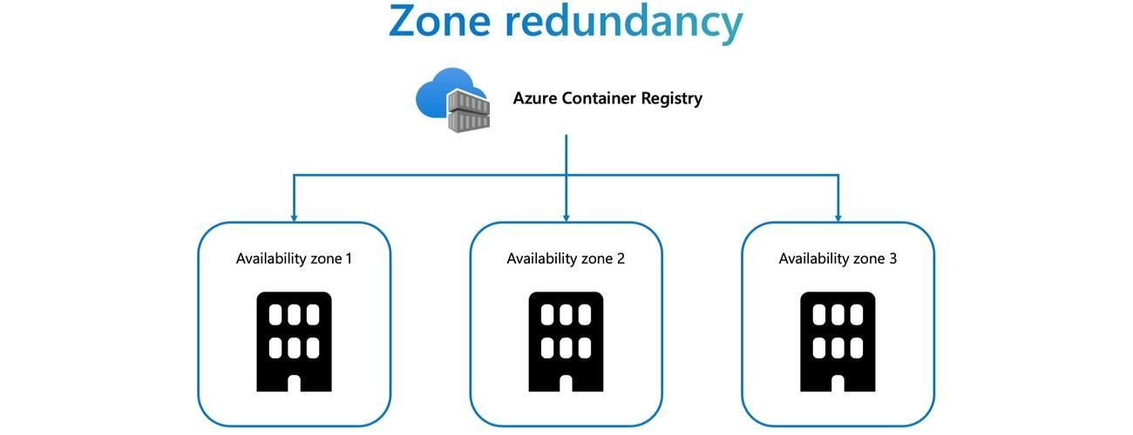
DevOps & IaC & Automation
Zone redundancy is now enabled by default in Azure Container Registry
MS announced a major resiliency enhancement for Azure Container Registry (ACR): Zone redundancy is now enabled by default for all ACR SKUs in regions that support Availability Zones. This means ACR resources are now more resilient automatically and at no additional cost.
Previously, zone redundancy was only available for registries using the Premium SKU. With this update, all SKUs, including Basic and Standard, now benefit from zone redundancy in supported regions. This change has been applied automatically to all new and existing registries in regions that support Availability Zones, with no action required from you.

Slide 29
Information

Slide 30
Information
Azure Times GitHub Repo

Slide 31
Questions

