Slide 1
Azure Times #179
September 22, 2025

Slide 2
Networking

Slide 3
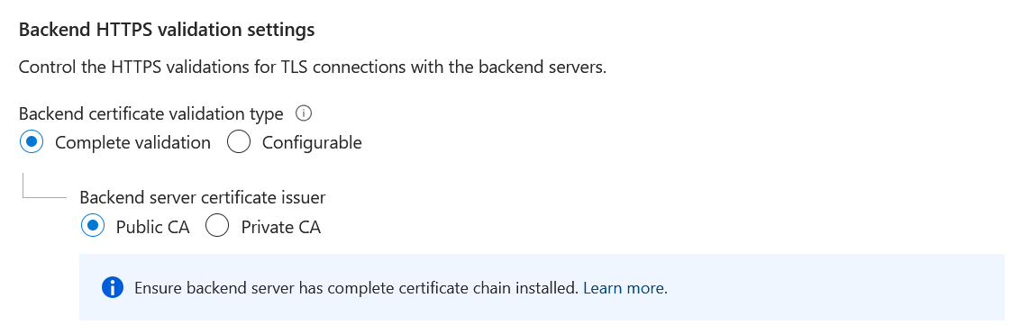
Networking Updates
Generally Available: Backend TLS validation controls in Azure Application Gateway
When the HTTPS protocol is selected in the Backend Settings of Azure Application Gateway, by default, it performs all validations in the TLS handshake before successfully establishing a connection with a backend server. Azure Application Gateway now supports the following configurable options, giving customers greater flexibility in managing backend TLS behavior across diverse environments.
Enable or disable Certificate chain and expiry verification
Enable or disable SNI verification
With these new settings, customers can customize TLS validations to align with their infrastructure needs.
MS recommends keeping all validations enabled for production environments. Disabling some or all validations is suggested only for testing and development purposes, such as when self-signed certificates are used.
These settings don't apply to test probe functionality when adding a custom Health Probe.
Currently, unsupported for TLS/TCP proxy.

Slide 4
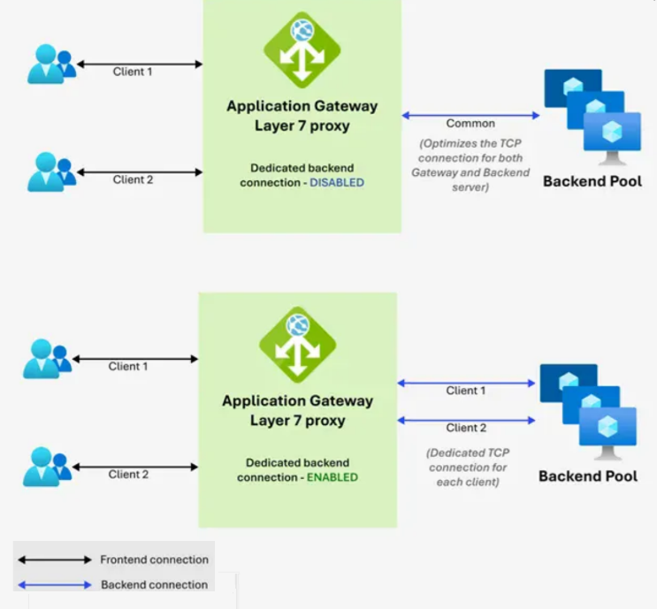
Networking Updates
Generally Available: Enabling dedicated connections to backends in Azure Application Gateway
By default, Application Gateway reuses the idle backend connections to optimize the resource usage of TCP connections, helping both the gateway and the backend servers. With the dedicated connection setting, each incoming client connection is mapped to a distinct backend connection, ensuring one-to-one communication between the frontend and the backend
Dedicated backend connection leads to an increase in the number of backend connections and hence could require more resources to support the increased concurrent connections on Application Gateway and the backend servers. On Application Gateway, please consider increasing the number of instances or enabling auto scale.
When the backend is a remote server, Application Gateway instances utilize SNAT ports for every connection. As each client connection establishes a dedicated backend connection, SNAT port consumption correspondingly increases. Therefore, it is important to account for potential SNAT port exhaustion.
Dedicated Backend connection is not supported with HTTP/2.

Slide 5
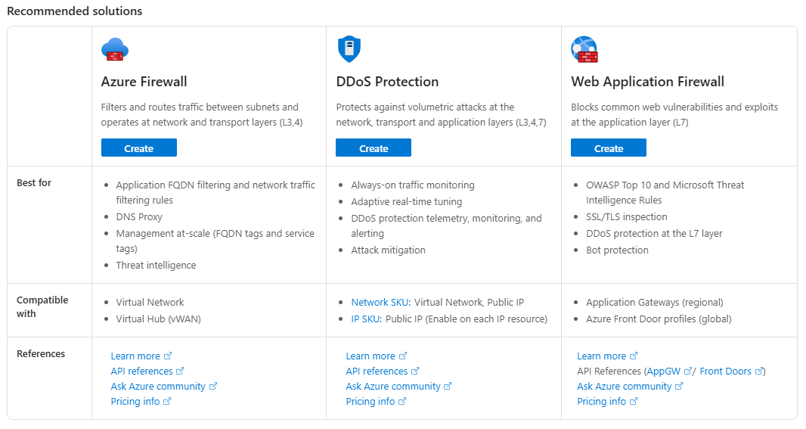
Networking Updates
Generally Available: Introducing the new Network Security Hub experience
The Azure Firewall Manager experience has been expanded and rebranded as the Network Security Hub—a centralized interface that brings together Azure Firewall, Web Application Firewall (WAF), and DDoS Protection. This change is part of a broader effort to simplify the Azure Networking portfolio and better align with customer needs.
Key Highlights
Unified experience: Manage Azure Firewall, WAF, and DDoS Protection from a single hub.
Improved visibility: Enhanced coverage dashboard shows protection across virtual networks, hubs, and applications.
Azure Advisor integration: Get personalized recommendations to improve security and optimize performance.
Streamlined navigation: Easier discovery of services like Virtual Hub deployments and Firewall Policies.
No pricing or support changes to Firewall Manager: This is a UX and naming update only.

Slide 6
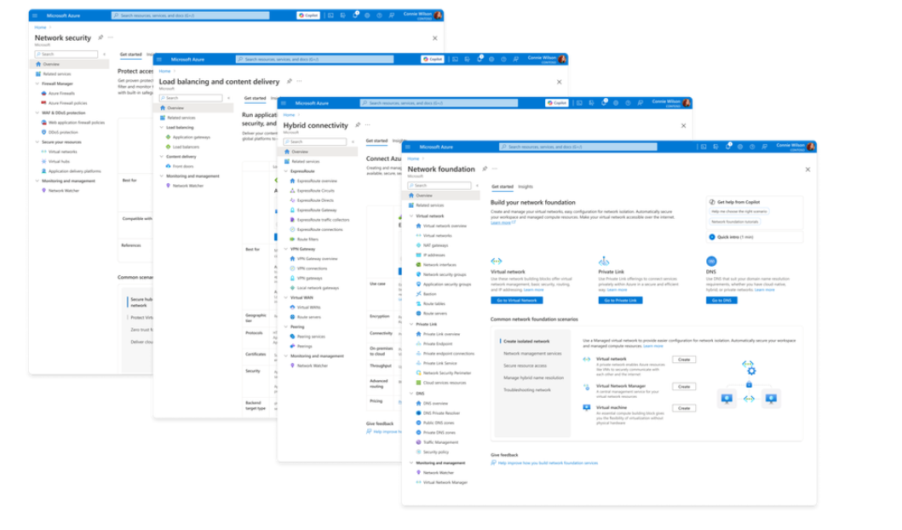
Networking Updates
Azure Networking Portfolio Consolidation
That's why we're excited to introduce a more focused, streamlined, and intuitive experience across Azure.com, the Azure portal, and our documentation pivoting around four core networking scenarios:
Network foundations: Network foundations provide the core connectivity for your resources, using Virtual Network, Private Link, and DNS to build the foundation for your Azure network.
Hybrid connectivity: Hybrid connectivity securely connects on-premises, private, and public cloud environments, enabling seamless integration, global availability, and end-to-end visibility, presenting major opportunities as organizations advance their cloud transformation.
Load balancing and content delivery: Load balancing and content delivery helps you choose the right option to ensure your applications are fast, reliable, and tailored to your business needs.
Network security: Securing environment is just as essential as building and connecting it. The Network Security hub brings together Azure Firewall, DDoS Protection, and Web Application Firewall (WAF) to provide a centralized, unified approach to cloud protection. With unified controls, it helps you manage security more efficiently and strengthen your security posture.

Slide 7
Security & Identity

Slide 8
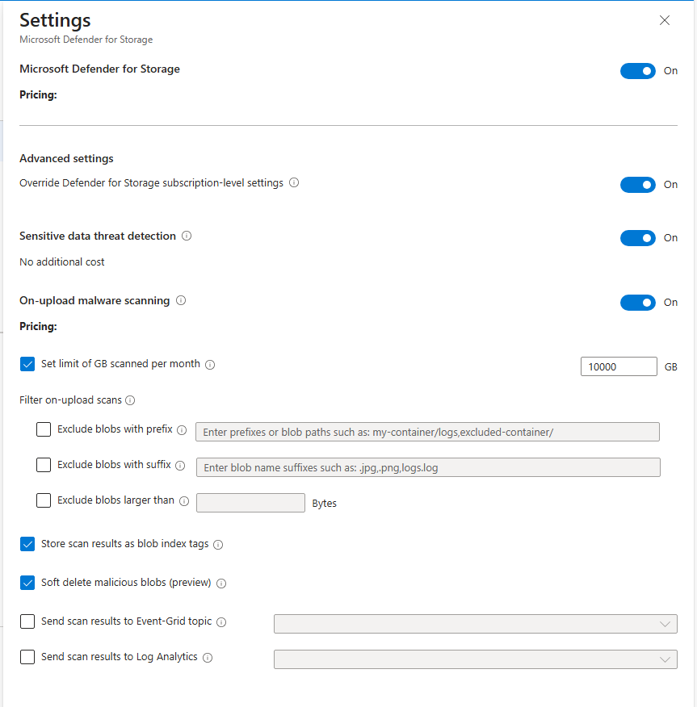
Security & Identity Updates
Automated Remediation for Malware Detection - Defender for Storage
Anytime that a blob is found malicious (malicious content was found in the blob), the Automated Remediation feature will kick in and soft-delete the blob.
As soon as you enable Automated Remediation for Malware Detection, at the subscription level or storage account level, under “Data Management”, two settings will get automatically configured:
Enable soft delete for blobs
Keep deleted blobs for (in days): 7 days (if this was not configured. If you had a different retention period, we will not modify it)
Enable soft delete for containers
Keep deleted containers for (in days): 7 days (if this was not configured. If you had a different retention period, we will not modify it)
This configuration will let you “undelete” or “recover” the deleted blobs.

Slide 9
Security & Identity Updates
Retirement: hsmPlatform 1 Keys in Azure Key Vault
As part of our ongoing commitment to improving security and performance, MS will be retiring support for hsmPlatform 1 keys, effective September 15, 2028.
To ensure the continued security and functionality of operations, MS recommends transitioning to hsmPlatform 2 keys as soon as possible.
Please note that:
Keys cannot be directly transferred from hsmPlatform 1 to hsmPlatform 2.

Slide 10
Management & Governance

Slide 11
Management & Governance Updates
Generally Available: High Scale mode for Azure Monitor – Container Insights
High scale mode is a feature in Container Insights that enables you to collect container console (stdout & stderr) logs with high throughput from your Azure Kubernetes Service (AKS) cluster nodes. This feature enables you to collect up to 50,000 logs/sec per node.
The following scenarios aren't supported:
Onboarding Azure Arc-enabled Kubernetes clusters
HTTP proxy with trusted certificate
Onboarding through Azure portal, Azure Policy, Terraform
Configuring through Monitor Settings in the AKS Insights portal experience
Automatic migration from existing Container Insights
Generally Available: At-cost data transfer between Azure and an external endpoint
Azure now offers at-cost transfer of data for customers and CSP partners in Europe transferring data via the internet between Azure to another data processing service provider. This applies to scenarios where multiple services of different providers are used in parallel, in an interoperable manner. Use the following steps to submit a request if you're transferring data in this manner.
This only applies to organizations with a billing address in the European Economic Area (EEA), European Free Trade Association (EFTA), or the United Kingdom
The at-cost data transfer only applies to Internet egress (routed via Routing preference transit ISP network) i

Slide 12
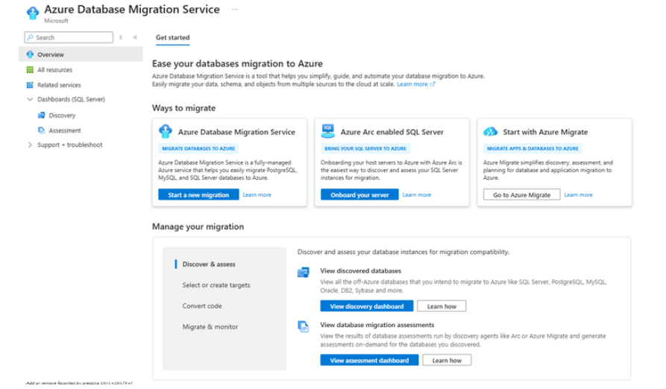
Management & Governance Updates
Announcing the Azure Database Migration Service Hub Experience
Azure Database Migration Service (DMS) Hub experience—a powerful new enhancement that simplifies how you view, manage, and track your SQL Server migration journey to Azure.

Slide 13
Management & Governance Updates
Retirement: Azure Kubernetes Service on VMware will be retired on March 16, 2026 - Replace with Azure Kubernetes Service on Azure Local
Azure Kubernetes Service on VMware (preview) will be retired on March 16, 2026. Please transition to a supported Azure Kubernetes Service on Azure Local by that date if needed.
MS encourage to transition to Azure Kubernetes Service on Azure Local before March 16, 2026, to benefit from its enhanced capabilities.
After March 16, 2026, you will no longer be able to deploy or receive support for Azure Kubernetes Service on VMware.

Slide 14
Compute

Slide 15
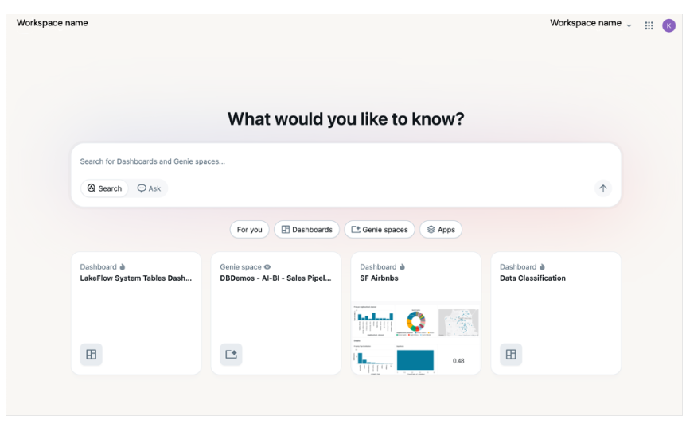
Compute Updates
Public Preview: Azure HBv5-series VMs
Azure HBv5-series VMs are now available in Preview in the Azure South Central US region.
HBv5 VMs are optimized for memory bandwidth-intensive HPC applications, such as computational fluid dynamics, automotive and aerospace simulations, weather modeling, energy research, molecular dynamics, computer-aided engineering, and more.
HBv5 VMs feature 6.7 TB/s of memory bandwidth across 450 GB (438 GiB) of memory (HBM) capacity. Also included are 368 4th Generation EPYC™ processor cores with a 3.5 GHz base frequency, 4 GHz boost frequency, and no simultaneous multithreading. HBv5-series VMs also provide 800 Gb/s of InfiniBand from NVIDIA Networking to enable supercomputer-scale MPI workloads, and 15 TiB of local NVMe SSD storage with up to 50 GB/s (reads) and 30 GB/s (writes) of block device performance.
Public Preview: Databricks One in Azure Databricks
Databricks One is a user interface designed for business users, giving them a single, intuitive entry point to interact with data and AI in Azure Databricks, without needing to navigate technical concepts such as clusters, queries, models, or notebooks.

Slide 16
Compute Updates
Public Preview: Azure Functions .NET 10 support
Azure Functions now supports .NET 10 in Public Preview. To use .NET 10, adjust the target framework in Functions project, and update references to Microsoft.Azure.Functions.Worker.Sdk to version 2.0.5 or later.
.NET 10 projects can be deployed to apps on both Linux and Windows. However, the Linux Consumption plan type is not yet supported. .NET 10 is only available to apps using the isolated worker model. If your app is still running on the legacy in-process model, migrate your application to the isolated worker model.
During the preview period, the latest preview version might not yet be available on Azure Functions right away. Please see the product documentation for the latest version available on the platform.
Public Preview: Azure Kubernetes Fleet Manager – update run approval gates
Azure Kubernetes Fleet Manager update runs now support approval gates. Gates can be placed before and after update groups and stages and provide additional control over the flow of the update run.
Gates allow to either manually approve the update run to continue or to integrate with other systems such as ticketing or health monitoring services to drive automated approvals.

Slide 17
Compute Updates
Public Preview: Azure Kubernetes Fleet Manager – auto-upgrade target Kubernetes version channel
Azure Kubernetes Fleet Manager has a new auto-upgrade channel that allows to set a target Kubernetes minor version. Using this channel means clusters on the target Kubernetes minor continue to receive only patch updates until the minor reaches the end of support.
This new auto-upgrade channel is equivalent to the AKS cluster patch channel and can be used with AKS long term support (LTS) clusters.
Introducing WireGuard In-Transit Encryption for AKS (Public Preview)
MS announced the public preview of WireGuard-based in-transit encryption in AKS, a new capability in Advanced Container Networking Services that enhances inter-node traffic protection with minimal operational overhead.
WireGuard is a modern, high-performance VPN protocol known for its simplicity, and robust cryptography. Integrated into the Cilium data plane and managed as part of AKS networking, WireGuard offers an efficient way to encrypt traffic transparently within your cluster.
With this new feature, WireGuard is now natively supported as part of Azure CNI powered by Cilium with Advanced Container Networking services, no need for third-party encryption tools or custom key management systems.
✅ Encrypted:
Inter-node pod traffic: Network communication between pods running on different nodes in the AKS cluster. This traffic traverses the underlying network infrastructure and is encrypted using WireGuard to ensure confidentiality and integrity.
❌ Not encrypted:
Same-node pod traffic: Communication between pods that are running on the same node. Since this traffic does not leave the node, it bypasses WireGuard and remains unencrypted.

Slide 18
Compute Updates
Public Preview: Azure Functions .NET 10 support
Azure Functions now supports .NET 10 in Public Preview. To use .NET 10, adjust the target framework in Functions project, and update references to Microsoft.Azure.Functions.Worker.Sdk to version 2.0.5 or later.
.NET 10 projects can be deployed to apps on both Linux and Windows. However, the Linux Consumption plan type is not yet supported. .NET 10 is only available to apps using the isolated worker model. If your app is still running on the legacy in-process model, migrate your application to the isolated worker model.
During the preview period, the latest preview version might not yet be available on Azure Functions right away. Please see the product documentation for the latest version available on the platform.

Slide 19
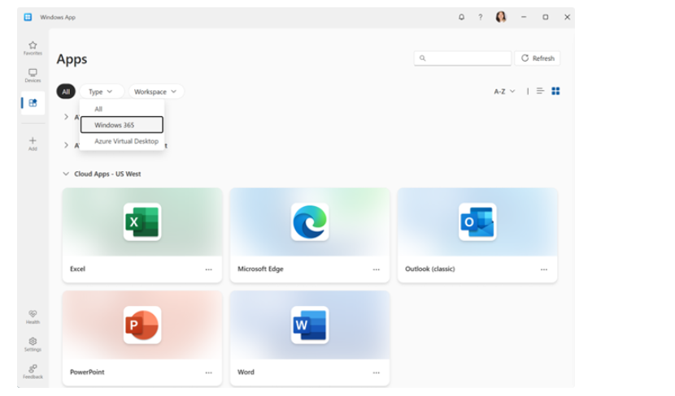
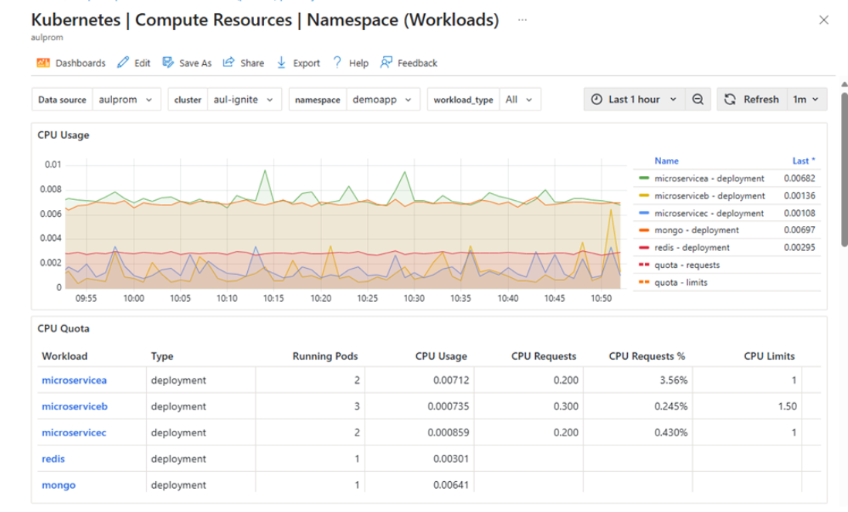
Compute Updates
Windows 365 Cloud Apps are now in public preview
Windows 365 Cloud Apps are now available to all customers during public preview.
Public Preview: Azure Managed Service for Prometheus now includes native Grafana dashboards within the Azure portal
Azure Managed Service for Prometheus now includes native Grafana dashboards within the Azure portal at no additional cost. This integration simplifies observability, reducing the administrative overhead and complexity compared to deploying and maintaining your own Grafana instances.
With this approach, no Grafana servers or additional Azure resources need to be provisioned or maintained. Teams can quickly leverage and customize Grafana dashboards within the Azure portal, reducing their deployment and management time while still gaining the benefits of dashboards and visualizations to improve monitoring and troubleshooting times.

Slide 20
Compute Updates
Generally Available: DCa/ECa v6 series AMD based confidential virtual machines (VMs)
Microsoft is announcing the general availability of the new DCa/ECa v6 series AMD-based confidential virtual machines (VMs) in the UAE North, Korea Central, West Central US, South Africa North, Switzerland North, and UK South regions with 4th generation AMD EPYC™ processors.
These VMs consist of our new general-purpose DCasv6-series and new memory-optimized ECasv6-series VMs. They offer better performance and better price-performance than our previous generation AMD-based confidential VMs, making them an attractive option for a wide range of workloads that involve the processing of sensitive data, such as PII and PHI.
Generally Available: AKS Automatic
Azure Kubernetes Service (AKS) Automatic offers an experience that makes the most common tasks on Kubernetes fast and frictionless, while preserving the flexibility, extensibility, and consistency of Kubernetes. Azure takes care of your cluster setup, including node management, scaling, security, and preconfigured settings that follow AKS well-architected recommendations. Automatic clusters dynamically allocate compute resources based on your specific workload requirements and are tuned for running production applications.
One-click, production-ready clusters
Intelligent autoscaling without manual tuning
Built-in best practices for security and reliability
Developer-friendly and fully extensible Kubernetes
A platform optimized for AI and cloud-native workloads
Open-source alignment

Slide 21
Compute Updates
Generally Available: Azure Container Storage v2.0.0 now with NVMe performance boost, open source, and no service fees
This release delivers up to 7× higher IOPS and 4× lower latency on local NVMe compared to v1.3.1, making Container Storage v2.0.0 the fastest storage available for Azure Kubernetes Service (AKS), now with zero service fees.
Included out of the box: This release focuses on local NVMe drives provided with select VM families, including storage-optimized L-series, GPU-enabled ND-series, and general-purpose Da-series.
Enhanced workload support: Optimized for demanding applications like PostgreSQL databases and KAITO-managed AI model serving
Superior performance: 7x improvement in read/write IOPS and 4x reduction in latency, with 60% better PostgreSQL transaction throughput
Open source: An alternative open-source version is available for easier installation on any Kubernetes cluster
Flexible scaling: Deploy on clusters with as few as one node, no minimum cluster size requirements
Zero service fees: Completely free to use for all storage pool sizes
Generally Available: Distributed tracing for Durable Functions
Distributed tracing V2 for Durable Functions introduces a robust and comprehensive tracing model that enables developers to correlate operations in orchestrations, activities, and durable entities. This capability is particularly useful for Durable Functions, which often span multiple services and systems.
With this release, distributed tracing V2 now supports:
All Durable Functions language SDKs
Traces for durable entities
Expanded trace span details for deeper insights into orchestration lifecycles and activity execution.
An Application Insights resource must be configured to collect and visualize trace data.

Slide 22
Compute Updates
Retirement: Azure Linux 2.0 on AKS
Azure Linux 2.0 on AKS will be retired on November 30, 2025, please transition to Azure Linux 3.0 by that date.
Azure Linux 2.0 has been replaced by the newer supported version Azure Linux 3.0. MS encourage to transition to Azure Linux 3.0 prior to the retirement date to experience the capabilities of Azure Linux 3.0 including kernel updates and security improvements.
From now to November 30, 2025, it is possible to use Azure Linux 2.0 without disruption. On November 30, 2025, Azure Linux 2.0 will no longer be supported on AKS; AKS will no longer create new node pools, produce new node images, or provide security updates for Azure Linux 2.0 after that date.
On March 31, 2026, Azure Linux 2.0 node images will be removed. This will cause scaling operations to fail.
Retirement: Licensing changes for future Azure VMware Solution subscriptions starting October 16, 2025.
Broadcom announced changes to their VMware licensing policies. The change now requires new customers to bring their own portable VCF subscriptions when using hyperscaler platforms. This is a licensing change only – there is no product change to the AVS service. Microsoft will continue to offer AVS as a fully managed VCF private cloud service in Azure.
What you need to know:
After October 15, 2025, new or existing customers purchasing new/additional nodes of AVS will need to provide a VCF subscription from Broadcom or one of its reseller partners.
For AVS with VCF included using an RI option: You can continue to operate the AVS nodes without any licensing or product changes through the end of the RI term.
If you would like to trade in your current AVS RI on or before October 15, 2025 for a new AVS RI that provides a later expiration date, you can leverage the self-service exchange process.
For AVS with VCF included PayGo subscriptions: Please contact your Microsoft Team for details & key dates for PayGo subscriptions.

Slide 23
Compute Updates
Retirement: Azure Databricks Standard tier will retire by October 2026
MS announced the retirement of Azure Databricks Standard Tier. Azure subscriptions will no longer support creation of Azure Databricks Standard Tier workspaces after April 1st, 2026.
Starting October 1st, 2026, all Azure Databricks Standard-tier workspaces will be automatically upgraded to Premium Tier.

Slide 24
Storage & Data

Slide 25
Storage & Data Updates
Generally Available: Azure File Sync in Poland Central and Spain Central
Azure File Sync enables seamless tiering of data from on-premises Windows Servers to Azure Files for hybrid use cases and simplified migration. It also enables to leverage the performance, flexibility and compatibility of on-premises File Server while leveraging the scale and cost effectiveness of Azure Files.
The expansion into Poland Central and Spain Central brings the service closer to organizations in these regions, offering lower latency, better performance, and support for local data residency requirements.
Generally Available: Azure Data Box Next Gen is now generally available in additional regions
Azure Data Box Next Gen is now Generally Available in NEW regions including: India, Qatar, South Africa and Korea.
With this new addition, we now have:
Both Azure Data box 120TB and 525 TB generally available (GA) in the US, UK, Europe, US Gov, Canada, Japan, Australia, Singapore, India and Qatar.
Azure Data Box 120TB is GA in Brazil, UAE, Hong Kong, Switzerland, Norway, South Arica and Korea.

Slide 26
Databases

Slide 27
Databases Updates
Introducing new update policy for Azure SQL Managed Instance
SQL Server 2025 update policy brings you the latest SQL engine innovation while retaining database portability to the new major release of SQL Server.
Update policy SQL Server 2025 benefit from all the SQL engine features that were gradually added to the Always-up-to-date policy over the past few years, and not available in the SQL Server 2022 update policy. Let’s name few most notable features, with complete list available in the update policy documentation:
Optimized locking
Mirroring in Fabric
Regular expression functions
Vector data type and functions
JSON data type and aggregate functions
Invoking HTTP REST endpoints

Slide 28
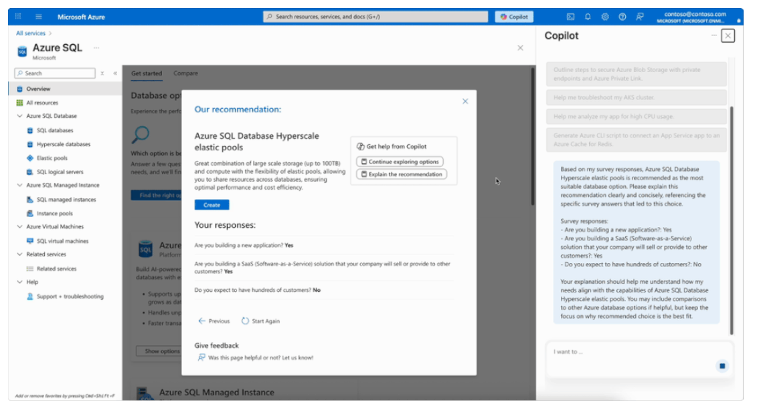
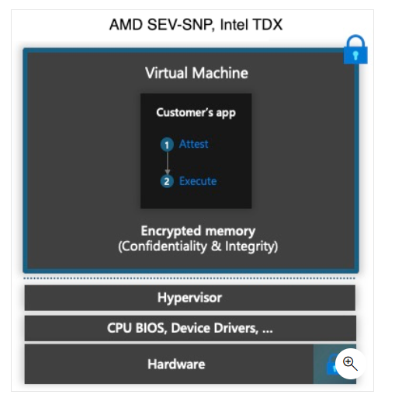
Databases Updates
Generally Available: Azure SQL hub experience in Azure portal
Azure SQL hub, a new home for everything related to Azure SQL in the Azure portal.
The hub helps find the right service quickly and decide, without disrupting existing workflows.
Generally Available: Confidential computing for Azure Database for PostgreSQL flexible server
Azure Confidential Computing encrypts data in hardware-based trusted execution environments (TEEs), processing data only when the cloud environment has been verified. When you deploy a flexible server instance on a supported confidential compute virtual machine, you can enhance the security of sensitive and regulated data, helping mitigate unwanted data access by cloud providers, administrators, or external users.

Slide 29
Information

Slide 30
Information
Azure Times GitHub Repo

Slide 31
Questions

