Slide 1
Azure Times #180
September 29, 2025

Slide 2
Networking

Slide 3
Networking Updates
Generally Available: Using Server-sent events with Application Gateway
Azure Application Gateway supports use of Server-sent events in general availability, enabling real-time data streaming from server to client. Server-sent events utilize server push technology on a persistent HTTP connection for seamless updates to the clients.
Azure DDoS Protection now supports QUIC protocol
QUIC was originally developed by Google and standardized by the IETF in 2021 (RFC 9000). Unlike traditional HTTP/2 over TCP, QUIC runs over UDP port 443, combining transport and security layers into a single handshake. This allows a secure, encrypted connection to be established in just one round trip — or even zero round trips for repeat connections.
Azure DDoS Protection now supports QUIC mitigation by default:
Protocol Compliance Validation
Initial Packet Verification
Source & Destination Rate Limiting
Global Limit IDs (GLID)
Retry Authentication
Packet Rate Limiting by Connection ID
Malformed Packet Filtering
Version Pinning
All existing Layer 4 protections for UDP traffic — such as flood detection, anomaly scoring, and adaptive thresholds — are fully applied to QUIC.

Slide 4
Security & Identity

Slide 5
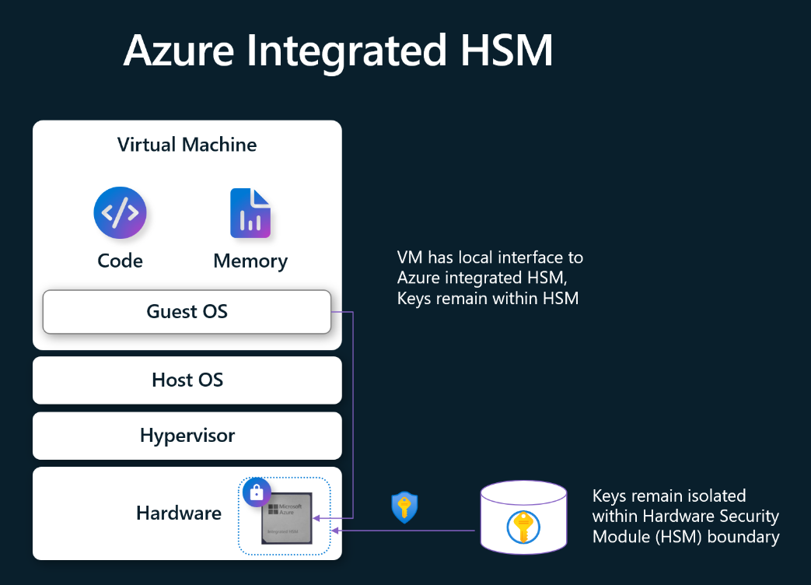
Security & Identity Updates
Microsoft Azure Introduces Azure Integrated HSM: A Key Cache for Virtual Machines
Azure Integrated HSM is hardware security module (HSM) cache and crypto offload designed to enhance the security and performance of cryptographic operations in virtual machines. Azure Integrated HSM protects keys and security assets while these assets are in-use. Azure Integrated HSM has specialized hardware cryptographic accelerators to perform encryption, decryption, signing, and verification operations while they remain within the bounds of the integrated HSM. Azure Integrated HSM eliminates the classic tradeoff between increased network round trip latency to remote HSM services or seeking the release of keys from the remote HSMs.
Azure Integrated HSM is now available to use in preview on the AMD v7 preview platform with support for general purpose Dasv7-series, Dadsv7-series, Easv7-series and Eadsv7-series for 8 vCores VMs and above. Use of this feature requires the VM to be launched with Trusted Launch enabled. The Azure Integrated HSM preview will initially have Windows support only, with Linux support coming soon. This feature will be offered at no additional cost.

Slide 6
Management & Governance

Slide 7
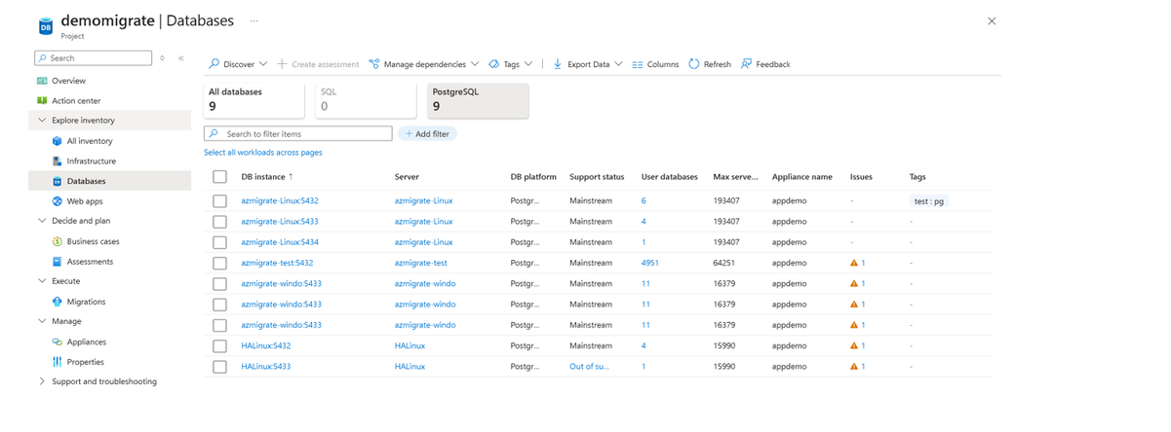
Management & Governance Updates
Public Preview: Discover and assess PostgreSQL in Azure Migrate
Azure Migrate now allows to discover and assess PostgreSQL resources across VMware, Hyper‑V, physical servers, and other cloud environments. Azure Migrate provides a centralized hub for discovering, assessing, and migrating on-premises assets—such as servers, databases, and web applications—hosted on physical or virtual environments to Azure targets at scale, including both platform as a service (PaaS) and infrastructure as a service (IaaS).
With the PostgreSQL discovery and assessment capability in Azure Migrate, it is possible to inventory PostgreSQL instances and their attributes, evaluate migration readiness for Azure Database for PostgreSQL flexible server, and receive recommendations on compute and storage options with detailed cost estimates.
Discover on-premises PostgreSQL deployments agentlessly, using lightweight Azure Migrate appliance—no need to install agents on each host
Identify installed applications and software running on server.
Use agentless dependency mapping to visualize application tiers and interdependent workloads that connect to PostgreSQL servers—helping ensure that no workload is left behind during migration.
Determine configuration details such as support status, PostgreSQL version, extensions, max server memory
Tag related workloads together such as define application etc.
Assess the readiness of PostgreSQL server for desired migration target, including configuration compatibility and supported extensions for
Modernize to Azure database for PostgreSQL - Flexible Server (PaaS)
Migration to Azure VM (IaaS)
Determine Azure compute SKU, storage SKU, its respective cost, migration blockers and migration guidance for each feasible migration target based on desired Azure region, environment, cost savings options and target service tier.

Slide 8
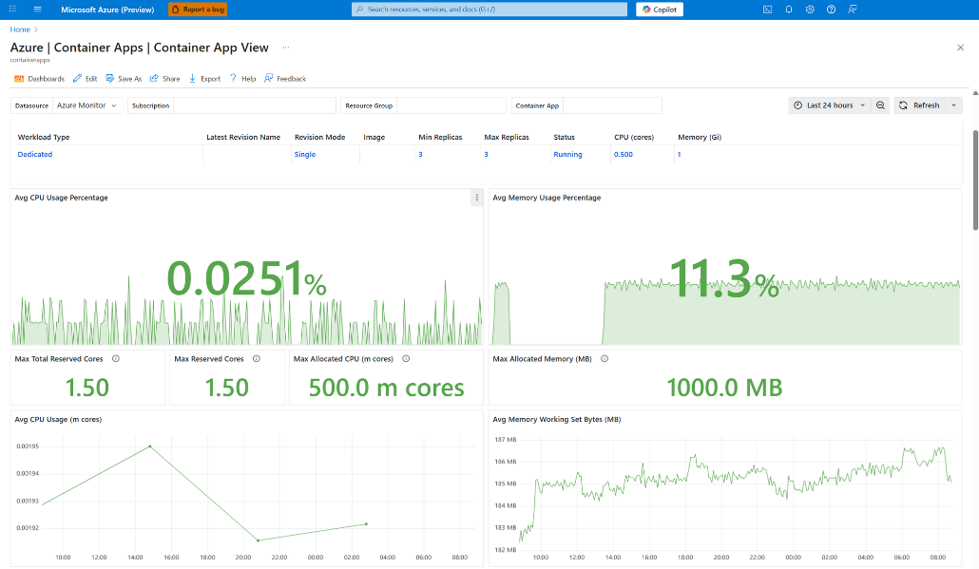
Management & Governance Updates
Grafana dashboards in Azure Container Apps (preview)
Azure Monitor Dashboards with Grafana provides prebuilt monitoring visualizations for Azure Container Apps. These dashboards are available directly within the Azure portal, with no extra setup or costs.
Integrated observability: Access powerful visualizations directly in the Azure portal
Centralized monitoring: View metrics for both individual apps and across your entire environment
Customizable views: Modify dashboards to meet your specific monitoring requirements
Grafana compatibility: Export and use dashboards with any Grafana instance
Secure sharing: Use Azure role-based access control (RBAC) to control dashboard access across your team

Slide 9
Management & Governance Updates
Generally Available: Delete on-demand backup in Azure DB for MySQL - Flexible Server
It is possible to manually trigger on-demand backups in Azure DB for MySQL - Flexible Server instead of solely relying on the system-initiated automated backups and schedule.
As part of this release, it will be also possible to delete on-demand backups that are no longer needed and get more control over backup management and storage costs.
Generally Available: Vaulted backup for Azure Files (Premium)
Azure Backup brings vaulted protection to Azure Files shares premium, to ensure business continuity and compliance, even in the face of accidental deletion, malicious activity, or ransomware. Vaulted backup provides a secure, off-site copy of data that’s independent of the source account.
Key capabilities of vaulted backups:
Off-site protection
Deletion and attack resilience
Automated and flexible backups
Long-term retention
Security-first design

Slide 10
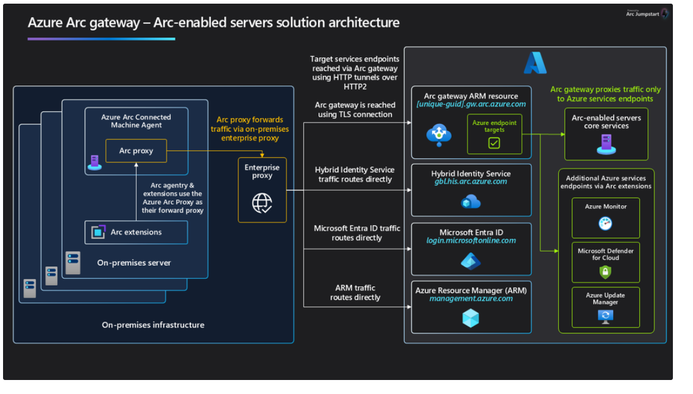
Management & Governance Updates
General Availability of the Azure Arc Gateway for Arc-enabled Servers!
Arc gateway dramatically simplifies the network configuration required to use Azure Arc by consolidating outbound connectivity through a small, predictable set of endpoints. For customers operating behind enterprise proxies or firewalls, this means faster onboarding, fewer change requests, and a smoother path to value with Azure Arc.
Customers previously had to allow 19 distinct endpoints. With Arc gateway GA, can do the same with just 7, a ~63% reduction that removes friction for security and networking teams.
Arc gateway introduces two components that work together to streamline connectivity:
Arc gateway (Azure resource): A single, unique endpoint in Azure tenant that receives incoming traffic from on‑premises Arc workloads and forwards it to the right Azure services.
Azure Arc Proxy (on every Arc‑enabled server): A component of the connected machine agent that routes agent and extension traffic to Azure via the Arc gateway endpoint. It’s part of the core Arc agent; no separate install is required.
At a high level, traffic flows: Arc agent → Arc Proxy → Enterprise Proxy → Arc gateway → Target Azure service.
As part of this GA release, common Arc‑enabled Server scenarios are supported through the gateway, including:
Windows Admin Center
SSH
Extended Security Updates (ESU)
Azure Extension for SQL Server

Slide 11
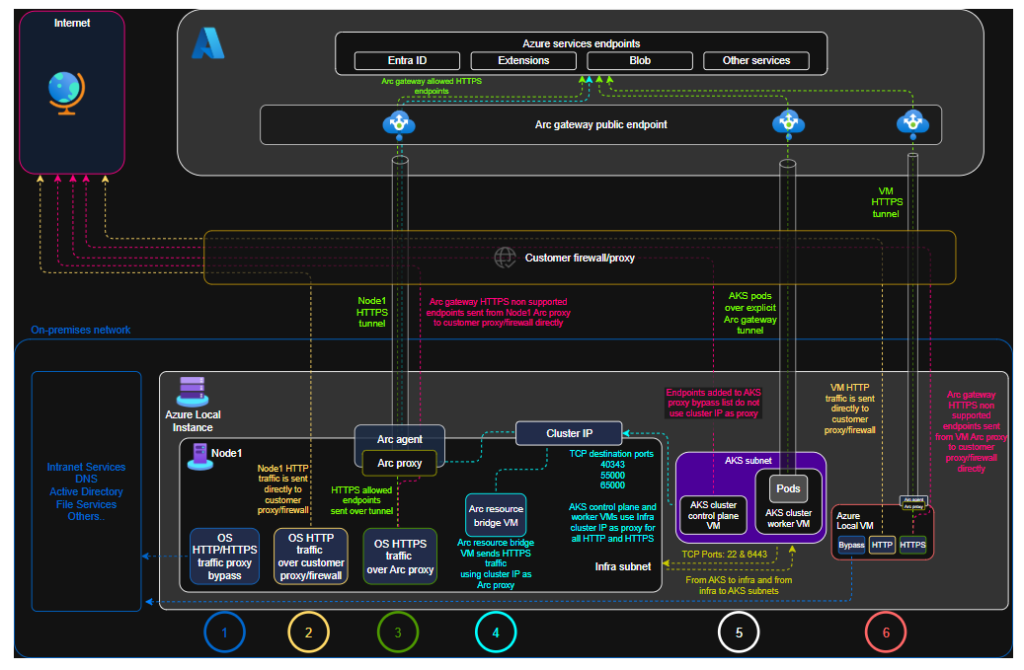
Management & Governance Updates
Announcing the General Availability of Arc Gateway for Azure Local
Azure Local with the Arc gateway simplifies and secures the connectivity of your on-premises servers to Azure. Instead of managing hundreds of firewall rules, you only need to allow fewer than 30 outbound connections. This significantly reduces administrative overhead, enhances security, and simplifies compliance with your organization's policies.
Generally Available: Azure Site Recovery Support for Virtual Machines with Premium SSD v2 disks
ASR provides seamless disaster recovery for Virtual Machines across Azure Regions and from on-premises to Azure, helping organizations maintain business continuity. It offers cost-effective replication, automated failover, and easy disaster recovery simulation, ensuring minimal production impact during disaster events. With built-in security, compliance support, and native integration with Azure services, ASR helps your organization stay resilient and minimize downtime.

Slide 12
Compute

Slide 13
Compute Updates
No in-place migration: It is not possible to directly convert ADE-encrypted disks to encryption at host. Migration requires creating new disks and VMs.
Linux OS disk limitation: Disabling ADE on Linux OS disks is not supported. For Linux VMs with ADE-encrypted OS disks, you must create a new VM with a new OS disk.
Windows ADE encryption patterns: On Windows VMs, Azure Disk Encryption can only encrypt the OS disk alone OR all disks (OS + data disks).
UDE flag persistence: Disks encrypted with Azure Disk Encryption have a Unified Data Encryption (UDE) flag that persists even after decryption. Both snapshots and disk copies using the Copy option retain this UDE flag. The migration requires creating new managed disks using the Upload method and copying the VHD blob data, which creates a new disk object without any metadata from the source disk.
Downtime required: The migration process requires VM downtime for disk operations and VM recreation.
Domain-joined VMs: If your VMs are part of an Active Directory domain, more steps are required:
The original VM must be removed from the domain before deletion
After creating the new VM, it must be rejoined to the domain
For Linux VMs, domain joining can be accomplished using Azure AD extensions
Retirement: Azure Disk Encryption
Azure Disk Encryption will be retired on September 15, 2028 and please transition to Encryption at Host by that date.
Alternate disk encryption solutions such as Encryption At Host and CVM OS disk encryption offer broader operating system support, improved performance, and better security.
Azure Disk Encryption (ADE) encrypts data within the VM using BitLocker (Windows) or dm-crypt (Linux), while encryption at host encrypts data at the VM host level without consuming VM CPU resources. Encryption at host enhances Azure's default server-side encryption (SSE) by providing end-to-end encryption for all VM data, including temp disks, caches, and data flows between compute and storage.
MS advice transition to Encryption at Host prior to the retirement date to experience the new capabilities of Encryption at Host including support for any operating system, custom disk images, and improved performance. Or consider switching to Confidential Virtual Machine sizes with OS disk encryption for confidential computing security benefits.

Slide 14
Compute Updates
Retirement: Azure App Service on Azure Arc enabled Kubernetes
Beginning on September 30th 2025, Azure App Service on Azure Arc-enabled Kubernetes will be retired, and it will no longer be possible to install the extension.
To continue to host application workloads, migrate to other solutions such as Azure Container Apps on Azure Arc enabled Kubernetes. Azure Container Apps on Azure Arc enabled Kubernetes also allows to take advantage of Logic Apps Hybrid for integration workloads.
Retirement: The Insights blade in AKS is now called Monitor
The Insights blade in AKS has been renamed to Monitor and relocated from the Monitoring section to the top level of the table of contents for increased visibility. You’ll continue to have access to the same monitoring data and features—there are no changes to functionality, just a more streamlined and unified navigation experience.

Slide 15
Compute Updates
Retirement: NVv3-series Azure Virtual Machines will be retired on September 30 ,2026
On September 30, 2026, Microsoft Azure will retire the Standard_NV12s_v3, Standard_NV12hs_v3, Standard_NV24s_v3, Standard_NV24ms_v3, Standard_NV32ms_v3, and Standard_NV48s_v3 virtual machines (VMs) in the NVv3-series virtual machines (VMs).
To avoid any disruptions to service, please change the VM sizing for workloads from the current NVv3-series VMs to the newer VM series in the same NV product line.
Retirement: The Linux Consumption hosting plan of Azure Functions will be retired on September 30, 2028. Migrate to Flex Consumption.
The Azure Functions Linux Consumption hosting plan is being retired. Migrate to Flex Consumption plan, which offers faster scaling, advanced networking, cold start mitigation, and concurrency control. To identify affected resources, check the Azure portal for App Service plans with Pricing Tier: Dynamic (Y1: 0) and Operating System: Linux. Key dates:
After September 30, 2025: No new features for Linux Consumption; it will be removed from the Azure Portal, Visual Studio, and VS Code, but can still be managed via infrastructure as code and Azure CLI.
After September 30, 2028: No technical support or ability to create new Linux Consumption function apps.

Slide 16
Compute Updates
Azure VMware Solution AV36 Node Retirement on June 30, 2028
Microsoft is announcing the retirement of the AV36 node type on June 30, 2028. The terms of your current AV36 Reserved Instance (RI) are not affected by this announcement.
Key dates for existing AV36 subscriptions with RIs:
October 15, 2025: Last day to buy a 1-year RI for AV36 (with VCF included)
June 30, 2026: Last day to buy a 1-year RI for AV36 VCF BYOL*
June 30, 2028: Retirement of AV36 and AV36 VCF BYOL
Please transition from AV36 nodes to a new AVS node type before the end of your current AV36 RI term.

Slide 17
Storage & Data

Slide 18
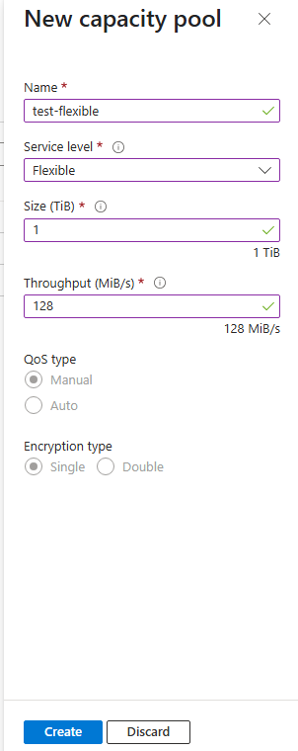
Storage & Data Updates
Generally Available: Azure NetApp Files Flexible service level
Flexible service level allows to independently configure storage capacity and throughput, optimizing costs and performance by right-sizing based on needs.
This new service level avoids overprovisioning by supporting a customizable throughput which could be up to five times that of the Ultra service level. This makes it ideal for demanding workloads (like Oracle or SAP HANA) offering higher throughput for smaller capacity pools, and for creating high-capacity volumes with low throughput needs. Right-sizing the throughput and capacity ensures flexibility and precise scaling to meet your price-performance requirements without the need for volume moves.
Flexible service level is supported with manual QoS capacity pools, where throughput can be adjusted between 128 MiB/s to 640 MiB/s per provisioned TiB. A baseline throughput of 128 MiB/s is provided for every pool irrespective of the size, at no additional cost.

Slide 19
Storage & Data Updates
Retirement: Upgrade BlobFuse v1 to latest version of Blobfuse v2
MS recommend upgrading from BlobFuse v1 to BlobFuse v2, as all future enhancements and innovations related to Azure Blob Storage file system access will be focused exclusively on BlobFuse v2. Please note that support for BlobFuse v1 will be discontinued effective September 2026.

Slide 20
Databases

Slide 21
Databases Updates
PostgreSQL 18 Preview on Azure Postgres Flexible Server
MS announced the preview release of PostgreSQL 18 on Azure Database for PostgreSQL!
Asynchronous I/O (AIO)
Vacuuming enhancements
Virtual generated columns
UUIDv7 support - Timestamp-ordered UUIDs improve index locality
B-Tree Skip Scan
Logical Replication & DDL
Preview limitations
Microsoft Entra ID authentication not yet available in preview (support coming soon).
Limited extension availability (see supported list).
Query store and index tuning not available.
Available only in East Asia region during preview.

Slide 22
ML & AI & IOT

Slide 23
ML & AI & IOT Updates
Generally Available: GitHub Copilot app modernization capabilities for Java and .NET are now available
App modernization is essential for enterprises to stay secure, scalable and innovative—but traditionally it requires a lot of effort that can be redundant and complex. These new capabilities include:
General availability of upgrade for .NET and Java: GitHub Copilot now uses AI to automate the upgrade process for Java and .NET applications. The AI agents in GitHub analyze codebase, detect breaking changes, suggest safe migration paths, and apply build fixes, CVE checks, and test validations with human in the loop throughout the entire process.
General availability of app modernization for Java, and Public Preview of app modernization for .NET: GitHub Copilot now streamlines end-to-end app modernization journey on Azure. The AI agents within GitHub Copilot analyze your application, identify dependencies, fix platform-specific issues, containerize the app, generate deployment artifacts, and deploy to Azure dev/test environments, all while aligning with your organization’s security and compliance standards.
Announcing GPT‑5‑Codex: Redefining Developer Experience in Azure AI Foundry
OpenAI’s GPT‑5‑Codex is generally available in Azure AI Foundry, and in public preview for GitHub Copilot in Visual Studio Code.
Next-level features for developers
Multimodal coding in a single flow: GPT-5-Codex accepts multimodal inputs including text and image.
Advanced tool use across various experiences
Code review expertise: GPT‑5‑Codex is specially trained to conduct code reviews and surface critical flows, helping developers catch issues early and improve code quality with AI-powered insights.

Slide 24
ML & AI & IOT Updates
Announcing the Grok 4 Fast Models from xAI: Now Available in Azure AI Foundry
grok-4-fast-reasoning and grok-4-fast-non-reasoning are now available in Public Preview in Azure AI Foundry

Slide 25
ML & AI & IOT Updates
Retirement: Entity Linking from Azure AI Language
Microsoft is announcing the planned retirement of Entity Linking from Azure AI Language. MS recommend considering a replacement solution; Named Entity Recognition from Azure AI Language also supports entity identification.
Microsoft will provide full support for all existing Entity Linking until September 8, 2028.

Slide 26
Information

Slide 27
Information
Azure Times GitHub Repo

Slide 28
Questions

