Slide 1
Azure Times #181
October 6, 2025

Slide 2
Networking

Slide 3
Networking Updates
Generally Available: New Health Check infrastructure for Azure Traffic Manager
Azure Traffic Manager has introduced new health check infrastructure to improve the resiliency and scalability of the service.
The rollout of the new probing infrastructure delivers improved horizontal scalability and better reliability for Traffic Manager health checks.
Health probes from the new infrastructure originate from updated IP addresses.

Slide 4
Networking Updates
Retirement: Azure VPN Gateway support for SSTP Protocol will be retired on March 31, 2027
Due to its limited scalability and suboptimal performance, support for SSTP will be phased out. MS strongly recommend transitioning to IKEv2 or OpenVPN, which offer significantly enhanced capabilities—including support for up to 10,000 connections and 10 Gbps aggregate throughput, depending on your gateway SKU.
Key dates:
Mar 31, 2026: Enabling SSTP protocol on VPN gateway will no longer be supported
Mar 31, 2027: Existing SSTP-enabled gateways can no longer be used to establish SSTP connections.

Slide 5
Security & Identity

Slide 6
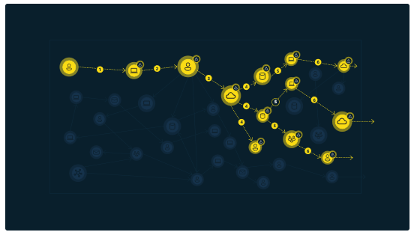
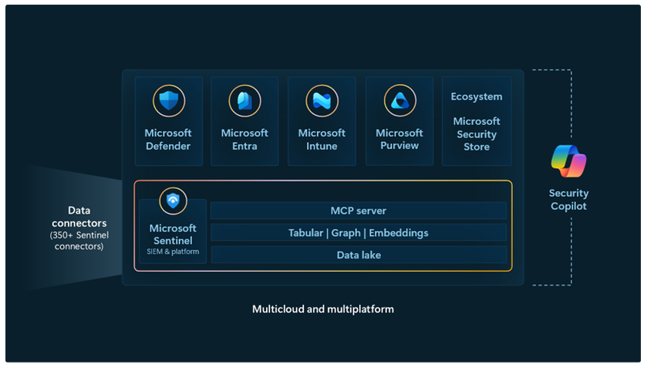
Security & Identity Updates
Announcing Microsoft Sentinel Model Context Protocol (MCP) server – Public Preview
Microsoft Sentinel MCP (Model Context Protocol) server, a fully managed cloud service built on an open standard that lets AI agents seamlessly access the rich security context in the Sentinel data lake.
Model Context Protocol (MCP) is a rapidly growing open standard that allows AI models to securely communicate with external applications, services, and data sources through a well-structured interface. Think of MCP as a bridge that lets an AI agents understand and invoke an application’s capabilities.
Introducing Microsoft Sentinel graph (Public Preview)
MS announced the public preview of Microsoft Sentinel graph, a deeply connected map of digital estate across endpoints, cloud, email, identity, SaaS apps, and enriched with our threat intelligence. Sentinel graph, a core capability of the Sentinel platform, enables Defenders and Agentic AI to connect the dots and bring deep context quickly, enabling modern defense across pre-breach and post-breach. Starting today, we are delivering new graph-based analytics and interactive visualization capabilities across Microsoft Defender and Microsoft Purview.

Slide 7
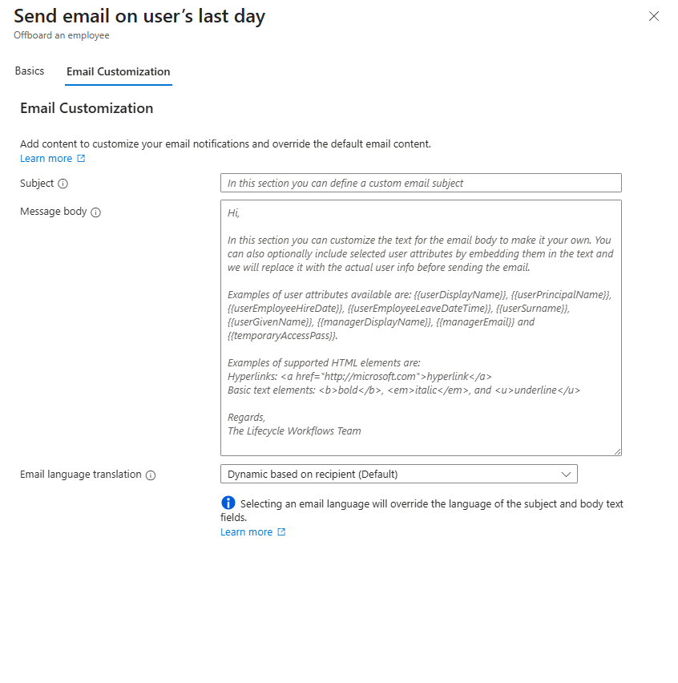
Security & Identity Updates
Public Preview - Basic HTML support in Lifecycle Workflow custom email notifications
Now it is possible further customize Lifecycle workflows email notifications to personalize, or emphasize, specific information using basic HTML elements. Email notifications can now be customized to include sending links using HTML hyperlinks and basic text formatting like bold, italics, and underline.
Public Preview - Global Secure Access Internet profile support for iOS client
MS announced the Internet Access support with iOS app. This feature protects access to the internet and SaaS apps with an identity-based Secure Web Gateway (SWG), blocking threats, unsafe content, and malicious traffic from the iPhones and iPads.
Global Secure Access client on mobile platforms requires no new agent installation/deployment for secure access to their resources, and uses existing MDE (Microsoft Defender for Endpoint) to route traffic through Microsoft SSE for both Microsoft 365, internet access and private access.

Slide 8
Security & Identity Updates
Public Preview - Trigger workflows for inactive employees and guests in Lifecycle Workflows
Lifecycle Workflows now enable customers to configure custom workflows to proactively manage dormant user accounts by automating identity lifecycle actions based on sign-in inactivity.
After detecting inactivity, the workflow automatically executes predefined tasks—such as sending inactivity notifications, disabling accounts, or initiating offboarding—for users that exceed the inactivity threshold. Admins can configure the inactivity threshold and scope, ensuring dormant accounts are handled efficiently and consistently - reducing security exposure, reducing license waste, and enforcing governance policies at scale.
Public Preview - Reprocess failed users and workflows in Lifecycle Workflows
Lifecycle Workflows now supports reprocessing of workflows to help organizations streamline the reprocessing of workflows when errors or failures are discovered. This feature includes the ability to reprocess previous runs of workflows, including failed runs or just runs that you might want to process again. Customers can choose from the following options to fit their needs:
Select specific workflow run to be reprocessed
Select which users from the workflow run to be reprocessed.

Slide 9
Security & Identity Updates
Public Preview - Delegate approvals in My Access
Users can now delegate access package approvals in My Access. Approvers can assign another individual to respond to access package approval requests on their behalf. The original approvers can still respond to their approvals during the delegation period.
Delegation is limited to one level. If User A delegates to User B, and User B delegates to User C, User C won't receive approvals from User A.
Delegation isn't restricted. Any user can be selected as a delegate.
Delegation applies only to approvals assigned after the delegation is configured.
Public Preview - Use SMS as a verification method in password reset flows in Microsoft Entra External ID
MS announced the public preview of SMS for self-service password reset (SSPR) in Microsoft Entra External ID. This change is actively rolling out to all tenants in production by the end of October.
SMS Authentication for Password Reset
Enhanced Security
Fraud Protection
Billing

Slide 10
Security & Identity Updates
Introducing Microsoft Security Store
Microsoft Security Store - a storefront designed for security professionals to discover, buy, and deploy security SaaS solutions and AI agents from our ecosystem partners such as Darktrace, Illumio, and BlueVoyant. Security SaaS solutions and AI agents on Security Store integrate with Microsoft Security products, including Sentinel platform, to enhance end-to-end protection. These integrated solutions and agents collaborate intelligently, sharing insights and leveraging AI to enhance critical security tasks like triage, threat hunting, and access management.

Slide 11
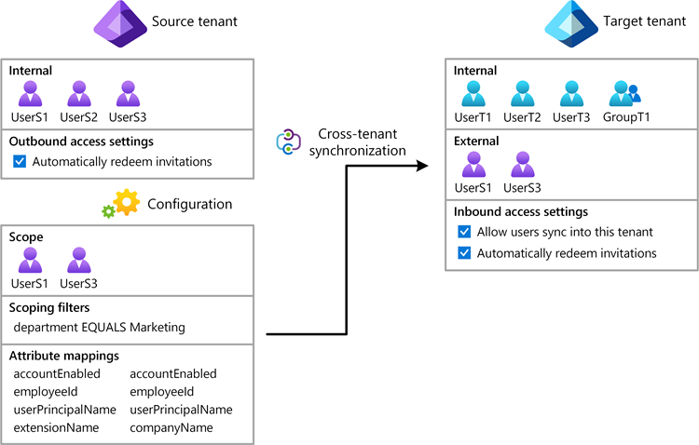
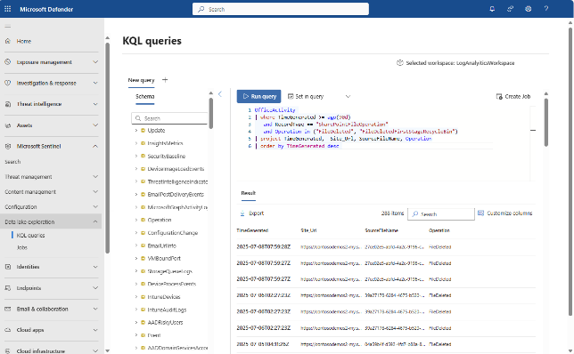
Security & Identity Updates
Microsoft Sentinel data lake is now generally available
Microsoft Sentinel data lake is a purpose-built, cloud-native security data lake that transforms how organizations manage and analyze security data. Designed as a true data lake, it ingests, stores, and analyzes large volumes of diverse security data at scale. By centralizing security data into a single, open-format, extensible platform, it provides deep visibility, long-term retention, and advanced analytics.
The Microsoft Sentinel data lake is fully managed and provides a unified data platform for end-to-end threat analysis and response. It stores a single copy of security data across assets, activity logs, and threat intelligence in the lake and leverages multiple analytics tools like KQL and Jupyter notebooks for deep security analytics.
General Availability - Cross-tenant synchronization (cross-cloud)
Automate creating, updating, and deleting users across tenants across Microsoft clouds. The following combinations are supported:
Commercial -> US Gov
US Gov -> Commercial
Commercial -> China

Slide 12
Security & Identity Updates
Retirement - Microsoft Authentication Library to MSAL Recommendations API
MS is retiring the ADAL to MSAL Recommendations API on December 15, 2025.
To continue monitoring authentication library usage, customers can query sign-in logs manually via Microsoft Graph API. The relevant data is available in the authenticationProcessingDetails field under the key "Azure AD App Authentication Library".

Slide 13
Management & Governance

Slide 14
Management & Governance Updates
Announcing General Availability of Azure Local on Microsoft Azure Government Cloud
MS announced that Azure Local is now generally available for Azure Government customers. Building on the momentum from public preview, Azure Local is ready for production deployments, enabling government organizations to run cloud-connected infrastructure at their own physical locations under their operational control and helps them align compliance with stringent regulatory and security requirements.
Generally Available: Visualize New Azure Resource Manager Metrics through Azure Monitor
MS Announced that Azure Resource Manager now offers enhanced integration with Azure Monitor Metrics!
It is now possible to access traffic, latency, and throttling insights by choosing the Azure Resource Manager metric in Azure Monitor.
New Dimensions Available:
Operation type: By high customer demand, you can now distinguish between different operation categories (read, write, delete)!
ARM request region: Identify where requests originate and monitor regional trends.
HTTP method: Break down metrics by request type (GET, POST, etc.).
HTTP status code: Track specific response codes for better troubleshooting.
HTTP status code class: Group responses by class (2xx, 4xx, 5xx) for high-level insights.
Resource type: Filter metrics by the type of Azure resource.
RP namespace: Analyze metrics by resource provider namespace.

Slide 15
Management & Governance Updates
Retirement: Azure Monitor SCOM Managed Instance will be retired on Sep 30, 2026
Azure Monitor SCOM Managed Instance is no longer in support and is planned to be deprecated by 30 September 2026.
MS recommend Azure Monitor or System Center Operations Manager as an alternative solution, based on your requirements.

Slide 16
Compute

Slide 17
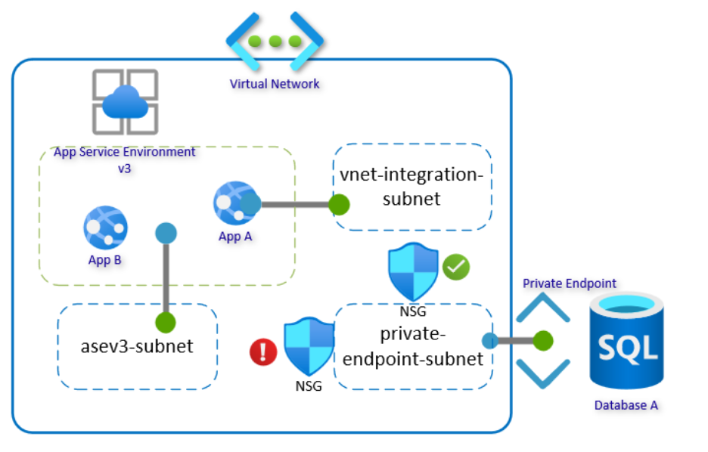
Compute Updates
Public Preview: Soft Delete feature in Azure Compute Gallery
The Soft Delete feature in Azure Compute Gallery lets recover accidentally deleted images within a 7-day retention period. After this timeframe, the platform permanently deletes the resources. This grace period gives users time to restore any images that were mistakenly deleted.
imitations
Soft Delete is only supported in the Azure portal or Rest API with some limitations.
Virtual Machine Apps Recovery isn't supported.
Deleting a gallery or image definition with Soft Deleted resources isn't supported.
Not supported in National Clouds.
You can't enable Soft Delete if the gallery or image definition and image version are in different locations.
Virtual Machine Scale Sets in Flexible orchestration aren't compatible with the Soft Delete feature.
Announcing Public Preview: ASEv3 Outbound Network Segmentation
Outbound Network Segmentation allows you to define and control how outbound traffic is routed from App Service Environment v3 apps. This means you can now segment outbound traffic at an app level, enabling fine-grained egress control that aligns with enterprise security policies and compliance requirements.
Previously, all outbound traffic from an App Service Environment v3 originated from the full subnet range hosting the App Service Environment, making it difficult for networking teams to apply per-app restrictions, like what is available with the multi-tenant App Service offering.
Enabling this feature on existing App Service Environments is not supported.

Slide 18
Compute Updates
Azure Virtual Desktop support for external identities, without FSLogix (preview)
Azure Virtual Desktop support for external identities, without FSLogix (preview)
It is now possible to provide Azure Virtual Desktop resources for an external identity. There is no change to the administrative flow to assign the resources, as you still assign the user to the app group. There are some requirements and limitations.
Global expansion of TURN Relay
Microsoft has expanded the TURN relay infrastructure globally, deploying it across 39 Azure regions with a dedicated IP range of 51.5.0.0/16 for Azure Virtual Desktop and Windows 365. This transition from the previously shared 20.202.0.0/16 subnet enhances RDP Shortpath for Public Networks, offering improved performance, reliability, and user experience.
Managed identity support for all host pools using session host configuration and cross-subscription image support
Windows 365 support for external identities (preview)
It is now possible to provision a Cloud PC for an external identity. There is no change to the administrative flow to provision this Cloud PC, as it follows the same provisioning flows for both Enterprise and Frontline Cloud PCs.

Slide 19
Compute Updates
Generally Available: CLI command for migration from Availability Sets and basic load balancer on AKS
Availability Sets and the basic load balancer are being deprecated on September 30 2025. AKS now supports, a simple Azure CLI command that will automatically migrate your AKS cluster from Availability Sets to the new Virtual Machines node pool and upgrade your load balancer SKU from basic to standard in one operation.
The minimum Kubernetes version for this script is 1.27
You need the version 2.76.0 Azure CLI installed.
If the cluster is running Key Management Service with private key vault, Key Management Service must be disabled for the duration of the migration.
If the cluster is using any ValidatingAdmissionWebhooks or MutatingAdmissionWebhooks, these web hooks must be disabled before the migration.
Announcement: Upcoming Changes to SQL Server on Linux Virtual Machine (VM) Provisioning in Azure
Linux-based SQL Server Virtual Machine (VM) images published by Microsoft will be removed from the Azure Marketplace.
As a result, these SQL Server on Linux images will no longer be visible in the Azure SQL hub during VM provisioning, nor accessible via CLI, Azure Portal, or PowerShell scripts.
MS is transitioning away from image-based provisioning to a script-based model that offers greater flexibility, automation, and control. This fresh approach will allow customers to:
Choose their preferred supported Linux distribution (RHEL, SLES or Ubuntu (Pro))
Select SQL Server version and edition
Configure licensing options
Customise deployment parameters through scripts and ability to add VM extensions.
This shift ensures a more consistent and extensible experience across all supported platforms.

Slide 20
Compute Updates
Retirement: Azure Network Policy Manager (NPM) for Linux nodes on AKS to Be Retired by September 30, 2028
On September 30, 2028, MS will end support for Azure Network Policy Manager (NPM) on Linux nodes in AKS.
Transitioning to Cilium Network Policy for AKS clusters using Azure CNI powered by Cilium provides significant improvements, including:
Robust support for Kubernetes-native policies.
Powerful extended features such as Layer 7 policy, and Fully Qualified Domain Name filtering.
eBPF-based architecture for packet processing, offering better performance, scalability and security.
Retirement: Support for Service Connector (preview) on Azure Container Apps will end on March 30th, 2026
Support for Service Connector (preview) on Azure Container Apps will end on March 30, 2026.
After this date, Service Connector (preview) will no longer be supported on Azure Container Apps.
If you created service connections using the Azure Portal, your existing connections will remain active and unaffected. If you used the Azure CLI, SDKs, or Visual Studio, your existing connections may require updates or migration. You will no longer be able to create new service connections using Service Connector (preview) through any interface for Azure Container Apps.

Slide 21
Compute Updates
Retirement: NVv4-series Azure Virtual Machines will be retired on September 30, 2026
On September 30, 2026, Microsoft Azure will retire the Standard_NV4as_v4, Standard_NV4ahs_v4,Standard_NV8as_v4, Standard_NV8ahs_v4,Standard_NV16as_v4, Standard_NV16ahs_v4, Standard_NV32as_v4, and Standard_NV32ahs_v4 virtual machines (VMs) in the NVv4-series virtual machines (VMs).
Microsoft is recommending the Azure NVads_V710_v5-series VMs, which offer greater GPU memory bandwidth per GPU. These VMs are targeted for graphics applications, virtual desktops, and visualizations as well as small AI inference workloads.
Retirement: Azure Static Web Apps database connection feature
Due to changes in underlying infrastructure, the database connections feature of Static Web Apps this feature (currently in public preview), will be deprecated effective November 30, 2025. To avoid issues in deployments using this feature you can refactor your application to a self-hosted instance of the Data API Builder and deploy that to Azure Container Apps.

Slide 22
Storage & Data

Slide 23
Storage & Data Updates
Public Preview: Azure NetApp Files Support for OpenLDAP, FreeIPA, and Red Hat Directory Server LDAP services
Azure NetApp Files now supports integration with FreeIPA, OpenLDAP, and Red Hat Directory Server—available in public preview. This LDAP integration enables secure LDAP over TLS connectivity for NFSv3 and NFSv4.1 volumes, allowing enterprises to use these identity systems alongside Microsoft Active Directory.
This enhancement offers seamless integration with existing infrastructure and secure access control for NFS workloads. It’s especially valuable for hybrid environments and regulated industries.
Key Benefits:
Support for FreeIPA, OpenLDAP, and Red Hat Directory Server in addition to Active Directory.
Secure LDAP over TLS for NFSv3/NFSv4.1.
Seamless integration with existing identity infrastructure.
Greater flexibility for hybrid and compliance-driven environments.

Slide 24
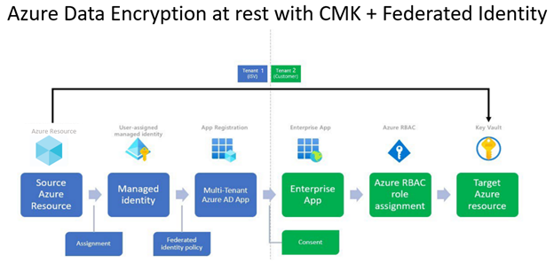
Storage & Data Updates
Generally Available: Cross-tenant customer-managed keys for Azure NetApp Files volume encryption
Cross-tenant customer-managed keys (CMK) for Azure NetApp Files volume encryption allows service providers based on Azure to offer customer-managed key encryption. In the cross-tenant scenario, the NetApp account resides in a tenant managed by an independent software vendor, while the key used for encryption of volumes in that NetApp account resides in a key vault in a tenant that you manage.

Slide 25
Storage & Data Updates
Retirement: General Purpose v1 (GPv1) and legacy blob storage accounts
The following account types will be retired:
General purpose v1 (GPv1) storage accounts (all redundancy options)
Legacy blob storage accounts.
Files storage accounts hosted on GPv1.
Customers are encouraged to migrate to General Purpose v2 (GPv2) or specialized alternatives such as BlockBlobStorage or FileStorage, depending on workload requirements.
October 13th, 2026: Final retirement. All remaining GPv1 accounts will be transitioned to GPv2.

Slide 26
Databases

Slide 27
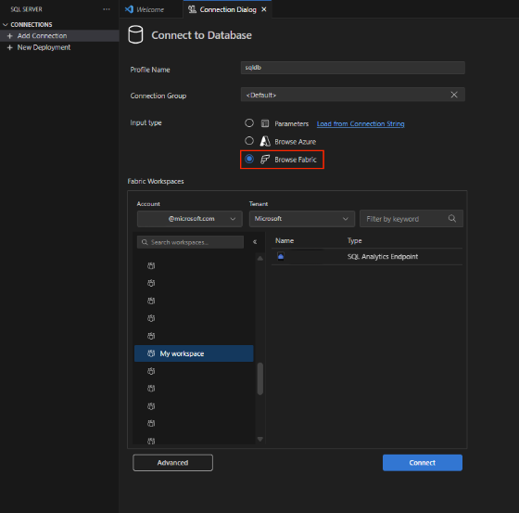
Databases Updates
Public Preview: Azure SQL updates for late September 2025
Backup immutability ensures that long-term retention (LTR) backups of an Azure SQL Database are stored in a Write Once, Read Many (WORM) state, making them non-modifiable and non-erasable for a user-defined retention period. Backup immutability provides robust protection against accidental or malicious deletion or modification—even by privileged administrators.
When immutability is enabled, the backups are written to Azure immutable storage. Azure immutable storage meets all the regulatory compliance requirements, as validated by Cohasset.
Azure SQL Database LTR backups supports two types of immutabilities:
Time-based immutability is enabled at the policy level. Once the time based immutability is enabled and locked, any new LTR backups taken from that point forward inherit these settings, and the backups remain immutable until the end of the configured retention period
Legal hold immutability is a type of immutability that can be enabled or disabled on a specific existing backup, independent of any existing time based immutability.
Public Preview: MSSQL extension integration with Microsoft Fabric
The MSSQL extension for Visual Studio Code (VS Code) now brings SQL database in Fabric directly into the development workflow. With the new Fabric connectivity option in the Connection Dialog, you can sign in using Microsoft Entra ID, browse your Fabric workspaces in a familiar tree view, search across them, and connect to SQL databases or endpoints—all without juggling connection strings. The experience is designed to feel native to Fabric users, with persistent sign-ins, tenant switching, and a seamless “Open in MSSQL” flow from the Fabric extension.
MS also introducing an SQL database in Fabric provisioning directly from VS Code.

Slide 28
Databases Updates
Oracle Database@Azure now supports Oracle Database 19c on Exadata Exascale and New UAE Regions
Oracle Database 19c Now Supported on Exadata Database Service on Exascale Infrastructure on Oracle Database@Azure
Migrate without delay – Move existing 19c workloads to Azure using Exadata Database Service on Exascale Infrastructure without immediately needing to upgrade to 23ai.
Optimize costs and performance – Take advantage of Exascale Infrastructure to realize performance benefits and granularly scale for mission-critical workloads.
Prepare for the future – Modernize now on Exascale, while maintaining a clear path to upgrade when business priorities allow.
New Regional Availability: UAE North and UAE Central

Slide 29
ML & AI & IOT

Slide 30
ML & AI & IOT Updates
Public Preview of the Azure SRE Agent
Azure SRE Agent is now available in public preview for everyone instantly – no sign up required.
Azure SRE Agent Preview is an AI-powered reliability assistant that helps teams diagnose and resolve production issues, reduce operational toil, and lower mean time to resolution (MTTR).
Incident Automation
Customizable incident handling
Explainable RCA
Dev work item creation
Natural language insights
Introducing the Microsoft Agent Framework
The Microsoft Agent Framework, now in public preview, is the open-source SDK and runtime that simplifies the orchestration of multi-agent systems. It converges AutoGen, a former Microsoft Research project, and the enterprise-ready foundations of Semantic Kernel into a unified, commercial-grade framework—bringing cutting-edge research to developers.
AutoGen’s simplicity in multi-agent orchestration.
Semantic Kernel’s robustness in thread-based state management, telemetry, and type safety.
New capabilities like graph-based workflows, checkpointing, and human-in-the-loop support
This convergence means developers no longer have to choose between experimentation and production. The Agent Framework is designed to scale from single-agent prototypes to complex, enterprise-ready systems

Slide 31
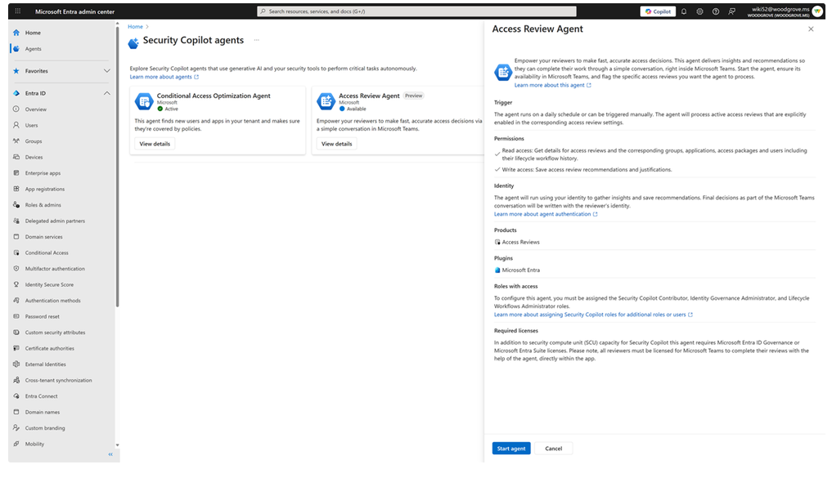
ML & AI & IOT Updates
Security Copilot support for Access Review in Microsoft Entra—now in public preview.
Access reviews received a major upgrade. With the introduction of the Microsoft Security Copilot Access Review Agent in Microsoft Entra, MS bringing the power of AI directly into the heart of access governance. No more static lists or disconnected portals—reviewers are guided through decisions in a natural, conversational flow right inside Microsoft Teams.

Slide 32
ML & AI & IOT Updates
Retirement: Spark Native Connector for Semantic Link
Starting October 1, 2025, the Spark native connector will be officially retired. This decision is based on internal analysis indicating low usage, high maintenance costs, and potential security vulnerabilities. To ensure continued support and improved security, MS recommend transitioning to the Semantic Python SDK, which offers comparable functionality and enhanced support.
Retirement: Azure Machine Learning - Data labeling Deprecation
On September 30, 2026, Azure Machine data labeling will be retired. Please transition to 3rd-party data labeling providers by 30 September 2026.
From today to September 30, 2026, you can continue to use data labelling without disruption. On September 30, 2026 workloads running data labelling will be deleted and associated application data will be lost.

Slide 33
Information

Slide 34
Information
Azure Times GitHub Repo

Slide 35
Questions

