Slide 1

Azure Times #214
July 13, 2026

Slide 2

Networking

Slide 3
Networking Updates (Preview)
Public Preview: Exceptions in WAF for Azure Application Gateway and Azure Front Door
Azure Web Application Firewall (WAF) helps protect your web applications from common threats and attacks. In some cases, WAF may block requests that are safe and expected for your application. Existing exclusions help reduce false positives by omitting specific request attributes, such as headers, cookies, query string arguments, or body fields, from WAF evaluation while the rest of the request continues to be inspected.
Exceptions provide additional flexibility by allowing specific requests to bypass WAF inspection at the rule, rule group, or managed ruleset level. Exceptions can be defined using request URI, remote IP address, or request header name and value, helping customers tune WAF policies more precisely while keeping other protections active.
To configure Exceptions, navigate to your WAF policy in the Azure portal, select Managed rules, and then add an exception.

Slide 4

Security & Identity

Slide 5
Security & Identity Updates (Preview)
External key management for Azure Managed HSM is now in public preview
Azure Managed HSM now supports External Key Management (EKM) in public preview, allowing organizations to use keys stored in Azure Managed HSM from applications and services that support the standard EKM interface. This enables enterprises to centralize encryption key management while integrating with existing databases and applications that require external key providers.
The feature is particularly valuable for Microsoft SQL Server and other EKM-enabled workloads, allowing encryption keys to remain securely protected within a FIPS 140-2 Level 3 validated Managed HSM while being accessed by supported applications for encryption operations. Organizations benefit from centralized key lifecycle management, auditing, role-based access control, and hardware-backed protection without changing their existing encryption architecture.
By introducing EKM support, Azure Managed HSM expands its enterprise cryptographic capabilities and simplifies migration of security-sensitive workloads to Azure. This enhancement helps organizations strengthen compliance, improve key governance, and consolidate encryption key management across hybrid and cloud environments.

Slide 6

Management &
Governance

Slide 7
Management & Governance Updates (Preview)
Public Preview: Export historical data from Log Analytics workspace with Export jobs
The Log Analytics Export job enables to export historical data from a Log Analytics workspace to an Azure Storage account based on a specified query and time range. This allows to extract only the data you need and move it to external systems for further processing or long-term retention.
Key scenarios include:
Compliance and audit – Export data from specific time periods to support audit requests, legal holds, and regulatory requirements.
Security investigations – Extract relevant datasets for forensic analysis or integration with third-party SIEM solutions.
Advanced analytics and machine learning – Use exported datasets to build and train models in external environments.
Business intelligence and reporting – Combine exported logs with other data sources to enable reporting and analytics across your organization.
Data migration – Move data out of Log Analytics for use in other platforms or long-term storage.

Slide 8
Management & Governance Updates (General Available)
Generally Available: Support 5x churn in Azure Site Recovery
Azure Site Recovery now supports up to 5x churn (500 MB/s per VM). This major enhancement empowers customers to confidently run high IOPS workloads with Azure Site Recovery, ensuring robust disaster recovery for even the most demanding applications like databases, big data and analytics systems, etc.

Slide 9

Compute

Slide 10
Compute Updates (Preview)
Announcing Flat File Schema Generation support in Azure Logic Apps Standard
Azure Logic Apps Standard now supports automatic flat file schema generation, simplifying the integration of legacy systems that exchange fixed-width or delimited text files. Instead of manually creating XML Schema (XSD) definitions, developers can generate flat file schemas directly from sample files, significantly reducing the effort required to onboard new integrations.
The generated schemas can be used with Logic Apps' built-in Flat File Encoder and Decoder actions, enabling seamless transformation between flat files and XML within integration workflows. This accelerates development for enterprise integration scenarios involving EDI, ERP systems, mainframes, banking, manufacturing, and other legacy applications that rely on flat file formats.
By automating schema generation, Azure Logic Apps reduces development time, minimizes manual errors, and simplifies modernization of business integration solutions. For organizations migrating legacy integration workloads to Azure, this capability makes it faster and easier to build reliable, cloud-native workflows while maintaining compatibility with existing flat file-based systems.

Slide 11
Compute Updates (General Available)
Generally Available: Azure Red Hat OpenShift in Chile Central
Azure Red Hat OpenShift (ARO) is now generally available in Azure Chile Central, expanding regional availability for OpenShift deployments across South America. With the launch of Microsoft’s first Azure region in Chile, customers can now run fully managed OpenShift clusters closer to their users and data, improving performance and reducing latency for cloud-native applications.
This new region enables organizations to deploy Kubernetes-based workloads while meeting local data residency and regulatory requirements. Built with multiple availability zones, Chile Central supports resilient, production-grade architectures for mission-critical applications running on ARO. Customers can take advantage of consistent OpenShift operations across hybrid and multi-cloud environments, while benefiting from Azure-native integration and enterprise-grade support.
The availability of ARO in Chile Central provides a strong foundation for regulated industries and enterprises that require in-country infrastructure. It also supports modern application development patterns, including AI-enabled and data-intensive workloads, with improved proximity, control, and scalability.
Generally Available: Confidential Computing support for Azure Event Hubs Dedicated
Azure Event Hubs Dedicated now supports Confidential Computing, enabling organizations to protect streaming data while it is being processed in memory. By leveraging hardware-based trusted execution environments (TEEs), customers can help safeguard sensitive event-streaming workloads against unauthorized access, including access to data in use.
This capability is designed for organizations with heightened security, privacy, and compliance requirements, allowing them to process highly sensitive streaming data with additional protection throughout the data lifecycle. Confidential Computing support for Event Hubs Dedicated helps customers strengthen their security posture while maintaining the scale and performance benefits of a dedicated Event Hubs environment.
This feature is available for Azure Event Hubs Dedicated customers.

Slide 12
Compute Updates (General Available)
Enhanced host pool management for Azure Virtual Desktop is now generally available
MS announced the general availability of enhanced host pool management for Azure Virtual Desktop. Enhanced host pool management includes:
Session host configuration and update
Dynamic autoscale
Ephemeral OS disks
These features make it easier than ever to manage secure, reliable, and efficient virtual environments while saving time and achieving cost-effective scalability.
RDP Multipath with redundant TCP is now generally available for Windows 365 and AVD
RDP Multipath with Redundant TCP is now generally available for Windows 365 and Azure Virtual Desktop (AVD), improving the reliability and resilience of Remote Desktop Protocol (RDP) connections. The feature establishes multiple simultaneous TCP connections between the client and the remote session, allowing active sessions to continue seamlessly if one network path experiences packet loss, congestion, or temporary interruption.
This enhancement delivers a more stable user experience, particularly for users on Wi-Fi, mobile broadband, VPNs, or other unreliable networks, by reducing session freezes, reconnects, and connection drops. Because the capability is built into the RDP protocol, users benefit automatically without requiring application changes.
For organizations deploying Windows 365 Cloud PCs and Azure Virtual Desktop, RDP Multipath improves the performance and availability of remote desktop sessions while reducing support incidents caused by network instability. This strengthens Microsoft's remote work platform by providing more resilient connectivity for business-critical virtual desktop environments.

Slide 13
Compute Updates (General Available)
Retirement: Support for Python-2.7; 3.8 and PowerShell- 7.1; 7.2 will be retired on September 30, 2026
Starting October 1, 2026, the specified runtime versions Python 2.7, Python 3.8, and PowerShell 7.1 & 7.2. will no longer be supported by Automation.
Runbooks using these versions may continue to run but will not receive security updates, bug fixes, or official support.
Recommended action:
To minimize security risks and take advantage of the latest features and improvements, it is strongly recommended upgrading your runbooks to supported runtime versions of Python and PowerShell.

Slide 14

Storage & Data

Slide 15
Storage & Data Updates (General Available)
Generally Available: Microsoft Entra ID-based access for Azure Blob Storage SFTP
Microsoft Entra ID-based access for Azure Blob Storage SFTP is now generally available in all regions. You can now use Entra ID identities including guest users via Entra External Identities to securely connect to Azure Blob Storage over SFTP, without provisioning or managing local SFTP users.
Key capabilities
Single Sign-On and Multi-Factor Authentication using existing corporate credentials.
Conditional Access policies based on user location, device compliance, sign-in risk, and other signals.
Unified identity lifecycle — SFTP access is automatically updated or revoked through your existing identity governance processes.
Native Azure RBAC, ABAC, and ACL integration — SFTP honors the same authorization model as the REST API, Azure CLI, and other data-plane access methods.
ABAC + Storage Blob Data Owner: resolved an inconsistency that could cause timeouts when combining ABAC conditions with the Storage Blob Data Owner role.
ABAC sub-operations: added support for sub-operations, enabling finer-grained conditional access.

Slide 16
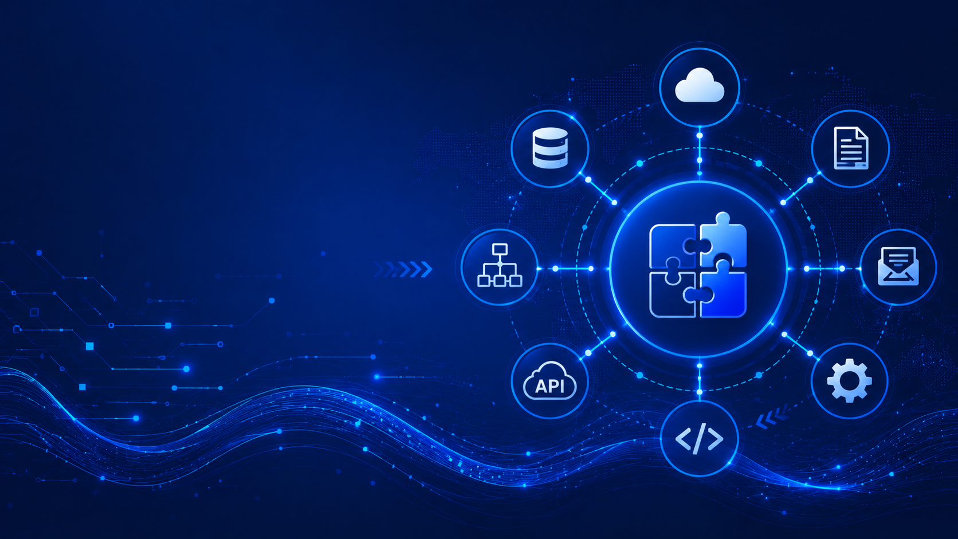
Integration

Slide 17
Integration Updates (General Available)
Generally Available: Network Security Perimeter support for Azure Event Hubs
Azure Event Hubs now supports Network Security Perimeter (NSP), enabling organizations to define a logical network isolation boundary for PaaS resources and control public network access through perimeter-based access rules.
With Network Security Perimeter, you can help reduce data exfiltration risks by restricting access to Event Hubs namespaces and managing inbound and outbound connectivity using centralized security controls. This capability complements existing network security features and helps organizations implement consistent network isolation policies across Azure services.
Network Security Perimeter support for Event Hubs enables you to:
Define secure network boundaries around Event Hubs resources.
Control public access using perimeter access rules.
Reduce exposure to unauthorized network traffic.
Apply consistent network security policies across supported Azure services.
This capability is now generally available for Azure Event Hubs.

Slide 18

ML & AI & IOT

Slide 19
ML & AI & IOT Updates (Preview)
Foundry IQ is now in Copilot Studio: Bring your enterprise data to every agent conversation
Foundry IQ is now integrated with Microsoft Copilot Studio, enabling organizations to connect enterprise knowledge directly to every Copilot and AI agent. Instead of building separate retrieval pipelines for each agent, developers can leverage Foundry IQ as a centralized knowledge layer that securely indexes and retrieves information from enterprise data sources.
The integration allows Copilot Studio agents to deliver more accurate, context-aware responses grounded in organizational content while respecting existing security permissions and governance policies. Developers can build intelligent agents that access a consistent, enterprise-wide knowledge base without implementing custom retrieval or search infrastructure for each solution.
By combining Copilot Studio with Foundry IQ, Microsoft simplifies the development of enterprise AI agents, improves response quality through centralized retrieval, and enables organizations to scale AI experiences across departments while maintaining consistent governance, security, and knowledge management.
Introducing Kimi K2.7 Code in Microsoft Foundry
Kimi K2 7B Code is now available in Microsoft Foundry, expanding the platform's portfolio of code-focused AI models for software development and automation. Optimized for programming tasks, the model supports code generation, code completion, debugging, refactoring, and technical reasoning across multiple programming languages, making it suitable for developer productivity and AI-assisted software engineering.
Through Microsoft Foundry, organizations can deploy Kimi K2 7B Code alongside other foundation models using a unified platform for model management, evaluation, governance, and observability. Developers can integrate the model into applications, AI agents, and development workflows while leveraging Foundry's enterprise security, content safety, and deployment capabilities.
The addition of Kimi K2 7B Code strengthens Foundry's multi-model ecosystem, giving customers greater flexibility to select the coding model that best meets their performance, cost, and quality requirements. For enterprises building AI-powered developer tools or software engineering assistants, it provides another enterprise-ready option within Microsoft's managed AI platform.

Slide 20
ML & AI & IOT Updates (General Available)
Generally Available: Open AI GPT-5.6 on Azure Databricks
Open AI GPT-5.6 is now available on Azure Databricks. You can use GPT 5.6 (purchased on Microsoft Foundry) via Model Serving Endpoint in Azure Databricks. Through integrations across Foundry and Azure Databricks, you can securely build, deploy, and manage AI applications in the context of their data while enforcing governance via Unity AI Gateway.

Slide 21

DevOps & IaC & Automation

Slide 22
DevOps & IaC & Automation (Preview)
Public Preview: Azure Chaos Studio Workspaces and Scenarios
Azure Chaos Studio now supports Workspaces and Scenarios, a faster, application-centric way to validate how workloads hold up during real outages.
Point a Workspace at application's scope—a subscription, resource group, or service group—and Chaos Studio discovers the resources inside it and recommends Scenarios: preconfigured tests that reproduce real-world outage patterns. Select a Scenario, and Chaos Studio injects the right faults, in the right order, across every affected resource, then produces a Scenario report showing exactly what happened.
With Workspaces and Scenarios, you can:
Simulate common outage patterns out of the box, including availability zone failures, DNS and Microsoft Entra ID outages, PostgreSQL and SQL Managed Instance failovers, cache stampedes, and messaging disruptions.
Keep tests in sync as app changes—resources are discovered automatically from the Workspace scope.
Control the blast radius with a managed identity governed by Azure RBAC.
Generate Scenario reports for game days, retrospectives, and compliance frameworks such as DORA.
Public Preview: Manage Azure Chaos Studio from the Azure CLI
It is now possible to create and run Azure Chaos Studio resilience Scenarios directly from the Azure CLI with the new az chaos extension — no more hand-assembling REST calls and JSON files. Get started in one step: az chaos setup stands up a workspace, wires up permissions, discovers your resources, and recommends Scenarios (like Zone Down) tailored to what you're running. From there, configure, validate, and run a Scenario in a few clear commands — with built-in --help, tab completion, and table/JSON/TSV output. Install with az extension add --name chaos.

Slide 23

Information

Slide 24
Information
Azure Times GitHub Repo

Slide 25

Questions

