Slide 1


Superpowers in Teams thanks to Messaging extensions by Ferran Chopo
collabdays | lisbon
November 13th, 2021

Slide 2







Our Sponsors
GOLD
COMMUNITY

Slide 3





Speaker Presentation
Ferran Chopo
Ferran Chopo garcia
Solution Expert
PlanB GmbH
fchopo
www.linkedin.com/in/fchopo
#Basketball #Run #Hiking #ThrillerFan

Slide 4
Agenda
What are Messaging extensions?
Extension types
Architecture
Demos
More demos

Slide 5
What are Messaging extensions?

Slide 6



Apps in Teams
Teams can act and make quick decisions
Reduce the number of context changes’ while working on important tasks
Creates collaboration opportunities

Slide 7






Teams development platform
Tabs
Bots
Easily access specific information from within Teams
Helps users in finishing tasks using conversations
Compose Extensions
Connectors
Allow users to share information using adaptive cards in conversations.
Publish notifications in channels
Actionable Messaging
Activity Feed
Add commands within adaptive cards
Engage with users using notifications.
Microsoft Graph
Connect with data to increase productivity

Slide 8
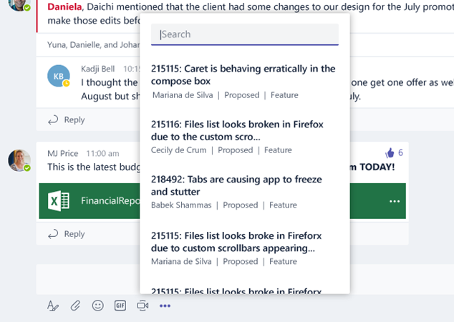
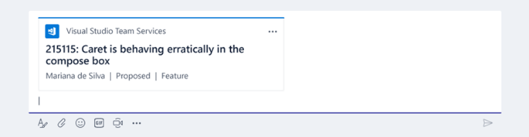
Messaging extensions
Customize compose actions using the content from MS Apps and services.
Users can use and add content provided by Apps in conversations.
Available from command line.
2 types of extensions:
Action commands
Search commands

Slide 9
Extension types

Slide 10
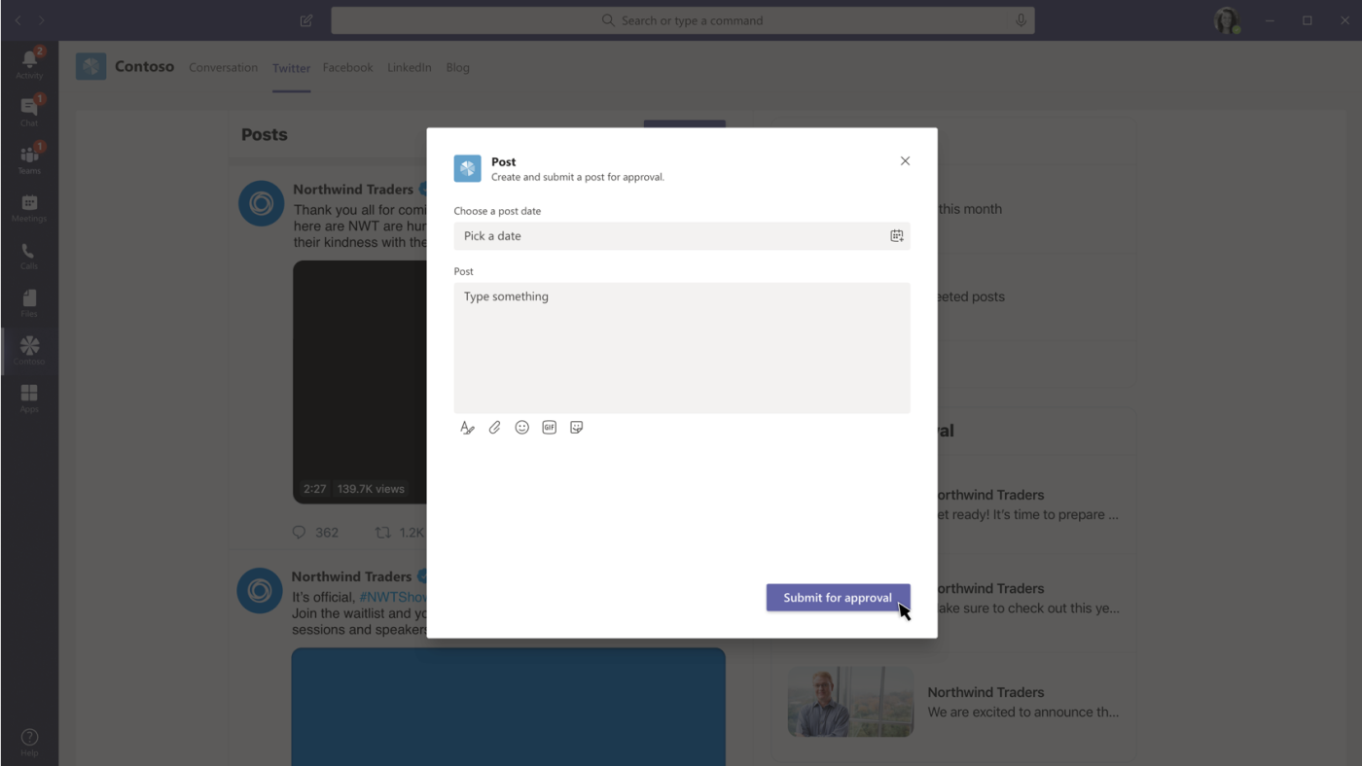

Action commands

Slide 11
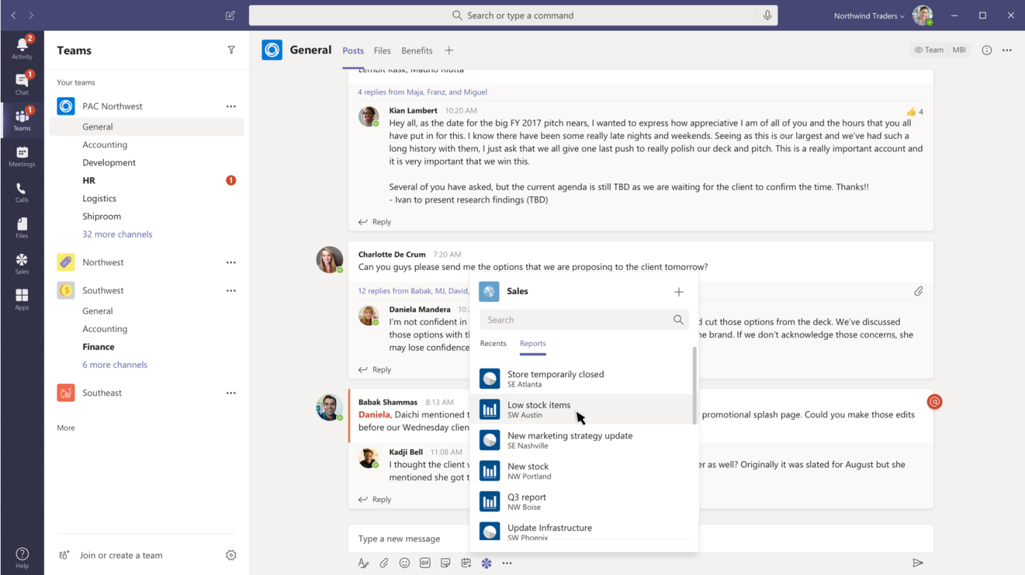

Search commands

Slide 12
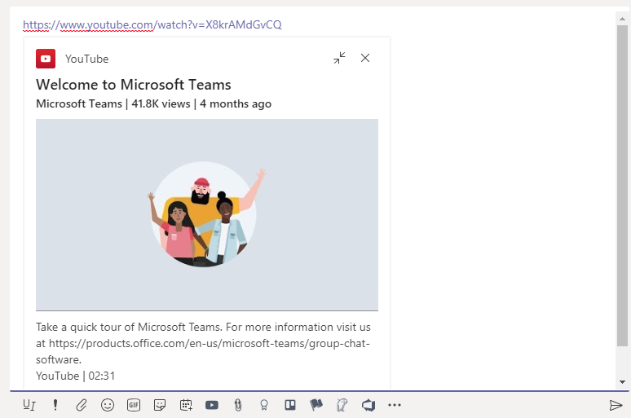

Link unfurling

Slide 13
Architecture

Slide 14







Architecture
Teams App
Graph API
Show information and user interaction
Publish the extension
Azure Bot Service

Slide 15
Demo
TV Maze Messaging extensions
Github.com/fchopo
Notes:
Vesa

Slide 16
Requirements
Visual Studio Community/Professional 2019
Microsoft Teams App / Microsoft Bot Framework SDK4 template
or
Visual Studio Code
Teams Toolkit (preview)

Slide 17
Our Sponsors
GOLD
COMMUNITY

Slide 18

MUITO OBRIGADO

