Slide 1
Understanding the Server Side

Slide 2
Part 1: Server-Side Technology
What happens "behind the scenes" of a website?

Slide 3
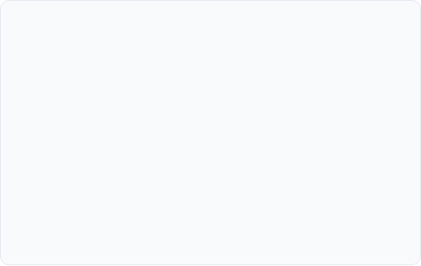
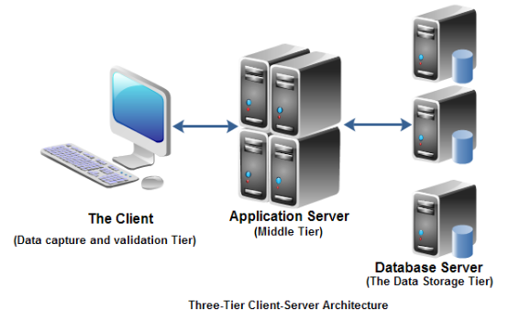
What is Server-Side? (An Analogy)
Think of a website like a restaurant.
Client-Side (The Menu):
This is what you, the user, see. It's the menu you read (HTML, CSS). It's static and looks the same for everyone.
Server-Side (The Kitchen):
This is where the work happens. It takes your order (a request), processes it (runs logic, gets data), and prepares your unique meal (the final webpage).

Slide 4






Why Do We Need It?
Store Data
Handle Security
Create Dynamic Content
Securely stores and retrieves user profiles, products, and posts from a database.
Manages user logins, protects private information, and processes payments safely.
Shows personalized content, like "Welcome, [Your Name]!" instead of the same page for everyone.

Slide 5
Part 2: What is a Web Server?
The 'waiter' that takes your order and delivers your page.

Slide 6

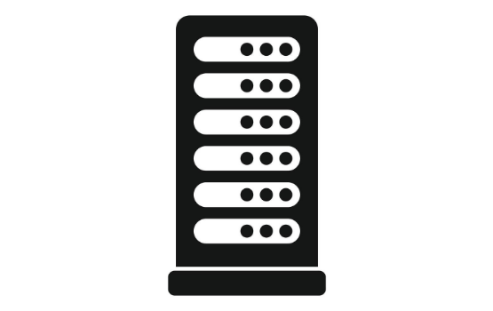
What is a Web Server?
A web server is special software (like Apache or IIS) that runs on a powerful computer, available 24/7.
Its Main Job:
✓
Listens: It constantly waits for HTTP requests from your browser.
✓
Processes: It finds the right files or runs the server-side code (like ASP.NET) to build the page.
✓
Responds: It sends the finished page (HTML, images) back to your browser to be displayed.

Slide 7



Examples of Web Servers
Apache HTTP Server
NGINX (Engine-X)
Microsoft IIS
A modern, high-performance server known for its speed and ability to handle thousands of connections at once.
(Internet Information Services) The server built into Windows. It's the primary choice for hosting ASP.NET applications.
One of the oldest and most popular. It's open-source, free, and runs a huge portion of the web.

Slide 8
Part 3: Introduction to ASP.NET
A powerful tool for building server-side applications.

Slide 9

What is ASP.NET?
ASP.NET is a framework (a set of pre-built tools and code) created by Microsoft.
✓
It's not a language, but a platform that uses languages like C# (C-Sharp).
✓
It's used to build powerful, fast, and secure web applications.
✓
The modern version, ASP.NET Core, is free, open-source, and can run on Windows, Linux, and macOS.

Slide 10
Part 4: Client-Server Communication
How it all talks to each other.

Slide 11

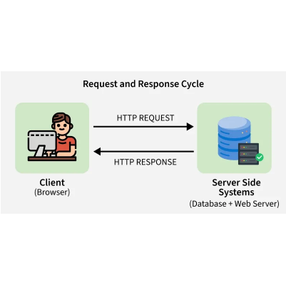
The Communication Flow
The Request-Response Cycle
✓
Client Request: Your browser (Client) sends an HTTP Request to the server's address.
✓
Server Processing: The Web Server (e.g., IIS) gets the request, runs the ASP.NET code, and gets data from a database.
✓
Server Response: The server bundles the finished HTML into an HTTP Response and sends it back.
✓
Client Renders: Your browser receives the response and "renders" (draws) the page you see.

Slide 12
Questions?
Thank you!

