Slide 1

Azure Cosmos DB
with SQL API .Net SDK
Bhavna Mangal

Slide 2




History
2010 Project Florence
2015 DocumentDB
2017 Azure Cosmos DB

Slide 3

Azure Cosmos DB
NoSQL
Multiple Data Models
Turnkey Global Distribution
Horizontal Partitioning
Scaling on Demand
Complete Indexing

Slide 4
Cosmos DB by Industries

Slide 5
Guaranteed Low Latency
Reads
(1KB)
Indexed Writes (1KB)
50th
< 2ms
< 6ms
99th
< 10ms
< 10ms

Slide 6
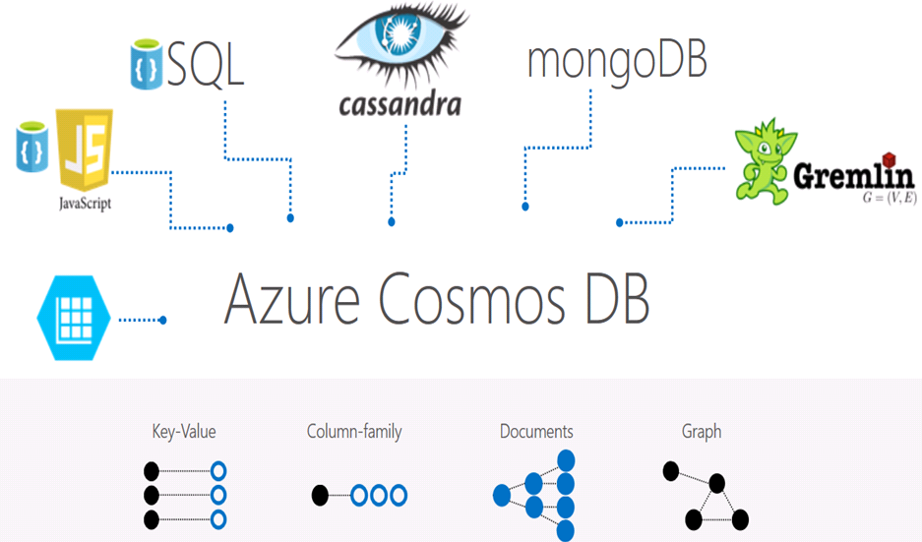

Slide 7




Supported Programming Languages
C#
Java
JS
JavaScript Node.js
Python
MongoDB Client Drivers

Slide 8
Architecture
Azure Cosmos DB Account
Database
Database
Container
Container
Container
Partition
Partition
Item
Item
Item
Item
Item
Item

Slide 9
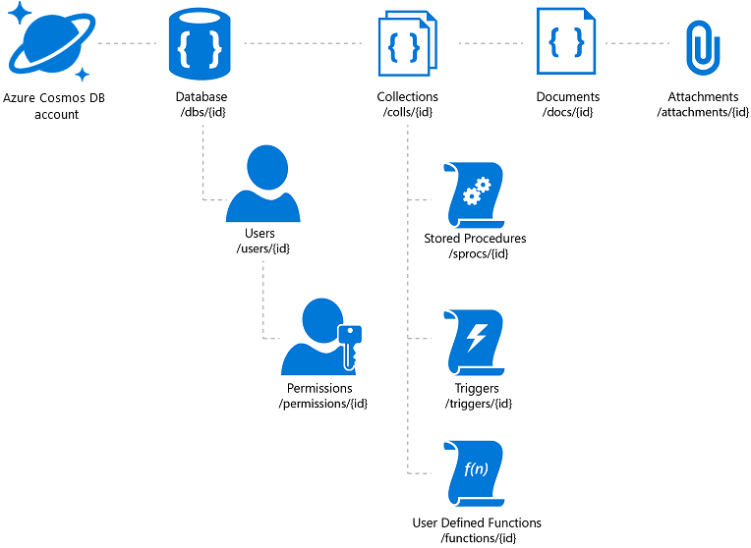
Resources Relationships

Slide 10



Horizontal Partitioning
Required for More than 10GB
Partition Key, Document Id Combination Unique
One Partition per
Partition Key

Slide 11
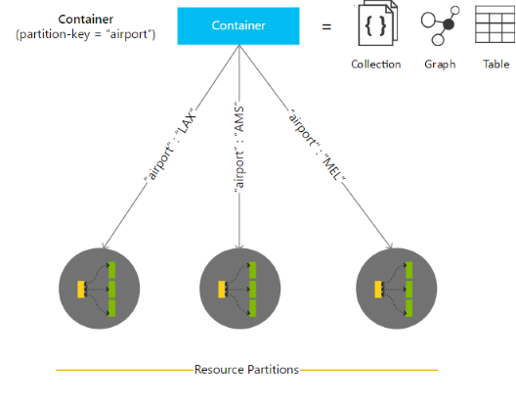

Slide 12
Five Consistency Models and Usage
Dirty
Order
P
P
P
P
P
P
P
P
Strong
4%
Bounded-stateless
18%
Session
73%
Consistent prefix
2%
Eventual
3%
Client
Usage
Higher Availability, Lower Latency, Weaker Consistency

Slide 13
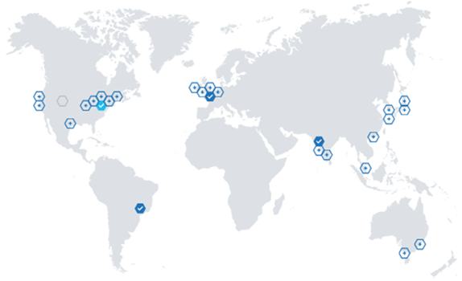
Turnkey Global Distribution

Slide 14
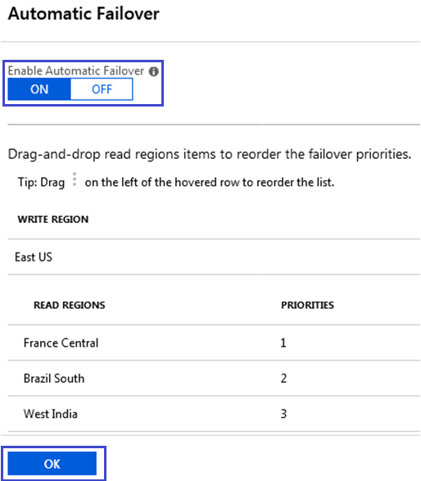
Automatic Failover
u
v
w

Slide 15
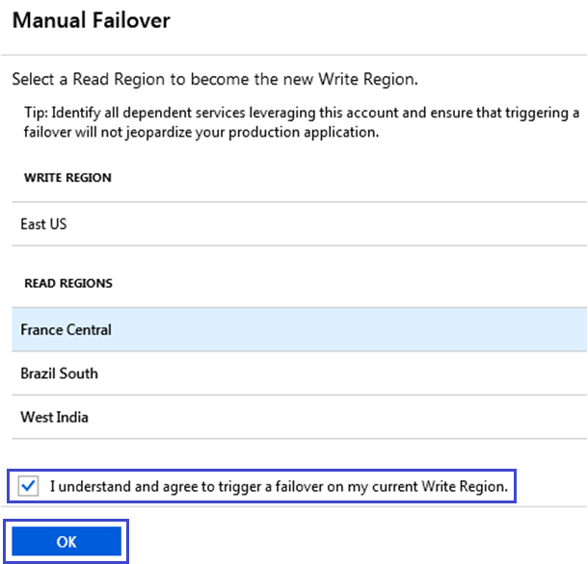
Manual Failover
u
v
w

Slide 16



Define and Save Document
User Defined, Auto Generated GUID
JSON
Single Document OR
Single Record
Properties
User Defined,
System Generated
ID

Slide 17
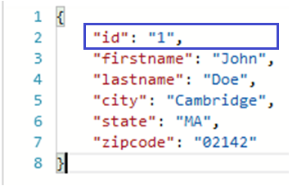
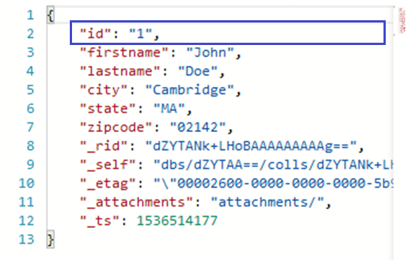
With Id
Before After

Slide 18
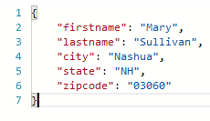
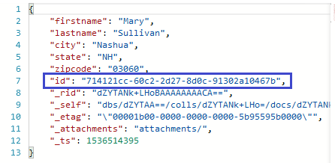
Without Id
Before After

Slide 19

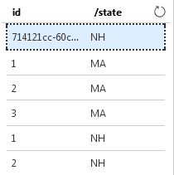
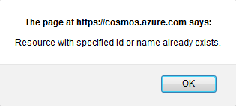
Unique Combination of Id and Partition Key

Slide 20
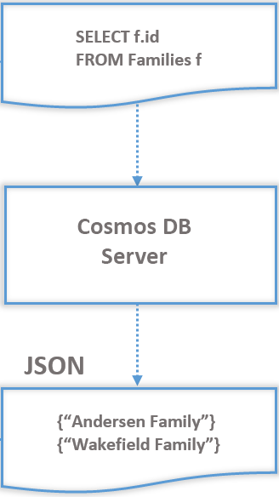
Query

Slide 21
Server Side Code

Slide 22




Server Side Code
Code Runs Inside Cosmos DB
Stored Procedures, User Defined Functions, Triggers
JavaScript Functions
Read Write
By
Partition Key
Call from Other Programs C#,
Java,
Python

Slide 23


Slide 24

Azure Cosmos DB Emulator Desktop app

Slide 25





Cosmos DB Emulator Desktop App
Free Tool
Local Machine
No Internet
Same Functionality as Portal
No Azure Subscription
Notes:
aka.ms/cosmosdb-emulator

Slide 26


Slide 27

DocumentDB Data Migration Tool

Slide 28
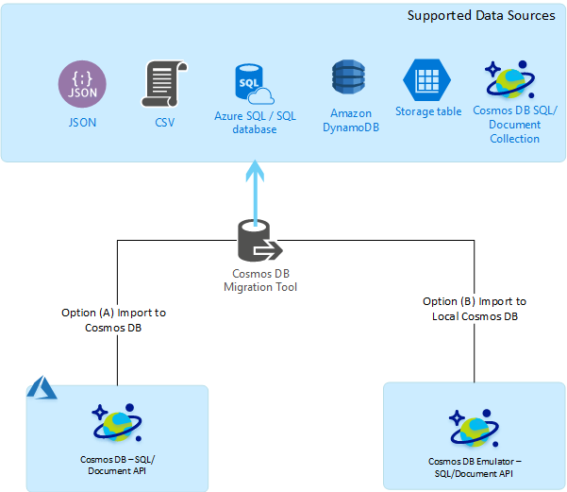
Notes:
www.microsoft.com/en-us/download/details.aspx?id=46436

Slide 29

Cosmos DB Explorer in Public View

Slide 30
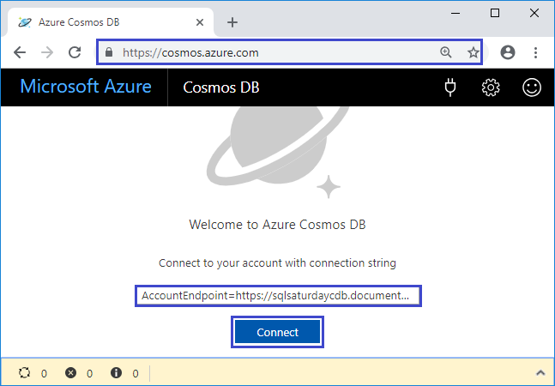
u
v
w
Notes:
https://cosmos.azure.com/

Slide 31

Microsoft Azure Storage Explorer

Slide 32
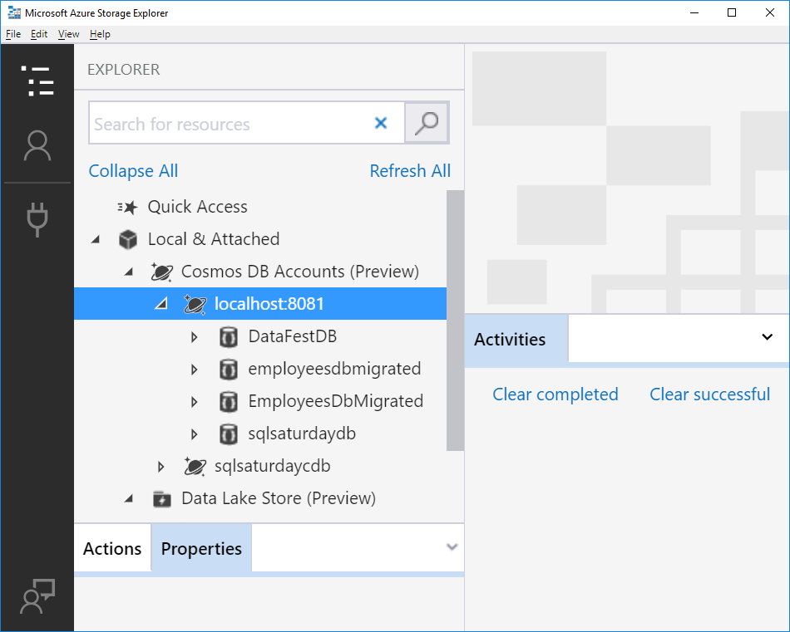
Notes:
azure.microsoft.com/en-us/features/storage-explorer

Slide 33
Resources
‘Microsoft Azure Cosmos DB Revealed: A Multi-Model Database Designed for the Cloud’ Jose Rolando Guay Paz
Pluralsight Course ‘Learning Azure Cosmos DB’ by Leonard Lobel
cosmos.azure.com
azure.microsoft.com/en-us/blog/new-azure-cosmosdb-explorer-now-in-public-preview/
documentdb.com/capacityplanner

Slide 34



Thank You!
@bhavna_mangal Mangal_Bhavna@yahoo.com
linkedin.com/in/bhavna-mangal

