Slide 1
130-Year-Old Publisher Deploys Automated Data Lake on Azure in Weeks... and So Can You
An End-To-End Automated Software Platform for Agile Data Engineering
January 9, 2019

Slide 2


Hi, I’m John Hope
Current:
Solution Architect @ Infoworks.io
Experience:
Cloudera, Oracle, Information Builders, Avocent, Compaq
10+ years in analytics/big data
33 years experience understanding difficult business challenges and applying advanced technologies to address these challenges
Expertise:
Data management
Big data technologies
Advanced analytics
Other: Application development, Network design and architecture, Cyber security

Slide 3
Agenda
130 Year Old Media Company Background
Data Projects and Challenges
The New Approach and Why
The Implementation
Successfully Deploy a Big Data Platform in Weeks vs. Months
Demonstration
Q&A

Slide 4

Case Study: Century Old Media Company
Diversified Media
Cable TV, TV Stations, magazines, newspapers, digital media, etc
360 Businesses
Grew through acquisition

Slide 5

Project I: Consolidated View of IT Spend
Goal: Consolidated Tech Spend Report
60 Divisions
12 different data sources
Tried multiple times and failed
12 month estimate using ETL and EDW
EDW approaches required:
Significant up front planning
Required cooperation at each division/company level (herding cats)
Requires most of reporting needs documented up front (rigid schema design)

Slide 6

Project II: Retire Legacy Systems
Goal: Retire legacy systems as project are moved to new cloud based platform.
Hyperion HFM/HCM applications
ESSBASE (30 systems)
Infinium application (DB2)
Required flexible, agile and scalable platform vs. using existing EDW platform requiring 3-6 months project planning

Slide 7

Business Challenges
Lack of in-house expertise
Hard to recruit experts
Data everywhere!
Compressed Timeline

Slide 8

The Bright Idea: Cloud Big Data
Instant on!
More flexible agile platform
Easier to on board data sources without upfront planning
Scales up at initial lower cost – supports fail fast philosophy
Easier to add new types of data
Easier to do new analytics (predictive, historical, data science, machine learning)

Slide 9

Technical Challenge: Big Data isn’t Easy Data Engineering is ”Death by 1000 Paper Cuts”
Data Ingestion
Change Data capture
Parallelization of data load
Slowly changing dimensions
Conversion of source types to big data types
Data Synchronization
Data Merge
Data Synch
History table creation
Data Transformation
Building initial load data pipelines
Building CDC pipelines
Building SCD pipelines
Pipeline change management
End to end lineage creation
Data Models
Building OLAP cubes
Building in-memory models
Data Governance
Data access control
Change management tracking
Enabling compliance reporting
Performance Optimization
Tuning of data load
Tuning of data transformation
Tuning of cube generation
Tuning of in memory models
Production Orchestration
Scaling jobs
Migration from dev to production
Operationalizing data science models
Monitoring operational environment
Identifying and restarting failed jobs

Slide 10
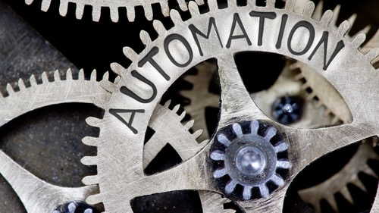
The Solution: Automate Away Complexity
Automate implementation of big data infrastructure
Leverage cloud big data platform
Abstract complexity
Automate away the complexity of big data engineering
Eliminate or minimize coding
Reduce the expertise required
Abstract complexity

Slide 11


An Agile Data Engineering Approach
DATA ENGINEERING

Slide 12
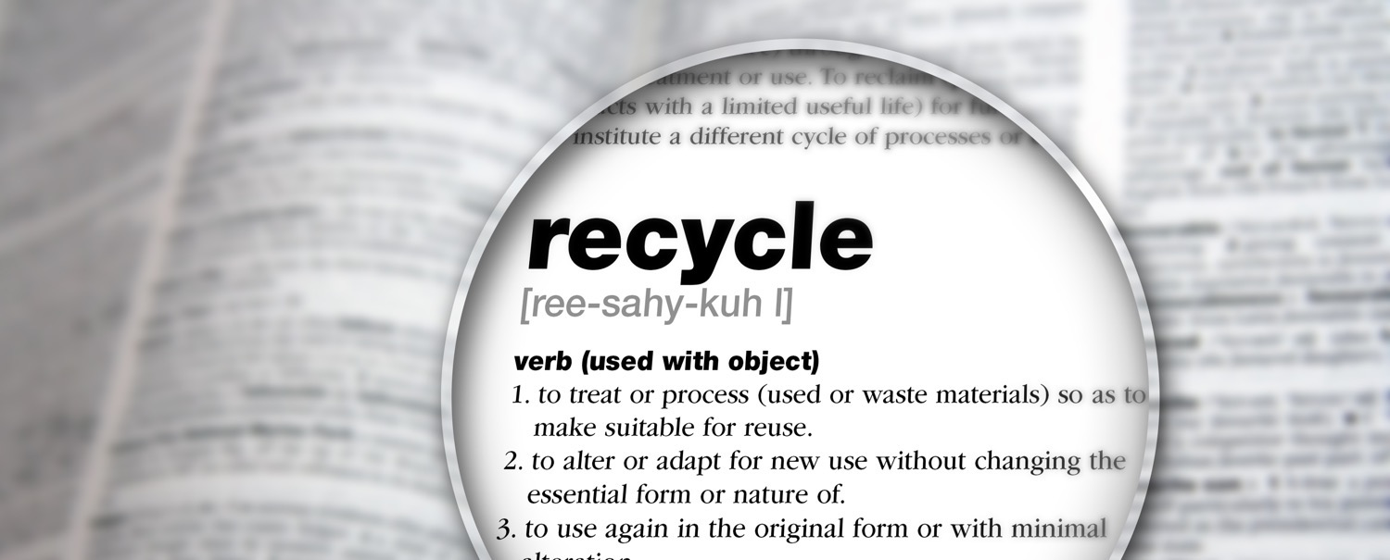
What is Agile Data Engineering?
Agile Data Engineering
ˈajəl / dādə / enjəˈniriNG
Ability to easily and quickly handle:
New analytics use cases
New data-driven applications
New data sources
New & hybrid compute and storage environments
Agile Data Engineering

Slide 13
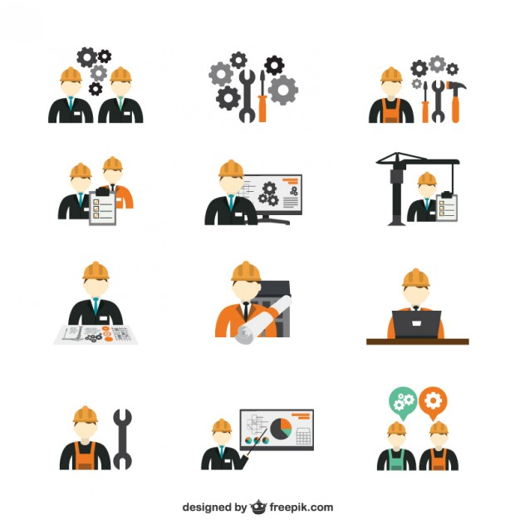



















Any Source, Any Big Data Platform, Any Analytics
DATA ENGINEERS/IT
DATA ANALYSTS
DATA SCIENTISTS
PROD OPS
ANY SOURCE
Autonomous Data Engine
ANY ANALYTICS
Platform, Metadata & Data APIs
Relational
Orchestration and Production Data Ops Management
Data Source Crawling
Data Models,
Cubes & In-Memory Models
Data Science
HDFS/Hive
Data Ingestion,
Export & Sync
Data
Transformation
& Pipeline Design
Workload Migration
Advanced
Analytics
Integration
AI & Machine Learning
Cloud
Compute/Storage Independence & Optimization
Streaming
Mainframe
XML/JSON
ANY
BIG DATA PLATFORM
Replicator
Exp rt

Slide 14



What’s Different? The Level of End-to-End Automation
Autonomous Data Engine
DATA INGESTION & SYNC
DATA TRANSFORMATION
HI-PERF MODELS
PRODUCTION OPERATIONS
BUSINESS ANALYSTS
ENTERPRISE IT
Automatic Ingestion / CDC
Automatic Data Type Conversion
Auto Crawling
Automatic Schema Change
Automatic Merge
Automated Incremental Pipelines
Automated Data Validation
Automated Dependency Management
Suggest New Data Connections
Automatically optimize data models
Auto create OLAP cubes
Automatically maintain time axis
Automated metadata lineage to source
Workflow
Management & Monitoring
Automated Fault tolerance
Restart Workflows
Monitor/ Debug
Migrate From Dev/Test to Prod
Configure New Data Sources & Authorize Access
Provision & Manage Platform Infrastructure
Define and Implement Analytics

Slide 15

The Implementation and Timeline

Slide 16
Project Overview
Tech Spend
Analytics
4 weeks, 1 data engineer from idea to completion
12 Data Sources
Data
Migration
Oracle/HFM – 30K+ tables
ESSBASE – 8 cubes
Infinium/DB2 – 5300+ tables
4 weeks, 1 data engineer from idea to completion
Incremental
Data Load
Required to support final systems retirement
0 incremental effort

Slide 17

Use Case Logical Architecture
Export
To
External
Oracle/DB2/ESSBASE
Synchronized Data
From Source Systems
Data Transformations
Combine, aggregate and cleanse data, for downstream analytics
Optimized Data Models
Cubes
SFTP/Files
DR Cluster
Analysts
&
Data Scientists
Orchestration
Fault-tolerant workflows
Microsoft Azure HDInsights v3.6 HBase
Replicator
Tech Spend Analytics from 60+ companies
Migration from Oracle/DB2/ESSBASE
Enable OLAP Data Models (Cubes)
Support historical reporting for SEC, FCC and IRS
* Synchronize Primary Cluster to DR Cluster

Slide 18
Production Physical Architecture
data flow
DN1
Export
To
External
Oracle
Data
EDGE NODE
DB2
Data
continuous
cdc/merge
transformations
workflow
DN2
Data Lake
Services
hdfs
map-reduce
hbase
yarn
spark
Hive
ADLS
BLOB
ESSBASE
jobs
MN1
HA NODE
orchestration
MN2
Azure HDInsights v3.6
DR
Other Data Sources
-SFDC
-RestAPI
-Files
-Excel
continuous
cdc/merge
transformations
workflow
DN3
on-premise & cloud
data flow
DNx
Replicator
Microsoft Azure HDInsights v3.6 HBase

Slide 19
Demonstration
The Only End-To-End Automated Software Platform for Agile Data Engineering

Slide 20
Any Source, Any Big Data Platform, Any Analytics
DATA ENGINEERS/IT
DATA ANALYSTS
DATA SCIENTISTS
PROD OPS
ANY SOURCE
Autonomous Data Engine
ANY ANALYTICS
Platform, Metadata & Data APIs
Relational
Orchestration and Production Data Ops Management
Data Source Crawling
Data Models,
Cubes & In-Memory Models
Data Science
HDFS/Hive
Data Ingestion,
Export & Sync
Data
Transformation
& Pipeline Design
Workload Migration
Advanced
Analytics
Integration
AI & Machine Learning
Cloud
Compute/Storage Independence & Optimization
Streaming
Mainframe
XML/JSON
ANY
BIG DATA PLATFORM
Replicator
Exp rt

Slide 21
Infoworks Logical Architecture
Infoworks Autonomous Data Engine
Data
Schema
Workload migration
Optimized data models
Queries
Infoworks High Performance Replicator
High speed data & metadata replication
Incremental replication
Fault tolerant execution
Any
Access
Method
Query
Tools
Export
To
Teradata
MSSQL
Cloud
…
Teradata
Data Models
data flow
schema
BTEQ
Data Lake
hdfs
map-reduce
hbase
yarn
spark
hive
impala
migrate
jobs
continuous
cdc/merge
transformations
workflow
orchestration
migrate
SQL
schema
data flow
MS SQL
Data Models
Replicator

Slide 22

The Infoworks Automation Flow
Discover, ingest, synchronize all data sources
Transform, standardize and prepare data for analytics
Organize analytics models for high-performance access
Complete Automation from ingestion to consumption
Autonomous Data Engine
Domains/Sources
Crawl Metadata
Ingest/CDC
Visual Data Transformations
Visual Cube Builder
Visual
Orchestrator
1 week
3 weeks
1 week
2 weeks

Slide 23
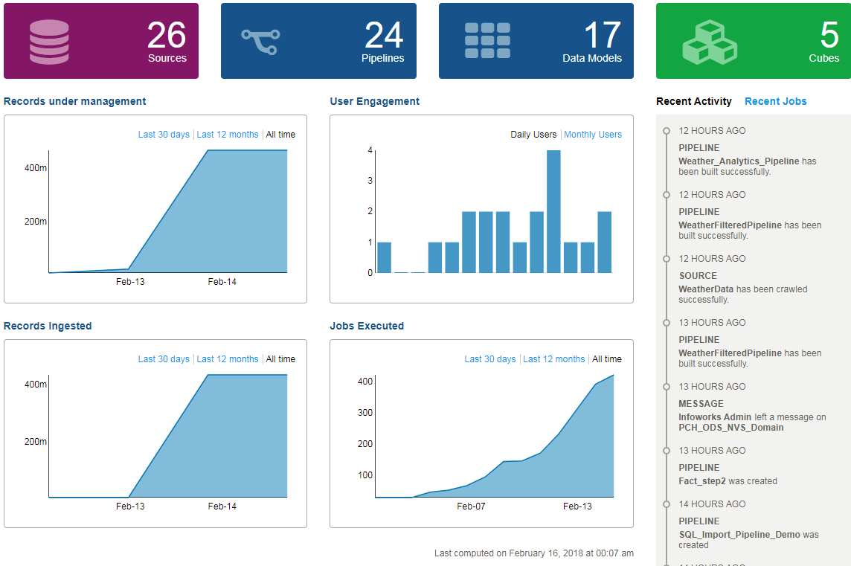
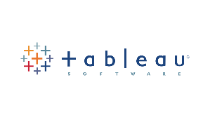
Infoworks Platform Demonstration
demo-2

Slide 24
Q&A
The Only End-To-End Automated Software Platform for Agile Data Engineering

Slide 25
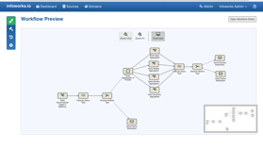
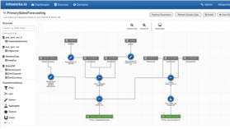
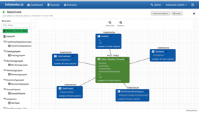
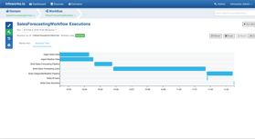
Infoworks Provides Data Engineering Agility
Automation
Complete code-free automation from data source to point of consumption by analytics
Infrastructure Independence
Portable between and across environments on premise and in the cloud
Platform Extensibility
Supports customer or 3rd party applications
Infoworks Software Delivers Big Data Agility
Through
Automation
www.infoworks.io

Slide 26
Accelerate Time to ML and Data Analytics Success

Slide 27

Q&A

