Slide 1

Welcome
January 9th, 2019
WIFI Network: MSFTGUEST
WIFI Event Code: msevent747an
Event Website: https://aka.ms/adfboston2019event

Slide 2
Thank you!
Over 200 attendees
40 Speakers
7 Sponsors
Myriad of local user group support

Slide 3

Sponsors

Slide 4
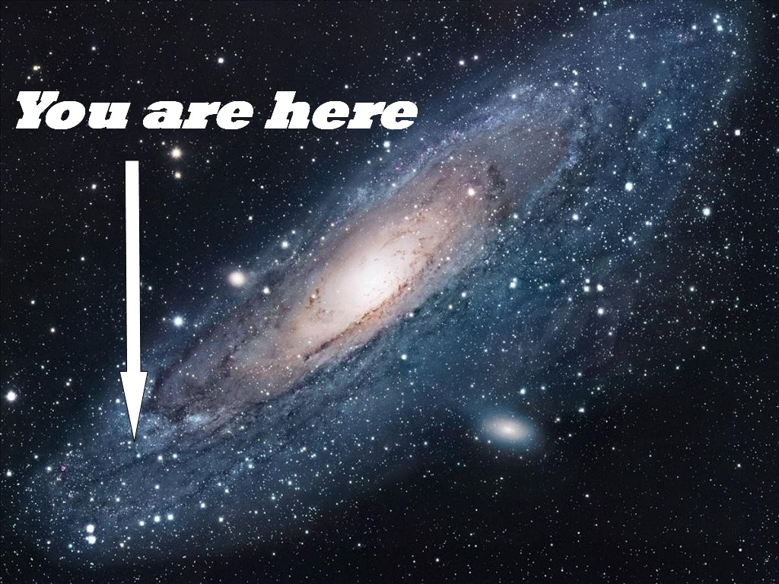
Logistics
Notes:
Exits, Food, Bathrooms, Room Locations, WIFI, website

Slide 5
Agenda
Time | Session
8:00 | Registration / Breakfast
9:00 | General Session
11:30 | Morning Breakout Session
12:30 | Lunch
1:15 | Afternoon Breakout #1
2:30 | Afternoon Breakout #2
3:45 | Afternoon Breakout #3
4:45 | Raffle and Closing

Slide 6
General Session
Welcome from Bob Familiar
Which Cloud is my Cloud?
Machine Learning with “Tiled” Human Genomes using Microsoft Azure and Arvados

