Slide 1
SequelGate Technologies
www.sequelgate.com

Slide 2
Parameters in Power Query
Intro(create, modify, manage them)
Configurations to your data sources
Make your queries dynamically load the data across environments
Load only required data(Filtering)
Create parameterized templates, make them sharable.
Demos
SequelGate Technologies
www.sequelgate.com

Slide 3
Functions
Code reusability
Making your queries dynamic
Demo:
We have capitalize each word, do not have opposite one, create the same.
(word as text) => let
Source = Text.Split(word," "),
ConvertedtoTable = Table.FromList(Source, Splitter.SplitTextByWhitespace(), null, null, ExtraValues.Error),
AddedCustom = Table.AddColumn(ConvertedtoTable, "Custom", each Text.Lower(Text.Start([Column1], 1))),
ChangedType = Table.TransformColumnTypes(AddedCustom,{{"Custom", type text}}),
AddedCustom1 = Table.AddColumn(ChangedType, "Custom.1", each Text.End([Column1],Text.Length([Column1])-1)),
AddedCustom2 = Table.AddColumn(AddedCustom1, "Custom.2", each [Custom]&""&[Custom.1]),
Custom2 = AddedCustom2[Custom.2],
stringbval=Text.Combine(Custom2, " ")
in
stringbval
SequelGate Technologies
www.sequelgate.com

Slide 4
Power Pivot
SequelGate Technologies
www.sequelgate.com

Slide 5
History
First Modeling Tool
SSAS Multidimensional Model(Corporate BI - Learning
Power Pivot from SQL Server 2008 R2(a local instance SSAS inside it)
SSAS Tabular Model from SQL Server 2012(Columnar Store)
Why Cube:
- Aggregations
- Shared Metadata
- Ad-hoc Analysis, KPIs, Built in cals.. etc.
SequelGate Technologies
www.sequelgate.com

Slide 6
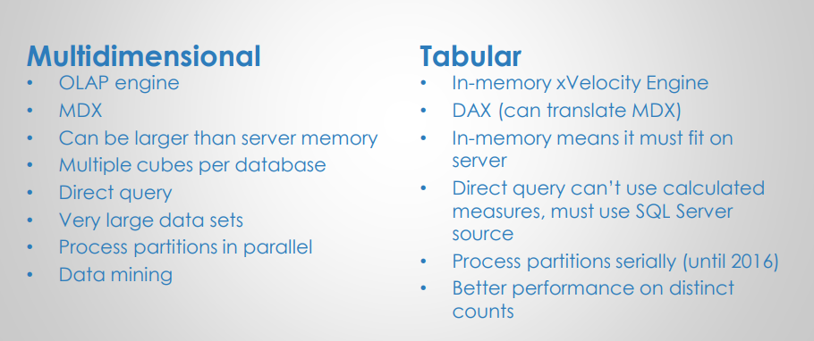
SequelGate Technologies
www.sequelgate.com

Slide 7
Power Pivot
- Introduced in SQL Server 2008 R2
- Available as Power Pivot for excel add in
- Also available as Power Pivot Share point mode
- follows xVelocity in memory analytics engine.
- Initially it was Vertipaq engine
- Columnar Store DB
- Compression
-
SequelGate Technologies
www.sequelgate.com

Slide 8
Vertipaq Engine -
The in-memory columnar database that stores and hosts your model.
This vertipaq engine executes your DAX queries
What will happen when you load into Model
Convert it as Columnar Store of Vertipaq(Quick access to column)
Compress it(Less scans)
SequelGate Technologies
www.sequelgate.com

Slide 9
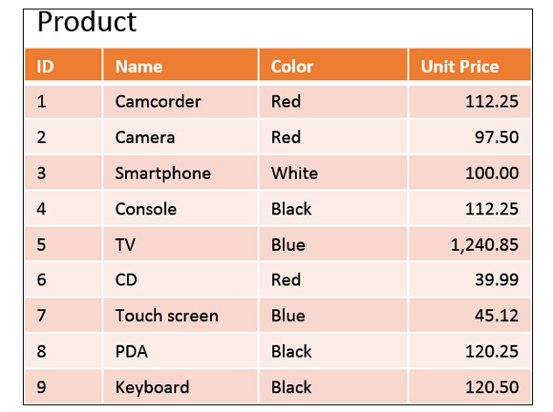
Engine Internals
How SUM(UnitPrice) will be calculated by DB Engine?
1. Scan All Rows
2. Each Row skip id, name, color columns, you can not
Read unit price directly.
3. Then calculate SUM
The Problem here is-
Reading and Skipping the Cols will take time.
How we(humans) will calculate:
we will simply skip other columns and calculate SUM.
SequelGate Technologies
www.sequelgate.com

Slide 10
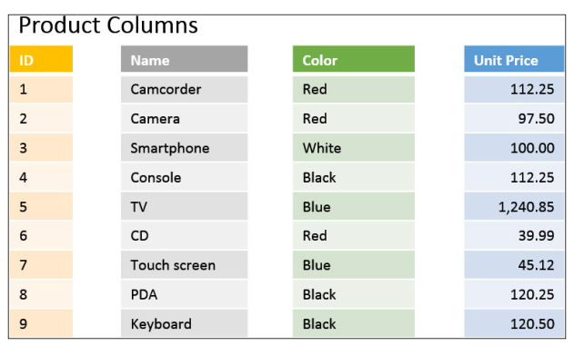
How data get stored internally -
Calculate SUM of Unit Price
Calculate SUM of Red Products
Calculate SUM of Red and Camera
SequelGate Technologies
www.sequelgate.com

Slide 11
Columnar stores aim to reduce the read time.
CPU cycles to rearrange the data when many columns from the same table are used.
Increasing CPU usage is a good deal.
When we have more columns in our expression, it is easy build row from column(if it is required), to make it(evaluating expression) easy.
SequelGate Technologies
www.sequelgate.com

Slide 12
Understanding compression
Aim to reduce your memory.
Small model, better use of hardware
Less data, less(faster) scans
SequelGate Technologies
www.sequelgate.com

Slide 13
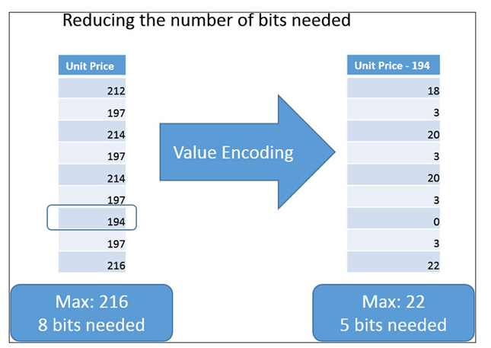
Value Encoding-
Data will not be store as it is(it will be transformed again when you need it(CPU).
SequelGate Technologies
www.sequelgate.com

Slide 14
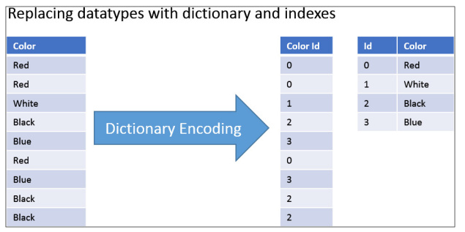
String Encoding –
For strings it follows dictionary encoding
SequelGate Technologies
www.sequelgate.com

Slide 15
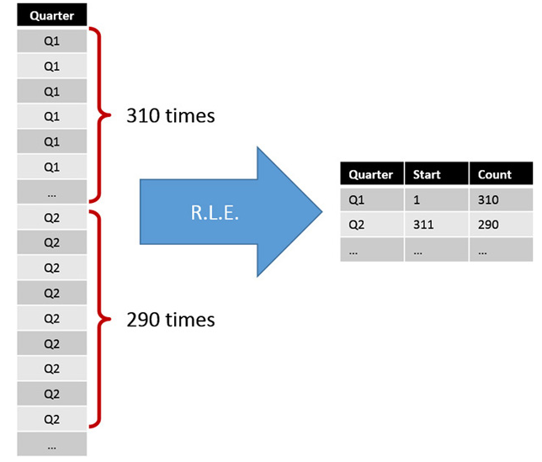
Run Length Encoding(RLE)
Reduces size of your dataset, avoid repeat values.
SequelGate Technologies
www.sequelgate.com

Slide 16
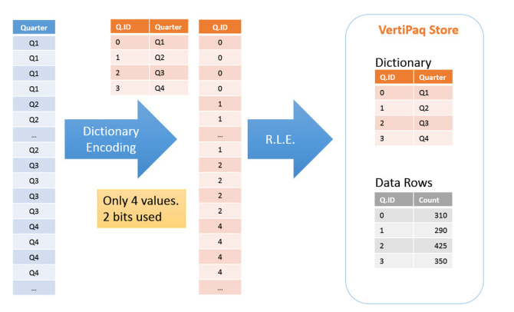
String Encoding - RLE
SequelGate Technologies
www.sequelgate.com

Slide 17
Power BI – Power Pivot
SequelGate Technologies
www.sequelgate.com

Slide 18
Load tables into model
How to analyze the data based on multiple dates
Create DimDate table using DAX
Why relationships
Data Modeling
Create relationships
SequelGate Technologies
www.sequelgate.com

Slide 19
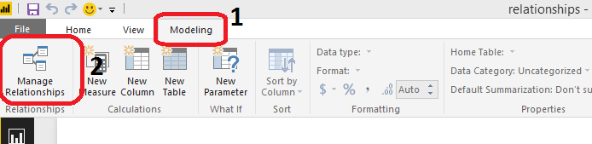
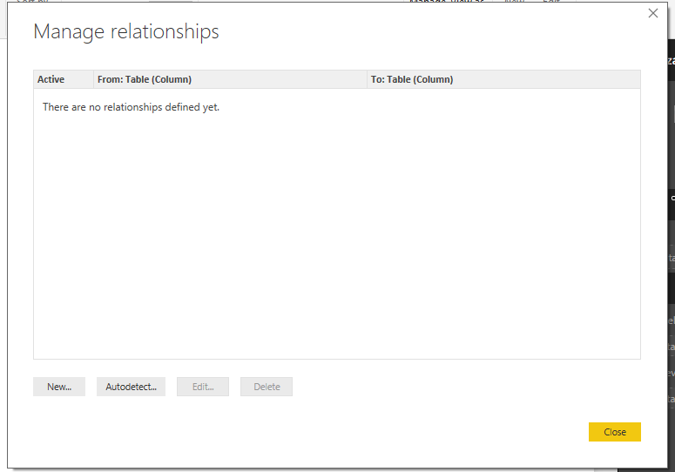
Create relationships
SequelGate Technologies
www.sequelgate.com

Slide 20
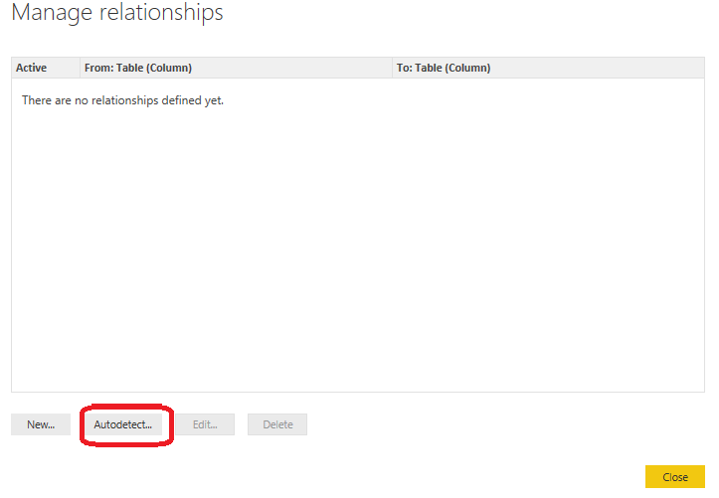
Relationships – Auto Detection
SequelGate Technologies
www.sequelgate.com

Slide 21
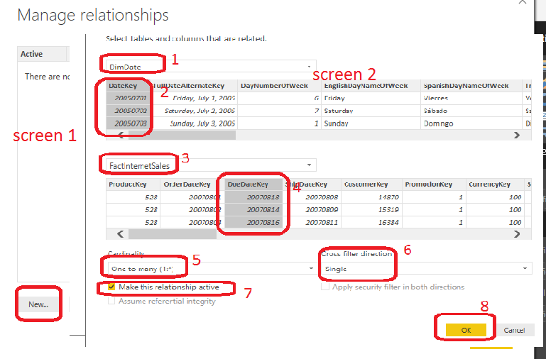
Relationships – Create them Manually
SequelGate Technologies
www.sequelgate.com

Slide 22
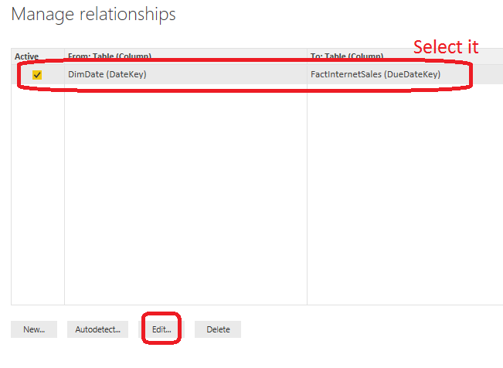
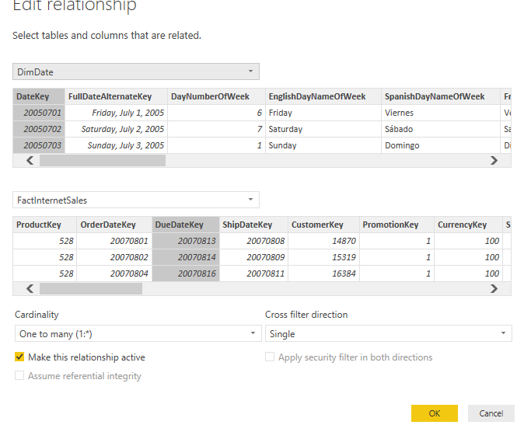
Edit relationships
SequelGate Technologies
www.sequelgate.com

Slide 23
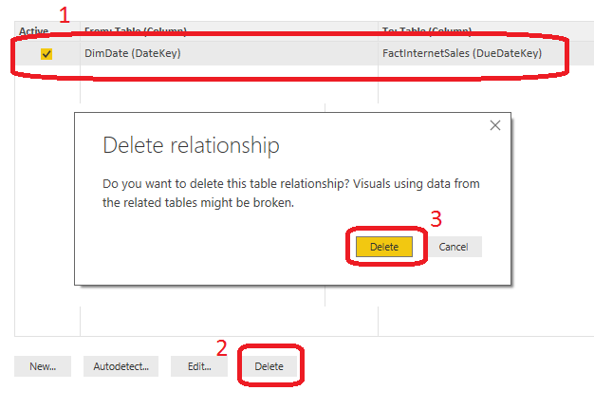
Manage Relationships – delete them
SequelGate Technologies
www.sequelgate.com

Slide 24
Column reference
Tablename[yourcolumnname](brackets mandatory)
ex:
DimProduct[Color](recommended)
If your table is having spaces(suggested not to have spaces)
Ex:
‘Dim Product’[Color]
SequelGate Technologies
www.sequelgate.com

Slide 25
DAX Expression is either Calculated Column Or Measure
Calculated Columns
Row Context(Current Row)
Similar to Derived Column in SQL Server
Measures:
Filter Context
Aggregation over multiple Rows
SequelGate Technologies
www.sequelgate.com

Slide 26
Row Context vs Filter Context
Row Context – always refers to current row, where calculation made
Filter Context: Collection of filters applied for calculating a
expression
Demo
SequelGate Technologies
www.sequelgate.com

Slide 27
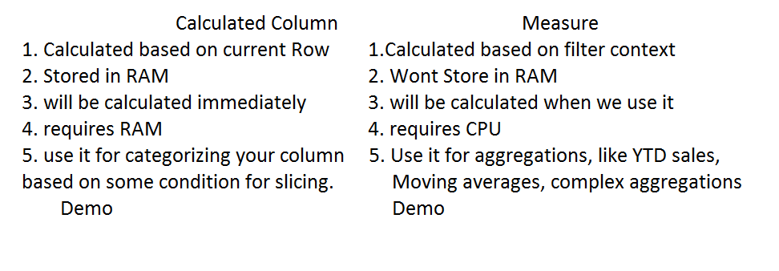
SequelGate Technologies
www.sequelgate.com

Slide 28
DAX
Handling Errors
IFERROR Function
Counting Values
SWITH() = Nested Ifs = Case in SQL Server
Variables
Relational Functions
SequelGate Technologies
www.sequelgate.com

Slide 29
Table Functions
FILTER
ALL
ALLEXCEPT
VALUES
RELATEDTABLE
SequelGate Technologies
www.sequelgate.com

Slide 30
Calculatetable
EARLIER
CALCULATE Function
Demos
All sales > 100
OR Function
SequelGate Technologies
www.sequelgate.com

Slide 31
SequelGate Technologies
www.sequelgate.com

Slide 32
SequelGate Technologies
www.sequelgate.com

