Slide 1
DWH – Core Concepts
SequelGate Technologies
www.sequelgate.com

Slide 2
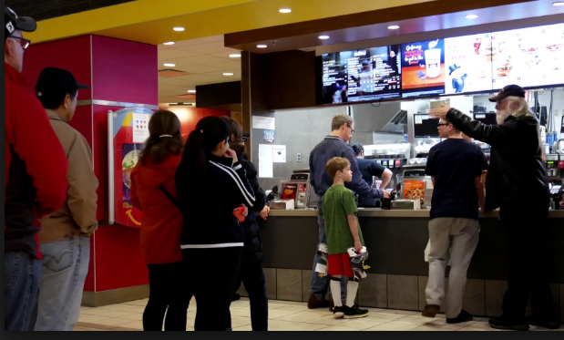
OLTP
1. Scenario – Day to Day operations
2. Users - you and me
3. Operations – individual
transactions(Insert & Update) & technical representation
4. Design: Normalized Schema – why?
5. Example(Any Commercial Operations)
SequelGate Technologies
www.sequelgate.com

Slide 3

OLAP
1. Scenario – Aggregating Day to Day operations periodically
2. Users - Big Heads in the company
3. Usage – Only Read(99.99%), business representation
4. Design: De-Normalized Schema – Why?
5. Example(Any Commercial Operations)
6. Self Service BI(User Driven) - Example
SequelGate Technologies
www.sequelgate.com

Slide 4
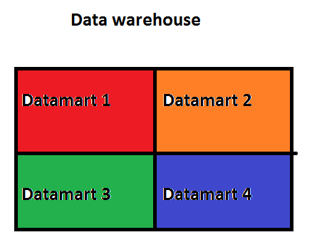

Buzz words – Terminology
Data warehouse –
Database only reading.
Multiple Subject areas
Ex: Multiple departments
SequelGate Technologies
www.sequelgate.com

Slide 5
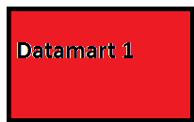
Data Mart –
Specific Subject Area.
Subset of Data warehouse
Ex: Single departments
SequelGate Technologies
www.sequelgate.com

Slide 6
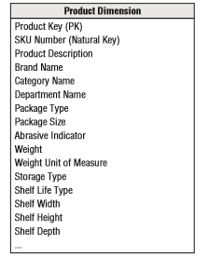
Dimension(Attributes)
Business Key Description
Analytical context
Who, What, Where, When and Why
Parent table(PK), Hundreds(thousands of records).
Without Dimension, no meaning to
Measure
SequelGate Technologies
www.sequelgate.com

Slide 7
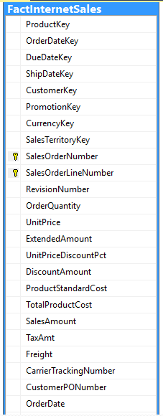
Fact Table(Measures)
Business Measure(Sales Amount, Production Cost, Quantity….)
Combine fact and measure
Child(FK, no PK) Table
Millions(Billions of records)
Will have multiple foreign Keys that
Connects to different Dimensions
SequelGate Technologies
www.sequelgate.com

Slide 8
Dimensional Modeling
Representation of business in-terms of Dims and Facts
Connects Dims and Facts to form a Dimensional Modeling.
Aggregates large data and responds quickly
4. Implement it using Star Schema and Snow Flake Schema.
SequelGate Technologies
www.sequelgate.com

Slide 9
Advantages:
Easy way of data representation for Business.
Less physical joins(responds quickly).
Self Service BI
Negatives:
Redundant data
SequelGate Technologies
www.sequelgate.com

Slide 10
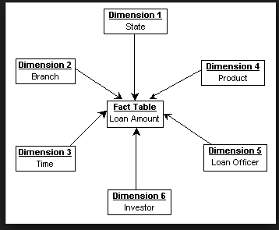
Typical Dimensional Model
SequelGate Technologies
www.sequelgate.com

Slide 11
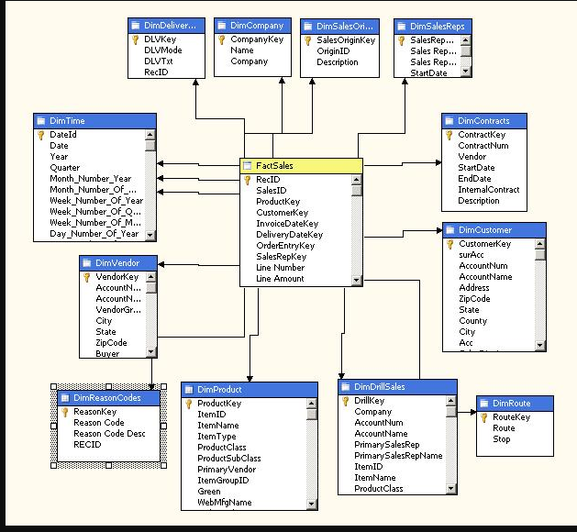
Star Schema
1. Dimension directly connects to fact.
SequelGate Technologies
www.sequelgate.com

Slide 12
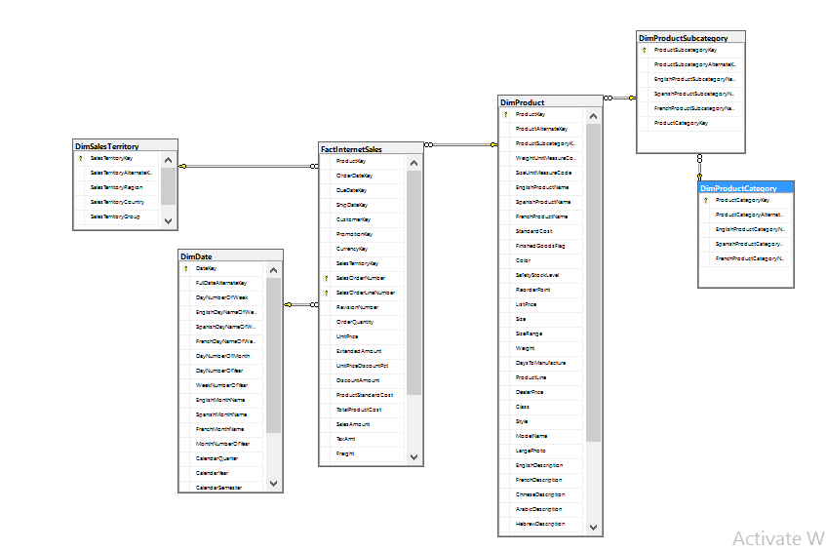
Snow Flake Schema:
Normalized Dimension
Intermediate Dimension
SequelGate Technologies
www.sequelgate.com

Slide 13
Star Schema
Snow flake SQL , Report Examples
SequelGate Technologies
www.sequelgate.com

Slide 14
Other DWH Concepts
Surrogate Keys
Shared Dims
Degenerate Dims
Junk Dims
Hierarchies - types
SequelGate Technologies
www.sequelgate.com

Slide 15
References:
The Data Warehouse Toolkit, 3rd Edition.pdf
SequelGate Technologies
www.sequelgate.com

Slide 16
Case Study 1 – Adventure Works
Case Study 2 – Your Example
SequelGate Technologies
www.sequelgate.com

Slide 17
Thanks You
SequelGate Technologies
www.sequelgate.com

