Slide 1
SequelGate Technologies
www.sequelgate.com

Slide 2
Parameters in Power Query
Intro(create, modify, manage them)
Configurations to your data sources
Make your queries dynamically load the data across environments
Load only required data(Filtering)
Create parameterized templates, make them sharable.
Demos
SequelGate Technologies
www.sequelgate.com

Slide 3
Functions
Code reusability
Making your queries dynamic
Demo:
We have capitalize each word, do not have opposite one, create the same.
(word as text) => let
Source = Text.Split(word," "),
ConvertedtoTable = Table.FromList(Source, Splitter.SplitTextByWhitespace(), null, null, ExtraValues.Error),
AddedCustom = Table.AddColumn(ConvertedtoTable, "Custom", each Text.Lower(Text.Start([Column1], 1))),
ChangedType = Table.TransformColumnTypes(AddedCustom,{{"Custom", type text}}),
AddedCustom1 = Table.AddColumn(ChangedType, "Custom.1", each Text.End([Column1],Text.Length([Column1])-1)),
AddedCustom2 = Table.AddColumn(AddedCustom1, "Custom.2", each [Custom]&""&[Custom.1]),
Custom2 = AddedCustom2[Custom.2],
stringbval=Text.Combine(Custom2, " ")
in
stringbval
SequelGate Technologies
www.sequelgate.com

Slide 4
Power Pivot
SequelGate Technologies
www.sequelgate.com

Slide 5
History
First Modeling Tool
SSAS Multidimensional Model
Power Pivot from SQL Server 2008 R2(a local instance SSAS inside it)
SSAS Tabular Model from SQL Server 2012(Columnar Store)
Why Cube:
- Aggregations
- Shared Metadata
- Ad-hoc Analysis, KPIs, Built in cals.. etc.
SequelGate Technologies
www.sequelgate.com

Slide 6
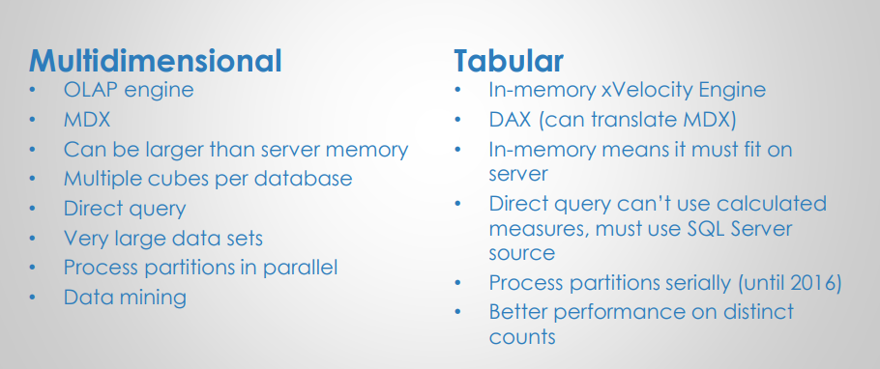
SequelGate Technologies
www.sequelgate.com

Slide 7
Power Pivot
- Introduced in SQL Server 2008 R2
- Available as Power Pivot for excel add in
- Also available as Power Pivot Share point mode
- follows xVelocity in memory analytics engine.
- Initially it was Vertipaq engine
- Column Store DB
- Compression
-
SequelGate Technologies
www.sequelgate.com

Slide 8
Vertipaq Engine -
The in-memory columnar database that stores and hosts your model.
This vertipaq engine executes your DAX queries
What will happen when you load into Model
Convert it as Columnar Store of Vertipaq(Quick access to column)
Compress it(Less scans)
SequelGate Technologies
www.sequelgate.com

Slide 9
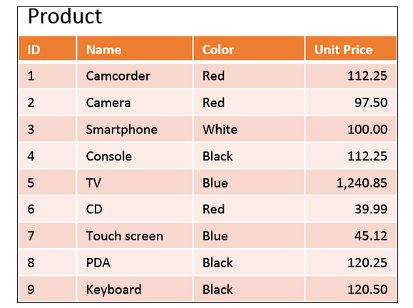
Engine Internals
How SUM(UnitPrice) will be calculated by DB Engine?
1. Scan All Rows
2. Each Row skip id, name, color columns, you can not
Read unit price directly.
3. Then calculate SUM
The Problem here is-
Reading and Skipping the Cols will take time.
How we(humans) will calculate:
we will simply skip other columns and calculate SUM.
SequelGate Technologies
www.sequelgate.com

Slide 10
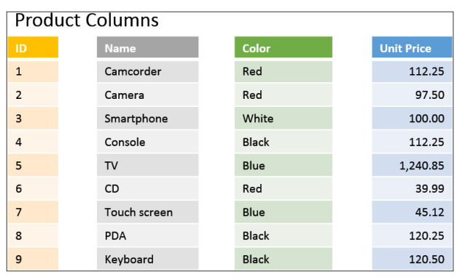
How data get stored internally -
Calculate SUM of Unit Price
Calculate SUM of Red Products
Calculate SUM of Red and Camera
SequelGate Technologies
www.sequelgate.com

Slide 11
Column stores aim to reduce the read time. However, they spend more CPU cycles to rearrange the data when many columns from the same table are used. Row stores, on the other hand, have a more linear algorithm to scan data, but they result in many useless reads. As a general rule, reducing reads at the cost of increasing CPU usage is a good deal, because with modern computers it is always easier (and cheaper) to increase the CPU speed versus reducing I/O (or memory access) time.
SequelGate Technologies
www.sequelgate.com

Slide 12
SequelGate Technologies
www.sequelgate.com

Slide 13
SequelGate Technologies
www.sequelgate.com

Slide 14
Data Modeling
Works based on xVelocity in memory analytics Engine
Prior to 2012 it was vertipaq engine(introduced in SQL Server 2008 R2)
Column store indexes
Compression
References:
https://blogs.technet.microsoft.com/dataplatforminsider/2012/03/08/introducing-xvelocity-in-memory-technologies-in-sql-server-2012-for-10-100x-performance/
https://blogs.msdn.microsoft.com/analysisservices/2012/03/09/xvelocity-and-analysis-services/
https://www.microsoftpressstore.com/articles/article.aspx?p=2449192&seqNum=3
SequelGate Technologies
www.sequelgate.com

Slide 15
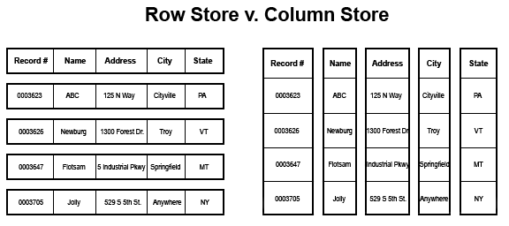
Column Oriented Storage
Stores data in column oriented manner
SequelGate Technologies
www.sequelgate.com

Slide 16
Domain Based, Similar values
High Compression
Accessing individual columns in column store
Good fit for large table scans, usually OLAP
Individual Row level seeks, row store usually OLTP
Each column physically stored separately
SequelGate Technologies
www.sequelgate.com

Slide 17
SequelGate Technologies
www.sequelgate.com

Slide 18
SequelGate Technologies
www.sequelgate.com

