Slide 1
SequelGate Technologies
www.sequelgate.com

Slide 2
Parameters in Power Query
Intro(create, modify, manage them)
Configurations to your data sources
Make your queries dynamically load the data across environments
Load only required data(Filtering)
Create parameterized templates, make them sharable.
Demos
SequelGate Technologies
www.sequelgate.com

Slide 3
Functions
Code reusability
Making your queries dynamic
Demo:
We have capitalize each word, do not have opposite one, create the same.
(word as text) => let
Source = Text.Split(word," "),
ConvertedtoTable = Table.FromList(Source, Splitter.SplitTextByWhitespace(), null, null, ExtraValues.Error),
AddedCustom = Table.AddColumn(ConvertedtoTable, "Custom", each Text.Lower(Text.Start([Column1], 1))),
ChangedType = Table.TransformColumnTypes(AddedCustom,{{"Custom", type text}}),
AddedCustom1 = Table.AddColumn(ChangedType, "Custom.1", each Text.End([Column1],Text.Length([Column1])-1)),
AddedCustom2 = Table.AddColumn(AddedCustom1, "Custom.2", each [Custom]&""&[Custom.1]),
Custom2 = AddedCustom2[Custom.2],
stringbval=Text.Combine(Custom2, " ")
in
stringbval
SequelGate Technologies
www.sequelgate.com

Slide 4
Power Pivot
SequelGate Technologies
www.sequelgate.com

Slide 5
Data Modeling
Works based on xVelocity in memory analytics Engine
Prior to 2012 it was vertipaq engine(introduced in SQL Server 2008 R2)
Column store indexes
Compression
References:
https://blogs.technet.microsoft.com/dataplatforminsider/2012/03/08/introducing-xvelocity-in-memory-technologies-in-sql-server-2012-for-10-100x-performance/
https://blogs.msdn.microsoft.com/analysisservices/2012/03/09/xvelocity-and-analysis-services/
https://www.microsoftpressstore.com/articles/article.aspx?p=2449192&seqNum=3
SequelGate Technologies
www.sequelgate.com

Slide 6
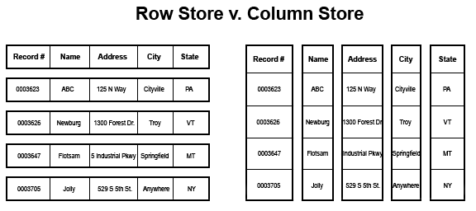
Column Oriented Storage
Stores data in column oriented manner
SequelGate Technologies
www.sequelgate.com

Slide 7
Domain Based, Similar values
High Compression
Accessing individual columns in column store
Good fit for large table scans, usually OLAP
Individual Row level seeks, row store usually OLTP
Each column physically stored separately
SequelGate Technologies
www.sequelgate.com

Slide 8
SequelGate Technologies
www.sequelgate.com

Slide 9
SequelGate Technologies
www.sequelgate.com

