Slide 1
網際網路程式設計
組員:賴浩瑜 CBE109012
1

Slide 2
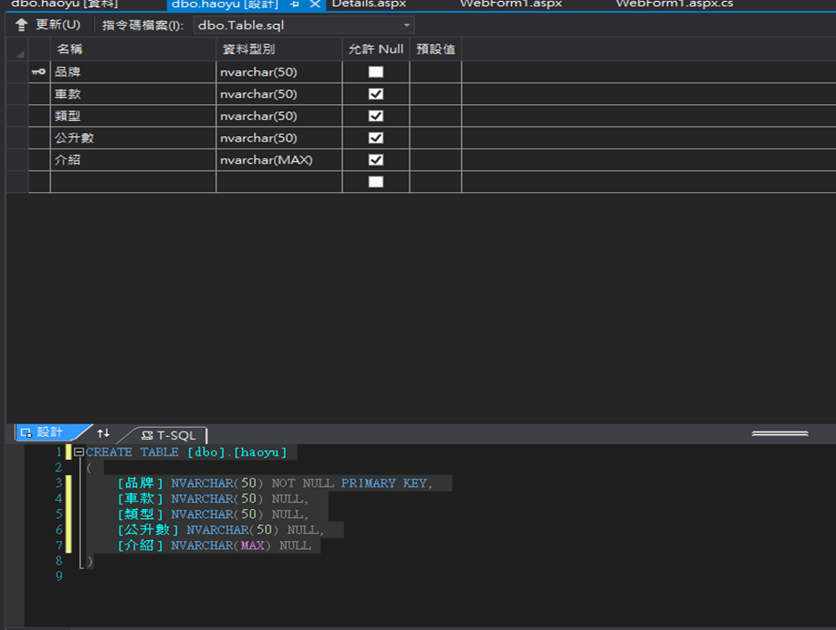
簡介
在ASP.NET網頁使用GridView控制項選取各種機車的品牌，在DetailsView控制項顯示詳細的款式、公升數、類型、和介紹，之後在套上Wizard後在每頁設計不同的內容，在各個品牌上加上HyperLink資料行，點進去各個品牌可以出現那個品牌車款的相關內容，也上ImageLink資料行，在頁面上可以顯示車款的圖片。

Slide 3
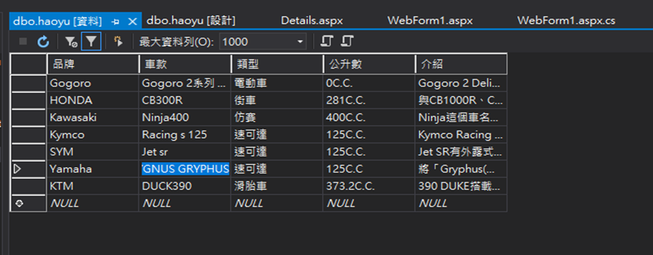
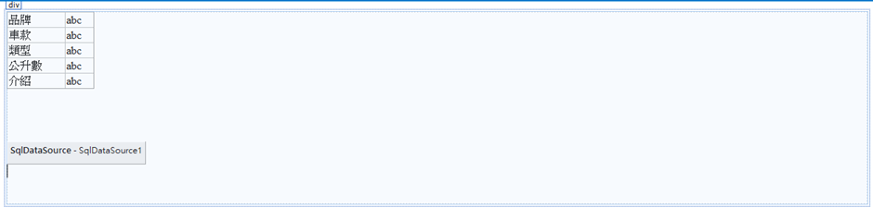
DetailsView

Slide 4
程式碼
<%@ Page Language="C#" AutoEventWireup="true" CodeBehind="Details.aspx.cs" Inherits="WebApplication1.Details" %>
<!DOCTYPE html>
<html xmlns="http://www.w3.org/1999/xhtml">
<head runat="server">
<meta http-equiv="Content-Type" content="text/html; charset=utf-8"/>
<title></title>
</head>
<body>
<form id="form1" runat="server">
<div>
<asp:DetailsView ID="DetailsView1" runat="server" AutoGenerateRows="False" DataKeyNames="品牌" DataSourceID="SqlDataSource1" Height="50px" Width="125px">
<Fields>
<asp:BoundField DataField="品牌" HeaderText="品牌" ReadOnly="True" SortExpression="品牌" />
<asp:BoundField DataField="車款" HeaderText="車款" SortExpression="車款" />
<asp:BoundField DataField="類型" HeaderText="類型" SortExpression="類型" />
<asp:BoundField DataField="公升數" HeaderText="公升數" SortExpression="公升數" />
<asp:BoundField DataField="介紹" HeaderText="介紹" SortExpression="介紹" />
</Fields>
</asp:DetailsView>
<br />
<br />
<br />
<asp:SqlDataSource ID="SqlDataSource1" runat="server" ConnectionString="<%$ ConnectionStrings:ConnectionString %>" SelectCommand="SELECT * FROM [haoyu] WHERE ([品牌] = @品牌)">
<SelectParameters>
<asp:QueryStringParameter Name="品牌" QueryStringField="No" Type="String" />
</SelectParameters>
</asp:SqlDataSource>
<br />
<br />
</div>
</form>
</body>
</html>

Slide 5
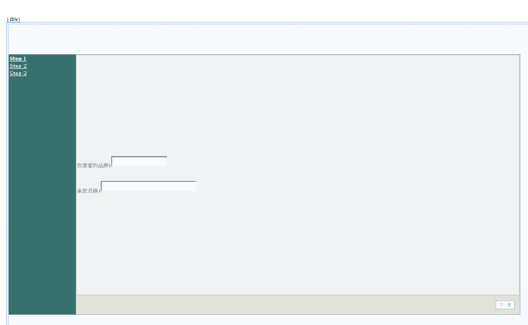

Slide 6
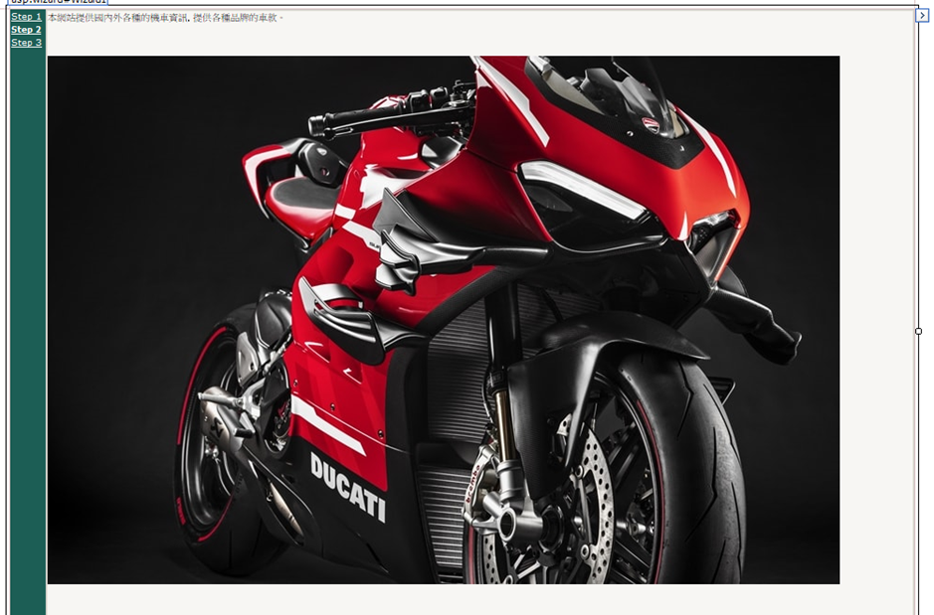

Slide 7
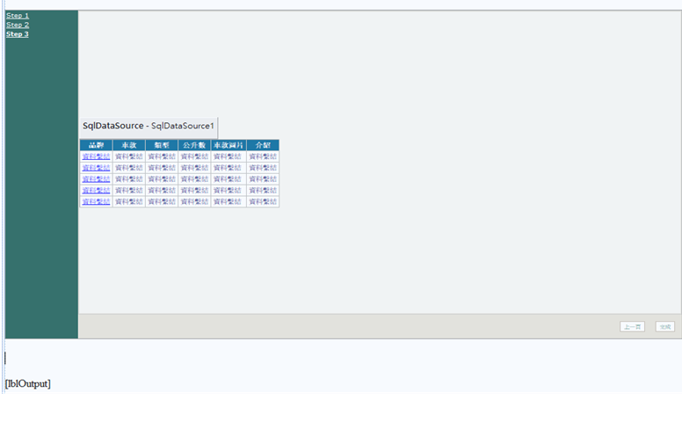

Slide 8
<%@ Page Language="C#" AutoEventWireup="true" CodeBehind="WebForm1.aspx.cs" Inherits="WebApplication1.WebForm1" %>
<!DOCTYPE html>
<html xmlns="http://www.w3.org/1999/xhtml">
<head runat="server">
<meta http-equiv="Content-Type" content="text/html; charset=utf-8"/>
<title></title>
</head>
<body>
<form id="form1" runat="server">
<div>
<br />
<br />
<asp:Wizard ID="Wizard1" runat="server" ActiveStepIndex="2" BackColor="#E6E2D8" BorderColor="#999999" BorderStyle="Solid" BorderWidth="1px" Font-Names="Verdana" Font-Size="0.8em" Height="496px" OnFinishButtonClick="Wizard1_FinishButtonClick" Width="972px">
<HeaderStyle BackColor="#666666" BorderColor="#E6E2D8" BorderStyle="Solid" BorderWidth="2px" Font-Bold="True" Font-Size="0.9em" ForeColor="White" HorizontalAlign="Center" />
<NavigationButtonStyle BackColor="White" BorderColor="#C5BBAF" BorderStyle="Solid" BorderWidth="1px" Font-Names="Verdana" Font-Size="0.8em" ForeColor="#1C5E55" />
<SideBarButtonStyle ForeColor="White" />
<SideBarStyle BackColor="#1C5E55" Font-Size="0.9em" VerticalAlign="Top" />
<StepStyle BackColor="#F7F6F3" BorderColor="#E6E2D8" BorderStyle="Solid" BorderWidth="2px" />
<WizardSteps>
<asp:WizardStep runat="server" title="Step 1">
您喜愛的品牌:<asp:TextBox ID="txtUser" runat="server"></asp:TextBox>
<br />
<br />
<br />
車款名稱:<asp:TextBox ID="txtPass" runat="server" Height="16px" Width="174px"></asp:TextBox>
</asp:WizardStep>
<asp:WizardStep runat="server" title="Step 2">
本網站提供國內外各種的機車資訊，提供各種品牌的車款。<br />
<br />
<br />
<br />
<img alt="比狂妄更狂妄DUCATI「Superleggera V4」 | Webike摩托新聞" src="https://news.webike.tw/wp-content/uploads/2020/02/2020-Superleggera-V4-06.jpg" />
<br />
<br />
<br />
<br />

Slide 9
</asp:WizardStep>
<asp:WizardStep runat="server" Title="Step 3">
<asp:SqlDataSource ID="SqlDataSource1" runat="server" ConnectionString="<%$ ConnectionStrings:ConnectionString %>" SelectCommand="SELECT * FROM [haoyu]"></asp:SqlDataSource>
<asp:GridView ID="GridView1" runat="server" AutoGenerateColumns="False" BackColor="White" BorderColor="#CCCCCC" BorderStyle="None" BorderWidth="1px" CellPadding="3" DataKeyNames="品牌" DataSourceID="SqlDataSource1" OnRowCommand="GridView1_RowCommand">
<Columns>
<asp:HyperLinkField DataNavigateUrlFields="品牌" DataNavigateUrlFormatString="Details.aspx?No={0}" DataTextField="品牌" HeaderText="品牌" />
<asp:BoundField DataField="車款" HeaderText="車款" SortExpression="車款" />
<asp:BoundField DataField="類型" HeaderText="類型" SortExpression="類型" />
<asp:BoundField DataField="公升數" HeaderText="公升數" SortExpression="公升數" />
<asp:ImageField DataImageUrlField="車款" DataImageUrlFormatString="~/images/{0}small.gif" HeaderText="車款圖片">
</asp:ImageField>
<asp:BoundField DataField="介紹" HeaderText="介紹" SortExpression="介紹" />
</Columns>
<FooterStyle BackColor="White" ForeColor="#000066" />
<HeaderStyle BackColor="#006699" Font-Bold="True" ForeColor="White" />
<PagerStyle BackColor="White" ForeColor="#000066" HorizontalAlign="Left" />
<RowStyle ForeColor="#000066" />
<SelectedRowStyle BackColor="#669999" Font-Bold="True" ForeColor="White" />
<SortedAscendingCellStyle BackColor="#F1F1F1" />
<SortedAscendingHeaderStyle BackColor="#007DBB" />
<SortedDescendingCellStyle BackColor="#CAC9C9" />
<SortedDescendingHeaderStyle BackColor="#00547E" />
</asp:GridView>
</asp:WizardStep>
</WizardSteps>
</asp:Wizard>
<br />
<br />
<br />
<asp:Label ID="lblOutput" runat="server"></asp:Label>
<br />
<br />
<br />
<br />
<br />
<br />
<br />
<br />
<br />
<br />
</div>

Slide 10
{
</form>
</body>
</html>
Aspx.cs
using System;
using System.Collections.Generic;
using System.Linq;
using System.Web;
using System.Web.UI;
using System.Web.UI.WebControls;
namespace WebApplication1
{
public partial class WebForm1 : System.Web.UI.Page
{
protected void Page_Load(object sender, EventArgs e)
{
Wizard1.Visible = true;
}
protected void GridView1_RowCommand(object sender, GridViewCommandEventArgs e)
{
int pos;
string no;
if (e.CommandName == "Select")
{
pos = Convert.ToInt32(e.CommandArgument);
no = GridView1.DataKeys[pos].Value.ToString();
lblOutput.Text = "品牌: " + no;
}
}
protected void Wizard1_FinishButtonClick(object sender, WizardNavigationEventArgs e)
{
lblOutput.Text = "您喜愛的品牌: " + txtUser.Text + "<br/>";
lblOutput.Text += "車款名稱: " + txtPass.Text + "<br/>";
Wizard1.Visible = false;
}
}

Slide 11
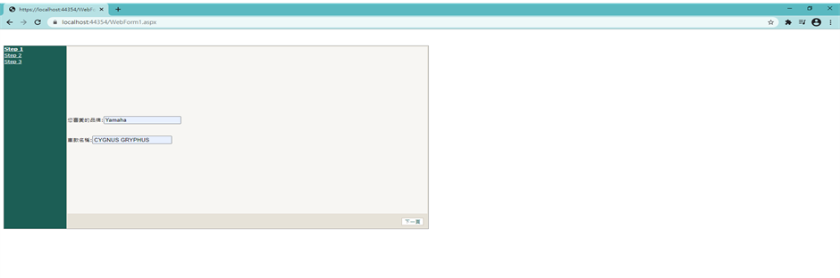
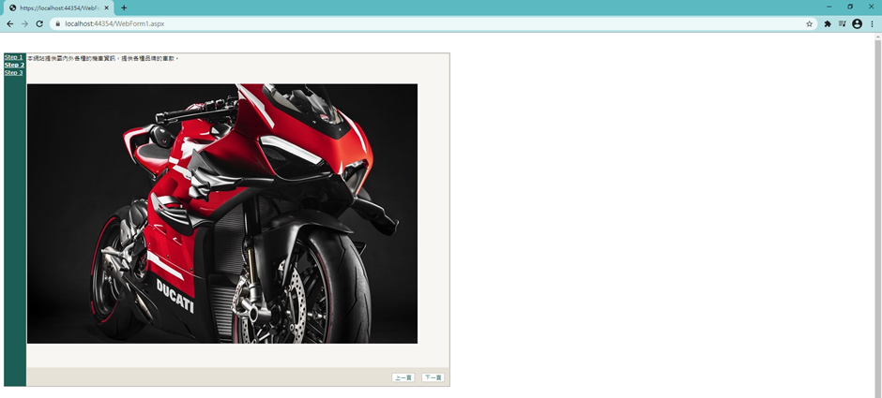

Slide 12
