Slide 1
Final Project Image Processing with Microsoft Cognitive Services Computer Vision API
Xia, Ge
Deep Azure@McKesson
Dr. Zoran B. Djordjević

Slide 2
Introduction
Microsoft Azure cloud-based Computer Vision API provides developers with access to advanced algorithms for processing images and returning useful information of the images.
The smart Computer Vision algorithms can analyze visual content in different ways based on inputs and user choices. Users can get processed image data by uploading an image or specifying an image URL.
With the Computer Vision API users can analyze images to:
Tag images based on content.
Categorize images.
Identify the type and quality of images.
Detect human faces and return their coordinates.
Recognize domain-specific content.
Generate descriptions of the content.
Use optical character recognition to identify printed text found in images.
Recognize handwritten text.
Distinguish color schemes.
Flag adult content.
Crop photos to be used as thumbnails.

Slide 3
Project Overview
In this project, I created two JSP pages using Computer Vision API to accomplish the following tasks:
Detect and extract printed text from an image (OCR)
Reference: https://docs.microsoft.com/en-us/azure/cognitive-services/Computer-vision/quickstarts/java#optical-character-recognition-ocr-with-computer-vision-api-using-javaa-nameocr-a
Detect and extract handwritten text from an image
Reference: https://docs.microsoft.com/en-us/azure/cognitive-services/Computer-vision/quickstarts/java#text-recognition-with-computer-vision-api-using-javaa-namerecognizetext-a
Input data set
Input method: image URL.
Supported image formats: JPEG, PNG, GIF, BMP.
Image file size: Less than 4 MB.
Image dimension: must be between 40 x 40 and 3200 x 3200 pixels.
Image URLs with printed text that I used:
https://encrypted-tbn0.gstatic.com/images?q=tbn:ANd9GcSJj9lLB9vU3HoGEGEIc8BWx-Mx_I-cJOTEDFAsL2_YqsMwxtGm
http://cdn.newsapi.com.au/image/v1/e10aad3abe8040f34c54ee73add530cf
Image URLs with handwritten text that I used:
https://d1qhuz9ahqnrhh.cloudfront.net/wp-content/uploads/2014/05/handwritten-banner2.png
http://www.productivity501.com/wp-content/uploads/2009/06/picture-9.png

Slide 4
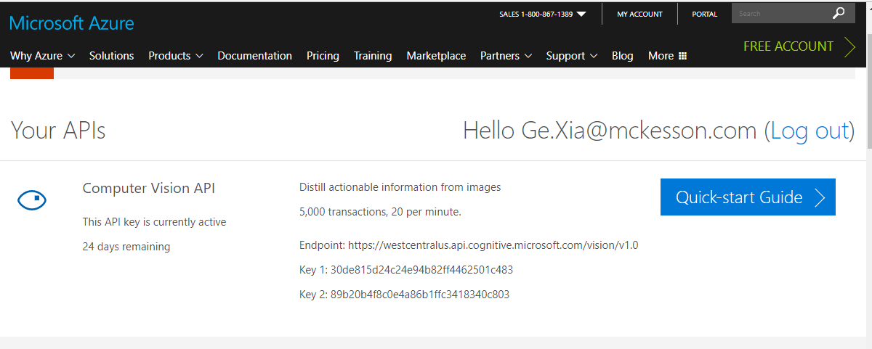
Project Install/Config/Set up
Download and install JDK 8:
http://www.oracle.com/technetwork/pt/java/javase/downloads/jdk8-downloads-2133151.html
Get Eclipse Oxygen IDE:
http://www.eclipse.org/downloads/
Download Apache Tomcat 9:
https://tomcat.apache.org/download-90.cgi
Obtain Endpoint url and subscription keys to Azure Cognitive Services
Endpoint: https://westcentralus.api.cognitive.microsoft.com/vision/v1.0

Slide 5
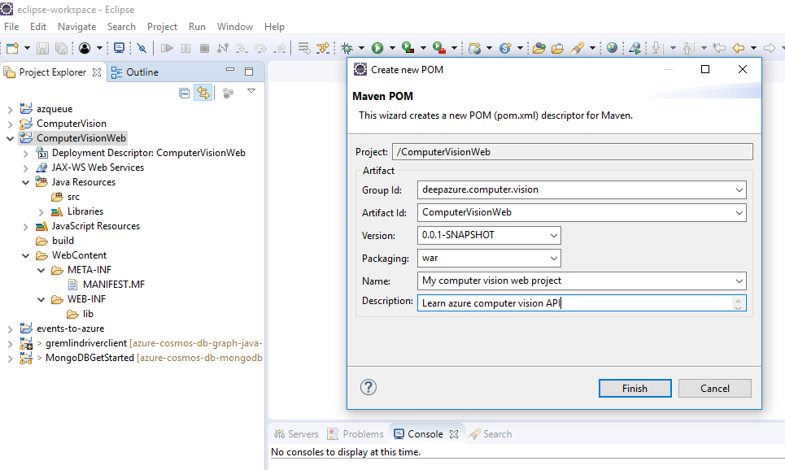
Eclipse project set up
Create a Dynamic Web Project in Eclipse IDE called ComputerVisionWeb
To add Maven as a build manager for the project, right click on the project and select Configure > Convert to Maven project. The Create New POM dialog appears, enter the following information:

Slide 6
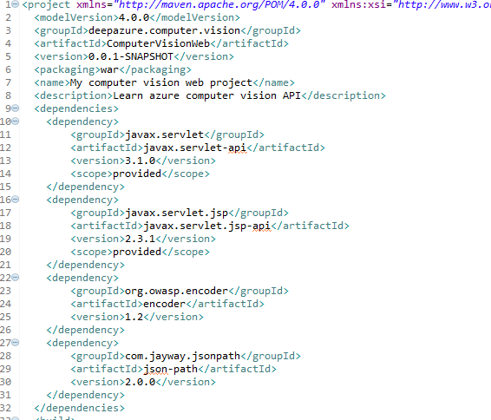
Eclipse project set up (continued)
Add dependencies in ComputerVisionWeb/pom.xml

Slide 7
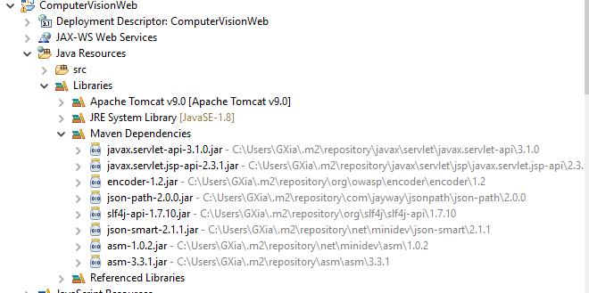
Eclipse project set up (continued)
Maven will download the dependent JAR files in few seconds, as you can see under the Libraries section of the project:

Slide 8
Creating JSP Pages
Right click on the web project and select New > JSP File. Enter ocrImage.jsp as the file name in the New JSP File dialog.
Click Finish. Eclipse created ocrImage.jsp file under the WebContent directory with some default code.
Modify the code using Azure Computer Vision Java API.
Using the same way, create a jsp file handwrittenImage.jsp
Here is the API and sample code reference online:
https://docs.microsoft.com/en-us/azure/cognitive-services/Computer-vision/quickstarts/java

Slide 9
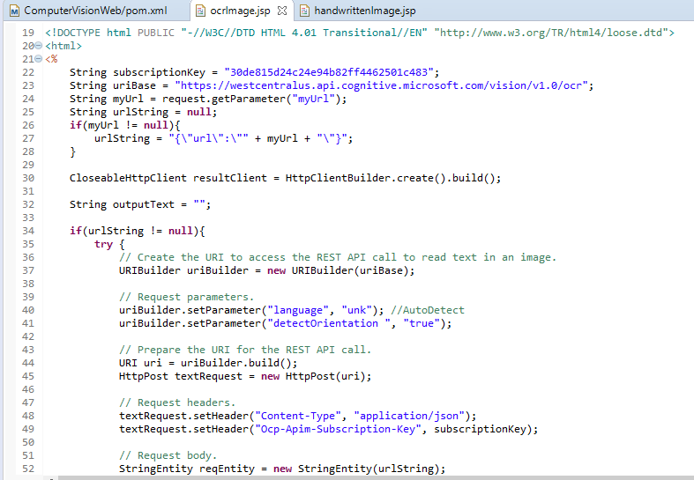
ocrImage.jsp

Slide 10
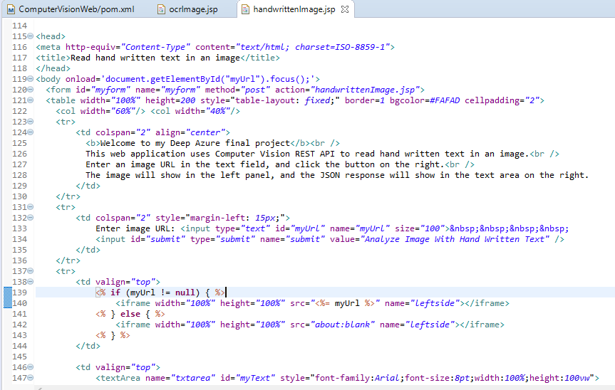
handwrittenImage.jsp

Slide 11
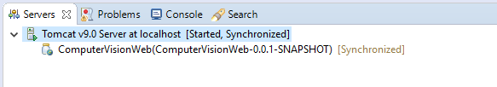
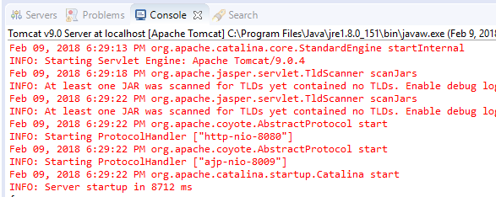
Deploy web application
In eclipse, add Apache Tomcat server to the IDE.
To deploy the project on Tomcat, simply drag the project from the Project Explorer view to Servers view.
Right click on the server and select Start. Tomcat will be in Started state after few seconds.

Slide 12
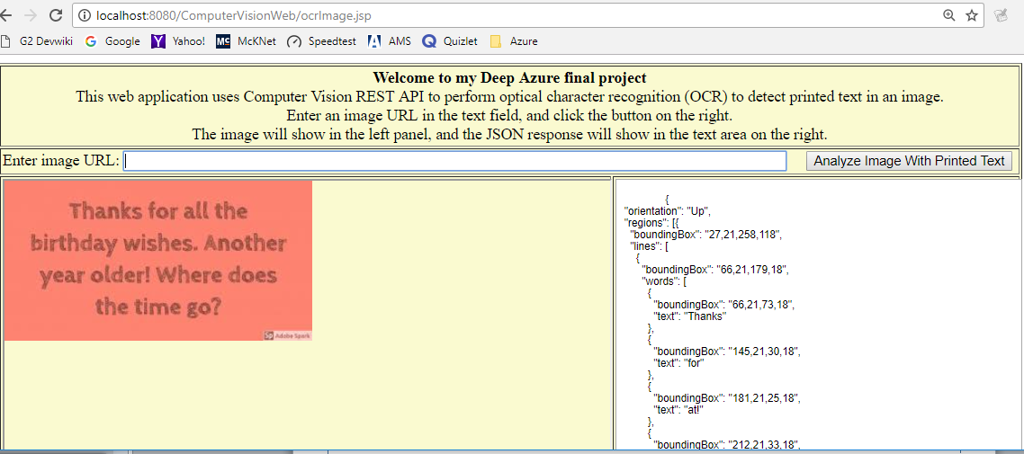
Launch ocrImage.jsp
Open a browser e.g. Google Chrome and enter the following URL:
http://localhost:8080/ComputerVisionWeb/ocrImage.jsp
Enter below image url in the text field and click the button on the right.
https://encrypted-tbn0.gstatic.com/images?q=tbn:ANd9GcSJj9lLB9vU3HoGEGEIc8BWx-Mx_I-cJOTEDFAsL2_YqsMwxtGm

Slide 13
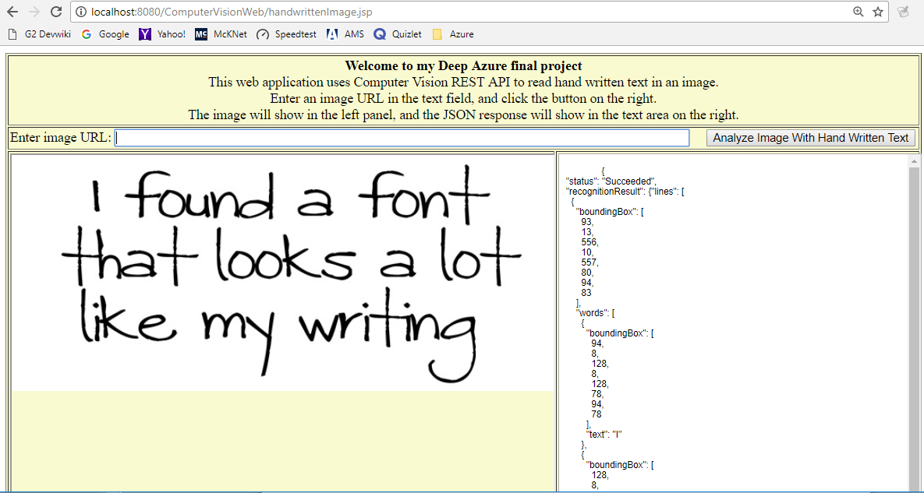
Launch handwrittenImage.jsp
Open another tab in the browser and enter this url:
http://localhost:8080/ComputerVisionWeb/handwrittenImage.jsp
Enter below image url in the text field and click the button on the right.
https://d1qhuz9ahqnrhh.cloudfront.net/wp-content/uploads/2014/05/handwritten-banner2.png

Slide 14
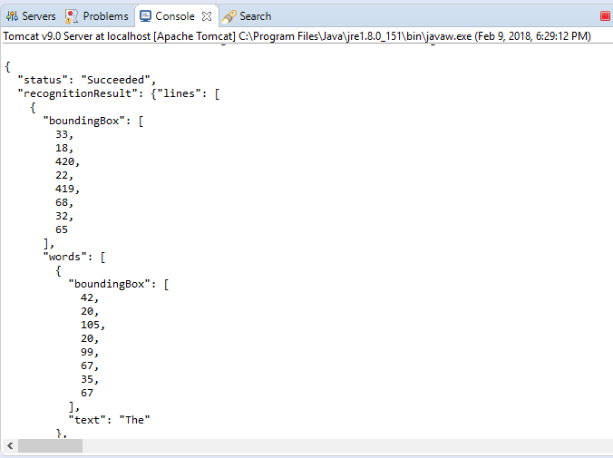
Eclipse console output
The response from the image processing API is in JSON format.
They are also displayed in eclipse console:

Slide 15
Summary
Optical character recognition (OCR)
Benefits: This technology can detect text in an image and extract the recognized words into a machine-readable character stream. It can analyze images to detect embedded text, generate character streams, and enable searching. It saves time and effort and can make you more productive by allowing you to take images of text, rather than having to transcribe it.
Limitations: On photos where text is dominant, false positives may come from partially recognized words. On some photos, especially photos without any text, precision can vary a lot depending on the type of image.
Recognize Handwritten Text
Benefits: This technology makes it possible to digitize notes, which then allows you to implement quick and easy search. It also reduces paper clutter. It can be used for numerous other purposes like medical records, security, and banking.
Limitations: This technology is currently in preview and is only available for English text.

Slide 16
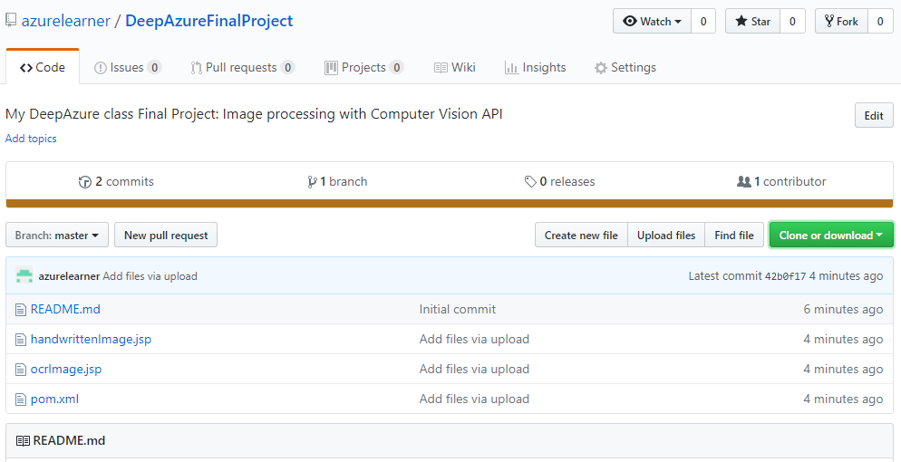
YouTube URLs, GitHub URL, Last Page
Two minute (short): https://youtu.be/Eizzpb7XzMU
15 minutes (long): https://youtu.be/4vOerTrCDmY
GitHub Repository with all artifacts:
https://github.com/azurelearner/DeepAzureFinalProject.git

