Slide 1
EuroSAT Satellite Image Classification
Deep Learning Capstone Project using PyTorch
Final CNN Accuracy
Weighted F1-score
Classes
92.07%
92.09%
10
Jianye Chen | Fanshawe College
EuroSAT Capstone | 1

Slide 2
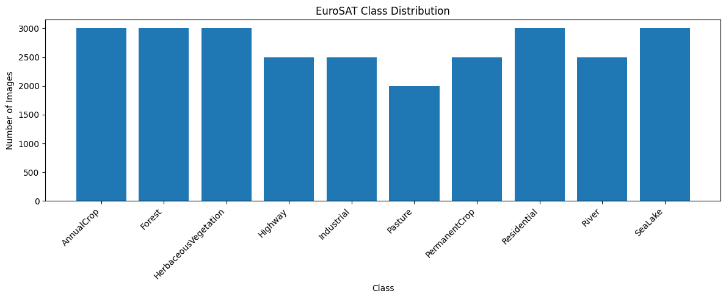
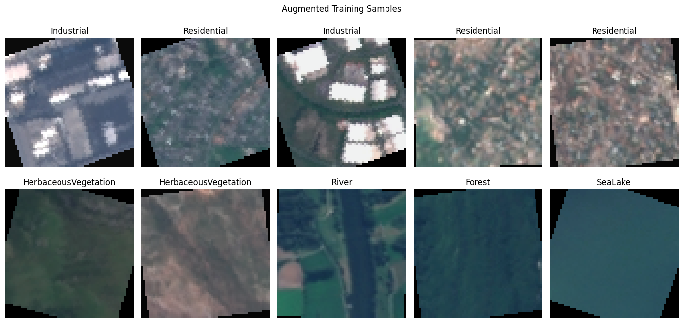
Task and Dataset
Classify EuroSAT satellite images into 10 land-use categories.
Total images
Train / Val / Test
27,000
70 / 15 / 15
• RGB remote-sensing images
• 10 balanced land-use classes
• Stratified split to prevent class imbalance artifacts
• Test set held out until final evaluation
EuroSAT Capstone | 2

Slide 3
Project Workflow
The project follows a complete deep-learning experiment pipeline.
Dataset
Preprocess
CNN
Tuning
Evaluate
Ablation
EuroSAT
Resize + normalize + augment
3-layer CNN
Manual 3-setting comparison
Metrics + confusion matrix
Test extra augmentation
• The final model was selected using validation loss.
• The final score was measured on a held-out test set.
• Ablation results justify why extra preprocessing was not adopted.
EuroSAT Capstone | 3

Slide 4
Final Preprocessing Choice
Simple augmentation performed best and kept the pipeline focused.
• Restricted crop: RandomResizedCrop(scale=(0.8, 1.0))
• Horizontal flip retained for simple orientation variation
• Normalize images before training
• VerticalFlip, Rotation pipeline, and ColorJitter were tested but not used
Decision: do not add preprocessing unless the ablation study shows a real improvement.
EuroSAT Capstone | 4

Slide 5
Custom CNN Architecture
Layer-by-layer operations, output sizes, and trainable parameter counts.
Stage | Operation | Output Size | Params | Role
Input | RGB image | 3 x 64 x 64 | 0 | Image tensor
Block 1 | Conv 3->32 + BN + ReLU + MaxPool | 32 x 32 x 32 | 960 | Low-level edges
Block 2 | Conv 32->64 + BN + ReLU + MaxPool | 64 x 16 x 16 | 18,624 | Texture patterns
Block 3 | Conv 64->128 + BN + ReLU + MaxPool | 128 x 8 x 8 | 74,112 | Land-use features
Flatten | Reshape features | 8,192 | 0 | Vectorize
FC1 | Linear 8192->256 + ReLU + Dropout | 256 | 2,097,408 | Classifier body
FC2 | Linear 256->10 | 10 classes | 2,570 | Class scores
Total trainable parameters
2,193,674
Part | Params
Conv + BN blocks | 93,696
FC1 layer | 2,097,408
FC2 layer | 2,570
Interpretation
Most parameters are in FC1 after flattening. The convolution blocks learn spatial features; the classifier maps them to 10 land-use classes.
EuroSAT Capstone | 5

Slide 6
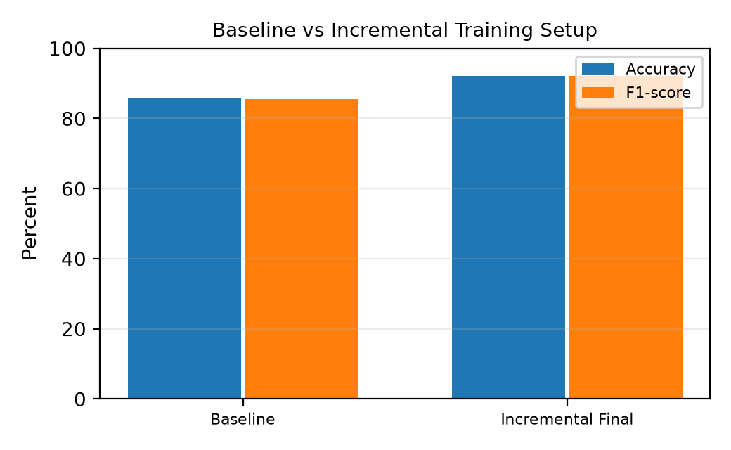
Baseline Problem: Training Setup Mattered
The first simple CNN was not bad, but the setup underperformed.
Baseline CNN
Incremental CNN
85.60%
92.07%
• CNN architecture stayed the same.
• Crop scale was restricted to preserve global structure.
• Tuning increased from 4 to 6 epochs.
• Accuracy improved by +6.47 percentage points.
EuroSAT Capstone | 6

Slide 7
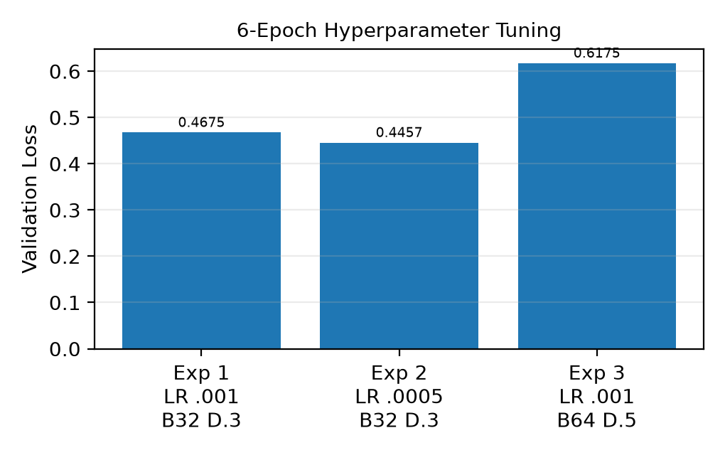
Hyperparameter Tuning
Experiment 2 was selected using lowest validation loss.
Exp | LR | Batch | Dropout | Val Loss
1 | 0.0010 | 32 | 0.30 | 0.4675
2 | 0.0005 | 32 | 0.30 | 0.4457
3 | 0.0010 | 64 | 0.50 | 0.6175
• Validation loss was the selection metric.
• Experiment 2 gave the lowest validation loss.
• Final training used LR=0.0005, batch=32, dropout=0.3.
EuroSAT Capstone | 7

Slide 8
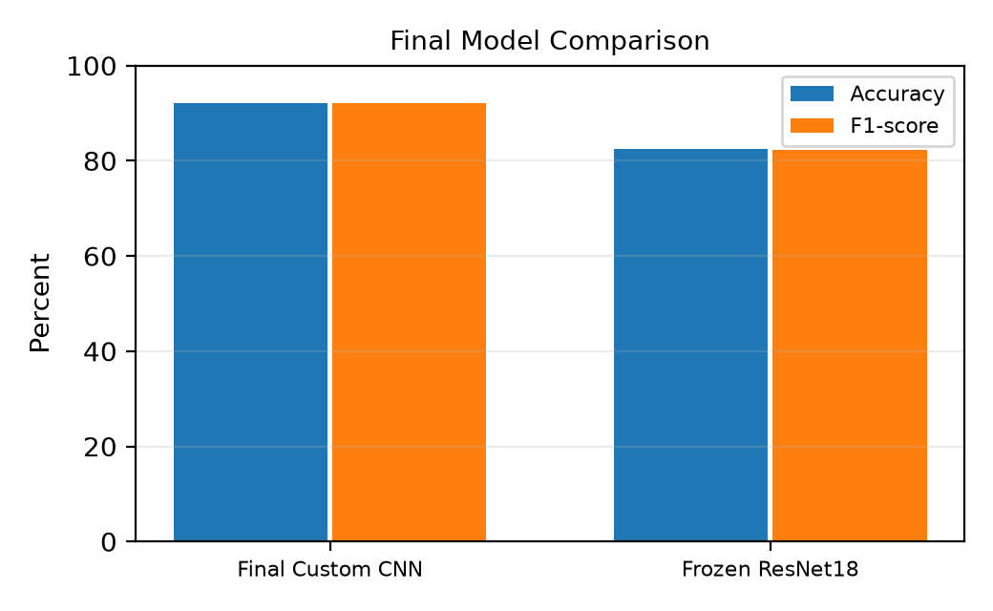
Final Model Comparison
The final Custom CNN outperformed the frozen ResNet18 baseline.
Final CNN Accuracy
ResNet18 Accuracy
92.07%
82.44%
• ResNet18 was used as a frozen feature extractor.
• Only the final classification layer was trained.
• EuroSAT satellite images differ from ImageNet natural images.
• Future work could unfreeze later ResNet blocks.
EuroSAT Capstone | 8

Slide 9
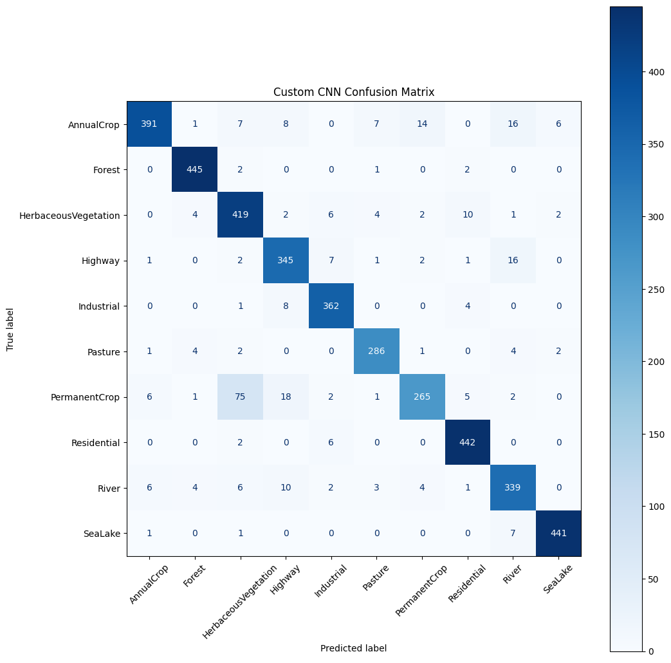
Final Confusion Matrix
Errors mainly occur between visually similar land-use classes.
• Most classes are predicted reliably.
• Remaining errors are mostly between agricultural and vegetation classes.
• Linear structures such as River and Highway can also be visually similar.
• Per-class evaluation is more informative than accuracy alone.
Final test accuracy: 92.07%
EuroSAT Capstone | 9

Slide 10
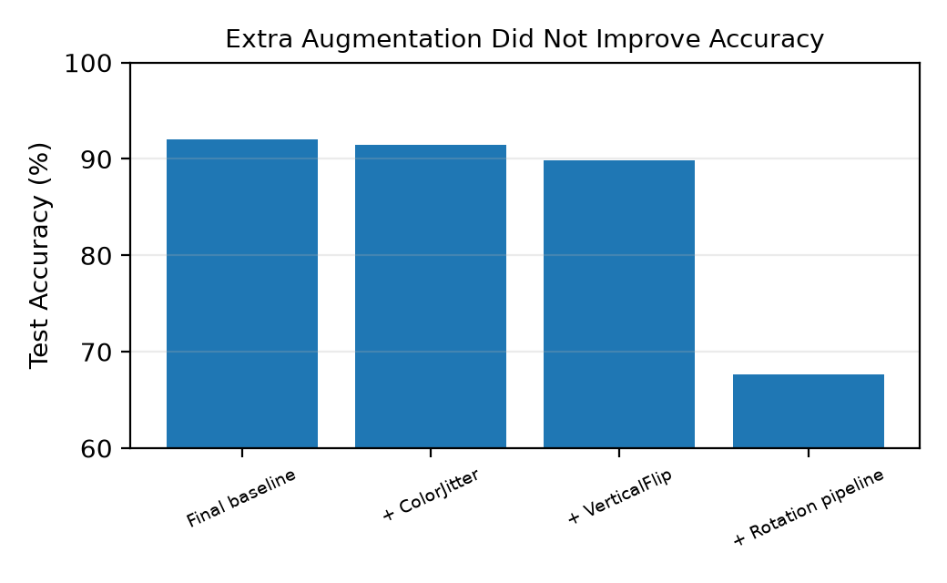
Ablation Study: More Augmentation Was Not Better
Extra preprocessing was tested one method at a time.
Setting | Acc. | Change
Final baseline | 92.07% | 0.00 pp
+ ColorJitter | 91.48% | -0.59 pp
+ VerticalFlip | 89.83% | -2.25 pp
+ Rotation pipeline | 67.60% | -24.47 pp
Rotation result is interpreted cautiously because the tested pipeline also included resize-and-crop operations.
EuroSAT Capstone | 10

Slide 11
Conclusion and Future Work
A simple 3-layer CNN achieved strong EuroSAT performance.
Accuracy
F1-score
Best method
92.07%
92.09%
Simple aug.
• Training setup mattered more than adding architecture complexity.
• Restricted crop preserved useful satellite-image structure.
• Extra augmentation was tested but not adopted.
• Future work: fine-tune ResNet18, test larger image size, add Grad-CAM, and repeat with multiple seeds.
Final takeaway: more preprocessing was not automatically better; the best model used the simplest validated pipeline.
EuroSAT Capstone | 11

