Slide 1

AUTOBOT
Team Members:
Bhavya Bansal (bbansal) Nitish Raghunathan (nraghun4) Pushpendra Singh Patel (ppatel16) Rezvan Mahdavi Hezaveh (rmahdav) Tanay Kothari (tkothar)
North Carolina State University
Dr. Christopher Parnin
CSC-510: Software Engineering
Fall 2017

Slide 2

Problem Statement
TIME TO PROVISION AND MANAGE VMs
Notes:
While development, there are many tasks that developers are responsible for. Some of these tasks are really tedious but are necessary to be performed. During the course of this project we have identified few such tasks and provided an automated solution to perform them.
Developers are responsible for managing their own virtual resources which includes creating virtual machines, installing necessary applications or packages on it and much more. These tasks are take ample amount of the developer’s time which could be used efficiently solving bigger problems.

Slide 3



Problem Statement
SETTING UP IDEs
Notes:
Also, setting up development environments with IDEs such as Eclipse can be a painful task as it involves creation of workspaces, installing required plugins and finally importing all the build projects into the workspace.

Slide 4

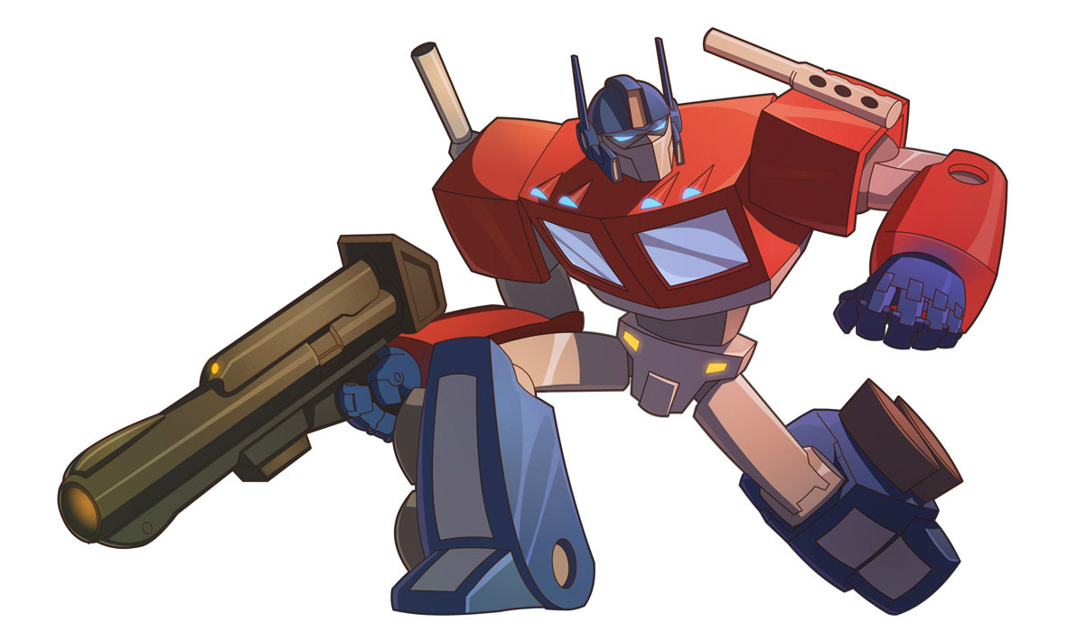
AUTOBOT is here to help!
Notes:
Our solution to these problems is Autobot, a slackbot which automates the provisioning and managing VMs. Autobot is also capable to IDE plugins on the VMs so that the users a free of such hassle.

Slide 5
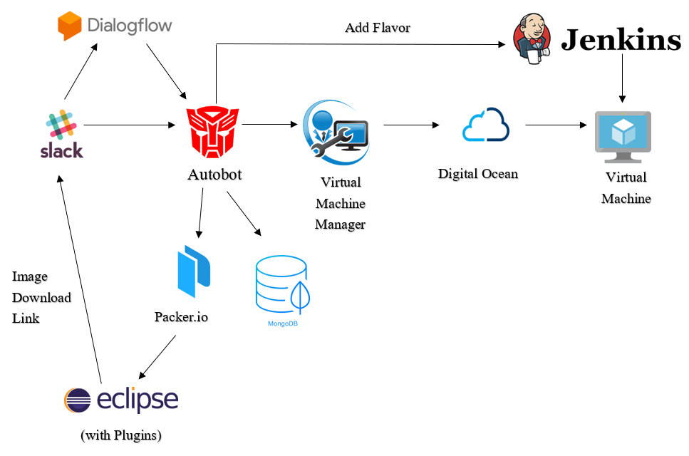
Architecture Design
Notes:
Autobot interacts with the user and uses Dialogflow API to understand what the user says. This makes it a Responder bot. Further, Autobot uses Digital Ocean platform, to create and host virtual machines requested by the user. These can be either plain VMs or even flavored with Jenkins on top. To provide virtual machines that can run on user’s local environment, Autobot makes the use of Packer to create these VMs with Eclipse pre-installed along with some of its plugins. All the user requests made through Autobot are stored in a database using MongoDB.

Slide 6
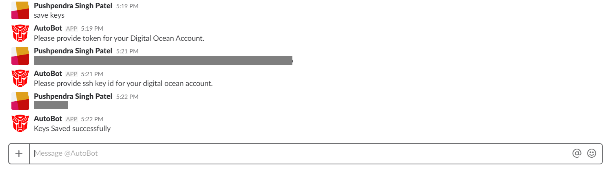

SETTING UP CREDENTIALS
Notes:
For creation of any virtual machine, Autobot needs to save the user’s credentials once. These are the token and SSH ID belonging to the user’s Digital Ocean account. These credentials are stored in the MongoDB database to further create and manage VMs.

Slide 7
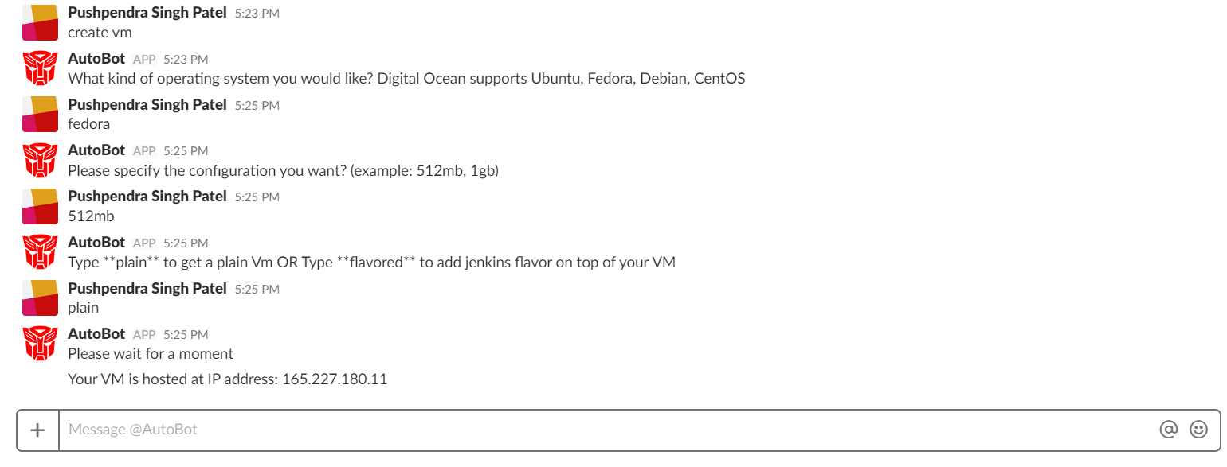
USE CASE 1 : Creating Plain VM
Notes:
With these credentials, Autobot is capable to create virtual machines with flexible configurations. Here, Autobot creates a plain virtual machine with custom Operating System and RAM as desired by the user.

Slide 8
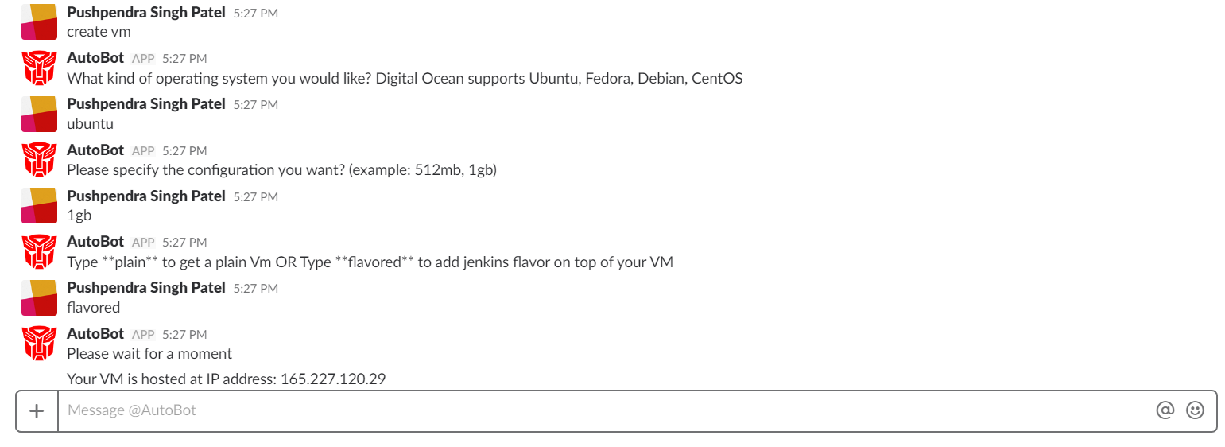

USE CASE 1 : Creating Flavored VM
Notes:
The process to create a Jenkins flavored is similar. Just instead of a plain VM, user needs to request for a flavored VM

Slide 9
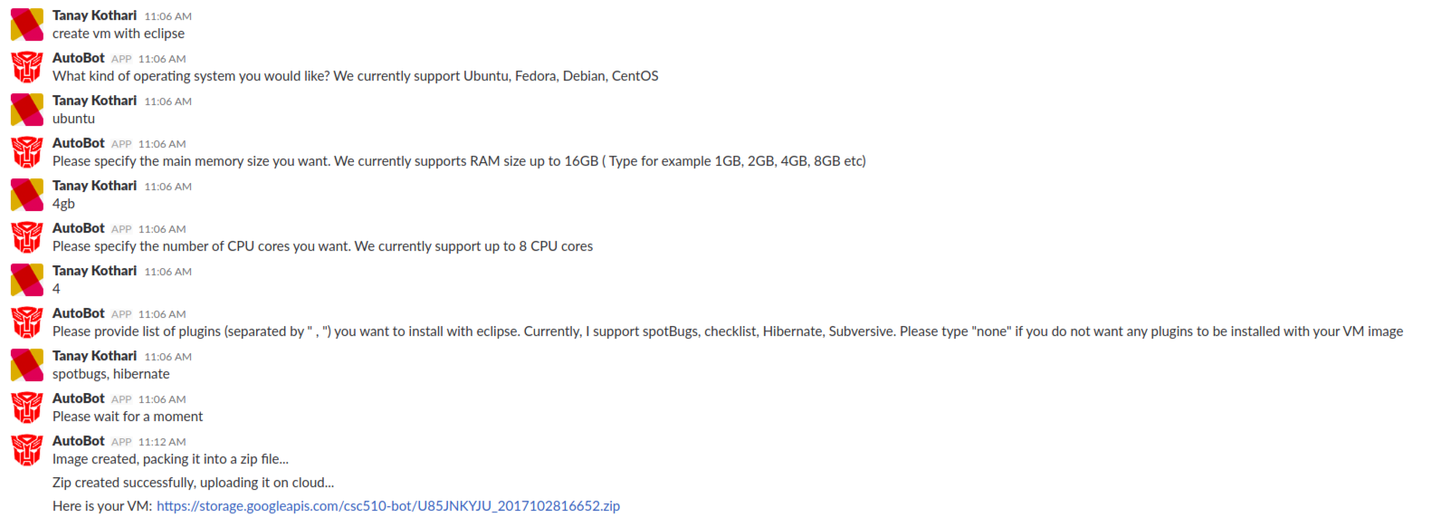
USE CASE 2 : VM with Eclipse IDE + Plugins
Notes:
Autobot is also capable to create virtual machines that users can run on their local machine. These VMs can have desired configuration and contain Eclipse IDE pre-installed on them. Users are also provided with a choice of Eclipse plugins that they can get installed on these VMs.

Slide 10
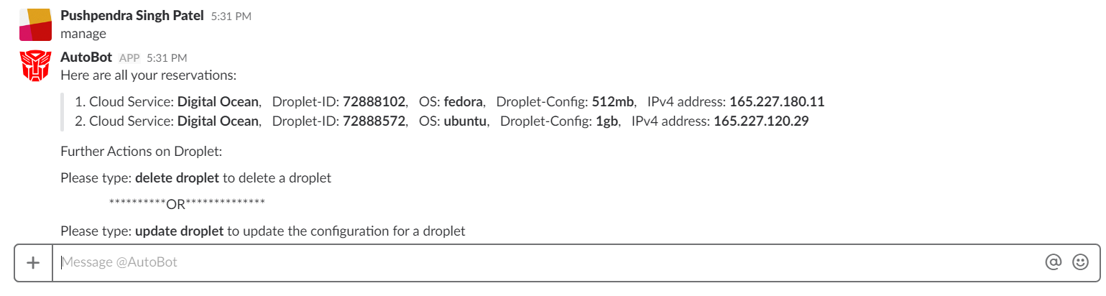
USE CASE 3 : Managing VMs
Notes:
Autobot can always manage your reservations with no sweat. The user just has to write “manage” or “manage reservations” and Autobot will display all the reservations of the user. The user can then update the configuration or destroy the virtual machine.

Slide 11
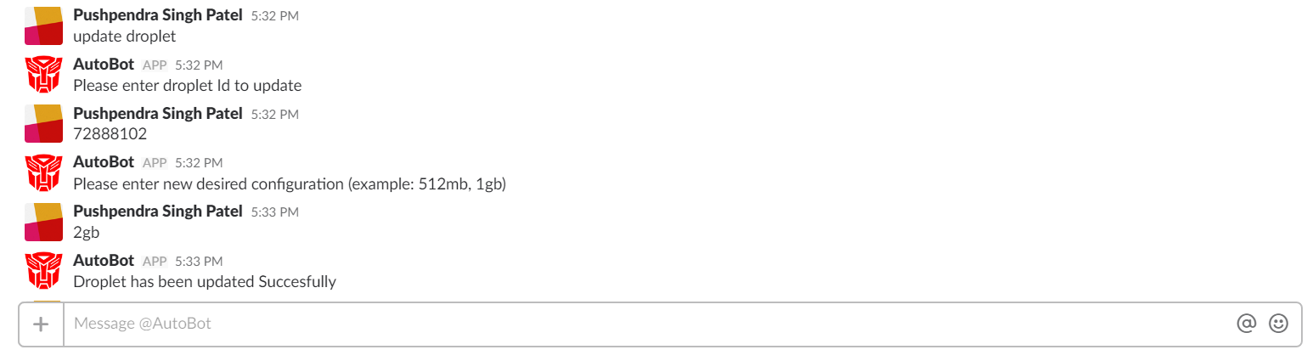
USE CASE 3 : Update Configurations
Notes:
For updating the configuration of the virtual machine, the user can write update droplet and enter the droplet ID and then provide the new configuration.

Slide 12
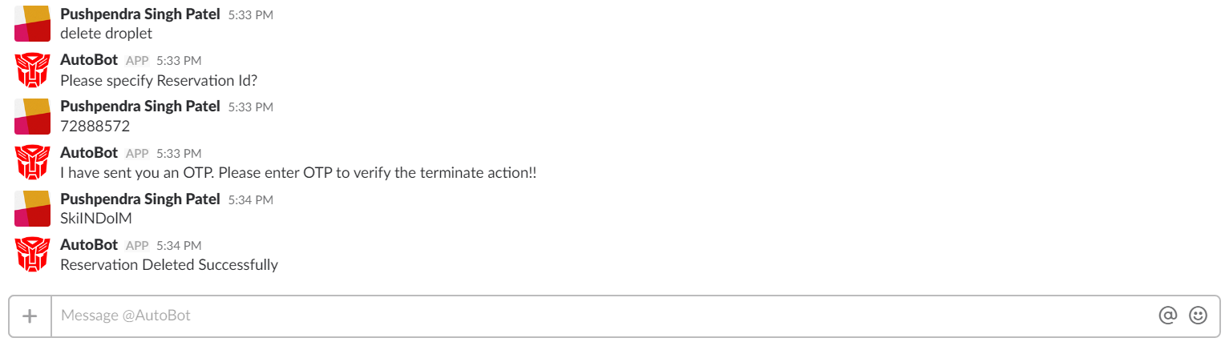
USE CASE 3 : Destroy VM
Notes:
The user can destroy the virtual machine by writing delete droplet and provide the reservation ID. But Autobot really cares about you so, it sends an One Time Password to the user’s email account for confirmation. After entering the OTP, Autobot destroys the virtual machine.

Slide 13

ONE FOR ALL:
DEVELOPERS
TESTERS
PROJECT MANAGERS
Notes:
Autobot takes off the load and precious time of the developers, testers and project managers by automating these mundane, tedious and time consuming tasks, and help focus on bigger things.

Slide 14
THANK YOU!
Notes:
Thank You for watching this video.

