Slide 1
Cake
+## #;;'
#;;# .+;;;;+,
'+;;#;,+';;;;;'#.
++'''';;;;;;;;;;# ;#;
##';;;;++'+#;;;;;'. `#:
;# '+'';;;;;;;;;'#` #.
`#, .'++;;;;;':..........#
'+ `.........';;;;':.........#
#..................+;;;;;':........#
#..................#';;;;;'+''''''.#
#.......,:;''''''''##';;;;;'+'''''#,
#''''''''''''''''''###';;;;;;+''''#
#''''''''''''''''''####';;;;;;#'''#
#''''''''''''''''''#####';;;;;;#''#
#''''''''''''''''''######';;;;;;#'#
#''''''''''''''''''#######';;;;;;##
#''''''''''''''''''########';;;;;;#
#''''''''''''++####+;#######';;;;;;#
#+####':,` ,#####';;;;;;'
+##'''''+.
___ _ ___ _ _ _
/ __\__ _| | _____ / __\_ _(_) | __| |
/ / / _` | |/ / _ \/__\// | | | | |/ _` |
/ /___ (_| | < __/ \/ \ |_| | | | (_| |
\____/\__,_|_|\_\___\_____/\__,_|_|_|\__,_|
Open source CI/CD pipeline

Slide 2
Welcome!
+## #;;'
#;;# .+;;;;+,
'+;;#;,+';;;;;'#.
++'''';;;;;;;;;;# ;#;
##';;;;++'+#;;;;;'. `#:
;# '+'';;;;;;;;;'#` #.
`#, .'++;;;;;':..........#
'+ `.........';;;;':.........#
#..................+;;;;;':........#
#..................#';;;;;'+''''''.#
#.......,:;''''''''##';;;;;'+'''''#,
#''''''''''''''''''###';;;;;;+''''#
#''''''''''''''''''####';;;;;;#'''#
#''''''''''''''''''#####';;;;;;#''#
#''''''''''''''''''######';;;;;;#'#
#''''''''''''''''''#######';;;;;;##
#''''''''''''''''''########';;;;;;#
#''''''''''''++####+;#######';;;;;;#
#+####':,` ,#####';;;;;;'
+##'''''+.
___ _ ___ _ _ _
/ __\__ _| | _____ / __\_ _(_) | __| |
/ / / _` | |/ / _ \/__\// | | | | |/ _` |
/ /___ (_| | < __/ \/ \ |_| | | | (_| |
\____/\__,_|_|\_\___\_____/\__,_|_|_|\__,_|
Mattias Karlsson
 https://medium.com/@devlead
 https://github.com/devlead
 https://twitter.com/devlead
❶ https://www.linkedin.com/in/devlead/
 https://officehours.io/people/devlead
 https://devlead.se

Slide 3
Agenda
Agenda
CI / CD why?
Cake intro
Cake demos
Cake’s OSS pipeline
Questions
CI / CD why?
Cake intro
Cake demos
Cake’s OSS pipeline
Questions



Slide 4

Mattias Karlsson
Mattias Karlsson
❻ Microsoft Azure MVP
 OzCode Magician
 Sr. architect, developer & partner at WCOM AB
 Started coding since late 80's on the C128
 First love was the Amiga 500
 Husband of 1 & father of 2
 Maintainer & Contributor Cake
❻ Microsoft Azure MVP
 OzCode Magician
 Sr. architect, developer & partner at WCOM
 Started coding since late 80's on the C128
 First love was the Amiga 500
 Husband of 1 & father of 2
 Maintainer & Contributor Cake

Slide 5
Why CI / CD?
Why CI / CD?
Reproducible
Quality
Confidence
Fidelity
Reproducible
Quality
Confidence
Fidelity



Slide 6
"The definition of insanity is doing the same thing over and over and expecting different results.” -Unknown

Slide 7
"The definition of sanity is doing the same thing over and over and expecting same results.”
- Mattias, 2018

Slide 8
Automation
Consistency
Reproducibility
Automation
Consistency
Reproducibility
Quality
Confidence
Quality
Confidence

Slide 9
WORKS
ON MY MACHINE! ¯\_(ツ)_/¯

Slide 10
WORKS ON ANY MACHINE!

Slide 11



Slide 12
The traits & goals of Cake
The traits & goals of Cake
Capable
Extensible
Modular
Configurable
Open Source
Communital
Everywhere
Available
Capable
Extensible
Modular
Configurable
Open Source
Communital
Everywhere
Available



Slide 13
Capable
Capable
Supports many common build tools / tasks OOTB
MSBuild / Xbuild
.NET Core CLI
NUnit / Xunit / MSTest / VSTest
NuGet / Chocolatey / ZIP
Globbing / Cleaning
etc.
400+ built-in aliases
Supports many common build tools / tasks OOTB
MSBuild / Xbuild
.NET Core CLI
NUnit / Xunit / MSTest / VSTest
NuGet / Chocolatey / ZIP
Globbing / Cleaning
etc.
400+ built-in aliases



Slide 14
Extensible
Extensible
NuGet
.NET Assemblies
Addins
Scripts
Tools
NuGet
.NET Assemblies
Addins
Scripts
Tools



Slide 15
Modular
Modular
Replace / Extend internals of Cake
Add core functionality
Tool resolution
Preprocessor directives
File system
Logging
etc.
Replace / Extend internals of Cake
Add core functionality
Tool resolution
Preprocessor directives
File system
Logging
etc.



Slide 16
Configurable
Configurable
Cake lets you through
Environment variables
Configuration file
Command line arguments
Control things like
Default behaviors (opt in/out features)
Default paths for tools, addins & modules
Default NuGet sources
Cake lets you through
Environment variables
Configuration file
Command line arguments
Control things like
Default behaviors (opt in/out features)
Default paths for tools, addins & modules
Default NuGet sources



Slide 17
Open source
Open source
Permissive MIT License
Source available on GitHub
Developed in the open
Member of the .NET Foundation
Permissive MIT License
Source available on GitHub
Developed in the open
Member of the .NET Foundation



Slide 18
.NET Foundation
.NET Foundation
Ensures longevity and stewardship of the project
Make .NET a credible open source development platform
Provide support to open source projects in the .NET ecosystem
Develop the grassroots .NET community
Takes on copyright and legal support
Does NOT take control of the project
Ensures longevity and stewardship of the project
Make .NET a credible open source development platform
Provide support to open source projects in the .NET ecosystem
Develop the grassroots .NET community
Takes on copyright and legal support
Does NOT take control of the project
○
○

Slide 19
Communital
Communital
Welcoming
Approachable
Civil
Helpful
Awesome
Welcoming
Approachable
Civil
Helpful
Awesome



Slide 20
Everywhere
Everywhere
Cross platform
Cross environment
Cross runtime
Cross platform
Cross environment
Cross runtime
⧫
⧫

Slide 21
Cross platform
Cross platform
Mac
Mac


Linux
Linux
Windows
Windows





Slide 22
Cross environment
Cross environment
AppVeyor
Bamboo
Bitbucket Pipelines
Bitrise
ContinuaCI
GitLab
GoCD
Jenkins
MyGet
TeamCity
TFS
VSTS
TravisCI
Developers machine
AppVeyor
Bamboo
Bitbucket Pipelines
Bitrise
ContinuaCI
GitLab
GoCD
Jenkins
MyGet
TeamCity
TFS
VSTS
TravisCI
Developers machine



Slide 23
Cross runtime
Cross runtime
.NET Full / Desktop
.NET Core
Mono
.NET Full / Desktop
.NET Core
Mono



Slide 24
Available
Available
NuGet
Chocolatey
Homebrew
GitHub
Docker HUB*
MyGet
NuGet
Chocolatey
Homebrew
GitHub
Docker HUB*
MyGet



Slide 25
So what is it?
So what is it?
Cake is a .NET based,
open source,
build orchestration tool,
with a C# scripting DSL,
powered by Roslyn
Cake is a .NET based,
open source,
build orchestration tool,
with a C# scripting DSL,
powered by Roslyn.



Slide 26
Obtaining Cake
Obtaining Cake
Default recommended way is via NuGet through official bootstrappers
build.ps1 
build.sh  
Default recommended way is via NuGet through official bootstrappers
build.ps1 
build.sh  



Slide 27


Obtaining Cake
Obtaining Cake
Invoke-WebRequest https://cakebuild.net/download/bootstrapper/windows -OutFile build.ps1
curl -Lsfo build.sh https://cakebuild.net/download/bootstrapper/linux
curl -Lsfo build.sh https://cakebuild.net/download/bootstrapper/osx
Invoke-WebRequest https://cakebuild.net/download/bootstrapper/windows -OutFile build.ps1
curl -Lsfo build.sh https://cakebuild.net/download/bootstrapper/linux
curl -Lsfo build.sh https://cakebuild.net/download/bootstrapper/osx

Slide 28


Why C# scripting?
Why C# scripting?
No cruft
No project files
No solution files
No class / Main()
Low ceremony
Self contained
No cruft
No project files
No solution files
No class / Main()
Low ceremony
Self contained
Compiled…
…the whole script
Strongly typed
Backed by all of .NET
Same experience regardless of…
SDK / Framework / Environment
Compiled…
…the whole script
Strongly typed
Backed by all of .NET
Same experience regardless of…
SDK / Framework / Environment
 CODE
 CODE

Slide 29
Information("Hello world!");

Slide 30
DSL?
DSL?
Task orchestrator
Preprocsessor directives
Aliases
Global Methods
Global Properties
Task orchestrator
Preprocsessor directives
Aliases
Global Methods
Global Properties



Slide 31
Task orchestration
Task orchestration


Clean
Task(“Clean”)
Task(“Clean”)
Restore
Task(“Restore”)
Task(“Restore”)
Build
Task(“Build”)
Task(“Build”)
.IsDependentOn(“Clean”)
.IsDependentOn(“Restore”)
.IsDependentOn(“Clean”)
.IsDependentOn(“Restore”)
Test
Task(“Test”)
Task(“Test”)
Package
Task(“Package”)
Task(“Package”)
Publish
Task(“Publish”)
Task(“Publish”)
.IsDependentOn(“Build”)
.IsDependentOn(“Build”)
.IsDependentOn(“Test”)
.IsDependentOn(“Test”)
.IsDependentOn(“Package”)
.IsDependentOn(“Package”)
 CODE

Slide 32
Task("Clean");
Task("Restore");
Task("Build")
.IsDependentOn("Clean")
.IsDependentOn("Restore");
Task("Test")
.IsDependentOn("Build");
Task("Package")
.IsDependentOn("Test");
Task("Publish")
.IsDependentOn("Package");

Slide 33
Task lifecycle
Task lifecycle
Setup
TaskSetup
Task
TaskTeardown
Teardown
Setup
TaskSetup
Task
TaskTeardown
Teardown


 CODE

Slide 34


Setup / Teardown
Setup / Teardown
Setup(context =>
{
// Executed BEFORE the first task.
});
Teardown(context =>
{
// Executed AFTER the last task.
});
Setup(context =>
{
// Executed BEFORE the first task.
});
Teardown(context =>
{
// Executed AFTER the last task.
});

Slide 35


Task Setup / Teardown
Task Setup / Teardown
TaskSetup((context, task) =>
{
var message = string.Format("Task: {0}", task.Task.Name);
// custom logging
});
TaskTeardown((context, task) =>
{
var message = string.Format("Task: {0}", task.Task.Name);
// custom logging
});
TaskSetup((context, task) =>
{
var message = string.Format("Task: {0}", task.Task.Name);
// custom logging
});
TaskTeardown((context, task) =>
{
var message = string.Format("Task: {0}", task.Task.Name);
// custom logging
});

Slide 36
Preprocessor directives
Preprocessor directives
Addin directive
Load directive
Module directive
Reference directive
Tool directive
Shebang directive
Break directive
Using directive
Addin directive
Load directive
Module directive
Reference directive
Tool directive
Shebang directive
Break directive
Using directive



Slide 37
Addin directive
Addin directive


#addin nuget:?package=Cake.Foo
#addin nuget:?package=Cake.Foo&version=1.2.3
#addin nuget:?package=Cake.Foo&prerelease
#addin nuget:https://myget.org/f/Cake/?package=Cake.Foo&prerelease
#addin nuget:?package=Cake.Foo&exclude=/**/NoFoo.dll
#addin nuget:?package=Cake.Foo&include=/**/Foo.dll
#addin nuget:?package=Cake.Foo
#addin nuget:?package=Cake.Foo&version=1.2.3
#addin nuget:?package=Cake.Foo&prerelease
#addin nuget:https://myget.org/f/Cake/?package=Cake.Foo&prerelease
#addin nuget:?package=Cake.Foo&exclude=/**/NoFoo.dll
#addin nuget:?package=Cake.Foo&include=/**/Foo.dll

Slide 38
Load directive
Load directive


#l scripts/utilities.cake
#load scripts/utilities.cake
#l nuget:?package=utilities.cake
#load nuget:?package=My.Cake.Scripts
#load nuget:?package=My.Cake.Scripts&exclude=/**/NoFoo.cake
#load nuget:?package=My.Cake.Scripts&include=/**/Foo.cake
#l scripts/utilities.cake
#load scripts/utilities.cake
#l nuget:?package=utilities.cake
#load nuget:?package=My.Cake.Scripts
#load nuget:?package=My.Cake.Scripts&exclude=/**/NoFoo.cake
#load nuget:?package=My.Cake.Scripts&include=/**/Foo.cake

Slide 39
Module directive
Module directive


#module nuget:?package=Cake.Foo.Module
#module nuget:?package=Cake.Foo.Module&version=1.2.3
./cake.exe build.cake --bootstrap
#module nuget:?package=Cake.Foo.Module
#module nuget:?package=Cake.Foo.Module&version=1.2.3
./cake.exe build.cake --bootstrap

Slide 40
Reference directive
Reference directive


#r "bin/myassembly.dll"
#reference "bin/myassembly.dll"
#r "bin/myassembly.dll"
#reference "bin/myassembly.dll"

Slide 41
Tool directive
Tool directive


#tool nuget:?package=Cake.Foo
#tool nuget:?package=Cake.Foo&version=1.2.3
#tool nuget:?package=Cake.Foo&prerelease
#tool nuget:https://myget.org/f/Cake/?package=Cake.Foo&prerelease
#tool nuget:?package=Cake.Foo&exclude=/**/NoFoo.exe
#tool nuget:?package=Cake.Foo&include=/**/Foo.exe
#tool nuget:?package=Cake.Foo
#tool nuget:?package=Cake.Foo&version=1.2.3
#tool nuget:?package=Cake.Foo&prerelease
#tool nuget:https://myget.org/f/Cake/?package=Cake.Foo&prerelease
#tool nuget:?package=Cake.Foo&exclude=/**/NoFoo.exe
#tool nuget:?package=Cake.Foo&include=/**/Foo.exe

Slide 42
Shebang directive
Shebang directive


#!path/to/launch/cake
#!path/to/launch/cake

Slide 43
Break directive
Break directive


#break
#break

Slide 44
Using directive
Using directive


using Newtonsoft.Json;
System System.Collections.Generic System.Text
System.Linq System.Threading.Tasks System.IO
Cake.Core Cake.Core.Scripting Cake.Core.IO
Cake.Core.Diagnostics
…and namespaces for alias methods & properties
using Newtonsoft.Json;
System System.Collections.Generic System.Text
System.Linq System.Threading.Tasks System.IO
Cake.Core Cake.Core.Scripting Cake.Core.IO
Cake.Core.Diagnostics
…and namespaces for alias methods & properties

Slide 45
Using static directive
Using static directive


using static System.Math;
Information(Round(1.1));
using static System.Math;
Information(Round(1.1));

Slide 46
Aliases
Aliases
Argument
Environment variables
Cleaning
Globbing
MSBuild
.NET Core CLI
…etc.
Argument
Environment variables
Cleaning
Globbing
MSBuild
.NET Core CLI
…etc.



Slide 47
Cake TL;DR
Cake TL;DR
Build orchestration tool
Superset of C#
Cross platform, environment & runtime
Configurable, extensible & modular
Versioned build & release definition
Build orchestration tool
Superset of C#
Cross platform, environment & runtime
Configurable, extensible & modular
Versioned build & release definition
∑
∑

Slide 48
Cake’s process
Cake’s process
Issue
Acceptance (Label & Milestone)
Pullrequest
Review
Merge
Release
Issue
Acceptance (Label & Milestone)
Pullrequest
Review
Merge
Release



Slide 49
Cake’s pull request flow
Cake’s pull request flow
Fork
Work
Submit
Automatic review (CI)
Manual review
Accept / Reject
Merge / Close
Fork
Work
Submit
Automatic review (CI)
Manual review
Accept / Reject
Merge / Close



Slide 50
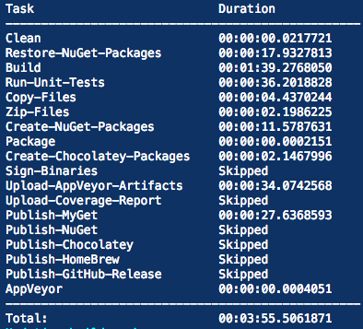
Cake’s pull request flow


Slide 51
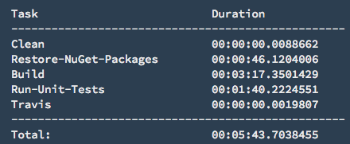
Cake’s pull request flow


Slide 52
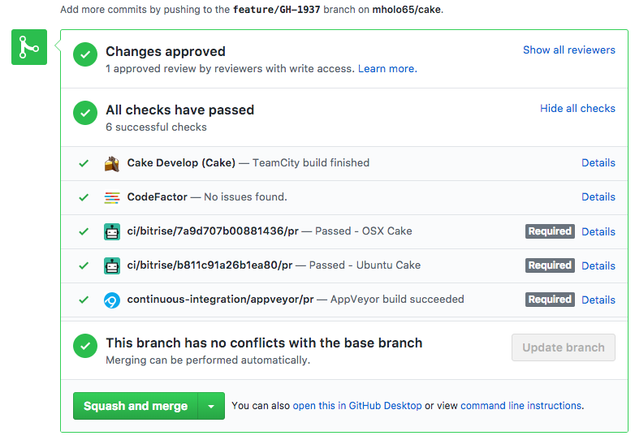
Cake’s pull request flow


Slide 53
Cake’s release flow
Cake’s release flow
Triage issues
Create release
CI/CD Magic (Cake script ☺)
Validate
Write blog post
Triage issues
Create release
CI/CD Magic (Cake script ☺)
Validate
Write blog post



Slide 54
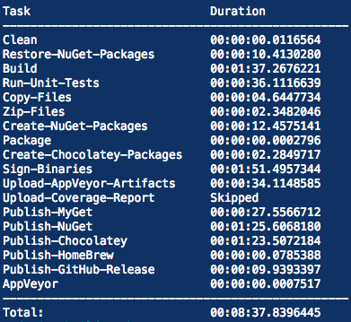
Cake’s release flow


Slide 55
Cake’s pre-release flow
Cake’s pre-release flow
Merge pull request
CI/CD Magic (Cake script ☺)
Merge pull request
CI/CD Magic (Cake script ☺)



Slide 56
Cake’s pre-release flow


Slide 57
Cake’s standard GIT flow
Cake’s standard GIT flow
Feature branch based on development
Merge into development
Merge into master
Feature branch based on development
Merge into development
Merge into master



Slide 58
Cake’s hotfix GIT flow
Cake’s hotfix GIT flow
Feature branch based on master
Merge into master
Merge into development
Feature branch based on master
Merge into master
Merge into development



Slide 59
Maintaining?
Maintaining?

Triaging issues & pull requests
Support
gitter.im/cake-build/cake
stackoverflow.com #cakebuild
The build server house keeper
Containers
…and a fair bit of coding too

Triaging issues & pull requests
Support
gitter.im/cake-build/cake
stackoverflow.com #cakebuild
The build server house keeper
Containers
…and a fair bit of coding too

Slide 60
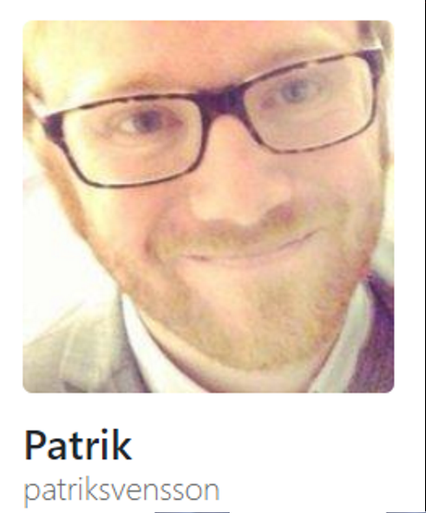
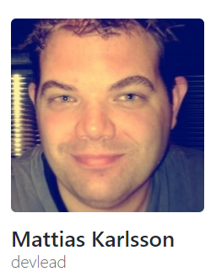


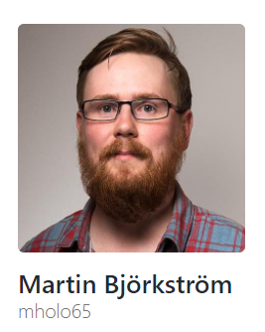
The Team
May
2014
September
2014
October
2015
September
2016
April
2017
May
2014
September
2014
October
2015
September
2016

Slide 61
Questions
?


Slide 62
THANKS!
+## #;;'
#;;# .+;;;;+,
'+;;#;,+';;;;;'#.
++'''';;;;;;;;;;# ;#;
##';;;;++'+#;;;;;'. `#:
;# '+'';;;;;;;;;'#` #.
`#, .'++;;;;;':..........#
'+ `.........';;;;':.........#
#..................+;;;;;':........#
#..................#';;;;;'+''''''.#
#.......,:;''''''''##';;;;;'+'''''#,
#''''''''''''''''''###';;;;;;+''''#
#''''''''''''''''''####';;;;;;#'''#
#''''''''''''''''''#####';;;;;;#''#
#''''''''''''''''''######';;;;;;#'#
#''''''''''''''''''#######';;;;;;##
#''''''''''''''''''########';;;;;;#
#''''''''''''++####+;#######';;;;;;#
#+####':,` ,#####';;;;;;'
+##'''''+.
___ _ ___ _ _ _
/ __\__ _| | _____ / __\_ _(_) | __| |
/ / / _` | |/ / _ \/__\// | | | | |/ _` |
/ /___ (_| | < __/ \/ \ |_| | | | (_| |
\____/\__,_|_|\_\___\_____/\__,_|_|_|\__,_|
✴
Mattias Karlsson - @devlead

Slide 63

Contact info
Mattias
 https://medium.com/@devlead
 https://github.com/devlead
 https://twitter.com/devlead
❶ https://www.linkedin.com/in/devlead/
 https://officehours.io/people/devlead
 https://devlead.se
Cake
 http://cakebuild.net/
 https://medium.com/@cakebuildnet
 https://github.com/cake-build
 https://twitter.com/cakebuildnet
 https://gitter.im/cake-build/cake

