Slide 1
BI-Zillow Rent Index
Yang Liao
The University of Chicago
liaoy@uchicago.edu

Slide 2
Project Introduction
Objective: Develop a BI solution to present and analyze rent index data from Zillow
Data source: Zillow research data
BI tools: SQL Server 2016, SSIS and SSRS

Slide 3
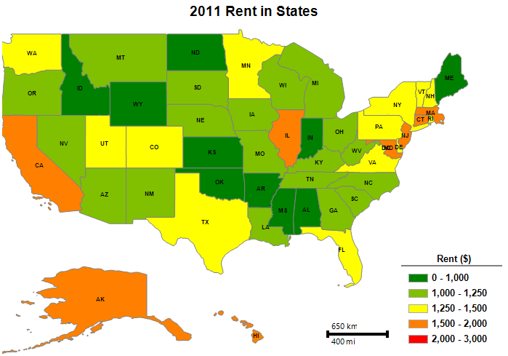
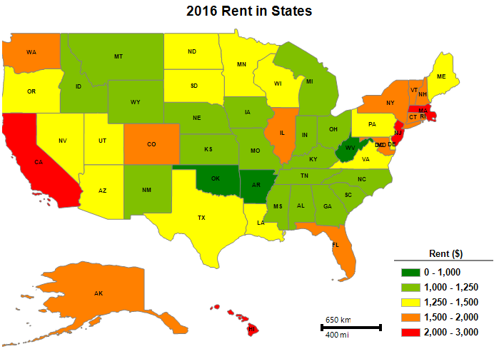
USA Rent Map (2011 vs 2016)

Slide 4
City Rent Highest TOP10 (2010 vs 2017)
2010 USA City Rent Rank
City | State | Rent
Jupiter Island | FL | $18,848
Belvedere | CA | $11,852
Westlake | TX | $11,649
Atherton | CA | $11,525
Ross | CA | $9,967
Rolling Hills | CA | $9,863
Fisher Island | FL | $9,632
Rancho Santa Fe | CA | $9,481
Hidden Hills | CA | $9,345
Stinson Beach | CA | $9,049
2017 USA City Rent Rank
City | State | Rent
Jupiter Island | FL | $17,985
Atherton | CA | $16,575
Fisher Island | FL | $14,971
Hidden Hills | CA | $12,504
Rolling Hills | CA | $12,428
Hillsborough | CA | $11,796
Belvedere | CA | $11,612
Sea Island | GA | $11,490
Westlake | TX | $11,187
Portola Valley | CA | $10,626

Slide 5
City Rent Lowest TOP10 (2010 vs 2017)
2010 USA City Rent Rank
City | State | Rent
Oaklawn-Sunview | KS | $547
Youngstown | OH | $552
Pink | OK | $593
Drexel | OH | $601
Mulga | AL | $608
Hoisington | KS | $611
Tishomingo | OK | $615
Coffeyville | KS | $628
Stafford | KS | $629
Saint John | KS | $631
2017 USA City Rent Rank
City | State | Rent
Flint | MI | $549
Mount Morris | MI | $555
Youngstown | OH | $569
West End-Cobb Town | AL | $590
Drexel | OH | $605
Campbell | OH | $614
Warren | OH | $629
Electra | TX | $631
Springfield | OH | $635
Anderson | IN | $637

Slide 6
Metro Rent Highest TOP10 (2010 vs 2017)
2010 USA Metro Rent Rank
City | State | Rent
San Francisco | CA | $3,276
San Jose | CA | $3,163
Edwards | CO | $2,868
Port St. Lucie | FL | $2,677
Stamford | CT | $2,656
Los Angeles | CA | $2,506
San Diego | CA | $2,503
Brunswick | GA | $2,489
Ventura | CA | $2,487
Sarasota | FL | $2,353
2017 USA Metro Rent Rank
City | State | Rent
San Jose | CA | $4,381
San Francisco | CA | $4,360
Edwards | CO | $3,697
Brunswick | GA | $3,353
Key West | FL | $3,110
New York | NY | $3,085
Los Angeles | CA | $3,082
San Diego | CA | $2,992
Port St. Lucie | FL | $2,973
Fort Myers | FL | $2,969

Slide 7
Metro Rent Lowest TOP10 (2010 vs 2017)
2010 USA Metro Rent Rank
City | State | Rent
Great Bend | KS | $636
Shawnee | OK | $641
Coffeyville | KS | $664
Dodge City | KS | $678
Altus | OK | $684
Green Bay | WI | $688
Hutchinson | KS | $697
Florence | SC | $703
McAlester | OK | $705
Wisconsin Rapids-Marshfield | WI | $708
2017 USA Metro Rent Rank
City | State | Rent
Coffeyville | KS | $660
New Castle | PA | $695
Rolla | MO | $699
St. Joseph | MO | $707
Weirton | OH | $716
Altus | OK | $716
Great Bend | KS | $720
Connersville | IN | $726
Joplin | MO | $727
Lawton | OK | $732

Slide 8
City Rent Rank in IL States (2010 vs 2017)
2010 IL City Rent Rank
Rank | City | Population Rank | Rent
1 | Kenilworth | 8571 | $7,172
2 | Winnetka | 3661 | $5,534
3 | Glencoe | 4822 | $5,014
4 | Barrington Hills | 3952 | $4,394
5 | Lake Forest | 2669 | $4,195
6 | Hinsdale | 2751 | $3,756
7 | Oak Brook | 4456 | $3,452
8 | North Barrington | 12368 | $3,404
9 | Riverwoods | 7549 | $3,386
10 | Long Grove | 6187 | $3,358
2017 IL City Rent Rank
Rank | City | Population Rank | Rent
1 | Kenilworth | 8571 | $7,611
2 | Winnetka | 3661 | $6,229
3 | Glencoe | 4822 | $5,609
4 | Lake Forest | 2669 | $4,785
5 | Hinsdale | 2751 | $4,665
6 | Barrington Hills | 3952 | $4,592
7 | Riverwoods | 7549 | $4,074
8 | Oak Brook | 4456 | $3,902
9 | Long Grove | 6187 | $3,796
10 | North Barrington | 12368 | $3,679

Slide 9
Top City with Increased/Decreased Rent (2010 vs 2017)
2010-2017 USA City Rent Increased Rank
City | State | Rent Increased
Fisher Island | FL | $5,360
Atherton | CA | $5,236
Sea Island | GA | $3,920
Boca Grande | FL | $3,301
Hillsborough | CA | $3,194
Hidden Hills | CA | $3,175
Los Altos Hills | CA | $3,062
Clyde Hill | WA | $3,017
Medina | WA | $2,863
Portola Valley | CA | $2,754
2010-2017 USA City Rent Decreased Rank
City | State | Rent Decreased
Town of Westerly | RI | ($1,213)
Ross | CA | ($1,156)
Bald Head Island | NC | ($1,046)
Ashaway | RI | ($971)
Jupiter Island | FL | ($832)
Longboat Key | FL | ($822)
Corolla | NC | ($749)
Pine Knoll Shores | NC | ($745)
Holmes Beach | FL | ($643)
Holtville | CA | ($612)

Slide 10
City Rent/sqft Highest TOP10 (2010 vs 2017)
2010 USA City Rent Rank
City | State | Rent per sqft
Fisher Island | FL | 4.49
Belvedere | CA | 4.45
Stinson Beach | CA | 4.38
Jupiter Island | FL | 4.01
Ross | CA | 3.74
Del Mar | CA | 3.58
Malibu | CA | 3.51
Tiburon | CA | 3.41
Laguna Beach | CA | 3.35
Gulf Stream | FL | 3.22
2017 USA City Rent Rank
City | State | Rent per sqft
Fisher Island | FL | 6.40
Stinson Beach | CA | 5.17
Atherton | CA | 4.65
Jupiter Island | FL | 4.55
Belvedere | CA | 4.39
Malibu | CA | 4.34
Laguna Beach | CA | 4.31
Boca Grande | FL | 4.27
Del Mar | CA | 4.26
Beverly Hills | CA | 4.12

Slide 11
City Rent/sqft Lowest TOP10 (2010 vs 2017)
2010 USA City Rent Rank
City | State | Rent per sqft
Fort Mitchell | AL | 0.36
Wheeler | TX | 0.37
Elkin | NC | 0.37
Allouez | WI | 0.38
Dobson | NC | 0.38
Ashwaubenon | WI | 0.38
Mount Airy | NC | 0.40
State Road | NC | 0.40
Sealy | TX | 0.41
Green Bay | WI | 0.42
2017 USA City Rent Rank
City | State | Rent per sqft
Elkin | NC | 0.37
Dobson | NC | 0.39
Wheeler | TX | 0.40
State Road | NC | 0.40
New Castle | PA | 0.40
Mount Airy | NC | 0.41
Belen | NM | 0.41
Bosque Farms | NM | 0.42
Eastland | TX | 0.43
Marshalltown | IA | 0.43

Slide 12
Top City with Changed Rent/sqft (2010 vs 2017)
2010-2017 USA City Rent/sqft Increased Rank
City | State | Rent per sqft
Fisher Island | FL | 1.91
Boca Grande | FL | 1.69
Atherton | CA | 1.46
Palo Alto | CA | 1.36
North Fair Oaks | CA | 1.32
Captiva | FL | 1.28
Emeryville | CA | 1.28
Menlo Park | CA | 1.25
Beverly Hills | CA | 1.19
Broadmoor Village | CA | 1.19
2010-2017 USA City Rent/sqft Increased Rank
City | State | Rent per sqft
Town of Westerly | RI | (0.74)
Ashaway | RI | (0.72)
Bald Head Island | NC | (0.70)
Washington Park | IL | (0.53)
East Saint Louis | IL | (0.50)
Blythe | CA | (0.48)
Alorton | IL | (0.48)
Centreville | IL | (0.44)
Fairmont City | IL | (0.43)
Holtville | CA | (0.38)

