Slide 1
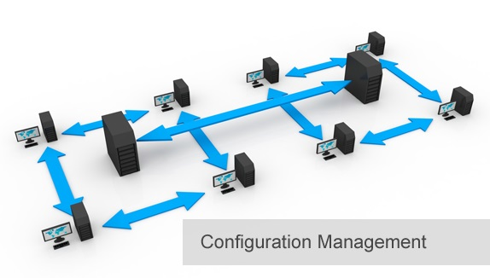
BCS 3293 SOFTWARE CONFIGURATION MANAGEMENT
Chapter One:
Source Code
Management

Slide 2
Chapter 1 Source Code Management
Why Is Source Code Management Important?
Source Code Management Core Concepts.
Managing the Globally Distributed Development Team.
Tools Selection
Recognizing the Cost of Quality
Defining the Usage Model

Slide 3
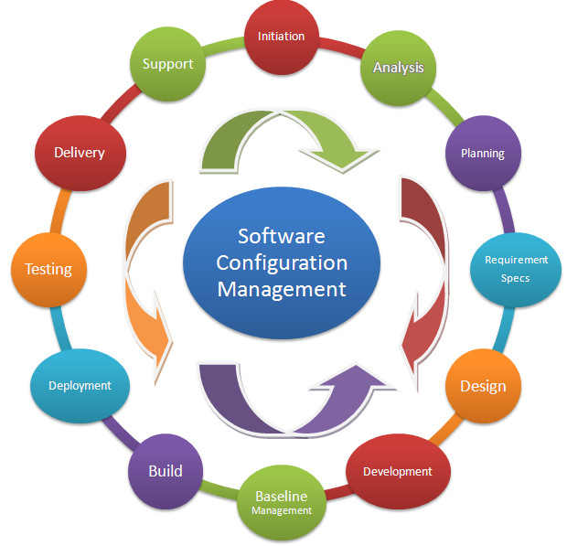
SCM ? 5W ?
Tracking and Controlling Changes in SDLC

Slide 4
SCM Functional Areas
Source code management
Build engineering
Environment configuration
Change control
Release engineering
Deployment

Slide 5

Source Code Management
Is a key function in SCM and directly impacts the productivity of your team and the quality of the product being developed.
Manage more than one line of code development at the same time.
Your assets secured and available in a controlled and reliable repository

Slide 6

Source Code Management Core Concepts
08:30 am
Baselines and Time Machines
Baselines must be Immutable
Sandboxes and Workspaces
Variant Management (Branching) and Copybranches.
Handle Bugfixes.
Streams.
Merging.
Changesets.
08:30 am .. Check in
Requesting “Registration V0.9”.
12:15 pm .. Check out
Then ??

Slide 7
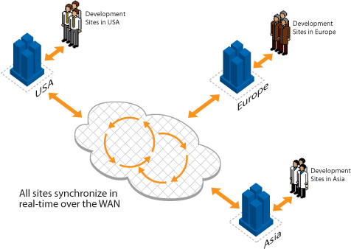
Managing the Globally Distributed Development Team
Change Requests (CRs)

Slide 8
Tools Selection
Ease of use
Branching capabilities
Merging (graphical and command line)
Baselining (such as tagging/labeling)
Changesets
Administration tools (such as checking for repository integrity)
Available training and support
Integration with common IDEs
Defect and requirements tracking
Open source versus commercial
Product maturity
Vendor commitment
Time to implement and risks to success
Your assignment is to find most suitable SCM tool

Slide 9
Recognizing the Cost of Quality
Planning for short or long term ?
Building your own repository or use 3rd party ?
How many staff you need ?
If you are kind of people who used to “setting for less” .. So be prepared for the Risks.

Slide 10
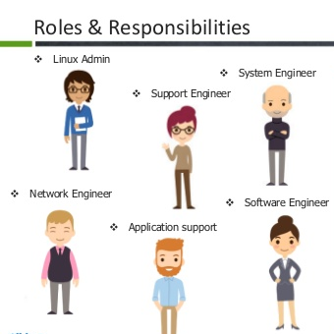
Defining the Usage Model
A staff dedicated to defining how your entire team will use the source code management tool.
How ?
Source code management is a team sport, and your source code management processes will be more effective if you have had the opportunity to learn and share CM best practices!

Slide 11
Thank you

