Slide 1
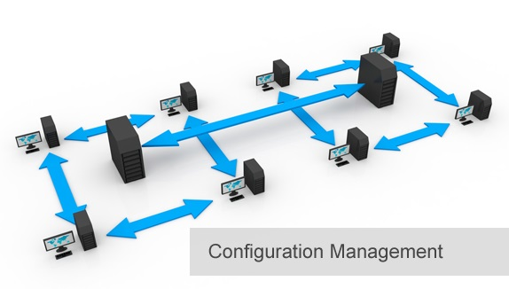
BCS 3293 SOFTWARE CONFIGURATION MANAGEMENT
Chapter Two:
Build Engineering

Slide 2
Chapter 2 Build Engineering
2.1 Why Is Build Engineering Important? 31
2.3 Build Engineering Core Concepts
2.4 Core Considerations for Scaling the Build Function
2.5 Build Tools Evaluation and Selection
2.6 Cost of Quality and Training
2.7 Making a Good Build Better
2.8 The Role of the Build Engineer
2.9 Architecture Is Fundamental
2.10 Establishing a Build Process
2.11 Continuous Integration Versus the Nightly Build
2.12 The Future of Build Engineering

Slide 3

Build Engineering
Able to reliably compile and link your source code into a binary executable in the shortest possible time.
Builds are understood and repeatable.
Builds are fast and reliable.
Every configuration item is identifiable.
Code should be built once and deployed anywhere.
Build anomalies are identified and managed in an acceptable way.
Every build consists of and creates Configuration Items (CIs).

Slide 4

Build Engineering Core Concepts
Version IDs or Branding Your Executables
Immutable Version IDs
Stamping In a Version Label or Tag
Managing Compile Dependencies
The Independent Build

Slide 5
Core Considerations for Scaling the Build Function
Selling the Independent Build. secured source code.
Overengineering the Build. Repeated bad builds.
Testing Your Own Integrity.
Reporting to Development Can Be a Conflict of Interest.
Organizational Choices. Politics and pressure from managers.

Slide 6

Build Tools Evaluation and Selection
Will be your lovely assignment next lab.

Slide 7
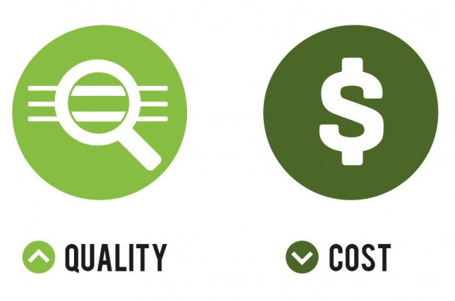
Cost of Quality and Training

Slide 8

Making a Good Build Better
Bob-Proofing” Your Build
Test-Driven Builds
Trust, But Verify
The Cockpit of a Plane

Slide 9

The Role of the Build Engineer
Know What You Build
Partner with Developers
Drafting a Rookie

Slide 10

Architecture Is Fundamental

Slide 11
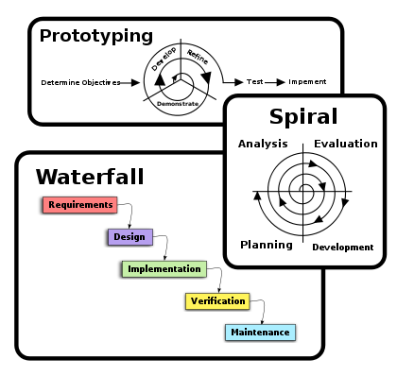
Establishing a Build Process

Slide 12
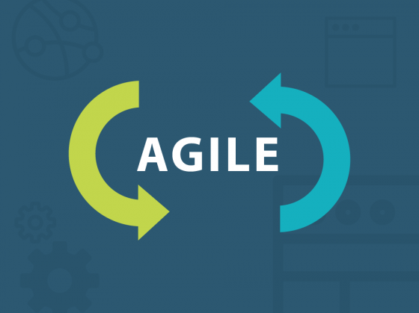
Continuous Integration Versus the Nightly Build

Slide 13

The Future of Build Engineering

Slide 14
Thank you

