Slide 1
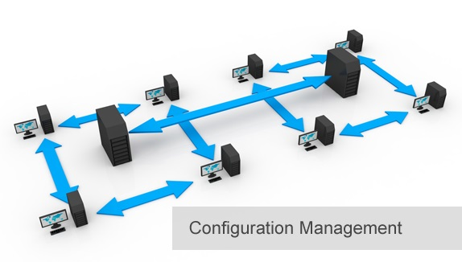
BCS 3293 SOFTWARE CONFIGURATION MANAGEMENT
Chapter Three Environment Configuration

Slide 2
Chapter Overview
3.1 Why Is Environment Configuration Important?
3.2 Where Do I Start?
3.3 Supporting Code Promotion
3.4 Managing the Configuration
3.5 Practical Approaches to Establishing a CMDB
3.6 Change Control Depends on Environment Configuration
3.7 Minimize the Number of Controls Required
3.8 Managing Environments
3.9 The Future of Environment Configuration

Slide 3


Environment Configurations
Identifying, modifying, managing and controlling the Runtime required for the system to run and behave correctly.
Runtime: impact how the code will behave when it is running in a particular environment (such as QA). Why ?
Are identified and well understood.
Can be interrogated for their current status (downtime).
Code should be built once. However, changed prior to deployment.
Should be changed in a controlled and predictable way.
Should be documented and understood by all parties.
Notes:
QA = CIA

Slide 4



Supporting Code Promotion
Then ?
Failed ??
Predictable and Repeatable

Slide 5




Managing the Configuration
Database duplicates.
Did That Trade Go Through?
Tokens or Symbols.
Centralized CMDB.

Slide 6
Practical Approaches to Establishing a CMDB
CMDBs are specialized devices that examine the runtime environment and report back the status of environment configuration values so that the correct values can be verified and serious mistakes prevented.
Identify and Then Control
Understanding the Environment Configuration

Slide 7



Change Control Depends on Environment Configuration
Review
Requests For Changes (RFCs)
Configuration Control Board (CCB)

Slide 8
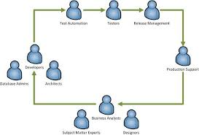
Minimize the Number of Controls Required
Keep it Light ongoing!!!

Slide 9
Managing Environments
Sufficient build and test resources is essential .. Then ?
Infrastructure to manage and maintain them on an ongoing basis.

Slide 10

The Future of Environment Configuration
Will be your lovely assignment next lab.

Slide 11
Thank you

