Slide 1
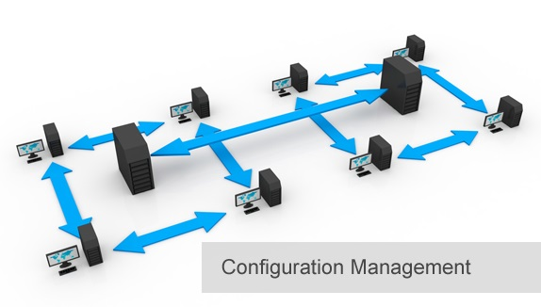
BCS 3293 SOFTWARE CONFIGURATION MANAGEMENT
Chapter Thirteen
Establishing IT Controls and Compliance

Slide 2
Chapter Overview
13.1 Why Are IT Controls and Compliance Important?
13.2 How Do I Get Started?
13.3 Understanding IT Controls and Compliance
13.4 Essential Compliance Requirements
13.5 The Moral Argument for Supporting CM Best Practices
13.6 Improving Quality and Productivity Through Compliance
13.7 Conducting a CM Assessment

Slide 3
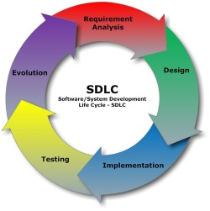
Software Configuration Management
Source Code Management 
Build Engineering 
Environment Configuration
Change Control 
Release Management 
Deployment 
Architecting Your Application.
Overcoming Resistance to Change.
Establishing IT Controls and Compliance. Why ? am I a lawyer or SE ?

Slide 4

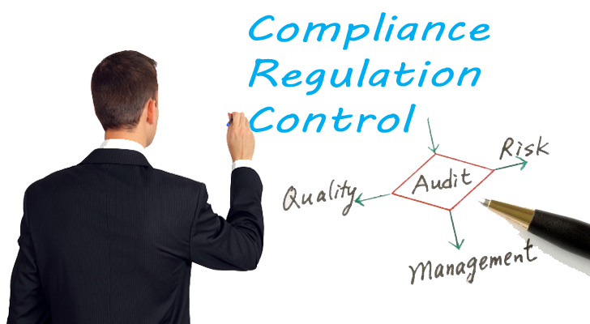
Establishing IT Controls
and Compliance

Slide 5




Why Are IT Controls and Compliance Important?
Comply with federal laws. What ?
CM plays an essential role in establishing IT controls and compliance by implementing the best practices required to pass an audit.
IT controls include security and accurate reports. How ?
IT governance as providing visibility to senior management to make the right decisions based on accurate and up-to-date information.

Slide 6

Understanding IT Controls
and Compliance
Will be your lovely assignment next lab.
There are 13 compliance models ..
I would love to hear about it from you .. Thus ..

Slide 7
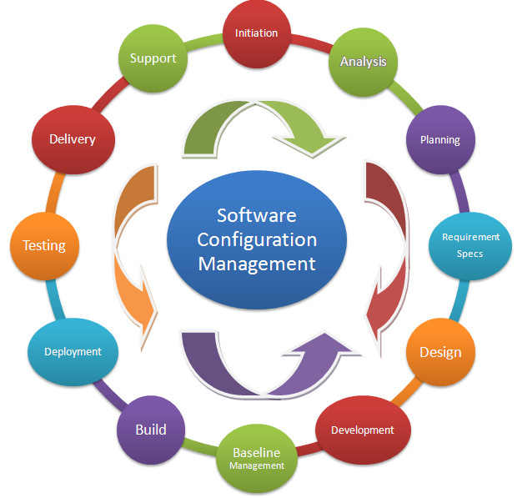
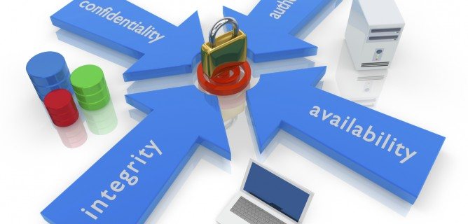
Essential Compliance Requirements
Providing Traceability of Requirements to Releases.
Production Separation of Controls.

Slide 8



The Moral Argument for Supporting CM Best Practices

Slide 9


Improving Quality and
Productivity Through Compliance
What is your Goal ?
Passing the Audit
Continuous process improvement
Setting for less ??
Improving productivity and quality

Slide 10

Conducting a CM Assessment
Gaining senior management’s support
Listen First Regardless of How Bad the Situation Appears

Slide 11
Thank you

Slide 12
SCM Mini Project
Objective:
“Develop, collaborate, test build, and deploy your code”, utilizing (Gitlab, Github or Bitbucket) Tool.
Expected Pipelines:
Create new project with repository.
Could be cloned from existing project or students could develop it.
Working with team with different roles (6 SCM core functions).
Team leader review code changes and approved it.
Continuously build and test code on preferred branch.
Continuously deploy application to preferred environment (development, production, or Staging or QA).
Rollback to preferred version if anything goes wrong.
Baseline and dashboard is essential.
Outcome:
Presentation Slides.
Technical Report.

