Slide 1
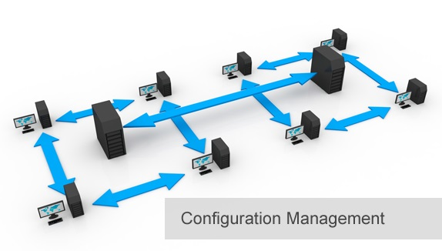
BCS 3293 SOFTWARE CONFIGURATION MANAGEMENT
Chapter Four
Change Control

Slide 2
Chapter Overview
4.1 Why Is Change Control Important?
4.2 Where Do I Start?
4.3 The Seven Types of Change Control
4.4 Creating a Change Control Function
4.5 Examples of Change Control in Action
4.6 Don’t Forget the Risk
4.7 Driving the CM Process Through Change Control
4.8 Entry/Exit Criteria
4.9 After-Action Review
4.10 Make Sure That You Evaluate Yourself

Slide 3

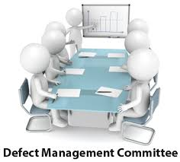


Change Control
Why ?
Review
Requests For Changes (RFCs)
Configuration Control Board (CCB)
Changes should be planned and not just last-minute events.
Changes should be understandable, including their sequences impacts.
Authority and approvals for changes should be established and obtained as appropriate.
Procedures for emergency changes should be established to cover emergency incidents.
Change control should assess and confirm that all configuration management processes are being followed.

Slide 4

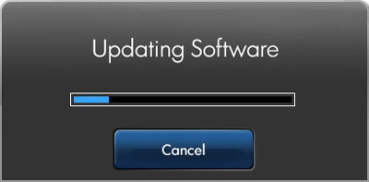


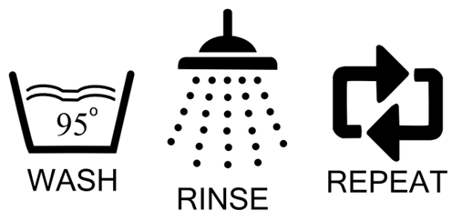
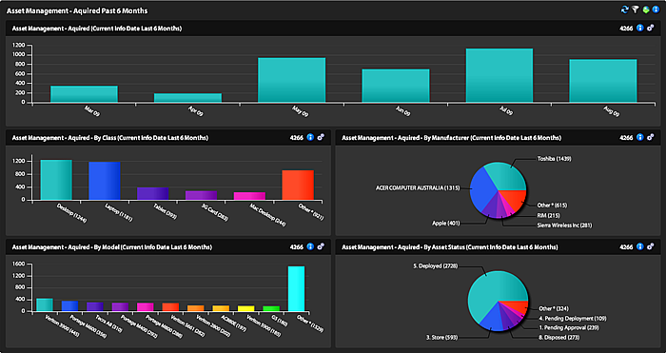
The Seven Types of Change Control
A Priori
Gatekeeping
Configuration Control (Interface sequences )
Change Advisory Board (an expert resource to the change management function).
Emergency Change Control. Then ?
Process Engineering
Senior Management Oversight

Slide 5

Creating a Change Control Function
How ?

Slide 6

Examples of Change Control in Action
Will be your lovely assignment next lab.

Slide 7

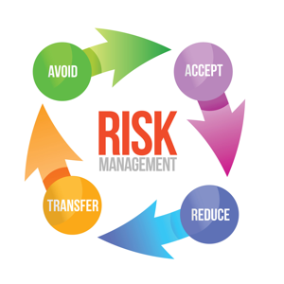
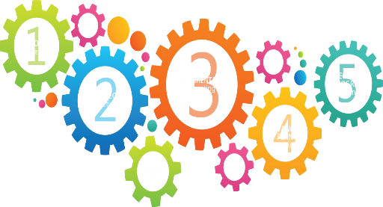

Don’t Forget the Risk
Current Process
Then ??

Slide 8

Driving the CM Process Through Change Control
How ?
Reviewing the CM plan.
Well-defined CM policy

Slide 9
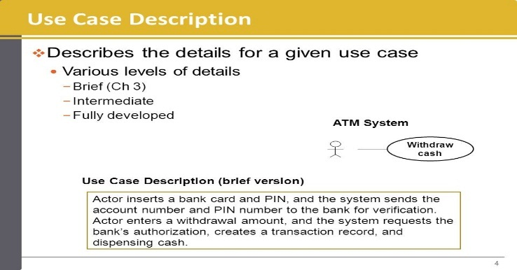
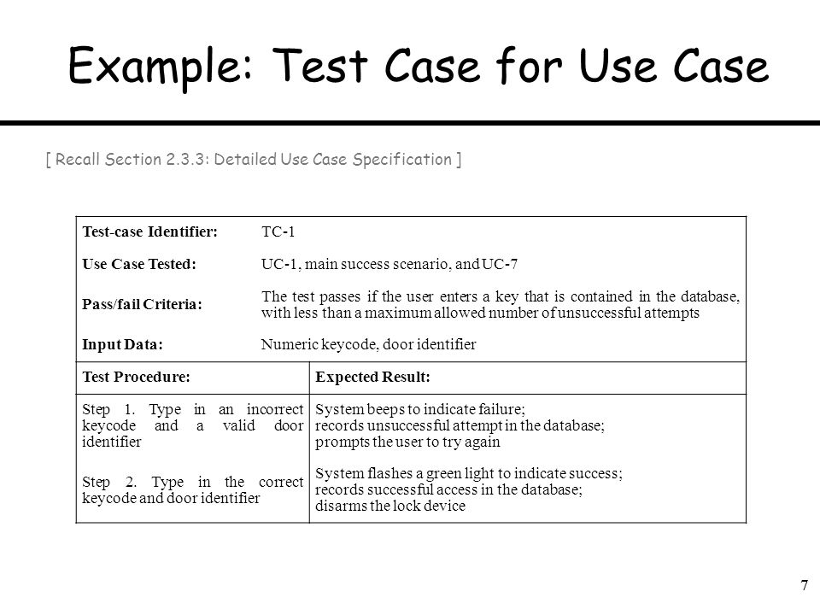
Entry/Exit Criteria
Entry
Exit
Requests For Changes (RFCs)

Slide 10
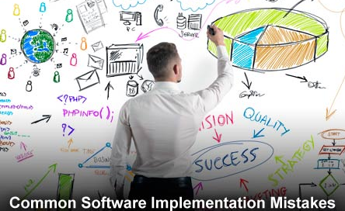
After-Action Review
Current Process
Then ??
Over all SDLC

Slide 11
Make Sure That You Evaluate Yourself
Current Process
Then ??
Over all SDLC + All Stakeholders

Slide 12
Thank you

