Slide 1
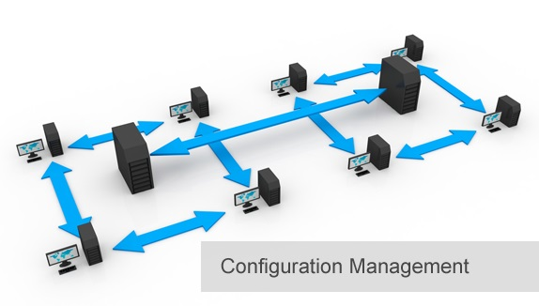
BCS 3293 SOFTWARE CONFIGURATION MANAGEMENT
Chapter Five
Release Management

Slide 2
Chapter Overview
5.1 Why Is Release Management Important?
5.2 Where Do I Start?
5.3 Release Management Concepts and Practices
5.4 The Ergonomics of Release Management
5.5 Release Management as Coordination
5.6 Requirements Tracking
5.7 Taking Release Management to the Next Level

Slide 3
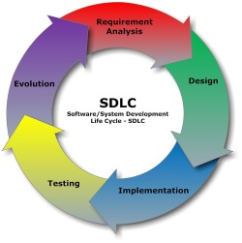
Software Configuration Management
Source Code Management 
Build Engineering 
Environment Configuration
Change Control 
Release Management .. Why ?

Slide 4

Release Management
System, Software or Application Components ?
Releases or Versions?
When to Release?
How much overlap?
Q1 04
Q2 04
Q3 04
Q4 04
Q1 05
J
F
M
A
M
J
J
A
S
O
N
D
J
F
M
Release 1
Packaging
Coordinating
Communicating the status of the release.
RM is the GLUE that keeps the development process on track.
Release 2
Release 3
Release 4

Slide 5
Principles of Release Management
Releases should be:
Readily identifiable with an immutable version ID.
Packaged with all the dependencies included.
Automated and designed to avoid human error.
Fast and reliable to facilitate iterative development.
Mechanism to conduct an audit of a release package to verify all of its CIs.
Well understood, including the tracking of requirements.
Source of information on the status of all releases: Dashboard.

Slide 6




Release M. Concepts and Practices
Packaging Strategies That Work. Source Code IDs vs Package ID.
Package Version Identification. Release was successfully deployed.
Sending a Release Map with the Release
What Does Immutable Mean? Intentionally or by accident.

Slide 7

The Ergonomics of Release Management
Will be your lovely assignment next lab.

Slide 8

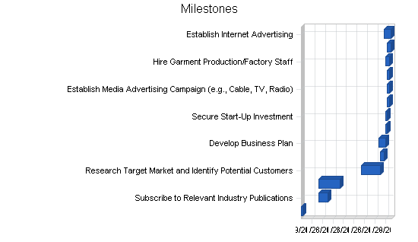
Release Management as Coordination
Communicating the Status of a Release
Don’t Forget the Release Calendar.
RM and Configuration Control. Same impact.

Slide 9



Requirements Tracking
Gathering Software Requirements
SRS + Clients
Release packaging with notes
Company Workstation
All Stakeholders

Slide 10
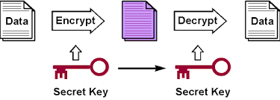
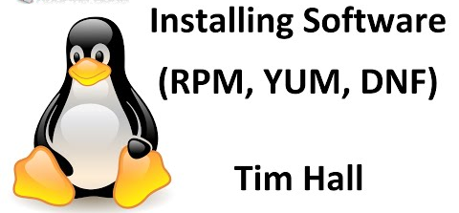

Taking Release Management to the Next Level
Using Cryptography to Sign Your Code.
Operating Systems Support for Release Management.
Improving Your RM Process. How ?

Slide 11
Thank you

