Slide 1
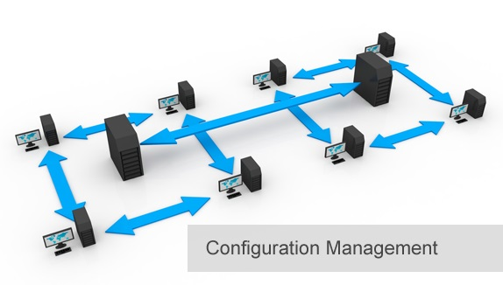
BCS 3293 SOFTWARE CONFIGURATION MANAGEMENT
Chapter Six
Deployment

Slide 2
Chapter Overview
6.1 Why Is Deployment Important?
6.2 Where Do I Start?
6.3 Practices and Examples
6.4 Conducting a Configuration Audit
6.5 Don’t Forget the Smoke Test
6.6 Little Things Matter a Lot
6.7 Communications Planning
6.8 Deployment Should Be Delegated
6.9 Trust But Verify
6.10 Improving the Deployment Process

Slide 3
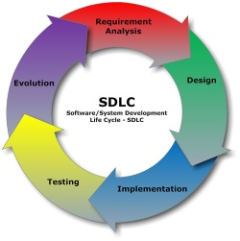
Software Configuration Management
Source Code Management 
Build Engineering 
Environment Configuration
Change Control 
Release Management 
Deployment .. Why ?

Slide 4



Deployment
Then ?
Environment Configuration: Code Promotion
Release Management (RM): Packaged Release
Failed ??
Predictable and Repeatable
Deployment: promoting packaged release into the target environment (QA).
Fail .. How ? Then .. How to overcome ?
RM team must create solid deployment procedures that can be gracefully completed by the operations team.
The main goal of deployment is to promote a release into production without any possible problem occurring.
All changes are tracked and that promoting a release or rolling back is simple, reliable, and predictable.

Slide 5
Principles of Deployment
Promoting a release (or backing it out) should be
Reliable and as simple as possible.
Completely traceable with an audit log of all changes.
Only authorized personnel should be involved with deployment.
In most organizations, there needs to be a separation of duties between developers and the team that deploys the release.
Any unauthorized changes should be detected immediately.
Well established procedure for checking the versions of a release in production (or QA).
The deployment process should be continuously reviewed and improved as needed.
Create reliable automation to promote the release and back it out if necessary.
Deployment should be as simple as possible and always ensure that it can be performed by your operations or systems administration team.

Slide 6

Practices and Examples
Will be your lovely assignment next lab.

Slide 7



Conducting a Configuration Audit
“Pre-audits” may be done by the CM team. How ?
Audits must be done by an independent body. Why ?
CM team should develop a procedures to verify that the correct versions of the system are in place.
The configuration audit should be automated and fully traceable, too. Why ?

Slide 8

Don’t Forget the Smoke Test
Functionality test
QA test

Slide 9

Little Things Matter a Lot
Must have enough processes in place to prevent any mistake from occurring that might impact your production systems

Slide 10

Communications Planning
Create a communications plan that ensures that all stakeholders are kept advised on the release management process

Slide 11
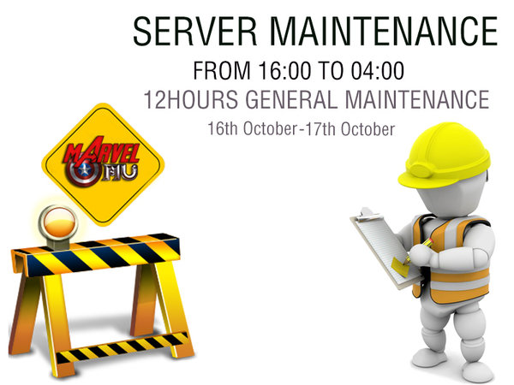
Announcing Outages and Completed Deployments

Slide 12

Deployment Should Be Delegated
Operations team (Deployment) can deploy and fall back to a previous release as necessary.

Slide 13
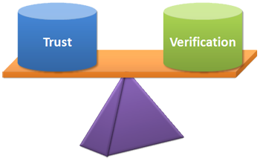
Trust But Verify
Deployment procedures was created. Thus why need to do so ? How ?
Automation to verify that no changes have taken place.
Automation is the Best practice.
Save you a lot of time—especially when an unexpected change occurs.

Slide 14

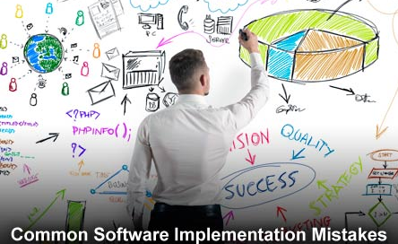


Improving the Deployment Process
Current Process
Then ??

Slide 15
Thank you

