Slide 1
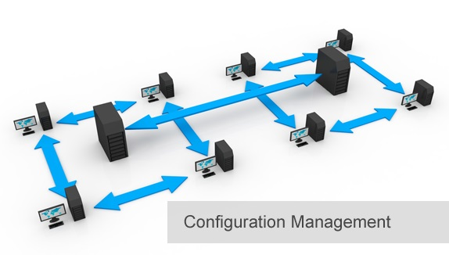
BCS 3293 SOFTWARE CONFIGURATION MANAGEMENT
Chapter Seven
Architecting Your Application for CM

Slide 2
Chapter Overview
7.1 Why Is Architecture Important?
7.2 Where Do I Start?
7.3 How CM Facilitates Good Architecture
7.4 What Architects Can Learn From Testers
7.5 Configuration Management–Driven Development (CMDD)
7.6 Coping with the Changing Architecture
7.7 Using Source Code Management to Facilitate Architecture
7.8 Training Is Essential
7.9 Source Code Management as a Service
7.10 Build Engineering as a Service

Slide 3
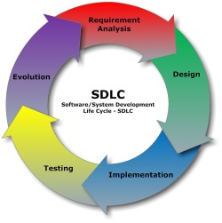
Software Configuration Management
Source Code Management 
Build Engineering 
Environment Configuration
Change Control 
Release Management 
Deployment  Done right ?
Architecting Your Application .. Is it CM task ?

Slide 4
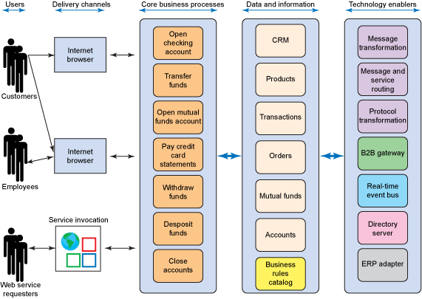
Enterprise Architecture: Banking Example

Slide 5
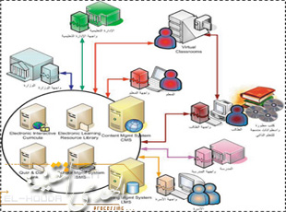


Goals of Architecting Your Application for CM
Current System
Undergo
Evolution of Software Architecture
Is it concern at all ??
Architecture is the Achilles’ heel of SCM.
Changing the software architecture of a system is typically very costly.
Implementing CM best practices will improve quality and productivity.

Slide 6
How CM Facilitates Good Architecture
Required System
Evolution of Software Architecture
How can CM help ?
Source Code Management.
Managing baselines and variants.
What else ?
Best Practices. And ..
Control for changes.

Slide 7
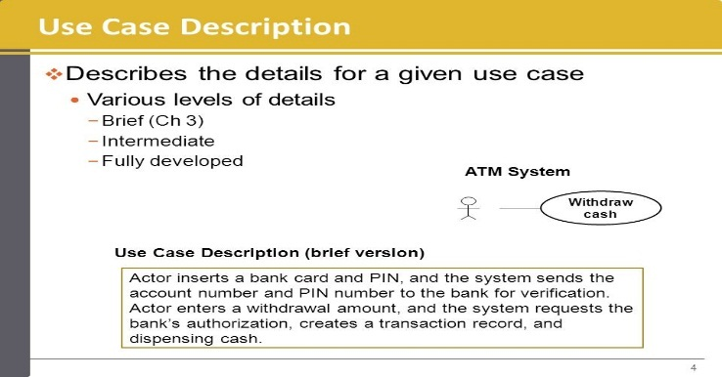

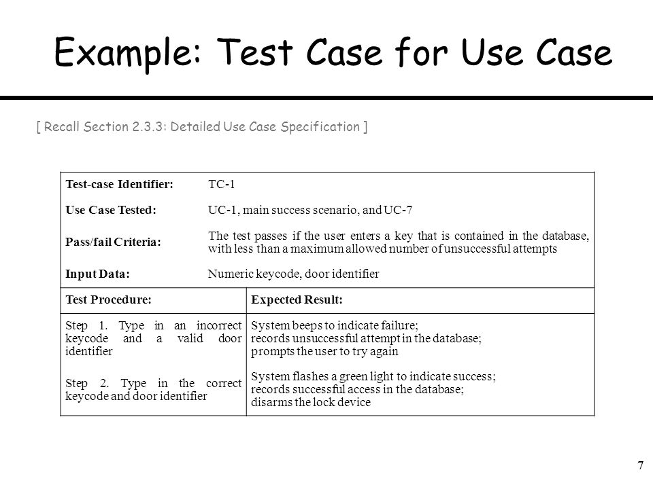
What Architects Can Learn From Testers
Entry
Exit
Requests For Changes (RFCs)
Automated test

Slide 8




Configuration Management–Driven Development (CMDD)
Creating CM Best Practices:
Packaging Application
Architectural Requirements
Software/Application Packaging

Slide 9

Coping with the Changing Architecture
Create a communications plan that ensures that all stakeholders are kept advised on the architecture changing. How ?
Baselines.

Slide 10
Using Source Code Management to Facilitate Architecture
Baselines and Time Machines
Baselines must be Immutable
Sandboxes and Workspaces
Variant Management (Branching) and Copybranches.
Streams.
As well as …
Establishing Change Control

Slide 11

Training Is Essential

Slide 12




Source Code Management as a Service
Firefox setup
developers as internal customers
Source code management team

Slide 13



Build Engineering as a Service
Then ?
Failed ??
Predictable and Repeatable
Automating the build.
Developers can make small sets of changes then rapidly build and test the application. Any impact ?
This helps improve both quality and productivity.

Slide 14
Thank you

