Slide 1
The Bronte Shops
Your convenience, our priority!

Slide 2
Objectives
to provide fresh goods to the local people
to provide people enhanced shop focussed sections to make their shopping experience more effective
to provide traders platform to display, update and delete items
to facilitate traders to view daily, weekly or monthly financial reports
to provide friendly UI to the user to compare products
to provide facility to buy goods without any geographical limitation and time boundaries

Slide 3
Scopes
the features to display all the products available in the supermarket
cart feature i.e enabling the users to add the products to purchase to their own carts where products also can be updated, added or deleted and purchased
connection to electronic payment with their debit/credit cards
divide time slots to the costumers on which they can come and receive the products they purchased
The project scope doesn’t include:
virtual 3D tour of the supermarket
delivery system

Slide 4
Raw Front End Prototype

Slide 5
Navigation bar with sign-in/sign-up options
Responsive image slider
Home page body with attractive images and animations
Simple footer common to every page
Product detail body with attractive images and animations

Slide 6

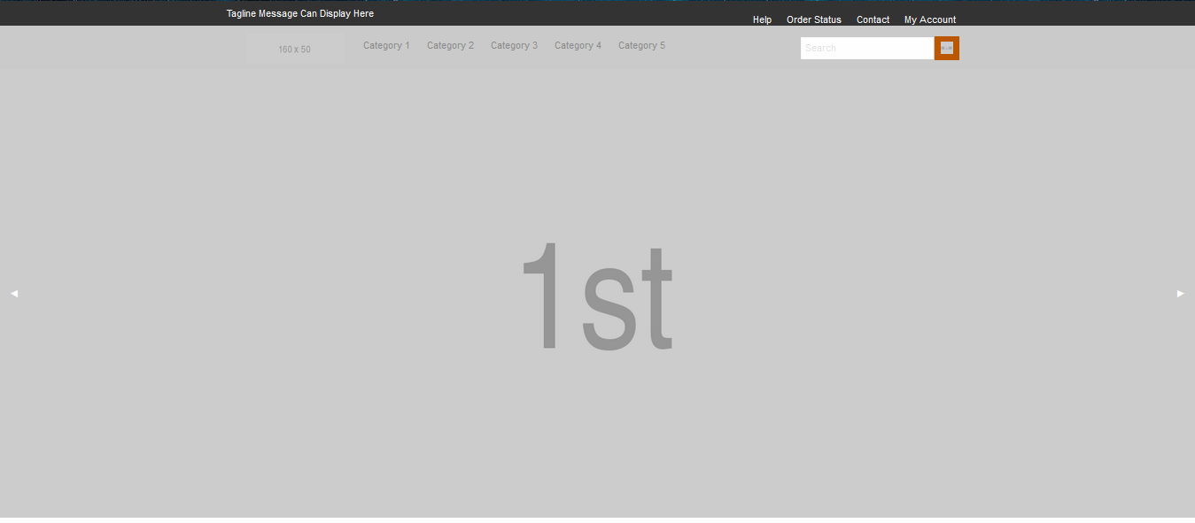

Slide 7
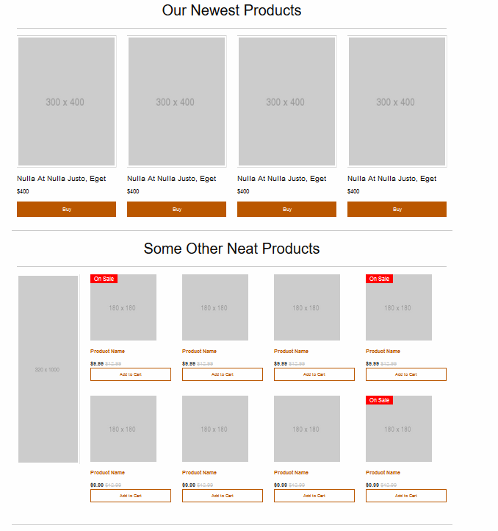

Slide 8

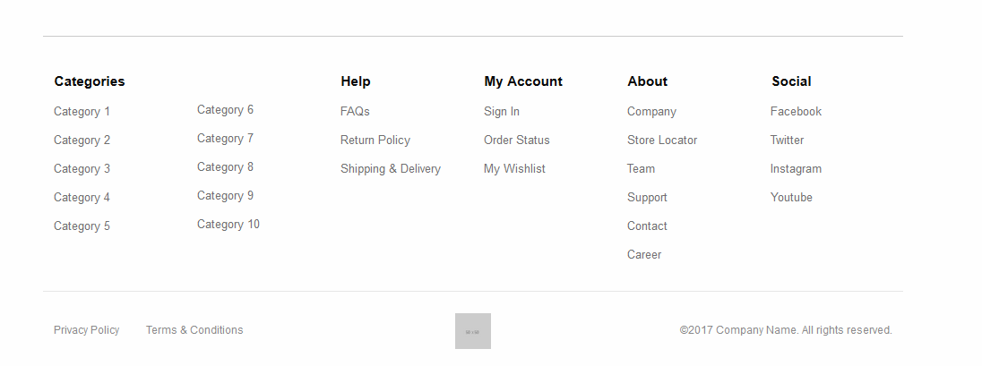

Slide 9
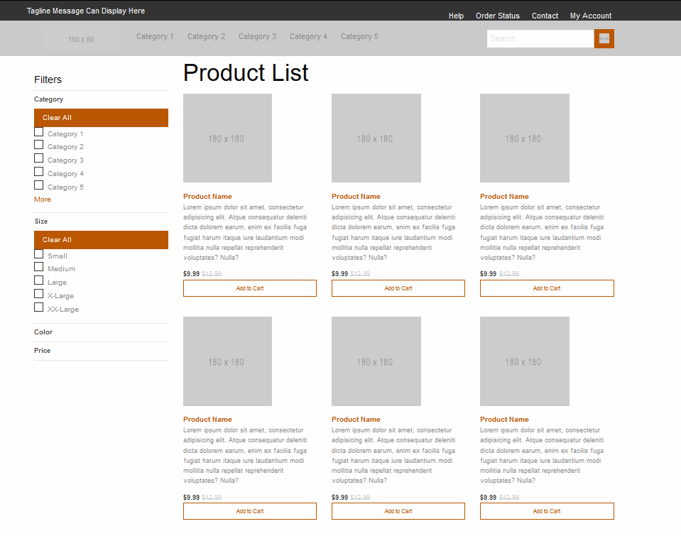

Slide 10
Entity
Relationship
Diagram

Slide 11
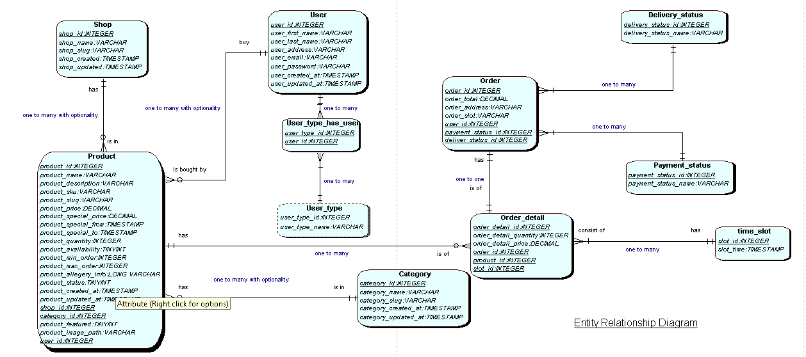

Slide 12

Database Tables

Slide 13
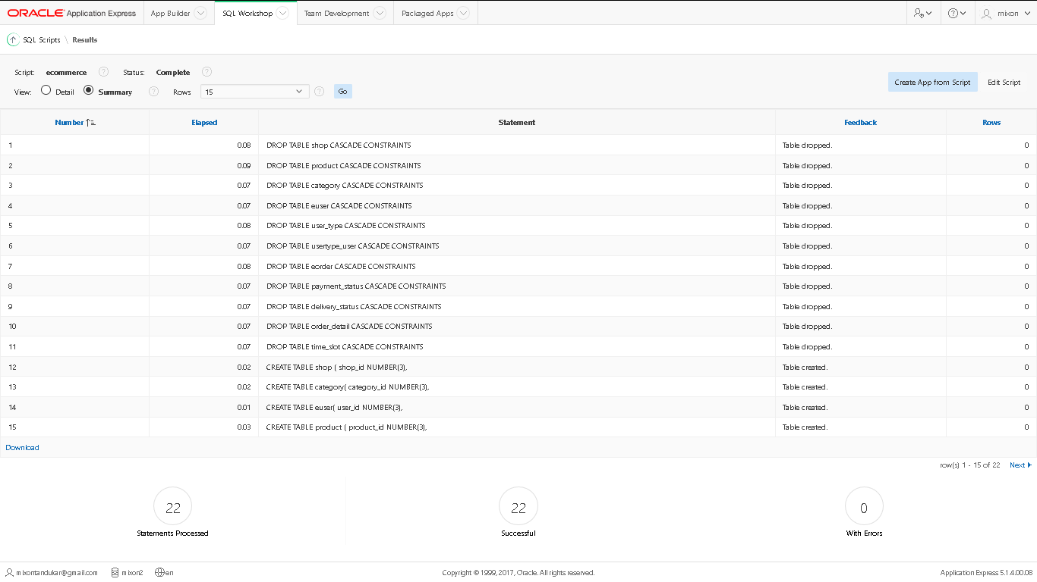

Slide 14
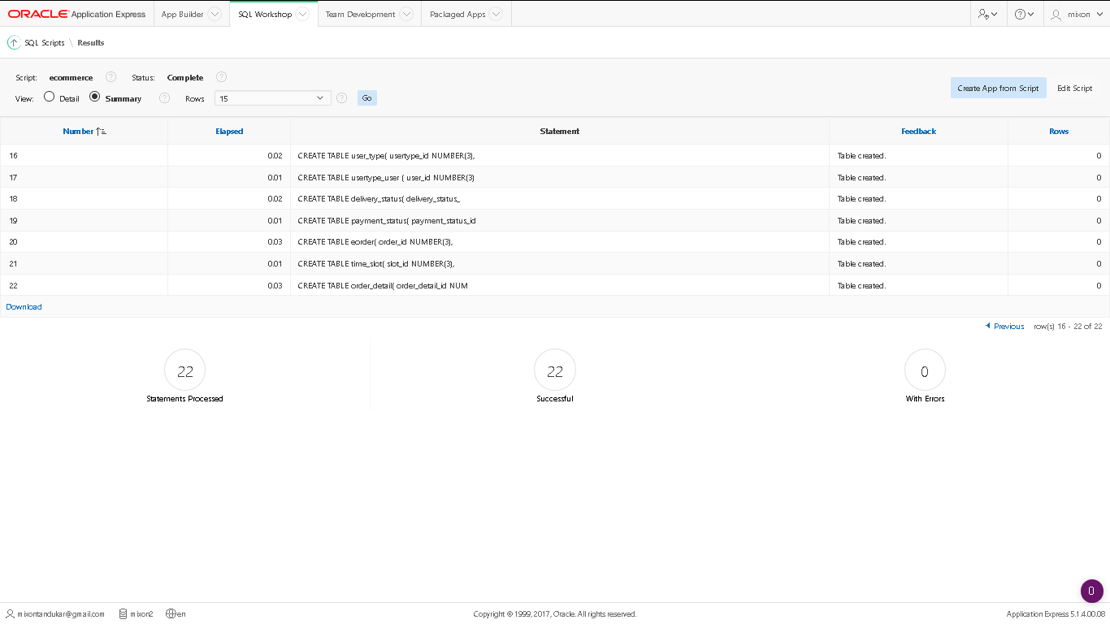

Slide 15
Use Case

Slide 16
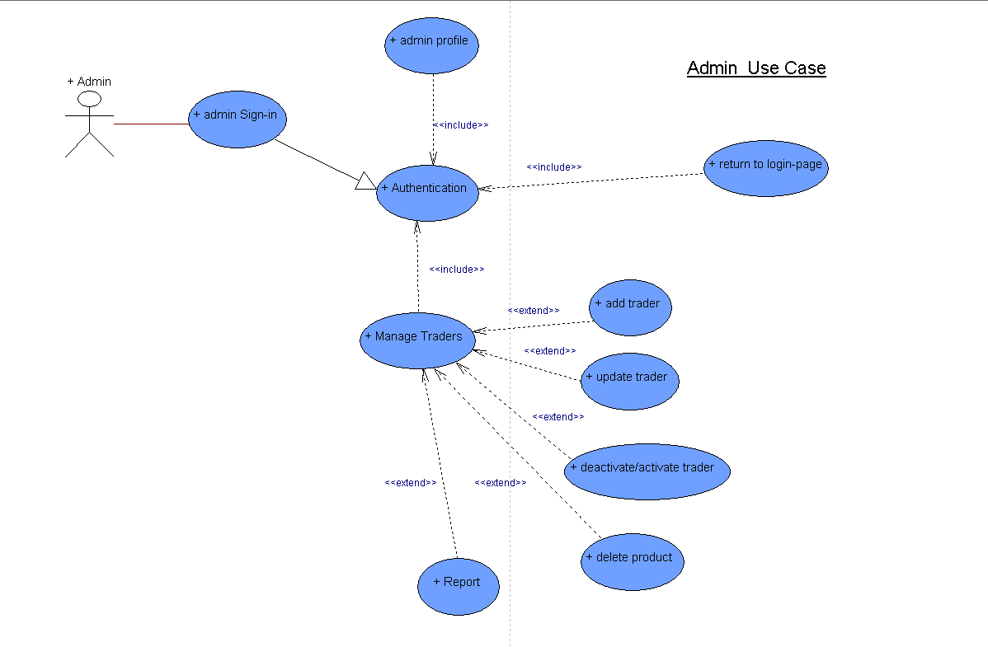

Slide 17
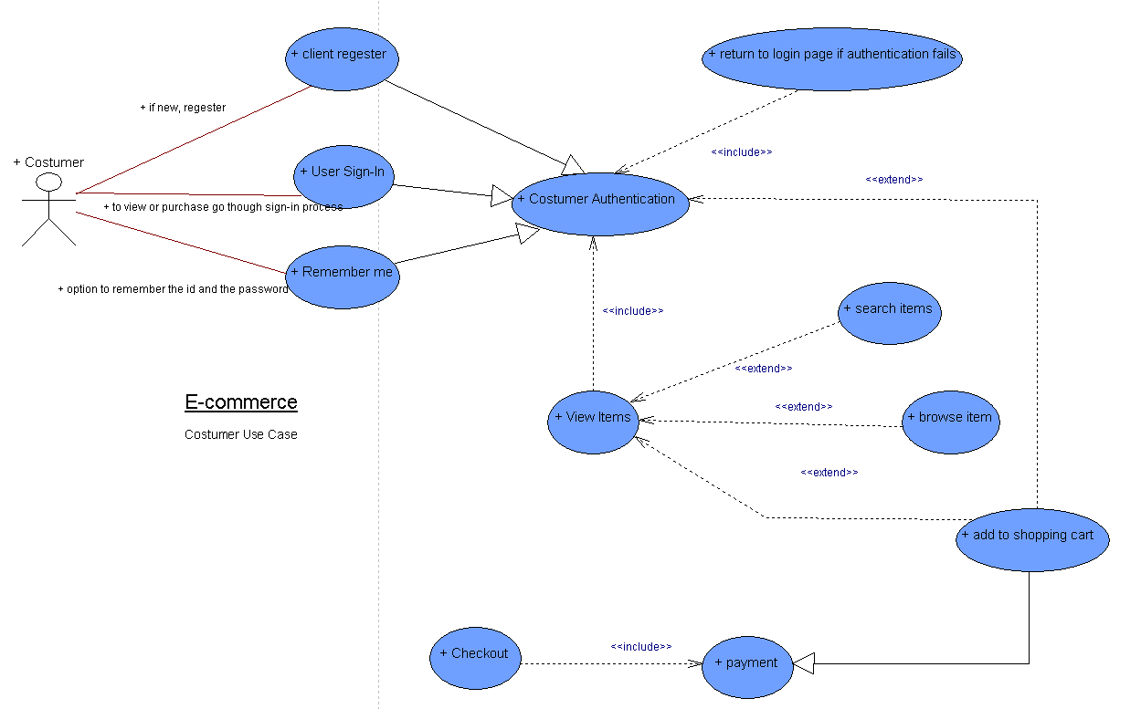

Slide 18
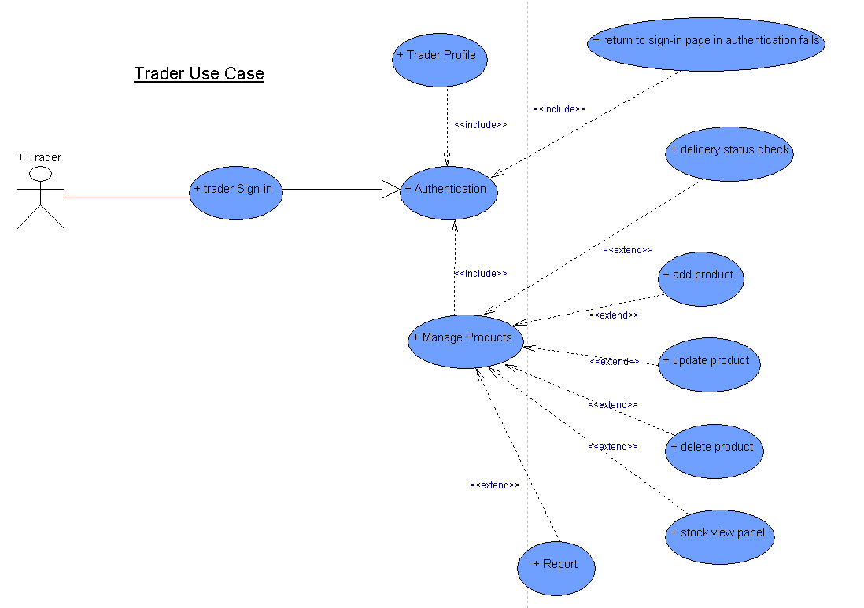

Slide 19
Security
Protection against CSRF (Cross Site Request Forgery)
Protection against SQL injection
Protection against XSS (Cross Site Scripting)
Two step verification for user security
Encryption and Hashing of User's Password

Slide 20
Advanced Features
Review section
Usability and Accessibility

Slide 21

Requirement Catalogue

Slide 22
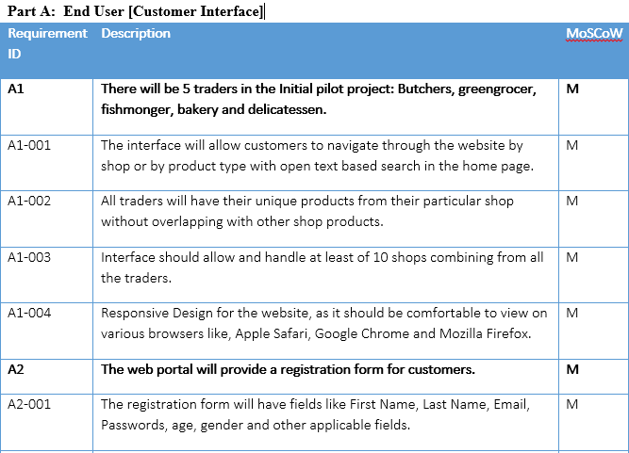
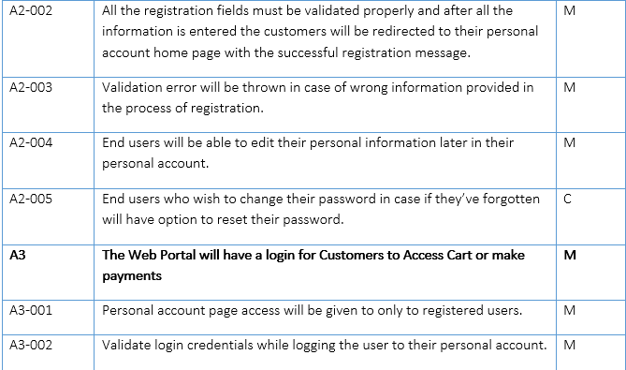

Slide 23
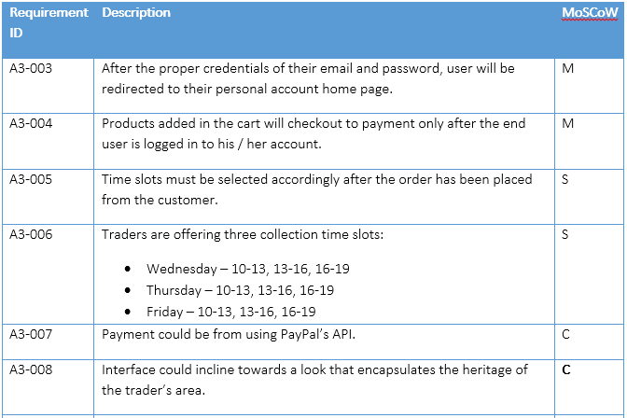
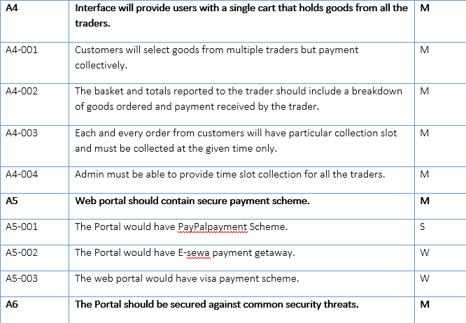

Slide 24
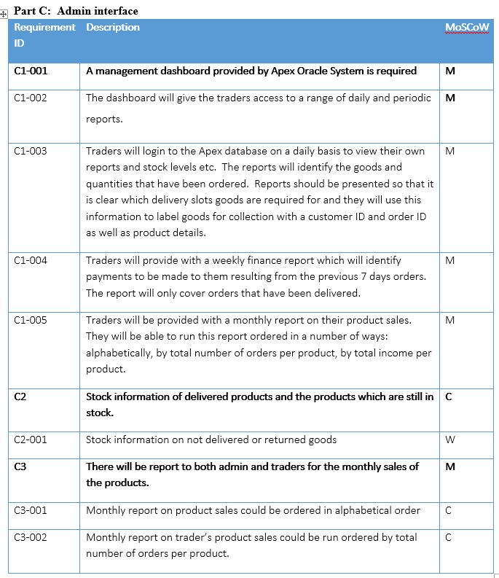
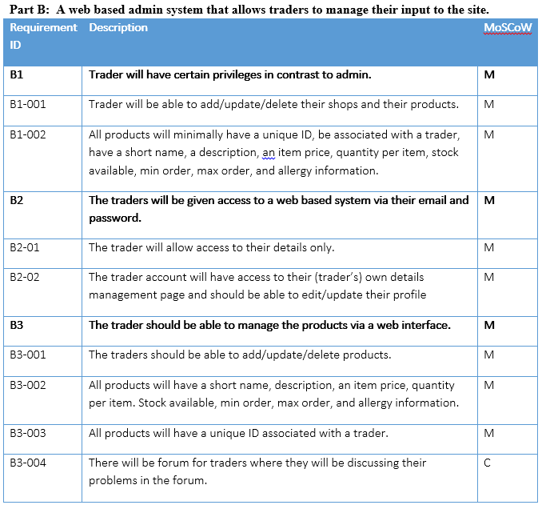

Slide 25
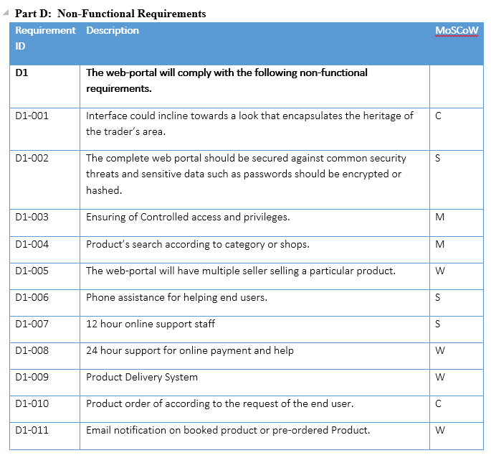

Slide 26

MS project

Slide 27
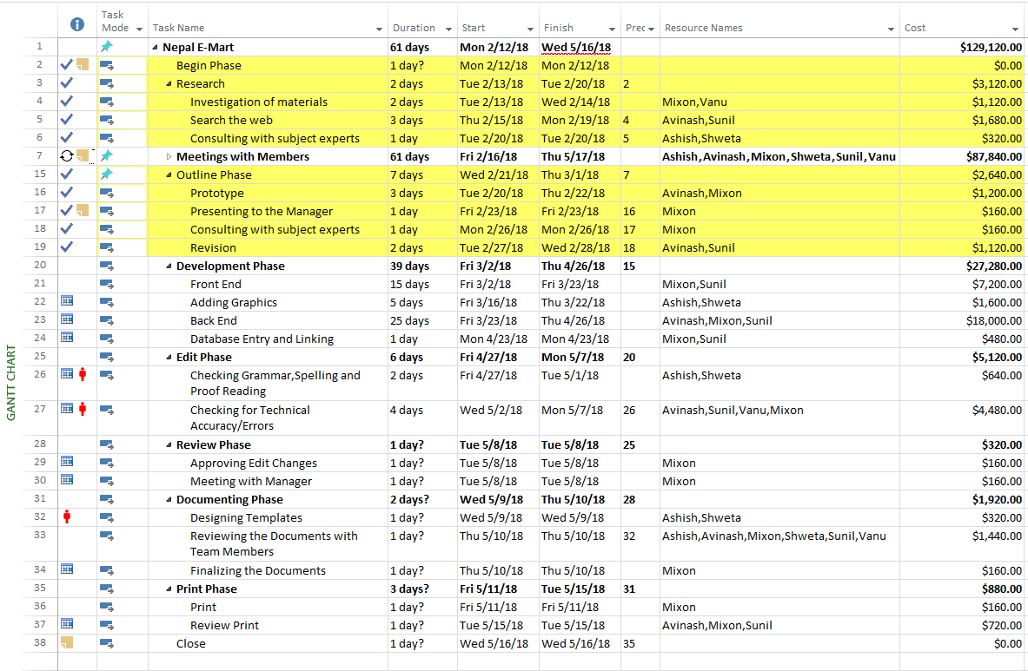

Slide 28
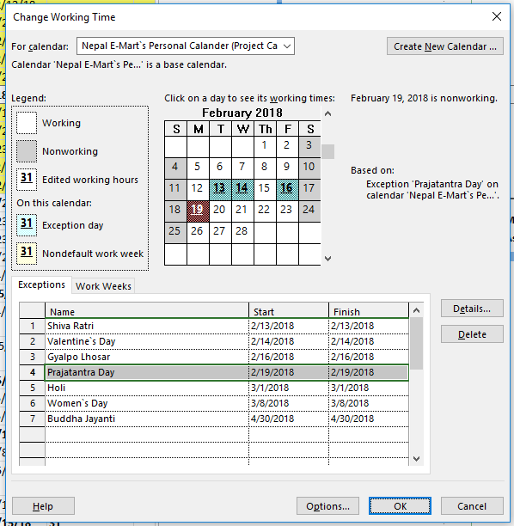

Slide 29
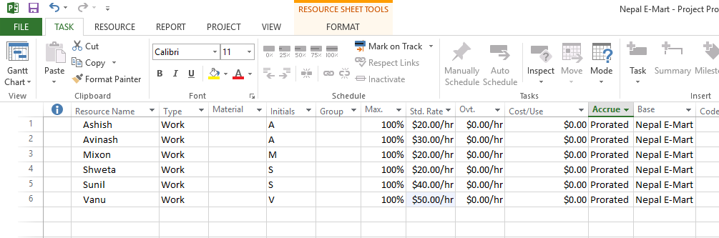

Slide 30
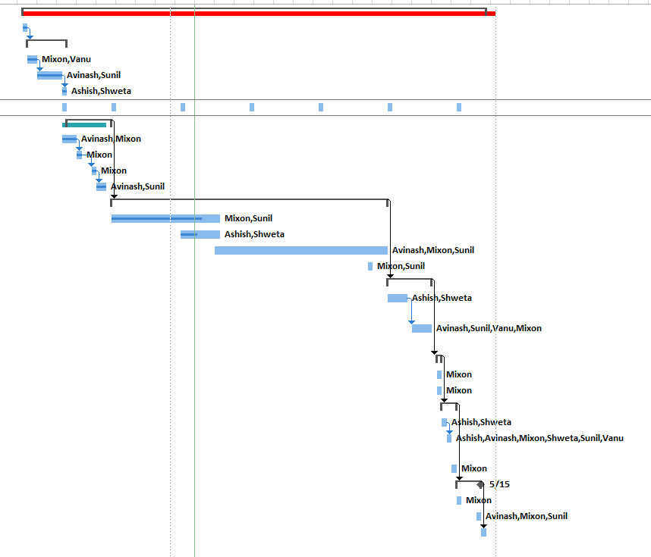

Slide 31
Communication tools
&
Collaborative tools

Slide 32
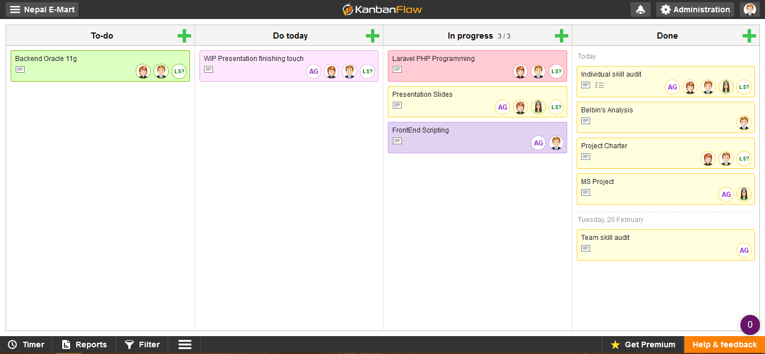

Slide 33
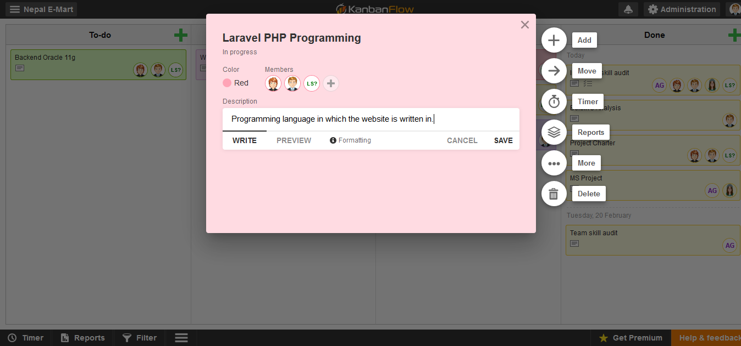

Slide 34
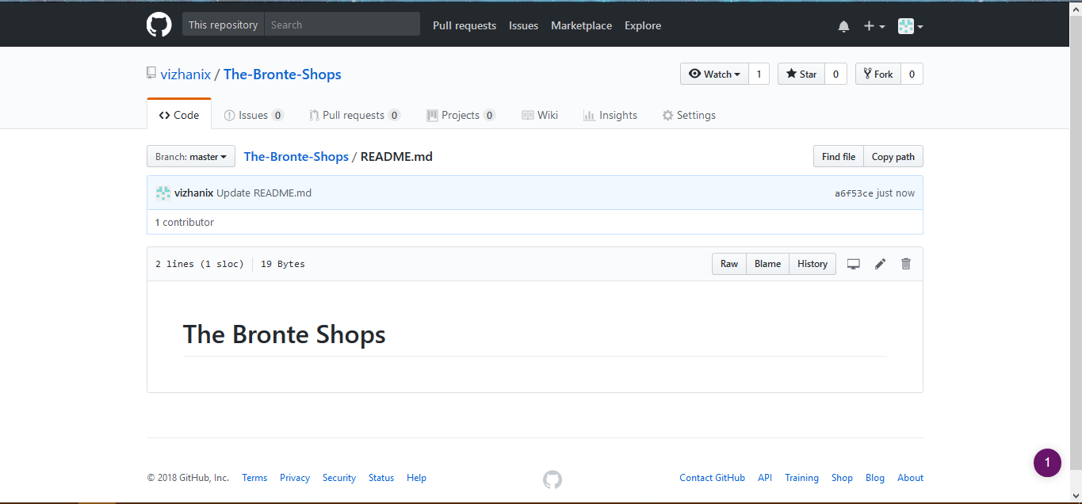

Slide 35
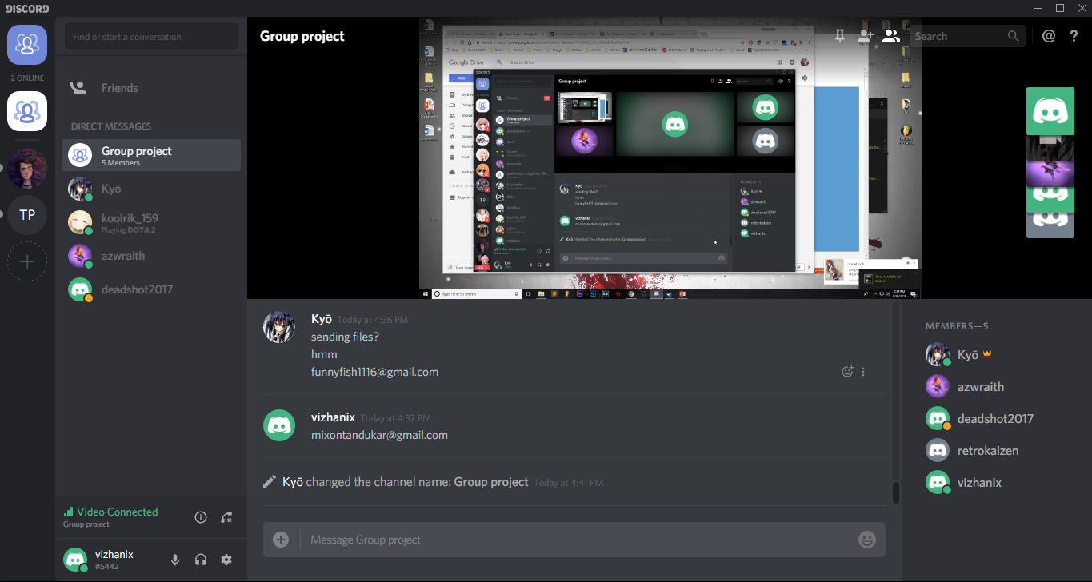

Slide 36
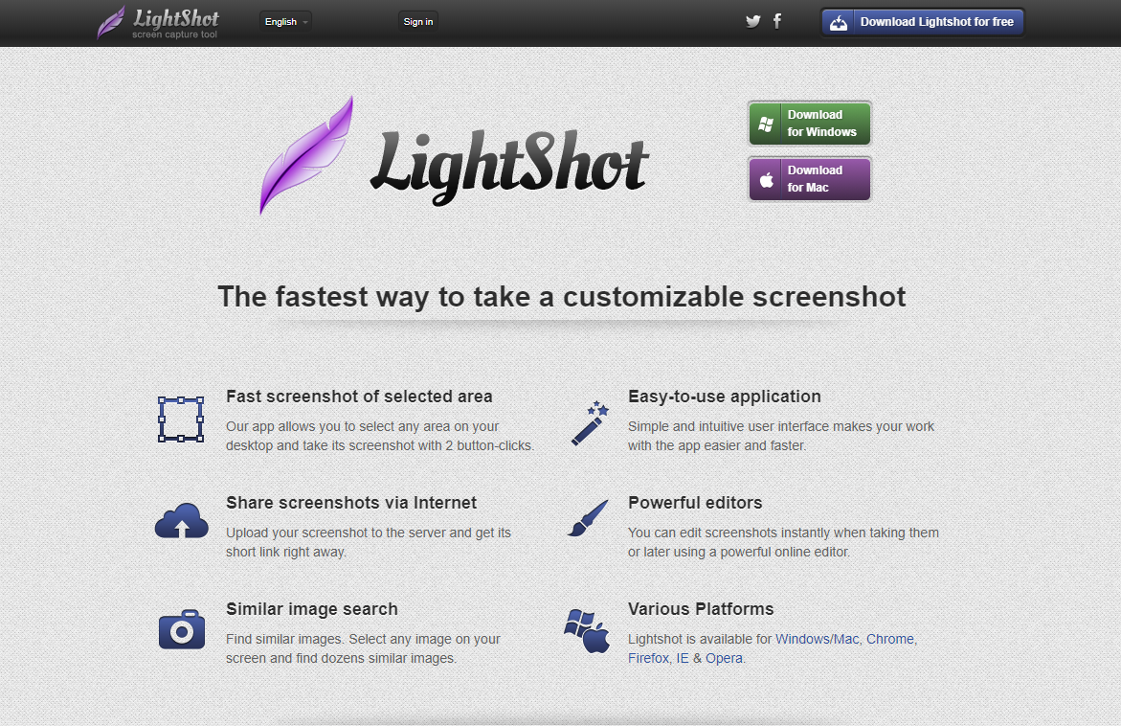

Slide 37


