Slide 1
final project - portfolio
Html 2 - assignment 3 – August 1, 2018
BY: AZZA BRUCE

Slide 2

About Me
Masters Degree McMaster University (Economics)
Undergraduate Degree York University (Economics)
Web Design and Web Development Mohawk College (In progress)
Languages used (JavaScript, PHP, SAS)
Current Projects: Portfolio, My Well Self and
Connect Commodities Inc.

Slide 3
Introduction to portfolio project
WHY I CHOSE THIS PROJECT
It is a selling point
Showcases samples of my best work
Living and changing collection of records that reflects my skills, experiences, attributes and accomplishments
Gives future clients and employers an option to download resume and contact me for hire

Slide 4


Design and development process
Wireframe
Color selection
Parallax deign
General design layout: navigation bar tabs, logo position on the page
Project Proposal
Sitemap
The “Fun” Part: Photoshop Mockup
Logo design:
colors font family and font size
Photo dimensions:
picked photos that matches overall design and re-sized them
Design the general layout of the home page:
Transferred paper sketch to Photoshop
Font family selection : navigation bar, home author and title
3. The Super Fun Part: HTML & CSS Coding

Slide 5
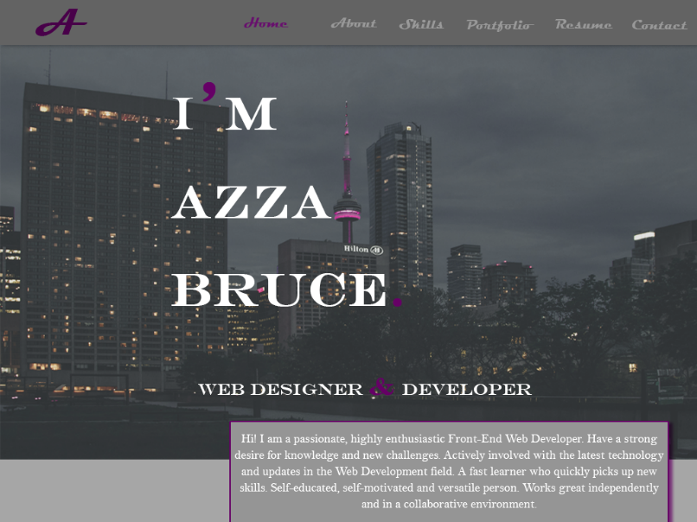
MOCKUP - SITE MAP - PROJECT PROPOSAL - STYLE GUIDE

Slide 6
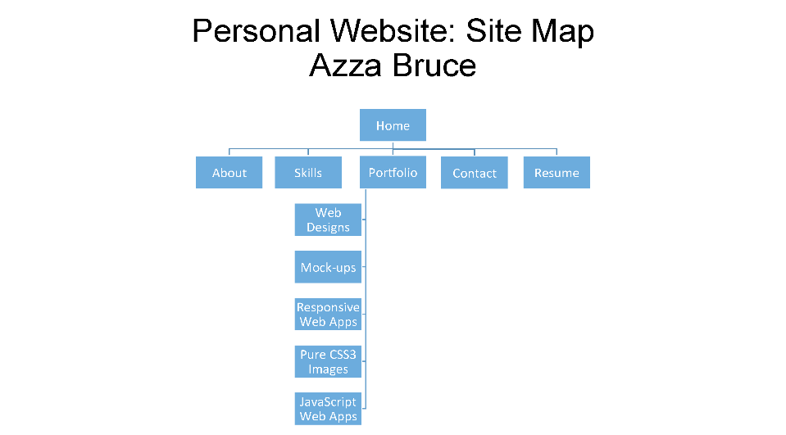

Slide 7
MOCKUP - SITE MAP - PROJECT PROPOSAL - STYLE GUIDE
Project Proposal
Style Guide

Slide 8
Tools Used
Site Map : PowerPoint
Mockup : Photoshop
Code: Dreamweaver
Host Website: 000webhost.com / GitHub Pages
https://azzabruce-portfolio.000webhostapp.com/
https://azzabruce.github.io/portfolio/

Slide 9
Questions

Slide 10
final project - portfolio
HTML 2 - ASSIGNMENT 3 – AUGUST 1, 2018
BY: AZZA BRUCE

